Slide 1
Chapter 13: Transactions

Slide 2
Outline
Transaction
Schedules
  Concurrent Executions
  Serializability
  Recoverability
Transaction Isolation Levels

Slide 3
Transaction

Slide 4
Thinking
SQL Server中，Employee职工表包含1000000条记录，假设要执行以下语句
  Update Employee Set salary = salary * 1.1
如果在执行到一半的时候，突然停电。那么重启后，Employee表会发生什么样的变化？

Slide 5
Transaction Concept
A transaction is a unit of program execution that accesses and possibly updates various data items. （要么都做，要么都不做）
E.g., transaction to transfer $50 from account A to account B:
  1. read(A)
  2. A := A – 50
  3. write(A)
  4. read(B)
  5. B := B + 50
  6. write(B)
Two main issues to deal with:
  Failures of various kinds, such as hardware failures and system crashes
  Concurrent execution of multiple transactions

Slide 6
Example of Fund Transfer
Transaction to transfer $50 from account A to account B:
  1. read(A)
  2. A := A – 50
  3. write(A)
  4. read(B)
  5. B := B + 50
  6. write(B)
Atomicity requirement — 原子性
  If the transaction fails after step 3 and before step 6, money will be “lost” leading to an inconsistent database state
    Failure could be due to software or hardware
  The system should ensure that updates of a partially executed transaction are not reflected in the database
Durability requirement — 持久性
  once the user has been notified that the transaction has completed (i.e., the transfer of the $50 has taken place), the updates to the database by the transaction must persist even if there are software or hardware failures.

Slide 7
Example of Fund Transfer (Cont.)
Consistency requirement — 一致性
  In above example:
    The sum of A and B is unchanged by the execution of the transaction
In general, consistency requirements include
  Explicitly specified integrity constraints such as primary keys and foreign keys
  Implicit integrity constraints
    e.g., sum of balances of all accounts, minus sum of loan amounts must equal value of cash-in-hand
  A transaction must see a consistent database.
  During transaction execution the database may be temporarily inconsistent.
  When the transaction completes successfully the database must be consistent
    Erroneous transaction logic can lead to inconsistency

Slide 8
Example of Fund Transfer (Cont.)
Isolation requirement — 隔离性
  if between steps 3 and 6, another transaction T2 is allowed to access the partially updated database, it will see an inconsistent database (the sum A + B will be less than it should be).
T1 T2
  1. read(A)
  2. A := A – 50
  3. write(A)
  read(A), read(B), print(A+B)
  4. read(B)
  5. B := B + 50
  6. write(B
Isolation can be ensured trivially by running transactions serially
  That is, one after the other.
However, executing multiple transactions concurrently has significant benefits, as we will see later.

Slide 9
ACID Properties
A transaction is a unit of program execution that accesses and possibly updates various data items. To preserve the integrity of data the database system must ensure: 事务的四个特性(ACID)
Atomicity. Either all operations of the transaction are properly reflected in the database or none are.
Consistency. Execution of a transaction in isolation preserves the consistency of the database.
Isolation. Although multiple transactions may execute concurrently, each transaction must be unaware of other concurrently executing transactions. Intermediate transaction results must be hidden from other concurrently executed transactions.
  That is, for every pair of transactions T_{i} and T_{j}, it appears to T_{i} that either T_{j}, finished execution before T_{i} started, or T_{j} started execution after T_{i} finished.
Durability. After a transaction completes successfully, the changes it has made to the database persist, even if there are system failures.

Slide 10
Thinking
事务以Begin transaction语句开始，以Commit 或Rollback 语句结束
下面的SQL程序包含几个事务?
  Begin Transaction
  Update account set money= money － 50 where no=“A”
  Update account set money= money ＋ 50 where no=“B”
  Commit
思考，如果执行完第一个update语句之后、没有执行第二个update语句之前，系统断电。那么在重启以后，两个帐户的金额会发生什么样的变化?

Slide 11
Thinking
下面的SQL程序包含几个事务?
  Update account set money= money － 50 where no=“A”
  Update account set money= money ＋ 50 where no=“B”
思考，如果执行完第一个update语句之后、没有执行第二个update语句之前，系统断电，那么两个帐户的金额会发生什么样的变化?

Slide 12
Transaction State
Active – the initial state; the transaction stays in this state while it is executing
Partially committed – after the final statement has been executed.
Failed -- after the discovery that normal execution can no longer proceed.
Aborted – after the transaction has been rolled back and the database restored to its state prior to the start of the transaction. Two options after it has been aborted:
  Restart the transaction
    Can be done only if no internal logical error
  Kill the transaction
Committed – after successful completion.

Slide 13
Transaction State
提交
(永久化每个修改)
提交完毕
执行全部
语句成功
_{部分}
_{提交状态}
_{提交状态}
执行
语句
写入永久化信息时失败
_{活动状态}
执行某个
语句失败
_{失败状态}
_{中止状态}
回滚完毕
事务开始
回滚（把数据改回旧值）

Slide 14
Transaction Schedules

Slide 15
Schedules
Schedule – a sequences of instructions that specify the chronological order in which instructions of concurrent transactions are executed
  A schedule for a set of transactions must consist of all instructions of those transactions
  Must preserve the order in which the instructions appear in each individual transaction.
A transaction that successfully completes its execution will have a commit instructions as the last statement
  By default transaction assumed to execute commit instruction as its last step
A transaction that fails to successfully complete its execution will have an abort instruction as the last statement

Slide 16
事务调度
事务调度
  指系统执行事务中指令的时间顺序
  一组多个事务的调度必须保证
    包含了所有事务的操作指令
    同一个事务中指令的相对顺序必须保持不变
两种类型
  串行调度
    执行完一个事务才开始执行下一个事务。因此从时间顺序上看，同一事务的指令紧挨在一起
  并发调度
    未执行完一个事务时，可转去执行另一个事务。因此从时间顺序上看，不同事务的指令彼此交叉

Slide 17
Concurrent Executions
Multiple transactions are allowed to run concurrently in the system. Advantages are:
  Increased processor and disk utilization, leading to better transaction throughput
    E.g., one transaction can be using the CPU while another is reading from or writing to the disk
  Reduced average response time for transactions: short transactions need not wait behind long ones.
Concurrency control schemes – mechanisms to achieve isolation
  That is, to control the interaction among the concurrent transactions in order to prevent them from destroying the consistency of the database
    Will study in Chapter 14, after studying notion of correctness of concurrent executions.

Slide 18
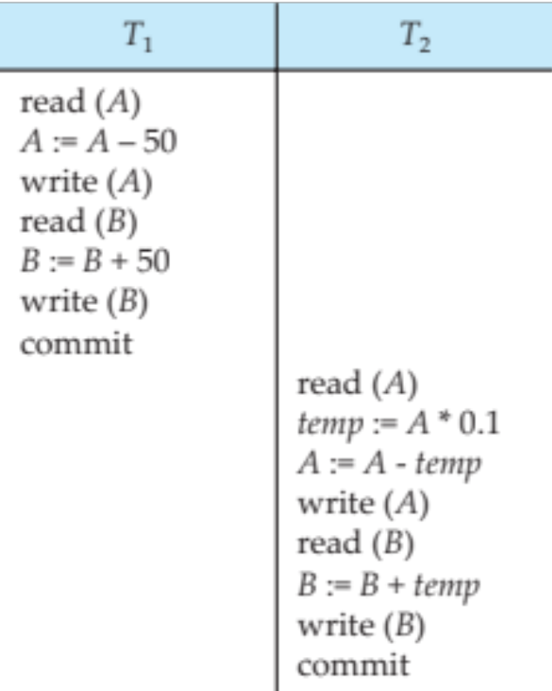
Schedule 1（串行）
Let T₁ transfer $50 from A to B, and T₂ transfer 10% of the balance from A to B.
A serial schedule in which T₁ is followed by T₂ :

Slide 19
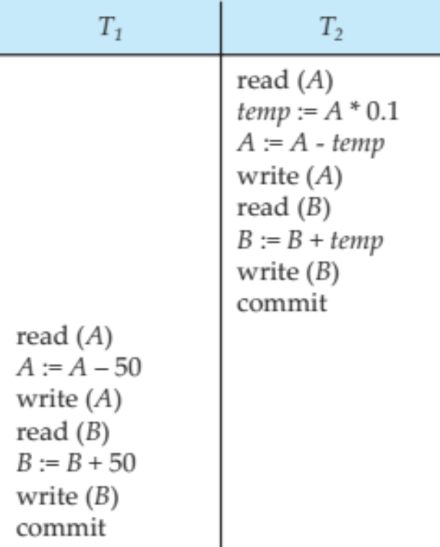
Schedule 2 （串行）
A serial schedule where T₂ is followed by T₁
Schedule 1 == Schedule 2 ？ No

Slide 20
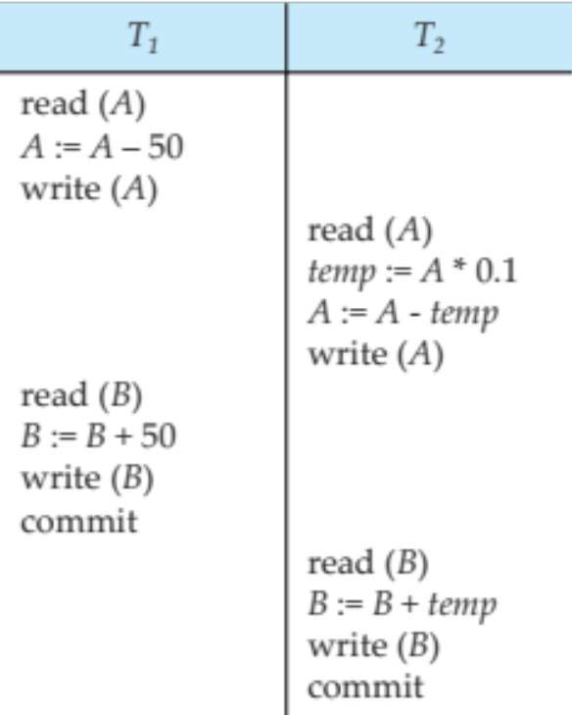
Schedule 3 （并行）
Let T₁ and T₂ be the transactions defined previously. The following schedule is not a serial schedule, but it is equivalent to Schedule 1
In Schedules 1, 2 and 3, the sum A + B is preserved.

Slide 21
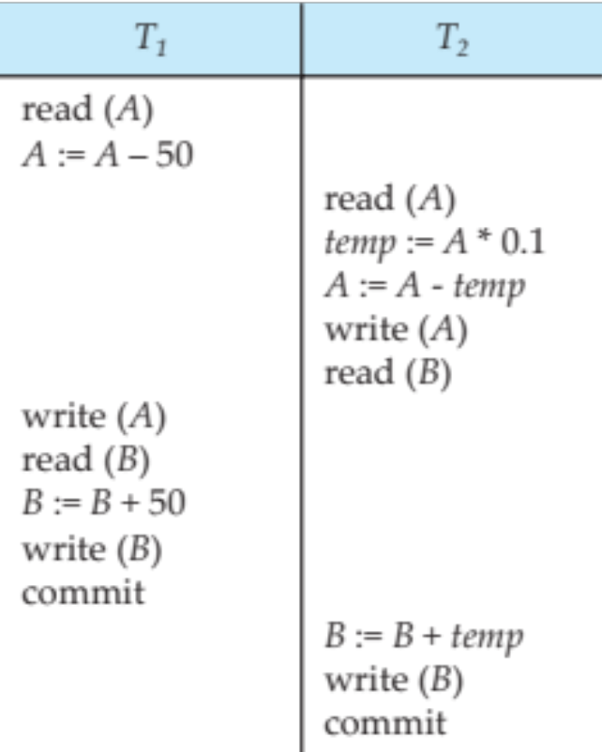
Schedule 4
The following concurrent schedule does not preserve the value of (A + B ).

Slide 22
并发调度的问题
并发调度的问题: 可能破坏数据一致性
  即使单个事务的执行保证一致性，不会破坏数据一致性；多个这样的事务在并发调度时，也可能破坏数据一致性
产生问题的原因: 事务隔离性未得到保证
  隔离性要求事务T1要么全部看到另一个事务T2对数据库的修改，要么全部看不到
  但在并发调度的情况下，有时没有做到这一点
解决问题的方法: 使并发调度可串行化
  事务的串行调度显然不会破坏数据一致性
  如果事务的并发调度是可串行化的，即效果上等价于某个串行调度时，也不会破坏数据一致性

Slide 23
三类数据不一致性
错误的并发调度可能产生三种错误，又称为三类数据不一致性
  丢失修改
  不可重复读
  读“脏”数据
Notes:
写覆盖

Slide 24
第一类：丢失修改
丢失修改的产生
  并发调度两个事务T1、T2
  T1与T2从数据库中读入同一数据后分别修改。假设T1先提交，而T2后提交
  则T2提交的修改覆盖了T1提交的修改，导致T1的修改丢失

Slide 25
第一类：丢失修改
T1
  丢失修改的并发调度
T2
开始状态：
A=0 ￥
read(A);
A := A + 200;
write(A);
read(A);
A := A + 100;
write(A);
T1和T2读入同一数据A，T2提交的修改覆盖了T1提交的修改，导致T1的修改丢失。
A=200￥
A=100￥

Slide 26
第二类：不可重复读
不可重复读的产生
  事务T1读取某些数据（记录）后，
  事务T2对这些数据（记录）做了某种修改操作
  当T1再次读取该数据（记录）时，得到的是与前一次不同的值

Slide 27
第二类：不可重复读
不可重复读又分为三种情况——
在事务T1两次读取之间，
  另一事务T2更新了记录。则当T1第二次读取时，得到与前一次不同的记录值
  另一事务T2删除了部分记录。则当T1第二次读取时，发现其中的某些记录神秘地消失了
  另一事务T2插入了一些记录。则当T1第二次按相同条件读取时，发现地神秘地多了一些记录
（后两种不可重复读有时也称为幻影现象）

Slide 28
第二类：不可重复读
T1
  不可重复读的并发调度
T2
read(A);
print(A);
read(A);
print(A);
read(A);
A := A + 100;
write(A);
事务T1读取某一数据A后，事务T2对其进行了更新操作，当T1再次读取该数据时，得到与前次不同的值。
打印A＝?
打印A ＝?

Slide 29
第二类：不可重复读
幻影的例子
  事务T1: 查询年龄为23的学生，重复两次；事务T2：插入一条学生记录
事务T1
Select * From S Where age=23; Select * From S Where age=23;
事务T2
insert into S values(1, “王”, 23);
串行调度T1、T2：
T1两次查询都
不包含学生“王”
串行调度T2、T1：
T1两次查询都
包含学生“王”

Slide 30
第二类：不可重复读
  产生“幻影”的并发调度
T1
T2
select ＊
from S
Where Age=23;
select ＊
from S
Where Age=23;
事务T1中，两次执行相同的查询有不同结果。前一次的查询结果就是 “幻影”
insert into S
values(1, “王”, 23);
两次查询的
结果是否相同?

Slide 31
第三类：读“脏”数据
读“脏”数据的产生
  事务T1修改某一数据，并写入数据库，但尚未结束(提交)
  事务T2读取同一数据，得到的是T1修改后的新值
  事务T1由于某种原因被撤消，则数据库中的数据恢复为修改前的旧值
  事务T2读到的数据就与数据库最终的数据不一致，是不正确的数据，又称为“脏”数据 —— 其它事务修改后但又被撤销的数据。

Slide 32
第三类：读“脏”数据
读“脏”数据的例子
  事务T1: 存款100后回滚；事务T2：读取并打印存款额
起始状态:
A=0￥
事务T1
read(A); A := A + 100 write(A); RollBack;
事务T2
read(A); print(A);
串行调度T1、T2：
A=0￥; 打印的A: 0
串行调度T1、T2：
A=0￥; 打印的A: 0

Slide 33
第三类：读“脏”数据
T1
  读“脏”数据的并发调度
T2
起始状态:
A＝0
read(A);
A := A + 100;
write(A);
Rollback;
T2读入T1修改过的数据A，尔后这个数据又被T1撤销了。致使T2读入的A是一个修改后被撤消的无效值，即“脏”数据。
read(A);
print(A);
A＝0
打印A=?

Slide 34
第三类：读“脏”数据
广义的“脏”数据
  凡是另一事务修改过但是还没有提交的数据，对本事务来说都是“脏”的。
  读这种广义的“脏”数据是件冒风险的事情：可能会正确——如果最后对方事务提交了这种修改；也可能会出错——如果象前面的例子一样，对方事务最后把这种修改撤销了
  所以在严格要求正确性的场合，读“脏”数据是不允许的

Slide 35
Serializability （可串行化）
Basic Assumption – Each transaction preserves database consistency.
A (possibly concurrent) schedule is serializable if it is equivalent to a serial schedule.
Thus, serial execution of a set of transactions preserves database consistency.
Different forms of schedule equivalence give rise to the notions of:
  1. Conflict serializability

Slide 36
Simplified view of transactions
We ignore operations other than read and write instructions
We assume that transactions may perform arbitrary computations on data in local buffers in between reads and writes.
Our simplified schedules consist of only read and write instructions.

Slide 37
Conflicting Instructions
Instructions l_{i} and l_{j} of transactions T_{i} and T_{j} respectively, conflict if and only if there exists some item Q accessed by both l_{i} and l_{j}, and at least one of these instructions wrote Q.
1. l_{i} = read(Q), l_{j} = read(Q). l_{i} and l_{j} don’t conflict.
2. l_{i} = read(Q), l_{j} = write(Q). They conflict.
3. l_{i} = write(Q), l_{j} = read(Q). They conflict
4. l_{i} = write(Q), l_{j} = write(Q). They conflict
Intuitively, a conflict between l_{i} and l_{j} forces a (logical) temporal order between them.
If l_{i} and l_{j} are consecutive in a schedule and they do not conflict, their results would remain the same even if they had been interchanged in the schedule.

Slide 38
Conflict Serializability
If a schedule S can be transformed into a schedule S’ by a series of swaps of non-conflicting instructions, we say that S and S’ are conflict equivalent.
We say that a schedule S is conflict serializable if it is conflict equivalent to a serial schedule

Slide 39
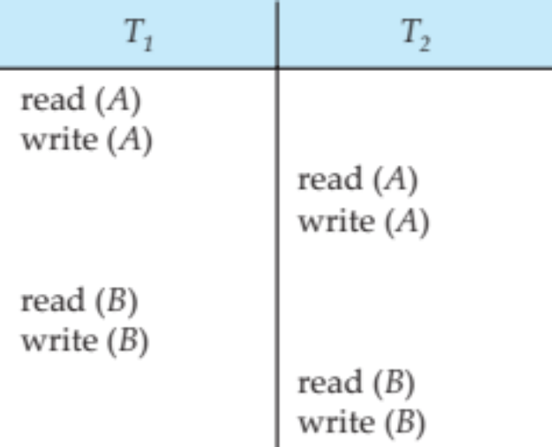
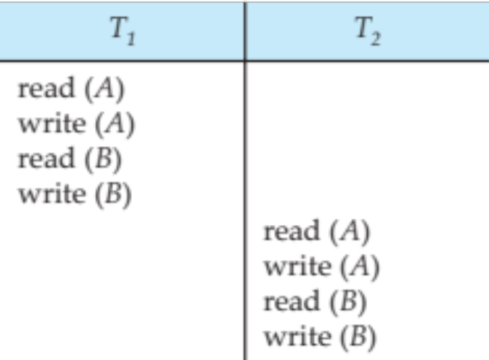
Conflict Serializability (Cont.)
Schedule 3 can be transformed into Schedule 6, a serial schedule where T₂ follows T₁, by series of swaps of non-conflicting instructions. Therefore Schedule 3 is conflict serializable.
Schedule 3
Schedule 6

Slide 40
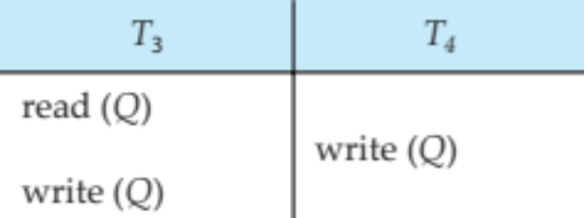
Conflict Serializability (Cont.)
Example of a schedule that is not conflict serializable:
We are unable to swap instructions in the above schedule to obtain either the serial schedule < T₃, T₄ >, or the serial schedule < T₄, T₃ >.

Slide 41
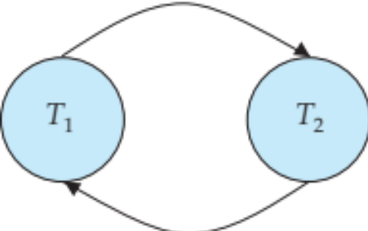
Testing for Serializability
Consider some schedule of a set of transactions T₁, T₂, ..., T_{n}
Precedence graph — a direct graph where the vertices are the transactions (names).
We draw an arc from T_{i} to T_{j} if the two transaction conflict, and T_{i} accessed the data item on which the conflict arose earlier.
We may label the arc by the item that was accessed.
Example of a precedence graph

Slide 42
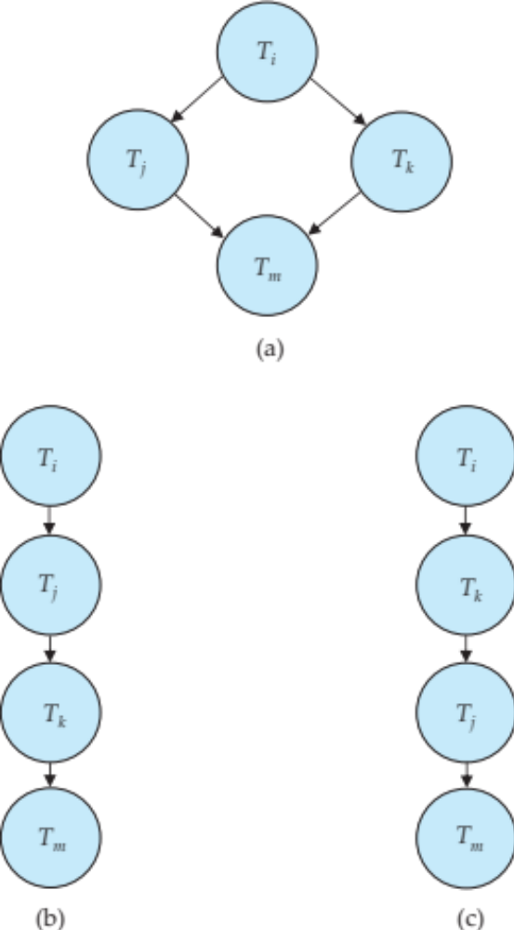
Test for Conflict Serializability
A schedule is conflict serializable if and only if its precedence graph is acyclic.
Cycle-detection algorithms exist which take order n² time, where n is the number of vertices in the graph.
  (Better algorithms take order n + e where e is the number of edges.)
If precedence graph is acyclic, the serializability order can be obtained by a topological sorting of the graph.
  This is a linear order consistent with the partial order of the graph.
  For example, a serializability order for Schedule A would be
  T₅ → T₁ → T₃ → T₂ → T₄
    Are there others?

Slide 43
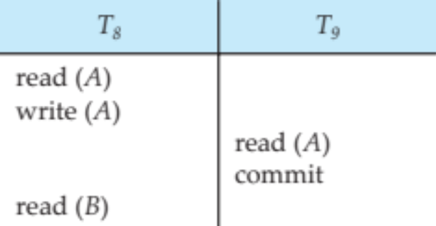
Recoverable Schedules
Need to address the effect of transaction failures on concurrently
running transactions.
Recoverable schedule — if a transaction T_{j} reads a data item previously written by a transaction T_{i} , then the commit operation of T_{i} appears before the commit operation of T_{j}.
The following schedule (Schedule 11) is not recoverable
If T₈ should abort, T₉ would have read (and possibly shown to the user) an inconsistent database state. Hence, database must ensure that schedules are recoverable.

Slide 44
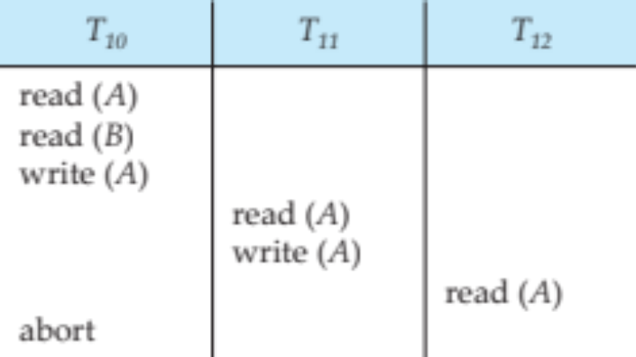
Cascading Rollbacks
Cascading rollback – a single transaction failure leads to a series of transaction rollbacks. Consider the following schedule where none of the transactions has yet committed (so the schedule is recoverable)
If T₁₀ fails, T₁₁ and T₁₂ must also be rolled back.
Can lead to the undoing of a significant amount of work

Slide 45
Cascadeless Schedules
Cascadeless schedules — cascading rollbacks cannot occur;
  For each pair of transactions T_{i} and T_{j} such that T_{j} reads a data item previously written by T_{i}, the commit operation of T_{i} appears before the read operation of T_{j}.
Every Cascadeless schedule is also recoverable
It is desirable to restrict the schedules to those that are cascadeless

Slide 46
Transaction Isolation Levels

Slide 47
Concurrency Control
A database must provide a mechanism that will ensure that all possible schedules are
  either conflict or view serializable, and
  are recoverable and preferably cascadeless
A policy in which only one transaction can execute at a time generates serial schedules, but provides a poor degree of concurrency
  Are serial schedules recoverable/cascadeless?
Testing a schedule for serializability after it has executed is a little too late!
Goal – to develop concurrency control protocols that will assure serializability.

Slide 48
Concurrency Control (Cont.)
Schedules must be conflict or view serializable, and recoverable, for the sake of database consistency, and preferably cascadeless.
A policy in which only one transaction can execute at a time generates serial schedules, but provides a poor degree of concurrency.
Concurrency-control schemes tradeoff between the amount of concurrency they allow and the amount of overhead that they incur.
Some schemes allow only conflict-serializable schedules to be generated, while others allow view-serializable schedules that are not conflict-serializable.

Slide 49
Concurrency Control vs. Serializability Tests
Concurrency-control protocols allow concurrent schedules, but ensure that the schedules are conflict/view serializable, and are recoverable and cascadeless .
Concurrency control protocols (generally) do not examine the precedence graph as it is being created
  Instead a protocol imposes a discipline that avoids non-serializable schedules.
Different concurrency control protocols provide different tradeoffs between the amount of concurrency they allow and the amount of overhead that they incur.
Tests for serializability help us understand why a concurrency control protocol is correct.

Slide 50
Weak Levels of Consistency
Some applications are willing to live with weak levels of consistency, allowing schedules that are not serializable
  E.g., a read-only transaction that wants to get an approximate total balance of all accounts
  E.g., database statistics computed for query optimization can be approximate (why?)
  Such transactions need not be serializable with respect to other transactions
Tradeoff accuracy for performance

Slide 51
Levels of Consistency in SQL-92
Serializable — default
Repeatable read — only committed records to be read.
  Repeated reads of same record must return same value.
  However, a transaction may not be serializable – it may find some records inserted by a transaction but not find others.
Read committed — only committed records can be read.
  Successive reads of record may return different (but committed) values.
Read uncommitted — even uncommitted records may be read.

Slide 52
Levels of Consistency
Lower degrees of consistency useful for gathering approximate
information about the database
Warning: some database systems do not ensure serializable schedules by default
E.g., Oracle (and PostgreSQL prior to version 9) by default support a level of consistency called snapshot isolation (not part of the SQL standard)

Slide 53
Transaction Definition in SQL
In SQL, a transaction begins implicitly.
A transaction in SQL ends by:
  Commit work commits current transaction and begins a new one.
  Rollback work causes current transaction to abort.
In almost all database systems, by default, every SQL statement also commits implicitly if it executes successfully
  Implicit commit can be turned off by a database directive
    E.g., in JDBC -- connection.setAutoCommit(false);
Isolation level can be set at database level
Isolation level can be changed at start of transaction
    E.g. In SQL set transaction isolation level serializable
    E.g. in JDBC -- connection.setTransactionIsolation( Connection.TRANSACTION_SERIALIZABLE)

Slide 54
Implementation of Isolation Levels
Locking
  Lock on whole database vs lock on items
  How long to hold lock?
  Shared vs exclusive locks
Timestamps
  Transaction timestamp assigned e.g. when a transaction begins
  Data items store two timestamps
    Read timestamp
    Write timestamp
  Timestamps are used to detect out of order accesses
Multiple versions of each data item
  Allow transactions to read from a “snapshot” of the database

Slide 55
Transactions as SQL Statements
E.g., Transaction 1:
select ID, name from instructor where salary > 90000
E.g., Transaction 2:
insert into instructor values ('11111', 'James', 'Marketing', 100000)
Suppose
  T1 starts, finds tuples salary > 90000 using index and locks them
  And then T2 executes.
  Do T1 and T2 conflict? Does tuple level locking detect the conflict?
  Instance of the phantom phenomenon
Also consider T3 below, with Wu’s salary = 90000
update instructor
set salary = salary * 1.1
where name = 'Wu’
Key idea: Detect “predicate” conflicts, and use some form of “predicate locking”

Slide 56
End of Chapter 13

