Slide 1
Chapter 6: Database Design Using the E-R Model

Slide 2
Outline
Overview of the Design Process
The Entity-Relationship Model
Complex Attributes
Mapping Cardinalities
Primary Key
Removing Redundant Attributes in Entity Sets
Reducing ER Diagrams to Relational Schemas
Extended E-R Features
Entity-Relationship Design Issues
Alternative Notations for Modeling Data
Other Aspects of Database Design

Slide 3
Outline
Extended E-R Features
Entity-Relationship Design Issues
Alternative Notations for Modeling Data
Other Aspects of Database Design

Slide 4
Design Phases
Initial phase -- characterize fully the data needs of the prospective database users.
Second phase -- choosing a data model
  Applying the concepts of the chosen data model
  Translating these requirements into a conceptual schema of the database.
  A fully developed conceptual schema indicates the functional requirements of the enterprise.
    Describe the kinds of operations (or transactions) that will be performed on the data.

Slide 5
Design Phases (Cont.)
Final Phase -- Moving from an abstract data model to the implementation of the database
  Logical Design – Deciding on the database schema.
    Database design requires that we find a “good” collection of relation schemas.
    This step typically consists of mapping the conceptual schema defined using the entity-relationship model into a relation schema.
  Physical Design – Deciding on the physical layout of the database

Slide 6
数据库设计的过程
开始
第一阶段：用户需求分析
第二阶段：概念设计
  将用户需求转化为选定的某种概念模型（常见是E-R模型）
  结果：得到(以E-R模型表示的)数据库概念模式
第三阶段：逻辑设计
  将概念模式转化为选定的某种数据模型（常见是关系模型）
  第四阶段：物理设计
1.需求分析
用户需求
2.概念设计
概念模式
(E-R模型)
3.逻辑设计
逻辑模式
(关系模型)
4.物理设计
数据库模式
姓名
性别
成绩
……

Slide 7
Design Alternatives
In designing a database schema, we must ensure that we avoid two major pitfalls:
  Redundancy: a bad design may result in repeat information.
    Redundant representation of information may lead to data inconsistency among the various copies of information
  Incompleteness: a bad design may make certain aspects of the enterprise difficult or impossible to model.
Avoiding bad designs is not enough. There may be a large number of good designs from which we must choose.

Slide 8
Outline of the ER Model

Slide 9
Design Approaches
Entity Relationship Model (covered in this chapter)
  Models an enterprise as a collection of entities and relationships
    Entity: a “thing” or “object” in the enterprise that is distinguishable from other objects
      Described by a set of attributes
    Relationship: an association among several entities
  Represented diagrammatically by an entity-relationship diagram:
Normalization Theory (Chapter 7)
  Formalize what designs are bad, and test for them

Slide 10
ER model -- Database Modeling
The ER data mode was developed to facilitate database design by allowing specification of an enterprise schema that represents the overall logical structure of a database.
The ER data model employs three basic concepts:
  entity sets,
  relationship sets,
  attributes.
The ER model also has an associated diagrammatic representation, the ER diagram, which can express the overall logical structure of a database graphically.

Slide 11
Entity Sets
An entity is an object that exists and is distinguishable from other objects.
  Example: specific person, company, event, plant
An entity set is a set of entities of the same type that share the same properties.
  Example: set of all persons, companies, trees, holidays
An entity is represented by a set of attributes; i.e., descriptive properties possessed by all members of an entity set.
  Example:
  instructor = (ID, name, salary )
  course= (course_id, title, credits)
A subset of the attributes form a primary key of the entity set; i.e., uniquely identifying each member of the set.

Slide 12
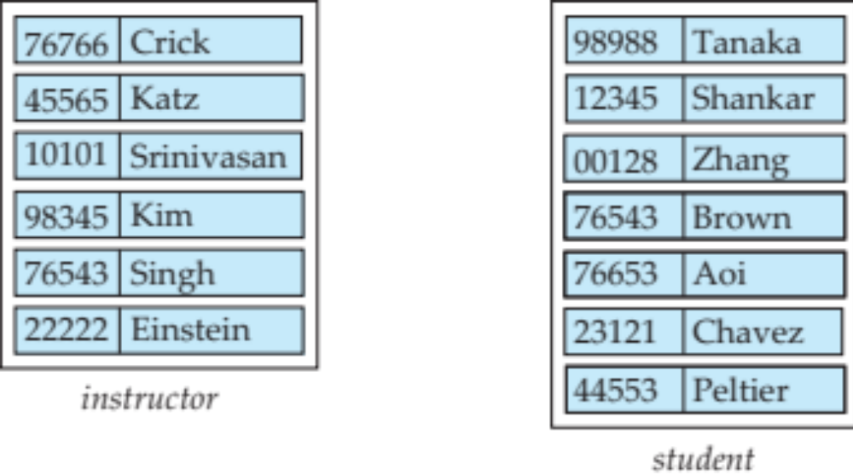
Entity Sets -- instructor and student

Slide 13
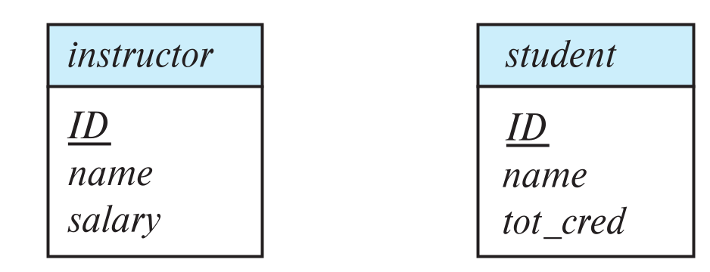
Representing Entity sets in ER Diagram
Entity sets can be represented graphically as follows:
  Rectangles represent entity sets.
  Attributes listed inside entity rectangle
  Underline indicates primary key attributes

Slide 14
Relationship Sets
A relationship is an association among several entities
Example:
44553 (Peltier) advisor 22222 (Einstein)
student entity relationship set instructor entity
A relationship set is a mathematical relation among n ≥ 2 entities, each taken from entity sets
{(e₁, e₂, … e_{n}) | e₁ ∈ E₁, e₂ ∈ E₂, …, e_{n} ∈ E_{n}}
where (e₁, e₂, …, e_{n}) is a relationship
  Example:
  (44553,22222) ∈ advisor

Slide 15
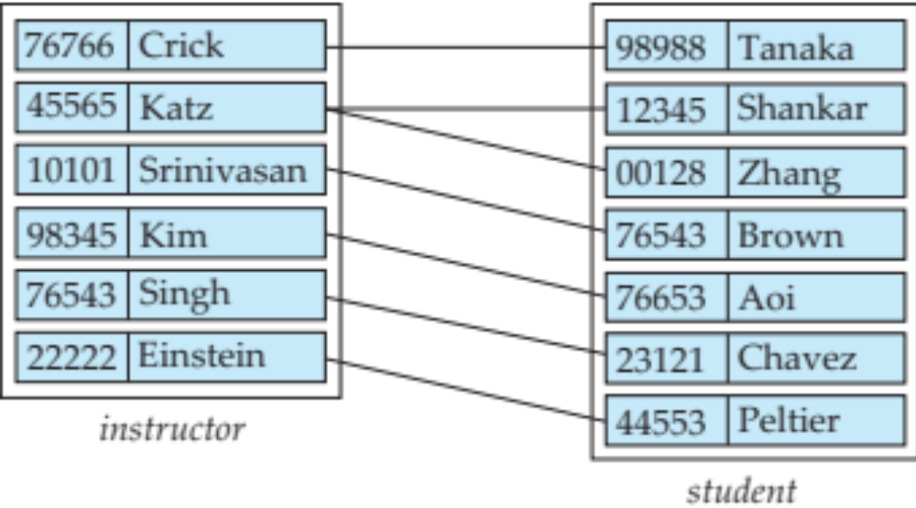
Relationship Sets (Cont.)
Example: we define the relationship set advisor to denote the associations between students and the instructors who act as their advisors.
Pictorially, we draw a line between related entities.

Slide 16
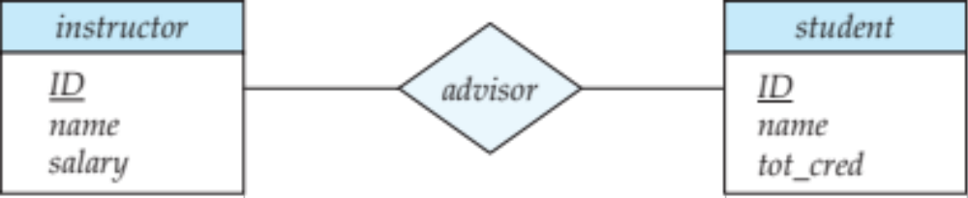
Representing Relationship Sets via ER Diagrams
Diamonds represent relationship sets.

Slide 17
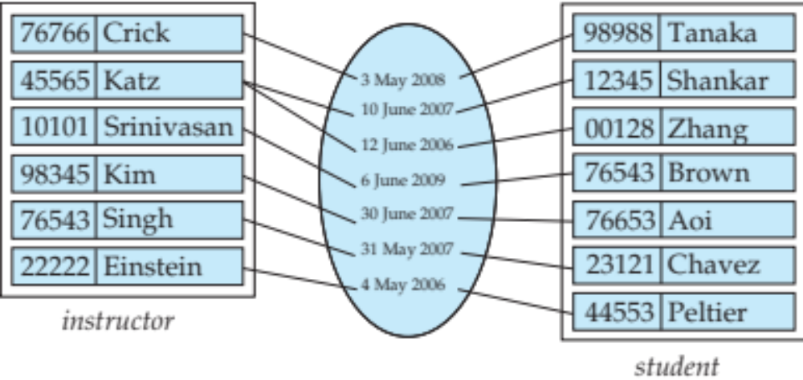
Relationship Sets (Cont.)
An attribute can also be associated with a relationship set.
For instance, the advisor relationship set between entity sets instructor and student may have the attribute date which tracks when the student started being associated with the advisor

Slide 18
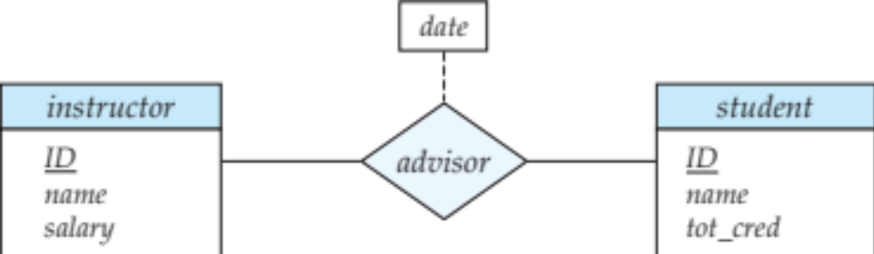
Relationship Sets with Attributes

Slide 19
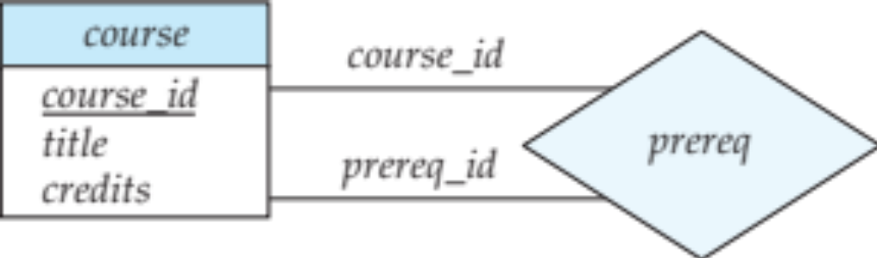
Roles
Entity sets of a relationship need not be distinct
  Each occurrence of an entity set plays a “role” in the relationship
The labels “course_id” and “prereq_id” are called roles.

Slide 20
Degree of a Relationship Set
Binary relationship
  involve two entity sets (or degree two).
  most relationship sets in a database system are binary.
Relationships between more than two entity sets are rare. Most relationships are binary. (More on this later.)
  Example: students work on research projects under the guidance of an instructor.
  relationship proj_guide is a ternary relationship between instructor, student, and project

Slide 21
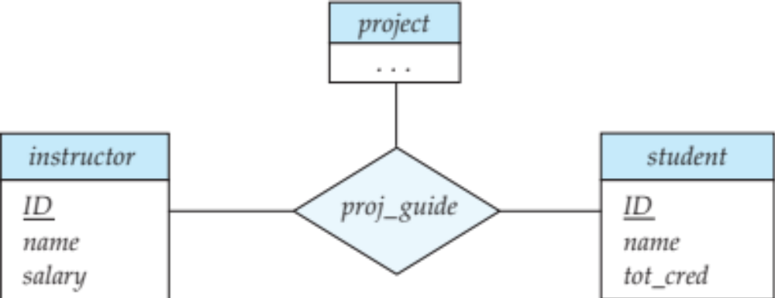
Non-binary Relationship Sets
Most relationship sets are binary
There are occasions when it is more convenient to represent relationships as non-binary.
E-R Diagram with a Ternary Relationship

Slide 22
Complex Attributes
Attribute types:
  Simple and composite attributes.
    Example: name (first name, last name)
  Single-valued and multivalued attributes
    Example: multivalued attribute: phone_numbers
  Derived attributes
    Can be computed from other attributes
    Example: age, given date_of_birth
Domain – the set of permitted values for each attribute

Slide 23
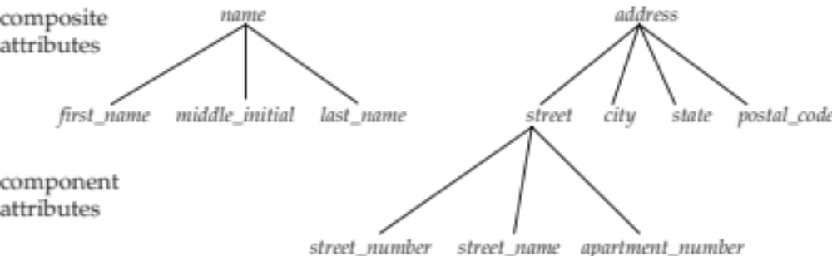
Composite Attributes
Composite attributes allow us to divided attributes into subparts (other attributes).

Slide 24
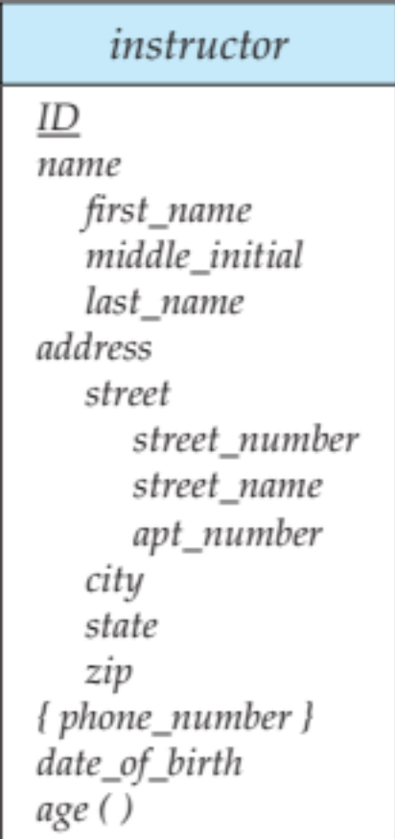
Representing Complex Attributes in ER Diagram

Slide 25
Mapping Cardinality Constraints
Express the number of entities to which another entity can be associated via a relationship set.
Most useful in describing binary relationship sets.
For a binary relationship set the mapping cardinality must be one of the following types:
  One to one
  One to many
  Many to one
  Many to many

Slide 26
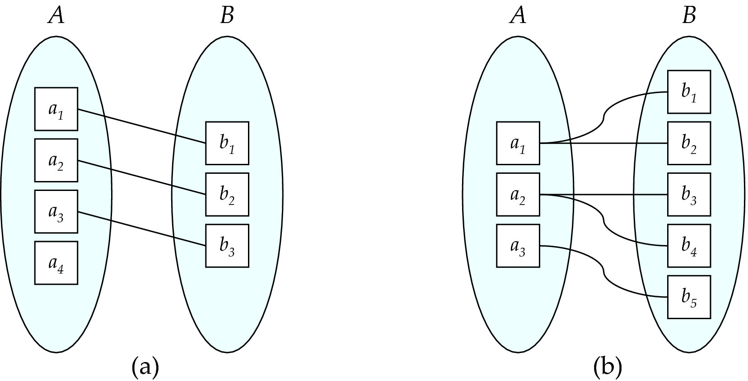
Mapping Cardinalities
One to one
One to many
Note: Some elements in A and B may not be mapped to any
elements in the other set

Slide 27
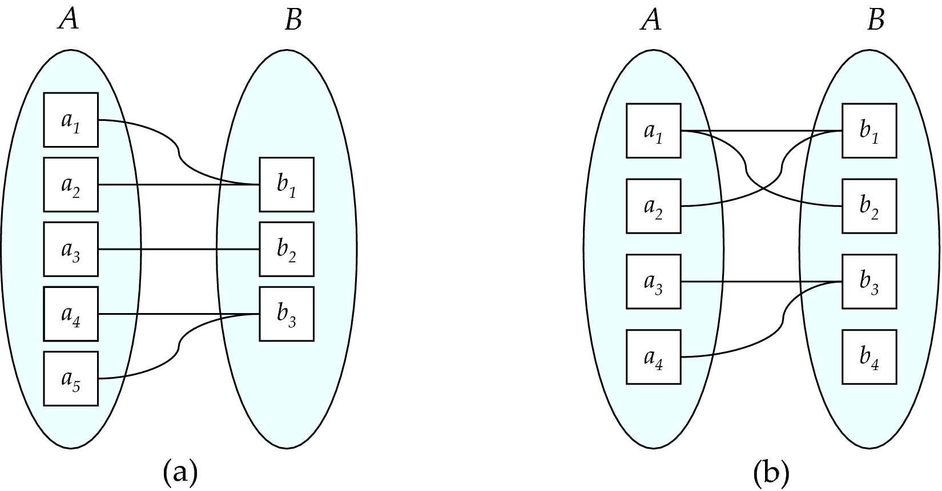
Mapping Cardinalities
Many to one
Many to many
Note: Some elements in A and B may not be mapped to any
elements in the other set

Slide 28
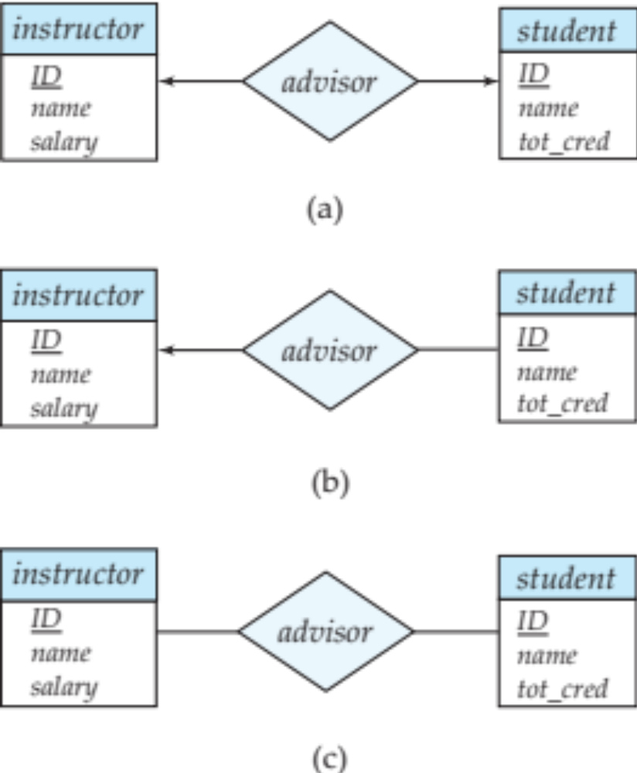
Representing Cardinality Constraints in ER Diagram
We express cardinality constraints by drawing either a directed line (→), signifying “one,” or an undirected line (—), signifying “many,” between the relationship set and the entity set.
One-to-one relationship between an instructor and a student :
  A student is associated with at most one instructor via the relationship advisor
  A student is associated with at most one department via stud_dept

Slide 29
One-to-Many Relationship
one-to-many relationship between an instructor and a student
  an instructor is associated with several (including 0) students via advisor
  a student is associated with at most one instructor via advisor,

Slide 30
Many-to-One Relationships
In a many-to-one relationship between an instructor and a student,
  an instructor is associated with at most one student via advisor,
  and a student is associated with several (including 0) instructors via advisor

Slide 31
Many-to-Many Relationship
An instructor is associated with several (possibly 0) students via advisor
A student is associated with several (possibly 0) instructors via advisor

Slide 32
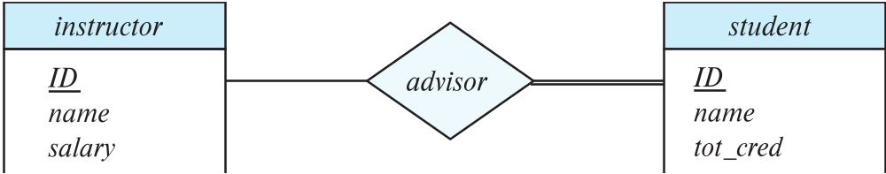
Total and Partial Participation
Total participation (indicated by double line): every entity in the entity set participates in at least one relationship in the relationship set
  participation of student in advisor relation is total
    every student must have an associated instructor
Partial participation: some entities may not participate in any relationship in the relationship set
  Example: participation of instructor in advisor is partial

Slide 33
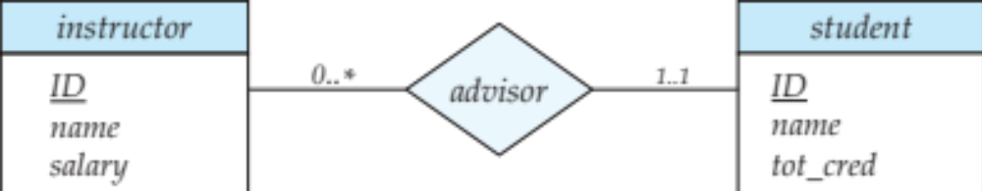
Notation for Expressing More Complex Constraints
A line may have an associated minimum and maximum cardinality, shown in the form l..h, where l is the minimum and h the maximum cardinality
  A minimum value of 1 indicates total participation.
  A maximum value of 1 indicates that the entity participates in at most one relationship
  A maximum value of * indicates no limit.
Example
  Instructor can advise 0 or more students. A student must have 1 advisor; cannot have multiple advisors

Slide 34
Cardinality Constraints on Ternary Relationship
We allow at most one arrow out of a ternary (or greater degree) relationship to indicate a cardinality constraint
For example, an arrow from proj_guide to instructor indicates each student has at most one guide for a project
If there is more than one arrow, there are two ways of defining the meaning.
  For example, a ternary relationship R between A, B and C with arrows to B and C could mean
    1. Each A entity is associated with a unique entity from B
    and C or
    2. Each pair of entities from (A, B) is associated with a unique C entity, and each pair (A, C) is associated with a unique B
  Each alternative has been used in different formalisms
  To avoid confusion we outlaw more than one arrow

Slide 35
Primary Key
Primary keys provide a way to specify how entities and relations are distinguished. We will consider:
  Entity sets
  Relationship sets.
  Weak entity sets

Slide 36
Primary key for Entity Sets
By definition, individual entities are distinct.
From database perspective, the differences among them must be expressed in terms of their attributes.
The values of the attribute values of an entity must be such that they can uniquely identify the entity.
  No two entities in an entity set are allowed to have exactly the same value for all attributes.
A key for an entity is a set of attributes that suffice to distinguish entities from each other

Slide 37
Primary Key for Relationship Sets
To distinguish among the various relationships of a relationship set we use the individual primary keys of the entities in the relationship set.
  Let R be a relationship set involving entity sets E1, E2, .. En
  The primary key for R is consists of the union of the primary keys of entity sets E1, E2, ..En
  If the relationship set R has attributes a1, a2, .., am associated with it, then the primary key of R also includes the attributes a1, a2, .., am
Example: relationship set “advisor”.
  The primary key consists of instructor.ID and student.ID
The choice of the primary key for a relationship set depends on the mapping cardinality of the relationship set.

Slide 38
Choice of Primary key for Binary Relationship
Many-to-Many relationships. The preceding union of the primary keys is a minimal superkey and is chosen as the primary key.
One-to-Many relationships . The primary key of the “Many” side is a minimal superkey and is used as the primary key.
Many-to-one relationships. The primary key of the “Many” side is a minimal superkey and is used as the primary key.
One-to-one relationships. The primary key of either one of the participating entity sets forms a minimal superkey, and either one can be chosen as the primary key.

Slide 39
Weak Entity Sets
Consider a section entity, which is uniquely identified by a course_id, semester, year, and sec_id.
Clearly, section entities are related to course entities. Suppose we create a relationship set sec_course between entity sets section and course.
Note that the information in sec_course is redundant, since section already has an attribute course_id, which identifies the course with which the section is related.
One option to deal with this redundancy is to get rid of the relationship sec_course; however, by doing so the relationship between section and course becomes implicit in an attribute, which is not desirable.

Slide 40
Weak Entity Sets (Cont.)
An alternative way to deal with this redundancy is to not store the attribute course_id in the section entity and to only store the remaining attributes section_id, year, and semester.
  However, the entity set section then does not have enough attributes to identify a particular section entity uniquely
To deal with this problem, we treat the relationship sec_course as a special relationship that provides extra information, in this case, the course_id, required to identify section entities uniquely.
A weak entity set is one whose existence is dependent on another entity, called its identifying entity
Instead of associating a primary key with a weak entity, we use the identifying entity, along with extra attributes called discriminator to uniquely identify a weak entity.

Slide 41
Weak Entity Sets (Cont.)
An entity set that is not a weak entity set is termed a strong entity set.
Every weak entity must be associated with an identifying entity; that is, the weak entity set is said to be existence dependent on the identifying entity set.
The identifying entity set is said to own the weak entity set that it identifies.
The relationship associating the weak entity set with the identifying entity set is called the identifying relationship.
Note that the relational schema we eventually create from the entity set section does have the attribute course_id, for reasons that will become clear later, even though we have dropped the attribute course_id from the entity set section.

Slide 42
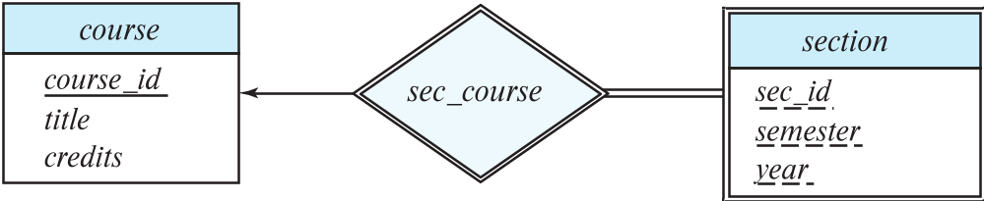
Expressing Weak Entity Sets
In E-R diagrams, a weak entity set is depicted via a double rectangle.
We underline the discriminator of a weak entity set with a dashed line.
The relationship set connecting the weak entity set to the identifying strong entity set is depicted by a double diamond.
Primary key for section – (course_id, sec_id, semester, year)

Slide 43
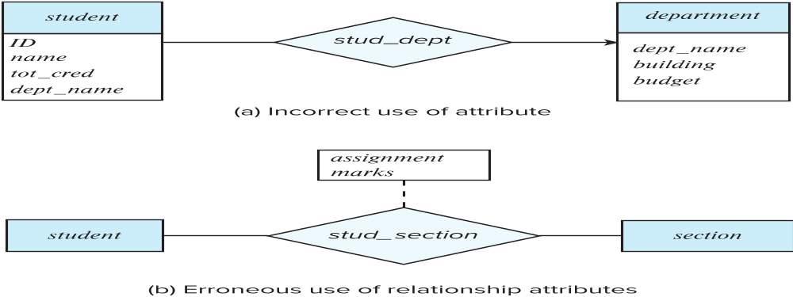
Redundant Attributes
Suppose we have entity sets:
  student, with attributes: ID, name, tot_cred, dept_name
  department, with attributes: dept_name, building, budget
We model the fact that each student has an associated department using a relationship set stud_dept
The attribute dept_name in student below replicates information present in the relationship and is therefore redundant
  and needs to be removed.
BUT: when converting back to tables, in some cases the attribute gets reintroduced, as we will see later.

Slide 44
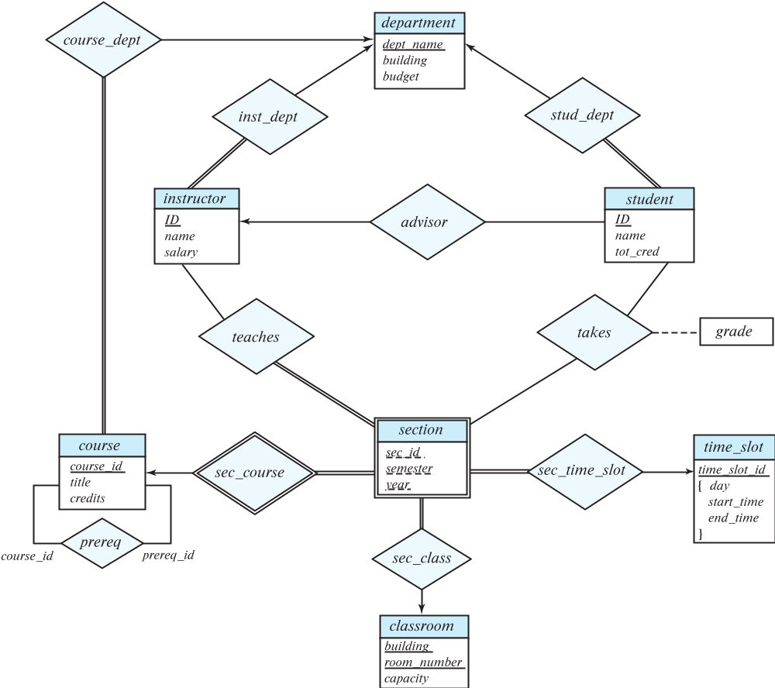
E-R Diagram for a University Enterprise

Slide 45
Reduction to Relation Schemas

Slide 46
Reduction to Relation Schemas
Entity sets and relationship sets can be expressed uniformly as relation schemas that represent the contents of the database.
A database which conforms to an E-R diagram can be represented by a collection of schemas.
For each entity set and relationship set there is a unique schema that is assigned the name of the corresponding entity set or relationship set.
Each schema has a number of columns (generally corresponding to attributes), which have unique names.

Slide 47
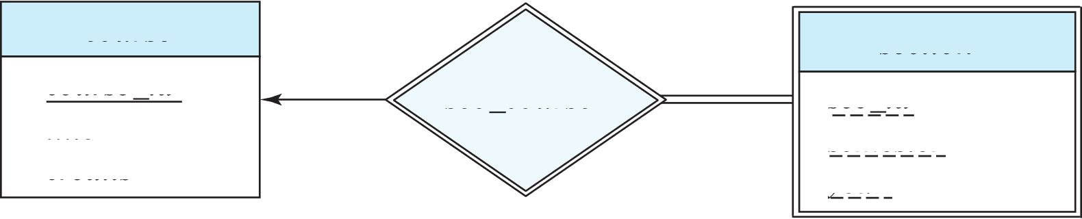
Representing Entity Sets
A strong entity set reduces to a schema with the same attributes
student(ID, name, tot_cred)
A weak entity set becomes a table that includes a column for the primary key of the identifying strong entity set
section ( course_id, sec_id, sem, year )
Example

Slide 48
Representation of Entity Sets with Composite Attributes
Composite attributes are flattened out by creating a separate attribute for each component attribute
  Example: given entity set instructor with composite attribute name with component attributes first_name and last_name the schema corresponding to the entity set has two attributes name_first_name and name_last_name
    Prefix omitted if there is no ambiguity (name_first_name could be first_name)
Ignoring multivalued attributes, extended instructor schema is
  instructor(ID,
  first_name, middle_initial, last_name,
  street_number, street_name,
  apt_number, city, state, zip_code,
  date_of_birth)

Slide 49
Representation of Entity Sets with Multivalued Attributes
A multivalued attribute M of an entity E is represented by a separate schema EM
Schema EM has attributes corresponding to the primary key of E and an attribute corresponding to multivalued attribute M
Example: Multivalued attribute phone_number of instructor is represented by a schema:
inst_phone= ( ID, phone_number)
Each value of the multivalued attribute maps to a separate tuple of the relation on schema EM
  For example, an instructor entity with primary key 22222 and phone numbers 456-7890 and 123-4567 maps to two tuples:
  (22222, 456-7890) and (22222, 123-4567)

Slide 50
Representing Relationship Sets
A many-to-many relationship set is represented as a schema with attributes for the primary keys of the two participating entity sets, and any descriptive attributes of the relationship set.
Example: schema for relationship set advisor
advisor = (s_id, i_id)

Slide 51
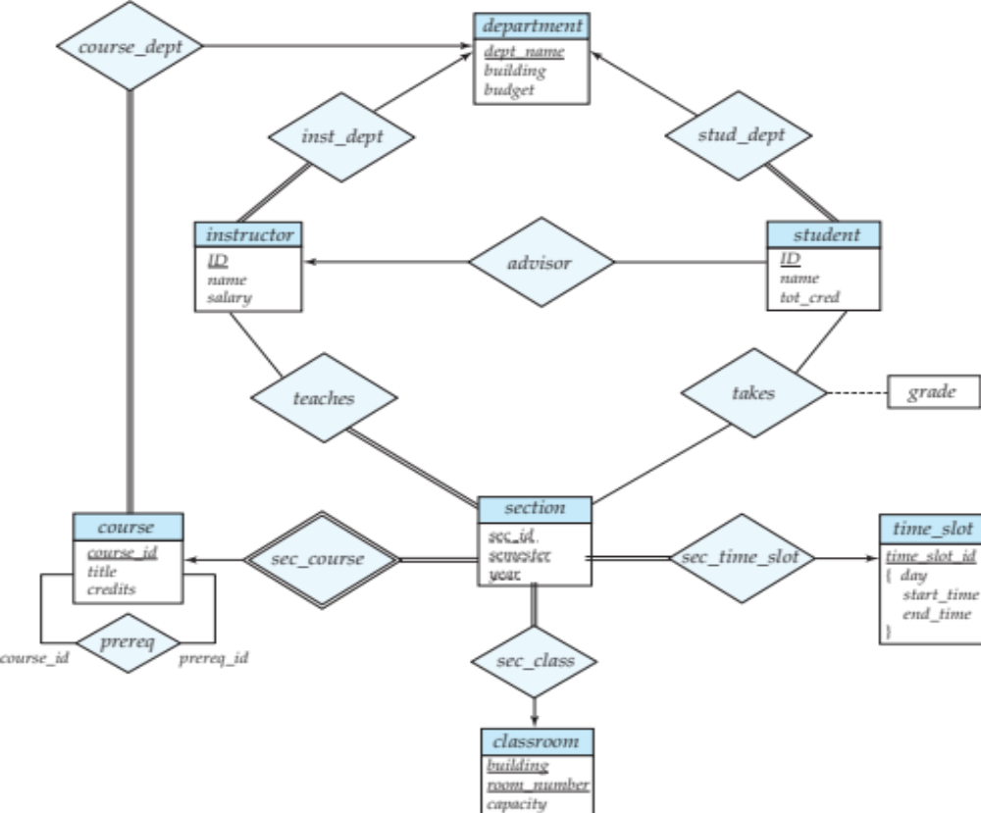
Redundancy of Schemas
Many-to-one and one-to-many relationship sets that are total on the many-side can be represented by adding an extra attribute to the “many” side, containing the primary key of the “one” side
Example: Instead of creating a schema for relationship set inst_dept, add an attribute dept_name to the schema arising from entity set instructor
Example

Slide 52
Redundancy of Schemas (Cont.)
For one-to-one relationship sets, either side can be chosen to act as the “many” side
  That is, an extra attribute can be added to either of the tables corresponding to the two entity sets
If participation is partial on the “many” side, replacing a schema by an extra attribute in the schema corresponding to the “many” side could result in null values

Slide 53
Redundancy of Schemas (Cont.)
The schema corresponding to a relationship set linking a weak entity set to its identifying strong entity set is redundant.
Example: The section schema already contains the attributes that would appear in the sec_course schema

Slide 54
Extended E-R Features

Slide 55
Specialization
Top-down design process; we designate sub-groupings within an entity set that are distinctive from other entities in the set.
These sub-groupings become lower-level entity sets that have attributes or participate in relationships that do not apply to the higher-level entity set.
Depicted by a triangle component labeled ISA (e.g., instructor “is a” person).
Attribute inheritance – a lower-level entity set inherits all the attributes and relationship participation of the higher-level entity set to which it is linked.
Notes:
特化

Slide 56
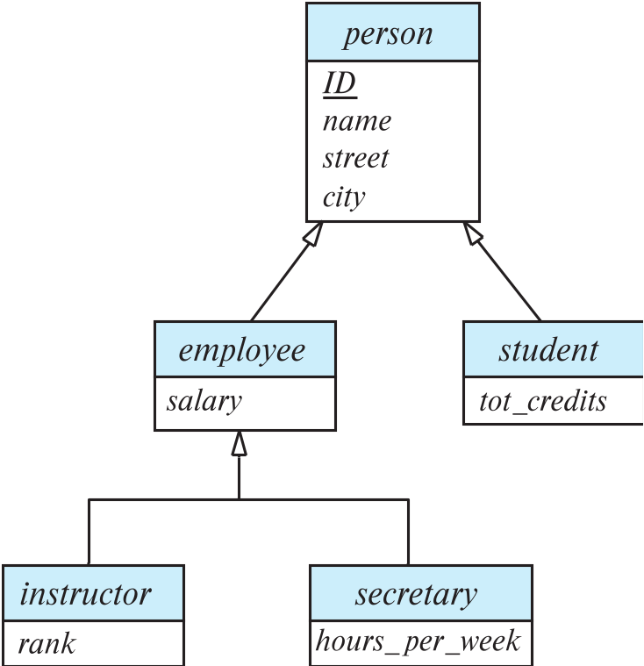
Specialization Example
Overlapping – employee and student
Disjoint – instructor and secretary
Total and partial

Slide 57
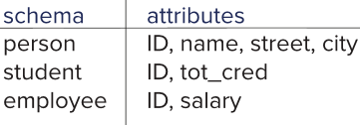
Representing Specialization via Schemas
Method 1:
  Form a schema for the higher-level entity
  Form a schema for each lower-level entity set, include primary key of higher-level entity set and local attributes
  Drawback: getting information about, an employee requires accessing two relations, the one corresponding to the low-level schema and the one corresponding to the high-level schema

Slide 58
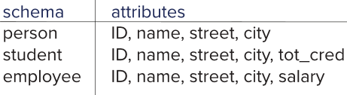
Representing Specialization as Schemas (Cont.)
Method 2:
  Form a schema for each entity set with all local and inherited attributes
  Drawback: name, street and city may be stored redundantly for people who are both students and employees

Slide 59
Generalization
A bottom-up design process – combine a number of entity sets that share the same features into a higher-level entity set.
Specialization and generalization are simple inversions of each other; they are represented in an E-R diagram in the same way.
The terms specialization and generalization are used interchangeably.
Notes:
概化

Slide 60
Completeness constraint
Completeness constraint -- specifies whether or not an entity in the higher-level entity set must belong to at least one of the lower-level entity sets within a generalization.
  total: an entity must belong to one of the lower-level entity sets
  partial: an entity need not belong to one of the lower-level entity sets

Slide 61
Completeness constraint (Cont.)
Partial generalization is the default.
We can specify total generalization in an ER diagram by adding the keyword total in the diagram and drawing a dashed line from the keyword to the corresponding hollow arrow-head to which it applies (for a total generalization), or to the set of hollow arrow-heads to which it applies (for an overlapping generalization).
The student generalization is total: All student entities must be either graduate or undergraduate. Because the higher-level entity set arrived at through generalization is generally composed of only those entities in the lower-level entity sets, the completeness constraint for a generalized higher-level entity set is usually total

Slide 62
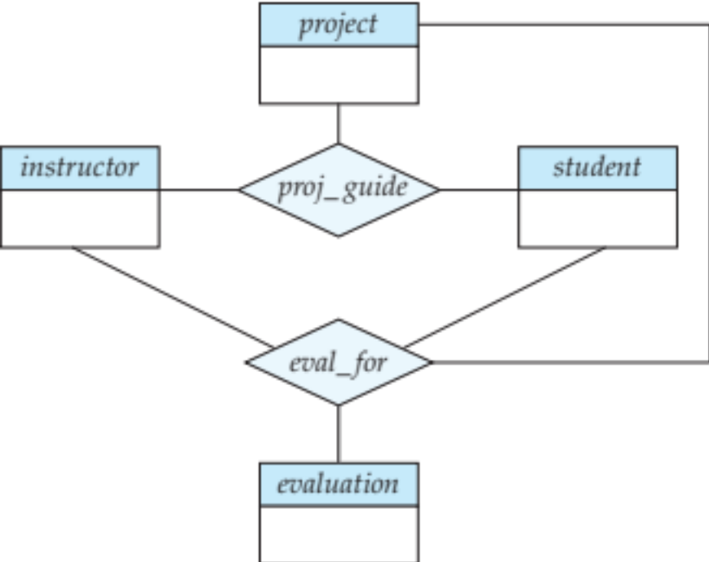
Aggregation
Consider the ternary relationship proj_guide, which we saw earlier
Suppose we want to record evaluations of a student by a guide on a project

Slide 63
Aggregation (Cont.)
Relationship sets eval_for and proj_guide represent overlapping information
  Every eval_for relationship corresponds to a proj_guide relationship
  However, some proj_guide relationships may not correspond to any eval_for relationships
    So we can’t discard the proj_guide relationship
Eliminate this redundancy via aggregation
  Treat relationship as an abstract entity
  Allows relationships between relationships
  Abstraction of relationship into new entity

Slide 64
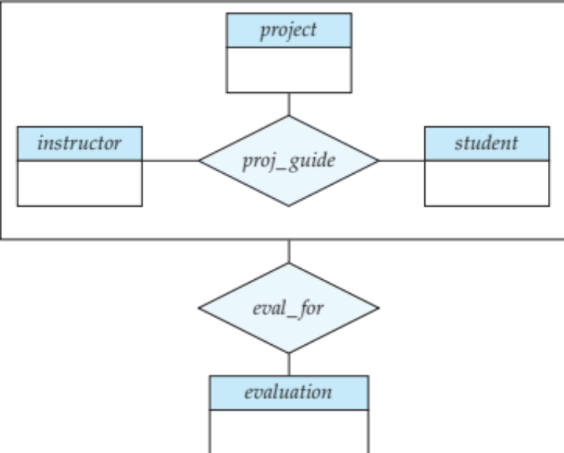
Aggregation (Cont.)
Eliminate this redundancy via aggregation without introducing redundancy, the following diagram represents:
  A student is guided by a particular instructor on a particular project
  A student, instructor, project combination may have an associated evaluation

Slide 65
Reduction to Relational Schemas
To represent aggregation, create a schema containing
  Primary key of the aggregated relationship,
  The primary key of the associated entity set
  Any descriptive attributes
In our example:
  The schema eval_for is:
  eval_for (s_ID, project_id, i_ID, evaluation_id)
  The schema proj_guide is redundant.

Slide 66
Design Issues

Slide 67

Common Mistakes in E-R Diagrams
Example of erroneous E-R diagrams

Slide 68
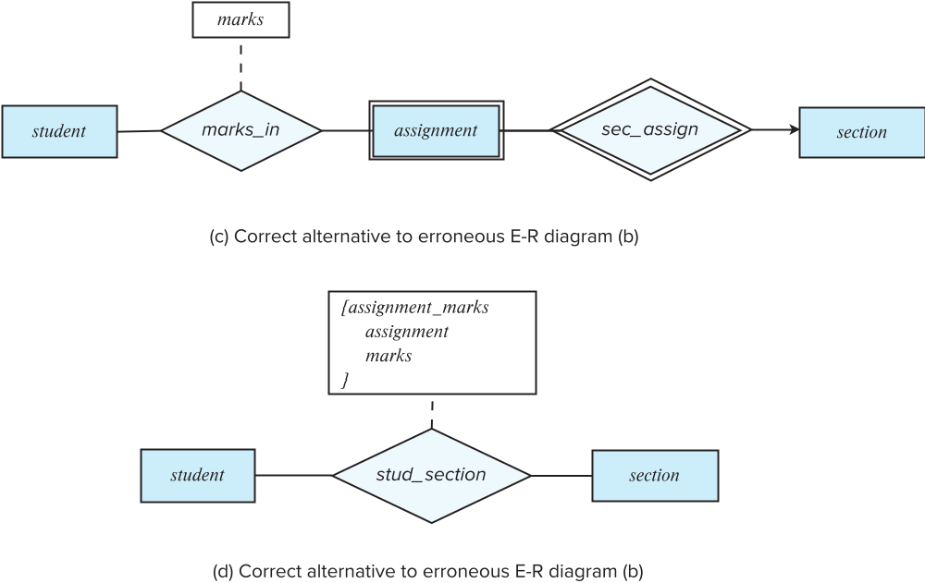
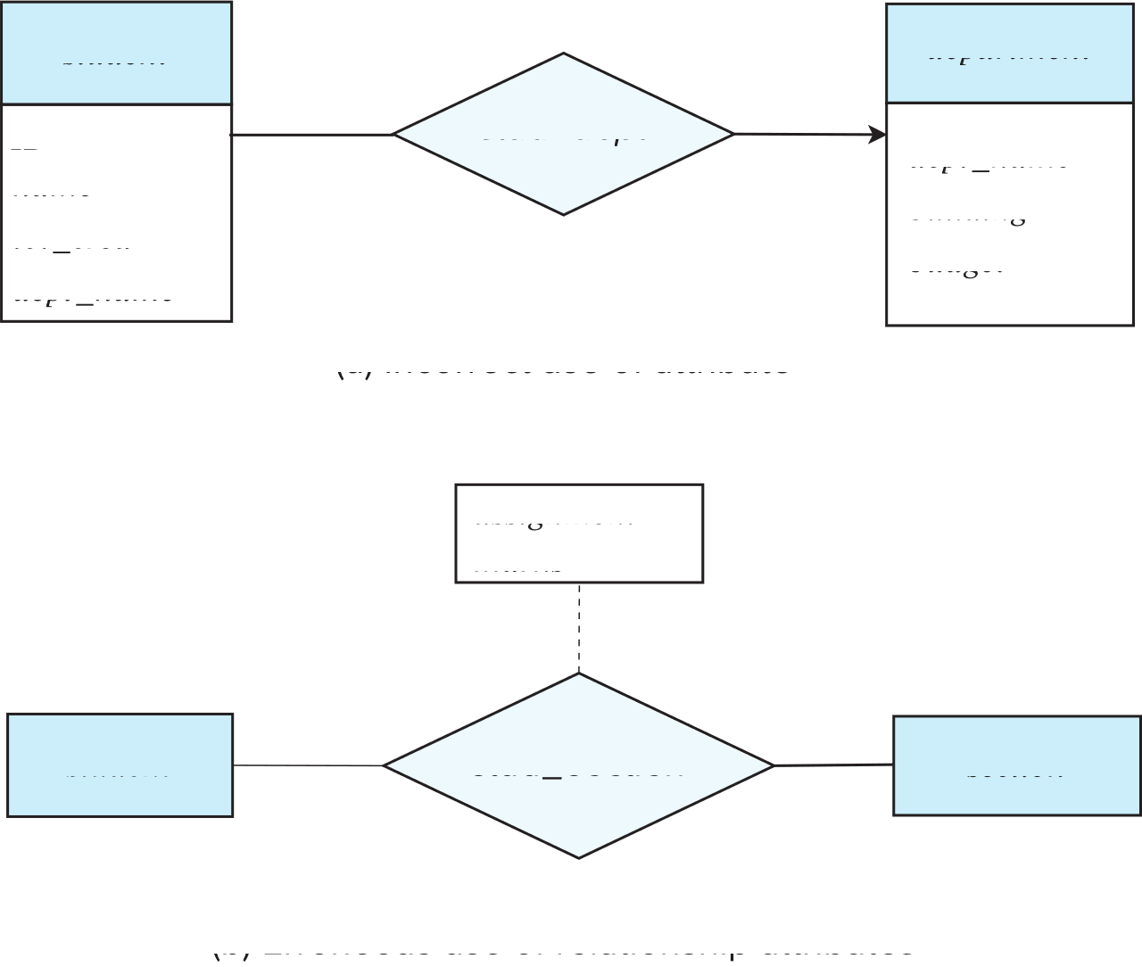
Common Mistakes in E-R Diagrams (Cont.)

Slide 69
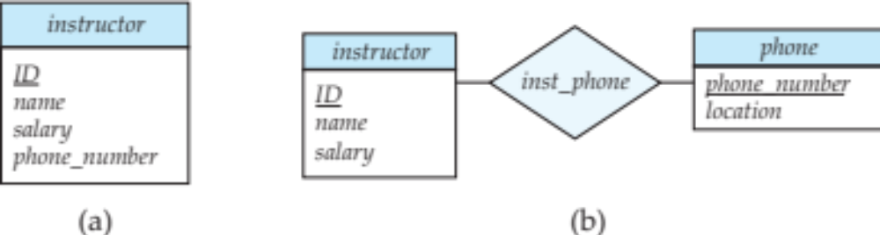
Entities vs. Attributes
Use of entity sets vs. attributes
Use of phone as an entity allows extra information about phone numbers (plus multiple phone numbers)

Slide 70
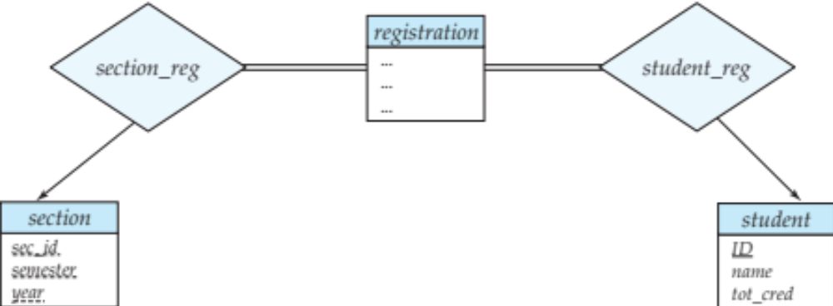
Entities vs. Relationship sets
Use of entity sets vs. relationship sets
Possible guideline is to designate a relationship set to describe an action that occurs between entities
Placement of relationship attributes
For example, attribute date as attribute of advisor or as attribute of student

Slide 71
Binary Vs. Non-Binary Relationships
Although it is possible to replace any non-binary (n-ary, for n > 2) relationship set by a number of distinct binary relationship sets, a n-ary relationship set shows more clearly that several entities participate in a single relationship.
Some relationships that appear to be non-binary may be better represented using binary relationships
  For example, a ternary relationship parents, relating a child to his/her father and mother, is best replaced by two binary relationships, father and mother
    Using two binary relationships allows partial information (e.g., only mother being known)
  But there are some relationships that are naturally non-binary
    Example: proj_guide

Slide 72
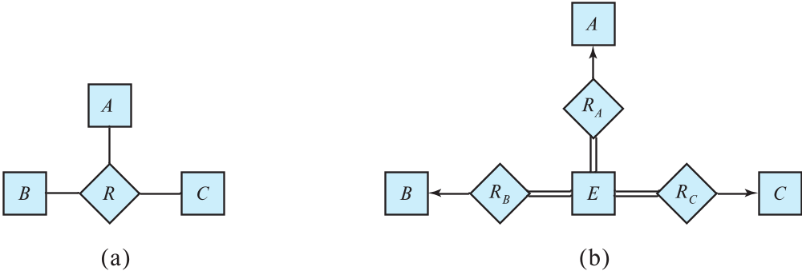
Converting Non-Binary Relationships to Binary Form
In general, any non-binary relationship can be represented using binary relationships by creating an artificial entity set.
  Replace R between entity sets A, B and C by an entity set E, and three relationship sets:
1. R_{A}, relating E and A 2. R_{B}, relating E and B
3. R_{C}, relating E and C
  Create an identifying attribute for E and add any attributes of R to E
  For each relationship (a_{i} , b_{i} , c_{i}) in R, create
1. a new entity e_{i} in the entity set E 2. add (e_{i} , a_{i} ) to R_{A}
3. add (e_{i} , b_{i} ) to R_{B} 4. add (e_{i} , c_{i} ) to R_{C}

Slide 73
Converting Non-Binary Relationships (Cont.)
Also need to translate constraints
  Translating all constraints may not be possible
  There may be instances in the translated schema that
  cannot correspond to any instance of R
    Exercise: add constraints to the relationships R_{A}, R_{B} and R_{C} to ensure that a newly created entity corresponds to exactly one entity in each of entity sets A, B and C
  We can avoid creating an identifying attribute by making E a weak entity set (described shortly) identified by the three relationship sets

Slide 74
E-R Design Decisions
The use of an attribute or entity set to represent an object.
Whether a real-world concept is best expressed by an entity set or a relationship set.
The use of a ternary relationship versus a pair of binary relationships.
The use of a strong or weak entity set.
The use of specialization/generalization – contributes to modularity in the design.
The use of aggregation – can treat the aggregate entity set as a single unit without concern for the details of its internal structure.

Slide 75
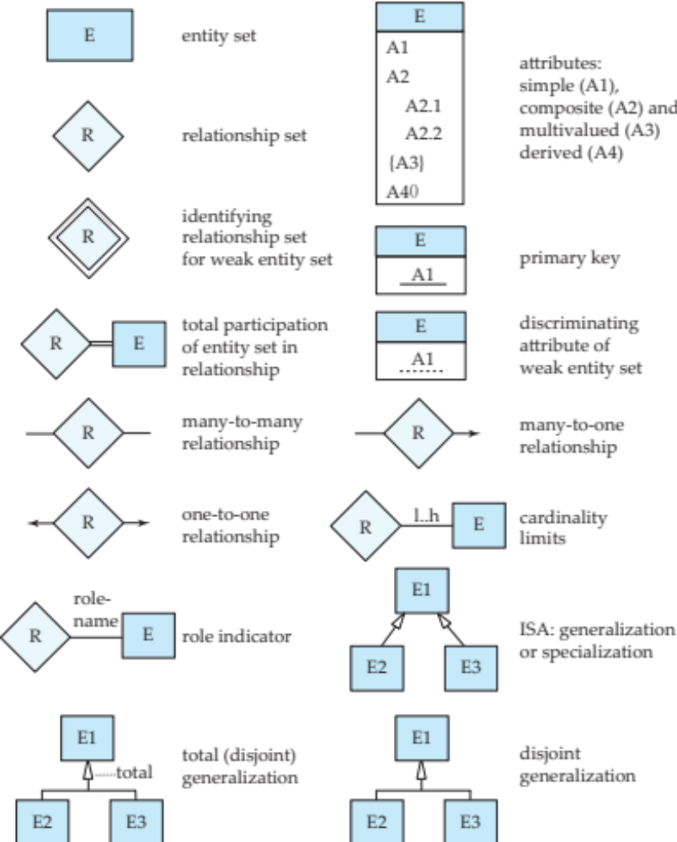
Summary of Symbols Used in E-R Notation

Slide 76
Symbols Used in E-R Notation (Cont.)

Slide 77
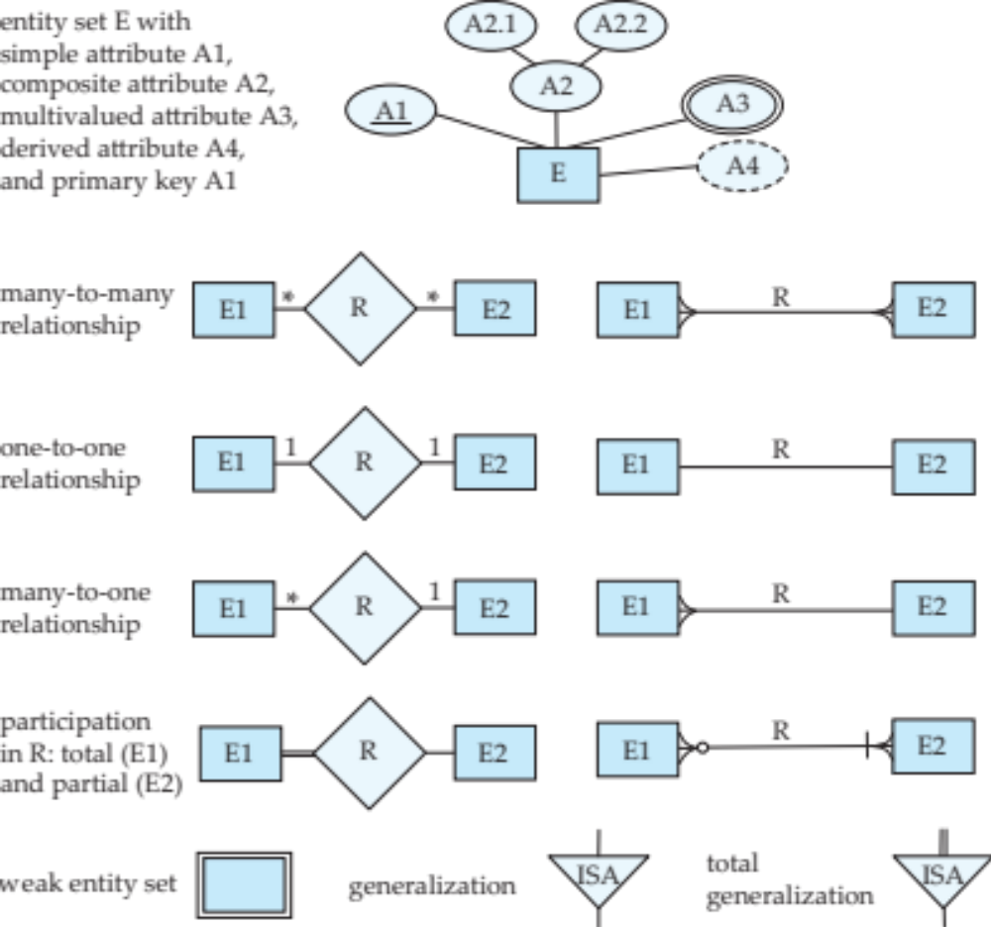
Alternative ER Notations
Chen, IDE1FX, …

Slide 78
Alternative ER Notations
Chen IDE1FX (Crows feet notation)

Slide 79
UML
UML: Unified Modeling Language
UML has many components to graphically model different aspects of an entire software system
UML Class Diagrams correspond to E-R Diagram, but several differences.

Slide 80
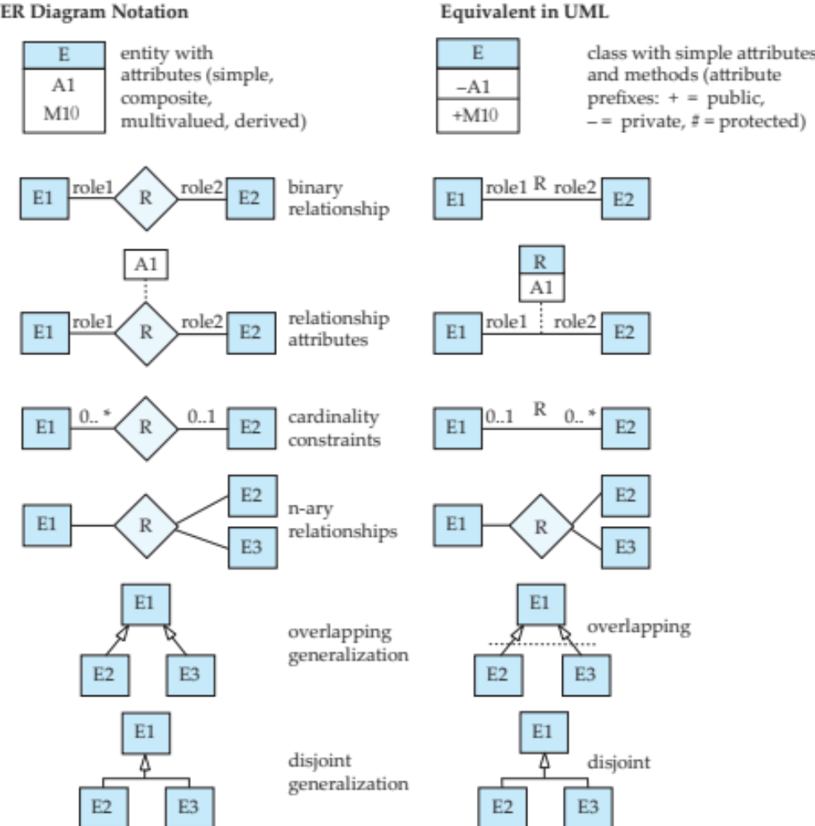
ER vs. UML Class Diagrams
* Note reversal of position in cardinality constraint depiction

Slide 81
ER vs. UML Class Diagrams
ER Diagram Notation
Equivalent in UML
* Generalization can use merged or separate arrows independent
of disjoint/overlapping

Slide 82
UML Class Diagrams (Cont.)
Binary relationship sets are represented in UML by just drawing a line connecting the entity sets. The relationship set name is written adjacent to the line.
The role played by an entity set in a relationship set may also be specified by writing the role name on the line, adjacent to the entity set.
The relationship set name may alternatively be written in a box, along with attributes of the relationship set, and the box is connected, using a dotted line, to the line depicting the relationship set.

Slide 83
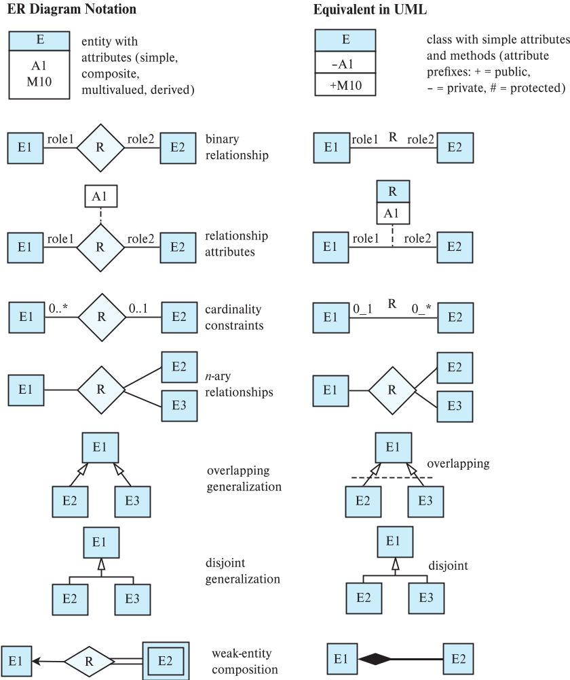
ER vs. UML Class Diagrams

Slide 84
例子：如何将用户需求转化为E-R模型
例子：一所大学必须维护以下信息
  各个系，包括名称，系主任和地址
  各个班级，包括班级编号，名字和年级
  各个教师，包括教师编号，姓名和年龄
  一个系有多个班级，但班级只属于一个系
  一个系聘请某些教师，一个教师被一个系聘请
  教师最多是一个班的班主任；但是任何班级都必须有一个班主任

Slide 85
Step(1): 实体集; 实体集的属性、主码
例子：一所大学必须维护以下信息
  各个系，包括名称，系主任和地址
  各个班级，包括班级编号，名字和年级
  各个教师，包括教师编号，姓名和年龄
  一个系有多个班级，但班级只属于一个系
  一个系聘请某些教师，一个教师被一个系聘请
  教师最多是一个班的班主任；但是任何班级都必须有一个班主任

Slide 86
Step(1): 实体集; 实体集的属性、主码
实体集
  系；班级；教师
实体集的属性
  “系”的属性：名称，系主任，地址
  “班级”的属性：班级编号，名称和年级
  教师的属性：教师编号，姓名和年龄
主码
  “系”的主码：名称
  “班级”的主码：名称
  “教师”的主码：教师编号

Slide 87
Step(1): 实体集; 实体集的属性、主码
？

Slide 88
Step(2): 联系集; 参与、角色、映射基数
例子：一所大学必须维护以下信息
  各个系，包括名称，系主任和地址
  各个班级，包括班级编号，名字和年级
  各个教师，包括教师编号，姓名和年龄
  一个系有多个班级，但班级只属于一个系
  一个系聘请某些教师，一个教师被一个系聘请
  教师最多是一个班的班主任；但是任何班级都必须有一个班主任

Slide 89
Step(2): 联系集; 参与、角色、映射基数
联系集
  隶属 = 班级 : 系 = 多对一
  聘请 = 系 : 教师 = 一对多
  班主任 = 教师 : 班级 = 一对一

Slide 90
Step(2): 联系集; 参与、角色、映射基数
？

Slide 91
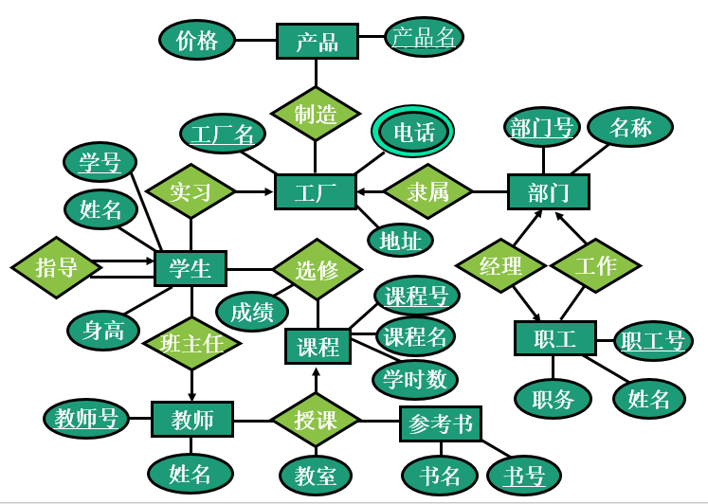
E-R图→关系模型

Slide 92
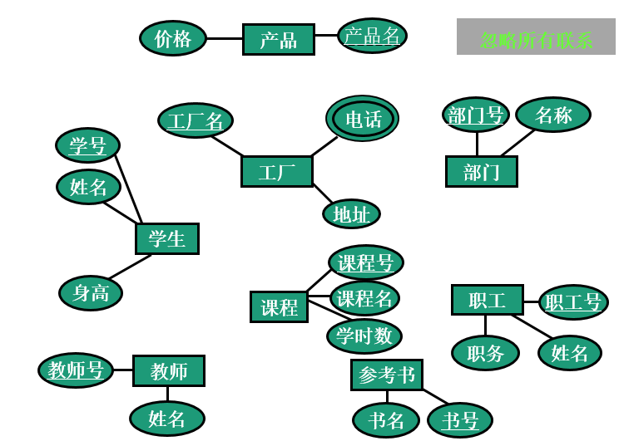
整体E-R图→关系模型

Slide 93
整体E-R图→关系模型
实体集 → 关系，实体集的属性 → 关系的属性
  产品(产品名,价格)
  工厂(工厂名,电话,地址)
  部门(部门号,名称)
  职工(职工号,姓名,职务)
  参考书(书号,书名)
  课程(课程号,课程名,学时数)
  教师(教工号,姓名)
  学生(学号,姓名,身高)

Slide 94
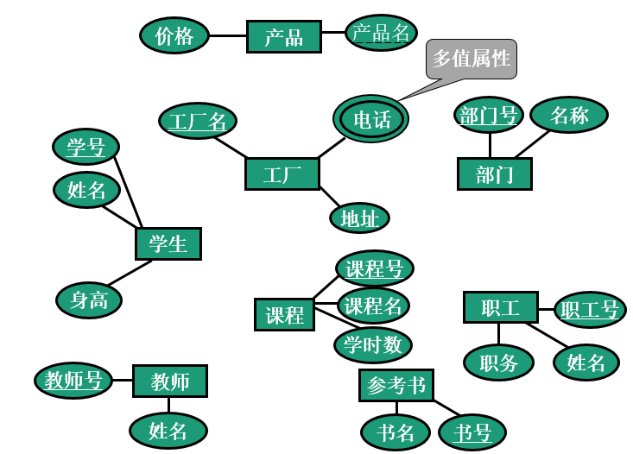
整体E-R图→关系模型

Slide 95
整体E-R图→关系模型
多值属性 + 原关系主码 → 分离的关系
  产品(产品名,价格)
  工厂(工厂名, 地址)
  工厂通讯簿(工厂名,电话)
  部门(部门号,名称)
  职工(职工号,姓名,职务)
  参考书(书号,书名)
  课程(课程号,课程名,学时数)
  教师(教师号,姓名)
  学生(学号,姓名,身高)

Slide 96
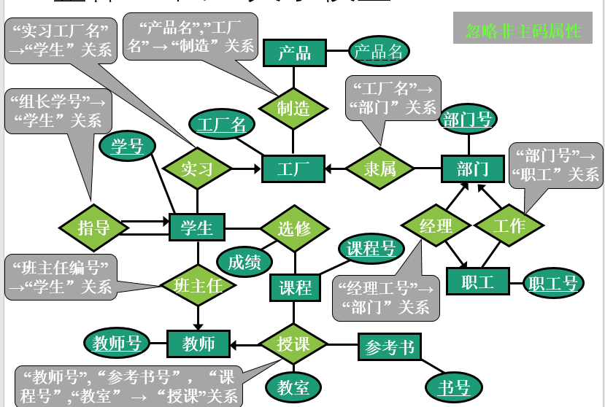
整体E-R图→关系模型

Slide 97
整体E-R图→关系模型
联系集 → 关系/属性
  产品(产品名,价格)
  工厂(工厂名, 地址)
  工厂通讯簿(工厂名,电话)
  部门(工厂名, 经理工号, 部门号,名称)
  职工(部门号,职工号,姓名,职务)
  参考书(书号,书名)
  课程(课程号,课程名,学时数)
  教师(教工号,姓名)
  学生(班主任编号, 组长学号, 实习工厂名, 学号,姓名,身高)
  制造(工厂号, 产品名)
  授课(教师号, 参考书号, 课程号, 教室)
  选修(学号, 课程号, 成绩)

Slide 98
Other Aspects of Database Design
Functional Requirements
Data Flow, Workflow
Schema Evolution

Slide 99
End of Chapter 6

