Slide 1
Chapter 12: Query Optimization

Slide 2
Outline
Query rewriting
  Relational Algebra Equivalences
Heuristics / Rules
  Rewrite the query to remove stupid / inefficient things.
  These techniques may need to examine catalog, but they do not need to examine data.
Cost-based Search
  Use a model to estimate the cost of executing a plan.
  Evaluate multiple equivalent plans for a query and pick the one with the lowest cost.

Slide 3
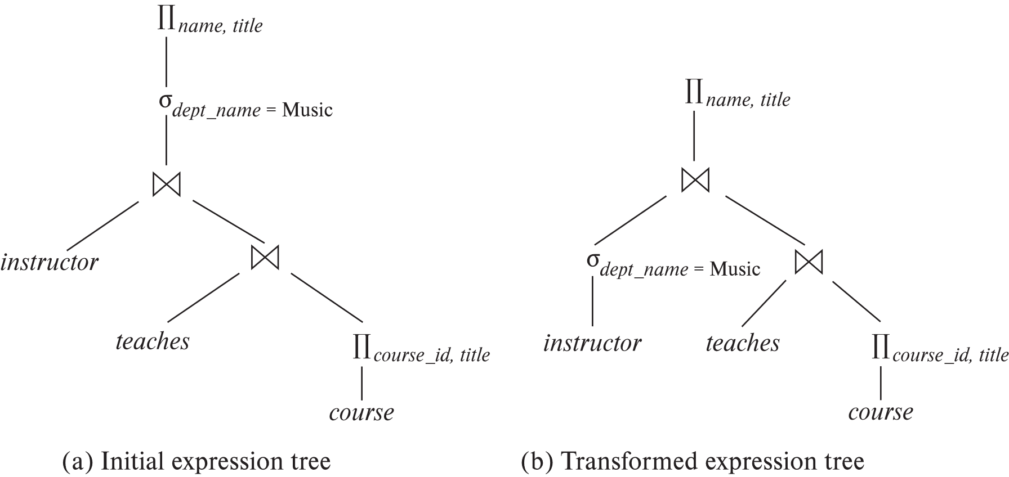
Relational Algebra Equivalences
Two relational algebra expressions are equivalent if they generate the same set of tuples.
Alternative ways of evaluating a given query
  Equivalent expressions
  Different algorithms for each operation

Slide 4
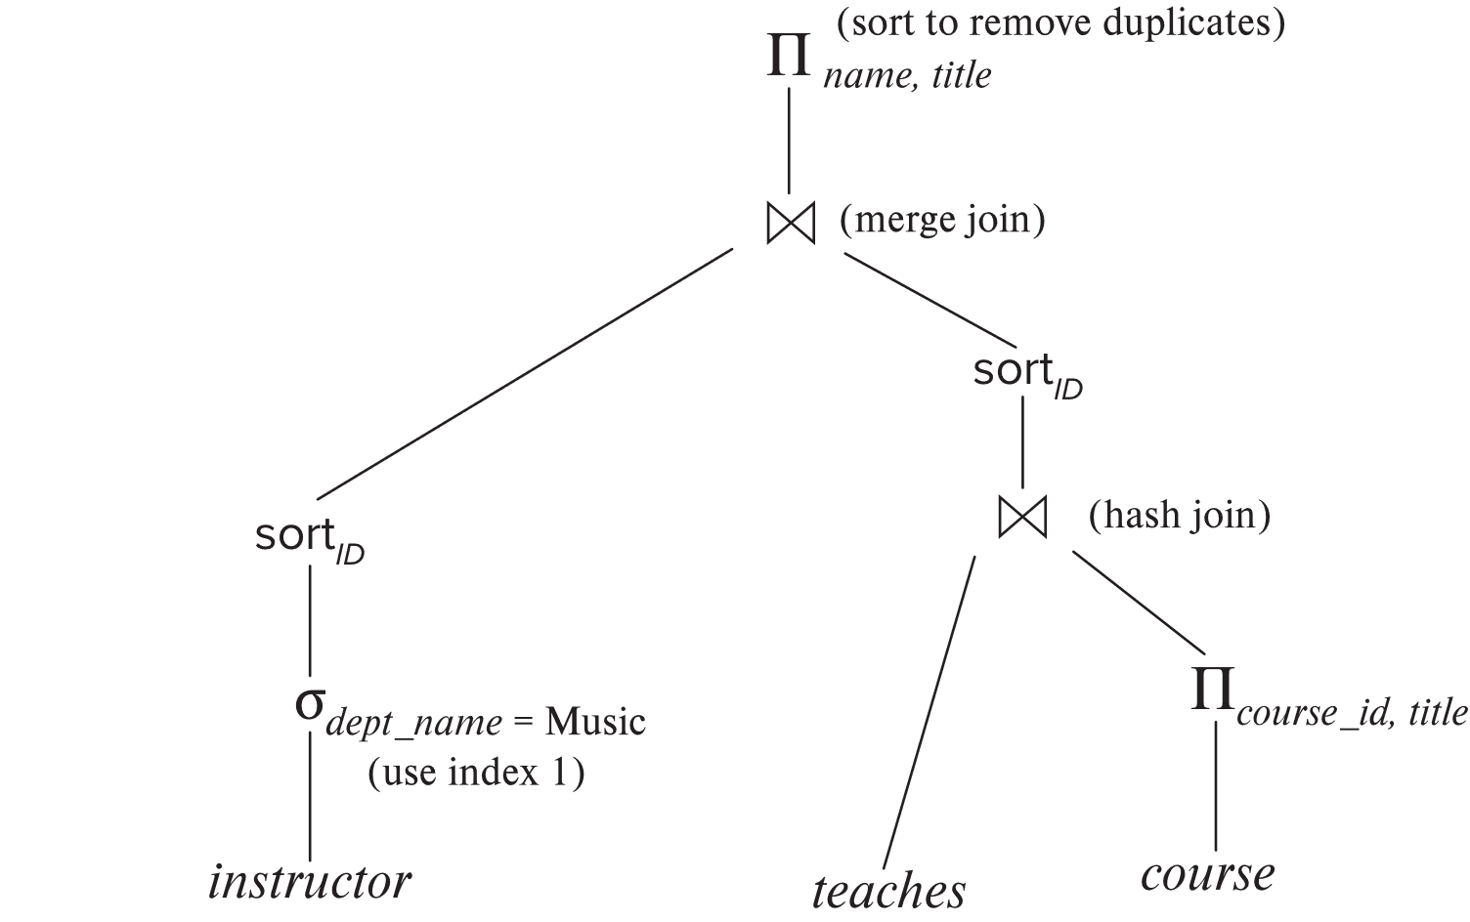
Relational Algebra Equivalences (Cont.)
An evaluation plan defines exactly what algorithm is used for each operation, and how the execution of the operations is coordinated.
Find out how to view query execution plans on your favorite database

Slide 5
Relational Algebra Equivalences (Cont.)
Cost difference between evaluation plans for a query can be enormous
  E.g., seconds vs. days in some cases
Steps in cost-based query optimization
  1. Generate logically equivalent expressions using equivalence rules
  2. Annotate resultant expressions to get alternative query plans
  3. Choose the cheapest plan based on estimated cost
Estimation of plan cost based on:
  Statistical information about relations. Examples:
    number of tuples, number of distinct values for an attribute
  Statistics estimation for intermediate results
    to compute cost of complex expressions
  Cost formulae for algorithms, computed using statistics

Slide 6
Viewing Query Evaluation Plans
Most database support explain <query>
  Displays plan chosen by query optimizer, along with cost estimates
  Some syntax variations between databases
    Oracle: explain plan for <query> followed by select * from table (dbms_xplan.display)
    SQL Server: set showplan_text on
Some databases (e.g. PostgreSQL) support explain analyse <query>
  Shows actual runtime statistics found by running the query, in addition to showing the plan
Some databases (e.g. PostgreSQL) show cost as f..l
  f is the cost of delivering first tuple and l is cost of delivering all results

Slide 7
Generating Equivalent Expressions

Slide 8
Transformation of Relational Expressions
Two relational algebra expressions are said to be equivalent if the two expressions generate the same set of tuples on every legal database instance
  Note: order of tuples is irrelevant
  we don’t care if they generate different results on databases that violate integrity constraints
In SQL, inputs and outputs are multisets of tuples
  Two expressions in the multiset version of the relational algebra are said to be equivalent if the two expressions generate the same multiset of tuples on every legal database instance.
An equivalence rule says that expressions of two forms are equivalent
  Can replace expression of first form by second, or vice versa

Slide 9
Equivalence Rules
1. Conjunctive selection operations can be deconstructed into a sequence of individual selections.
σ_{θ1 ∧ θ2} (E) ≡ σ_{θ1} (σ_{θ2} (E))
2. Selection operations are commutative.
σ_{θ1}(σ_{θ2}(E)) ≡ σ_{θ2} (σ_{θ1}(E))
3. Only the last in a sequence of projection operations is needed, the others can be omitted.
∏ _{L1}(∏ _{L2}(…(∏ _{Ln}(E))…)) ≡ ∏ _{L1}(E)
where L₁ ⊆ L₂ … ⊆ L_{n}
4. Selections can be combined with Cartesian products and theta joins.
  σ_{θ} (E₁ x E₂) ≡ E₁ ⨝ _{θ} E₂
  σ _{θ1} (E₁ ⨝_{θ2} E₂) ≡ E₁ ⨝ _{θ1∧θ2} E₂

Slide 10
Equivalence Rules (Cont.)
5. Theta-join operations (and natural joins) are commutative.
E₁ ⨝ E₂ ≡ E₂ ⨝ E₁
6. (a) Natural join operations are associative:
(E₁ ⨝ E₂) ⨝ E₃ ≡ E₁ ⨝ (E₂ ⨝ E₃)
(b) Theta joins are associative in the following manner:
(E₁ ⨝ _{θ1} E₂) ⨝ _{θ2 ∧ θ3} E₃ ≡ E₁ ⨝_{θ1 ∧ θ3} (E₂ ⨝ _{θ2} E₃)
where θ₂ involves attributes from only E₂ and E₃.

Slide 11
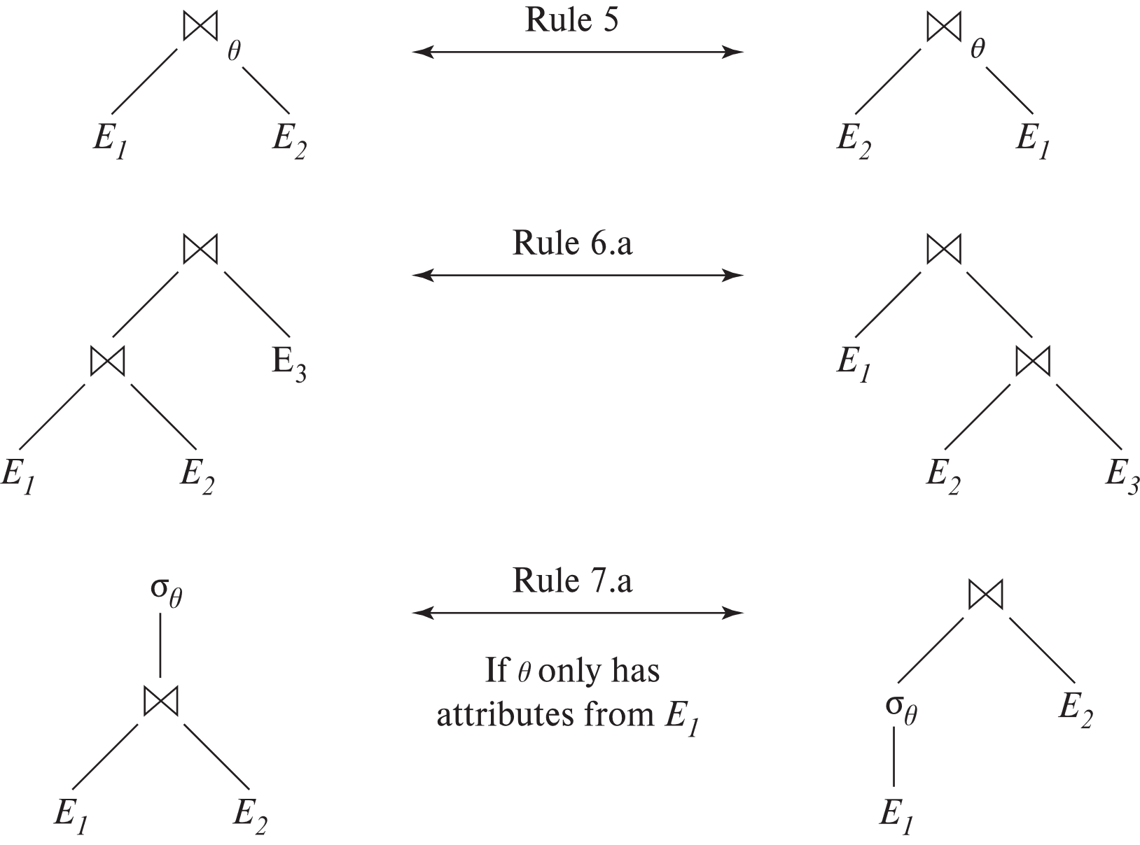
Pictorial Depiction of Equivalence Rules

Slide 12
Equivalence Rules (Cont.)
7. The selection operation distributes over the theta join operation under the following two conditions:
(a) When all the attributes in θ₀ involve only the attributes of one
of the expressions (E₁) being joined.
σ_{θ0} (E₁ ⨝_{θ} E₂) ≡ (σ_{θ0}(E₁)) ⨝_{θ} E₂
(b) When θ₁ involves only the attributes of E₁ and θ₂ involves
only the attributes of E₂.
σ_{θ1 ∧ θ2} (E₁ ⨝_{θ} E₂) ≡ (σ_{θ1}(E₁)) ⨝_{θ} (σ_{θ2}(E₂))

Slide 13
Equivalence Rules (Cont.)
8. The projection operation distributes over the theta join operation as follows:
(a) if θ involves only attributes from L₁ ∪ L₂:
∏ _{L1 ∪ L2}(E₁ ⨝_{θ} E₂) ≡ ∏ _{L1}(E₁) ⨝_{θ} ∏ _{L2}(E₂)
(b) In general, consider a join E₁ ⨝_{θ} E₂.
  Let L₁ and L₂ be sets of attributes from E₁ and E₂, respectively.
  Let L₃ be attributes of E₁ that are involved in join condition θ, but are not in L₁ ∪ L₂, and
  let L₄ be attributes of E₂ that are involved in join condition θ, but are not in L₁ ∪ L₂.
  ∏ _{L1 ∪ L2}(E₁ ⨝_{θ} E₂) ≡ ∏ _{L1 ∪ L2}(∏ _{L1 ∪ L3}(E₁) ⨝_{θ} ∏ _{L2 ∪ L4}(E₂))
  Similar equivalences hold for outerjoin operations: ⟕, ⟖, and ⟗

Slide 14
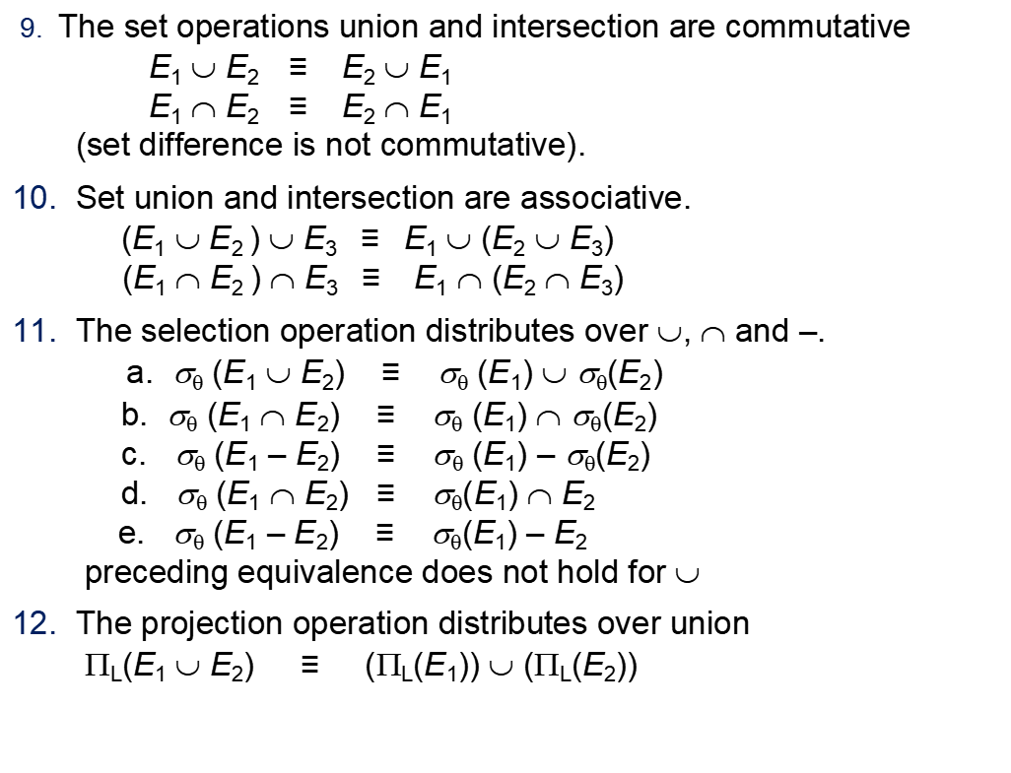
Equivalence Rules (Cont.)
9. The set operations union and intersection are commutative
E₁ ∪ E₂ ≡ E₂ ∪ E₁
E₁ ∩ E₂ ≡ E₂ ∩ E₁
(set difference is not commutative).
10. Set union and intersection are associative.
(E₁ ∪ E₂ ) ∪ E₃ ≡ E₁ ∪ (E₂ ∪ E₃)
(E₁ ∩ E₂ ) ∩ E₃ ≡ E₁ ∩ (E₂ ∩ E₃)
11. The selection operation distributes over ∪, ∩ and –.
a. σ_{θ} (E₁ ∪ E₂) ≡ σ_{θ} (E₁) ∪ σ_{θ}(E₂)
b. σ_{θ} (E₁ ∩ E₂) ≡ σ_{θ} (E₁) ∩ σ_{θ}(E₂)
c. σ_{θ} (E₁ – E₂) ≡ σ_{θ} (E₁) – σ_{θ}(E₂)
d. σ_{θ} (E₁ ∩ E₂) ≡ σ_{θ}(E₁) ∩ E₂
e. σ_{θ} (E₁ – E₂) ≡ σ_{θ}(E₁) – E₂
preceding equivalence does not hold for ∪
12. The projection operation distributes over union
Π_{L}(E₁ ∪ E₂) ≡ (Π_{L}(E₁)) ∪ (Π_{L}(E₂))

Slide 15
Exercise
Create equivalence rules involving
  The group by/aggregation operation
  Left outer join operation

Slide 16
Equivalence Rules (Cont.)
13. Selection distributes over aggregation as below
σ_{θ}(_{G}𝛾_{A}(E)) ≡ _{G}𝛾_{A}(σ_{θ}(E))
provided θ only involves attributes in G
14. a. Full outerjoin is commutative:
E₁ ⟗ E₂ ≡ E₂ ⟗ E₁
b. Left and right outerjoin are not commutative, but:
E₁ ⟕ E₂ ≡ E₂ ⟖ E₁
15. Selection distributes over left and right outerjoins as below, provided θ₁
only involves attributes of E₁
a. σ_{θ1} (E₁ ⟕_{θ} E₂) ≡ (σ_{θ1} (E₁)) ⟕_{θ} E₂
b. σ_{θ1} (E₁ ⟖_{θ} E₂) ≡ E₂ ⟕_{θ} (σ_{θ1} (E₁))
16. Outerjoins can be replaced by inner joins under some conditions
a. σ_{θ1} (E₁ ⟕_{θ} E₂) ≡ σ_{θ1} (E₁ ⨝_{θ} E₂)
b. σ_{θ1} (E₁ ⟖_{θ} E₁) ≡ σ_{θ1} (E₁ ⨝_{θ} E₂)
provided θ₁ is null rejecting on E₂

Slide 17
Equivalence Rules (Cont.)
Note that several equivalences that hold for joins do not hold for outerjoins
σ_{year=2017}(instructor ⟕ teaches) ≢ σ_{year=2017}(instructor ⨝ teaches)
Outerjoins are not associative
(r ⟕ s) ⟕ t ≢ r ⟕ (s ⟕ t)
  e.g. with r(A,B) = {(1,1), s(B,C) = { (1,1)}, t(A,C) = { }
Notes:
How about (r ⟕ s) ⟕ t vs (r ⟕ t) ⟕ s assuming r has common attributes with s and t? Hint: consider 2 cases where s and t have common attributes and those where they have no common attribute

Slide 18
Join Ordering Example
For all relations r_{1,} r_{2,} and r₃,
(r₁ ⨝ r₂) ⨝ r₃ = r₁ ⨝ (r₂ ⨝ r₃ )
(Join Associativity) ⨝
If r₂ ⨝ r₃ is quite large and r₁ ⨝ r₂ is small, we choose
(r₁ ⨝ r₂) ⨝ r₃
so that we compute and store a smaller temporary relation.

Slide 19
Enumeration of Equivalent Expressions
Query optimizers use equivalence rules to systematically generate expressions equivalent to the given expression
Can generate all equivalent expressions as follows:
  Repeat
    apply all applicable equivalence rules on every subexpression of every equivalent expression found so far
    add newly generated expressions to the set of equivalent expressions
    Until no new equivalent expressions are generated above
The above approach is very expensive in space and time
  Two approaches
    Optimized plan generation based on transformation rules
    Special case approach for queries with only selections, projections and joins

Slide 20
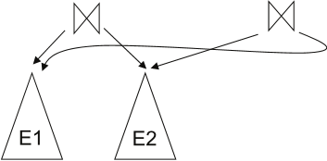
Implementing Transformation Based Optimization
Space requirements reduced by sharing common sub-expressions:
  when E1 is generated from E2 by an equivalence rule, usually only the top level of the two are different, subtrees below are the same and can be shared using pointers
    E.g., when applying join commutativity
  Same sub-expression may get generated multiple times
    Detect duplicate sub-expressions and share one copy
Time requirements are reduced by not generating all expressions
  Dynamic programming
    We will study only the special case of dynamic programming for join order optimization

Slide 21
Cost Estimation
Cost of each operator computer as described in Chapter 11
  Need statistics of input relations
    E.g., number of tuples, sizes of tuples
Inputs can be results of sub-expressions
  Need to estimate statistics of expression results
  To do so, we require additional statistics
    E.g., number of distinct values for an attribute
More on cost estimation later

Slide 22
Choice of Evaluation Plans
Must consider the interaction of evaluation techniques when choosing evaluation plans
  choosing the cheapest algorithm for each operation independently may not yield best overall algorithm. E.g.
    merge-join may be costlier than hash-join, but may provide a sorted output which reduces the cost for an outer level aggregation.
    nested-loop join may provide opportunity for pipelining
Practical query optimizers incorporate elements of the following two broad approaches:
  1. Search all the plans and choose the best plan in a
  cost-based fashion.
  2. Uses heuristics to choose a plan.

Slide 23
Structure of Query Optimizers
Many optimizers considers only left-deep join orders.
  Plus heuristics to push selections and projections down the query tree
  Reduces optimization complexity and generates plans amenable to pipelined evaluation.
Heuristic optimization used in some versions of Oracle:
  Repeatedly pick “best” relation to join next
    Starting from each of n starting points. Pick best among these
Intricacies of SQL complicate query optimization
  E.g., nested subqueries

Slide 24
Structure of Query Optimizers (Cont.)
Some query optimizers integrate heuristic selection and the generation of alternative access plans.
  Frequently used approach
    heuristic rewriting of nested block structure and aggregation
    followed by cost-based join-order optimization for each block
  Some optimizers (e.g. SQL Server) apply transformations to entire query and do not depend on block structure
  Optimization cost budget to stop optimization early (if cost of plan is less than cost of optimization)
  Plan caching to reuse previously computed plan if query is resubmitted
    Even with different constants in query
Even with the use of heuristics, cost-based query optimization imposes a substantial overhead.
  But is worth it for expensive queries
  Optimizers often use simple heuristics for very cheap queries, and perform exhaustive enumeration for more expensive queries

Slide 25
Heuristics / Rules

Slide 26
Heuristic Optimization （启发式优化）
Cost-based optimization is expensive, even with dynamic programming.
Systems may use heuristics to reduce the number of choices that must be made in a cost-based fashion.
Heuristic optimization transforms the query-tree by using a set of rules that typically (but not in all cases) improve execution performance:
  Perform selection early (reduces the number of tuples)
  Perform projection early (reduces the number of attributes)
  Perform most restrictive selection and join operations (i.e., with smallest result size) before other similar operations.
  Some systems use only heuristics, others combine heuristics with partial cost-based optimization.

Slide 27

Transformation: Selections
Performing the selection as early as possible reduces the size of the relation to be joined.
Break a complex predicate, and push down
Example： Simplify a complex predicate
  (X=Y AND Y=3) → X=3 AND Y=3

Slide 28
Example with Multiple Transformations
Query: Find the names of all instructors in the Music department who have taught a course in 2017, along with the titles of the courses that they taught
  Π_{name, title}(σ_{dept_name= "Music”∧year = 2017}
  (instructor ⨝ (teaches ⨝ Π_{course_id, title} (course))))
Transformation using join associatively (Rule 6a):
  Π_{name, title}(σ_{dept_name= “Music”∧year = 2017}
  ((instructor ⨝ teaches) ⨝ Π_{course_id, title} (course)))
Second form provides an opportunity to apply the “perform selections early” rule, resulting in the subexpression
σ_{dept_name = “Music”} (instructor) ⨝ σ _{year = 2017} (teaches)

Slide 29
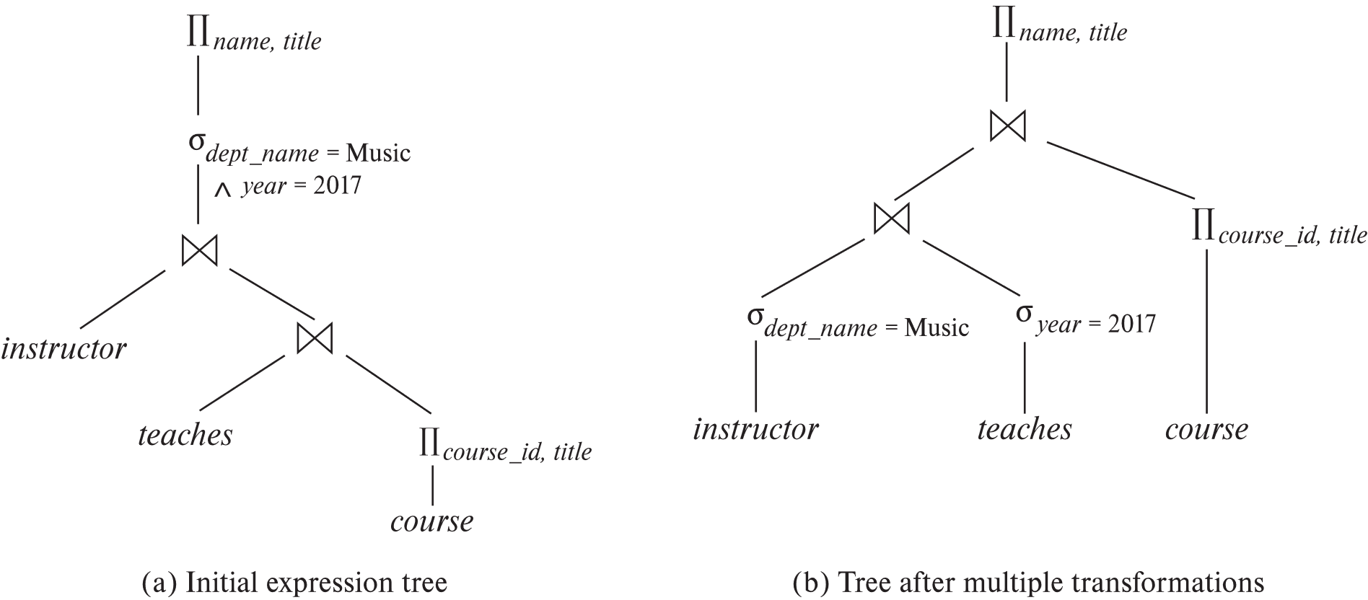
Multiple Transformations (Cont.)

Slide 30
Transformation : Projections
Consider: Π_{name, title}(σ_{dept_name= “Music”} (instructor) ⨝ teaches)
⨝ Π_{course_id, title} (course))))
When we compute
(σ_{dept_name = “Music”} (instructor ⨝ teaches)
we obtain a relation whose schema is:
(ID, name, dept_name, salary, course_id, sec_id, semester, year)
Push projections using equivalence rules 8a and 8b; eliminate unneeded attributes from intermediate results to get:
Π_{name, title}(Π_{name, course_id} (
σ_{dept_name= “Music”} (instructor) ⨝ teaches))
⨝ Π_{course_id, title} (course))))
Performing the projection as early as possible reduces the size of the relation to be joined.

Slide 31
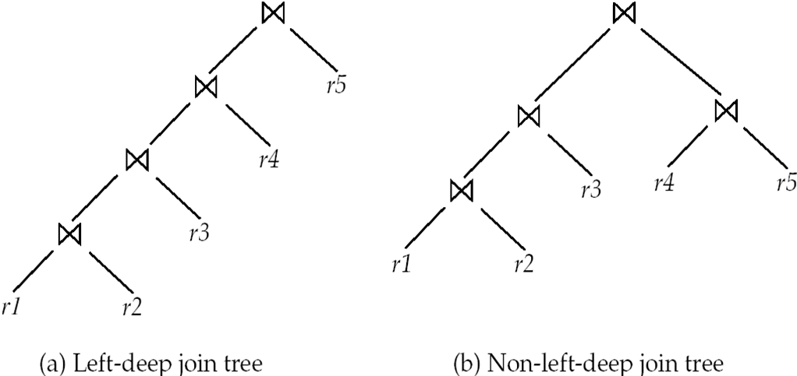
Transformation : Join--Left Deep Join Trees
In left-deep join trees, the right-hand-side input for each join is a relation, not the result of an intermediate join.
Most systems implement left-deep join trees

Slide 32
Example: Steps of Heuristics
Split Conjunctive Predicates
Predicate Pushdown
Replace Cartesian Products with Joins
Projection Pushdown

Slide 33
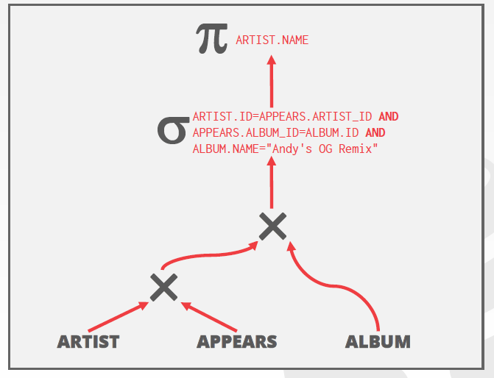

Example: Steps of Heuristics
Split Conjunctive Predicates
SELECT ARTIST.NAME
FROM ARTIST, APPEARS, ALBUM
WHERE ARTIST.ID=APPEARS.ARTIST_ID
AND APPEARS.ALBUM_ID=ALBUM.ID
AND ALBUM.NAME="Andy's OG Remix"
Step1: Decompose predicates into their simplest forms to make it easier for the optimizer to move them around.

Slide 34
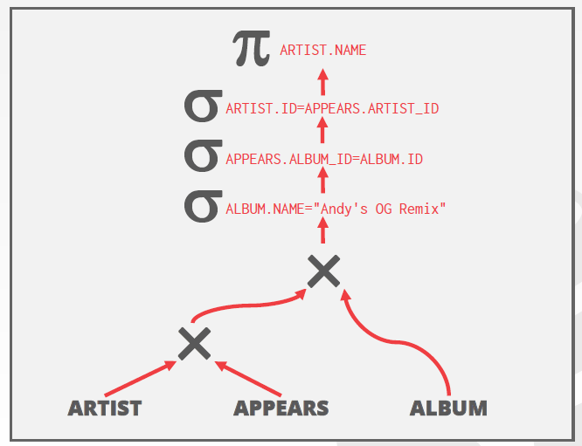
Example: Steps of Heuristics
Split Conjunctive Predicates
SELECT ARTIST.NAME
FROM ARTIST, APPEARS, ALBUM
WHERE ARTIST.ID=APPEARS.ARTIST_ID
AND APPEARS.ALBUM_ID=ALBUM.ID
AND ALBUM.NAME="Andy's OG Remix"
Step1: Decompose predicates into their simplest forms to make it easier for the optimizer to move them around.

Slide 35
Example: Steps of Heuristics
Split Conjunctive Predicates
SELECT ARTIST.NAME
FROM ARTIST, APPEARS, ALBUM
WHERE ARTIST.ID=APPEARS.ARTIST_ID
AND APPEARS.ALBUM_ID=ALBUM.ID
AND ALBUM.NAME="Andy's OG Remix"
Step 2: Move the predicate to the lowest applicable point in the plan.

Slide 36
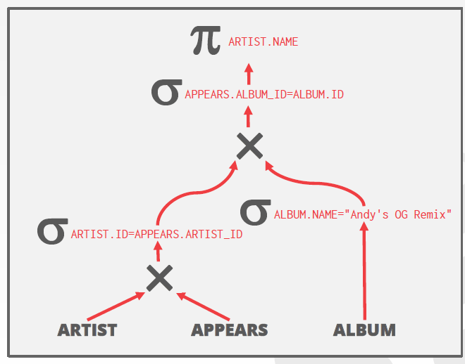
Example: Steps of Heuristics
Split Conjunctive Predicates
SELECT ARTIST.NAME
FROM ARTIST, APPEARS, ALBUM
WHERE ARTIST.ID=APPEARS.ARTIST_ID
AND APPEARS.ALBUM_ID=ALBUM.ID
AND ALBUM.NAME="Andy's OG Remix"
Step 2: Move the predicate to the lowest applicable point in the plan.

Slide 37
Example: Steps of Heuristics
Split Conjunctive Predicates
SELECT ARTIST.NAME
FROM ARTIST, APPEARS, ALBUM
WHERE ARTIST.ID=APPEARS.ARTIST_ID
AND APPEARS.ALBUM_ID=ALBUM.ID
AND ALBUM.NAME="Andy's OG Remix"
Step 3: Replace all Cartesian Products with inner joins using the join predicates.

Slide 38
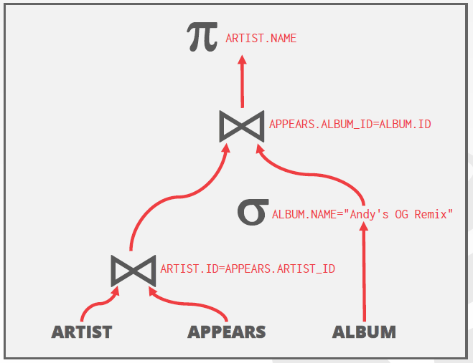
Example: Steps of Heuristics
Split Conjunctive Predicates
SELECT ARTIST.NAME
FROM ARTIST, APPEARS, ALBUM
WHERE ARTIST.ID=APPEARS.ARTIST_ID
AND APPEARS.ALBUM_ID=ALBUM.ID
AND ALBUM.NAME="Andy's OG Remix"
Step 3: Replace all Cartesian Products with inner joins using the join predicates.

Slide 39
Example: Steps of Heuristics
Split Conjunctive Predicates
SELECT ARTIST.NAME
FROM ARTIST, APPEARS, ALBUM
WHERE ARTIST.ID=APPEARS.ARTIST_ID
AND APPEARS.ALBUM_ID=ALBUM.ID
AND ALBUM.NAME="Andy's OG Remix"
Step 4: Eliminate redundant attributes before pipeline breakers to reduce materialization cost.

Slide 40
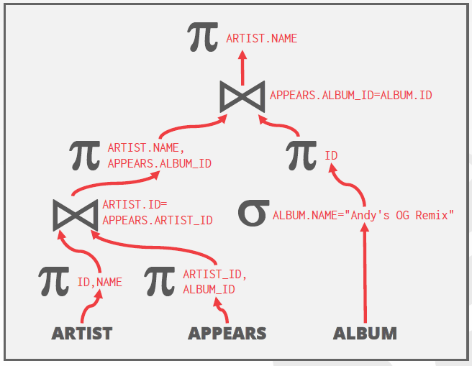
Example: Steps of Heuristics
Split Conjunctive Predicates
SELECT ARTIST.NAME
FROM ARTIST, APPEARS, ALBUM
WHERE ARTIST.ID=APPEARS.ARTIST_ID
AND APPEARS.ALBUM_ID=ALBUM.ID
AND ALBUM.NAME="Andy's OG Remix"
Step 4: Eliminate redundant attributes before pipeline breakers to reduce materialization cost.

Slide 41
Statistics for Cost Estimation

Slide 42
Cost Based Optimization with Equivalence Rules
Cost Based Optimization：Generate an estimate of the cost of executing a particular query plan for the current state of the database.
Use a model to estimate the cost of executing a plan.
  Evaluate multiple equivalent plans for a query and pick the one with the lowest cost.

Slide 43
Cost Based Optimization with Equivalence Rules
Choice #1: Physical Costs （See ch11）
  Predict CPU cycles, I/O, cache misses, RAM consumption, pre-fetching, etc…
  Depends heavily on hardware.
Choice #2: Logical Costs
  Estimate result sizes per operator.
  Independent of the operator algorithm.
  Need estimations for operator result sizes.
Choice #3: Algorithmic Costs
  Complexity of the operator algorithm implementation.

Slide 44
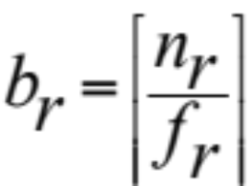
Statistical Information for Cost Estimation
The DBMS stores internal statistics about tables, attributes, and indexes in its internal catalog.
  n_{r}: number of tuples in a relation r.
  b_{r}: number of blocks containing tuples of r.
  l_{r}: size of a tuple of r.
  f_{r}: blocking factor of r — i.e., the number of tuples of r that fit into one block.
  V(A, r): number of distinct values that appear in r for attribute A; same as the size of ∏_{A}(r).
  If tuples of r are stored together physically in a file, then:
Notes:
The DBMS stores internal statistics about tables, attributes, and indexes in its internal catalog.

Slide 45
Statistical Information for Cost Estimation
The selection cardinality SC(A,R) is the average number of records with a value for an attribute A given n_{r} / V(A, r)
Note that this formula assumes data uniformity where every value has the same frequency as all other values.
  Example: 10,000 students, 10 colleges –how many students in SCS?

Slide 46
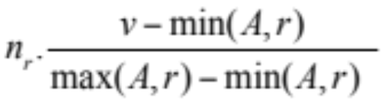
Selection Size Estimation
σ_{A=v}(r)
  n_{r} / V(A,r) : number of records that will satisfy the selection
  Equality condition on a key attribute: size estimate = 1
σ_{A≤V}(r) (case of σ_{A ≥ V}(r) is symmetric)
  Let c denote the estimated number of tuples satisfying the condition.
  If min(A,r) and max(A,r) are available in catalog
    c = 0 if v < min(A,r)
    c =
  If histograms available, can refine above estimate
  In absence of statistical information c is assumed to be n_{r} / 2.

Slide 47
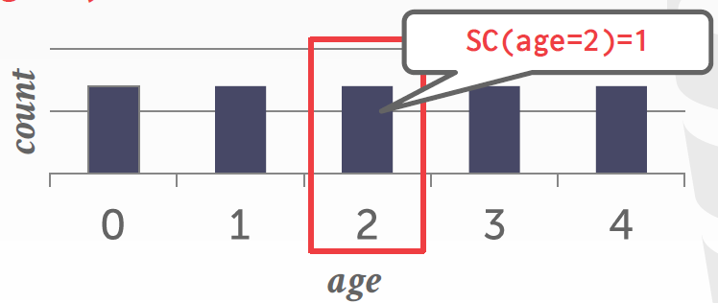
Examples
Assume that V(age, people) has five distinct values (0–4) and n_{r} = 5
Equality Predicate: A=constant
  SC(P) = n_{r} / V(A, r)
  Example: SC(age=2)= 1
CREATE TABLE people (
id INT PRIMARY KEY,
val INT NOT NULL,
age INT NOT NULL,
status VARCHAR(16)
);
SELECT * FROM people WHERE age = 2

Slide 48
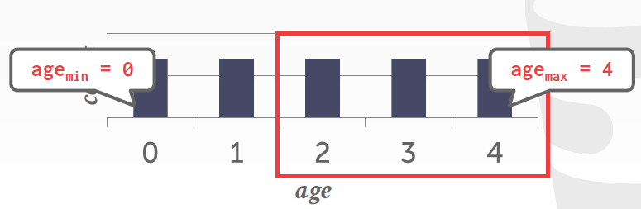
Examples
Assume that V(age, people) has five distinct values (0–4) and n_{r} = 5
Range Predicate:
  SC(A>=a) = n_{r}(Amax–a+1) / (Amax–Amin+1)
  Example: SC(age>=2) ≈ 5x(4–2+1) / (4–0+1)≈ 5x3/5=3
SELECT * FROM people WHERE age >= 2

Slide 49
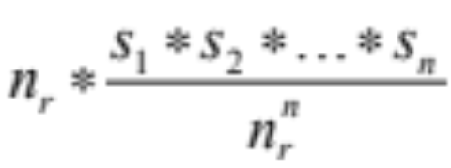
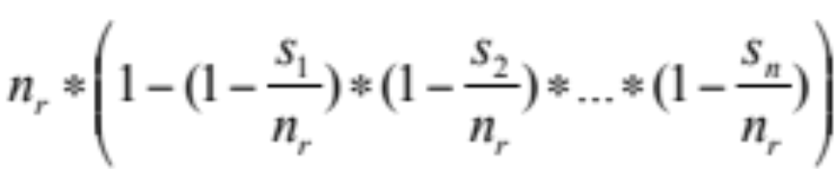
Size Estimation of Complex Selections
The selectivity of a condition θ_{i} is the probability that a tuple in the relation r satisfies θ_{i} .
  If s_{i} is the number of satisfying tuples in r, the selectivity of θ_{i} is given by s_{i} /n_{r}.
Conjunction: σ_{θ1∧ θ2∧. . . ∧ θn} (r). Assuming independence, estimate of
tuples in the result is:
Disjunction:σ_{θ1∨} _{θ2 ∨. . . ∨} _{θn} (r). Estimated number of tuples:
Negation: σ_{¬θ}(r). Estimated number of tuples:
n_{r} – size(σ_{θ}(r))

Slide 50
Examples
Assume that V(age, people) has five distinct values (0–4) and n_{r} = 5
Negation Query:
Conjunction:
Disjunction:
CREATE TABLE people (
id INT PRIMARY KEY,
val INT NOT NULL,
age INT NOT NULL,
status VARCHAR(16)
);
SELECT * FROM people WHERE age != 2
SELECT * FROM people WHERE age = 2 and name LIKE'A%'
SELECT * FROM people WHERE age = 2 or name LIKE'A%'

Slide 51
Join Operation: Running Example
Running example:
student ⨝ takes
Catalog information for join examples:
n_{student} = 5,000.
f_{student} = 50, which implies that
b_{student} =5000/50 = 100.
n_{takes} = 10000.
f_{takes} = 25, which implies that
b_{takes} = 10000/25 = 400.
V(ID, takes) = 2500, which implies that on average, each student who has taken a course has taken 4 courses.
  Attribute ID in takes is a foreign key referencing student.
  V(ID, student) = 5000 (primary key!)

Slide 52
Estimation of the Size of Joins
The Cartesian product r x s contains n_{r} .n_{s} tuples; each tuple occupies s_{r} + s_{s} bytes.
If R ∩ S = ∅, then r ⋈ s is the same as r x s.
If R ∩ S is a key for R, then a tuple of s will join with at most one tuple from r
  therefore, the number of tuples in r ⋈ s is no greater than the number of tuples in s.
If R ∩ S in S is a foreign key in S referencing R, then the number of tuples in r ⋈ s is exactly the same as the number of tuples in s.
    The case for R ∩ S being a foreign key referencing S is symmetric.
In the example query student ⋈ takes, ID in takes is a foreign key referencing student
  hence, the result has exactly n_{takes} tuples, which is 10000

Slide 53
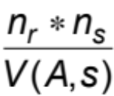
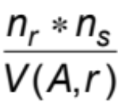
Estimation of the Size of Joins (Cont.)
If R ∩ S = {A} is not a key for R or S.
If we assume that every tuple t in R produces tuples in R S, the number of tuples in R ⨝ S is estimated to be:
If the reverse is true, the estimate obtained will be:
The lower of these two estimates is probably the more accurate one.
Can improve on above if histograms are available
  Use formula similar to above, for each cell of histograms on the two relations

Slide 54
Estimation of the Size of Joins (Cont.)
Compute the size estimates for depositor ⨝ customer without using information about foreign keys:
  V(ID, takes) = 2500, and
  V(ID, student) = 5000
  The two estimates are 5000 * 10000/2500 = 20,000 and 5000 * 10000/5000 = 10000
  We choose the lower estimate, which in this case, is the same as our earlier computation using foreign keys.

Slide 55
Estimation of the Size of Joins (Cont.)
Consider finding the best join-order for r₁ ⨝ r₂ ⨝ . . . ⨝ r_{n}.
There are (2(n – 1))!/(n – 1)! different join orders for above expression. With n = 7, the number is 665280, with n = 10, the number is greater than 176 billion!
No need to generate all the join orders. Using dynamic programming, the least-cost join order for any subset of
{r₁, r₂, . . . r_{n}} is computed only once and stored for future use.
Use dynamic programming to reduce the number of cost estimations.

Slide 56
Dynamic Programming in Optimization
To find best join tree for a set of n relations:
  To find best plan for a set S of n relations, consider all possible plans of the form: S₁ ⨝ (S – S₁) where S₁ is any non-empty subset of S.
  Recursively compute costs for joining subsets of S to find the cost of each plan. Choose the cheapest of the 2^{n} – 2 alternatives.
  Base case for recursion: single relation access plan
    Apply all selections on R_{i} using best choice of indices on R_{i}
  When plan for any subset is computed, store it and reuse it when it is required again, instead of recomputing it
    Dynamic programming

Slide 57
Join Order Optimization Algorithm
procedure findbestplan(S)
if (bestplan[S].cost ≠ ∞)
return bestplan[S]
// else bestplan[S] has not been computed earlier, compute it now
if (S contains only 1 relation)
set bestplan[S].plan and bestplan[S].cost based on the best way
of accessing S using selections on S and indices (if any) on S else for each non-empty subset S1 of S such that S1 ≠ S
P1= findbestplan(S1)
P2= findbestplan(S - S1)
for each algorithm A for joining results of P1 and P2
… compute plan and cost of using A (see next page) ..
if cost < bestplan[S].cost
bestplan[S].cost = cost
bestplan[S].plan = plan;
return bestplan[S]

Slide 58
Join Order Optimization Algorithm (cont.)
for each algorithm A for joining results of P1 and P2
// For indexed-nested loops join, the outer could be P1 or P2
// Similarly for hash-join, the build relation could be P1 or P2
// We assume the alternatives are considered as separate algorithms
if algorithm A is indexed nested loops
Let P_{i} and P_{o} denote inner and outer inputs
if P_{i} has a single relation r_{i} and r_{i} has an index on the join attribute
plan = “execute P_{o}.plan; join results of P_{o} and r_{i} using A”,
with any selection conditions on P_{i} performed as part of
the join condition
cost = P_{o}.cost + cost of A
else cost = ∞; /* cannot use indexed nested loops join */
else
plan = “execute P1.plan; execute P2.plan;
join results of P1 and P2 using A;”
cost = P1.cost + P2.cost + cost of A
…. See previous page

Slide 59
Cost of Optimization
With dynamic programming time complexity of optimization with bushy trees is O(3^{n}).
  With n = 10, this number is 59000 instead of 176 billion!
Space complexity is O(2^{n})
To find best left-deep join tree for a set of n relations:
  Consider n alternatives with one relation as right-hand side input and the other relations as left-hand side input.
  Modify optimization algorithm:
    Replace “for each non-empty subset S1 of S such that S1 ≠ S”
    By: for each relation r in S
    let S1 = S – r .
If only left-deep trees are considered, time complexity of finding best join order is O(n 2^{n})
  Space complexity remains at O(2^{n})
Cost-based optimization is expensive, but worthwhile for queries on large datasets (typical queries have small n, generally < 10)

Slide 60
Size Estimation for Other Operations
Projection: estimated size of ∏_{A}(r) = V(A,r)
Aggregation : estimated size of _{G}𝛾_{A}(r) = V(G,r)
Set operations
  For unions/intersections of selections on the same relation: rewrite and use size estimate for selections
    E.g., σ_{θ1} (r) ∪ σ_{θ2} (r) can be rewritten as σ_{θ1 or θ2} (r)
  For operations on different relations:
    estimated size of r ∪ s = size of r + size of s.
    estimated size of r ∩ s = minimum size of r and size of s.
    estimated size of r – s = r.
    All the three estimates may be quite inaccurate, but provide upper bounds on the sizes.

Slide 61
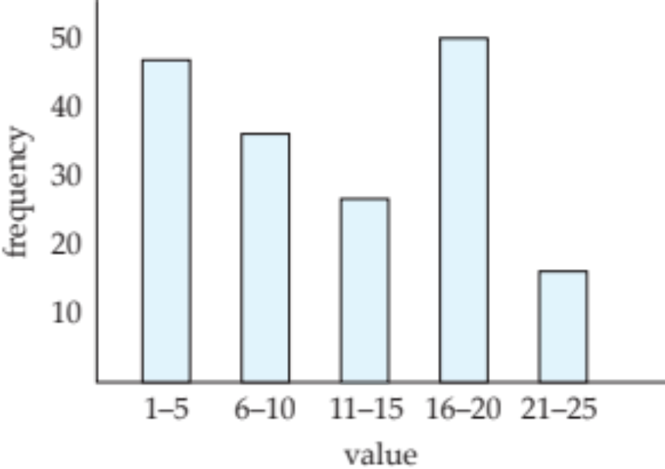
Histograms
Histogram on attribute age of relation person
Equi-width histograms
Equi-depth histograms break up range such that each range has (approximately) the same number of tuples
  E.g. (4, 8, 14, 19)
Many databases also store n most-frequent values and their counts
  Histogram is built on remaining values only

Slide 62
Histograms (cont.)
Histograms and other statistics usually computed based on a random sample
Statistics may be out of date
  Some database require a analyze command to be executed to update statistics
  Others automatically recompute statistics
    e.g., when number of tuples in a relation changes by some percentage

Slide 63
Size Estimation (Cont.)
Outer join:
  Estimated size of r ⟕ s = size of r ⨝ s + size of r
    Case of right outer join is symmetric
  Estimated size of r ⟗ s = size of r ⨝ s + size of r + size of s

Slide 64
Estimation of Number of Distinct Values
Selections: σ_{θ} (r)
If θ forces A to take a specified value: V(A,σ_{θ} (r)) = 1.
    e.g., A = 3
If θ forces A to take on one of a specified set of values:
V(A,σ_{θ} (r)) = number of specified values.
    (e.g., (A = 1 V A = 3 V A = 4 )),
If the selection condition θ is of the form A op r
estimated V(A,σ_{θ} (r)) = V(A.r) * s
    where s is the selectivity of the selection.
In all the other cases: use approximate estimate of
min(V(A,r), n_{σθ (r)} )
  More accurate estimate can be got using probability theory, but this one works fine generally

Slide 65
Estimation of Distinct Values (Cont.)
Joins: r ⨝ s
If all attributes in A are from r
estimated V(A, r ⨝ s) = min (V(A,r), n _{r ⨝ s})
If A contains attributes A1 from r and A2 from s, then estimated
V(A,r ⨝ s) =
min(V(A1,r)*V(A2 – A1,s), V(A1 – A2,r)*V(A2,s), n_{r ⨝ s})
  More accurate estimate can be got using probability theory, but this one works fine generally

Slide 66
Estimation of Distinct Values (Cont.)
Estimation of distinct values are straightforward for projections.
  They are the same in ∏_{A (r)} as in r.
The same holds for grouping attributes of aggregation.
For aggregated values
  For min(A) and max(A), the number of distinct values can be estimated as min(V(A,r), V(G,r)) where G denotes grouping attributes
  For other aggregates, assume all values are distinct, and use V(G,r)

Slide 67
Observation
Now that we can (roughly) estimate the selectivity of predicates, and subsequently the cost of query plans, what can we do with them?
After performing rule-based rewriting, the DBMS will enumerate different plans for the query and estimate their costs.
  Single relation.
  Multiple relations.
  Nested sub-queries.
It chooses the best plan it has seen for the query after exhausting all plans or some timeout.

Slide 68
Additional Optimization techniques

Slide 69
Optimizing Nested Subqueries**
Nested query example:
select name
from instructor
where exists (select *
from teaches
where instructor.ID = teaches.ID and teaches.year = 2019)
SQL conceptually treats nested subqueries in the where clause as functions that take parameters and return a single value or set of values
  Parameters are variables from outer level query that are used in the nested subquery; such variables are called correlation variables
Conceptually, nested subquery is executed once for each tuple in the cross-product generated by the outer level from clause
  Such evaluation is called correlated evaluation
  Note: other conditions in where clause may be used to compute a join (instead of a cross-product) before executing the nested subquery

Slide 70
Optimizing Nested Subqueries (Cont.)
Correlated evaluation may be quite inefficient since
  a large number of calls may be made to the nested query
  there may be unnecessary random I/O as a result
SQL optimizers attempt to transform nested subqueries to joins where possible, enabling use of efficient join techniques
E.g.,: earlier nested query can be rewritten as
∏ _{name}(instructor ⨝instructor.ID=teaches.ID ∧ teaches.year=2019 teaches)
Note: the two queries generate different numbers of duplicates (why?)
  Can be modified to handle duplicates correctly using semijoins

Slide 71
Optimizing Nested Subqueries (Cont.)
The semijoin operator ⋉ is defined as follows
  A tuple r_{i} appears n times in r ⋉ _{θ} s if it appears n times in r, and there is at least one matching tuple s_{i} in s
E.g.: earlier nested query can be rewritten as
∏ _{name}(instructor ⋉ instructor.ID=teaches.ID ∧ teaches.year=2019 teaches)
  Or even as: ∏_{name}(instructor ⋉_{instructor.ID=teaches.ID} (σ_{teaches.year=2019} teaches))
  Now the duplicate count is correct!
The above relational algebra query is also equivalent to
from instructor
where ID in (select teaches.ID
from teaches
where teaches.year = 2019)

Slide 72
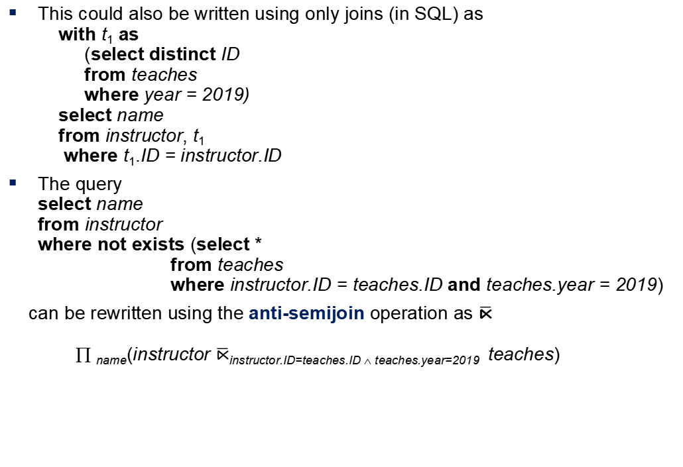
Optimizing Nested Subqueries (Cont.)
This could also be written using only joins (in SQL) as
with t₁ as
(select distinct ID
from teaches
where year = 2019)
select name
from instructor, t₁
where t₁.ID = instructor.ID
The query
select name
from instructor
where not exists (select *
from teaches
where instructor.ID = teaches.ID and teaches.year = 2019)
can be rewritten using the anti-semijoin operation as $\overline{\text{⋉}}$
∏ _{name}(instructor $\overline{\text{⋉}}$instructor.ID=teaches.ID ∧ teaches.year=2019 teaches)

Slide 73
Optimizing Nested Subqueries (Cont.)
In general, SQL queries of the form below can be rewritten as shown
Rewrite: select A
from r₁, r₂ ,…, r_{n}
where P₁ and exists (select *
from s₁, s₂ ,…, s_{m}
where P₂¹ and P₂² )
To: ∏ _{A}(σ _{P1} (r₁ x r₂ x … x r_{n} ) ⋉ _{P22} σ _{P21} (s₁ x s₂ x … x s_{m} )
  P₂¹ contains predicates that do not involve any correlation variables
  P₂² contains predicates involving correlation variables
The process of replacing a nested query by a query with a join/semijoin (possibly with a temporary relation) is called decorrelation.
Decorrelation is more complicated in several cases, e.g.
    The nested subquery uses aggregation, or
    The nested subquery is a scalar subquery
  Correlated evaluation used in these cases

Slide 74
Decorrelation (Cont.)
Decorrelation of scalar aggregate subqueries can be done using groupby/aggregation in some cases
select name
from instructor
where 1 < (select count(*)
from teaches
where instructor.ID = teaches.ID
and teaches.year = 2019)
∏ _{name}(instructor ⋉ _{instructor.ID=TID ∧ 1 < cnt} (
_{ID as TID} 𝛾_{count(*) as cnt} (σ _{teaches.year=2019} (teaches))))

Slide 75
Materialized Views
A materialized view is a view whose contents are computed and stored.
Consider the view
create view department_total_salary(dept_name, total_salary) as
select dept_name, sum(salary)
from instructor
group by dept_name
Materializing the above view would be very useful if the total salary by department is required frequently
  Saves the effort of finding multiple tuples and adding up their amounts

Slide 76
Materialized View Maintenance
The task of keeping a materialized view up-to-date with the underlying data is known as materialized view maintenance
Materialized views can be maintained by recomputation on every update
A better option is to use incremental view maintenance
  Changes to database relations are used to compute changes to the materialized view, which is then updated
View maintenance can be done by
  Manually defining triggers on insert, delete, and update of each relation in the view definition
  Manually written code to update the view whenever database relations are updated
  Periodic recomputation (e.g. nightly)
  Incremental maintenance supported by many database systems
    Avoids manual effort/correctness issues

Slide 77
Incremental View Maintenance
The changes (inserts and deletes) to a relation or expressions are referred to as its differential
  Set of tuples inserted to and deleted from r are denoted i_{r} and d_{r}
To simplify our description, we only consider inserts and deletes
  We replace updates to a tuple by deletion of the tuple followed by insertion of the update tuple
We describe how to compute the change to the result of each relational operation, given changes to its inputs
We then outline how to handle relational algebra expressions

Slide 78
Join Operation
Consider the materialized view v = r ⨝ s and an update to r
Let r^{old} and r^{new} denote the old and new states of relation r
Consider the case of an insert to r:
  We can write r^{new} ⨝ s as (r^{old} ∪ i_{r}) ⨝ s
  And rewrite the above to (r^{old} ⨝ s) ∪ (i_{r} ⨝ s)
  But (r^{old} ⨝ s) is simply the old value of the materialized view, so the incremental change to the view is just i_{r} ⨝ s
Thus, for inserts v^{new} = v^{old} ∪(i_{r} ⨝ s)
Similarly for deletes v^{new} = v^{old} – (d_{r} ⨝ s)
A, 1
B, 2
1, p
2, r
2, s
A, 1, p
B, 2, r
B, 2, s
C,2
C, 2, r
C, 2, s

Slide 79
Selection and Projection Operations
Selection: Consider a view v = σ_{θ}(r).
  v^{new} = v^{old} ∪σ_{θ}(i_{r})
  v^{new} = v^{old} - σ_{θ}(d_{r})
Projection is a more difficult operation
  R = (A,B), and r(R) = { (a,2), (a,3)}
  ∏_{A}(r) has a single tuple (a).
  If we delete the tuple (a,2) from r, we should not delete the tuple (a) from ∏_{A}(r), but if we then delete (a,3) as well, we should delete the tuple
For each tuple in a projection ∏_{A}(r) , we will keep a count of how many times it was derived
  On insert of a tuple to r, if the resultant tuple is already in ∏_{A}(r) we increment its count, else we add a new tuple with count = 1
  On delete of a tuple from r, we decrement the count of the corresponding tuple in ∏_{A}(r)
    if the count becomes 0, we delete the tuple from ∏_{A}(r)

Slide 80
Aggregation Operations
Count : v = _{A} 𝛾 _{count(B)}^{(r)}.
  When a set of tuples i_{r} is inserted
    For each tuple r in i_{r}, if the corresponding group is already present in v, we increment its count, else we add a new tuple with count = 1
  When a set of tuples d_{r} is deleted
    for each tuple t in i_{r.}we look for the group t.A in v, and subtract 1 from the count for the group.
      If the count becomes 0, we delete from v the tuple for the group t.A
Sum: v = _{A} 𝛾 _{sum (B)}^{(r)}
  We maintain the sum in a manner similar to count, except we add/subtract the B value instead of adding/subtracting 1 for the count
  Additionally we maintain the count in order to detect groups with no tuples. Such groups are deleted from v
    Cannot simply test for sum = 0 (why?)

Slide 81
Aggregate Operations (Cont.)
Avg: How to handle average?
  Maintain sum and count separately, and divide at the end
min, max: v = _{A} 𝛾 _{min (B)} (r).
  Handling insertions on r is straightforward.
  Maintaining the aggregate values min and max on deletions may be more expensive. We have to look at the other tuples of r that are in the same group to find the new minimum

Slide 82
Other Operations
Set intersection: v = r ∩ s
  when a tuple is inserted in r we check if it is present in s, and if so we add it to v.
  If the tuple is deleted from r, we delete it from the intersection if it is present.
  Updates to s are symmetric
  The other set operations, union and set difference are handled in a similar fashion.
Outer joins are handled in much the same way as joins but with some extra work
  we leave details to you.

Slide 83
Handling Expressions
To handle an entire expression, we derive expressions for computing the incremental change to the result of each sub-expressions, starting from the smallest sub-expressions.
E.g., consider E₁ ⨝ E₂ where each of E₁ and E₂ may be a complex expression
  Suppose the set of tuples to be inserted into E₁ is given by D₁
    Computed earlier, since smaller sub-expressions are handled first
  Then the set of tuples to be inserted into E₁ ⨝ E₂ is given by
  D₁ ⨝ E₂
    This is just the usual way of maintaining joins

Slide 84
Query Optimization and Materialized Views
Rewriting queries to use materialized views:
  A materialized view v = r ⨝ s is available
  A user submits a query r ⨝ s ⨝ t
  We can rewrite the query as v ⨝ t
    Whether to do so depends on cost estimates for the two alternative
Replacing a use of a materialized view by the view definition:
  A materialized view v = r ⨝ s is available, but without any index on it
  User submits a query σ_{A=10}(v).
  Suppose also that s has an index on the common attribute B, and r has an index on attribute A.
  The best plan for this query may be to replace v by r ⨝ s, which can lead to the query plan σ_{A=10}(r) ⨝ s
Query optimizer should be extended to consider all above
alternatives and choose the best overall plan

Slide 85
Materialized View Selection
Materialized view selection: “What is the best set of views to materialize?”
Index selection: “what is the best set of indices to create”
  closely related, to materialized view selection
    but simpler
Materialized view selection and index selection based on typical system workload (queries and updates)
  Typical goal: minimize time to execute workload , subject to constraints on space and time taken for some critical queries/updates
  One of the steps in database tuning
    more on tuning in later chapters
Commercial database systems provide tools (called “tuning assistants” or “wizards”) to help the database administrator choose what indices and materialized views to create

Slide 86
Top-K Queries
Top-K queries
  select *
  from r, s
  where r.B = s.B
  order by r.A ascending
  limit 10
  Alternative 1: Indexed nested loops join with r as outer
  Alternative 2: estimate highest r.A value in result and add selection (and r.A <= H) to where clause
    If < 10 results, retry with larger H

Slide 87
Optimization of Updates
Halloween problem
  update R set A = 5 * A
  where A > 10
  If index on A is used to find tuples satisfying A > 10, and tuples updated immediately, same tuple may be found (and updated) multiple times
  Solution 1: Always defer updates
    collect the updates (old and new values of tuples) and update relation and indices in second pass
    Drawback: extra overhead even if e.g. update is only on R.B, not on attributes in selection condition
  Solution 2: Defer only if required
    Perform immediate update if update does not affect attributes in where clause, and deferred updates otherwise.

Slide 88
Join Minimization
Join minimization
  select r.A, r.B
  from r, s
  where r.B = s.B
Check if join with s is redundant, drop it
  E.g., join condition is on foreign key from r to s, r.B is declared as not null, and no selection on s
  Other sufficient conditions possible
  select r.A, s2.B
  from r, s as s1, s as s2
  where r.B=s1.B and r.B = s2.B and s1.A < 20 and s2.A < 10
    join with s1 is redundant and can be dropped (along with selection on s1)
  Lots of research in this area since 70s/80s!

Slide 89
Multiquery Optimization
Example
Q1: select * from (r natural join t) natural join s
Q2: select * from (r natural join u) natural join s
  Both queries share common subexpression (r natural join s)
  May be useful to compute (r natural join s) once and use it in both queries
    But this may be more expensive in some situations
      e.g. (r natural join s) may be expensive, plans as shown in queries may be cheaper
Multiquery optimization: find best overall plan for a set of queries, expoiting sharing of common subexpressions between queries where it is useful

Slide 90
Multiquery Optimization (Cont.)
Simple heuristic used in some database systems:
  optimize each query separately
  detect and exploiting common subexpressions in the individual optimal query plans
    May not always give best plan, but is cheap to implement
  Shared scans: widely used special case of multiquery optimization
Set of materialized views may share common subexpressions
  As a result, view maintenance plans may share subexpressions
  Multiquery optimization can be useful in such situations

Slide 91
Parametric Query Optimization
Example
select *
from r natural join s
where r.a < $1
  value of parameter $1 not known at compile time
    known only at run time
  different plans may be optimal for different values of $1
Solution 1: optimize at run time, each time query is submitted
    can be expensive
Solution 2: Parametric Query Optimization:
  optimizer generates a set of plans, optimal for different values of $1
    Set of optimal plans usually small for 1 to 3 parameters
    Key issue: how to do find set of optimal plans efficiently
  best one from this set is chosen at run time when $1 is known
Solution 3: Query Plan Caching
  If optimizer decides that same plan is likely to be optimal for all parameter values, it caches plan and reuses it, else reoptimize each time
  Implemented in many database systems

Slide 92
Plan Stability Across Optimizer Changes
What if 95% of plans are faster on database/optimizer version N+1 than on N, but 5% are slower?
  Why should plans be slower on new improved optimizer?
    Answer: Two wrongs can make a right, fixing one wrong can make things worse!
Approaches:
  Allow hints for tuning queries
    Not practical for migrating large systems with no access to source code
  Set optimization level, default to version N (Oracle)
    And migrate one query at a time after testing both plans on new optimizer
  Save plan from version N, and give it to optimizer version N+1
    Sybase, XML representation of plans (SQL Server)

Slide 93
Adaptive Query Processing
Some systems support adaptive operators that change execution algorithm on the fly
  E.g., (indexed) nested loops join or hash join chosen at run time, depending on size of outer input
Other systems allow monitoring of behavior of plan at run time and adapt plan
  E.g., if statistics such as number of rows is found to be very different in reality from what optimizer estimated
  Can stop execution, compute fresh plan, and restart
    But must avoid too many such restarts

Slide 94
End of Chapter 12

Slide 95
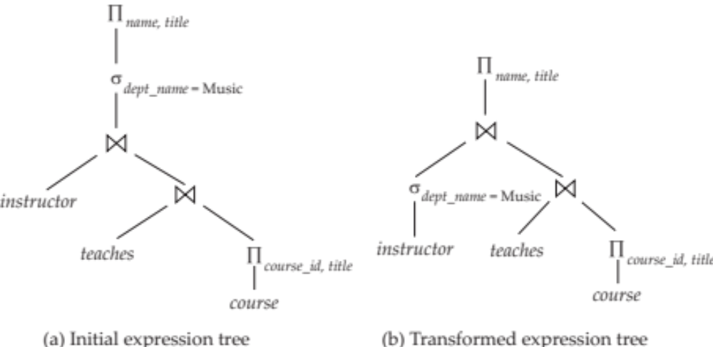
Figure 13.01

Slide 96
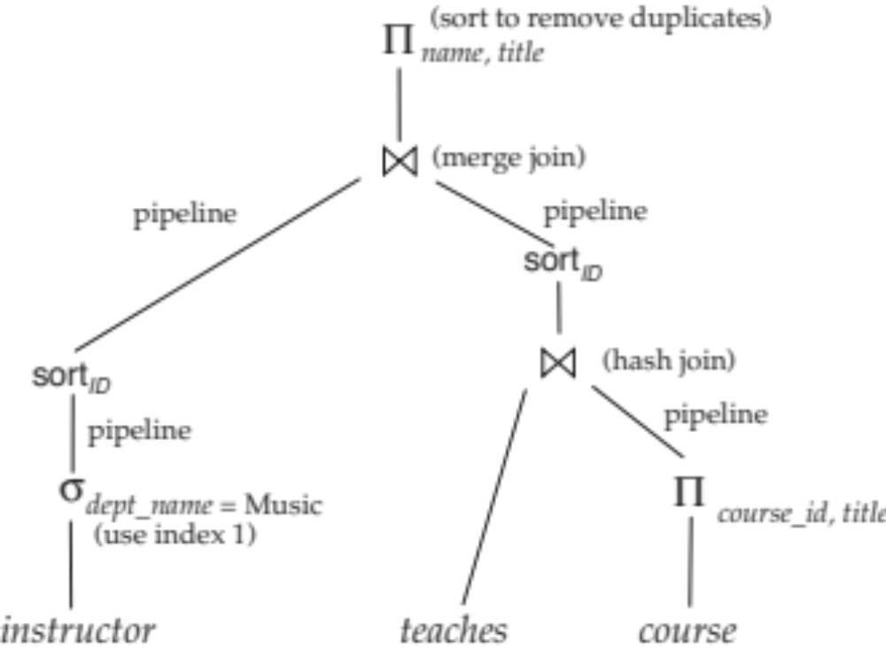
Figure 13.02

Slide 97
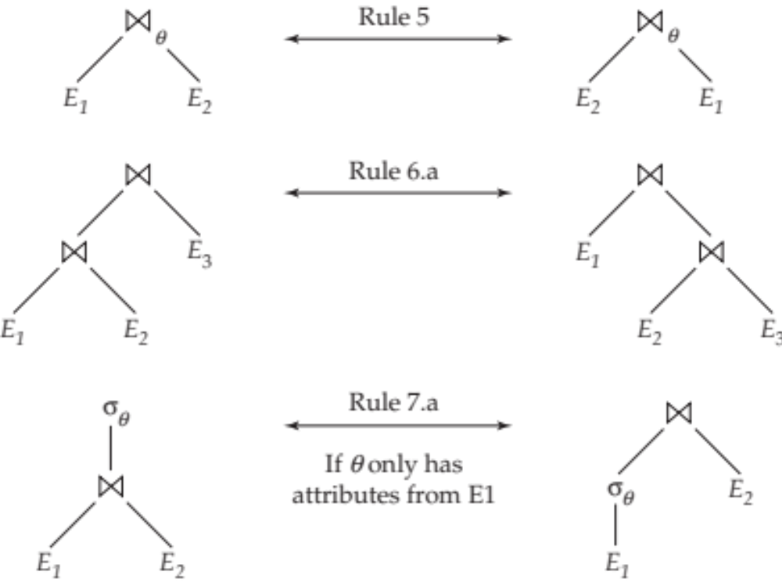
Figure 13.03

Slide 98
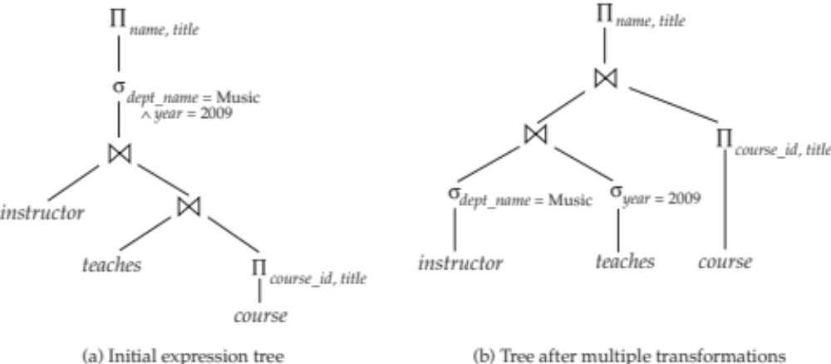
Figure 13.04

Slide 99

Figure 13.06

Slide 100
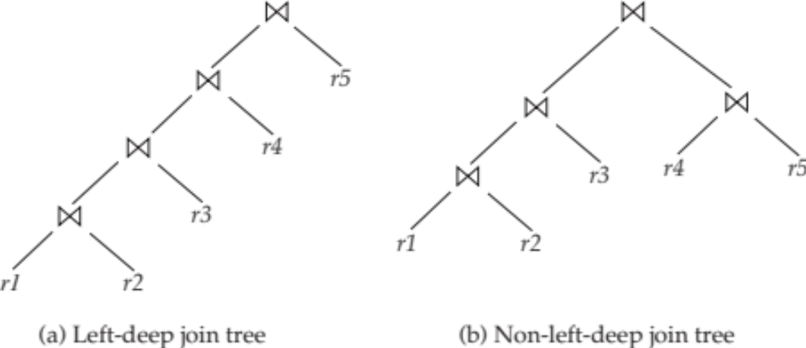
Figure 13.08

