Slide 1
Chapter 14 : Concurrency Control

Slide 2
Outline
We need a way to guarantee that all execution schedules are correct (i.e., serializable) without knowing the entire schedule ahead of time.
Lock-Based Protocols
Timestamp-Based Protocols
Multiversion Schemes

Slide 3
Lock Based Concurrency Control

Slide 4
Lock-Based Protocols
A lock is a mechanism to control concurrent access to a data item
Data items can be locked in two modes :
1. exclusive (X) mode. Data item can be both read as well as
written. X-lock is requested using lock-X instruction.
2. shared (S) mode. Data item can only be read. S-lock is
requested using lock-S instruction.
Lock requests are made to concurrency-control manager. Transaction can proceed only after request is granted.

Slide 5
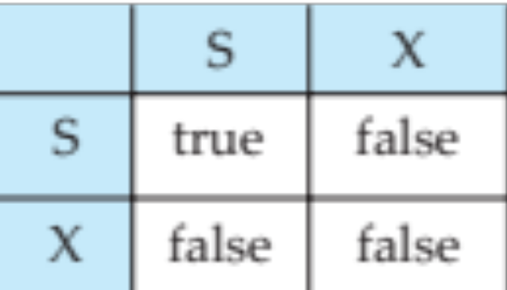
Lock-Based Protocols (Cont.)
Lock-compatibility matrix
A transaction may be granted a lock on an item if the requested lock is compatible with locks already held on the item by other transactions
Any number of transactions can hold shared locks on an item,
But if any transaction holds an exclusive on the item no other transaction may hold any lock on the item.
Notes:
If a lock cannot be granted, the requesting transaction is made to wait till all incompatible locks held by other transactions have been released. The lock is then granted.

Slide 6
Lock-Based Protocols (Cont.)
Example of a transaction performing locking:
T₂: lock-S(A);
read (A);
unlock(A);
lock-S(B);
read (B);
unlock(B);
display(A+B)
Locking as above is not sufficient to guarantee serializability

Slide 7
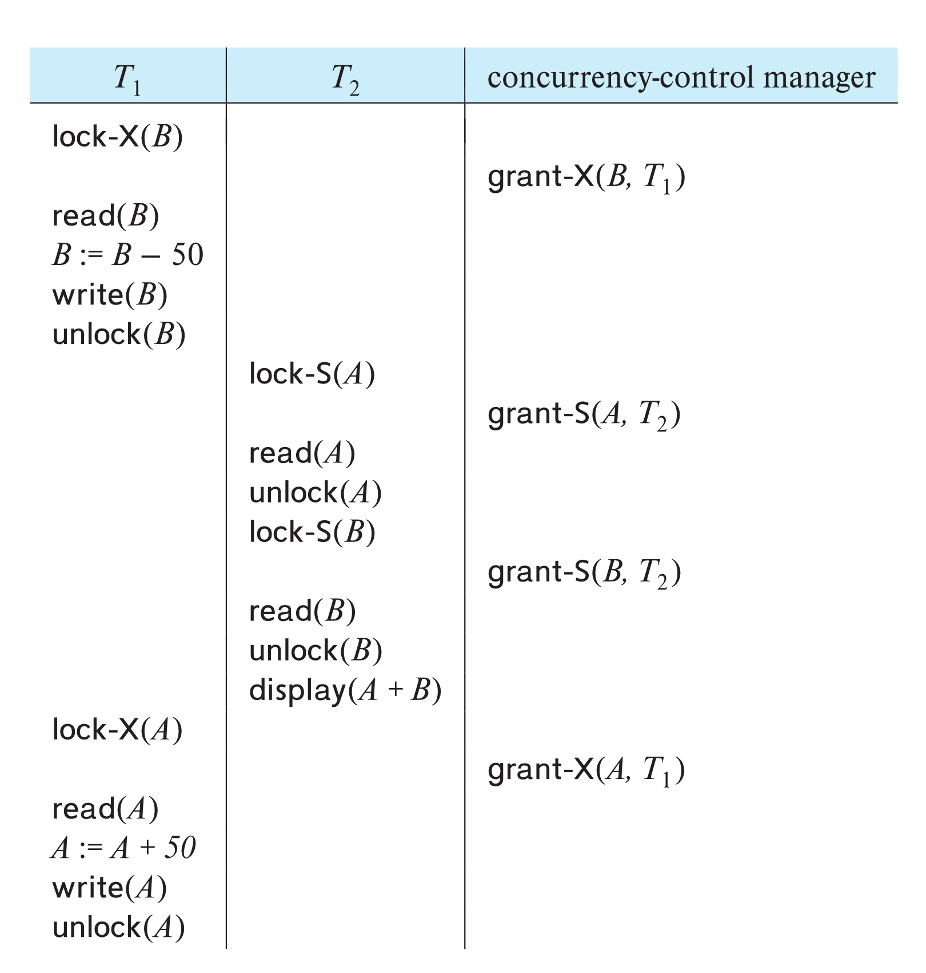
Schedule With Lock Grants
Grants omitted in rest of chapter
  Assume grant happens just before the next instruction following lock request
This schedule is not serializable (why?)
A locking protocol is a set of rules followed by all transactions while requesting and releasing locks.
Locking protocols enforce serializability by restricting the set of possible schedules.

Slide 8
The Two-Phase Locking Protocol（重点）
A protocol which ensures conflict-serializable schedules.
Phase 1: Growing Phase
  Transaction may obtain locks
  Transaction may not release locks
Phase 2: Shrinking Phase
  Transaction may release locks
  Transaction may not obtain locks
The protocol assures serializability. It can be proved that the transactions can be serialized in the order of their lock points (i.e., the point where a transaction acquired its final lock). （Why？）
Locks
Time

Slide 9
EXAMPLE
T1
Lock-S (B)
Lock-X (A)
read(B);
read(A);
A := A + 0.1*B
unLock (B)
write(A);
unLock (A)
commit
T1
Lock-S (B)
read(B);
unLock (B)
Lock-X (A)
read(A);
A := A + 0.1*B
write(A);
unLock (A)
commit
符合两阶段封锁协议
不符合两阶段封锁协议

Slide 10
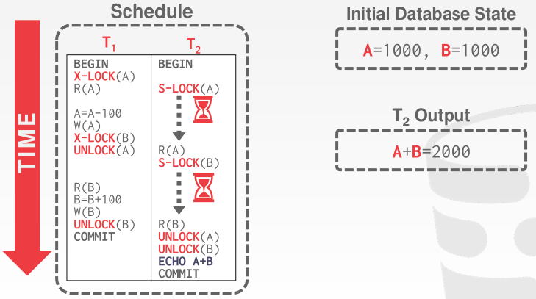
The Two-Phase Locking Protocol (Cont.)
2PL EXAMPLE

Slide 11
The Two-Phase Locking Protocol (Cont.)
Extensions to basic two-phase locking needed to ensure recoverability of freedom from cascading roll-back
  Strict two-phase locking: a transaction must hold all its exclusive locks till it commits/aborts.
    Ensures recoverability and avoids cascading roll-backs
  Rigorous two-phase locking: a transaction must hold all locks till commit/abort.
    Transactions can be serialized in the order in which they commit.
Most databases implement rigorous two-phase locking, but refer to it as simply two-phase locking

Slide 12
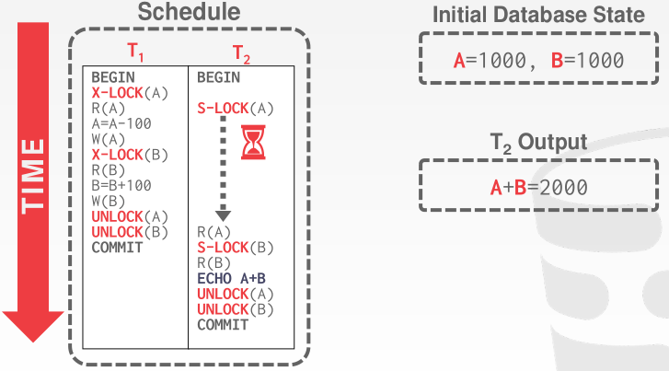
The Two-Phase Locking Protocol (Cont.)
Rigorous 2PL EXAMPLE

Slide 13

The Two-Phase Locking Protocol (Cont.)
Two-phase locking is not a necessary condition for serializability 充分而不是必要条件
  There are conflict serializable schedules that cannot be obtained if the two-phase locking protocol is used.
In the absence of extra information (e.g., ordering of access to data), two-phase locking is necessary for conflict serializability in the following sense:
  Given a transaction T_{i} that does not follow two-phase locking, we can find a transaction T_{j} that uses two-phase locking, and a schedule for T_{i} and T_{j} that is not conflict serializable.

Slide 14
Locking Protocols
Given a locking protocol (such as 2PL)
  A schedule S is legal under a locking protocol if it can be generated by a set of transactions that follow the protocol
  A protocol ensures serializability if all legal schedules under that protocol are serializable

Slide 15
Lock Conversions
Two-phase locking protocol with lock conversions:
– Growing Phase:
  can acquire a lock-S on item
  can acquire a lock-X on item
  can convert a lock-S to a lock-X (upgrade)
– Shrinking Phase:
  can release a lock-S
  can release a lock-X
  can convert a lock-X to a lock-S (downgrade)
This protocol ensures serializability

Slide 16
Automatic Acquisition of Locks
A transaction T_{i} issues the standard read/write instruction, without explicit locking calls.
The operation read(D) is processed as:
if T_{i} has a lock on D
then
read(D)
else begin
if necessary wait until no other
transaction has a lock-X on D
grant T_{i} a lock-S on D;
read(D)
end

Slide 17
Automatic Acquisition of Locks (Cont.)
The operation write(D) is processed as:
if T_{i} has a lock-X on D
then
write(D)
else begin
if necessary wait until no other trans. has any lock on D,
if T_{i} has a lock-S on D
then
upgrade lock on D to lock-X
else
grant T_{i} a lock-X on D
write(D)
end;
All locks are released after commit or abort

Slide 18
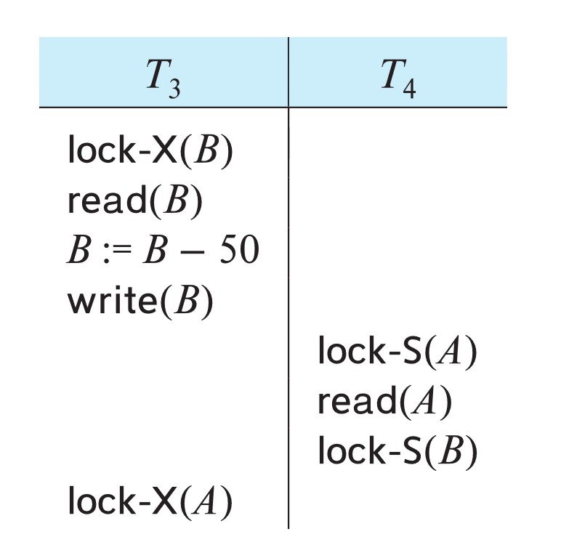
Deadlock
Consider the partial schedule
Neither T₃ nor T₄ can make progress — executing lock-S(B) causes T₄ to wait for T₃ to release its lock on B, while executing lock-X(A) causes T₃ to wait for T₄ to release its lock on A.
Such a situation is called a deadlock.
  To handle a deadlock one of T₃ or T₄ must be rolled back
  and its locks released.

Slide 19
Deadlock (Cont.)
The potential for deadlock exists in most locking protocols. Deadlocks are a necessary evil.
Starvation is also possible if concurrency control manager is badly designed. For example:
  A transaction may be waiting for an X-lock on an item, while a sequence of other transactions request and are granted an S-lock on the same item.
  The same transaction is repeatedly rolled back due to deadlocks.
Concurrency control manager can be designed to prevent starvation.

Slide 20
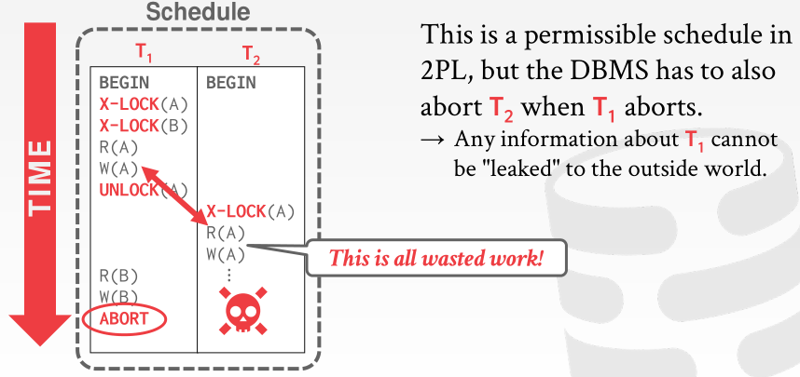
The Two-Phase Locking Protocol (Cont.)
Two-phase locking does not ensure freedom from deadlocks
Extensions to basic two-phase locking needed to ensure recoverability of freedom from cascading roll-back
CASCADING ABORTS

Slide 21

Deadlock Handling
System is deadlocked if there is a set of transactions such that every transaction in the set is waiting for another transaction in the set.

Slide 22
Deadlock Handling
Deadlock prevention protocols ensure that the system will never enter into a deadlock state. Some prevention strategies:
  Require that each transaction locks all its data items before it begins execution (pre-declaration).
  Impose partial ordering of all data items and require that a transaction can lock data items only in the order specified by the partial order (graph-based protocol).

Slide 23
More Deadlock Prevention Strategies
wait-die scheme — non-preemptive
  Older transaction may wait for younger one to release data item.
  Younger transactions never wait for older ones; they are rolled back instead.
  A transaction may die several times before acquiring a lock
wound-wait scheme — preemptive
  Older transaction wounds (forces rollback) of younger transaction instead of waiting for it.
  Younger transactions may wait for older ones.
  Fewer rollbacks than wait-die scheme.
In both schemes, a rolled back transactions is restarted with its original timestamp.
  Ensures that older transactions have precedence over newer ones, and starvation is thus avoided.

Slide 24
Deadlock prevention (Cont.)
Timeout-Based Schemes:
  A transaction waits for a lock only for a specified amount of time. After that, the wait times out and the transaction is rolled back.
  Ensures that deadlocks get resolved by timeout if they occur
  Simple to implement
  But may roll back transaction unnecessarily in absence of deadlock
    Difficult to determine good value of the timeout interval.
  Starvation is also possible

Slide 25
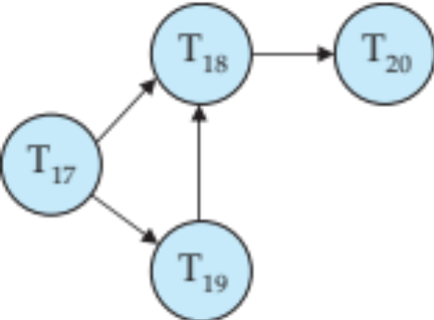
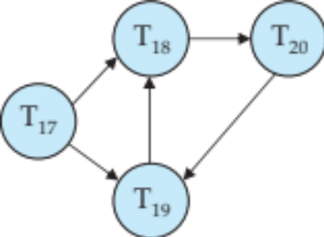
Deadlock Detection
Wait-for graph
  Vertices: transactions
  Edge from T_{i} →T_{j}. : if T_{i} is waiting for a lock held in conflicting mode by T_{j}
The system is in a deadlock state if and only if the wait-for graph has a cycle.
Invoke a deadlock-detection algorithm periodically to look for cycles.
Wait-for graph without a cycle
Wait-for graph with a cycle

Slide 26
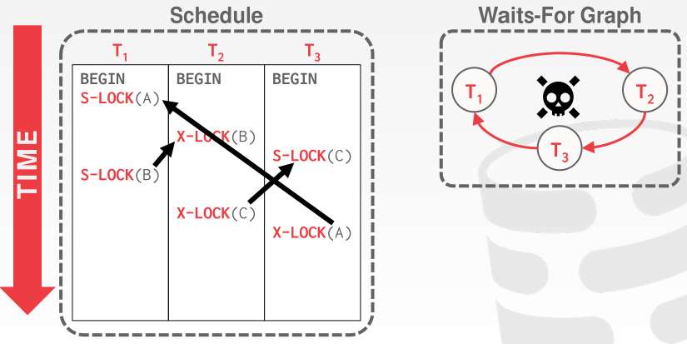
Deadlock Detection
Wait-for graph

Slide 27
Deadlock Recovery
When deadlock is detected :
  Some transaction will have to rolled back (made a victim) to break deadlock cycle.
    Select that transaction as victim that will incur minimum cost
  Rollback -- determine how far to roll back transaction
    Total rollback: Abort the transaction and then restart it.
    Partial rollback: Roll back victim transaction only as far as necessary to release locks that another transaction in cycle is waiting for
Starvation can happen (why?)
  One solution: oldest transaction in the deadlock set is never chosen as victim

Slide 28
Implementation of Locking
A lock manager can be implemented as a separate process
Transactions can send lock and unlock requests as messages
The lock manager replies to a lock request by sending a lock grant messages (or a message asking the transaction to roll back, in case of a deadlock)
  The requesting transaction waits until its request is answered
The lock manager maintains an in-memory data-structure called a lock table to record granted locks and pending requests

Slide 29
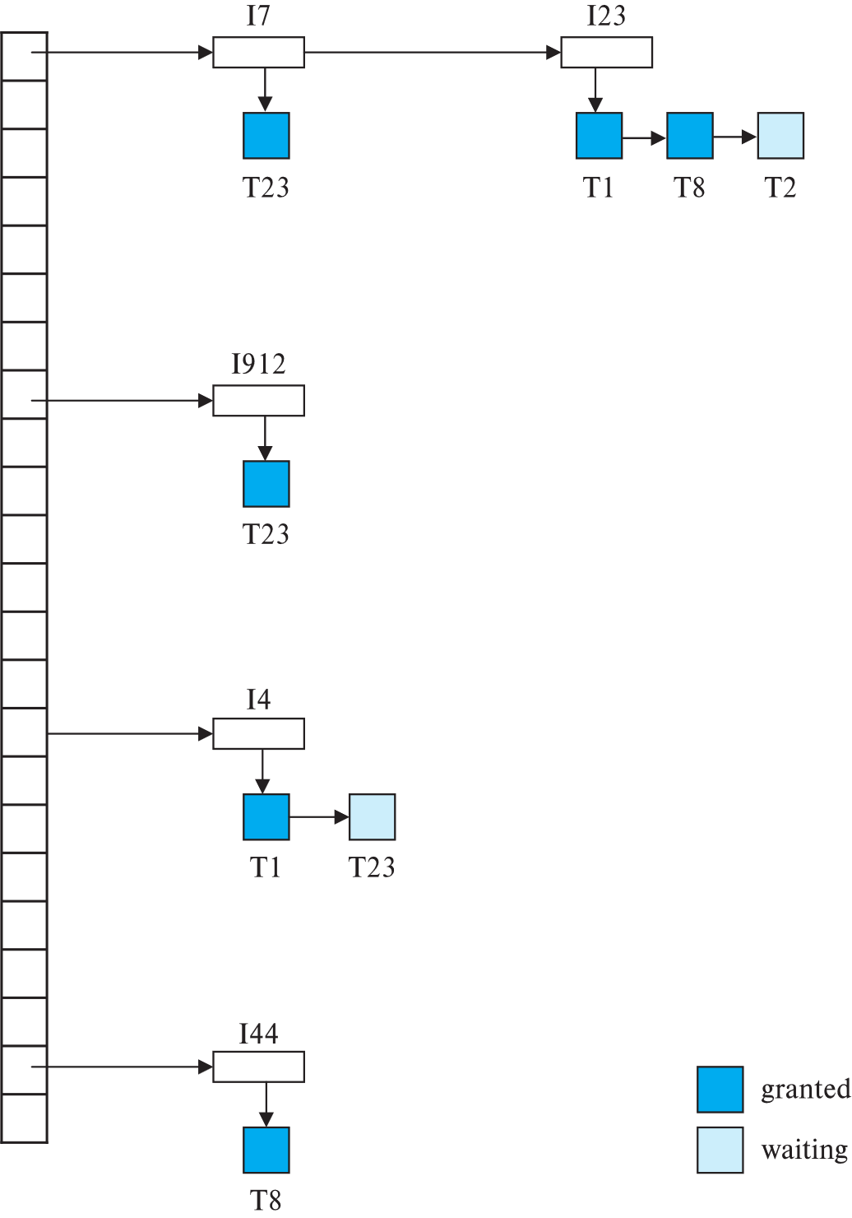
Lock Table
Dark rectangles indicate granted locks, light colored ones indicate waiting requests
Lock table also records the type of lock granted or requested
New request is added to the end of the queue of requests for the data item, and granted if it is compatible with all earlier locks
Unlock requests result in the request being deleted, and later requests are checked to see if they can now be granted
If transaction aborts, all waiting or granted requests of the transaction are deleted
  lock manager may keep a list of locks held by each transaction, to implement this efficiently

Slide 30
Graph-Based Protocols
Graph-based protocols are an alternative to two-phase locking
Impose a partial ordering → on the set D = {d₁, d₂ ,..., d_{h}} of all data items.
  If d_{i} → d_{j} then any transaction accessing both d_{i} and d_{j} must access d_{i} before accessing d_{j}.
  Implies that the set D may now be viewed as a directed acyclic graph, called a database graph.
The tree-protocol is a simple kind of graph protocol.

Slide 31
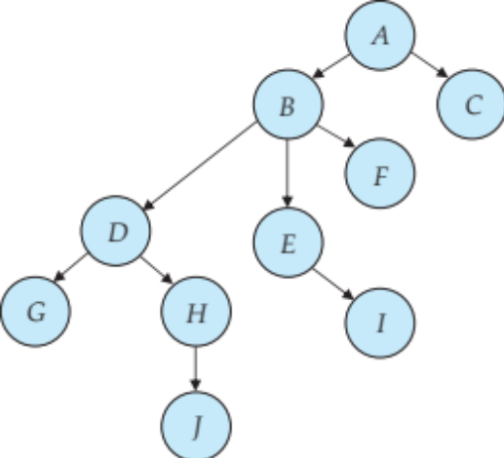
Tree Protocol
Only exclusive locks are allowed.
The first lock by T_{i} may be on any data item. Subsequently, a data Q can be locked by T_{i} only if the parent of Q is currently locked by T_{i}.
Data items may be unlocked at any time.
A data item that has been locked and unlocked by T_{i} cannot subsequently be relocked by T_{i}

Slide 32
Graph-Based Protocols (Cont.)
The tree protocol ensures conflict serializability as well as freedom from deadlock.
Unlocking may occur earlier in the tree-locking protocol than in the two-phase locking protocol.
  Shorter waiting times, and increase in concurrency
  Protocol is deadlock-free, no rollbacks are required
Drawbacks
  Protocol does not guarantee recoverability or cascade freedom
    Need to introduce commit dependencies to ensure recoverability
  Transactions may have to lock data items that they do not access.
    increased locking overhead, and additional waiting time
    potential decrease in concurrency
Schedules not possible under two-phase locking are possible under the tree protocol, and vice versa.

Slide 33
Multiple Granularity（自学）
Allow data items to be of various sizes and define a hierarchy of data granularities, where the small granularities are nested within larger ones
Can be represented graphically as a tree (but don't confuse with tree-locking protocol)
When a transaction locks a node in the tree explicitly, it implicitly locks all the node's descendants in the same mode.
Granularity of locking (level in tree where locking is done):
  Fine granularity (lower in tree): high concurrency, high locking overhead
  Coarse granularity (higher in tree): low locking overhead, low concurrency

Slide 34
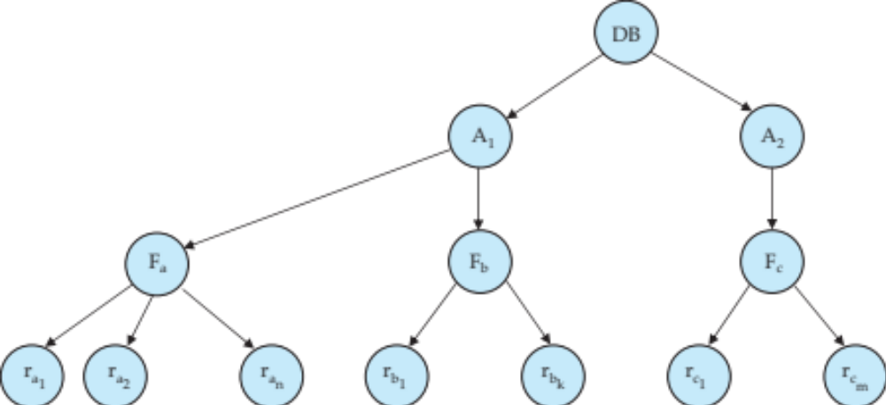
Example of Granularity Hierarchy（自学）
The levels, starting from the coarsest (top) level are
  database
  area
  file
  record

Slide 35
Example of Granularity Hierarchy（自学）
The levels, starting from the coarsest (top) level are
  database
  area
  file
  record
The corresponding tree

Slide 36
Intention Lock Modes（自学）
In addition to S and X lock modes, there are three additional lock modes with multiple granularity:
  intention-shared (IS): indicates explicit locking at a lower level of the tree but only with shared locks.
  intention-exclusive (IX): indicates explicit locking at a lower level with exclusive or shared locks
  shared and intention-exclusive (SIX): the subtree rooted by that node is locked explicitly in shared mode and explicit locking is being done at a lower level with exclusive-mode locks.
Intention locks allow a higher level node to be locked in S or X mode without having to check all descendent nodes.

Slide 37
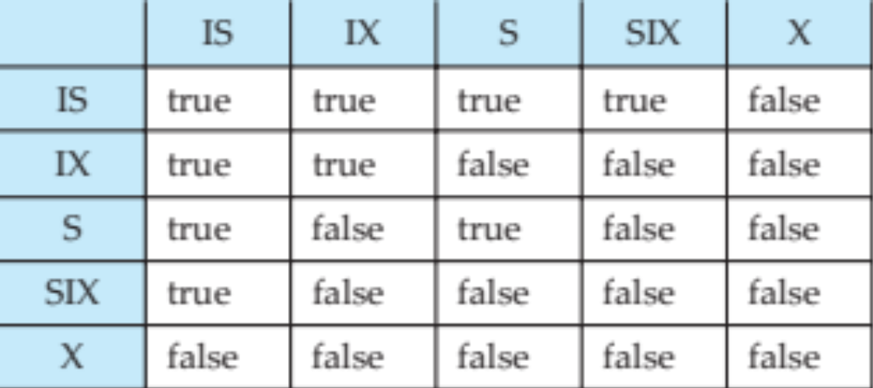
Compatibility Matrix with Intention Lock Modes（自学）
The compatibility matrix for all lock modes is:

Slide 38
Multiple Granularity Locking Scheme（自学）
Transaction T_{i} can lock a node Q, using the following rules:
  The lock compatibility matrix must be observed.
  2. The root of the tree must be locked first, and may be locked in any
  mode.
  3. A node Q can be locked by T_{i} in S or IS mode only if the parent of Q is
  currently locked by T_{i} in either IX or IS mode.
  4. A node Q can be locked by T_{i} in X, SIX, or IX mode only if the parent
  of Q is currently locked by T_{i} in either IX or SIX mode.
  5. T_{i} can lock a node only if it has not previously unlocked any node (that
  is, T_{i} is two-phase).
  6. T_{i} can unlock a node Q only if none of the children of Q are currently
  locked by T_{i}.
Observe that locks are acquired in root-to-leaf order, whereas they are released in leaf-to-root order.
Lock granularity escalation: in case there are too many locks at a particular level, switch to higher granularity S or X lock

Slide 39
Insert/Delete Operations and Predicate Reads
Locking rules for insert/delete operations
  An exclusive lock must be obtained on an item before it is deleted
  A transaction that inserts a new tuple into the database I automatically given an X-mode lock on the tuple
Ensures that
  reads/writes conflict with deletes
  Inserted tuple is not accessible by other transactions until the transaction that inserts the tuple commits

Slide 40
Phantom Phenomenon
Example of phantom phenomenon.
  A transaction T1 that performs predicate read (or scan) of a relation
    select count(*)
    from instructor
    where dept_name = 'Physics'
  and a transaction T2 that inserts a tuple while T1 is active but after predicate read
    insert into instructor values ('11111', 'Feynman', 'Physics', 94000)
    (conceptually) conflict in spite of not accessing any tuple in common.
If only tuple locks are used, non-serializable schedules can result
  E.g. the scan transaction does not see the new instructor, but may read some other tuple written by the update transaction
Can also occur with updates
  E.g. update Wu’s department from Finance to Physics

Slide 41
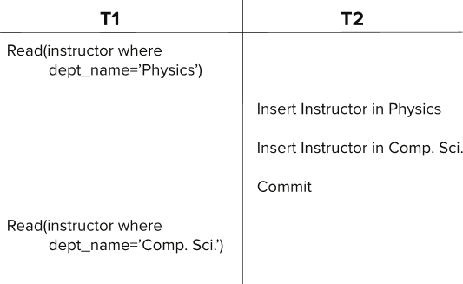
Insert/Delete Operations and Predicate Reads
Another Example: T1 and T2 both find maximum instructor ID in parallel, and create new instructors with ID = maximum ID + 1
  Both instructors get same ID, not possible in serializable schedule
Schedule

Slide 42
Handling Phantoms
There is a conflict at the data level
  The transaction performing predicate read or scanning the relation is reading information that indicates what tuples the relation contains
  The transaction inserting/deleting/updating a tuple updates the same information.
  The conflict should be detected, e.g. by locking the information.
One solution:
  Associate a data item with the relation, to represent the information about what tuples the relation contains.
  Transactions scanning the relation acquire a shared lock in the data item,
  Transactions inserting or deleting a tuple acquire an exclusive lock on the data item. (Note: locks on the data item do not conflict with locks on individual tuples.)
Above protocol provides very low concurrency for insertions/deletions.

Slide 43
Index Locking To Prevent Phantoms
Index locking protocol to prevent phantoms
  Every relation must have at least one index.
  A transaction can access tuples only after finding them through one or more indices on the relation
  A transaction T_{i} that performs a lookup must lock all the index leaf nodes that it accesses, in S-mode
    Even if the leaf node does not contain any tuple satisfying the index lookup (e.g. for a range query, no tuple in a leaf is in the range)
  A transaction T_{i} that inserts, updates or deletes a tuple t_{i} in a relation r
    Must update all indices to r
    Must obtain exclusive locks on all index leaf nodes affected by the insert/update/delete
  The rules of the two-phase locking protocol must be observed
Guarantees that phantom phenomenon won’t occur

Slide 44
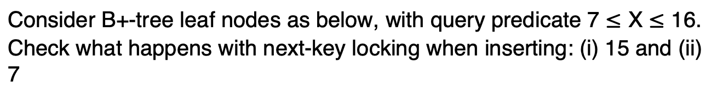
Next-Key Locking to Prevent Phantoms
Index-locking protocol to prevent phantoms locks entire leaf node
  Can result in poor concurrency if there are many inserts
Next-key locking protocol: provides higher concurrency
  Lock all values that satisfy index lookup (match lookup value, or fall in lookup range)
  Also lock next key value in index
    even for inserts/deletes
  Lock mode: S for lookups, X for insert/delete/update
Ensures detection of query conflicts with inserts, deletes and updates
Consider B+-tree leaf nodes as below, with query predicate 7 $≤$ X $≤$ 16.
Check what happens with next-key locking when inserting: (i) 15 and (ii) 7

Slide 45
Timestamp Based Concurrency Control

Slide 46
Timestamp-Based Protocols
Each transaction T_{i} is issued a timestamp TS(T_{i}) when it enters the system.
  Each transaction has a unique timestamp
  Timestamp could be based on a logical counter
    Real time may not be unique
    Can use (wall-clock time, logical counter) to ensure
Timestamp-based protocols manage concurrent execution such that
time-stamp order = serializability order
If TS(T_{i})< TS(T_{j}), then the DBMS must ensure that the execution schedule is equivalent to a serial schedule where T_{i} appears before T_{j}.

Slide 47
Timestamp-Ordering Protocol
The timestamp ordering (TSO) protocol
Maintains for each data Q two timestamp values:
  W-timestamp(Q) is the largest time-stamp of any transaction that executed write(Q) successfully.
  R-timestamp(Q) is the largest time-stamp of any transaction that executed read(Q) successfully.
  Check timestamps for every operation:
  If txn tries to access an object "from the future", it aborts and restarts.
Imposes rules on read and write operations to ensure that
  Any conflicting operations are executed in timestamp order
  Out of order operations cause transaction rollback

Slide 48
Timestamp-Based Protocols (Cont.)
Suppose a transaction T_{i} issues a read(Q)
  1. If TS(T_{i}) < W-timestamp(Q), then T_{i} needs to read a value of Q that was already overwritten.
    Hence, the read operation is rejected, and T_{i} is rolled back.
  2. If TS(T_{i}) ≥ W-timestamp(Q), then the read operation is executed, and R-timestamp(Q) is set to
  max(R-timestamp(Q), TS(T_{i})).

Slide 49
Timestamp-Based Protocols (Cont.)
Suppose that transaction T_{i} issues write(Q).
  1. If TS(T_{i}) < R-timestamp(Q), then the value of Q that T_{i} is producing was needed previously, and the system assumed that that value would never be produced.
    Hence, the write operation is rejected, and T_{i} is rolled back.
  2. If TS(T_{i}) < W-timestamp(Q), then T_{i} is attempting to write an obsolete value of Q.
    Hence, this write operation is rejected, and T_{i} is rolled back.
  3. Otherwise, the write operation is executed, and W-timestamp(Q) is set to TS(T_{i}).

Slide 50
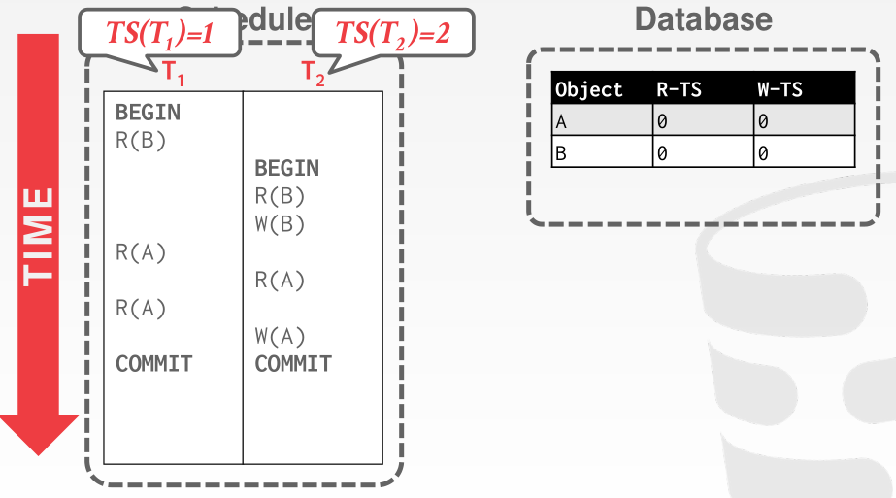
Example of Schedule Under TSO

Slide 51
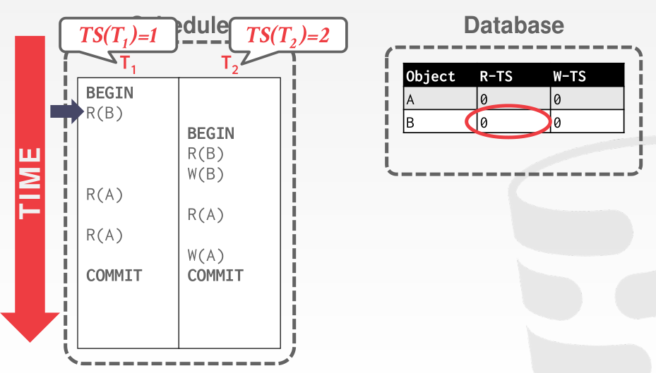
Example of Schedule Under TSO

Slide 52
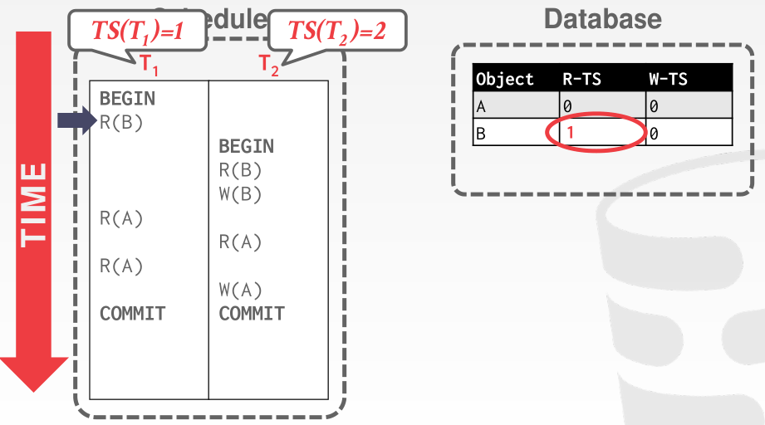
Example of Schedule Under TSO

Slide 53

Example of Schedule Under TSO

Slide 54
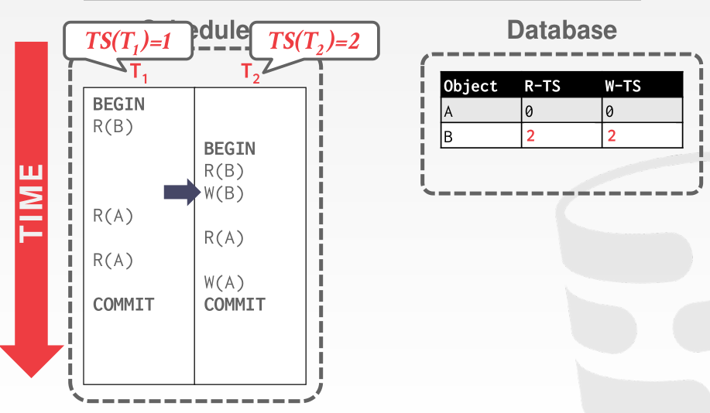
Example of Schedule Under TSO

Slide 55
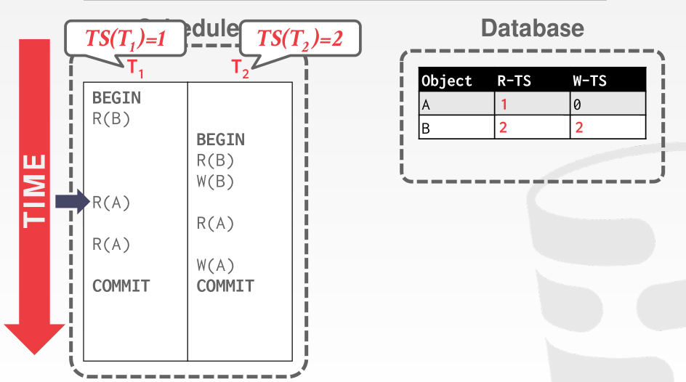
Example of Schedule Under TSO

Slide 56
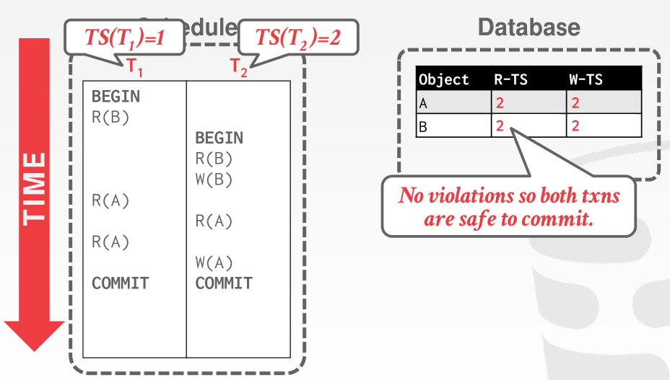
Example of Schedule Under TSO

Slide 57
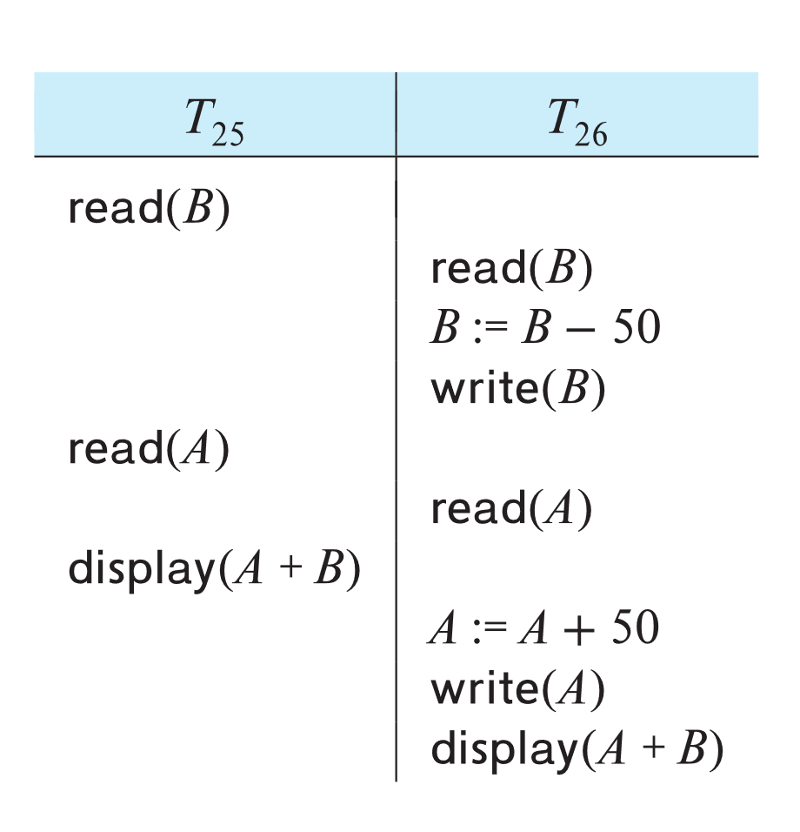
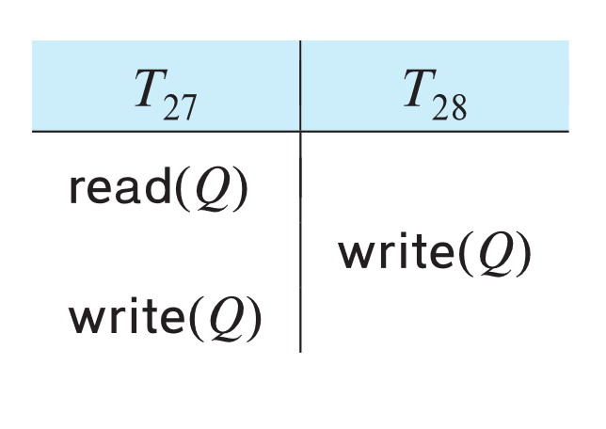
Example of Schedule Under TSO
Is this schedule valid under TSO?
Assume that initially:
R-TS(A) = W-TS(A) = 0
R-TS(B) = W-TS(B) = 0
Assume TS(T₂₅) = 25 and
TS(T₂₆) = 26
How about this one,
where initially
R-TS(Q)=W-TS(Q)=0

Slide 58
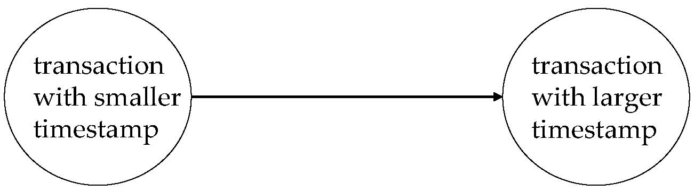
Correctness of Timestamp-Ordering Protocol
The timestamp-ordering protocol guarantees serializability since all the arcs in the precedence graph are of the form:
Thus, there will be no cycles in the precedence graph
Timestamp protocol ensures freedom from deadlock as no transaction ever waits.
But the schedule may not be cascade-free, and may not even be recoverable.

Slide 59
Thomas’ Write Rule
Modified version of the timestamp-ordering protocol in which obsolete write operations may be ignored under certain circumstances.
When T_{i} attempts to write data item Q, if TS(T_{i}) < W-timestamp(Q), then T_{i} is attempting to write an obsolete value of {Q}.
  Rather than rolling back T_{i} as the timestamp ordering protocol would have done, this {write} operation can be ignored. （把写操作去掉不会影响结果，因为该写操作最后都会被覆盖）
Otherwise this protocol is the same as the timestamp ordering protocol.
Thomas' Write Rule allows greater potential concurrency.
  Allows some view-serializable schedules that are not conflict-serializable.

Slide 60
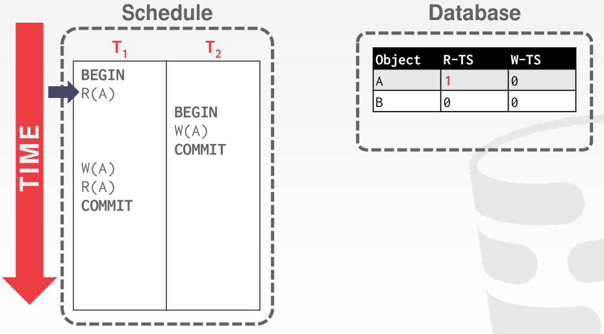
Thomas’ Write Rule

Slide 61
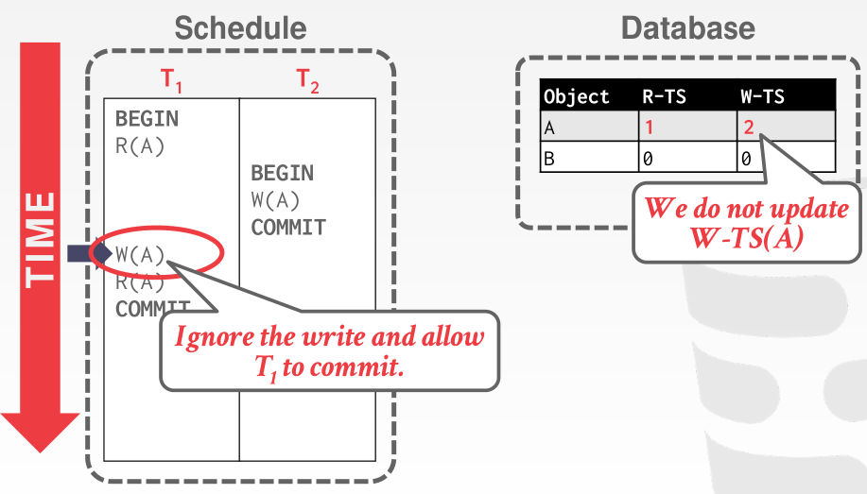
Thomas’ Write Rule

Slide 62
Validation-Based Protocol
Idea: can we use commit time as serialization order?
To do so:
  Postpone writes to end of transaction
  Keep track of data items read/written by transaction
  Validation performed at commit time, detect any out-of-serialization order reads/writes
Also called as optimistic concurrency control (乐观并发控制) since transaction executes fully in the hope that all will go well during validation

Slide 63
Validation-Based Protocol
Execution of transaction T_{i} is done in three phases.
1. Read and execution phase: Transaction T_{i} writes only to
temporary local variables
2. Validation phase: Transaction T_{i} performs a '‘validation test''
to determine if local variables can be written without violating
serializability.
3. Write phase: If T_{i} is validated, the updates are applied to the
database; otherwise, T_{i} is rolled back.
The three phases of concurrently executing transactions can be interleaved, but each transaction must go through the three phases in that order.
  We assume for simplicity that the validation and write phase occur together, atomically and serially
    I.e., only one transaction executes validation/write at a time.

Slide 64
Validation-Based Protocol (Cont.)
Each transaction T_{i} has 3 timestamps
  StartTS(T_{i}) : the time when T_{i} started its execution
  ValidationTS(T_{i}): the time when T_{i} entered its validation phase
  FinishTS(T_{i}) : the time when T_{i} finished its write phase
Validation tests use above timestamps and read/write sets to ensure that serializability order is determined by validation time
  Thus, TS(T_{i}) = ValidationTS(T_{i})
Validation-based protocol has been found to give greater degree of concurrency than locking/TSO if probability of conflicts is low.

Slide 65
Validation Test for Transaction T_{j}
If for all T_{i} with TS (T_{i}) < TS (T_{j}) either one of the following condition holds:
  finishTS(T_{i}) < startTS(T_{j})
  startTS(T_{j}) < finishTS(T_{i}) < validationTS(T_{j}) and the set of data items written by T_{i} does not intersect with the set of data items read by T_{j}.
then validation succeeds and T_{j} can be committed.
Otherwise, validation fails and T_{j} is aborted.
Justification:
  First condition applies when execution is not concurrent
    The writes of T_{j} do not affect reads of T_{i} since they occur after T_{i} has finished its reads.
  If the second condition holds, execution is concurrent, T_{j} does not read any item written by T_{i}.

Slide 66
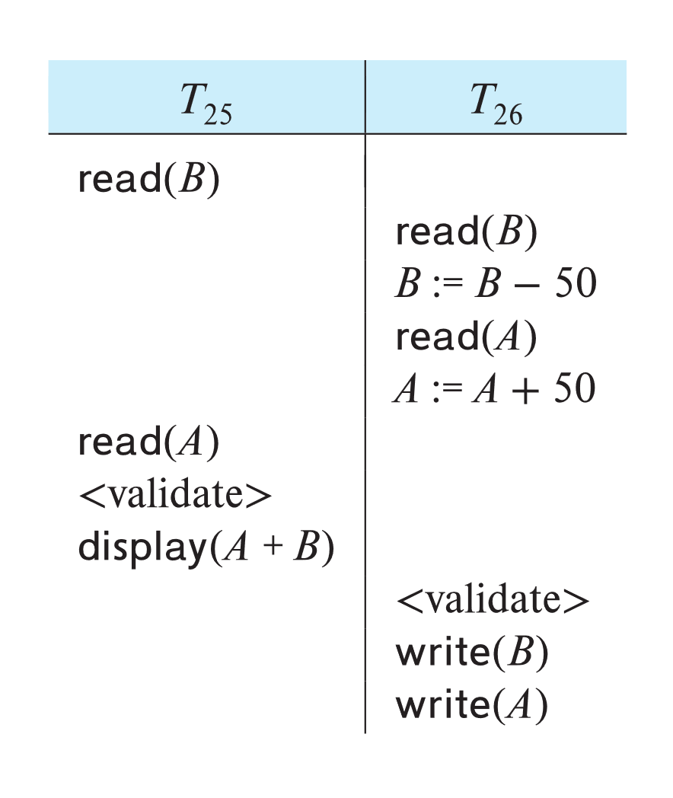
Schedule Produced by Validation
Example of schedule produced using validation

Slide 67
Multiversion Concurrency Control

Slide 68
Multiversion Schemes
The DBMS maintains multiple physical versions of a single logical object in the database:
  When a txn writes to an object, the DBMS creates a new version of that object.
  When a txn reads an object, it reads the newest version that existed when the txn started.
reads never have to wait as an appropriate version is returned immediately.

Slide 69
Multiversion Schemes
Multiversion schemes keep old versions of data item to increase concurrency. Several variants:
  Multiversion Timestamp Ordering
  Multiversion Two-Phase Locking
  Snapshot isolation
Key ideas:
  Each successful write results in the creation of a new version of the data item written.
  Use timestamps to label versions.
  When a read(Q) operation is issued, select an appropriate version of Q based on the timestamp of the transaction issuing the read request, and return the value of the selected version.

Slide 70
Multiversion Timestamp Ordering
Each data item Q has a sequence of versions <Q₁, Q₂,...., Q_{m}>. Each version Q_{k} contains three data fields:
  Content -- the value of version Q_{k}.
  W-timestamp(Q_{k}) -- timestamp of the transaction that created (wrote) version Q_{k}
  R-timestamp(Q_{k}) -- largest timestamp of a transaction that successfully read version Q_{k}

Slide 71
Multiversion Timestamp Ordering (Cont)
Suppose that transaction T_{i} issues a read(Q) or write(Q) operation. Let Q_{k} denote the version of Q whose write timestamp is the largest write timestamp less than or equal to TS(T_{i}).
  1. If transaction T_{i} issues a read(Q), then
    the value returned is the content of version Q_{k}
    If R-timestamp(Q_{k}) < TS(T_{i}), set R-timestamp(Q_{k}) = TS(T_{i}),
  2. If transaction T_{i} issues a write(Q)
    if TS(T_{i}) < R-timestamp(Q_{k}), then transaction T_{i} is rolled back.
    if TS(T_{i}) = W-timestamp(Q_{k}), the contents of Q_{k} are overwritten
    Otherwise, a new version Q_{i} of Q is created
      W-timestamp(Q_{i}) and R-timestamp(Q_{i}) are initialized to TS(T_{i}).

Slide 72
Multiversion Timestamp Ordering (Cont)
Observations
  Reads always succeed
  A write by T_{i} is rejected if some other transaction T_{j} that (in the serialization order defined by the timestamp values) should read T_{i}'s write, has already read a version created by a transaction older than T_{i}.
Protocol guarantees serializability

Slide 73
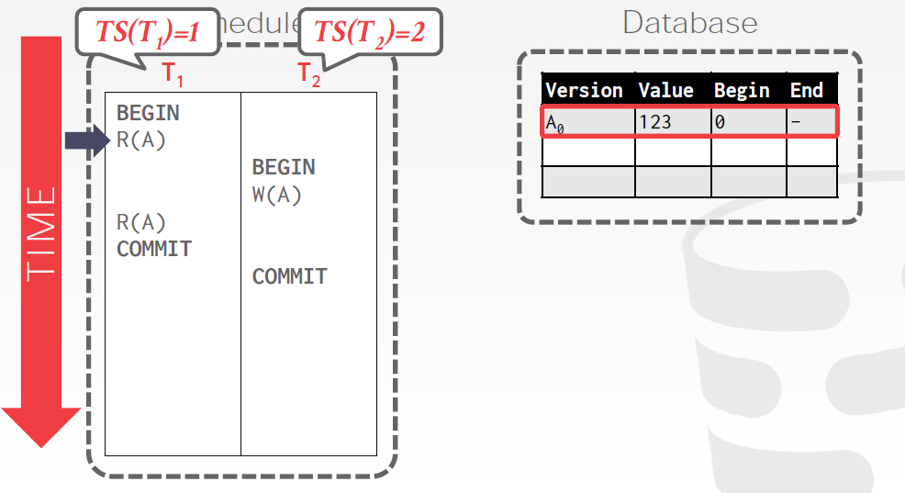
Example

Slide 74
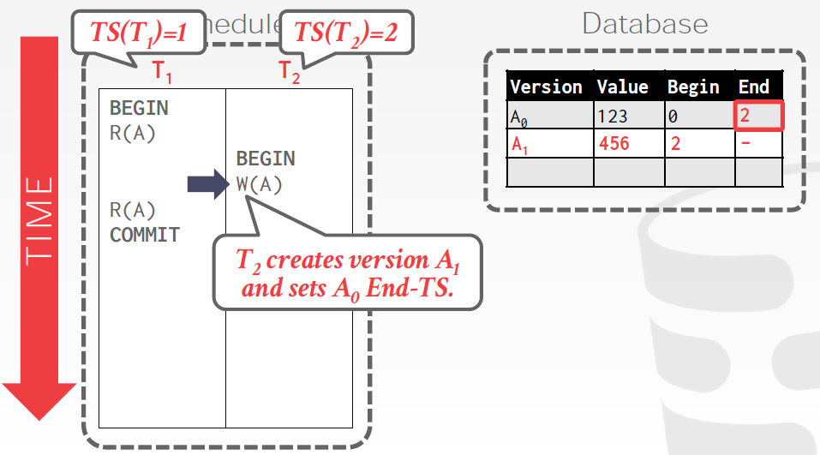
Example

Slide 75
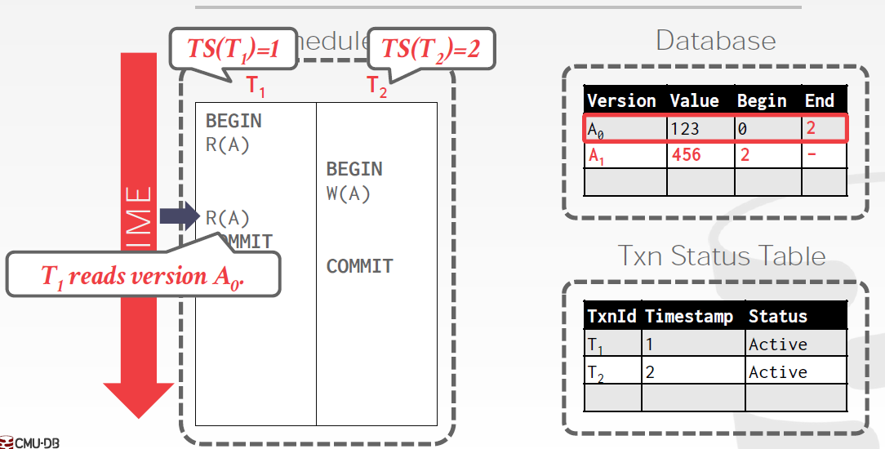
Example

Slide 76
Multiversion Two-Phase Locking
Differentiates between read-only transactions and update transactions
Update transactions acquire read and write locks, and hold all locks up to the end of the transaction. That is, update transactions follow rigorous two-phase locking.
  Read of a data item returns the latest version of the item
  The first write of Q by T_{i} results in the creation of a new version Q_{i} of the data item Q written
    W-timestamp(Q_{i}) set to ∞ initially
  When update transaction T_{i} completes, commit processing occurs:
    Value ts-counter stored in the database is used to assign timestamps
      ts-counter is locked in two-phase manner
    Set TS(T_{i}) = ts-counter + 1
    Set W-timestamp(Q_{i}) = TS(T_{i}) for all versions Q_{i} that it creates
    ts-counter = ts-counter + 1

Slide 77
Multiversion Two-Phase Locking (Cont.)
Read-only transactions
  are assigned a timestamp = ts-counter when they start execution
  follow the multiversion timestamp-ordering protocol for performing reads
    Do not obtain any locks
Read-only transactions that start after T_{i} increments ts-counter will see the values updated by T_{i}.
Read-only transactions that start before T_{i} increments the
ts-counter will see the value before the updates by T_{i}.
Only serializable schedules are produced.

Slide 78
MVCC: Implementation Issues
Creation of multiple versions increases storage overhead
  Extra tuples
  Extra space in each tuple for storing version information
Versions can, however, be garbage collected
  E.g., if Q has two versions Q5 and Q9, and the oldest active transaction has timestamp > 9, than Q5 will never be required again
Issues with
  primary key and foreign key constraint checking
  Indexing of records with multiple versions
  See textbook for details

Slide 79
Snapshot Isolation
Motivation: Decision support queries that read large amounts of data have concurrency conflicts with OLTP transactions that update a few rows
  Poor performance results
Solution 1: Use multiversion 2-phase locking
  Give logical “snapshot” of database state to read only transaction
    Reads performed on snapshot
  Update (read-write) transactions use normal locking
  Works well, but how does system know a transaction is read only?
Solution 2 (partial): Give snapshot of database state to every transaction
  Reads performed on snapshot
  Use 2-phase locking on updated data items
  Problem: variety of anomalies such as lost update can result
  Better solution: snapshot isolation level (next slide)

Slide 80
Snapshot Isolation
A transaction T1 executing with Snapshot Isolation
  Takes snapshot of committed data at start
  Always reads/modifies data in its own snapshot
  Updates of concurrent transactions are not visible to T1
  Writes of T1 complete when it commits
  First-committer-wins rule:
    Commits only if no other concurrent transaction has already written data that T1 intends to write.
T1 | T2 | T3
W(Y := 1) Commit
 | Start R(X) → 0 R(Y)→ 1
 |  | W(X:=2) W(Z:=3) Commit
 | R(Z) → 0 R(Y) → 1 W(X:=3) Commit-Req Abort
Concurrent updates not visible
Own updates are visible
Not first-committer of X
Serialization error, T2 is rolled back

Slide 81
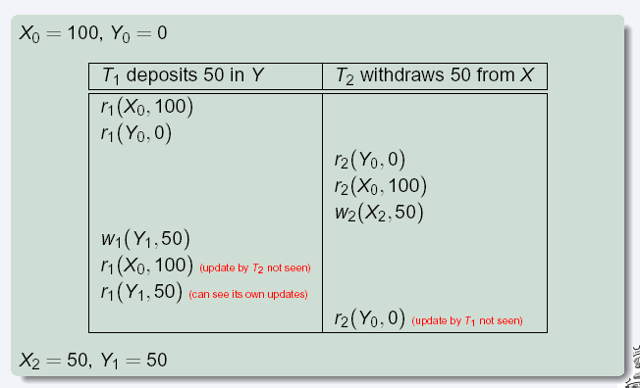
Snapshot Read
Concurrent updates invisible to snapshot read

Slide 82
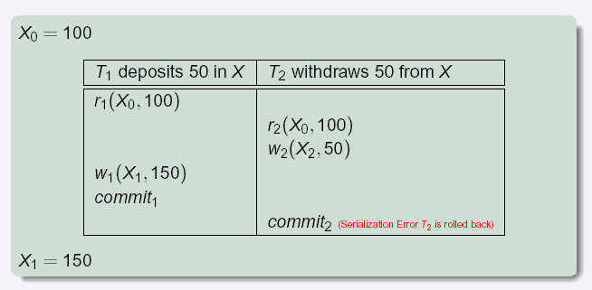
Snapshot Write: First Committer Wins
Variant: “First-updater-wins”
  Check for concurrent updates when write occurs by locking item
    But lock should be held till all concurrent transactions have finished
  (Oracle uses this plus some extra features)
  Differs only in when abort occurs, otherwise equivalent

Slide 83
Benefits of SI
Reads are never blocked,
  and also don’t block other txns activities
Performance similar to Read Committed
Avoids several anomalies
  No dirty read, i.e. no read of uncommitted data
  No lost update
    I.e., update made by a transaction is overwritten by another transaction that did not see the update)
  No non-repeatable read
    I.e., if read is executed again, it will see the same value
Problems with SI
  SI does not always give serializable executions
    Serializable: among two concurrent txns, one sees the effects of the other
    In SI: neither sees the effects of the other
  Result: Integrity constraints can be violated

Slide 84
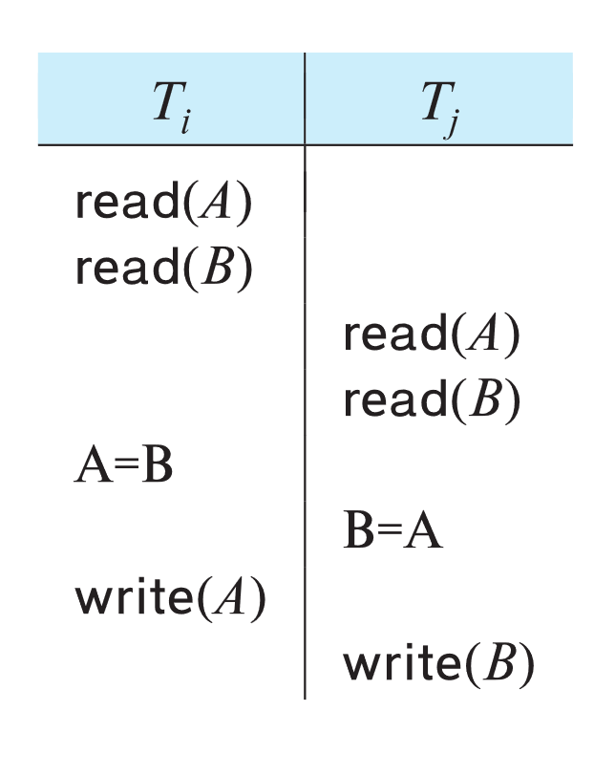
Snapshot Isolation
Example of problem with SI
  Initially A = 3 and B = 17
    Serial execution: A = ??, B = ??
    if both transactions start at the same time,
    with snapshot isolation: A = ?? , B = ??
Called skew write
Skew also occurs with inserts
  E.g:
    Find max order number among all orders
    Create a new order with order number = previous max + 1
    Two transaction can both create order with same number
      Is an example of phantom phenomenon

Slide 85
Snapshot Isolation Anomalies
SI breaks serializability when transactions modify different items, each based on a previous state of the item the other modified
  Not very common in practice
    E.g., the TPC-C benchmark runs correctly under SI
    when txns conflict due to modifying different data, there is usually also a shared item they both modify, so SI will abort one of them
  But problems do occur
    Application developers should be careful about write skew
SI can also cause a read-only transaction anomaly, where read-only transaction may see an inconsistent state even if updaters are serializable
  We omit details
Using snapshots to verify primary/foreign key integrity can lead to inconsistency
  Integrity constraint checking usually done outside of snapshot

Slide 86
Serializable Snapshot Isolation
Serializable snapshot isolation (SSI): extension of snapshot isolation that ensures serializability
Snapshot isolation tracks write-write conflicts, but does not track read-write conflicts
  Where T_{i} writes a data a data item Q, T_{j} reads an earlier version of Q, but T_{j} is serialized after T_{i}
Idea: track read-write dependencies separately, and roll-back transactions where cycles can occur
  Ensures serializability
  Details in book
Implemented in PostgreSQL from version 9.1 onwards
  PostgreSQL implementation of SSI also uses index locking to detect phantom conflicts, thus ensuring true serializability

Slide 87
SI Implementations
Snapshot isolation supported by many databases
  Including Oracle, PostgreSQL, SQL Server, IBM DB2, etc
  Isolation level can be set to snapshot isolation
Oracle implements “first updater wins” rule (variant of “first committer wins”)
  Concurrent writer check is done at time of write, not at commit time
  Allows transactions to be rolled back earlier
Warning: even if isolation level is set to serializable, Oracle actually uses snapshot isolation
  Old versions of PostgreSQL prior to 9.1 did this too
  Oracle and PostgreSQL < 9.1 do not support true serializable execution

Slide 88
Working Around SI Anomalies
Can work around SI anomalies for specific queries by using select .. for update (supported e.g. in Oracle)
  Example
    select max(orderno) from orders for update
    read value into local variable maxorder
    insert into orders (maxorder+1, …)
select for update (SFU) clause treats all data read by the query as if it were also updated, preventing concurrent updates
Can be added to queries to ensure serializability in many applications
  Does not handle phantom phenomenon/predicate reads though

Slide 89
Weak Levels of Concurrency

Slide 90
Weak Levels of Consistency
Degree-two consistency: differs from two-phase locking in that S-locks may be released at any time, and locks may be acquired at any time
  X-locks must be held till end of transaction
  Serializability is not guaranteed, programmer must ensure that no erroneous database state will occur]
Cursor stability:
  For reads, each tuple is locked, read, and lock is immediately released
  X-locks are held till end of transaction
  Special case of degree-two consistency

Slide 91
Weak Levels of Consistency in SQL
SQL allows non-serializable executions
  Serializable: is the default
  Repeatable read: allows only committed records to be read, and repeating a read should return the same value (so read locks should be retained)
    However, the phantom phenomenon need not be prevented
      T1 may see some records inserted by T2, but may not see others inserted by T2
  Read committed: same as degree two consistency, but most systems implement it as cursor-stability
  Read uncommitted: allows even uncommitted data to be read
In most database systems, read committed is the default consistency level
  Can be changed as database configuration parameter, or per transaction
    set isolation level serializable

Slide 92
Concurrency Control across User Interactions
Many applications need transaction support across user interactions
  Can’t use locking for long durations
Application level concurrency control
  Each tuple has a version number
  Transaction notes version number when reading tuple
    select r.balance, r.version into :A, :version
    from r where acctId =23
  When writing tuple, check that current version number is same as the version when tuple was read
    update r set r.balance = r.balance + :deposit, r.version = r.version+1
    where acctId = 23 and r.version = :version

Slide 93
Concurrency Control across User Interactions
Equivalent to optimistic concurrency control without validating read set
  Unlike SI, reads are not guaranteed to be from a single snapshot.
  Does not guarantee serializability
  But avoids some anomalies such as “lost update anomaly”
Used internally in Hibernate ORM system
Implemented manually in many applications
Version numbers stored in tuples can also be used to support first committer wins check of snapshot isolation

Slide 94
Advanced topics in Concurrency Control

Slide 95
Online Index Creation
Problem: how to create an index on a large relation without affecting concurrent updates
  Index construction may take a long time
  Two-phase locking will block all concurrent updates
Key ideas:
  Build index on a snapshot of the relation, but keep track of all updates that occur after snapshot
    Updates are not applied on the index at this point
  Then apply subsequent updates to catch up
  Acquire relation lock towards end of catchup phase to block concurrent updates
  Catch up with remaining updates, and add index to system catalog
  Subsequent transactions will find the index in catalog and update it

Slide 96
Concurrency in Index Structures
Indices are unlike other database items in that their only job is to help in accessing data.
Index-structures are typically accessed very often, much more than other database items.
  Treating index-structures like other database items, e.g. by 2-phase locking of index nodes can lead to low concurrency.
There are several index concurrency protocols where locks on internal nodes are released early, and not in a two-phase fashion.
  It is acceptable to have nonserializable concurrent access to an index as long as the accuracy of the index is maintained.
    In particular, the exact values read in an internal node of a
    B⁺-tree are irrelevant so long as we land up in the correct leaf node.

Slide 97
Concurrency in Index Structures (Cont.)
Crabbing protocol used instead of two-phase locking on the nodes of the B⁺-tree during search/insertion/deletion:
  First lock the root node in shared mode.
  After locking all required children of a node in shared mode, release the lock on the node
  During insertion/deletion, upgrade leaf node locks to exclusive mode.
  When splitting or coalescing requires changes to a parent, lock the parent in exclusive mode.
Above protocol can cause excessive deadlocks
  Searches coming down the tree deadlock with updates going up the tree
  Can abort and restart search, without affecting transaction
The B-link tree locking protocol improves concurrency
  Intuition: release lock on parent before acquiring lock on child
    And deal with changes that may have happened between lock release and acquire

Slide 98
Concurrency Control in Main-Memory Databases
Index locking protocols can be simplified with main-memory databases
  Short term lock can be obtained on entire index for duration of an operation, serializing updates on the index
    Avoids overheads of multiple lock acquire/release
    No major penalty since operations finish fast, since there is no disk wait
Latch-free techniques for data-structure update can speed up operations further

Slide 99
Latch-Free Data-structure Updates
This code is not safe without latches if executed concurrently:
insert(value, head) {
node = new node
node−>value = value
node−>next = head
head = node
}
This code is safe
insert latchfree(head, value) {
node = new node
node−>value = value
repeat
oldhead = head
node−>next = oldhead
result = CAS(head, oldhead, node)
until (result == success)
}

Slide 100
Latch-Free Data-structure Updates
This code is not safe without latches if executed concurrently:
insert(value, head) {
node = new node
node−>value = value
node−>next = head
head = node
}
This code is safe
insert latchfree(head, value) {
node = new node
node−>value = value
repeat
oldhead = head
node−>next = oldhead
result = CAS(head, oldhead, node)
until (result == success)
}

Slide 101
Latch-Free Data-structures (Cont.)
Consider:
delete latchfree(head) {
/* This function is not quite safe; see explanation in text. */
repeat
oldhead = head
newhead = oldhead−>next
result = CAS(head, oldhead, newhead)
until (result == success)
}
Above code is almost correct, but has a concurrency bug
  P1 initiates delete with N1 as head; concurrently P2 deletes N1 and next node N2, and then reinserts N1 as head, with N3 as next
  P1 may set head as N2 instead of N3.
Known as ABA problem
See book for details of how to avoid this problem

Slide 102
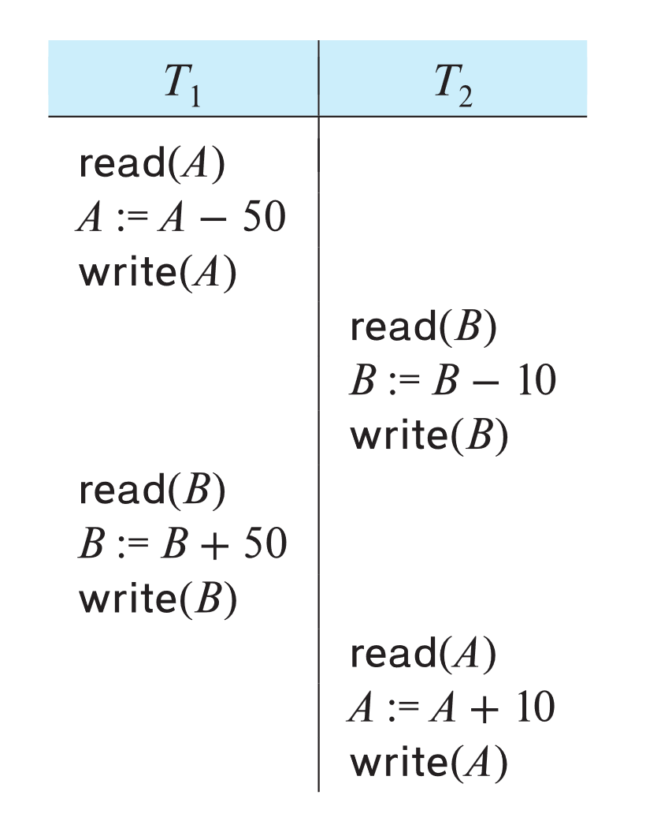
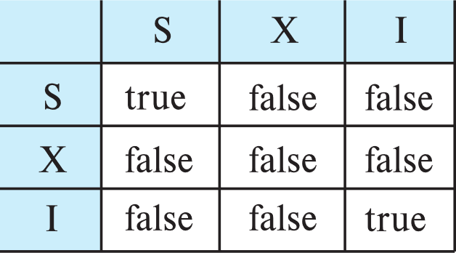
Concurrency Control with Operations
Consider this non-two phase schedule, which preserves database integrity constraints
Can be understood as transaction performing increment operation
  E.g., increment(A, -50), increment (B, 50)
  As long as increment operation does not return actual value, increments can be reordered
    Increments commute
  New increment-mode lock to support reordering
  Conflict matrix with increment lock mode
    Two increment operations do not conflict with each other

Slide 103
Concurrency Control with Operations (Cont.)
Undo of increment(v, n) is performed by increment (v, -n)
Increment_conditional(v, n):
  Updates v by adding n to it, as long as final v > 0, fails otherwise
  Can be used to model, e.g. number of available tickets, avail_tickets, for a concert
  Increment_conditional is NOT commutative
    E.g., last few tickets for a concert
  But reordering may still be acceptable

Slide 104
Real-Time Transaction Systems
Transactions in a system may have deadlines within which they must be completed.
  Hard deadline: missing deadline is an error
  Firm deadline: value of transaction is 0 in case deadline is missed
  Soft deadline: transaction still has some value if done after deadline
Locking can cause blocking
Optimistic concurrency control (validation protocol) has been shown to do will in a real-time setting

Slide 105
End of Chapter 14

