Slide 1
Chapter 8: Application Development

Slide 2
Outline
Application Programs and User Interfaces
Web Fundamentals
Servlets and JSP
Application Architectures
Rapid Application Development
Application Performance
Application Security
Encryption and Its Applications

Slide 3
Application Programs and User Interfaces
Most database users do not use a query language like SQL
An application program acts as the intermediary between users and the database
  Applications split into
    front-end
    middle layer
    backend
Front-end: user interface
  Forms
  Graphical user interfaces
  Many interfaces are Web-based

Slide 4
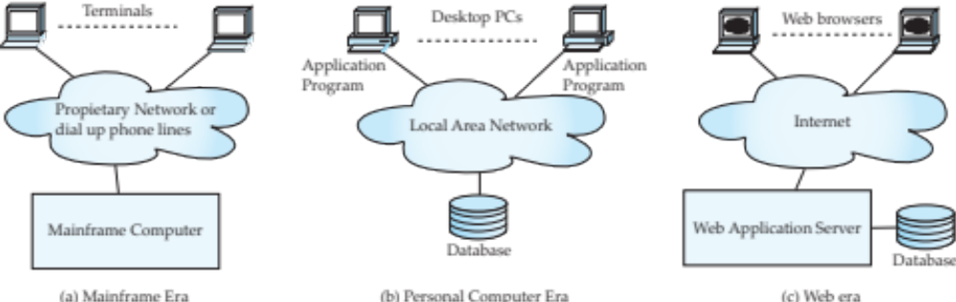
Application Architecture Evolution
Three distinct era’s of application architecture
  Mainframe (1960’s and 70’s)
  Personal computer era (1980’s)
  Web era (mid 1990’s onwards)
  Web and Smartphone era (2010 onwards)

Slide 5
Web Interface
Web browsers have become the de-facto standard user interface to databases
Enable large numbers of users to access databases from anywhere
Avoid the need for downloading/installing specialized code, while providing a good graphical user interface
  Javascript, Flash and other scripting languages run in browser, but are downloaded transparently
Examples: banks, airline and rental car reservations, university course registration and grading, an so on.

Slide 6
The World Wide Web
The Web is a distributed information system based on hypertext.
Most Web documents are hypertext documents formatted via the HyperText Markup Language (HTML)
HTML documents contain
  text along with font specifications, and other formatting instructions
  hypertext links to other documents, which can be associated with regions of the text.
  forms, enabling users to enter data which can then be sent back to the Web server

Slide 7
Uniform Resources Locators
In the Web, functionality of pointers is provided by Uniform Resource Locators (URLs).
URL example:
http://www.acm.org/sigmod
  The first part indicates how the document is to be accessed
    “http” indicates that the document is to be accessed using the Hyper Text Transfer Protocol.
  The second part gives the unique name of a machine on the Internet.
  The rest of the URL identifies the document within the machine.
The local identification can be:
    The path name of a file on the machine, or
    An identifier (path name) of a program, plus arguments to be passed to the program
      E.g., http://www.google.com/search?q=silberschatz

Slide 8
HTML and HTTP
HTML provides formatting, hypertext link, and image display features
  including tables, stylesheets (to alter default formatting), etc.
HTML also provides input features
    Select from a set of options
      Pop-up menus, radio buttons, check lists
    Enter values
      Text boxes
  Filled in input sent back to the server, to be acted upon by an executable at the server
HyperText Transfer Protocol (HTTP) used for communication with the Web server
Notes:
https://www.runoob.com/html/html-tutorial.html

Slide 9
Sample HTML Source Text
<html>
<body>
<table border>
<tr> <th>ID</th> <th>Name</th> <th>Department</th> </tr>
<tr> <td>00128</td> <td>Zhang</td> <td>Comp. Sci.</td> </tr>
….
</table>
<form action="PersonQuery" method=get>
Search for:
<select name="persontype">
<option value="student" selected>Student </option>
<option value="instructor"> Instructor </option>
</select> <br>
Name: <input type=text size=20 name="name">
<input type=submit value="submit">
</form>
</body> </html>

Slide 10
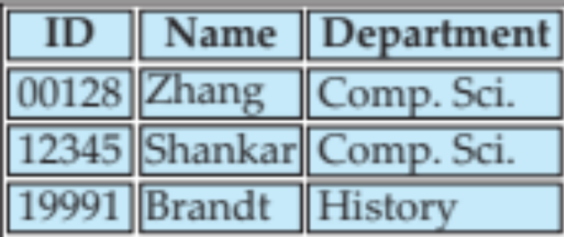
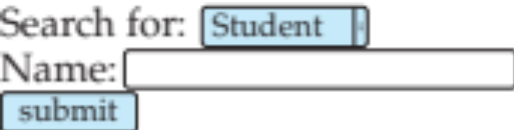
Display of Sample HTML Source

Slide 11
Web Servers
A Web server can easily serve as a front end to a variety of information services.
The document name in a URL may identify an executable program, that, when run, generates a HTML document.
  When an HTTP server receives a request for such a document, it executes the program, and sends back the HTML document that is generated.
  The Web client can pass extra arguments with the name of the document.
To install a new service on the Web, one simply needs to create and install an executable that provides that service.
  The Web browser provides a graphical user interface to the information service.
Common Gateway Interface (CGI): a standard interface between web and application server

Slide 12
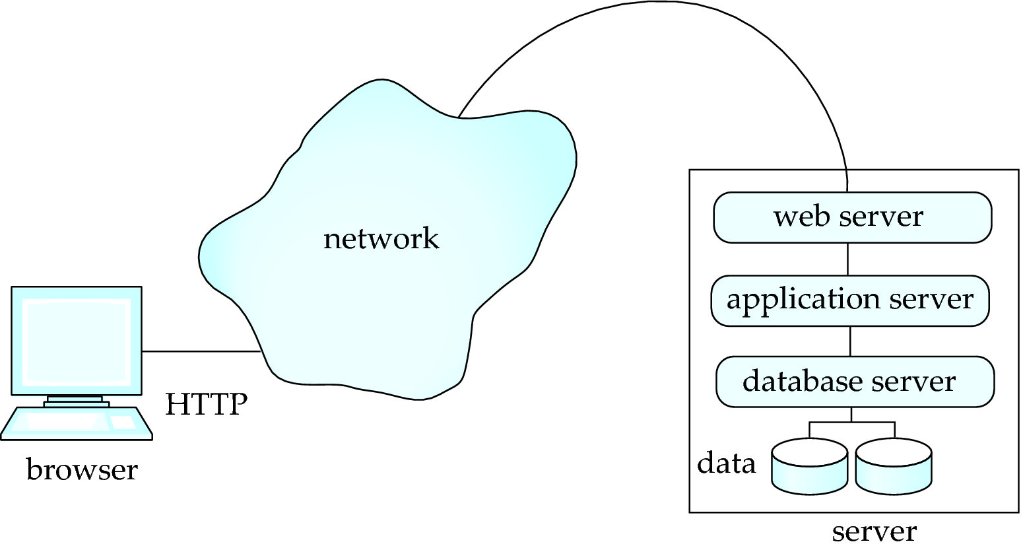
Three-Layer Web Architecture

Slide 13
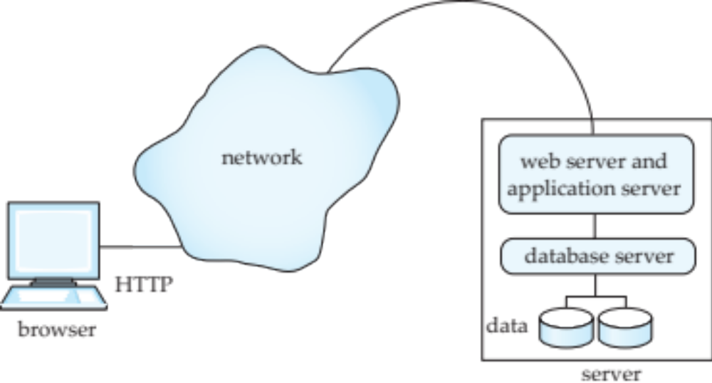
Two-Layer Web Architecture
Multiple levels of indirection have overheads
  Alternative: two-layer architecture

Slide 14
HTTP and Sessions
The HTTP protocol is connectionless
  That is, once the server replies to a request, the server closes the connection with the client, and forgets all about the request
  In contrast, Unix logins, and JDBC/ODBC connections stay connected until the client disconnects
    retaining user authentication and other information
  Motivation: reduces load on server
    operating systems have tight limits on number of open connections on a machine
Information services need session information
  E.g., user authentication should be done only once per session
Solution: use a cookie

Slide 15
Sessions and Cookies
A cookie is a small piece of text containing identifying information
  Sent by server to browser
    Sent on first interaction, to identify session
  Sent by browser to the server that created the cookie on further interactions
    part of the HTTP protocol
  Server saves information about cookies it issued, and can use it when serving a request
    E.g., authentication information, and user preferences
Cookies can be stored permanently or for a limited time

Slide 16
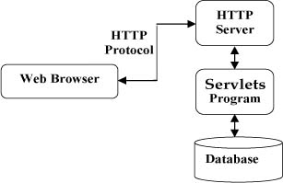
Servlets
Java Servlet specification defines an API for communication between the Web/application server and application program running in the server
  E.g., methods to get parameter values from Web forms, and to send HTML text back to client
Application program (also called a servlet) is loaded into the server
  Each request spawns a new thread in the server
    thread is closed once the request is serviced
  Programmer creates a class that inherits from HttpServlet
    And overrides methods doGet, doPost, …
  Mapping from servlet name (accessible via HTTP), to the servlet class is done in a file web.xml
    Done automatically by most IDEs when you create a Servlet using the IDE
Notes:
https://www.runoob.com/servlet/servlet-intro.html
https://www.runoob.com/servlet/servlet-database-access.html

Slide 17
Example Servlet Code
import java.io.*;
import javax.servlet.*;
import javax.servlet.http.*;
public class PersonQueryServlet extends HttpServlet {
public void doGet (HttpServletRequest request, HttpServletResponse response)
throws ServletException, IOException
{
response.setContentType("text/html");
PrintWriter out = response.getWriter();
out.println("<HEAD><TITLE> Query Result</TITLE></HEAD>");
out.println("<BODY>");
….. BODY OF SERVLET (next slide) …
out.println("</BODY>");
out.close();
}
}
Notes:
https://zhuanlan.zhihu.com/p/38225742
https://www.runoob.com/servlet/servlet-tutorial.html

Slide 18
Example Servlet Code
String persontype = request.getParameter("persontype");
String number = request.getParameter("name");
if(persontype.equals("student")) {
... code to find students with the specified name ...
... using JDBC to communicate with the database ..
out.println("<table BORDER COLS=3>");
out.println(" <tr> <td>ID</td> <td>Name: </td>" + " <td>Department</td> </tr>");
for(... each result ...){
... retrieve ID, name and dept name
... into variables ID, name and deptname
out.println("<tr> <td>" + ID + "</td>" + "<td>" + name + "</td>" + "<td>" + deptname
+ "</td></tr>");
};
out.println("</table>");
}
else {
... as above, but for instructors ...
}

Slide 19
Servlet Sessions
Servlet API supports handling of sessions
  Sets a cookie on first interaction with browser, and uses it to identify session on further interactions
To check if session is already active:
  if (request.getSession(false) == true)
    .. then existing session
    else .. redirect to authentication page
  authentication page
    check login/password
    Create new session
      HttpSession session = request.getSession(true)
    Store/retrieve attribute value pairs for a particular session
      session.setAttribute(“userid”, userid)
  If existing session:
  HttpSession = request.getSession(false);
  String userid = (String) session.getAttribute(“userid”)

Slide 20
Servlet Support
Servlets run inside application servers such as
  Apache Tomcat, Glassfish, JBoss
  BEA Weblogic, IBM WebSphere and Oracle Application Servers
Application servers support
  Deployment and monitoring of servlets
  Java 2 Enterprise Edition (J2EE) platform supporting objects, parallel processing across multiple application servers, etc

Slide 21
Server-Side Scripting
Server-side scripting simplifies the task of connecting a database to the Web
  Define an HTML document with embedded executable code/SQL queries.
  Input values from HTML forms can be used directly in the embedded code/SQL queries.
  When the document is requested, the Web server executes the embedded code/SQL queries to generate the actual HTML document.
Numerous server-side scripting languages
  JSP, PHP
  General purpose scripting languages: VBScript, Perl, Python

Slide 22
Java Server Pages (JSP)
A JSP page with embedded Java code
<html>
<head> <title> Hello </title> </head>
<body>
<% if (request.getParameter(“name”) == null)
{ out.println(“Hello World”); }
else { out.println(“Hello, ” + request.getParameter(“name”)); }
%>
</body>
</html>
JSP is compiled into Java + Servlets
JSP allows new tags to be defined, in tag libraries
  Such tags are like library functions, can are used for example to build rich user interfaces such as paginated display of large datasets
Notes:
https://www.runoob.com/jsp/jsp-tutorial.html
https://www.runoob.com/jsp/jsp-database-access.html
https://blog.csdn.net/qq_44886213/article/details/106366727

Slide 23
PHP
PHP is widely used for Web server scripting
Extensive libaries including for database access using ODBC
<html>
<head> <title> Hello </title> </head>
<body>
<?php if (!isset($_REQUEST[‘name’]))
{ echo “Hello World”; }
else { echo “Hello, ” + $_REQUEST[‘name’]; }
?>
</body>
</html>

Slide 24
Client Side Scripting
Browsers can fetch certain scripts (client-side scripts) or programs along with documents, and execute them in “safe mode” at the client site
  Javascript
  Adobe Flash and Shockwave for animation/games
  VRML
  Applets (now defunct)
Client-side scripts/programs allow documents to be active
  E.g., animation by executing programs at the local site
  E.g., ensure that values entered by users satisfy some correctness checks
  Permit flexible interaction with the user.
    Executing programs at the client site speeds up interaction by avoiding many round trips to server

Slide 25
Client Side Scripting and Security
Security mechanisms needed to ensure that malicious scripts do not cause damage to the client machine
  Easy for limited capability scripting languages, harder for general purpose programming languages like Java
E.g., Java’s security system ensures that the Java applet code does not make any system calls directly
  Disallows dangerous actions such as file writes
  Notifies the user about potentially dangerous actions, and allows the option to abort the program or to continue execution.

Slide 26
Javascript
Javascript very widely used
  Forms basis of new generation of Web applications (called Web 2.0 applications) offering rich user interfaces
Javascript functions can
  Check input for validity
  Modify the displayed Web page, by altering the underling document object model (DOM) tree representation of the displayed HTML text
  Communicate with a Web server to fetch data and modify the current page using fetched data, without needing to reload/refresh the page
    Forms basis of AJAX technology used widely in Web 2.0 applications
    E.g. on selecting a country in a drop-down menu, the list of states in that country is automatically populated in a linked drop-down menu

Slide 27
Javascript
Example of Javascript used to validate form input
  <html> <head>
  <script type="text/javascript">
  function validate() {
  var credits=document.getElementById("credits").value;
  if (isNaN(credits)|| credits<=0 || credits>=16) {
  alert("Credits must be a number greater than 0 and less than 16");
  return false
  }
  }
  </script>
  </head> <body>
  <form action="createCourse" onsubmit="return validate()">
  Title: <input type="text" id="title" size="20"><br />
  Credits: <input type="text" id="credits" size="2"><br />
  <Input type="submit" value="Submit">
  </form>
  </body> </html>

Slide 28
Application Architectures

Slide 29
Application Architectures
Application layers
  Presentation or user interface
    model-view-controller (MVC) architecture
      model: business logic
      view: presentation of data, depends on display device
      controller: receives events, executes actions, and returns a view to the user
  business-logic layer
    provides high level view of data and actions on data
      often using an object data model
    hides details of data storage schema
  data access layer
    interfaces between business logic layer and the underlying database
    provides mapping from object model of business layer to relational model of database
Notes:
http://c.biancheng.net/spring_mvc/mvc.html
http://c.biancheng.net/spring_mvc/

Slide 30
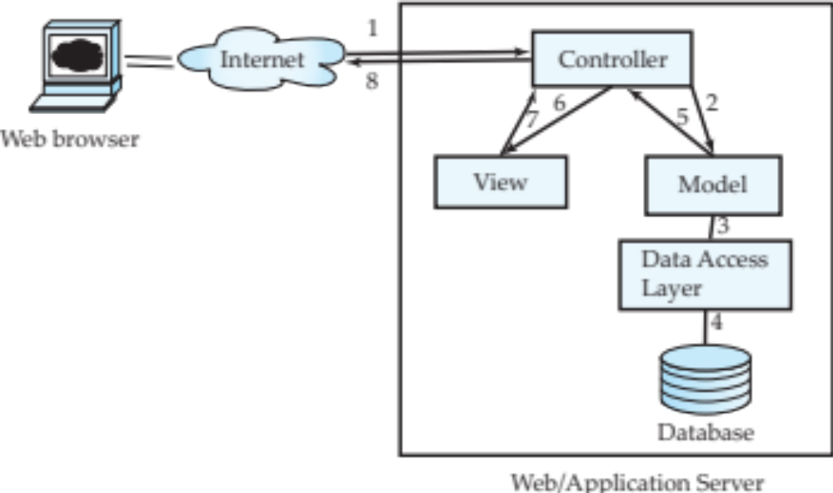
Application Architecture
Notes:
https://www.runoob.com/design-pattern/mvc-pattern.html

Slide 31
Business Logic Layer
Provides abstractions of entities
  E.g., students, instructors, courses, etc
Enforces business rules for carrying out actions
  E.g., student can enroll in a class only if she has completed prerequsites, and has paid her tuition fees
Supports workflows which define how a task involving multiple participants is to be carried out
  E.g., how to process application by a student applying to a university
  Sequence of steps to carry out task
  Error handling
    E.g. what to do if recommendation letters not received on time

Slide 32
Object-Relational Mapping
Allows application code to be written on top of object-oriented data model, while storing data in a traditional relational database
  Alternative: implement object-oriented or object-relational database to store object model
    Has not been commercially successful
Schema designer has to provide a mapping between object data and relational schema
  E.g., Java class Student mapped to relation student, with corresponding mapping of attributes
  An object can map to multiple tuples in multiple relations
Application opens a session, which connects to the database
Objects can be created and saved to the database using session.save(object)
  Mapping used to create appropriate tuples in the database
Query can be run to retrieve objects satisfying specified predicates

Slide 33
Object-Relational Mapping and Hibernate (Cont.)
The Hibernate object-relational mapping system is widely used
  Public domain system, runs on a variety of database systems
  Supports a query language that can express complex queries involving joins
    Translates queries into SQL queries
  Allows relationships to be mapped to sets associated with objects
    E.g., courses taken by a student can be a set in Student object
Notes:
https://www.runoob.com/java/java-hibernate.html

Slide 34
Web Services
Allow data on Web to be accessed using remote procedure call mechanism
Two approaches are widely used
  Representation State Transfer (REST): allows use of standard HTTP request to a URL to execute a request and return data
    Returned data is encoded either in XML, or in JavaScript Object Notation (JSON)
  Big Web Services:
    Uses XML representation for sending request data, as well as for returning results
    Standard protocol layer built on top of HTTP
    See Section 23.7.3

Slide 35
Disconnected Operations
Tools for applications to use the Web when connected, but operate locally when disconnected from the Web
  Make use of HTML5 local storage

Slide 36
Rapid Application Development
A lot of effort is required to develop Web application interfaces
  More so, to support rich interaction functionality associated with Web 2.0 applications
Several approaches to speed up application development
  Function library to generate user-interface elements
  Drag-and-drop features in an IDE to create user-interface elements
  Automatically generate code for user interface from a declarative specification
Above features have been in used as part of rapid application development (RAD) tools even before advent of Web
Web application development frameworks
  Java Server Faces (JSF) includes JSP tag library
  Ruby on Rails
    Allows easy creation of simple CRUD (create, read, update and delete) interfaces by code generation from database schema or object model

Slide 37
ASP.NET and Visual Studio
ASP.NET provides a variety of controls that are interpreted at server, and generate HTML code
Visual Studio provides drag-and-drop development using these controls
  E.g., menus and list boxes can be associated with DataSet object
  Validator controls (constraints) can be added to form input fields
    JavaScript to enforce constraints at client, and separately enforced at server
  User actions such as selecting a value from a menu can be associated with actions at server
  DataGrid provides convenient way of displaying SQL query results in tabular format

Slide 38
Application Performance

Slide 39
Improving Web Server Performance
Performance is an issue for popular Web sites
  May be accessed by millions of users every day, thousands of requests per second at peak time
Caching techniques used to reduce cost of serving pages by exploiting commonalities between requests
  At the server site:
    Caching of JDBC connections between servlet requests
      a.k.a. connection pooling
    Caching results of database queries
      Cached results must be updated if underlying database changes
    Caching of generated HTML
  At the client’s network
    Caching of pages by Web proxy

Slide 40
Application Security

Slide 41
SQL Injection
Suppose query is constructed using
  "select * from instructor where name = ’" + name + "’"
Suppose the user, instead of entering a name, enters:
  X’ or ’Y’ = ’Y
then the resulting statement becomes:
  "select * from instructor where name = ’" + "X’ or ’Y’ = ’Y" + "’"
  which is:
    select * from instructor where name = ’X’ or ’Y’ = ’Y’
  User could have even used
    X’; update instructor set salary = salary + 10000; --
Prepared statement internally uses:
"select * from instructor where name = ’X\’ or \’Y\’ = \’Y’
Always use prepared statements, with user inputs as parameters
Is the following prepared statemen secure?
  conn.prepareStatement("select * from instructor where name = ’" + name + "’“)

Slide 42
Cross Site Scripting
HTML code on one page executes action on another page
  E.g., <img src = http://mybank.com/transfermoney?amount=1000&toaccount=14523>
  Risk: if user viewing page with above code is currently logged into mybank, the transfer may succeed
  Above example simplistic, since GET method is normally not used for updates, but if the code were instead a script, it could execute POST methods
Above vulnerability called cross-site scripting (XSS) or cross-site request forgery (XSRF or CSRF)
Prevent your web site from being used to launch XSS or XSRF attacks
  Disallow HTML tags in text input provided by users, using functions to detect and strip such tags
Protect your web site from XSS/XSRF attacks launched from other sites
  ..next slide

Slide 43
Cross Site Scripting
Protect your web site from XSS/XSRF attacks launched from other sites
Use referer value (URL of page from where a link was clicked) provided by the HTTP protocol, to check that the link was followed from a valid page served from same site, not another site
Ensure IP of request is same as IP from where the user was authenticated
  Prevents hijacking of cookie by malicious user
Never use a GET method to perform any updates
  This is actually recommended by HTTP standard

Slide 44
Password Leakage
Never store passwords, such as database passwords, in clear text in scripts that may be accessible to users
  E.g., in files in a directory accessible to a web server
    Normally, web server will execute, but not provide source of script files such as file.jsp or file.php, but source of editor backup files such as file.jsp~, or .file.jsp.swp may be served
Restrict access to database server from IPs of machines running application servers
  Most databases allow restriction of access by source IP address

Slide 45
Application Authentication
Single factor authentication such as passwords too risky for critical applications
  Guessing of passwords, sniffing of packets if passwords are not encrypted
  Passwords reused by user across sites
  Spyware which captures password
Two-factor authentication
  E.g., password plus one-time password sent by SMS
  E.g., password plus one-time password devices
    Device generates a new pseudo-random number every minute, and displays to user
    User enters the current number as password
    Application server generates same sequence of pseudo-random numbers to check that the number is correct.

Slide 46
Application Authentication
Man-in-the-middle attack
  E.g., web site that pretends to be mybank.com, and passes on requests from user to mybank.com, and passes results back to user
  Even two-factor authentication cannot prevent such attacks
Solution: authenticate Web site to user, using digital certificates, along with secure http protocol
Central authentication within an organization
  Application redirects to central authentication service for authentication
  Avoids multiplicity of sites having access to user’s password
  LDAP or Active Directory used for authentication

Slide 47
Single Sign-On
Single sign-on allows user to be authenticated once, and applications can communicate with authentication service to verify user’s identity without repeatedly entering passwords
Security Assertion Markup Language (SAML) standard for exchanging authentication and authorization information across security domains
  E.g., user from Yale signs on to external application such as acm.org using userid joe@yale.edu
  Application communicates with Web-based authentication service at Yale to authenticate user, and find what the user is authorized to do by Yale (e.g., access certain journals)
OpenID standard allows sharing of authentication across organizations
  E.g., application allows user to choose Yahoo! as OpenID authentication provider, and redirects user to Yahoo! for authentication

Slide 48
Application-Level Authorization
Current SQL standard does not allow fine-grained authorization such as “students can see their own grades, but not other’s grades”
  Problem 1: Database has no idea who are application users
  Problem 2: SQL authorization is at the level of tables, or columns of tables, but not to specific rows of a table
One workaround: use views such as
  create view studentTakes as
  select *
  from takes
  where takes.ID = syscontext.user_id()
  where syscontext.user_id() provides end user identity
    End user identity must be provided to the database by the application
  Having multiple such views is cumbersome

Slide 49
Application-Level Authorization (Cont.)
Currently, authorization is done entirely in application
Entire application code has access to entire database
  Large surface area, making protection harder
Alternative: fine-grained (row-level) authorization schemes
  Extensions to SQL authorization proposed but not currently implemented
  Oracle Virtual Private Database (VPD) allows predicates to be added transparently to all SQL queries, to enforce fine-grained authorization
    E.g., add ID= sys_context.user_id() to all queries on student relation if user is a student

Slide 50
Audit Trails
Applications must log actions to an audit trail, to detect who carried out an update, or accessed some sensitive data
Audit trails used after-the-fact to
  Detect security breaches
  Repair damage caused by security breach
  Trace who carried out the breach
Audit trails needed at
  Database level, and at
  Application level

Slide 51
Encryption

Slide 52
Encryption
Data may be encrypted when database authorization provisions do not offer sufficient protection.
Properties of good encryption technique:
  Relatively simple for authorized users to encrypt and decrypt data.
  Encryption scheme depends not on the secrecy of the algorithm but on the secrecy of a parameter of the algorithm called the encryption key.
  Extremely difficult for an intruder to determine the encryption key.
Symmetric-key encryption: same key used for encryption and for decryption
Public-key encryption (a.k.a. asymmentric-key encryption): use different keys for encryption and decryption
  Encryption key can be public, decryption key secret

Slide 53
Encryption (Cont.)
Data Encryption Standard (DES) substitutes characters and rearranges their order on the basis of an encryption key which is provided to authorized users via a secure mechanism. Scheme is no more secure than the key transmission mechanism since the key has to be shared.
Advanced Encryption Standard (AES) is a new standard replacing DES, and is based on the Rijndael algorithm, but is also dependent on shared secret keys.
Public-key encryption is based on each user having two keys:
  Public key – publicly published key used to encrypt data, but cannot be used to decrypt data
  Private key -- key known only to individual user, and used to decrypt data. Need not be transmitted to the site doing encryption.
Encryption scheme is such that it is impossible or extremely hard to decrypt data given only the public key.
The RSA public-key encryption scheme is based on the hardness of factoring a very large number (100's of digits) into its prime components

Slide 54
Encryption (Cont.)
Hybrid schemes combining public key and private key encryption for efficient encryption of large amounts of data
Encryption of small values such as identifiers or names vulnerable to dictionary attacks
  Especially if encryption key is publicly available
  But even otherwise, statistical information such as frequency of occurrence can be used to reveal content of encrypted data
  Can be deterred by adding extra random bits to the end of the value, before encryption, and removing them after decryption
    Same value will have different encrypted forms each time it is encrypted, preventing both above attacks
    Extra bits are called salt bits

Slide 55
Encryption in Databases
Database widely support encryption
Different levels of encryption:
  disk block
    Every disk block encrypted using key available in database-system software.
    Even if attacker gets access to database data, decryption cannot be done without access to the key.
  Entire relations, or specific attributes of relations
    Non-sensitive relations, or non-sensitive attributes of relations need not be encrypted
    However, attributes involved in primary/foreign key constraints cannot be encrypted.
Storage of encryption or decryption keys
  Typically, single master key used to protect multiple encryption/decryption keys stored in database
Alternative: encryption/decryption is done in application, before sending values to the database

Slide 56
Encryption and Authentication
Password based authentication is widely used, but is susceptible to sniffing on a network.
Challenge-response systems avoid transmission of passwords
  DB sends a (randomly generated) challenge string to user.
  User encrypts string and returns result.
  DB verifies identity by decrypting result
  Can use public-key encryption system by DB sending a message encrypted using user’s public key, and user decrypting and sending the message back.
Digital signatures are used to verify authenticity of data
  E.g., use private key (in reverse) to encrypt data, and anyone can verify authenticity by using public key (in reverse) to decrypt data. Only holder of private key could have created the encrypted data.
  Digital signatures also help ensure nonrepudiation: sender
  cannot later claim to have not created the data

Slide 57
End of Chapter 8

Slide 58
Digital Certificates
Digital certificates are used to verify authenticity of public keys.
Problem: when you communicate with a web site, how do you know if you are talking with the genuine web site or an imposter?
  Solution: use the public key of the web site
  Problem: how to verify if the public key itself is genuine?
Solution:
  Every client (e.g., browser) has public keys of a few root-level certification authorities
  A site can get its name/URL and public key signed by a certification authority: signed document is called a certificate
  Client can use public key of certification authority to verify certificate
  Multiple levels of certification authorities can exist. Each certification authority
    Presents its own public-key certificate signed by a
    higher level authority, and
    Uses its private key to sign the certificate of other web sites/authorities

Slide 59
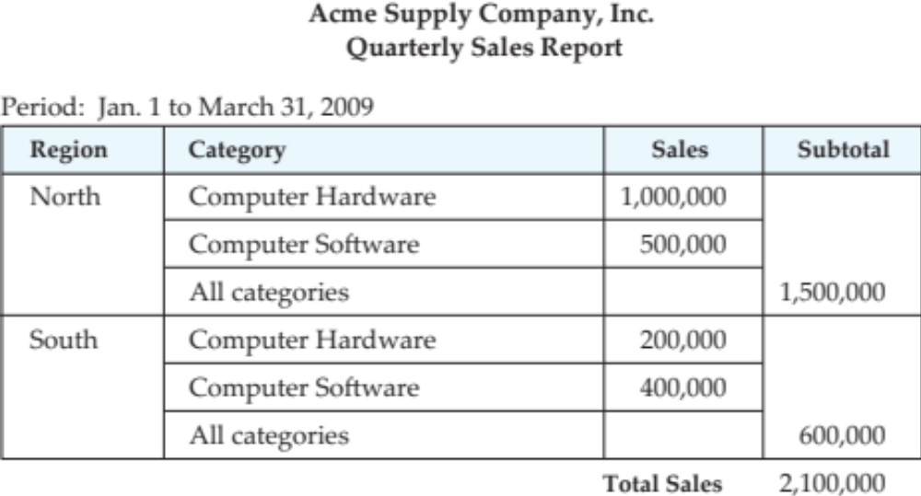
A formatted report

