Slide 1
React Basics & Component-Based Design

Slide 2
What is React?
JavaScript library for building UIs
Developed by Facebook (Meta)
Popular for SPAs (Single Page Applications)
a web application that interacts with the user by dynamically rewriting the current page rather than loading entire new pages from a server

Slide 3
What is React?
Declarative:
React promotes a declarative approach by allowing developers to describe what the UI should look like for a given state, rather than how to achieve that state through direct DOM manipulations. This abstraction simplifies code, makes it more predictable, and easier to debug, as React handles the underlying updates to match the declared UI.

Slide 4
What is React?
Efficient:
React achieves efficiency primarily through its Virtual DOM. Instead of directly manipulating the browser's DOM on every state change, React first updates a lightweight, in-memory representation (the Virtual DOM). It then efficiently calculates the minimal set of changes required to update the actual DOM, leading to faster rendering and improved performance, especially in complex applications with frequent UI updates.

Slide 5
What is React?
Flexible:
Component-based architecture
Unopinionated nature
Integration capabilities

Slide 6
Why React?
Component reusability
Virtual DOM for performance
Large community and ecosystem
Easy integration with back-end APIs

Slide 7
React vs Traditional Web Development
Traditional: HTML, CSS, JS tied together
React: Component-based, modular, reusable

Slide 8
React Core Concepts
^{Components}
^{Props}
^{State} ^{JSX}

Slide 9
Components in React
^{Building blocks of UI}
^{Types:}
Functional Components (modern standard)
Class Components (legacy, but still seen)

Slide 10
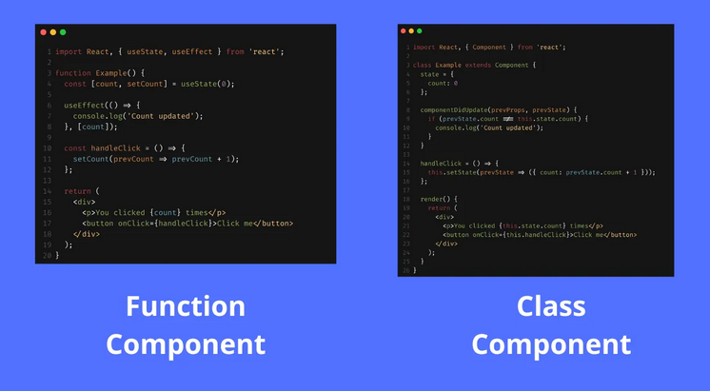
Components in React
^{Class vs Functional components}

Slide 11
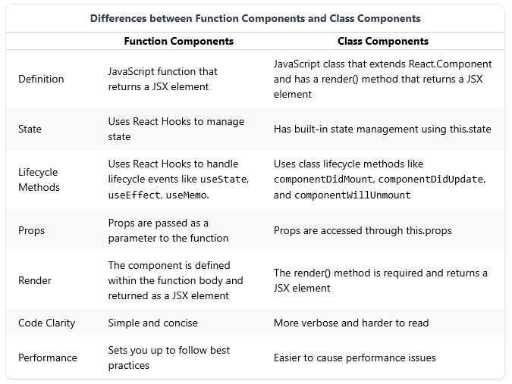
Components in React
^{Class vs Functional components}

Slide 12

Props in React
^{Pass data into components}

Slide 13

JSX (JavaScript XML)
^{Looks like HTML but inside JS}
Must return a single parent element

Slide 14
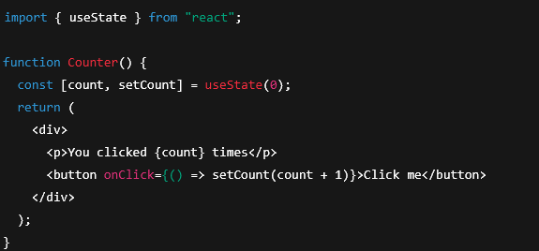
State in React
^{Manages component data}
^{Example with useState:}

Slide 15
Component Hierarchy
^{Components inside components}
Parent ↔ Child communication with props
^{Example: App → Header → Navbar}

Slide 16
Best Practices in Component Design
Keep components small and focused
Reuse components whenever possible
^{Use clear naming conventions}
Separate concerns (logic vs UI)

Slide 17
Summary
React is a component-based JS library
Components = reusable building blocks
JSX mixes HTML-like syntax with JS
Props = data in, State = data that changes
Component hierarchy builds scalable UIs

