Slide 1
LINEAR MOMENTUM AND COLLISION
SCHOOL OF ENGINEERING AND ARCHITECTURE
GENERAL ENGINEERING DEPARTMENT

Slide 2
Momentum Analysis Models
Force and acceleration are related by Newton’s second law.
When force and acceleration vary by time, the situation can be very complicated.
The techniques developed in this chapter will enable you to understand and analyze these situations in a simple way.
Will develop momentum versions of analysis models for isolated and non-isolated systems
These models are especially useful for treating problems that involve collisions and for analyzing rocket propulsion.

Slide 3
Thought Experiment
A 60-kg archer stands at rest on frictionless ice and fires a 0.030-kg arrow horizontally at 85 m/s. With what velocity does the archer move across the ice after firing the arrow?
Motion models such as a particle under constant acceleration cannot be used.
No information about the acceleration of the arrow
Model of a particle under constant force cannot be used.
No information about forces involved
Energy models cannot be used.
No information about the work or the energy (energies) involved
A new quantity is needed – linear momentum.

Slide 4
Linear Momentum
The linear momentum of a particle or an object that can be modeled as a particle of mass m moving with a velocity is defined to be the product of the mass and velocity:
The terms momentum and linear momentum will be used interchangeably in the text.
Linear momentum is a vector quantity.
Its direction is the same as the direction of the velocity.
The dimensions of momentum are ML/T.
The SI units of momentum are kg · m / s.
Momentum can be expressed in component form:
p_{x} = m v_{x} p_{y} = m v_{y} p_{z} = m v_{z}

Slide 5
Momentum and Kinetic Energy
Momentum and kinetic energy both involve mass and velocity.
There are major differences between them:
Kinetic energy is a scalar and momentum is a vector.
Kinetic energy can be transformed to other types of energy.
There is only one type of linear momentum, so there are no similar transformations.
Analysis models based on momentum are separate from those based on energy.
This difference allows an independent tool to use in solving problems.

Slide 6
Newton’s Second Law and Momentum
Newton’s Second Law can be used to relate the momentum of a particle to the resultant force acting on it.
with constant mass
The time rate of change of the linear momentum of a particle is equal to the net force acting on the particle.
This is the form in which Newton presented the Second Law.
It is a more general form than the one we used previously.
This form also allows for mass changes.

Slide 7
Conservation of Linear Momentum
Whenever two or more particles in an isolated system interact, the total momentum of the system remains constant.
The momentum of the system is conserved, not necessarily the momentum of an individual particle.
Avoid applying conservation of momentum to a single particle.
This also tells us that the total momentum of an isolated system equals its initial momentum.

Slide 8
Conservation of Momentum, 2
Conservation of momentum can be expressed mathematically in various ways:
This is the mathematical statement of a new analysis model, the isolated system (momentum).
In component form, the total momenta in each direction are independently conserved.
p_{1ix} + p_{2ix} = p_{1fx} + p_{2fx} p_{1iy} + p_{2iy} = p_{1fy}+ p_{2fy} p_{1iz} + p_{2iz} = p_{1fz} + p_{2fz}
Conservation of momentum can be applied to systems with any number of particles.
The momentum version of the isolated system model states whenever two or more particles in an isolated system interact, the total momentum of the system remains constant.

Slide 9
Forces and Conservation of Momentum
In conservation of momentum, there is no statement concerning the types of forces acting on the particles of the system.
The forces are not specified as conservative or non-conservative.
There is no indication if the forces are constant or not.
The only requirement is that the forces must be internal to the system.
This gives a hint about the power of this new model.

Slide 10
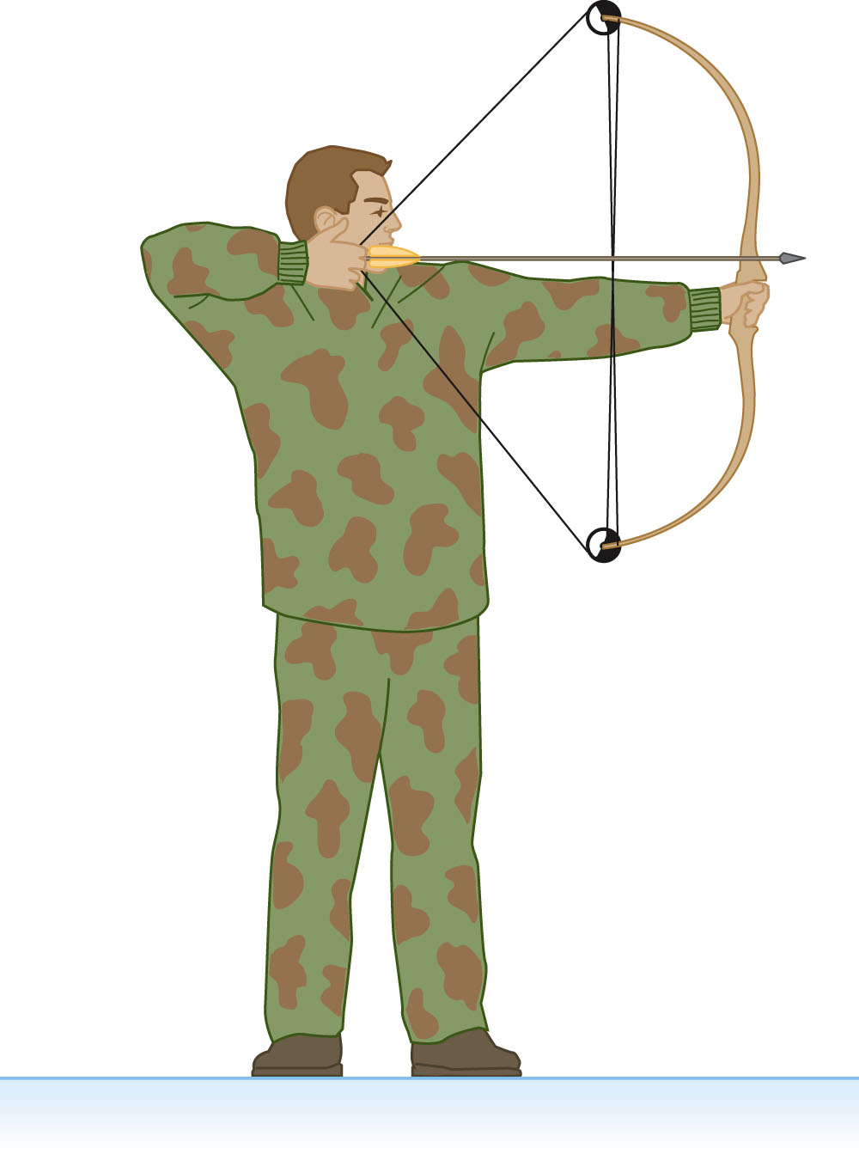
Conservation of Momentum, Archer Example Revisited
A 60-kg archer stands at rest on frictionless ice and fires a 0.030-kg arrow horizontally at 85 m/s. With what velocity does the archer move across the ice after firing the arrow?
Approaches:
Motion – no
No information about velocities, etc.
Newton’s Second Law – no
No information about F or a
Energy approach – no
No information about work or energy
Momentum – yes

Slide 11
Archer Example, 2
Conceptualize
The arrow is fired one way and the archer recoils in the opposite direction.
Categorize
Momentum
Let the system be the archer with bow (particle 1) and the arrow (particle 2).
It is not an isolated system in the y-direction because the gravitational force and the normal force act on it.
There are no external forces in the x-direction, so it is isolated in terms of momentum in the x-direction.
Apply the isolated system (momentum) model in terms of momentum components in the x-direction.

Slide 12
Archer Example, 3
Analyze, cont.
Total momentum before releasing the arrow is 0
The total momentum after releasing the arrow is
Finalize
The final velocity of the archer is negative.
Indicates he moves in a direction opposite the arrow
Archer has much higher mass than arrow, so velocity is much lower
Notes
The problem seems very simple, but could not be solved using previous analysis models.
Using the new momentum model made the solution quite simple.
ANS = -0.042 M/S

Slide 13
Impulse and Momentum
The momentum of a system changes if a net force from the environment acts on the system.
For momentum considerations, a system is non-isolated if a net force acts on the system for a time interval.
From Newton’s Second Law,
Solving for gives
Integrating to find the change in momentum over some time interval.
The integral is called the impulse, , of the force acting on an object over Δt.

Slide 14
Impulse-Momentum Theorem
This equation expresses the impulse-momentum theorem: The change in the momentum of a particle is equal to the impulse of the new force acting on the particle.
This is equivalent to Newton’s Second Law.
This is identical in form to the conservation of energy equation.
This is the most general statement of the principle of conservation of momentum and is called the conservation of momentum equation.
This form applies to non-isolated systems.
This is the mathematical statement of the non-isolated system (momentum) model.

Slide 15
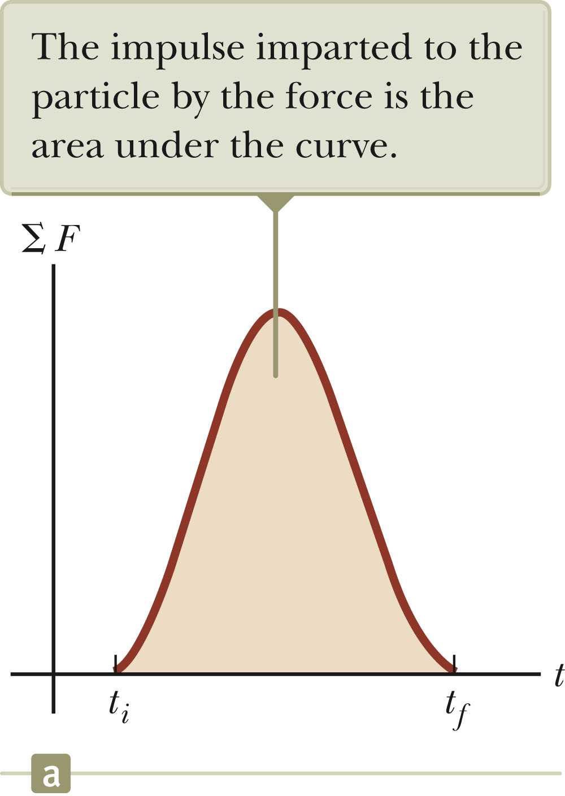
More About Impulse
Impulse is a vector quantity.
The magnitude of the impulse is equal to the area under the force-time curve.
The force may vary with time.
Dimensions of impulse are M L / T
Impulse is not a property of the particle, but a measure of the change in momentum of the particle.

Slide 16
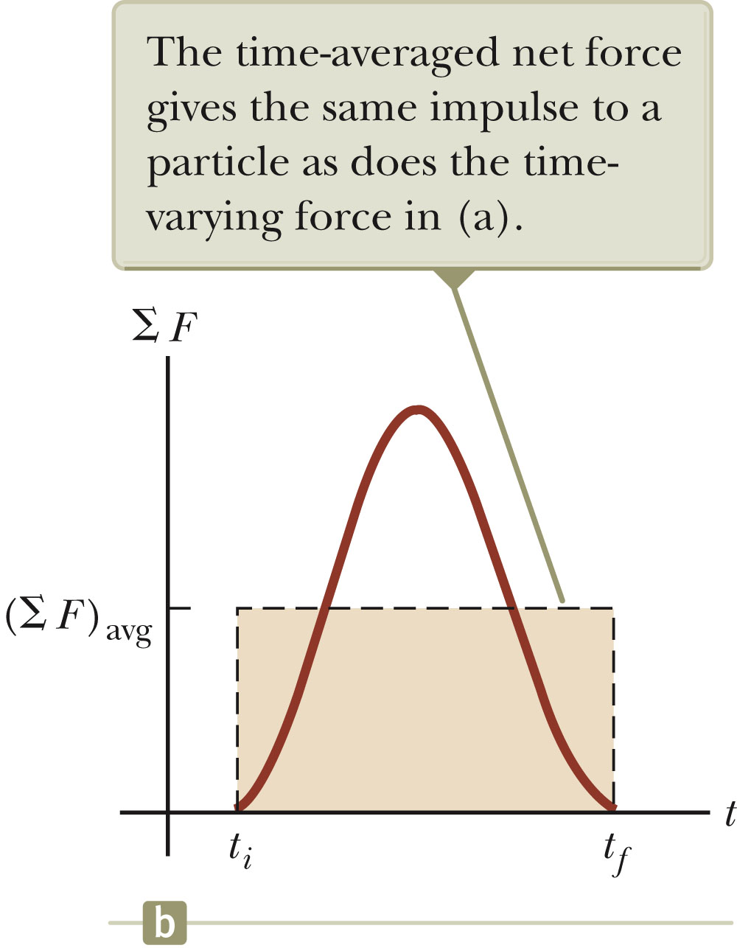
Impulse, Final
The impulse can also be found by using the time averaged force.
This would give the same impulse as the time-varying force does.

Slide 17
Impulse Approximation
In many cases, one force acting on a particle acts for a short time, but is much greater than any other force present.
When using the Impulse Approximation, we will assume this is true.
Especially useful in analyzing collisions
The force will be called the impulsive force.
The particle is assumed to move very little during the collision.
represent the momenta immediately before and after the collision.

Slide 18
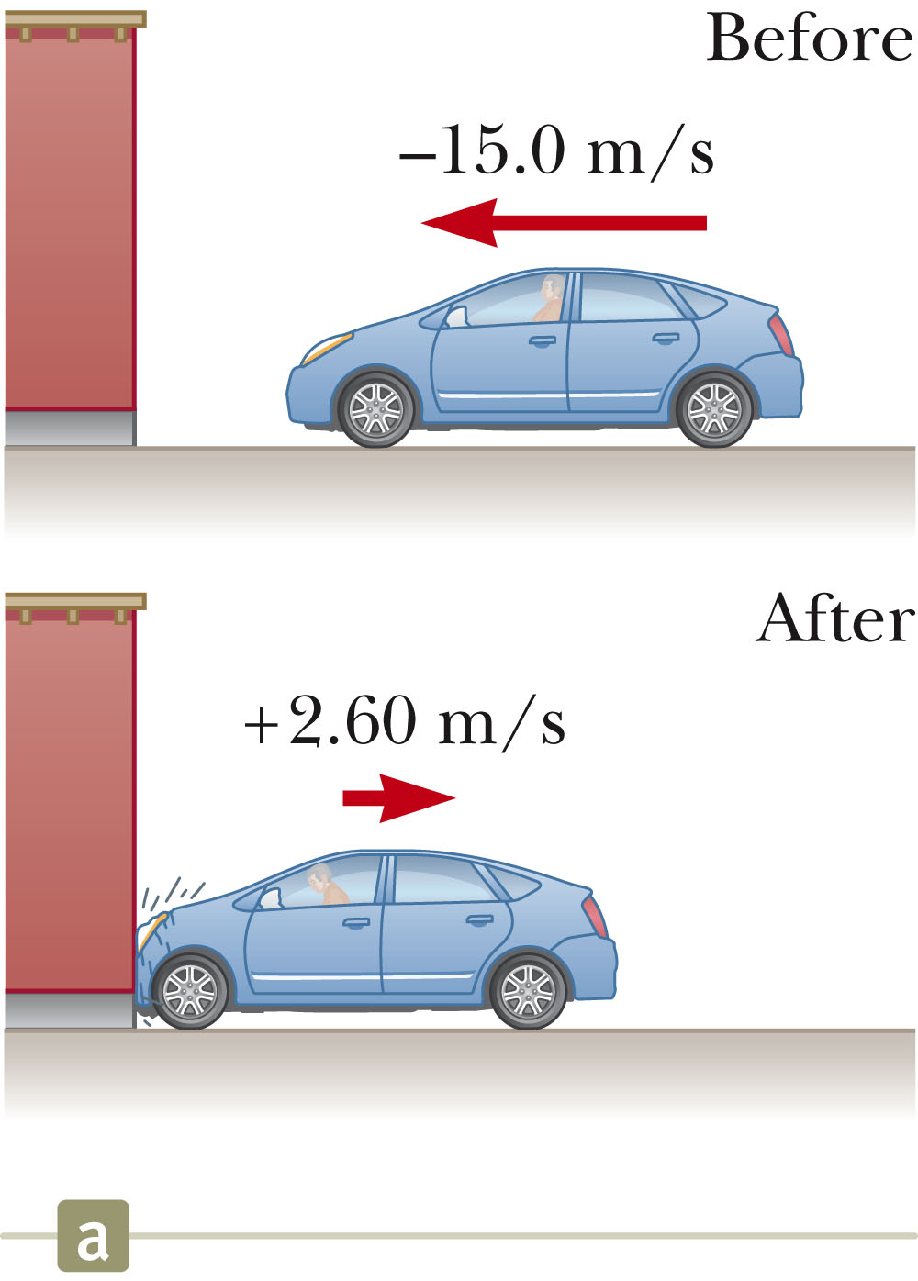
Impulse-Momentum: Crash Test Example
Conceptualize
The collision time is short.
We can image the car being brought to rest very rapidly and then moving back in the opposite direction with a reduced speed.
Categorize
Assume net force exerted on the car by wall and friction with the ground is large compared with other forces.
Gravitational and normal forces are perpendicular and so do not effect the horizontal momentum.

Slide 19
Crash Test Example, 2
Categorize, cont.
Can apply impulse approximation
The car’s change in momentum is due to an impulse from the environment.
Therefore, the non-isolated system (momentum) model can be applied.
Analyze
The momenta before and after the collision between the car and the wall can be determined .
Find
Initial momentum
Final momentum
Impulse
Average force

Slide 20
Crash Test Example, 3
Finalize
The net force is a combination of the normal force on the car from the wall and nay friction force between the tires and the ground as the front of the car crumples.
Check signs on velocities to be sure they are reasonable

Slide 21
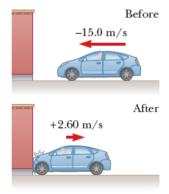
SAMPLE PROBLEM
In a particular crash test, a car of mass 1 500 kg collides with a wall. The initial and final velocities of the car are vi = -15.0 i^ m/s and vf = 2.60 i^ m/s, respectively. If the collision lasts 0.150 s, find the impulse caused by the collision and the average net force exerted on the car.

Slide 22
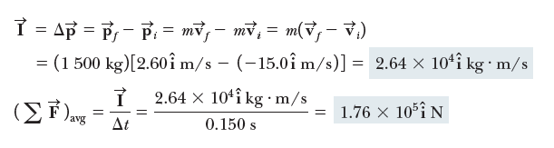
ANSWER

Slide 23
Collisions – Characteristics
The term collision represents an event during which two particles come close to each other and interact by means of forces.
May involve physical contact, but must be generalized to include cases with interaction without physical contact
The interaction forces are assumed to be much greater than any external forces present.
This means the impulse approximation can be used.

Slide 24
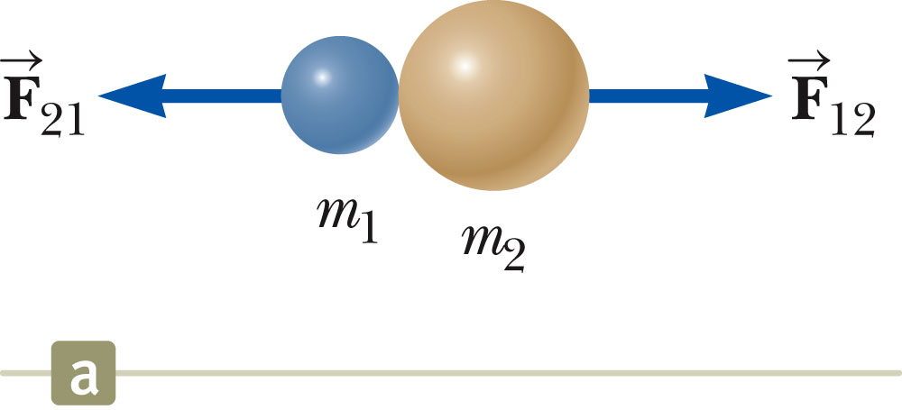
Collisions – Example 1
Collisions may be the result of direct contact.
The impulsive forces may vary in time in complicated ways.
This force is internal to the system.
Observe the variations in the active figure.
Momentum is conserved.

Slide 25
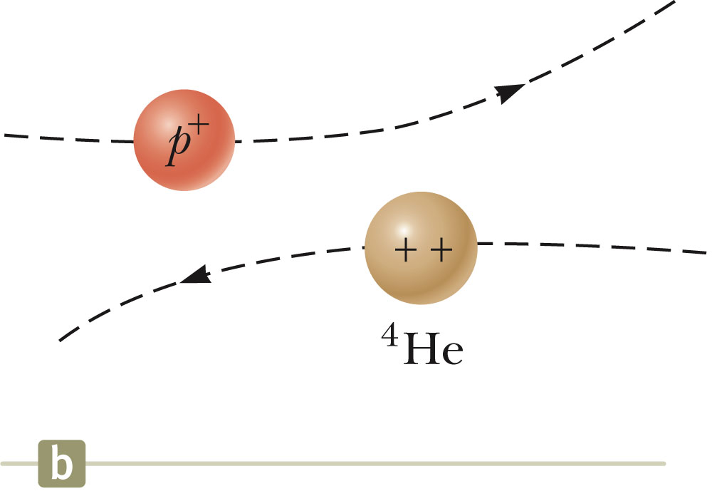
Collisions – Example 2
The collision need not include physical contact between the objects.
There are still forces between the particles.
This type of collision can be analyzed in the same way as those that include physical contact.

Slide 26
Types of Collisions
In an elastic collision, momentum and kinetic energy are conserved.
Perfectly elastic collisions occur on a microscopic level.
In macroscopic collisions, only approximately elastic collisions actually occur.
Generally some energy is lost to deformation, sound, etc.
These collisions are described by the isolated system model for both energy and momentum.
There must be no transformation of kinetic energy into other types of energy within the system.
In an inelastic collision, kinetic energy is not conserved, although momentum is still conserved.
If the objects stick together after the collision, it is a perfectly inelastic collision.

Slide 27
Collisions, cont.
In an inelastic collision, some kinetic energy is lost, but the objects do not stick together.
Elastic and perfectly inelastic collisions are limiting cases, most actual collisions fall in between these two types .
Momentum is conserved in all collisions

Slide 28
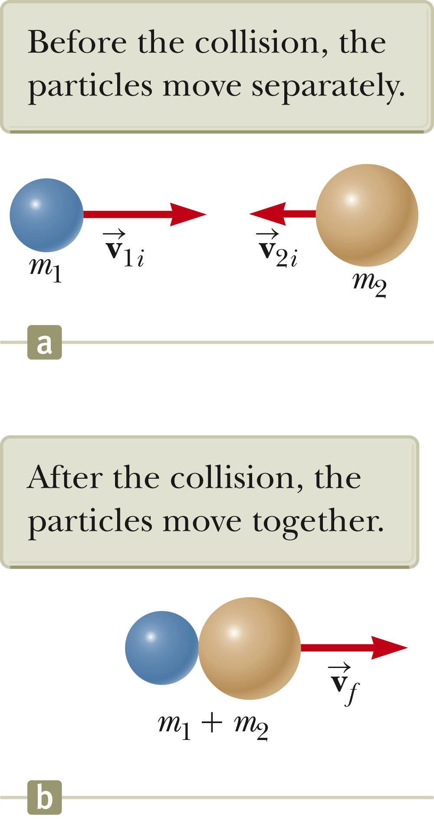
Perfectly Inelastic Collisions
Momentum of an isolated system is conserved in any collision, so the total momentum before the collision is equal to the total momentum of the composite system after the collision.
Since the objects stick together, they share the same velocity after the collision.

Slide 29
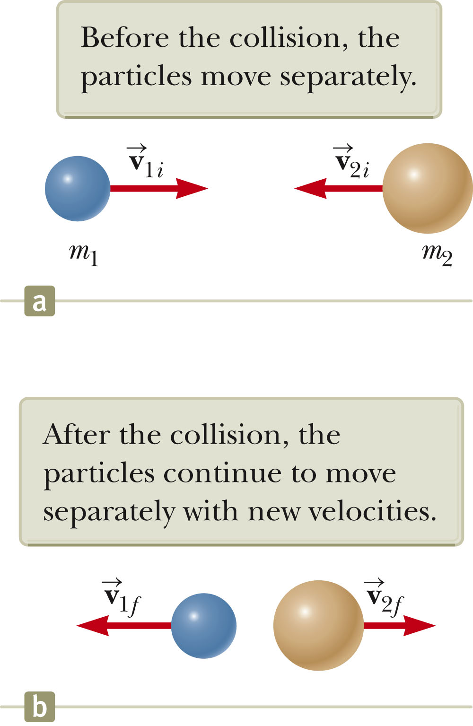
Elastic Collisions
Both momentum and kinetic energy are conserved.
Typically, there are two unknowns to solve for and so you need two equations.

Slide 30
Elastic Collisions, cont.
The kinetic energy equation can be difficult to use.
With some algebraic manipulation, a different equation can be used.
v_{1i} – v_{2i} = -(v_{1f} - v_{2f} )
This equation, along with conservation of momentum, can be used to solve for the two unknowns.
It can only be used with a one-dimensional, elastic collision between two objects.
Using this equation eliminates the need for using an equation with quadratic terms (from the kinetic energy equation).
Remember to use the appropriate signs for all velocities.

Slide 31
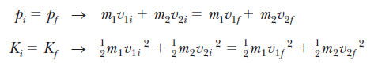





DERIVE
EQN 1
EQN 2
EQN 2
EQN 1
DIVIDE THEM

Slide 32
Elastic Collisions, final
Example of some special cases:
m₁ = m₂ – the particles exchange velocities
When a very heavy particle collides head-on with a very light one initially at rest, the heavy particle continues in motion unaltered and the light particle rebounds with a speed of about twice the initial speed of the heavy particle.
When a very light particle collides head-on with a very heavy particle initially at rest, the light particle has its velocity reversed and the heavy particle remains approximately at rest.

Slide 33
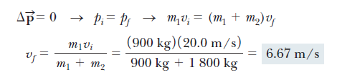
SAMPLE PROBLEM
An 1 800-kg car stopped at a traffic light is struck from the rear by a 900-kg car. The two cars become entangled, moving along the same path as that of the originally moving car. If the smaller car were moving at 20.0 m/s before the collision, what is the velocity of the entangled cars after the collision?

Slide 34
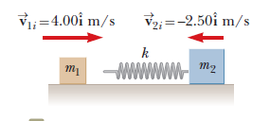
SAMPLE PROBLEM 2
A block of mass m1 = 1.60 kg initially moving to the right with a speed of 4.00 m/s on a frictionless, horizontal track collides with a light spring attached to a second block of mass m2 = 2.10 kg initially moving to the left with a speed of 2.50 m/s as shown in Figure 9.10a. The spring constant is 600 N/m.

Slide 35





LETS PLAY ON THE FORMULAS
EQN 1
EQN 2
ADD 1 & 2

Slide 36
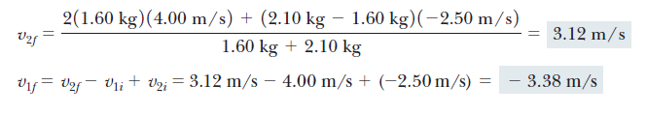
SOLVE

Slide 37
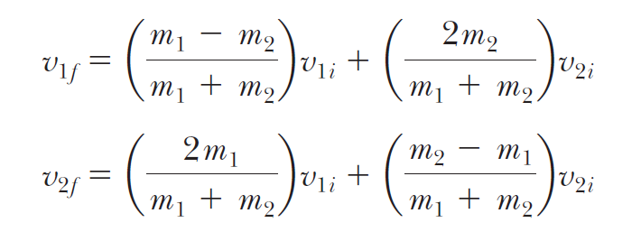
THEREFORE, FORE ELASTIC COLLISION (SIMPLIFIED FORMULAS)

