Slide 1
Smart Energy Monitoring System
Donovan Brooks
ECE 441 Senior Project
May 4, 2026
Notes:
Good [afternoon], my name is [Donovan], and today I’ll be presenting my senior design project, which is a Smart Electrical Power Monitoring System. This system is designed to measure and display key electrical parameters in real time using a microcontroller-based approach.”

Slide 2
Project Overview
Real-time monitoring of voltage, current, power, frequency, energy
Built using ESP32 and PZEM-004T
Designed for low-cost, practical applications
Notes:
“This project focuses on developing a real-time electrical monitoring system capable of measuring voltage, current, power, energy, and frequency. The system uses an ESP32 microcontroller along with a PZEM-004T energy monitoring module. The goal was to create a low-cost and practical solution for monitoring electrical loads.”

Slide 3
Problem Statement
Limited access to real-time energy monitoring
Existing systems are expensive or complex
Notes:
One of the main issues this project addresses is the lack of accessible and real-time energy monitoring, especially for small-scale systems. Many existing solutions are either too expensive or too complex for simple applications, making it difficult for users to understand their energy usage.

Slide 4


Motivation
Improve energy awareness
Low-cost solution
Notes:
The motivation behind this project is to improve energy awareness and provide a low-cost monitoring solution. Additionally, this project serves as an opportunity to apply core electrical and embedded systems concepts learned throughout the degree.

Slide 5

Project Objectives
Measure electrical parameters
Ensure safety
Provide real-time output
Notes:
The main objectives were to accurately measure AC electrical parameters, safely interface with high-voltage systems, provide real-time output, and build a reliable working prototype that demonstrates these capabilities

Slide 6

Hardware Components
ESP32
PZEM-004T
CT Clamp
Lamp/load
Notes:
The hardware used includes the ESP32 microcontroller, the PZEM-004T-100A module, a current transformer clamp, and a lamp used as the test load.

Slide 7
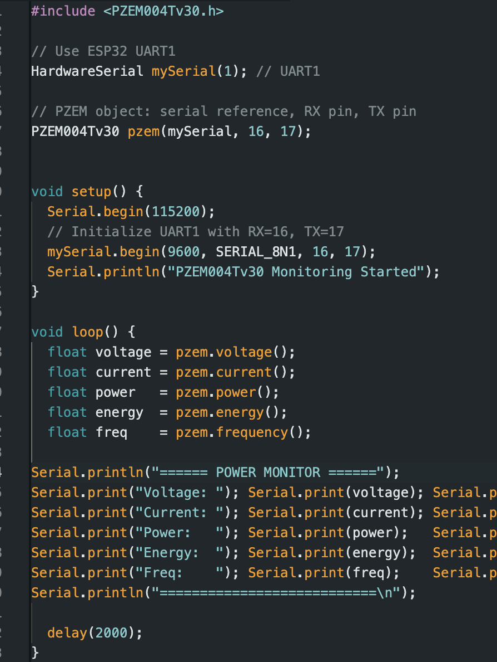
Software Components
Arduino IDE
PZEM library
UART communication
Notes:
The software side includes the Arduino IDE for development, the PZEM library for communication, and UART protocol for data transfer between the ESP32 and the PZEM module.

Slide 8
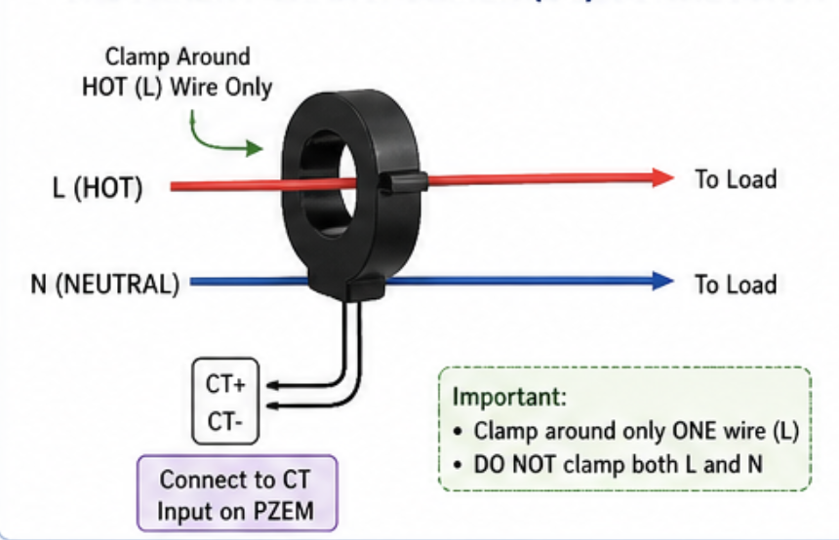
Current Transformer
Measures current via magnetic field
Non-invasive

Slide 9
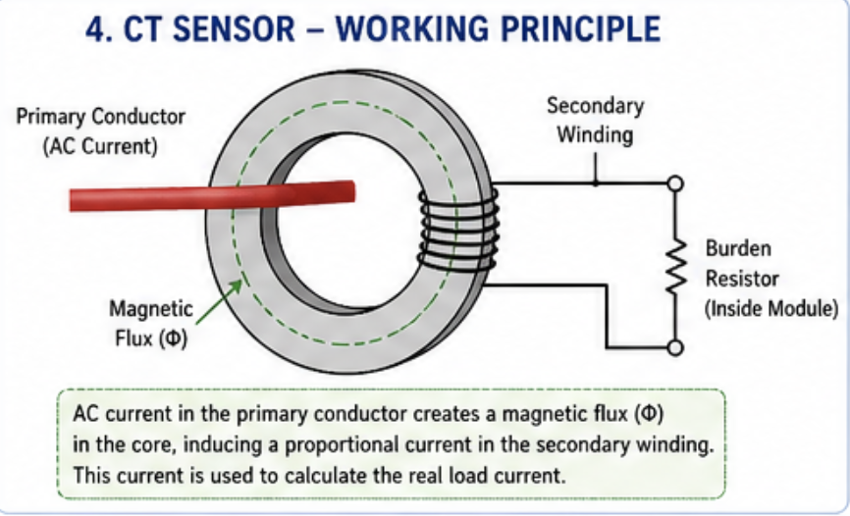
Current Transformer (CT) Principle
Works using electromagnetic induction
Current → magnetic field → induced current
Key concept:
Non-contact measurement
Why only one wire:
Opposite currents cancel magnetic field
Notes:
The current transformer works using electromagnetic induction. When current flows through a conductor, it generates a magnetic field. The CT senses this field and produces a proportional current. This allows for non-invasive current measurement.

Slide 10
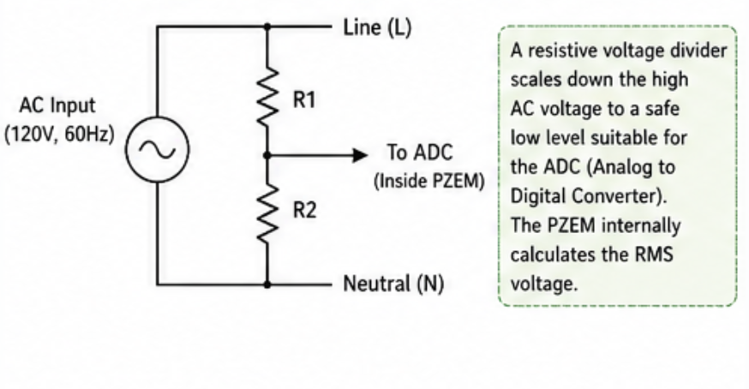
AC Voltage Measurement
Uses voltage divider inside PZEM
Measures RMS voltage:
Effective AC value
Important for:
Real-world power calculations
Notes:
The PZEM module measures voltage using an internal voltage divider that scales down the AC voltage to a safe level. It then calculates the RMS voltage, which represents the effective value of the AC signal

Slide 11
Power Calculation
Real power equation:
P = V × I × PF
For resistive loads:
PF ≈ 1
P ≈ V × I
Notes:
The power equation is P equals V times I times the power factor. For resistive loads like a lamp, the power factor is approximately one, so power simplifies to voltage times current.

Slide 12
Embedded Systems
ESP32 reads sensor data
Processes and formats output in Real-time
Communicates via UART interface
Notes:
The ESP32 acts as the central processor. It reads measurement data from the PZEM, processes it, and formats it for output. This is done in real time, making the system responsive to changes.

Slide 13
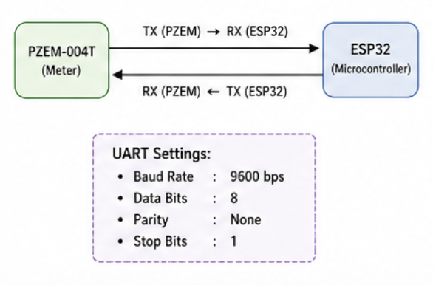
UART Communication
Serial communication protocol
TX ↔ RX data exchange
Parameters:
9600 baud
8 data bits
No parity
Notes:
Communication between the ESP32 and PZEM uses UART. Data is transmitted through TX and RX lines at 9600 baud, with standard settings of 8 data bits, no parity, and one stop bit.

Slide 14
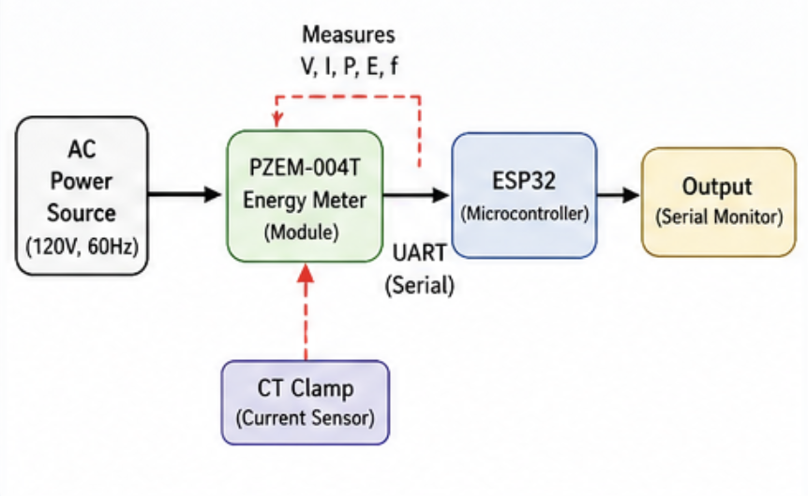
System Architecture
Input: AC source
Measurement: PZEM
Processing: ESP32
Output: Serial
Notes:
The system consists of four main parts. First, the AC power source provides the input. Second, the PZEM module performs measurement. Third, the ESP32 processes the data. Finally, the results are displayed through the serial monitor. This diagram shows the system flow. AC power enters the PZEM module, which measures electrical parameters. The current transformer provides current data. The ESP32 communicates with the PZEM via UART and outputs the results

Slide 15
Challenges Encountered
Incorrect wiring:
Voltage = NaN
CT misplacement:
No current readings
Hardware failure:
Damaged module
Notes:
Several challenges were encountered, including incorrect wiring that resulted in invalid readings, improper CT placement that caused zero current readings, and hardware damage during testing.

Slide 16
Solutions
Fix wiring configuration
Proper CT placement
Replace damaged board
Verify correct setup
Notes:
These issues were resolved by correcting the wiring configuration, ensuring proper CT placement around the hot wire, and replacing the damaged module. Careful testing was used to verify each fix.

Slide 17
Results
Voltage $≈$120V
Voltage ≈120V
Current $≈$0.2A
Current ≈ 0.2A
Power $≈$25W
Power ≈ 25W
Freq $≈$60Hz
Freq ≈ 60Hz
Notes:
The system produced consistent results, with voltage around 123 volts, current around 0.2 amps, power around 25 watts, and frequency near 60 hertz.

Slide 18
Validation
25W light bulb was used
Verified:
P ≈ VI
Observations:
Stable readings
Responsive to load
Notes:
These results were validated using the power equation. The measured power closely matched the product of voltage and current, confirming the accuracy of the system with a 4 percent difference

Slide 19
Overall Experience
Key Takeaways
Gained hands-on experience with AC power systems
Safe handling of high-voltage circuits
Applied core electrical engineering principles
Ohm’s Law, power calculations, signal measurement
Technical Skills Developed
Embedded systems integration (ESP32 + sensors)
UART communication
Hardware troubleshooting and circuit validation
Challenges & Growth
Learned from wiring mistakes and hardware failure
Improved problem-solving and debugging approach
Developed better understanding of real-world systems
Project Impact
Strengthened confidence in building complete systems
Bridged theory and practical implementation
Notes:
This project provided valuable hands-on experience working with both hardware and software. I was able to apply core electrical engineering principles in a real-world setting, especially when working with AC power and measurement systems. Throughout the project, I developed skills in embedded systems, communication protocols, and troubleshooting. I also faced challenges such as wiring errors and hardware failure, which helped me improve my problem-solving approach. Overall, this project helped bridge the gap between theory and practical implementation.

Slide 20
Conclusion
Functional system achieved
Objectives met
Engineering principles applied
Notes:
In conclusion, the project successfully demonstrates a working electrical monitoring system that applies key engineering principles and meets all initial objectives.

Slide 21
Future Work
Add display (LCD/OLED)
Data logging
Mobile or web interface
Apply on extension cord
Notes:
Future improvements could include adding a display, implementing data logging, developing a mobile interface, and expanding the system to monitor multiple loads.

