Slide 1

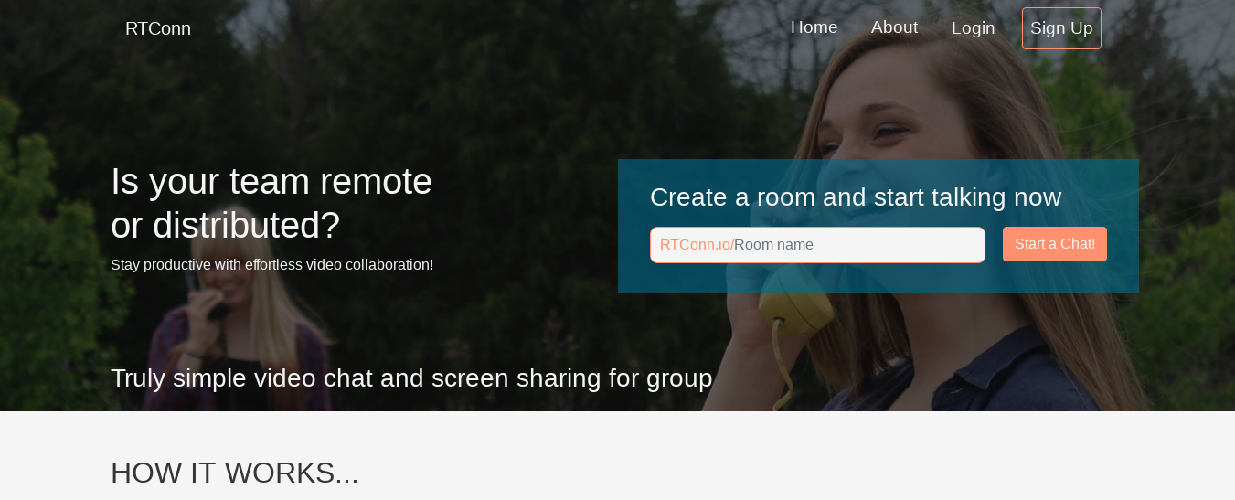
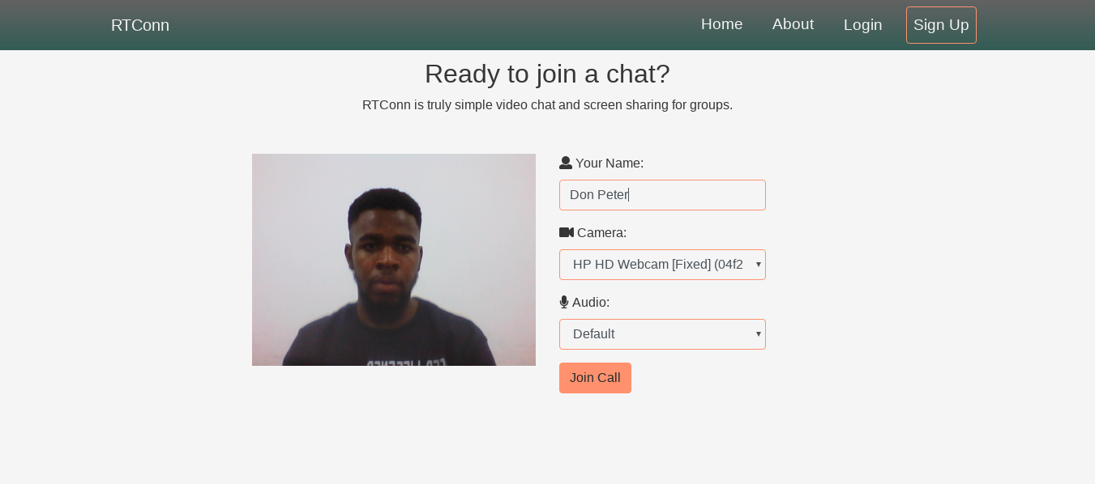


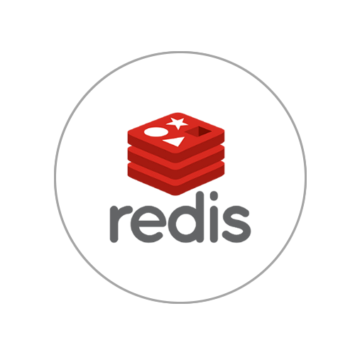


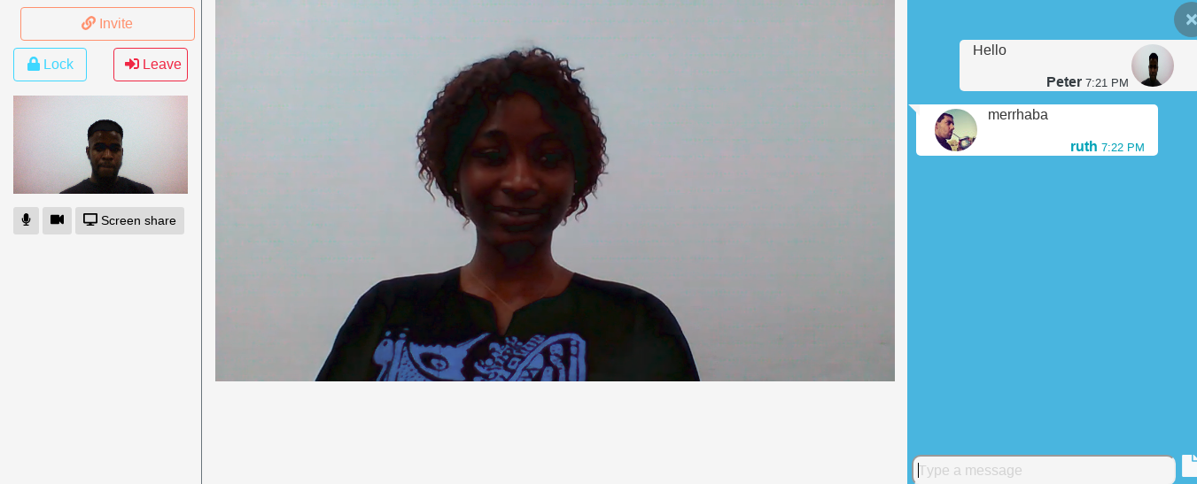
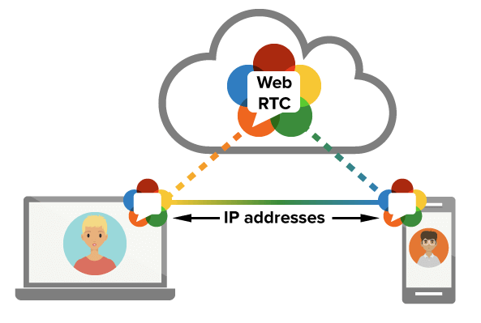
REAL TIME SECURED COMMUNICATION SYSTEM USING WEBRTC Peter Chidubem Atunalu Asst. Prof. Dr. Zafer Erenel European University of Lefke, Engineering Faculty, Lefke, T.R.N.C
Introduction
Results
Conclusions
RTConn is a secured real time communication system that connects multiple users across the globe using native web API (WebRTC). RTConn allow users connect with each other through video, text, files and screen sharing in real time.
In just three steps you can connect with anyone anywhere in the world. In a very secure network where no one can ever eye drop on your conversation.
Connect and Chat with any one in just 3 step
Humanize Your Conversation
Take this point in contrast with voice communication or email correspondence. Video is moving pictures, which are worth more than a million words.
Improve Mobile Experience
RTConn technologies create a more compelling user experience on mobile devices.
Learn and Teach Online
If you are a teacher or trainer, your market may be lying far from where you are. This app is a great way of acquiring and sharing knowledge beyond hurdles. While it will not be like being physically present, the interaction is adequate.
Secure Connection
It is a secure, consent-based, audio/video (and data) peer-to-peer communication API between HTML5 browsers. WebRTC is an evolution in web applications world
Create a Room….
Methods & Materials
Invite your Friend…
References
Real-Time Communication with WebRTC, Salvatore Loreto and Simon Pietro Romano
Peer-to-peer communication in web browsers using WebRTC, 2015
Chat knowing no one can ever be Listening to your Conversation
Acknowledgements
I would like to thank all those who made this possible. To all my colleges in school, my family and friends. I want to specially thank my project supervisor Asst. Prof. Dr. Zefer Ernel, Asst, and to my professors, Asst.Prof. Dr. Ferhun Yorgancıoğlu, Asst. Prof. Dr. Cem Kalyoncu and also my course advisor Asst. Prof. Dr. Vesile Evrim.

