Slide 1
Book Identification From Bookshelf Images
Pavel Rubinson
ICBV151

Slide 2
Motivation
Amazon has book reviews and rankings – useful information for potential buyers.
Brick and mortar stores have nothing.
Possible solution: Identifying book titles from an image of a bookshelf using machine vision, then extracting the relevant information from the internet. (Think augmented reality).

Slide 3
Goals
Main goal: given a photo of a book shelf, correctly identify and recognize the words on each book spine (title + author).
Display Amazon’s ranking for each book using Amazon’s API.

Slide 4
Pipeline
Spine Seperation
Text Segmentation
Layout Analysis
Character Recognition

Slide 5
Spine Separation
Canny edge detection
Hough transform:
Look for approximately vertical lines (-20⁰ to 20⁰)
Merge nearby lines.
Crop individual spines and warp to fit a rectangle.

Slide 6
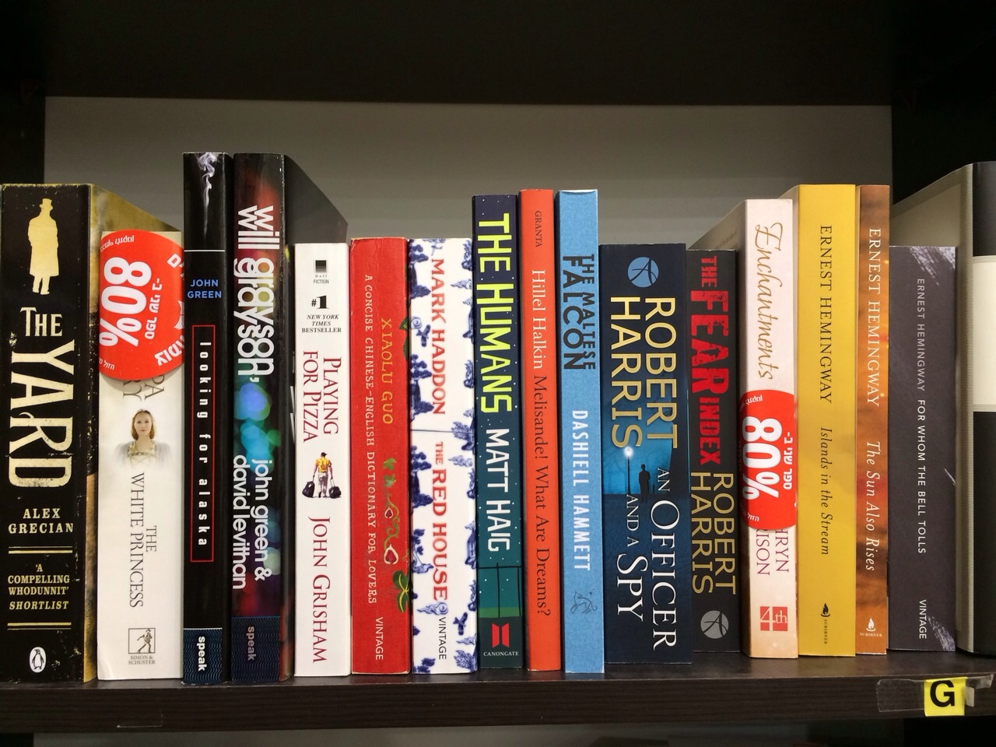
Spine Separation - Results

Slide 7
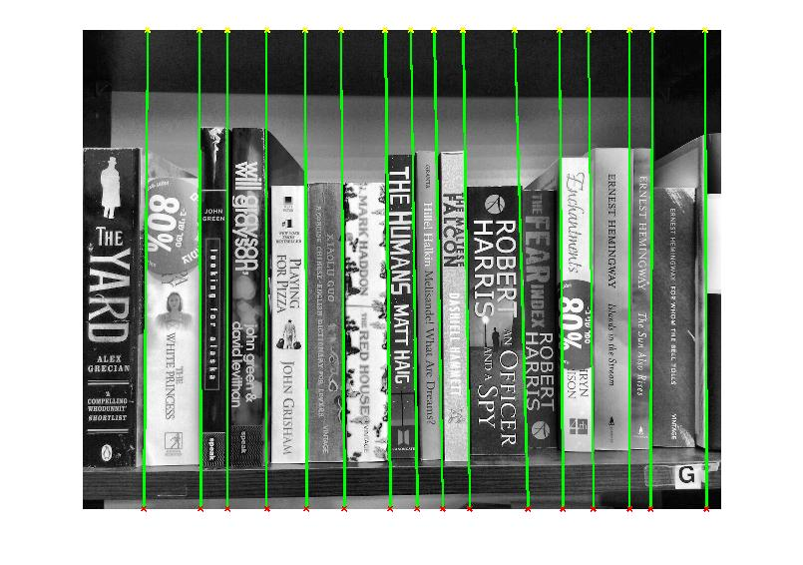
Spine Separation - Results

Slide 8
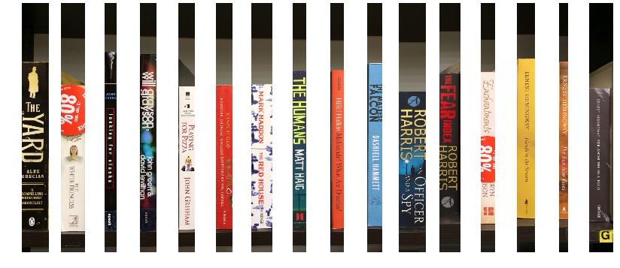
Spine Separation - Results

Slide 9
Text Segmentation
Challenges:
Variability in colors across both foreground and background.
Non-text graphics.

Slide 10
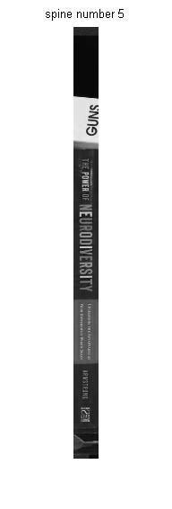
Text Segmentation - Methodology
Move a narrow window along the spine.
In each location, threshold the window using Otsu’s method.
Based on the result – flip colors if necessary (we expect the text to be surrounded by background pixels).
Find CCs and filter further based on region properties.

Slide 11
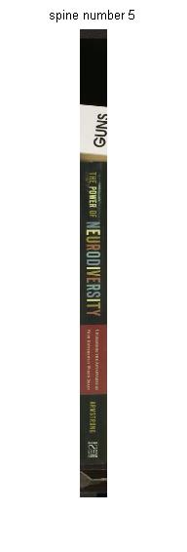
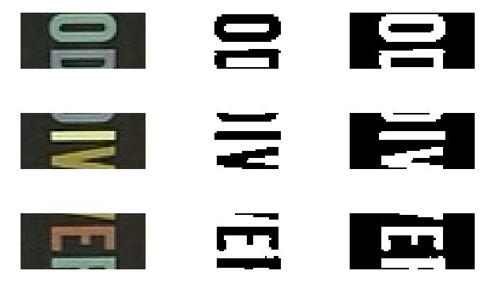
Text Segmentation - Results
Before Thresholding
After
Thresholding
Color flipping

Slide 12
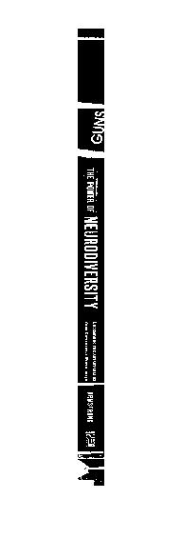
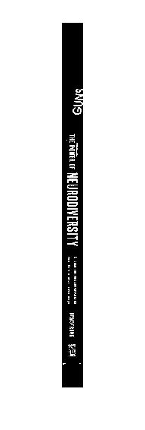
Text Segmentation - Results

Slide 13
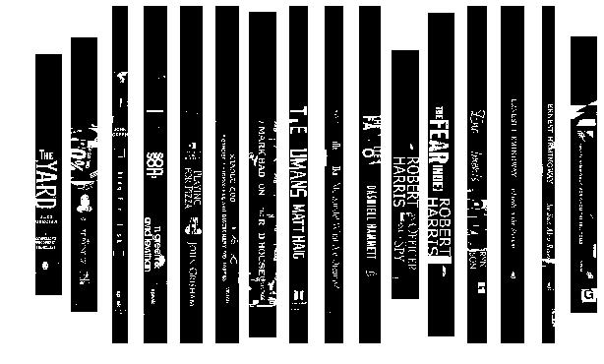
Text Segmentation - Results

Slide 14
Layout Analysis
Goal: Group individual characters into words
Challenges
A single spine can have two different text orientation within it.
Different font sizes and typefaces – character and word properties differ between different text blocks.
No uniform structure (no fixed line spacing, etc’)
Can be “solved” by assuming books have only a single line of text – as do most books. But still for many books this isn’t true.

Slide 15
Layout Analysis - Algorithm
Construct a cycle among the connected components such that the child of A is the nearest non-ancestor of A.
Cut the path in locations with a high difference between parent and child distances (word border candidates).
Merge regions based on end-point distance and intra-region properties (mean distance). Currently unimplemented.
Vertical/horizontal orientation for each word can then be derived from its width/height ratio. We assume top-to-bottom orientation (though this can be inferred from OCR)

Slide 16

Layout Analysis - Algorithm
Spine example – which white blobs belong to the same word?

Slide 17
Layout Analysis - Algorithm
Create a cycle of connected components.
Go to the next nearest component which hasn’t been visited yet.
Hello
World

Slide 18
Layout Analysis - Algorithm
Let (a,b,c) be some path of length 3 on the cycle.
If dist(a,b)>>dist(b,c) (or dist(b,c)>>dist(a,b)) – delete (a,b) (or (bc))
There are some edge cases where this won’t delete everything we want, but those cases are rare.
Hello
World

Slide 19
Layout Analysis - Algorithm
Delete edges.
Hello
World

Slide 20
Layout Analysis - Algorithm
Resulting groups.
Hello
World

Slide 21
Layout Analysis - Algorithm
Merge groups according to distance and group statistics.
Currently not implemented.
Hello
World

Slide 22
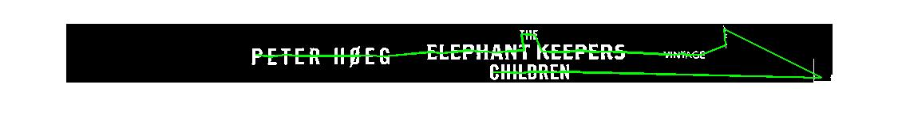


Layout Analysis – Partial Results

Slide 23
Character Recognition
Fonts vary and the images are taken under natural light conditions, so simple template matching isn’t likely to work (well).
We train a KNN (or possibly SVM) classifier using Chars74k dataset from Microsoft Research: 62 classes, 1016 images per class = 62992 images. [Image]
HOG (Histogram of Oriented Gradients) descriptors as features vector.
Currently not working because my laptop runs out of memory during training.

Slide 24
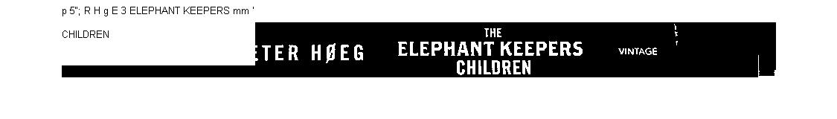
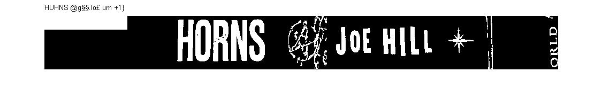
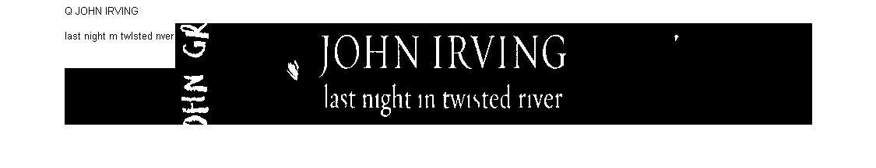
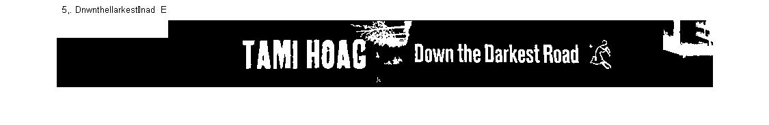
Some results using Matlab’s OCR

Slide 25
Future work
Word grouping.
Classifier.
More work on noise and artefact removal.
Over segmented and uder segmented characters.
Relaxation of assumptions - additional book angles, more complicated covers (requires a different approach to segmentation).

Slide 26
Questions?

