Slide 1

Java Web Development
Stanislav Stanev
ehub
One place for latest Rss news

Slide 2
About me ...
Education:
Telecommunication Technologies – Master degree, Technical University Varna
Accounting and Audit – Master degree,
Software University
Professional way:
Btc, Btc_vivatel, VIVACOM – Account manager, Area Manager, Trainer in Vivacom Academy
Nemetschek Bulagria – ERP Consultant
Gensoft – Web developer – till now;
All my portfolio is published at : http://donstany.github.io/

Slide 3
Goals
Dynamically place for dynamic world!
About Idea for creating application:
+ One place ”one roof” to put latest information;
+ Auto update periodically, no ads, no commercial;
+ Oriented for users with same interesting. (Education, Free time, etc.);
- Not chat, no messenger, not facebook...

Slide 4
Customer Wishes
Good place to accumulate dynamic information which
is helpful for group of people
Don't need to read what to do to use application;
“Good” user experience, user journey, enjoy to work with application,
nice to “touch” and etc.
“Good” to work in different devices (desktop, tablet, Tvs, mobiles, etc.);
Very important to work all features;
Ready to run on server with different database;
There is no sensitive data but will be good to good external security.
Right from admin to “ban”/remove users. Admin can remove all users and blogs, user can remove only own blogs but not to other users internal security.

Slide 5
Development essentials 1 of 2
Presentation layer
responsive design – Twitter Bootstrap, support auto response design;
easy to add new styling – use Apache Tiles for layout engine;
Validation
dynamic validation /as type check is there existing user/– login form validation JQuery, AJAX;
front end validation for all input fields - JQuery plug-in validator;
back end validation for all methods - Hibernate Validator;
Custom created annotation for valid is new entere user is unique

Slide 6
Development essentials 2 of 2
Security
Internal - from registered user. User can remove only our blogs;
Dinamic show button of navigation for different user and different stage of app;
External - prevent cross site forgery – html and Javascipt injection;
Unit test
Used Junit framework
Others
Comments almost at all key moments,setting of project will adjust from TweakAppConst

Slide 7
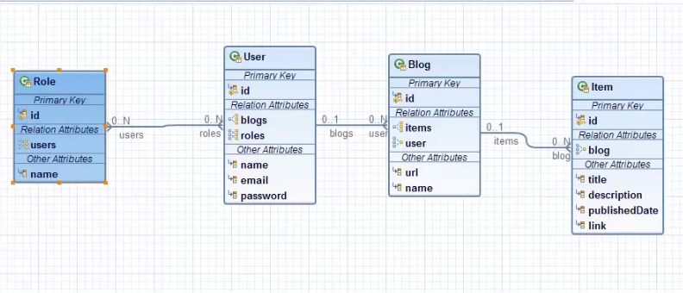
E/R Diagram
Eclipse diagram editor

Slide 8
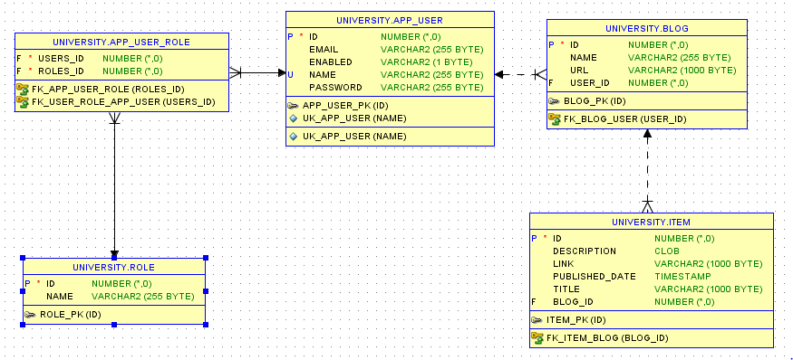
E/R Diagram
Oracle developer diagram

Slide 9
Architecture
Common | RssServiceTest, UniqueUsernameValidator, TweakAppConst, RssException, bg.stanev.ehub.rss and rss.xsd
MVC | AdminController, IndexController, LoginController, RegisterController, UserController,
Services | BlogService, ItemService, RssService, UserService, InitDbService
DAO/Repository | BlogRepository, ItemRepository, RoleRepository, UserRepository
Entities | Blog, Item, Role, User

Slide 10
Questions
        ?
Project is deployed at:
http://ehubjava.herokuapp.com/
        </end>

