Slide 1
Item Tracker
Donald Taylor Jacob Manser Mohammad Aljagthmi Ryan Ly

Slide 2
Agenda
Introduction
Description
Requirements
Constraints
Standards
Hardware Components
Software Components
Shopping List

Slide 3
Agenda
How it Works
Timeline
Test Plan
Safety Risks
Security Risks
Summary
Questions

Slide 4
Introduction

Slide 5
Description
It is a small electronic device that attaches to most household objects for easy and up-to-date location tracking within the building

Slide 6
requirements

Slide 7
constraints

Slide 8
Standards

Slide 9
Hardware components
Adafruit HUZZAH ESP8266 breakout
Standard 22 gauge wires
3V button cell batteries
Electrical tape
Duct tape
Hook-and-loop fasteners (Velcro©)
Breadboard (used for prototyping before soldering)
Soldering station (used to finalize the hardwiring)

Slide 10
Software components
Android Studio
SDK Tools
Firebase
WorkManager
Arduino 1.8.7

Slide 11
Shopping List
150 ft 22 Gauge Wire $16.95
Elegoo Brand Solderless Breadboards (3 pcs) $9.99
Weller 40-Watt Soldering Station $38.37
20 CR2032 3V Button Cell Batteries $6.80
Duck Brand 60 ft Electrical Tape (2 rolls) $5.62
Duck Brand All-Purpose Duct Tape 45 Yard (1 roll) $9.31
Velcro Brand Sticky Back Hook-and-Loop Fasteners 30 ft $26.91
Adafruit HUZZAH ESP8266 breakout (8 count) $79.60
FTDI USB Cable (2 count) $35.90
Glad Cling Wrap (1 roll) 200 sq ft $2.65
Total Cost $232.10

Slide 12

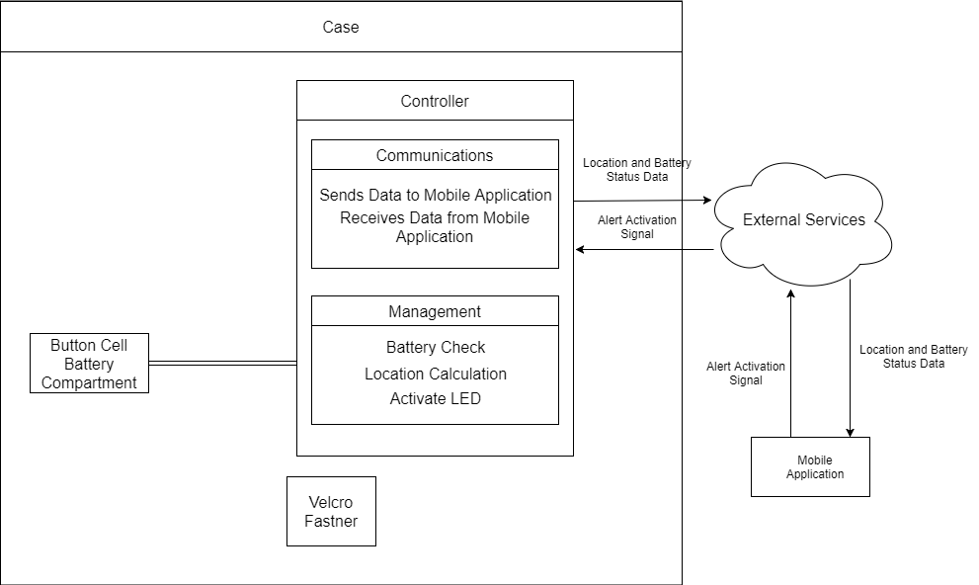
how it works

Slide 13

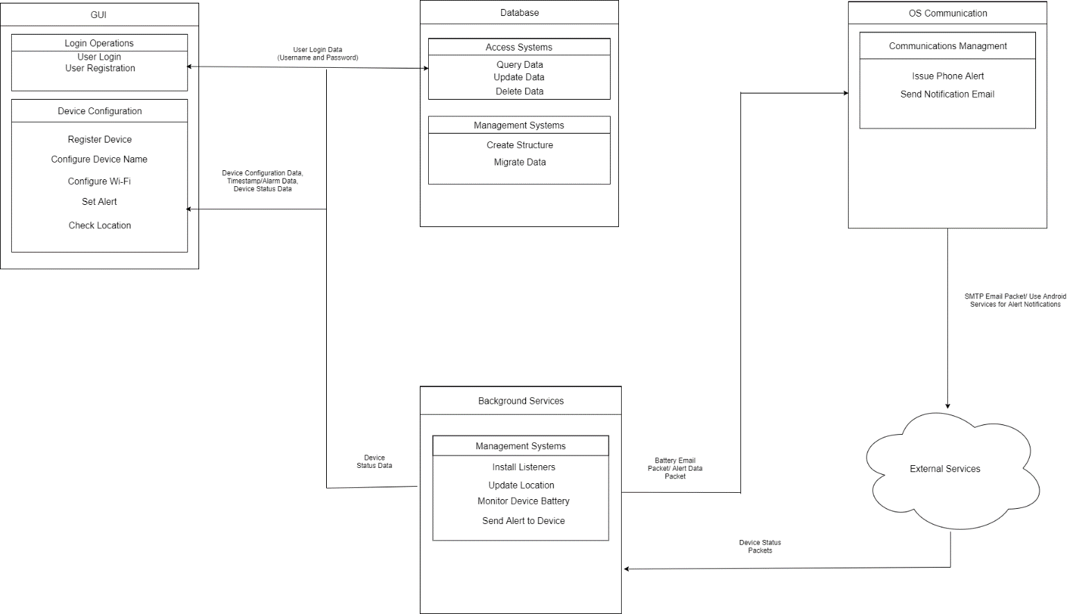
How it works

Slide 14
Safety Risks
Every component is commercial and thus has been tested and approved by the IEC 61508 electronics safety standard
The final product will be tested by UL60335 safety standard for household appliances.

Slide 15
Security Risks

