Slide 1
Item Tracker
Donald Taylor Jacob Manser Mohammad Aljagthmi Ryan Ly

Slide 2
Agenda
Introduction
Description
Requirements
Constraints
Standards
Timeline
Milestones
Schedule Risks

Slide 3
Agenda
Hardware Tradeoffs
Hardware Components
Shopping List
How it Works – Hardware
Safety Risks
Security Risks

Slide 4
Agenda
Software Tradeoffs
Software Components
How it Works – Software
GUI Mock-up
Test Plan
Summary
Questions

Slide 5





InTroduction
Competition is fierce in the home user market

Slide 6
Introduction
What about other markets?
What other kind of problems can we solve?
What can we do to create a need?

Slide 7
Introduction
“Medical mistakes are now the third leading cause of death in the United States. A recent Johns Hopkins study claims that more than 250,000 to as many as 440,000 people die from medial errors. Medical error is one that is caused by inadequately skilled staff, error in judgement or care, a system defect or a preventable adverse effect. This includes computer breakdowns, mix-ups with the dose or types of medications administered and further complications.”
R. Sipherd, "The third-leading cause of death in America most doctors don't want you to know about", CNBC, 2018. [Online]. Available: https://www.cnbc.com/2018/02/22/medical-errors-third-leading-cause-of-death-in-america.html. [Accessed: 18- Nov- 2018].

Slide 8
Introduction
The NHE, or National Healthcare Expenditure, was 17.9% of the GDP, or Gross Domestic Product, in 2016 with an expected growth percentage of 5.5% per year for the next 10 years. The GDP was listed as $18,707,200M, making the NHE $3,348,589M.

Slide 9
Introduction
Medical errors cost the industry $20,800 million dollars annually. Adding to this the additional quality adjusted life years of those who are lost due to these errors at $75,000 - $100,000, with 10 years lost life, the QALYs for these deaths makes up an additional $187,500M - $250,000M.

Slide 10
Description
The solution we as a group come up with is to create a tracker connected to an application that will be the user access way to the tracker.
The Tracker that can keep track of the location of objects.
The Tracker can be attached and removed from objects manually and without extra tools.
Tracker connects and syncs with application using Wi-Fi to interface with the user.

Slide 11
Requirements
Req No. | Obj No. | Requirement
1.0 | 1 | Device shall comply with IEEE 802.11 communication standard
2.0 | 1 | Device shall use an open source positioning system over Wi-Fi
3.0 | 1 | Device shall communicate with a mobile application
4.0 | 2 | Device shall adhere to surfaces that meet SPI standards A-3, B-1, B-2, B-3, C-1, C-2, C-3 for molded plastic with Velcro© pads
5.0 | 4 | Device shall contain an attached LED light that conforms to ANSI C82.16-2015 standard
6.0 | 1 | Device shall include a mobile application
7.0 | 3 | Mobile application shall be usable on a mobile device running Android 4.4 or newer
8.0 | 3 | Mobile application shall email the user provided email address when battery voltage drops below 80% of factory listed voltage
9.0 | 3 | Mobile application shall allow the user to configure a visual alarm for an input date and time
10.0 | 3 | Mobile application shall allow the user to configure an audible tone of at least 60dB for an input date and time
11.0 | 3 | Mobile application shall allow the user to configure the LED light to turn on for an input date and time
12.0 | 3 | Mobile application shall allow the user to see location information for the device
13.0 | 3 | Mobile application shall allow the user to define a custom name for the device
14.0 | 3 | Mobile application shall store user defined email
15.0 | 3 | Mobile application shall store user defined wi-fi network credentials
16.0 | 5 | Device shall provide the user access to the battery through a folding panel
17.0 | 5 | Device shall accept a replacement battery of the same form factor
18.0 | 6 | Device shall function in temperatures above 32­­­­⁰F
19.0 | 6 | Device shall function in temperatures not exceeding 150⁰F
20.0 | 6 | Device shall function if exposed to 8 fl oz of water
21.0 | 6 | Device shall function following a 3 ft exposure to unaccelerated gravity
IEEE – Institute of Electrical and Electronics Engineers
SPI – Society of the Plastics Industry
ANSI – American National Standards Institute

Slide 12
Constraints
Const No. | Constraints
10 | Device height shall not exceed 45 cm
20 | Device depth shall not exceed 45 cm
30 | Device width shall not exceed 60 cm
40 | Device weight shall not exceed 20 kg
50 | Device power supply shall not exceed 10 Ah
60 | Device shall comply with UL60335
70 | Device shall comply with one or more of the standards under IEEE 802.11
80 | Mobile application shall be compatible with Android 4.4 or newer
90 | Mobile application audible tone shall not exceed 80dB
100 | Device LED shall not exceed 60 lumens in brightness
110 | Device LED shall have a minimum brightness of 15 lumens
120 | Mobile application shall comply with ISO/IEC 29179:2012 standard
130 | Mobile application shall comply with ISO 9241 standard
140 | Mobile application shall comply with ISO 25062 standard
150 | Device user input stored data shall be encrypted by a means which complies with FIPS 180-4 standard for secure hash algorithms
160 | Device wiring shall comply with ANSI/NEMA WD 6-2016
170 | Device Wi-Fi antenna shall be FCC certified
180 | Device data transmission shall meet RFC 1042 standard for IP datagrams
UL – Underwriters Laboratories
IEEE – Institute of Electrical and Electronics Engineers
LED – Light emitting diode
ISO – International Organization for Standardization
IEC – International Electrotechnical Commission.
ANSI – American National Standards Institute
NEMA – National Electrical Manufacturing Association.
FIPS – Federal Information Processing Standard.
RFC – Request For Comments.

Slide 13
Standards
Definitions:
IEEE – Institute of Electrical and Electronics Engineers.
SPI – Society of the Plastics Industry.
ANSI – American National Standards Institute.
ISO – International Organization for Standardization.
IEC – International Electrotechnical Commission.
NEMA – National Electrical Manufacturing Association.
FIPS – Federal Information Processing Standard.
RFC – Request For Comments.
UL – Underwriters Laboratories.
Stand. No. | Standard
10 | The wireless fidelity connectivity (Wi-Fi) connection shall conform to IEEE 802.11 standard.
20 | The molded plastic surface textures represented will adhere to SPI standards A-3, B-1, B-2, B-3, C-1, C-2, and C-3.
30 | The LED used will comply to LED production standard ANSI C82.16-2015.
40 | The tracker’s will conform to the home appliance safety standard UL 60335.
50 | The mobile application will conform to ISO/IEC 29179:2012 standard for user interface design.
60 | The mobile application’s hardware and software will interact in a system that will comply with ISO 9241 standard.
70 | The mobile application’s usability will be tested with ISO 25062 standard.
80 | The user’s inputted stored data will use encryption standard FIPS 180-4.
90 | The tracker device’s wiring will conform to ANSI/NEMA WD 6-2016 standard.
100 | The device’s data transmission for IP datagrams will comply with RFC 1042 standard.

Slide 14
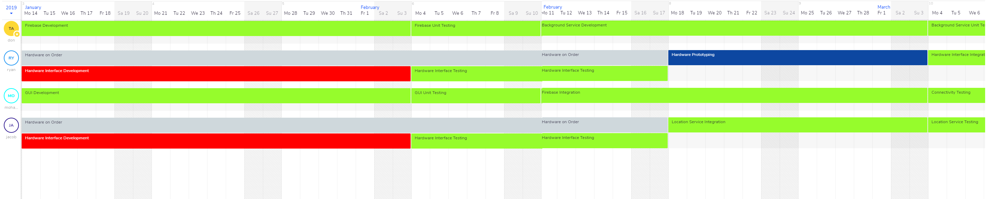
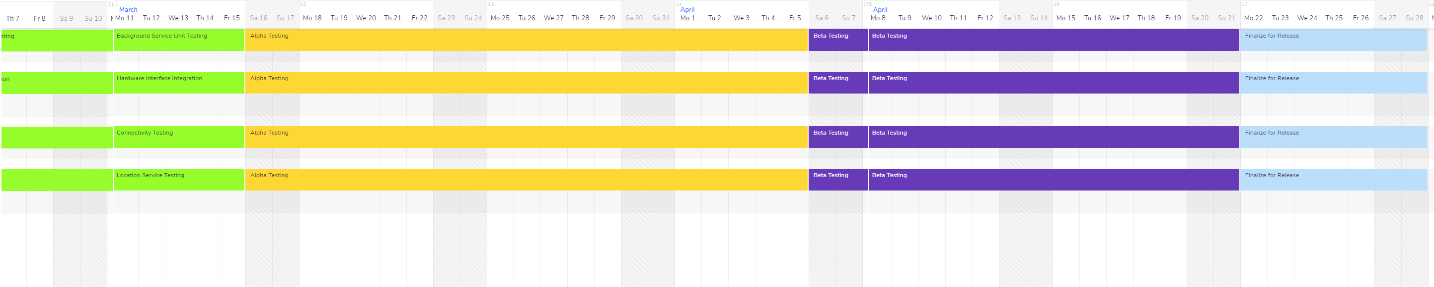
Timeline

Slide 15
Milestones
- Week 1 – Week 4:
- Review the document and check the parts.
- Development of database.
- GUI development.
- Hardware Interface development.
- Firebase, GUI unit, and Hardware Interface testing.
- Week 5 – Week 8
- Hardware prototyping.
- Background services development.
- Hardware interface integration (cont.)
- Firebase Integration.
- Location Service Integration.
- Background Service Unit testing.
- Hardware Integration testing.
- Connectivity testing.
- Location service testing.

Slide 16
Milestones
Week 9 – week 12
Week 13 – Week 16
- Background service Unit testing (cont.)
Hardware Integration Testing (done in Week 9)
Connectivity Testing (Done in week 9)
Location Service Testing.
Alpha testing.
- Beta testing.
- Finalize for release.

Slide 17
Schedule Risks
Development
Creation of the mobile application might take longer than anticipated
Equipment shipment may be delayed to factors outside our control
Utilizing WPS may take time to fully understand
Creation of the physical Item Tracker may take a while

Slide 18
Hardware Tradeoffs
Microcontroller choices
Raspberry Pi Zero W
Arduino MKR Wi-Fi 1010
Adafruit Feather M0 Wi-Fi – ATSAMD21 + ATWINC1500
Adafruit HUZZAH ESP8266 breakout
Power source choices
4 AAA batteries in series
3.7V 1100 mAh LiPo battery pack
Solar cell panels
2 3V button cell batteries in series
Encasement method
Tupperware
Plastic cling wrap
Aluminum foil
Attachment method choices
Rubber bands
Hook-and-loop fasteners
Epoxy

Slide 19
Hardware components
Adafruit HUZZAH ESP8266 breakout
Standard 22 gauge wires
3.7V 1100 mAh Battery packs
Electrical tape
Duct tape
Hook-and-loop fasteners (Velcro©)
Breadboard (used for prototyping before soldering)
Soldering station (used to finalize the hardwiring)

Slide 20
Shopping List (Includes Shipping)
150 ft 22 Gauge Wire $15.95
Solderless Breadboards (2 pcs) $11.98
3.7V 1100 mAh LiPo Battery Packs (4 batteries) $42.79
Duck Brand 60 ft Electrical Tape (2 rolls) $5.63
Duck Brand All-Purpose Duct Tape 45 Yard (1 roll) $7.66
Velcro Brand Sticky Back Hook-and-Loop Fasteners 30 ft $22.04
Adafruit HUZZAH ESP8266 breakout (7 count) $73.80
FTDI Serial TTL-232 USB Cable (3 count) $63.75
Total Cost $243.60

Slide 21

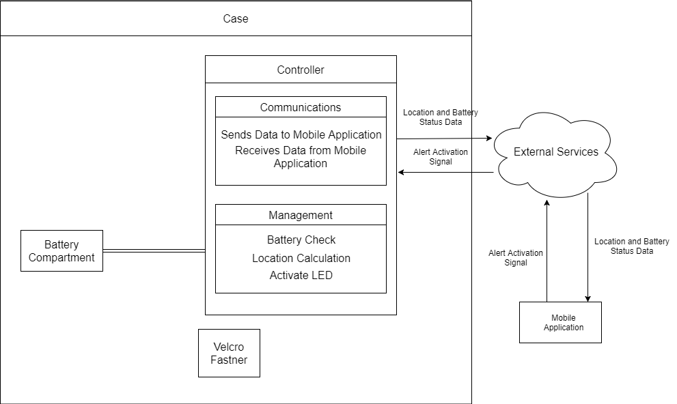
how it works
External Services – describes external communication means and hardware to interact with the IoT
Case – housing of the controller and the battery compartment to protect hardware
Velcro Fastener – Velcro pad used to attach the case to SPI standards A-3, B-1, B-2, B-3, C-1, C-2, C-3 for molded plastic.
Battery Compartment – container to hold the battery that powers the controller
Controller – controller for supplying location information and communicating location data back to the application. Contains two subsystems:
Communications – sends and receives data via the internal Wi-Fi antenna of the controller
Management – collects status data from the battery, accumulates the location footprint data, and activates the LED upon receipt of alert data packet

Slide 22
Safety Risks
Every component is commercial and thus has been tested and approved by the IEC 61508 electronics safety standard
The final product will be tested by UL60335 safety standard for household appliances.
Other possible electrical safety risks, such as shocking hazards, have been identified and mitigated.

Slide 23
Security Risks
Possible security risks include the leakage of Wi-Fi credentials and email information. This has been identified and will be mitigated to the best of our ability and tested by RFC 1042 standard for transmission of IP datagrams.

Slide 24
Software Tradeoffs
Delivery Platform
Local to Smart Device
Remote Server
Database Language
Postgres
SQL
Room
Firebase
Background Services API
Celery[Redis]
Lettuce[Dory]
Firebase
OS API
Kotlin
Java
Firebase

Slide 25
Software components
Android Studio
SDK Tools
Firebase
WorkManager
Arduino 1.8.7

Slide 26

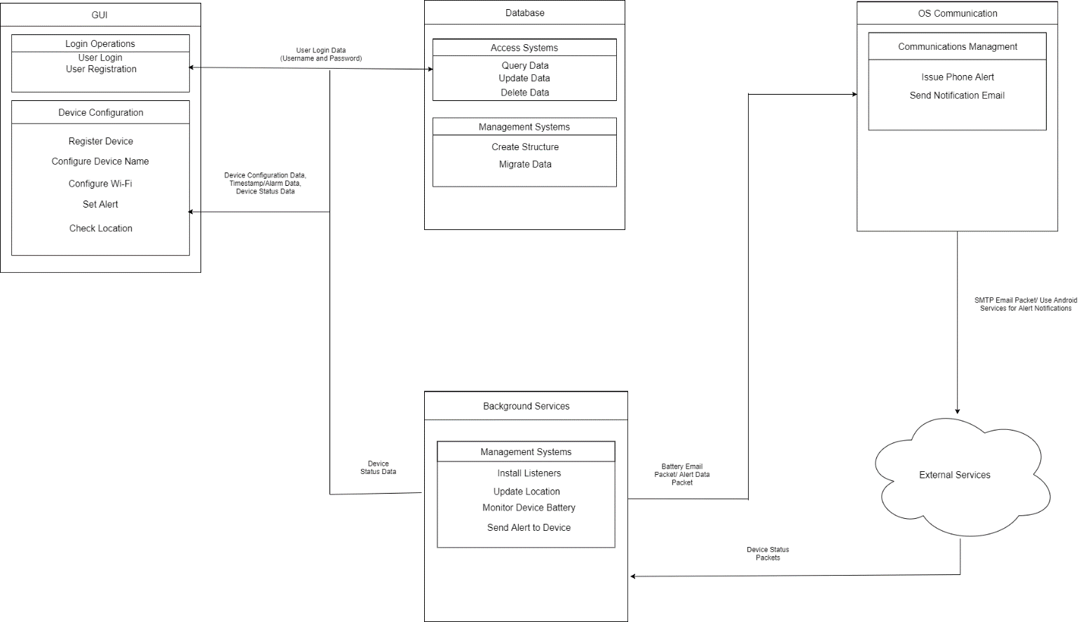
How it works
GUI – graphical user interface application designed to allow user to access and edit data stored in the database. Contains two subsystems:
Login Operations – controls the user access to the application or registration if no user data is found
Device Configuration – controls configuration, addition, and display of Tracker information from and to the database for the GUI
Database – storage paradigm for Tracker statistics and configurations. Contains two subsystems:
Access Systems – runs queries against the stored data and returns, updates, or deletes that data according to user defined or system requested inputs
Managements Systems – controls the database modules construction or migration

Slide 27
How it works
Background Services – subsystems that will launch when the device is started. Handles the intermittent communication with the Trackers. Contains one subsystem:
Management Systems – controls initial setup and controls behaviors for the listening routes required for intermittent reporting of data by the Tracker
OS Communications – subsystem to interact with the OS features that allow for external communications from the device. Contains one subsystem:
Communication Management – Issues mobile alerts, notifications, or email to user.
External Services – used to describe external communication means and hardware to interact with the IoT.

Slide 28
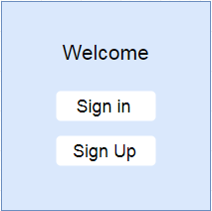
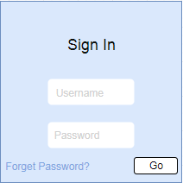
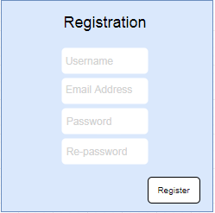
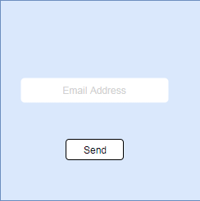
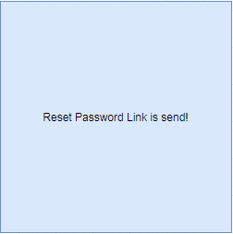
Gui Mock-up
This is an example of what we will design the GUI to appear to the user. The example is of the registration of the tracker and initializing the database

Slide 29
Test plan
Parts of the device should be ordered in the first week of January
Creation of a viable mobile application should be completed within the month of January 2018
Creation of the online database should also be completed in the month of January
A physical Tracking device should be created by the second week of February
Establishing a client server connection should be completed by the first week of February

Slide 30
Prototype Testing
Facilities & Hardware
Requires a room to act as testing area to test the tracker’s tracking and configurable alert functionalities
Requires a household object to test the tracker’s attachment method’s effectiveness.
Other things to test
Requires extra batteries to test the tracker’s replaceable battery feature

Slide 31
Software Testing
Software testing plan is consisted of two phases:
1- User interface.
2- Database storage.

Slide 32
User interface
Test case ID | Test case | Test steps | Description | Expecting results | Actual results | Statue of result | Comments
U0000 | Validate log in credentials | Pre-condition | A – Make sure that the application is testable and. B- Make sure that the log in data is available.
----- |  | Step 1 | Testing the availability of the application | The application lunched properly.
----- |  | Step 2 | Navigate to Login page. | Log in page is displayed to user with username and password fields are displayed on the page.
----- |  | Step 3 | Testing valid username in username field. | Username field should be editable and accept the username
----- |  | Step 4 | Testing valid password in password field. | Password field should be editable and accept the password and display as stars or dots.
----- |  | Step 5 | Click on log in button | User should log in into application and navigate to Home page.

Slide 33
Database
Testing of back-end components (database components and DBMS systems).
Testing stored procedures, views, schemas in DB, tables, indexes, key, triggers, data validations and data consistence check.
The type of testing in database is functional testing type which involves checking functionality of database from user point of view.
Nonfunctional testing could be used to check the stress testing, minimum system requirements and deals with the performance of the database.

Slide 34
Summary
The item tracker is designed to locate objects within the range of house or room
The item tracker’s total cost for development is $243.60
The item tracker uses Wi-Fi positioning to locate the tracker and subsequently the item that the tracker it attached to
Risks to schedule, safety, and security have been identified and mitigated through standards and design constraints
The development process has been scheduled to begin on January 14 and end by April 28. This includes initial development, prototyping, and testing

Slide 35
Questions
?????? ? ? ? ? ? ?
?

