Slide 1
Item Tracker
Donald Taylor Jacob Manser Mohammad Aljagthmi Ryan Ly

Slide 2
Agenda
Introduction
Description
Requirements
Constraints
Standards
Hardware Components
Software Components
Shopping List

Slide 3
Agenda
How it Works
Timeline
Milestones
Test Plan
Safety Risks
Security Risks
Summary
Questions

Slide 4
Introduction
People tend to forget things every day when they get out of their home, such as phones, keys, wallets, etc.
The goal is to help people to remember what they have forgotten (physical objects are included). According to F. Chen et al “A smart reminding mechanism is designed to remind the user what he or she has forgotten to bring along when leaving home for work or school” [1, p1].
These kind of reminder systems play an important role for assisted living solutions that enable people to remain independent in their home. According to F. Ghorbel et al “The main problem, especially for those who live alone, is performing the basic everyday activities e.g., taking medicines on time, joining their family” [2, p1].
[1] F. Chen, H. Hsu and N. Lee, “An RFID-Based Reminder System for Smart Home,” international Conference on Advanced Information Networking and Applications, 2011.
[2] F. Ghorbel, N. Ellouze, E. Metais, F. Hamdi and F. Gargouri, “MEMO_Calendring: a smart reminder for Alzheimer’s disease patients,” university of Sfax, February 2017.

Slide 5
Introduction
RFID (Radio Frequency Identification)
According to H. Hsu et all “When the front door is open, the RFID reader is triggered to read the nearby tags and send their ID numbers to the server. The maximum detection distance should be set at around 1 meter” [1, p4]. The RFID does not just remind people, but it also senses objects by name. When people leave home, RFID checks objects that leave in a bag or by hand to see if it is forgotten. It is a smart reminder which has an easy way to record objects that the user takes out.
MedRem (medication reminder)
an automatic tracker that can identify track tags attached to objects. This technology can track the location of objects that are forgotten.
It depends on history data that the reminder system analyzes to know what the user should bring along on that specific time or day. In MedRem, according to M. Mondol et all “To provide an alert, MedRem vibrates the device. Since the device is attached to the wrist, the user gets the alert while the device is worn” [2, p4].
[1] H. Hsu, C. Lee, J. Hung and T. Shih, “Smart Object reminders with RFID and mobile technologies,” Mobile Information System., vol.27, 2011.
[2] M.Mondol, I.Emi and J.Stankovic, “MedRem: an Interactive Medication Reminder and Tracking System on Wrist Devices,” university of Virginia, October 2016.

Slide 6
Description
The solution we as a group come up with is to create a tracker connected to an application that will be the user access way to the tracker.
Household tracker that can keep track of the location of household objects.
The tracker can be attached and removed from household objects manually and without extra tools.
Tracker connects and syncs with application using Wi-Fi to interface with the user.

Slide 7
Requirements
Req No. | Obj No. | Requirement
1.0 | 1 | Device shall comply with IEEE 802.11 communication standard
2.0 | 1 | Device shall use an open source positioning system over Wi-Fi
3.0 | 1 | Device shall communicate with a mobile application
4.0 | 2 | Device shall adhere to surfaces that meet SPI standards A-3, B-1, B-2, B-3, C-1, C-2, C-3 for molded plastic with Velcro© pads
5.0 | 4 | Device shall contain an attached LED light that conforms to ANSI C82.16-2015 standard
6.0 | 1 | Device shall include a mobile application
7.0 | 3 | Mobile application shall be usable on a mobile device running Android 4.4 or newer
8.0 | 3 | Mobile application shall email the user provided email address when battery voltage drops below 80% of factory listed voltage
9.0 | 3 | Mobile application shall allow the user to configure a visual alarm for an input date and time
10.0 | 3 | Mobile application shall allow the user to configure an audible tone of at least 60dB for an input date and time
11.0 | 3 | Mobile application shall allow the user to configure the LED light to turn on for an input date and time
12.0 | 3 | Mobile application shall allow the user to see location information for the device
13.0 | 3 | Mobile application shall allow the user to define a custom name for the device
14.0 | 3 | Mobile application shall store user defined email
15.0 | 3 | Mobile application shall store user defined wi-fi network credentials
16.0 | 5 | Device shall provide the user access to the battery through a folding panel
17.0 | 5 | Device shall accept a replacement battery of the same form factor
18.0 | 6 | Device shall function in temperatures above 32­­­­⁰F
19.0 | 6 | Device shall function in temperatures not exceeding 150⁰F
20.0 | 6 | Device shall function if exposed to 8 fl oz of water
21.0 | 6 | Device shall function following a 3 ft exposure to unaccelerated gravity
IEEE – Institute of Electrical and Electronics Engineers
SPI – Society of the Plastics Industry
ANSI – American National Standards Institute

Slide 8
Requirements
Req No. | Obj No. | Requirement
1.0 | 1 | Device shall comply with IEEE 802.11 communication standard
2.0 | 1 | Device shall use an open source positioning system over Wi-Fi
3.0 | 1 | Device shall communicate with a mobile application
4.0 | 2 | Device shall adhere to surfaces that meet SPI standards A-3, B-1, B-2, B-3, C-1, C-2, C-3 for molded plastic with Velcro© pads
5.0 | 4 | Device shall contain an attached LED light that conforms to ANSI C82.16-2015 standard
6.0 | 1 | Device shall include a mobile application
7.0 | 3 | Mobile application shall be usable on a mobile device running Android 4.4 or newer
8.0 | 3 | Mobile application shall email the user provided email address when battery voltage drops below 80% of factory listed voltage
9.0 | 3 | Mobile application shall allow the user to configure a visual alarm for an input date and time
10.0 | 3 | Mobile application shall allow the user to configure an audible tone of at least 60dB for an input date and time
11.0 | 3 | Mobile application shall allow the user to configure the LED light to turn on for an input date and time
12.0 | 3 | Mobile application shall allow the user to see location information for the device
13.0 | 3 | Mobile application shall allow the user to define a custom name for the device
14.0 | 3 | Mobile application shall store user defined email
15.0 | 3 | Mobile application shall store user defined wi-fi network credentials
16.0 | 5 | Device shall provide the user access to the battery through a folding panel
17.0 | 5 | Device shall accept a replacement battery of the same form factor
18.0 | 6 | Device shall function in temperatures above 32­­­­⁰F
19.0 | 6 | Device shall function in temperatures not exceeding 150⁰F
20.0 | 6 | Device shall function if exposed to 8 fl oz of water
21.0 | 6 | Device shall function following a 3 ft exposure to unaccelerated gravity
IEEE – Institute of Electrical and Electronics Engineers
SPI – Society of the Plastics Industry
ANSI – American National Standards Institute

Slide 9
Standards
Definitions:
IEEE – Institute of Electrical and Electronics Engineers.
SPI – Society of the Plastics Industry.
ANSI – American National Standards Institute.
ISO – International Organization for Standardization.
IEC – International Electrotechnical Commission.
NEMA – National Electrical Manufacturing Association.
FIPS – Federal Information Processing Standard.
RFC – Request For Comments.
UL – Underwriters Laboratories.
Stand. No. | Standard
10 | The wireless fidelity connectivity (WiFi) connection shall conform to IEEE 802.11 standard.
20 | The molded plastic surface textures represented will adhere to SPI standards A-3, B-1, B-2, B-3, C-1, C-2, and C-3.
30 | The LED used will comply to LED production standard ANSI C82.16-2015.
40 | The tracker’s will conform to the home appliance safety standard UL 60335.
50 | The mobile application will conform to ISO/IEC 29179:2012 standard for user interface design.
60 | The mobile application’s hardware and software will interact in a system that will comply with ISO 9241 standard.
70 | The mobile application’s usability will be tested with ISO 25062 standard.
80 | The user’s inputted stored data will use encryption standard FIPS 180-4.
90 | The tracker device’s wiring will conform to ANSI/NEMA WD 6-2016 standard.
100 | The device’s data transmission for IP datagrams will comply with RFC 1042 standard.

Slide 10
Hardware components
Adafruit HUZZAH ESP8266 breakout
Standard 22 gauge wires
3V button cell batteries
Electrical tape
Duct tape
Hook-and-loop fasteners (Velcro©)
Breadboard (used for prototyping before soldering)
Soldering station (used to finalize the hardwiring)

Slide 11
Software components
Android Studio
SDK Tools
Firebase
WorkManager
Arduino 1.8.7

Slide 12
Shopping List
150 ft 22 Gauge Wire $16.95
Elegoo Brand Solderless Breadboards (3 pcs) $9.99
Weller 40-Watt Soldering Station $38.37
20 CR2032 3V Button Cell Batteries $6.80
Duck Brand 60 ft Electrical Tape (2 rolls) $5.62
Duck Brand All-Purpose Duct Tape 45 Yard (1 roll) $9.31
Velcro Brand Sticky Back Hook-and-Loop Fasteners 30 ft $26.91
Adafruit HUZZAH ESP8266 breakout (8 count) $79.60
FTDI USB Cable (2 count) $35.90
Glad Cling Wrap (1 roll) 200 sq ft $2.65
Total Cost $232.10

Slide 13

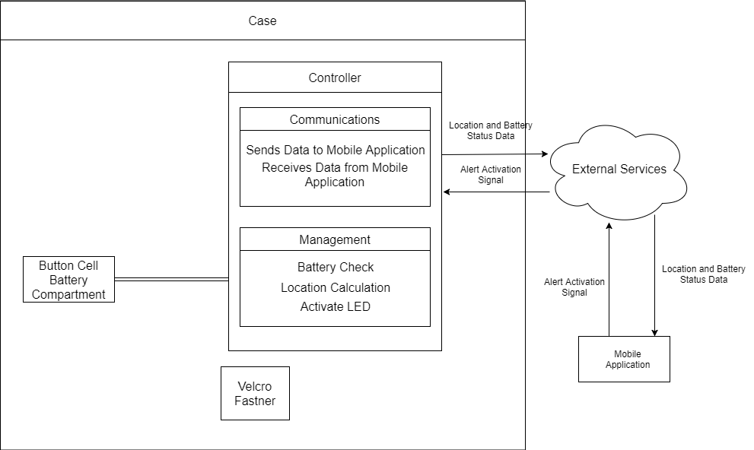
how it works

Slide 14

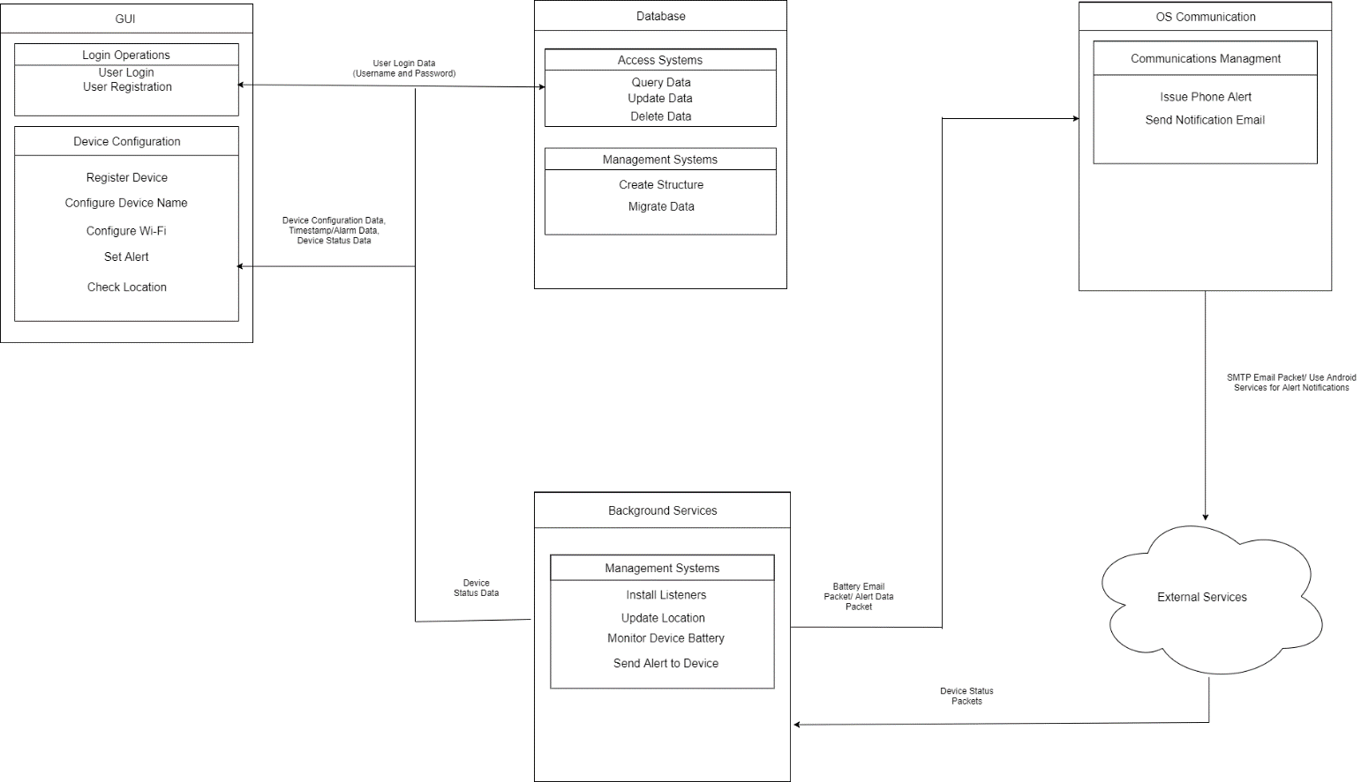
How it works

Slide 15
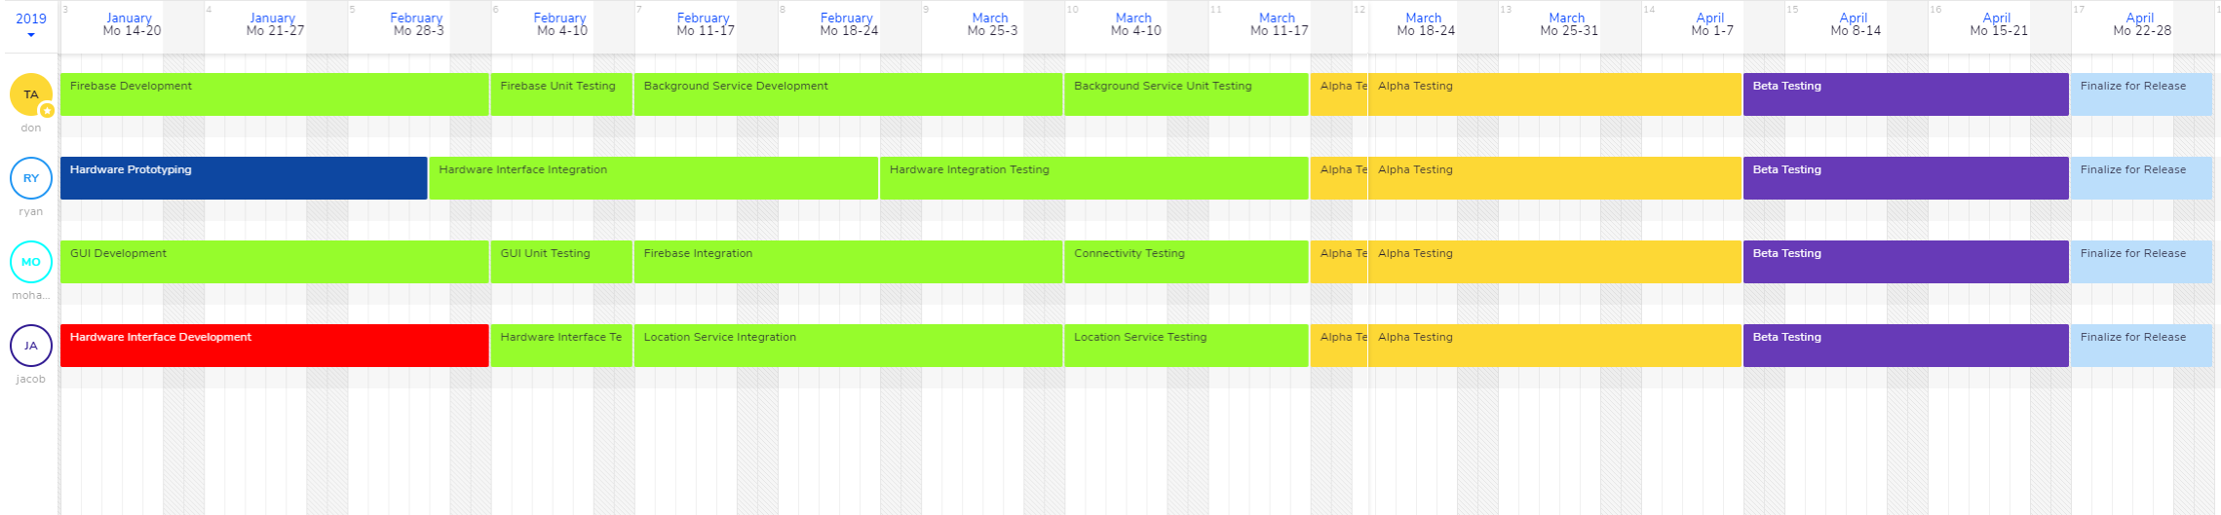
Timeline

Slide 16
Milestones

Slide 17
Schedule Risks
Development

Slide 18
Test plan

Slide 19
Prototype Testing
Facilities & Hardware

Slide 20
Software Testing
Facilities & Hardware

Slide 21
Safety Risks
Every component is commercial and thus has been tested and approved by the IEC 61508 electronics safety standard
The final product will be tested by UL60335 safety standard for household appliances.

Slide 22
Security Risks

Slide 23
Summary

Slide 24
Questions

