Slide 1

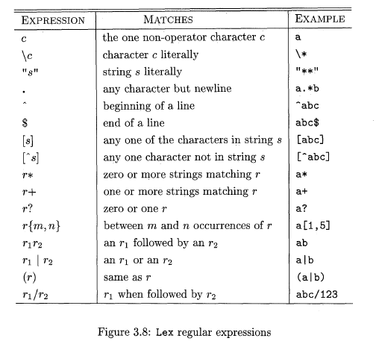
Structure of Lex programs
Notes:
1

