Slide 1
COMPILER CONSTRUCTION
CS F363
YACC Basics
Notes:
1

Slide 2
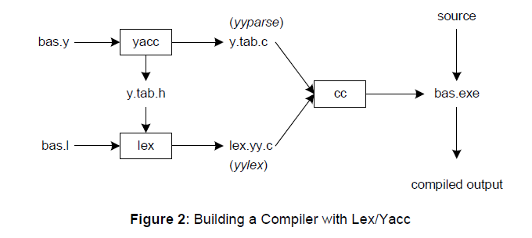

Slide 3
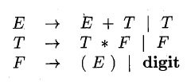
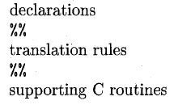
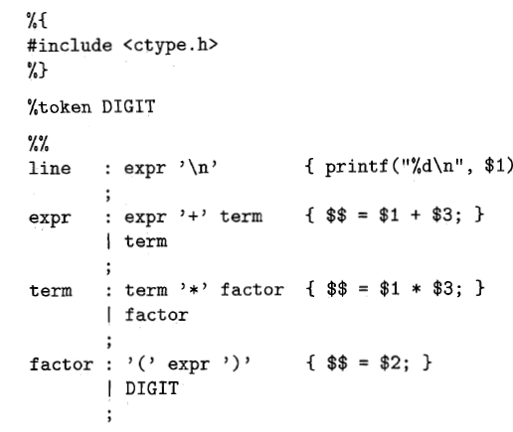
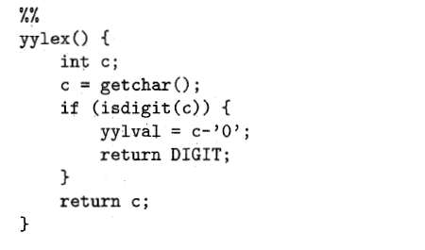

Slide 4



%token
%left
%type
%union {
int tInt;
char *tStr;
};
YYSTYPE.

