Slide 1
CS375 Design & Analysis of Algorithms Maze Generation
Thomas Donuhue
Matt Diana
Khasham Cheema
Department of Computer Science
State University of New York at Binghamton
Spring 2015

Slide 2
Purpose
Generate a random maze by finding a minimum spanning tree on a connected, weighted, undirected graph.
Inputs: Maze Width, Maze Height, Cell size
Output: Minimum spanning tree with randomized weights

Slide 3

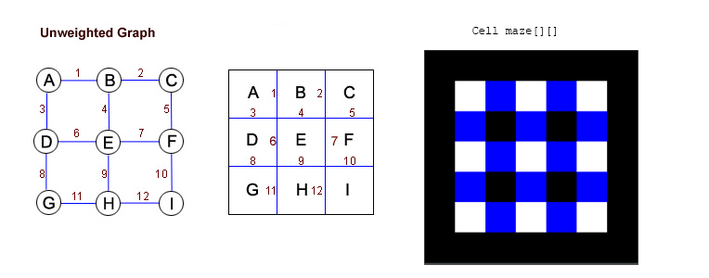
Implementation
Java 7
Java SwingGUI for maze viewing
Java Graphics2D for displaying
maze

Slide 4
Problem Statement
Which minimum spanning tree is more efficient for maze generation?
Entertainment? Add more……

Slide 5
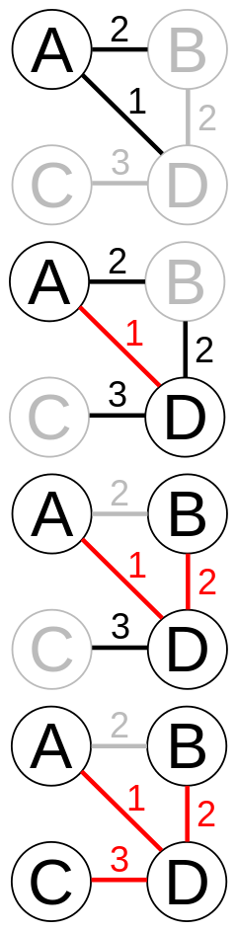
General Prim’s Algorithm
1. Initialize a tree with a single vertex, chosen arbitrarily from the graph
2. Grow the tree by one edge: of the edges that connect the tree to vertices not yet in the tree, find the minimum-weighted edge, and transfer it to the tree.
3. Repeat step 2 until all vertices are in the tree.

Slide 6
Prim’s Algorithm Maze Application
In our maze application the graph has randomized weights.
1. Start with a grid full of walls.
2. Pick a cell, mark its as part of the maze. Add the walls of the cell to the wall list.
3. While there are walls in the list:
1. Pick a random wall from the list. If the cell on the opposite side isn’t in the maze yet:
1. Make the wall a passage and mark the cell on the opposite side as part of the maze.
2. Add the neighboring walls of the cell to the wall list.
2. Else remove the wall from the list.

Slide 7
Prim’s Algorithm Implementation
ArrayList of Cells for Wall list.
inner class Cell
X-Y coordinate and state (passage/wall).
Boolean variable tracks in maze.
Cell pickRandWall()
Cell getOppositeCell(Cell cell)
void makePassage(Cell cell)
void addWall(Cell cell)

Slide 8
Prim’s Algorithm Analysis
O(V²)

Slide 9
General Kruskal’s Algorithm
Starting with a graph:
Create a list of all of the edges that connect the nodes
Consider each node to contain a tree (initially rooted by the node).
Iterate of the list of edges
Choose one with the least weight
If the nodes linked by this edge are contained in two different trees, connect their tree and continue
Otherwise, simply continue to the next edge
Repeat until all edges have been looked at and/or all nodes in the graph are contained by the same (spanning) tree

Slide 10
Kruskal’s Algorithm Maze Application
1. Create a list of all walls, and create a set for each cell, each containing just that one cell
2. For each wall, in some random order
If the cells divided by this wall belong to distinct sets
Remove the current wall
Join the sets of the formerly divided cells

Slide 11
Kruskal’s Algorithm Implementation
Inner class Edge
Inner class Tree

Slide 12
Kruskal’s Algorithm Analysis
Each union and find operation on two sets can perform can perform in nearly constant amortized time.

