Slide 1

Objectives
In this session, you will learn to:
  Identify email protocols
  Send an email using a PHP script
  Identify the object-oriented methodology
  Identify the advantages of object orientation

Slide 2
Identifying Mail Protocols
Simple Mail Transfer Protocol (SMTP):
  Is used to establish communication between email servers.
  Is a TCP/IP protocol used to send emails over the Internet from one email server to another.
Mail Transfer Agent (MTA):
  Is a software that handles the process of sending and receiving emails across the Internet.
Microsoft User Agent (MUA):
  Is a set of software that is used to read, compose, and access emails from MTA.

Slide 3
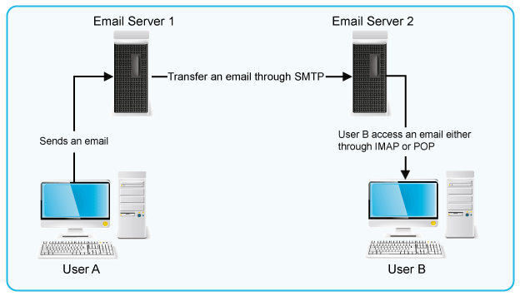
Identifying Mail Protocols (Contd.)
The following figure shows how emails are sent and accessed using MTA and MUA.

Slide 4
Identifying Mail Protocols (Contd.)
Flash presentation: Sending Mail

Slide 5
Identifying Mail Protocols (Contd.)
The following protocols are used to access emails from MTA:
  Post Office Protocol (POP)
  Internet Message Access Protocol (IMAP)

Slide 6
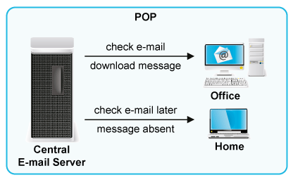
Post Office Protocol
  POP:
  Is a protocol used by MUAs or email clients to access emails from a server.
  Is used to retrieve emails, store them on the client machine, delete them from the server, and then disconnect from the server.
  The following figure shows the functionality of POP.

Slide 7
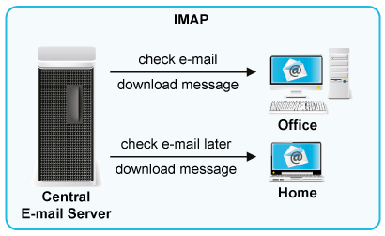
Internet Message Access Protocol
  IMAP:
  Is also a protocol used to access emails from a mail server.
  Works in a connected environment.
  The following figure shows the functionality of IMAP.

Slide 8
Just a Minute
Which protocol is used by MUAs or email clients to access emails from a server?
Answer:
  POP

Slide 9
Sending an Email Using a PHP Script
  To send an email through PHP script:
  You need to configure some email delivery options.
  You can send emails to multiple users by using the Carbon Copy (Cc) and Blind Carbon Copy (Bcc) email options.

Slide 10
Configuring Email Delivery Options
  Before sending an email, you need to configure various settings related to the email in the php.ini file.
  The configuration settings include:
  smtp_string
  SMTP
  smtp_port
  sendmail_from

Slide 11
Sending a Simple Email
  The mail() function:
  Is used to send an email through PHP.
  Returns true if the email is successfully accepted for delivery. Otherwise, it returns false.
  Syntax:
    bool mail(string $to, string $subject, string $message[, string $header])

Slide 12
Sending a Simple Email (Contd.)
  For example:
    <?php
    $to = 'recipient@example.com';
    $subject = 'Invitation';
    $body = 'Hi,\n\nHow are you?\n You are cordially invited to my birthday party';
    if (mail($to, $subject, $body))
    {
    echo('Mail sent!');
    }
    else
    {
    echo('Mail delivery failed');
    }
    ?>

Slide 13
Sending Additional Headers with an Email
  The mail() function:
  Allows you to specify all the headers you want to include in your email.
  For example:
    <?php
    …..
    …..
    $headers = 'From: sender@example.com' . "\r\n" .
    'Bcc: feedback@example.com';
    mail($to, $subject, $message, $headers);
    ?>

Slide 14
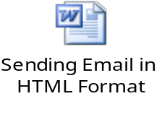
Sending an Email in an HTML Format
  To send data in the tabular format through the PHP script, you need to use HTML tags in the script.
  The following embedded Word document contains the code to send an email in the HTML format:

Slide 15
Just a Minute
Which configuration setting specifies the address of the user who is sending the email?
Answer:
  sendmail_from

Slide 16
Demo: Sending an Email
Problem Statement:
  The HR Manager of an organization needs to schedule the interview of the candidates. For this, the Manager has to fill in the interview details, such as the candidates’ name and email ID and the interview date, in the Schedule form. When the Manager clicks the Schedule button on the form, an email containing all the details will be sent to the department head in a format, as shown in the following table.
  How will you implement this functionality?
Candidate Name | Candidate’s Email ID | Interview Date

Slide 17
Demo: Sending an Email (Contd.)
Solution:
  To create the PHP application that sends the email in a tabular format, you need to perform the following tasks:
    Create the Email form.
    Create the Schedule file.
    Execute the application and verify the output.

Slide 18
Defining Object Orientation
Object orientation is a software development methodology that relates to the real world.
An object is the core concept involved in object orientation.
An object is the representation of a real-world entity or concept.
For example, an employee, a window, a car, or a bird can be modeled as objects.
You can think of an OO model as a collection of objects and their inter-relationships.
Notes:
Students know the importance of surrogate keys. In this session students will learn the strategy to generate the surrogate key. Give an example to explain the strategy to generate the surrogate keys by concatenating the primary key of the source table with the date stamp. For example, data from a Product table has to be loaded into the Product_Dim dimension table on Feb 09, 2006. The product_code is the primary key column in the Product table. To insert the surrogate key values before loading the data into the dimension table, you can combine the primary key value with the date on which the data has to be loaded. In this case the surrogate key value can be product_code+09022006.

Slide 19

The Foundation of Object Orientation
Object orientation involves splitting the software system into component parts and arranging the parts in a hierarchy.
An OO program consists of classes and objects.
Objects communicate with each other by using messages.
What are classes, objects, and messages?
Notes:
Students know what is the structure of Flat dimension. You can initiate the session by asking the following questions:
1. What are flat dimension tables?
2. What is the structure of flat dimension?
3. Given examples of a flat dimension?
Next, tell the strategy to load the data into the flat dimension table. You can explain the loading strategy with the help of the example given in SG.
Continue this session by asking the following questions:
4. What are large flat dimension tables?
5. Give examples of large flat dimensions?
Then, explain the strategy to load data into the large flat dimension table.
Before explaining the strategy to load data into the small dimension table ask the following questions and the tell the strategy to load the data into the dimension table.
6. What are small flat dimension tables?
7. Give examples of small flat dimension tables.
With the help of these questions, students will be able to recall about flat dimensions, they have learnt in Module I.
Explain this topic with the help of an example given in SG.

Slide 20
Objects
An object means a material thing that can be presented physically.
An object:
  Has a state.
  May display behavior.
  Has a unique identity.
Notes:
Students know what is the structure of Flat dimension. You can initiate the session by asking the following questions:
1. What are flat dimension tables?
2. What is the structure of flat dimension?
3. Given examples of a flat dimension?
Next, tell the strategy to load the data into the flat dimension table. You can explain the loading strategy with the help of the example given in SG.
Continue this session by asking the following questions:
4. What are large flat dimension tables?
5. Give examples of large flat dimensions?
Then, explain the strategy to load data into the large flat dimension table.
Before explaining the strategy to load data into the small dimension table ask the following questions and the tell the strategy to load the data into the dimension table.
6. What are small flat dimension tables?
7. Give examples of small flat dimension tables.
With the help of these questions, students will be able to recall about flat dimensions, they have learnt in Module I.
Explain this topic with the help of an example given in SG.

Slide 21

Objects (Contd.)
Two objects may have the same behavior and state, but they can never have the same identity.
Let us consider an example.
Notes:
Students know what is the structure of Flat dimension. You can initiate the session by asking the following questions:
1. What are flat dimension tables?
2. What is the structure of flat dimension?
3. Given examples of a flat dimension?
Next, tell the strategy to load the data into the flat dimension table. You can explain the loading strategy with the help of the example given in SG.
Continue this session by asking the following questions:
4. What are large flat dimension tables?
5. Give examples of large flat dimensions?
Then, explain the strategy to load data into the large flat dimension table.
Before explaining the strategy to load data into the small dimension table ask the following questions and the tell the strategy to load the data into the dimension table.
6. What are small flat dimension tables?
7. Give examples of small flat dimension tables.
With the help of these questions, students will be able to recall about flat dimensions, they have learnt in Module I.
Explain this topic with the help of an example given in SG.

Slide 22
Objects (Contd.)
Movement of the car defines its behavior.
A car positioned at one place defines its state.
The car’s registration number, MMY 88, shows its identity.
MMY 88

Slide 23
Classes
A class consists of a set of objects that share a common structure and behavior.
In OO programming terminology, the data stored within an object represents the state of the object. This data is called attributes.
The behaviors are contained in methods. A method contains the programming code to implement a particular behavior.
An object can be associated with multiple methods, each having a set of instructions included in it.
Each of these methods has a unique purpose and helps implement a particular behavior of the object.

Slide 24
Classes (Contd.)
An object is an instance of a class.
Let us consider an example.

Slide 25
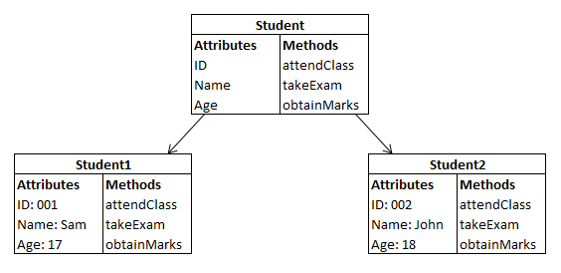
Classes (Contd.)
Class
Object of the Student Class
Object of the Student Class

Slide 26
Messages and Methods
Messages are used for communication between objects.
Let us consider an example.
Notes:
Students know what is the structure of Flat dimension. You can initiate the session by asking the following questions:
1. What are flat dimension tables?
2. What is the structure of flat dimension?
3. Given examples of a flat dimension?
Next, tell the strategy to load the data into the flat dimension table. You can explain the loading strategy with the help of the example given in SG.
Continue this session by asking the following questions:
4. What are large flat dimension tables?
5. Give examples of large flat dimensions?
Then, explain the strategy to load data into the large flat dimension table.
Before explaining the strategy to load data into the small dimension table ask the following questions and the tell the strategy to load the data into the dimension table.
6. What are small flat dimension tables?
7. Give examples of small flat dimension tables.
With the help of these questions, students will be able to recall about flat dimensions, they have learnt in Module I.
Explain this topic with the help of an example given in SG.

Slide 27
Messages and Methods (Contd.)
A car is flashing its lights to pass messages to the other car.

Slide 28
Just a Minute
Identify the possible states of the following objects:
  A mobile phone
  An MP3 player
Answer:
  States of a mobile phone: Off, Ring, Vibrate, and Call
  States of an MP3 Player: Play, Stop, Rewind, and Forward

Slide 29
Just a Minute (Contd.)
John went to a shopping mall to buy some clothes. The door of the shopping mall was automatic, which opened as soon as John stepped near it and closed as soon as John entered the mall. Identify the following:
  The possible receiver of the message.
  The possible method that the receiver can use.
Answer:
  The receiver of the message will be the door of the shopping mall.
  The door will use the method, Open Door, when John steps near it and Close Door when he enters the mall.

Slide 30
Advantages of Object Orientation
What are the advantages of the object-oriented approach?
Notes:
Student already have learnt about SCDs in Module I. Therefore, you can start this topic by asking the following questions to students:
What are type 1 SCDs?
Given an example to explain type 1 SCDs.
This will recapitulate what they have learnt about type 1 SCD in Module 1.
Now explain the strategy to load the data into these dimension tables with help of the given diagram. Relate this diagram to the example given in SG.

Slide 31

Advantages of Object Orientation (Contd.)
Realistic modeling:
  The object-oriented approach models the real world.
MMY 88
Real-world object
Object-oriented representation of the real-world object

Slide 32
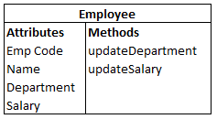
Advantages of Object Orientation (Contd.)
Reusability:
  The object-oriented approach allows you to reuse existing classes or objects.
Payroll application
Leave accounting
application
Employee recruitment
application
Employee Class

Slide 33
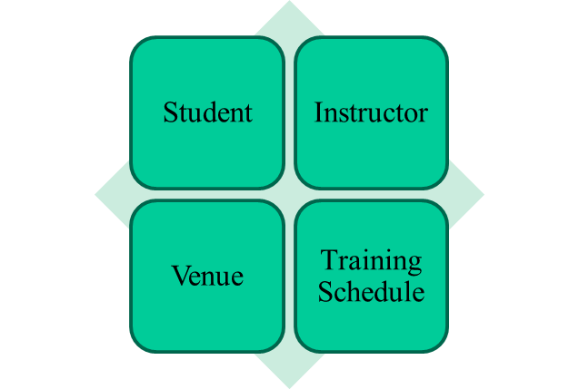
Advantages of Object Orientation (Contd.)
Modularity:
  The object-oriented approach allows objects to be maintained independently of other objects.
Independent Objects in
Training Management System

Slide 34
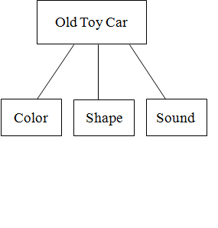
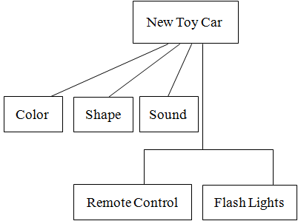
Advantages of Object Orientation (Contd.)
Flexibility to change:
  The object-oriented approach allows you to create a new class by adding some new features to an existing class.

Slide 35

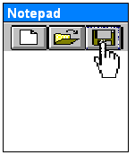
Advantages of Object Orientation (Contd.)
Information hiding:
  The object-oriented approach allows programmers to limit the access to information.
A person who is saving a file on a computer does not know how the computer saves the file on the hard disk.
The person just knows that clicking the Save button will save the file.

Slide 36
Summary
In this session, you learned that:
  An email server is a computer, on which the software, which handles the process of sending and receiving emails across the Internet, is installed.
  An MUA is a set of software that is used to read, compose, and access emails from MTA.
  The SMTP protocol is used to send emails to a mail server or MTA.
  POP is a protocol used by MUAs or email clients to access emails from a server.
  Similar to POP, IMAP is also a protocol used to access emails from a mail server. However, unlike POP, IMAP works in a connected environment.
  To send an email through PHP, you can use the mail() function.

Slide 37
Summary (Contd.)
  To include multiple headers in the email, you need to separate each header by using the escape sequence, \r\n , where \r and \n specify the carriage return and newline characters.
  According to the object-oriented approach, systems consist of component objects that interact with each other.
  A class consists of a set of objects that share a common structure and behavior.
  The advantages of the object-oriented approach are:
    Realistic modeling
    Reusability
    Modularity
    Flexibility to change
    Information hiding
Notes:
You can summarize the session by running through the summary given in SG.
In addition, you can also ask students summarize what they have learnt in this session.

