Slide 1
Machine Learning
With Stocks
CX1115 FE1 Team 03
Kelvin Pang Jun Wei
Donvis Nguyen

Slide 2
Contribution
Donvis Nguyen
Kelvin Pang
API Pull
Classification Tree
Cleaning of Data
Constructing API for JSON
Knowledge Sharing
Regression Model
Setting of Goal
Confusion Matrix
Correlation
Defining the motivation
Drafting of Schedules
Insights
Knowledge Sharing
Quality Assurance
Slides + Recording
Notes:
Last 2 minutes of your presentation You MUST conclude by clearly mentioning who in your team worked on which portion of work.
Reshuffled.

Slide 3
Instruments
Learned from this course
Not learned from this course
Basic Heatmap Features
Classification Tree Model
Correlation Model
Exploratory Skills
Regression Model
Analysis of Time Series Data
Financial Knowledge
Heatmap Features (Masking)
Importing using JSON
Knowledge of Stock Model
Notes:
Next 3 Mins: Did you only use tools and techniques learned in this course? What ELSE did you learn/try?
Reshuffled

Slide 4
Introduction
Dataset extracted:
Alpha Vantage Stock API
Our Motivation:
Earning additional money independently.
Defined Problem:
As a trader, predict the stock price movement of a stock
To determine if we should take up or not
Notes:
First 2 minutes of your presentation

Slide 5
Our Goals
Determine the best “Moving Average” (MA) indicator amongst 9 chosen:
Which provides the best profits margin?
Decision to:
Jump in?
Not to jump in?

Slide 6
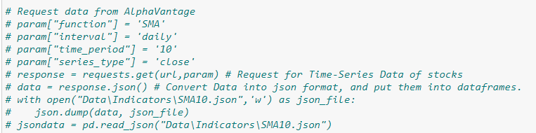
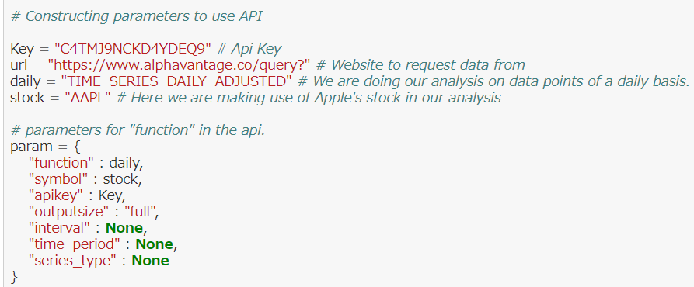
Data Collection
Requesting API from AlphaVantage in JSON format.
Saving data into files to reduce API request spam.
Notes:
First 2 minutes of your presentation: You MUST then mention how you collected, curated, and prepared the data for your problem.
Collection of data is done by requesting data from the website through an API request.
We defined parameters to use in our API request so that it is easier for us to request different data.

Slide 7
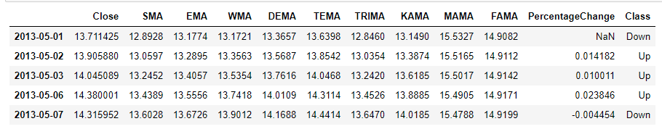
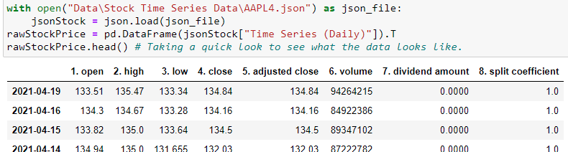
Data Preparation
Taking only Closing Price as reference.
Combining Closing Price with Moving Averages.
Added a Categorical Column “PercentageChange” for Classes.
Decision Tree Approach
Converting to relevant Data Types.
Notes:
First 2 minutes of your presentation: You MUST then mention how you collected, curated, and prepared the data for your problem.
Due to the API pull request limit of up to 5 per minute and 500 a day, we’ve decided to save the data from the API into files, so we can easily reuse them as we work on our project. As such, our data’s most recent data point is around 8th of April 2021.

Slide 8
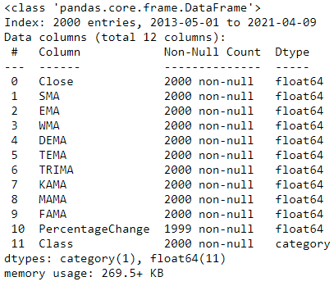
Exploratory Data
Basic Data Summary
Excluded Usage of Basic Statistical Summary in this project:
Not extremely relevant in our analysis
Correlation Heatmap.
Notes:
First 2 minutes of your presentation: You may then want to BRIEFLY present relevant Exploratory Data Analysis and observations.
This is an example of one of the Moving Averages line plotted with the daily closing price of AAPL over 100 days.

Slide 9
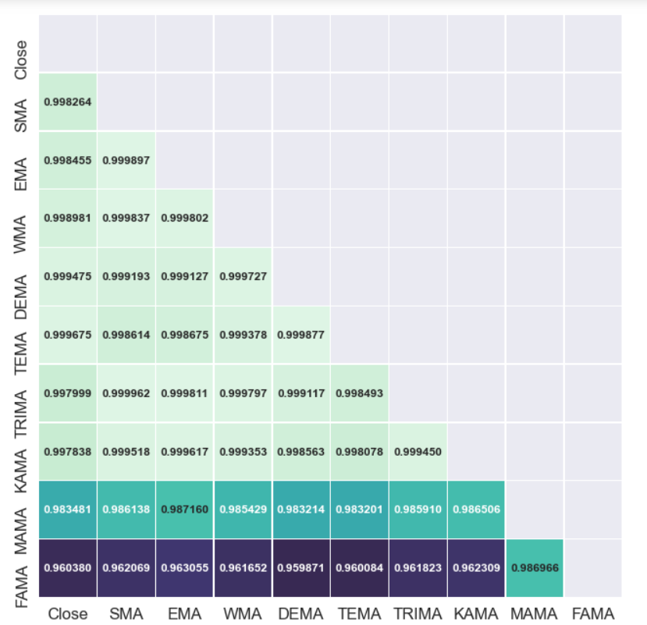
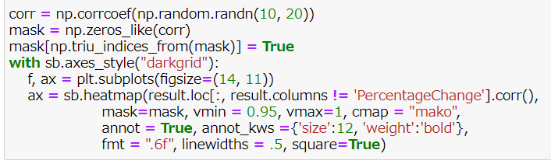
Exploratory Data
Correlation Heatmap
Masking feature used.
Adjusted Heatmap Range due to its extreme close proximity.
Notes:
First 2 minutes of your presentation: You may then want to BRIEFLY present relevant Exploratory Data Analysis and observations.
This is an example of one of the Moving Averages line plotted with the daily closing price of AAPL over 100 days.

Slide 10
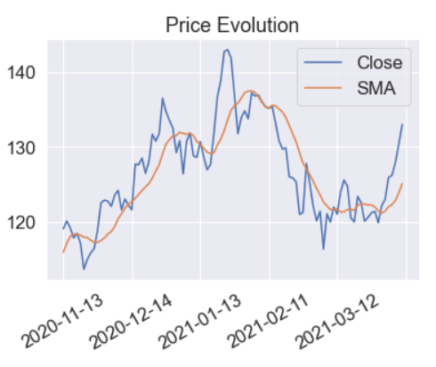
Exploratory Data
How Does Moving Average Work?
Example of plotting SMA with Daily Closing Price of AAPL.
Close Price < SMA : Stock = Undervalued.
Close Price > SMA : Stock = Overvalued.
Notes:
First 2 minutes of your presentation: You may then want to BRIEFLY present relevant Exploratory Data Analysis and observations.
This is an example of one of the Moving Averages line plotted with the daily closing price of AAPL over 100 days.

Slide 11
Machine Learning
Regression
Linear Regression Model:
To look for a model that can support or counter our point of view.
Determine:
The possibility of variation that results in wrong representation.
The confidence level that we should have.
Notes:
Next 3 Mins: If you used ML (regression, classification, or something else); mention mainly WHICH one(s).
You may now briefly CLARIFY why and how the ML problem(s) aim(s) to solve your objective.

Slide 12
Algorithmic Optimisation
Linear Regression
Pros
Cons
Provides Accuracy.
Dealing with Time Series.
Cannot randomised the split of Train & Test Data.
Extremely low MSE in majority.
Extremely CLOSE R^2 in majority.
Close + xMA | R^2 | MSE
SMA | 0.996 | 0.103
EMA | 0.997 | 0.182
WMA | 0.998 | 0.0455
DEMA | 0.999 | 0.000343
TEMA | 0.999 | 5.844
TRIMA | 0.996 | 0.0737
KAMA | 0.996 | 0.110
MAMA | 0.967 | 87.428
FAMA | 0.921 | 1007.828
End Result: Not ample enough to influence our decision!
Notes:
Next 3 Mins: If you used ML (regression, classification, or something else); mention mainly WHICH one(s).
You may now briefly CLARIFY why and how the ML problem(s) aim(s) to solve your objective.
How did you apply ML technique(s) to SOLVE your problem? Which model(s), how and why?

Slide 13
Machine Learning
Decision Tree
Decision Classification Tree Model:
To look for a better alternative than Linear Regression Model.
Should be able to show us the breakdowns distinctly.
Look in depth into Modified Confusion Matrices
4 Modified Metrics
Notes:
Next 3 Mins: If you used ML (regression, classification, or something else); mention mainly WHICH one(s).
You may now briefly CLARIFY why and how the ML problem(s) aim(s) to solve your objective.

Slide 14
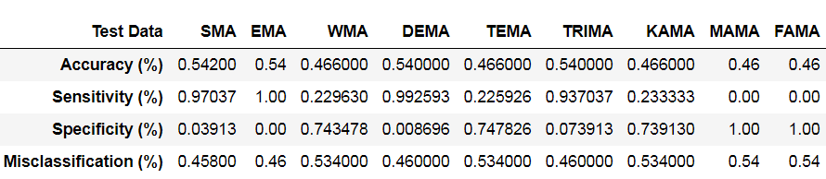
Algorithmic Optimisation
Confusion Matrix
More helpful than Regression Approach.
Able to influence with our viewpoint of the Stock Price.
Able to pinpoint the most prominent MA.
Something Linear Regression is unable to due to its correlation extremity.
Notes:
Next 3 Mins: If you used ML (regression, classification, or something else); mention mainly WHICH one(s).
You may now briefly CLARIFY why and how the ML problem(s) aim(s) to solve your objective.
How did you apply ML technique(s) to SOLVE your problem? Which model(s), how and why?

Slide 15
Outcome
Regression Model
Classification Model
Limited usage
Further enhancement is needed for more in depth analysis
Wide range of analysis
By concentrating on CM, able to understand the main factors towards our defined problem
Problem is solved! How?
By in depth CM analysis.
Notes:
Last 2 minutes of your presentation: What is the OUTCOME of your project? Did it solve your original problem? Anything interesting?
What are your data-driven INSIGHTS and recommendations/views towards the target problem?

Slide 16
Dilema/Decision
As Data Scientist, want high Accuracy data.
As trader, want error to be as low as possible to seek profitability.
~50% accuracy is extremely high for a trader.
Percentage may go even lower when external factors are added in.
So how?
Consider your current position, seeking profitability? Or just casually doing Data Science?
Notes:
Last 2 minutes of your presentation: What is the OUTCOME of your project? Did it solve your original problem? Anything interesting?
What are your data-driven INSIGHTS and recommendations/views towards the target problem?

Slide 17


Slide 18
References
https://www.alphavantage.co/documentation/
https://www.alphavantage.co/
https://realpython.com/api-integration-in-python/
https://blog.quantinsti.com/use-decision-trees-machine-learning-predict-stock-movements/
https://seaborn.pydata.org/generated/seaborn.jointplot.html#seaborn.jointplot
https://seaborn.pydata.org/generated/seaborn.heatmap.html
https://www.investopedia.com/terms/m/movingaverage.asp
https://www.investopedia.com/articles/trading/10/double-exponential-moving-average.asp
https://corporatefinanceinstitute.com/resources/knowledge/trading-investing/kaufmans-adaptive-moving-average-kama/
https://www.investopedia.com/terms/t/triple-exponential-moving-average.asp
http://www.fxcorporate.com/help/MS/NOTFIFO/i_TMA.html
https://www.slidemembers.com/en_US/view/PPT-Templates/artificial-intelligence-best-powerpoint-templates-5174
https://learn.tradimo.com/advanced-stock-trading/impact-of-policy-politics-on-share-prices
https://towardsdatascience.com/predicting-short-term-stock-movements-with-quantitative-finance-and-machine-learning-in-python-e6e04e3e0337
https://lucenaresearch.com/2019/01/08/how-to-qualify-the-best-machine-learning-model-for-investment-research-2/
Course Materials from NTU CX1115 , Introduction to Data Science & Arti Intell.
Course Materials from NTU BU8201, Business Finance
Notes:
List of References

