Slide 1
Rewriting multi-platform apps with Claude Code
One person. Three days. Seven platforms.
Don Browning

Slide 2
What This App/Service Is
Volusia County operates ~30 vehicle beach access ramps that open and close throughout the day based on tides, weather, capacity, and turtle nesting. Claude and I built an app that polls the county GIS system every 60 seconds and serves that data alongside NOAA tide predictions, water temperature, and NWS weather — so you can check conditions before you load up the truck.
3 Days
Part-Time
From blank repo to fully deployed
multi-platform application
Overview:
Go backend API server, data ingester, PostgreSQL migrations, external web service integration
Swift apps iOS, iPadOS, watchOS, tvOS — all sharing a single Swift package
Responsive website Vanilla HTML/JS + Tailwind CSS with tide charts, dark mode, live webcam
IoT templates TRMNL e-ink display + backward-compatible Tidbyt device
Infrastructure Dockerfile, GitHub Actions CI, DigitalOcean App Platform deploy
5 languages • 7 platforms • 1 monorepo

Slide 3
System Architecture
Single Go binary handles data ingestion + API serving — clients consume via REST
DATA SOURCES
Volusia County GIS
ArcGIS MapServer — poll every 60s
NOAA Tides & Currents
Station 8721164 — predictions + water temp
National Weather Service
NWS API — forecast + conditions
▼
Go Service (Echo v4)
PostgreSQL
DO Managed DB
⟷
API Server
Data Ingester
NOAA Client
Weather Client
internal/handlers | internal/ingester | internal/noaa | internal/weather
ramp_status
ramp_status_history
▼
REST ENDPOINTS
/api/v2/ramps
/api/v2/tides
/api/v2/weather
/api/v2/trmnl
/rampstatus (v1)
/tides (v1)
▼
CLIENT PLATFORMS
Web App
HTML/JS + Tailwind
iOS App
SwiftUI
watchOS
SwiftUI
tvOS
SwiftUI
TRMNL
Liquid template
Tidbyt
Pixlet (frozen)

Slide 4
All Platforms Shippable
Six implementation phases complete — every platform reached a shippable baseline
Go API
v1 + v2 endpoints, GIS ingester, NOAA tides/temp, NWS weather — running on DigitalOcean App Platform
PRODUCTION
Go · Echo v4 · pgx · slog
Website
Responsive dashboard with ramp grid, tide chart, weather, webcam, dark mode, favorites, PWA
PRODUCTION
HTML · JS · Tailwind CSS
iOS + iPad
Universal SwiftUI app with ramps, tide chart, weather, webcam, city/status filtering
BUILDABLE
SwiftUI · async/await · SPM
watchOS
Glance-first ramp status with NSB default and all-cities drill-down
BUILDABLE
SwiftUI · WatchKit
tvOS
Ambient dashboard with ramps, tide chart, weather, auto-refresh, Siri Remote navigation
BUILDABLE
SwiftUI · Focus engine
TRMNL
Monochrome e-ink template: 4 NSB ramps, tide bar, water temp, local clock
READY
Liquid · HTML

Slide 5
The Build Timeline
6 phases across 3 days — each phase built on the last
DAY 1 — MAR 9
DAY 2 — MAR 10
DAY 3 — MAR 11
1
Foundation
2
Website
4
iOS App
Go API + ingester, PostgreSQL schema, v1 compat endpoints, NOAA client
Tailwind site, canvas tide chart, NWS weather, PWA, dark mode, favorites
Universal SwiftUI (iPhone + iPad), shared BeachStatus Swift package
Custom migration runner with go:embed — no external library
~500 lines vanilla JS, zero frameworks, no build step
Shared SPM package for cross-platform reuse
3
CI/CD + Deploy
5
Watch + TV
GitHub Actions, DigitalOcean App Platform, live at donwb.com
watchOS glance app, tvOS ambient dashboard, programmatic app icons
lint → test → build → deploy + smoke test
Separate theme files per platform — avoids cross-compilation
6
TRMNL
E-ink Liquid template, monochrome status differentiation
Pure CSS, no JS — reused v2 endpoints, zero backend changes

Slide 6
Engineer-Driven, AI-Built
No code editor. All work done in Claude Code — but every architectural decision was human-made.
The Workflow
Architecture Calls (Human-Made)
1
Write detailed requirements first
Single binary: API + ingester in one process
1,100-line REQUIREMENTS.md — the spec drove everything. Claude Code consumed it phase by phase.
Goroutine-based ingester avoids a separate worker — simpler deploy, one service on App Platform
1,100-line requirements doc before any code
2
Make architecture decisions
Phased spec drove the entire build — Claude Code consumed it phase by phase as the source of truth
Human chose: Echo v4 over Chi, custom migration runner over golang-migrate, goroutine ingester over separate process.
Shared Swift Package across 3 Apple targets
Models, networking, utilities written once — iOS, watchOS, tvOS all depend on one SPM package
3
Claude Code implements
Custom migration runner, no external library
All code written in the terminal. No VS Code, no Xcode (except project scaffolding). Every Swift, Go, HTML, and Liquid file.
go:embed bakes SQL files into the binary — zero runtime dependencies, auto-runs at startup
External AWS RDS instead of DO managed DB
4
Document decisions back into the spec
Same Postgres instance for dev and prod — simpler than managing two databases
Each phase ends with "Key decisions made" — the requirements doc is both input and living record.
Canvas API tide chart, no charting library
~500 lines vanilla JS total on the website — zero frameworks, zero build step

Slide 7
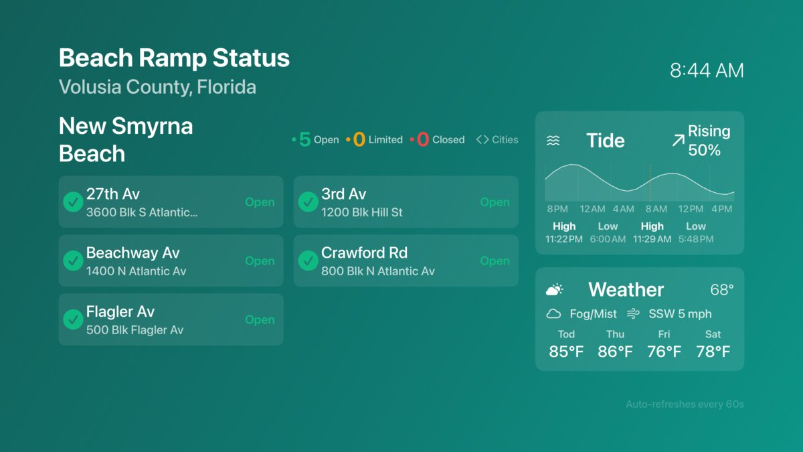
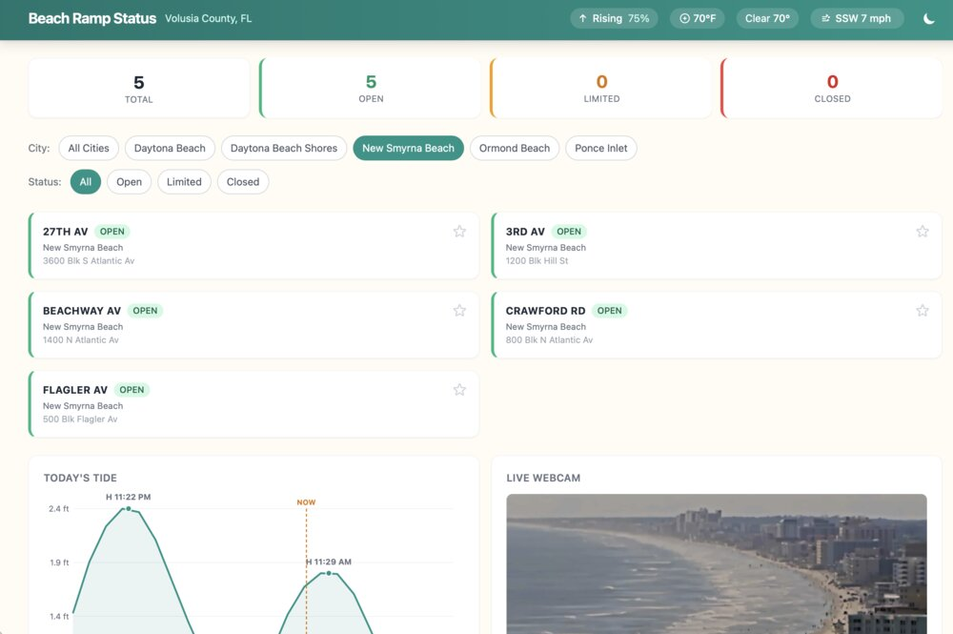
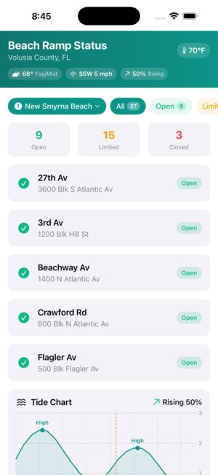
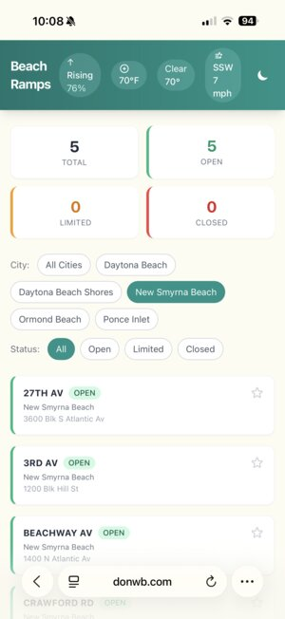
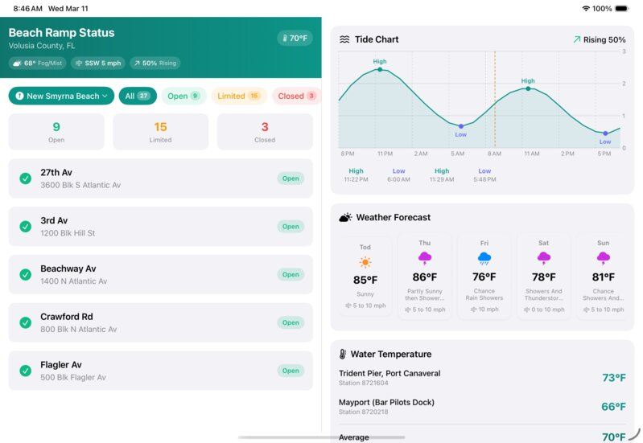
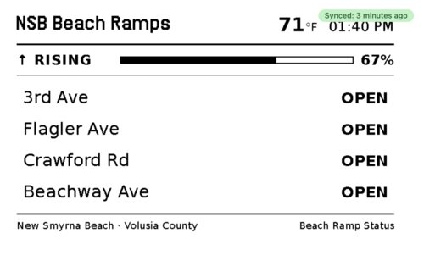
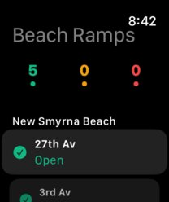
One Codebase, Every Screen
Live on 7 platforms — built part-time over 3 days with Claude Code
Apple TV
Web — Desktop
iPhone
Web Mobile
iPad
TRMNL E-Ink
Apple Watch

