Slide 1

SENTIMENT ANALYSIS
By: Omar Ajamieh , Donya Albarbarawi

Slide 2

Background
This project focuses on sentiment analysis of customer reviews on Amazon, with the goal of understanding public opinion about products by classifying user sentiments as positive, negative, or neutral.

Slide 3
Projects Goals
The main goal of this project is to develop and evaluate machine learning models that can automatically classify user-generated reviews into three sentiment categories: Positive, Negative, and Neutral. By analyzing textual data collected from Amazon reviews.

Slide 4
Methodology
DATA CLEANING AND PREPROCESSING
DATA COLLECTION:
Thedataset was collected from kaggle, Amazon product reviews, which includes user ratings and textual feedback. The dataset originally contained mul tiple columns, including an id column, which was dropped as it was not relevant for the analysis
To prepare the data, ratings were grouped into three sentiment classes: Positive, Negative, and Neutral.
A new "Sentiment" column was added to reflect these categories.
Text preprocessing included removing special characters, lowercasing, tokenization, and stop word removal.
These steps were applied directly to the "Review" column in a single preprocessing function.

Slide 5
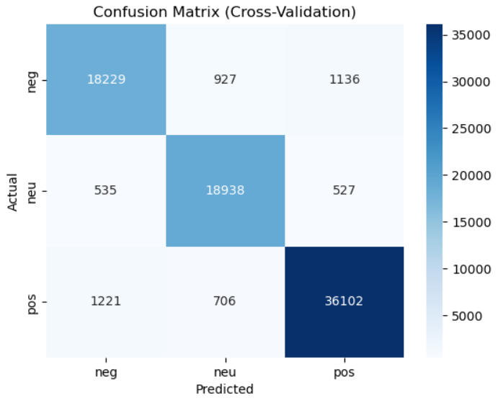
Result
• Random Forest The Random Forest classifier achieved the highest overall perfor mance, with an accuracy of 94.
• Logistic Regression The Logistic Regression model showed a moderate performance with an average cross-validation accuracy of 83.4 Its macro-averaged precision, recall, and F1-score were approximately 81 each.
• LinearSVC The LinearSVC model achieved an average accuracy of around 82.5 based on cross-validation scores. Although slightly lower than Logistic Regression, it still provided competitive results for sentiment classification.

Slide 6
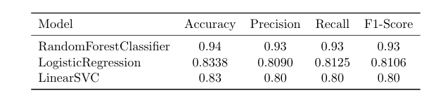
Model Performance Comparison

Slide 7
Conclusion
While all models showed solid results, Random Forest proved most effective for this dataset. The findings align with existing research that supports the strength of classical models when combined with proper preprocessing.

Slide 8
Thank You

