Slide 1


Social Buzz
Data Analytics of Social Media Engagement and Trends

Slide 2


AGENDA
Project Recap
Problem
The Analytics team
Process
Insights
Summary

Slide 3

Social Buzz, a rapidly growing social media platform with over 500 million monthly users, seeks outside expertise to navigate its expansion.
Accenture has initiated a 3-month project with these areas of focus:
Audit of Social Buzz’s big data practice
Recommendations for a successful IPO
Analysis to identify Social Buzz’s top 5 most popular content categories
Project Recap

Slide 4

Problem
Over 100,000 posts daily!
36,500,000 pieces of content a year!
So much data to manage!
Are there best practices for this?

Slide 5
Andrew Fleming
Chief Technical Architect
The Analytics Team
Marcus Rompton
Chief Technical Architect
Daniel Emami
Data Analyst

Slide 6
Process
1
Requirements Gathering
2
Data Cleaning
3
Data Modelling
4
Data Analysis
5
Uncover Insights

Slide 7
Insights
PHOTO
ANIMALS
HEART
Most Uploaded Content
Most Frequent Category
Most Used Reaction
6,589
entries
1,897
entries
1,622
entries

Slide 8
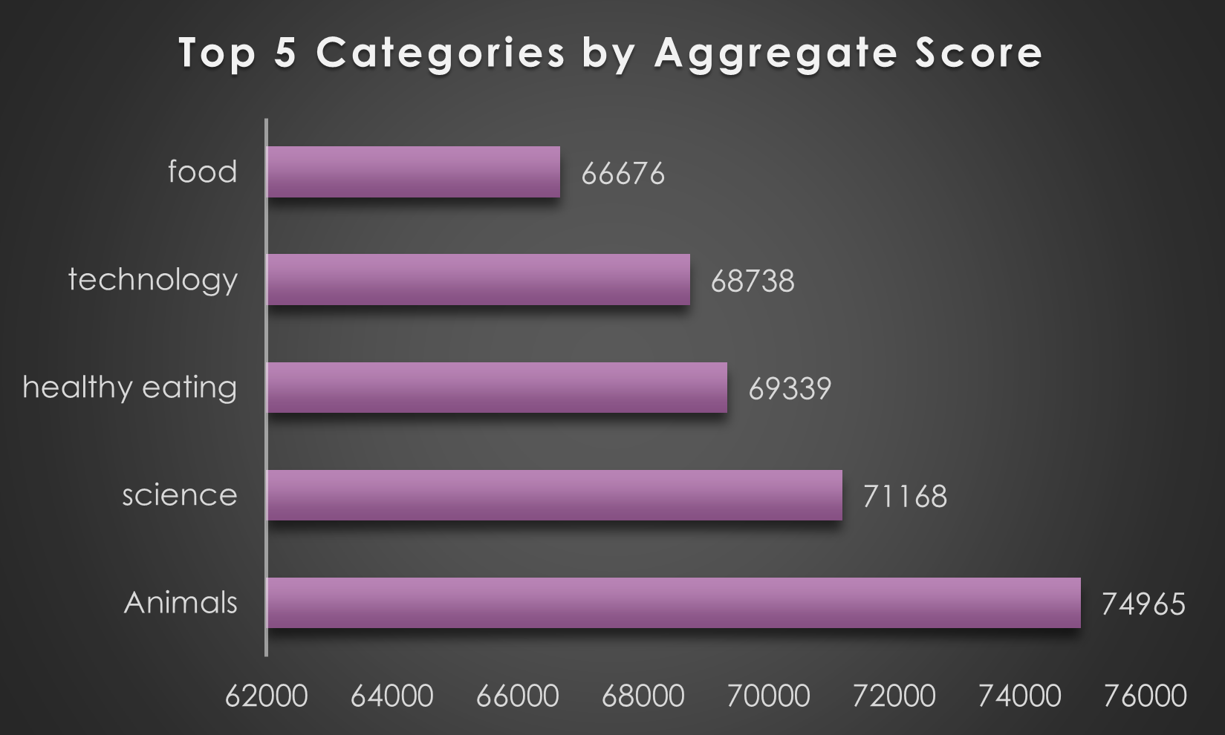

Slide 9
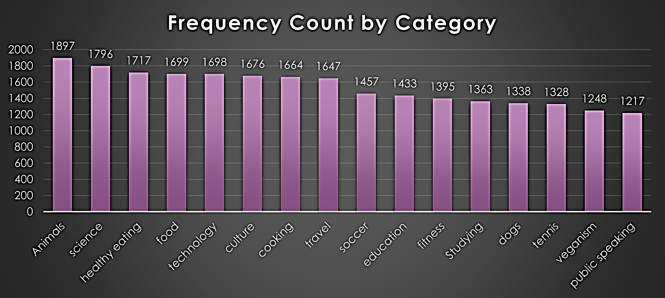
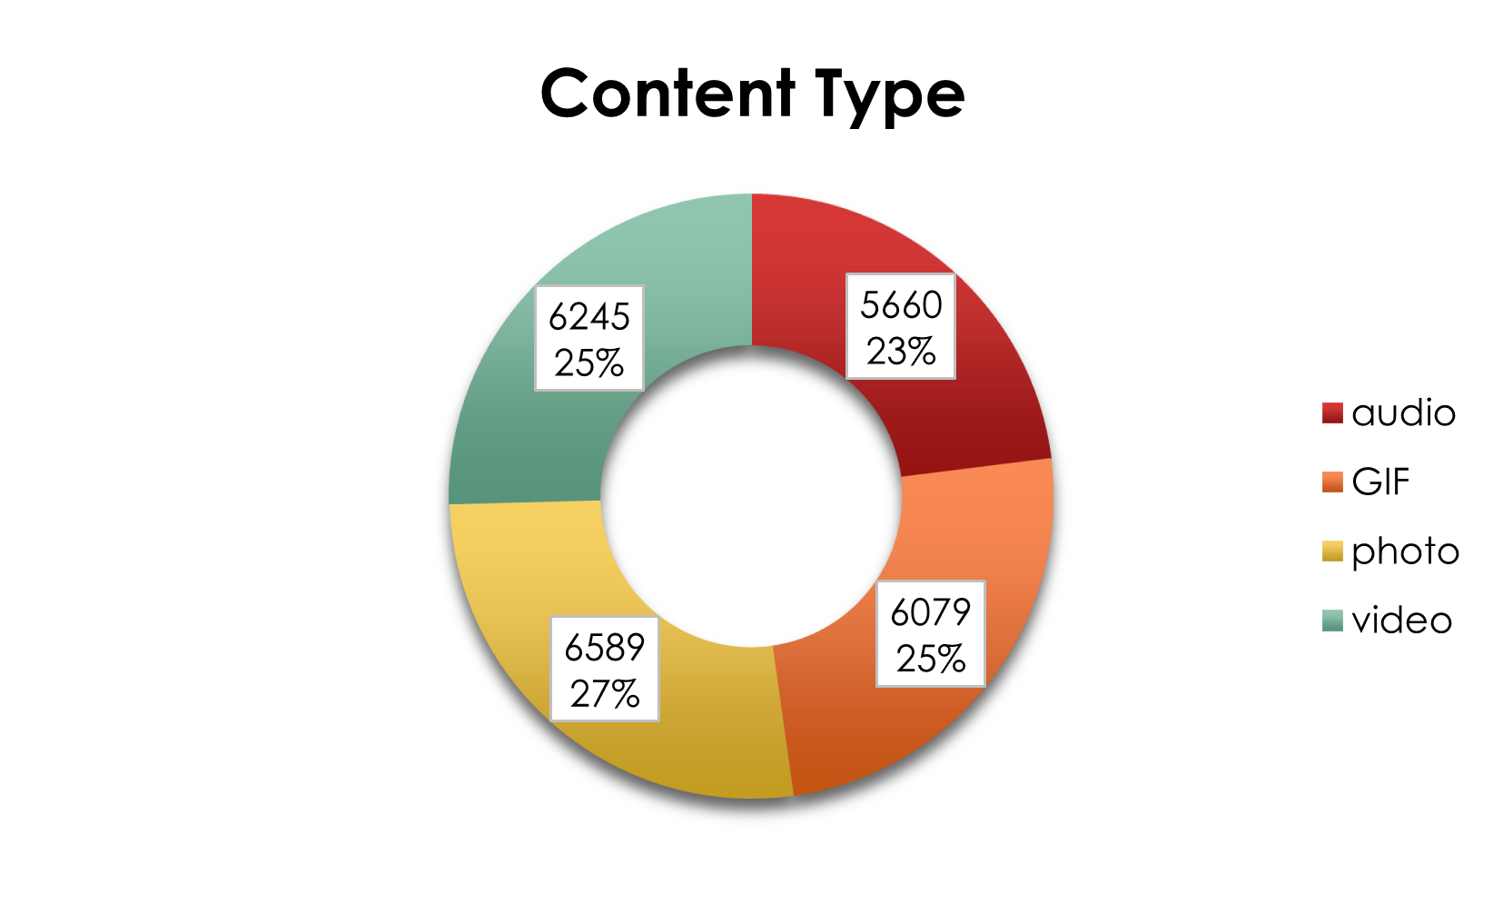

Slide 10

Of the 24,573 entries, the highest
count in content type, category
type, and reaction type were
photos, animals, and heart,
respectively.
Social Buzz should prioritize the top 5 engagement categories: Animals, Science, Healthy Eating, Technology, and Food. Focusing on these areas will boost user interaction and attract more advertisers.
Summary
Maximize strategy effectiveness by A/B testing content and campaigns to identify top engagement drivers. Align marketing with peak periods like May and use sentiment analysis to adapt to user behavior. These steps will support growth and IPO readiness.

Slide 11
Thank you!
ANY QUESTIONS?

