Slide 1
Diabetes analysis
By Donye Wakefield,

Slide 2

Background

Slide 3
Research Question
What are the best factors to predict the outcomes of diabetes?

Slide 4

Data source(s)
Obtained from National Institute of Diabetes and Digestive and Kidney Diseases

Slide 5
Exploratory analysis
Histogram
Box plot
Bar graph
Checking for outliers
Visualization of variables
Shapiro Wilk Test

Slide 6
Advanced analysis
Standardization of predictors
Scatter plot
Correlation matrix
Linear regression modeling

Slide 7
Descriptive statistics
Blood Pressure
Age
BMI
Skin Thickness
Glucose
Diabetes Pedigree Function
BloodPressure Age BMI SkinThickness Glucose
Min. : 0.00 Min. :21.00 Min. : 0.00 Min. : 0.00 Min. : 0.0
1st Qu.: 62.00 1st Qu.:24.00 1st Qu.:27.30 1st Qu.: 0.00 1st Qu.: 99.0
Median : 72.00 Median :29.00 Median :32.00 Median :23.00 Median :117.0
Mean : 69.11 Mean :33.24 Mean :31.99 Mean :20.54 Mean :120.9
3rd Qu.: 80.00 3rd Qu.:41.00 3rd Qu.:36.60 3rd Qu.:32.00 3rd Qu.:140.2
Max. :122.00 Max. :81.00 Max. :67.10 Max. :99.00 Max. :199.0
DiabetesPedigreeFunction Outcome
Min. :0.0780 Min. :0.000
1st Qu.:0.2437 1st Qu.:0.000
Median :0.3725 Median :0.000
Mean :0.4719 Mean :0.349
3rd Qu.:0.6262 3rd Qu.:1.000
Max. :2.4200 Max. :1.000

Slide 8
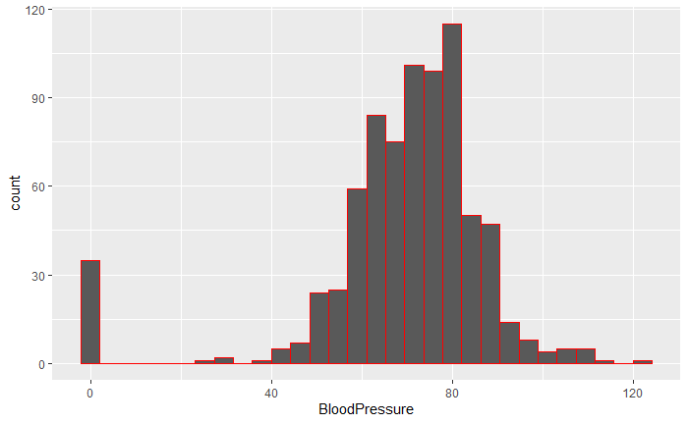
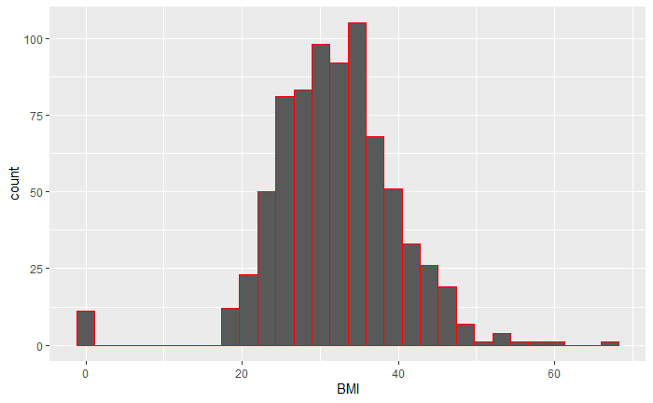
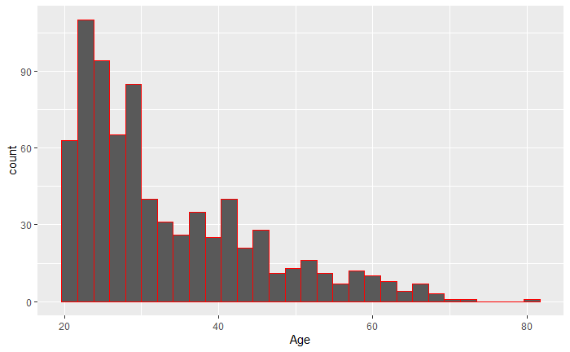
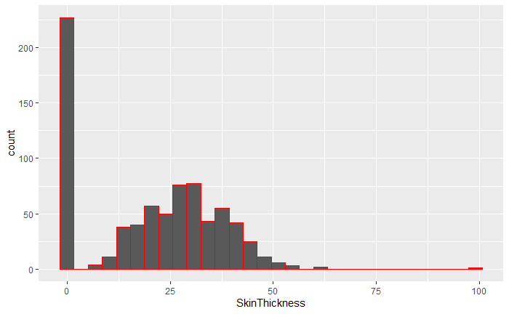
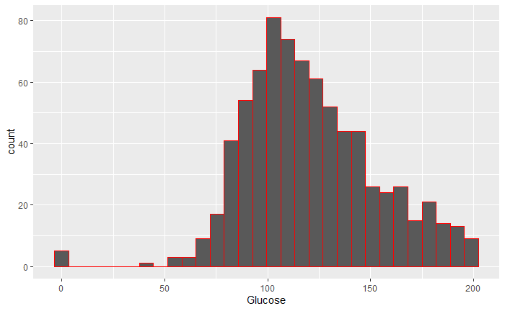
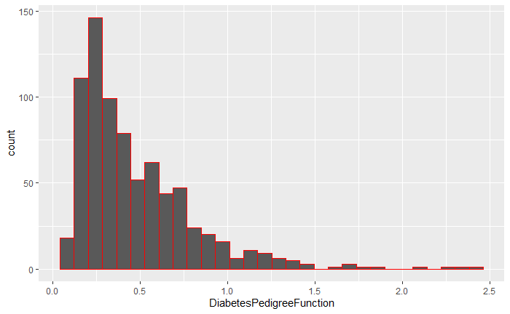
What does the distributions look like?

Slide 9
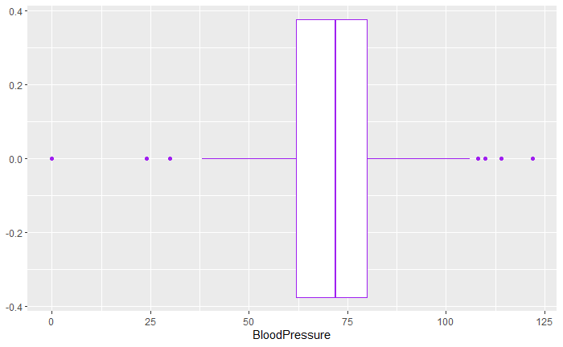
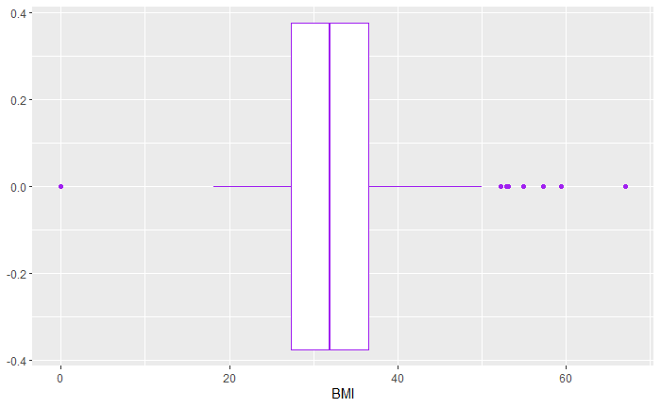
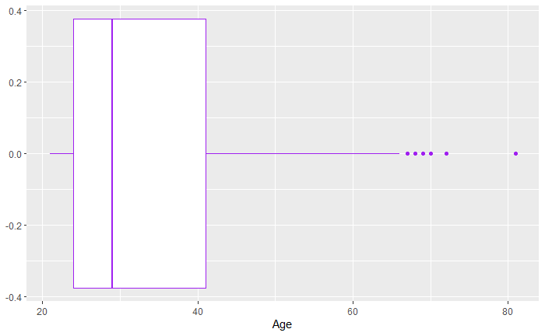
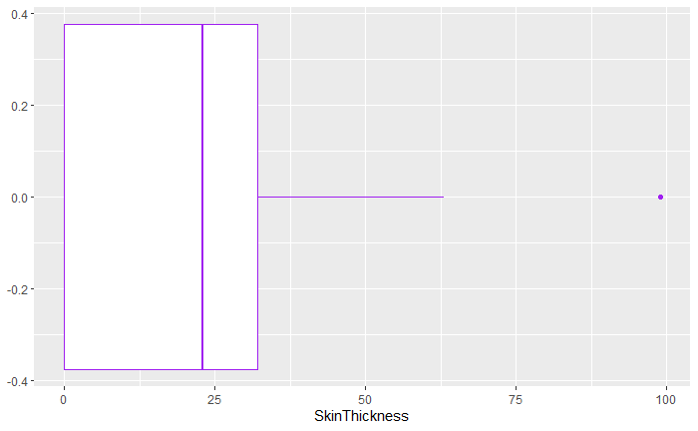
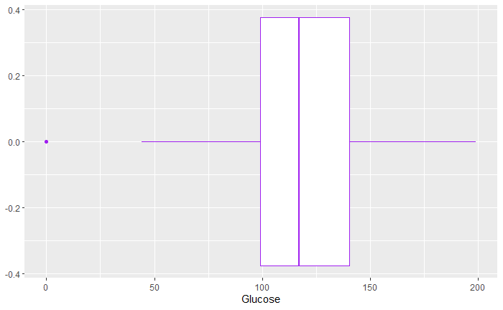
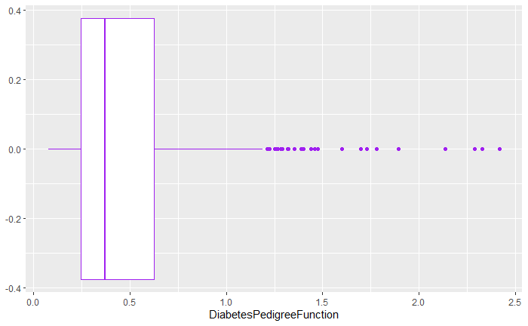
Are there outliers?

Slide 10
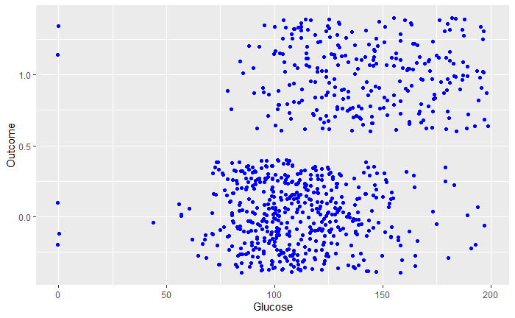
What is the strongest predictor?
It would seem that Glucose wins

Slide 11
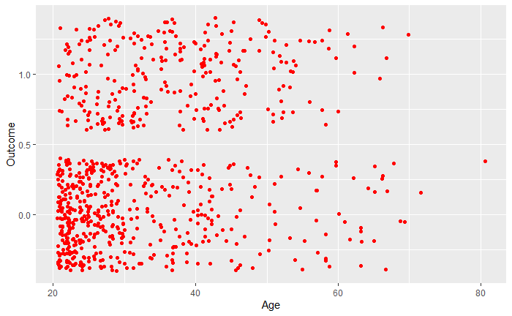
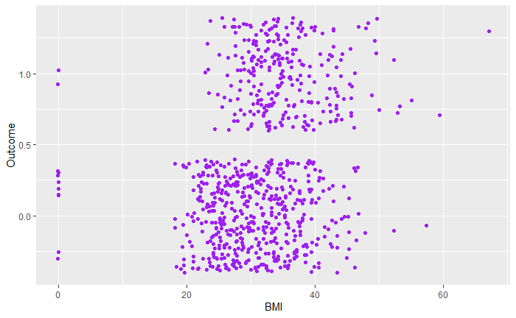
What other 2 has relatively strong correlations?

Slide 12
What is the best model?
Model1
Glucose
Model2
Glucose + Age
Model3
Glucose + Age + BMI
Model4
Glucose + BMI

Slide 13
What are the takeaways?
Glucose is by far the strongest predictor in predicting outcome of diabetes
Age, BMI, and Glucose together formulates the best model for prediction of the outcome of diabetes

Slide 14
Sources
Academic Source #1:
https://www.cdc.gov/diabetes/pdfs/data/statistics/national-diabetes-statistics-report.pdf
Data Source:
https://www.kaggle.com/uciml/pima-indians-diabetes-database
Academic Source #2:
https://towardsdatascience.com/end-to-end-data-science-example-predicting-diabetes-with-logistic-regression-db9bc88b4d16

