Slide 1
Guestfish and the HPE Synergy Image Streamer

Slide 2
Agenda
Overview of the HPE Image Streamer and associated terminology
What is guestfish ?
How does it works
Golden image and OS-Volume creation processes
Image Streamer Plan Scripts
guestfish command examples

Slide 3
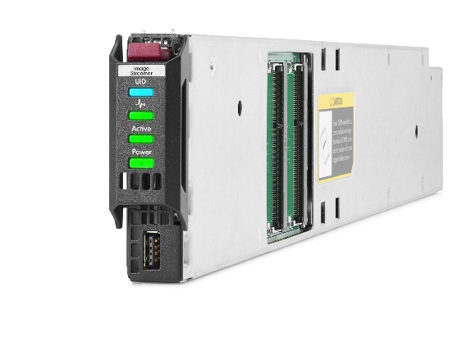
Overview of the HPE Image Streamer
Embedded management appliance used to:
  Deploy personalized OS on Synergy compute nodes
Concepts:
  Golden Image
  Personalized deployment of Golden image using scripts
Technology
  Extensive use of guestfish, the Linux guest filesystem shell
Related Image Streamer terminology
  Plan scripts ; OS Build Plan ; Deployment plan

Slide 4
Image Streamer terminology
Plan scripts – Build Plan – Deployment Plan – Server Profile
Plan script A
OS Deployment Plan
OS Build Plan
Server Profile
Plan script B
OS Build Plan
1
Plan script A
1
Plan script A
Plan script C
OS Deployment
2
Plan script C
2
Plan script C
3
Plan script X
3
Plan script X
Plan script X
OS Golden Image
OS Build Plan contains a list of plan scripts
OS Deployment plan specifies the OS Golden Image and the OS Build Plan to be deployed in the compute node
Plan Scripts perform OS volume configuration
Notes:
Same framework as ICSP

Slide 5
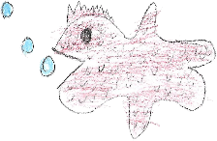
What is guestfish ?
guestfish is a Linux tool for reading and modifying disk images.
guestfish has read and write capabilities in OS-Volumes
HPE Synergy Image Streamer uses guestfish to:
  Capture golden images
  Personalize OS-Volumes
A Plan Script is a set of guestfish commands
mkdir
mount
echo
OS-Volume
ls
VM.vmdk
/
etc
usr
…
init.d
passwd
…
…
Plan Script
Plan Script
Plan Script

Slide 6
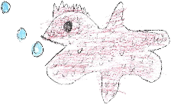
Image Streamer Personalization Environment
Secure Personalization Environment for configuring boot images
OS-Volume
A guestfish environment is used to personalize a boot image’s content (OS-Volume)
  guestfish creates a teardown secured environment within which OS-Volume is presented and Plan scripts are executed.
  Plans scripts have no direct exposure to the Image Streamer host environment
guestfish executes within a non-privileged non-interactive Image Streamer OS user – imguser
  imguser context is mapped to an SELinux guest role.
  Prevents execution of privileged commands within Plan scripts
imguser is assigned a restricted bash (rbash) as shell and a separately mounted scratch partition as its home directory.
  This further constrains what is accessible to the Plan script.
Image Streamer
guestfish isolated secure environment
Plan Script
Hardware

Slide 7
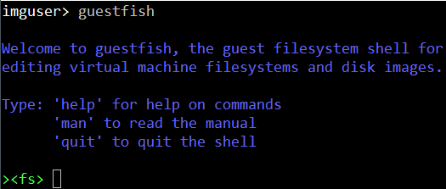



How does this works?
Interaction between the Image Streamer and guestfish
OS-Volume
Image Streamer prepares a secure working place with visibility to an OS-Volume properly formatted.
Image Streamer starts guestfish as a non privileged user
guestfish connects to the OS-Volume in Read-Write mode
guestfish gets Plan Scripts from the Image Streamer and execute them
Image Streamer cleans the working place
Image Streamer
Secure place
Plan Script
Hardware

Slide 8
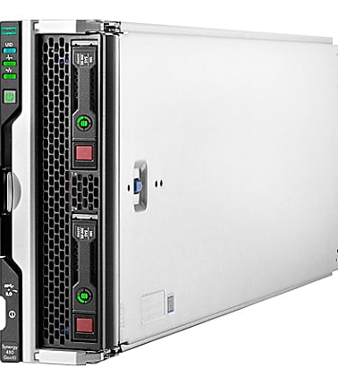

Golden image creation process (1/2)
Building the image foundation
OS-Volume with OS installed
Image Streamer creates an empty OS-Volume
  OneView applies a specific profile to server
System Administrator performs a manual OS installation in this empty OS-Volume
  Mount .iso as Virtual Media
  Kickstart
  ….
Empty OS-Volume
Image Streamer
Hardware

Slide 9

Golden image creation process (2/2)
Capture and creation of a golden image
Golden-Volume
OS-Volume with OS installed
Image Streamer transforms OS-Volume into a Golden Volume
Image Streamer prepares secure environment and starts guestfish as an unprivileged user
Image Streamer connects guestfish to the Golden-Volume
Capture Scripts executed by guestfish
Image Streamer cleanup
Image Streamer transforms the Golden Volume into a Golden Image
Capture Script
Golden Image
Capture Script
Image Streamer
Secure place
Hardware

Slide 10
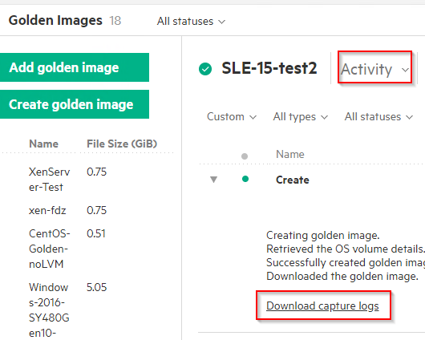
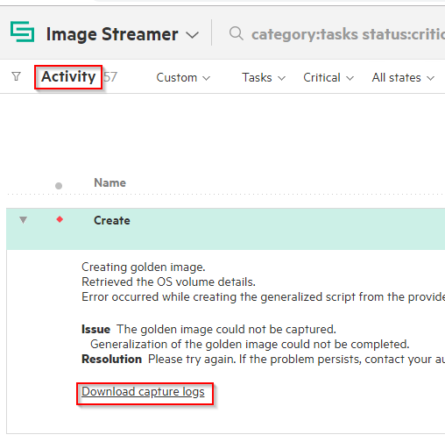
Golden image creation logs
For debug and troubleshooting purposes
Golden Image Activity logs
Image Streamer Activity logs

Slide 11
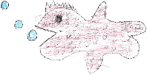

OS-Volume personalization process
Use of Deployment Plan Scripts
OS-Volume
Personalized OS-Volume
Plan Script
Image Streamer clones Golden image into an OS-Volume
Image Streamer creates secure environment and starts guestfish as an unprivileged user
guestfish connects to OS-Volume in RW mode
Deployment Plan Scripts executed by guestfish
Image Streamer cleanup
Compute node ready to boot on the personalized OS-Volume
Golden Image
Plan Script
Image Streamer
Secure place
Hardware

Slide 12
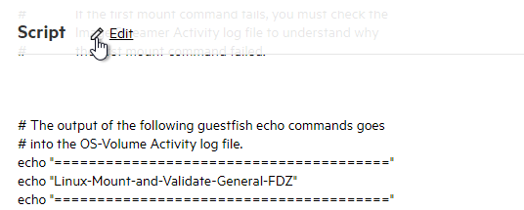
What is an Image Streamer Plan Script ?
OS-Volume
It is a text file containing:
  Comments starting with a “#” sign
  guestfish commands executed in OS-Volume:
    list-filesystems
    mount /dev/sda2 /
    write /file-in-OSVolume "content text"
  Commands executed by the Image Streamer’s restricted bash:
    !grep "string" ./file-in-ImageStreamer
  guestfish commands generated by the Image Streamer’s rbash:
    <!for i in `seq 1 9`; do echo " write /file-in-OSVolume.$i $i "; done
Image Streamer
Secure place
(restricted bash)
Hardware

Slide 13
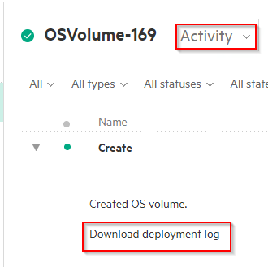
OS-Volume deployment Plan script log files
For debug and troubleshooting purposes
OS-Volume Activity logs
Image Streamer Activity logs

Slide 14
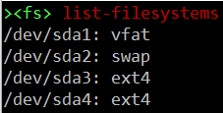



guestfish command examples
Commands for reading or modifying the OS-Volume content
Description
guestfish command
  List file systems and associated type present in the OS-Volume
  Locate the root OS file system of this OS-Volume
  Retrieve distro type
  Mount the OS root file system. The “-“ prefix ensures guestfish don’t exit on failure
  Make directories recursively in the OS-Volume
  Create an empty file in the OS-Volume
  Remove recursively files or directories from the OS-Volume

Slide 15
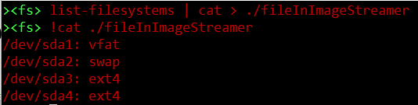
Mixed guestfish and bash command examples (1/2)
Interaction between the OS-Volume and the Image Streamer
Description
guestfish command
The output of the list-filesystems guestfish command is processed by the bash cat command writing in a file located in the Image Streamer secure place.
The cat command is executed by the restricted bash.
It prints the content of a file based in the Image Streamer restricted area.

Slide 16
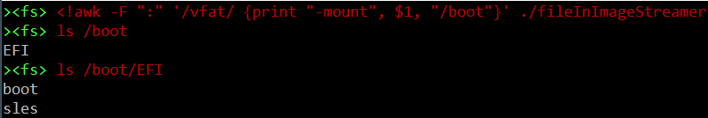

Mixed guestfish and bash command examples (2/2)
Interaction between the OS-Volume and the Image Streamer
Description
guestfish command
The awk command is executed by the restricted bash of the Image Streamer.
It looks for string vfat in a file located in the Image Streamer secure place.
When found, it prints a guestfish -mount command.
The “-mount” string produced by the awk command is processed by guestfish.
It mounts the EFI partition of the OS-Volume on /boot. guestfish won’t exit upon error.
Un-mount all mounted file systems in the OS-Volume:
/boot and /

Slide 17
In and out communications (1/4)
Exporting files from the OS-Volume to the Image Streamer
OS-Volume
download: copy-out an OS-Volume file toward the Image Streamer secure area
  download /tmp/OSV-file ./IS-file
/tmp/OSV-file
Image Streamer
Secure area
./IS-file
Hardware

Slide 18
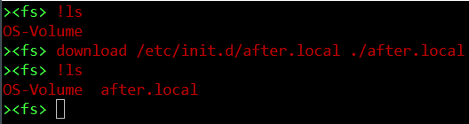
In and out communications (2/4)
Example
There is only one file in the secure area of the Image Streamer
Copy-out a file to the Image Streamer secure area
List files in the secure area of the Image Streamer

Slide 19
In and out communications (3/4)
Importing files from the Image Streamer to the OS-Volume
OS-Volume
upload: copy-in an Image Streamer file toward the OS-Volume
  upload ./IS-file /tmp/OSV-file
/tmp/OSV-file
Image Streamer
Secure area
(restricted bash)
./IS-file
Hardware

Slide 20
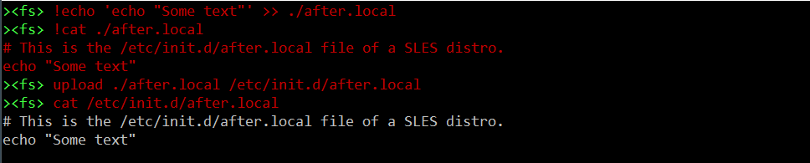
In and out communications (4/4)
Common example used in Plan Scripts
Restricted bash appends text in an Image Streamer file
Rbash prints the content of the Image Streamer file
guestfish copies the file in the OS-Volume
guesfish prints the content of the OS-Volume file

Slide 21
Advanced examples
How do I populate an OS-Volume file?
OS-Volume
Solution 1: Use write and write-append guestfish commands:
write /dir/OSV-file "text1"
write-append /dir/OSV-file "text2"
Solution 2: upload rbash’s standard input into OS-Volume until anystring is encountered:
upload -<<anystring /dir/OSV-file
text1
text2
anystring
text1
text2
Image Streamer
Secure area
(restricted bash)
text1
text2
Hardware

Slide 22
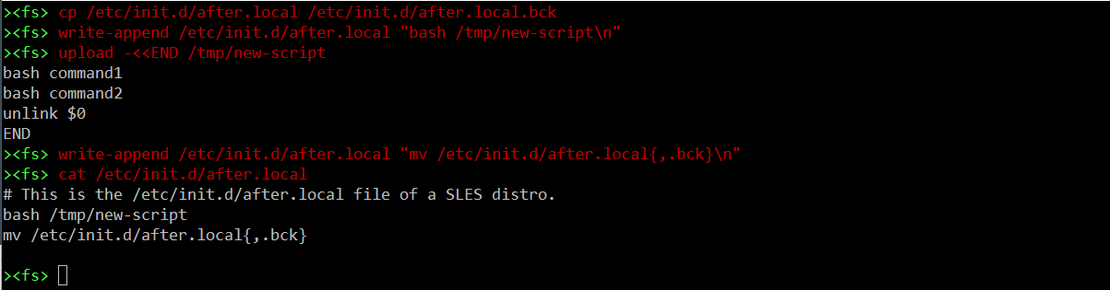
In and out communications (2/4)
Guestfish creates script to be executed during OS-Volume first boot only
Guestfish backups OS-Volume rc file
Guestfish appends string to OS-Volume rc file
Guestfish creates script in OS-Volume
Guestfish appends rc file restore command and prints content of current OS-Volume rc file

Slide 23
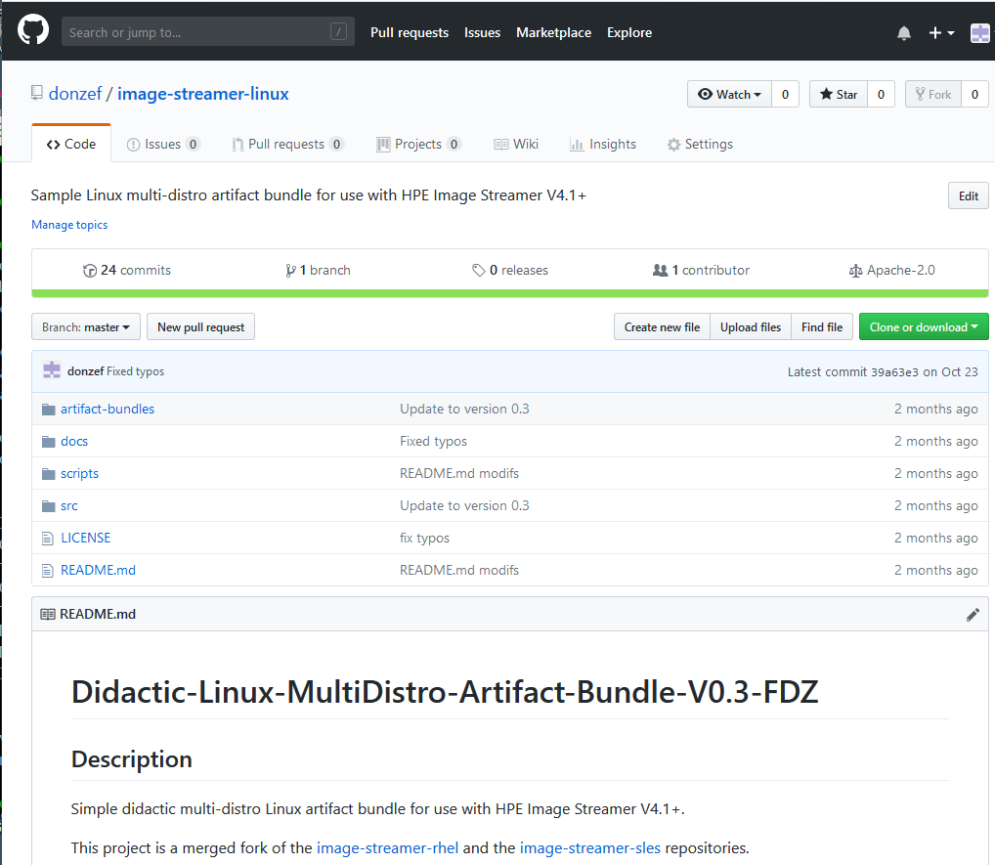
Take away
More examples on GitHub
Didactic Linux MultiDistro artifact bundle
  GitHub repository: image-streamer-Linux
  Single bundle for SLES, RHEL, CentOS and XenServer
  No installation needed to view Plan Scripts sources
  Script provided to extract Plan Scripts from .ZIP artifact bundles
  Plan Scripts with a lot of comments

Slide 24
Thank you
Music: http://www.bensound.com/royalty-free-music

