Slide 1

University of Ghana:
Project Work Repository System

Slide 2

Contents
Below are the list of contents in the University of Ghana: Project Work Repository System Presentation Template:
Introduction.
Problem Statement.
Objectives.
Methodology.
Conclusion.

Slide 3
01
Introduction
Navigating Innovation: Unveiling the University of Ghana: Project Work Repository

Slide 4
Introduction
Idea
In an ever-evolving land scape of academia,the pursuit of knowledge is a dynamic journey, marked by exploration and innovation. As we delve into the heart of this topic, envision an odyssey that transends the traditional boundries. It serves as a centralized hub, meticoulously designed to archive and showcase the rich tapestry of project works that define the accademic prowess of the university of Ghana

Slide 5
02
Problem Statement
Unveiling Challenges, Unlocking Solutions: Navigating the Landscape of Academic Project Work Management at the University of Ghana.

Slide 6
Problem Statement: Understanding the Problem
In the contemporary academic landscape, the University of Ghana faces a challenge in efficiently managing, preserving, and disseminating the diverse array of project works produced by its scholars. The absence of a centralized and user-friendly repository hampers the accessibility and visibility of these invaluable contributions to knowledge.
The current disjointed systems for storing and sharing project works result in difficulties for both contributors and stakeholders. Scholars lack a unified platform to showcase their research, hindering collaboration and the cross-pollination of ideas. Moreover, the absence of a comprehensive repository diminishes the University's capacity to highlight and celebrate the intellectual achievements of its academic community.
This project aims to address these challenges by establishing the "University of Ghana: Project Work Repository," a centralized and dynamic digital platform designed to streamline the storage, accessibility, and collaboration around project works. By doing so, we seek to enhance the visibility of scholarly efforts, foster interdisciplinary collaboration, and provide a robust foundation for showcasing the intellectual prowess of the University.
The problem at hand is not merely technological; it is a challenge of knowledge curation, collaboration facilitation, and academic recognition. Through the implementation of this repository, we aspire to create a solution that not only mitigates these challenges but also transforms the way we perceive, share, and celebrate the collective intellectual journey of the University of Ghana.

Slide 7
03
Objectives
Nurturing a Digital Haven: Achieving Comprehensive Objectives for the University of Ghana Project Work Repository.

Slide 8
Objectives
Establish a Centralized Platform
Develop a robust and intuitive interface that facilitates easy navigation, search, and retrieval of project works for both contributors and users.
01
02
Enhance Accessibility
Create a user-friendly digital repository that consolidates project works from diverse disciplines within the University of Ghana.
Integrate with Academic Systems
04
Establish mechanisms to encourage and hold both students and supervisors accountable, fostering a holistic relationship to ensure the success and integrity of the repository.
03
Establish seamless integration with existing academic systems to simplify the process of adding project works and to enhance the overall academic workflow.
Encourage Accountability

Slide 9
04
Methodology
Navigating the Digital Landscape: Methodological Strategies Implemented in the University of Ghana Project Work Repository.

Slide 10
Methodology Approach
The methodology employed in the development of the "University of Ghana: Project Work Repository" encompasses a comprehensive and systematic approach to ensure the success of this transformative initiative. Through a combination of qualitative and quantitative methods, our methodology aims to capture the richness of project works, understand stakeholder needs, and implement a user-friendly digital platform that fosters collaboration and knowledge exchange.
At its core, the methodology aligns with the overarching goals of the project title by addressing the challenges faced in managing, preserving, and disseminating project works within the University of Ghana. The systematic approach ensures the creation of a centralized repository that not only simplifies the storage and retrieval of project works but also promotes collaboration and recognition within the academic community.
To bring structure and clarity to the development process, we adopted the Waterfall Model. This model is well-suited for our project, offering a sequential and linear approach that aligns with the nature of creating a comprehensive repository. The Waterfall Model consists of distinct phases, each building upon the previous one, providing a clear roadmap for development and ensuring a thorough understanding of project requirements.

Slide 11
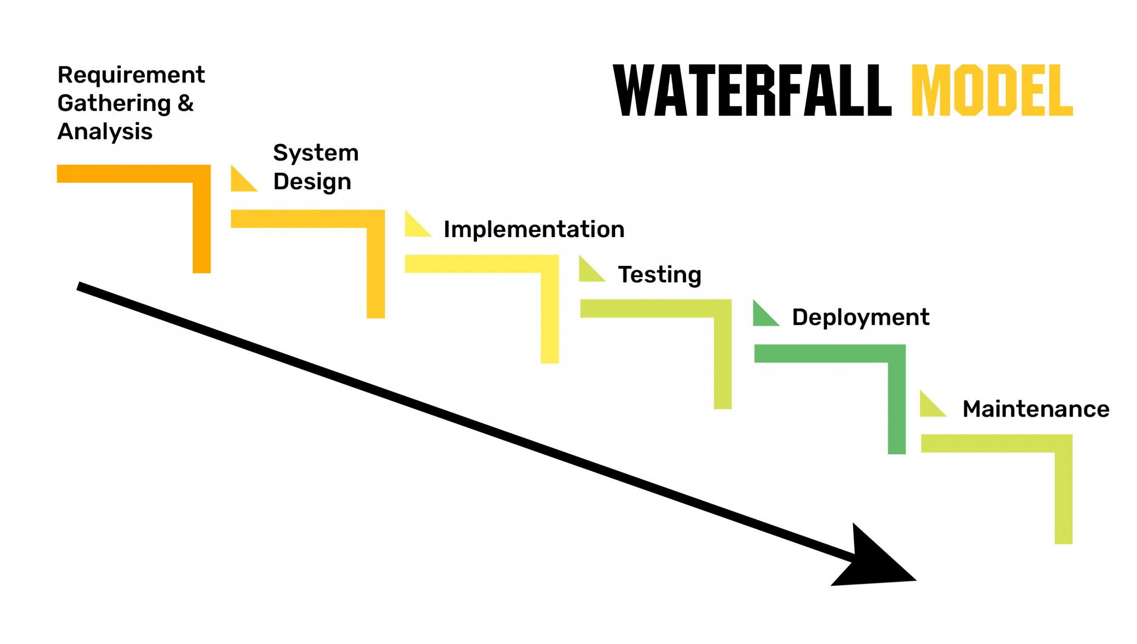

Slide 12
Brief Explanation of The Waterfall Model
Requirements Gathering and Analysis: In this phase, the project team identifies and documents the specific needs and expectations of stakeholders. For the "University of Ghana: Project Work Repository," this involves understanding the requirements of both contributors (students and faculty) and users (those accessing project works). It ensures that the repository is designed to meet diverse needs, ranging from content organization to user interface preferences.
System Design: Once the requirements are gathered, the system design phase begins. This involves creating a detailed plan for the repository's architecture and functionality. For this project, the emphasis is on developing a robust and intuitive interface that facilitates easy navigation and incorporates features supporting collaboration and recognition. The goal is to create a user-friendly platform that aligns with the project's objectives.
Implementation: With the system design in place, the implementation phase involves building the actual repository according to the design specifications. This includes coding, database creation, and integrating functionalities such as easy navigation, version control, and robust data security. The aim is to bring the planned design to life, ensuring that the repository aligns with the project's vision and goals.
Testing: The testing phase is crucial for validating the functionality and usability of the repository. Rigorous testing is conducted to identify and address any potential issues or bugs. Testing ensures that the repository meets the highest standards of performance, usability, and reliability. For the project at hand, this phase ensures that contributors and users have a seamless experience and that the repository functions as intended.

Slide 13
Continuation
Deployment: After successful testing, the deployment phase involves launching the repository. It becomes accessible to the University of Ghana community, allowing contributors to upload project works, and users to explore and engage with the content. This phase marks the transition from development to the active use of the repository by the target audience.
Maintenance: The maintenance phase involves ongoing support and updates. It ensures that the repository continues to function effectively and adapts to evolving needs. Maintenance may include addressing user feedback, implementing enhancements, and keeping the platform secure. This phase is essential for the long-term success and sustainability of the project.
Note: In the context of the Waterfall Model, each phase is completed before moving on to the next, providing a structured and linear approach to project development.

Slide 14
Simplifying Technicalities
Understanding that not all stakeholders may be interested in the technical details, I have provided a comprehensive documentation package that delves into the intricacies of the methodology and development process. For those who wish to explore the project's technical aspects further, the documentation includes the Waterfall Model diagram, detailed explanations of each phase, and insights into why this model was the optimal choice for our project.
In this way, I aim to strike a balance between providing transparency about the development approach and respecting the diverse interests of our stakeholders.

Slide 15
05
Conclusion
Empowering Academic Excellence: A Glimpse into the Future of Collaborative Knowledge Discovery at the University of Ghana.

Slide 16
Conclusion
In the culmination of the "University of Ghana: Project Work Repository" initiative, we stand at the threshold of a new era in academic collaboration and knowledge dissemination. Through a meticulous methodology rooted in stakeholder engagement, intuitive design, and a commitment to excellence, we have laid the foundation for a transformative digital repository.
Navigating the Digital Landscape: From the inception of the project, our aim was clear — to navigate the digital landscape of academia and create a centralized repository that not only stores project works but also fosters collaboration, recognition, and the seamless exchange of knowledge.
The Waterfall Model: Guided by the structured approach of the Waterfall Model, we progressed through distinct phases — from requirements gathering and system design to implementation, testing, deployment, and ongoing maintenance. Each step was a testament to our dedication to precision and the creation of a repository that meets the diverse needs of our academic community.
Empowering Academic Excellence: As we conclude this chapter, we anticipate the repository's role in empowering academic excellence at the University of Ghana. It stands as a digital haven where the collective wisdom of our scholars converges, creating a dynamic space for the exploration of ideas and the celebration of intellectual achievements.
A Special Thanks: A special note of gratitude goes to my esteemed supervisor, whose guidance, expertise, and unwavering support has been the cornerstone of this endeavor. Your mentorship has not only shaped the project but has also contributed significantly to my growth as an aspiring professional. Thank you for your dedication and belief in the vision of this repository.

Slide 17
Continuation
Looking Forward: As we look forward, the "University of Ghana: Project Work Repository" is not just a culmination; it is a beginning. It is an invitation for all to explore, engage, and contribute to the vibrant academic tapestry of our institution. Together, let us embrace this digital frontier and continue the journey of collaborative knowledge discovery.
With sincere gratitude,
Daniel Osei-Tutu Abrokwa
Student
Student ID – 10713901
Project Title – University of Ghana: Project Work Repository

Slide 18
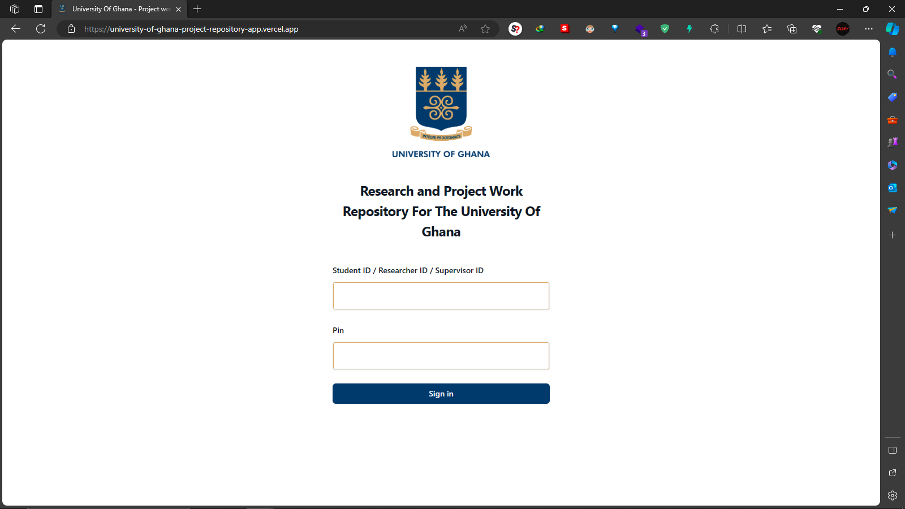
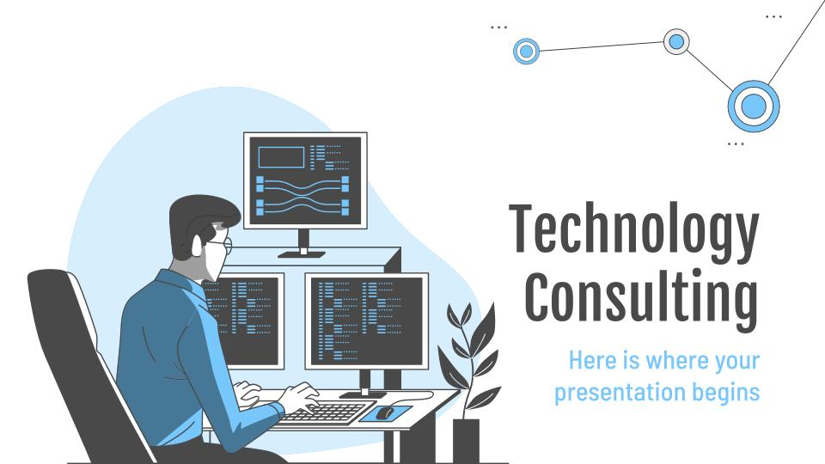
Desktop Software
This is to showcase how the final product or project looks like.

Slide 19
Thanks!
Do you have any questions?
danielabrokwajnr@gmail.com
+233 50 857 9330
Please keep this slide for attribution

Slide 20
Alternative Resources
Find more illustrations like these on Stories by Freepik

Slide 21


