Slide 1

日常是怎样使用GIT
分享者：河蟹堡
2023 / 01 / 28

Slide 2
1. 基本流程图
目录
2. 生命周期图
3. 工作流程图
4. 常用命令行

Slide 3

GIT协同开发
>

Slide 4
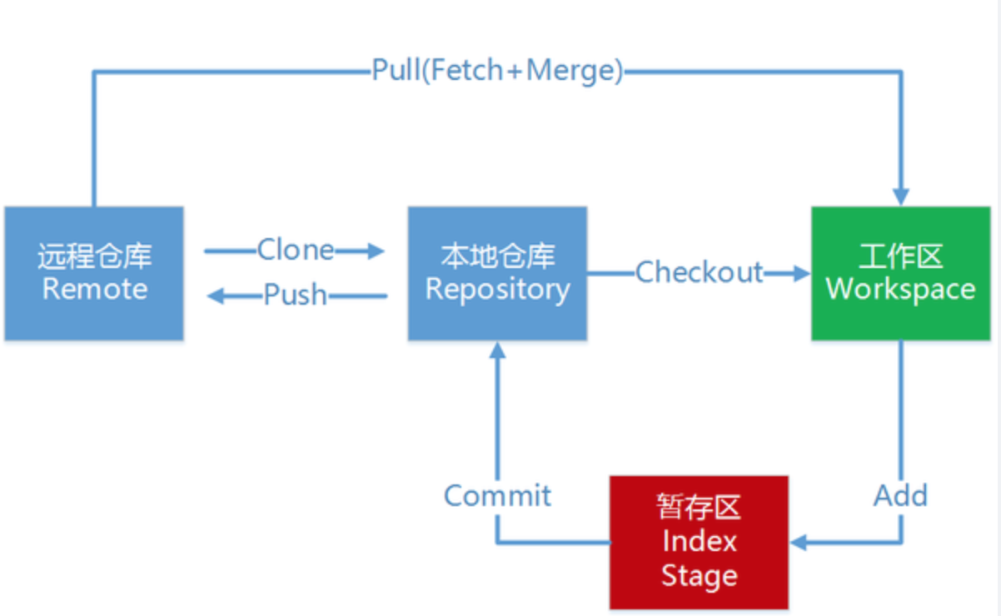
基本流程图

Slide 5
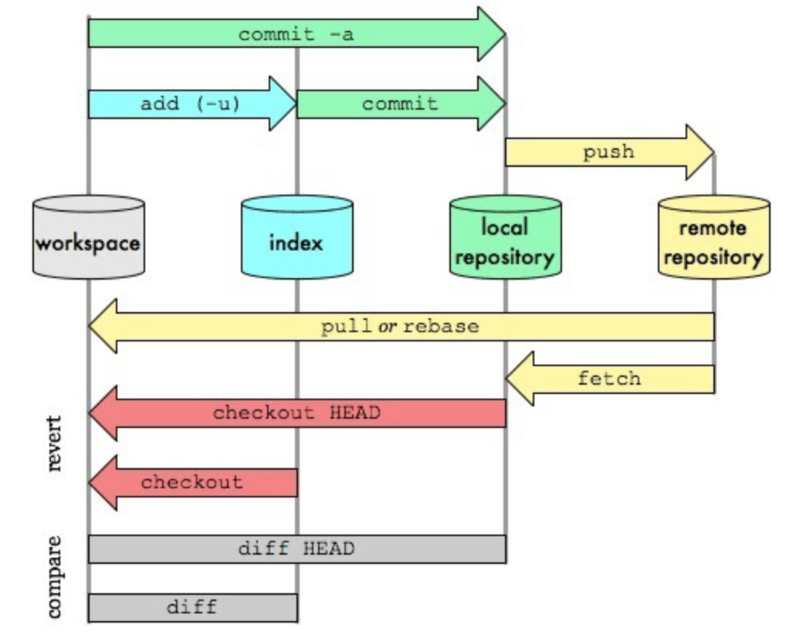
生命周期图

Slide 6
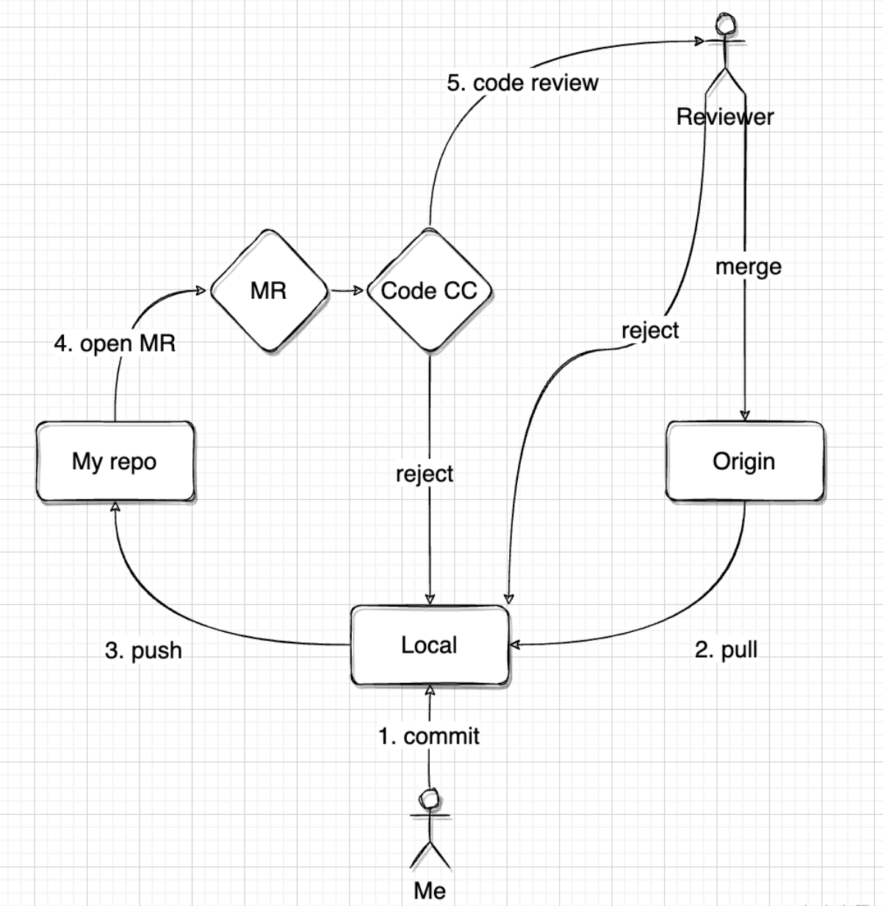
工作流程图

Slide 7
常用命令行
# 抓取origin仓库master分支的代码
git fetch origin master
# 将origin仓库master分支的代码与当前分支的代码合并(先fetch再merge)
git merge origin/master
# 将origin仓库master分支的代码与当前分支的代码强制合并
git merge origin/master --allow-unrelated-histories
# 查看合并后的情况（包括冲突文件）
git diff
# 解决有冲突的提交
git stash #将本地修改存储起来
git stash list #查看保存的信息
git pull #暂存了本地修改之后，就可以pull了
git stash pop stash@{0}
# 还原暂存的内容, 最后解决文件中冲突的的部分
Updated upstream 和=====之间的内容就是pull下来的内容，====和stashed changes之间的内容就是本地修改的内容
Notes:
Core Objects
Core objects include the following types of objects −
Logger Object
The top-level layer is the Logger which provides the Logger object. The Logger object is responsible for capturing logging information and they are stored in a namespace hierarchy.
Layout Object
The layout layer provides objects which are used to format logging information in different styles. It provides support to appender objects before publishing logging information.
Layout objects play an important role in publishing logging information in a way that is human-readable and reusable.
Appender Object
This is a lower-level layer which provides Appender objects. The Appender object is responsible for publishing logging information to various preferred destinations such as a database, file, console, UNIX Syslog, etc.
Support Objects
There are other important objects in the log4j framework that play a vital role in the logging framework:
Level Object
The Level object defines the granularity and priority of any logging information. There are seven levels of logging defined within the API: OFF, DEBUG, INFO, ERROR, WARN, FATAL, and ALL.
Filter Object
The Filter object is used to analyze logging information and make further decisions on whether that information should be logged or not.
An Appender objects can have several Filter objects associated with them. If logging information is passed to a particular Appender object, all the Filter objects associated with that Appender need to approve the logging information before it can be published to the attached destination.
ObjectRenderer
The ObjectRenderer object is specialized in providing a String representation of different objects passed to the logging framework. This object is used by Layout objects to prepare the final logging information.
LogManager
The LogManager object manages the logging framework. It is responsible for reading the initial configuration parameters from a system-wide configuration file or a configuration class.

Slide 8
总结
>

