Slide 1
Matrix Multiplication Problem
Aaron Soares Bahzad Ahmed Owais Bin Asad

Slide 2
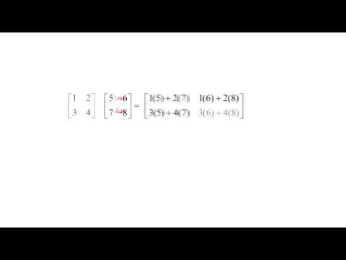
An Introduction to Matrix Multiplication

Slide 3
Naïve Implementation
Assumes we have two square matrices
Iterates over every row of the first matrix and every column of the second matrix
Multiplies every element from row of first matrix to subsequent element from column of second matrix
Sums the values and inserts them into the resultant matrix

Slide 4
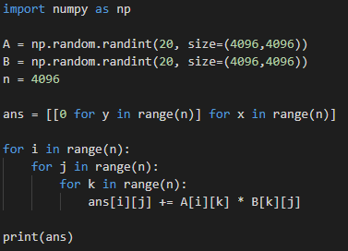
Naïve Implementation Analysis
Time Complexity is O(n³)

Slide 5
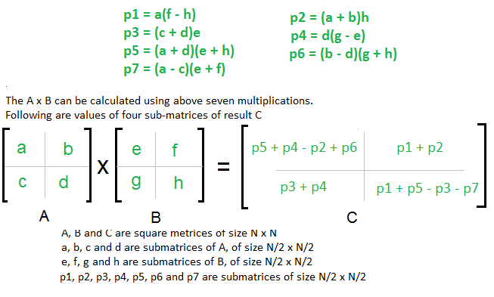
Strassen's Algorithm
Uses divide and conquer strategy
Divides the matrices being multiplied into smaller sub-matrices thereby forming smaller sub-problems to our original problem of multiplication

Slide 6
Strassen's Algorithm Analysis
Addition and subtraction of the two matrices takes O(n²) time
T(n) = 7T(n/2) + O(n²)
Using the Master's Theorem, time complexity is:
O(n^{Log7}) ≈ O(n^{2.8074})

Slide 7
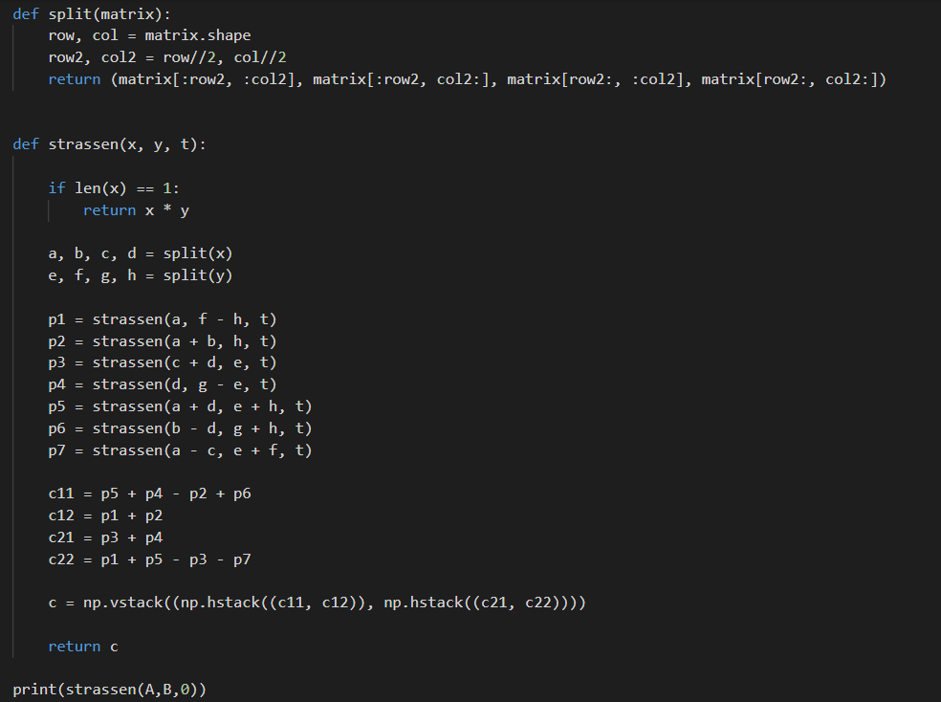

Slide 8
Theoretical Comparison
Naïve Implementation
Strassen's Implementation
O(n^{log7})
O(n³)

Slide 9
Empirical Comparison
Naïve Method
Strassen's Method
Dimensions: 1024x1024
Runtime (avg): 2207 s ~ 37 mins
Dimensions: 512x512
Runtime (avg): 286 s ~ 4.75 mins
Dimensions: 256x256
Runtime (avg): 32 s
Dimensions: 128x128
Runtime (avg): 5 s
Dimensions: 1024x1024​
Runtime (avg): 3211 s ~ 54 mins​
​
Dimensions: 512x512​
Runtime (avg): 496 s ~ 8.2 mins
Dimensions: 256x256
Runtime (avg): 64 s
Dimensions: 128x128
Runtime (avg): 8.7 s
System Configuration: Processor: Intel Core i5 8250U RAM: 12 GB Power Saving: Max Performance Mode
*Averages are of a sample size of 5 each

Slide 10
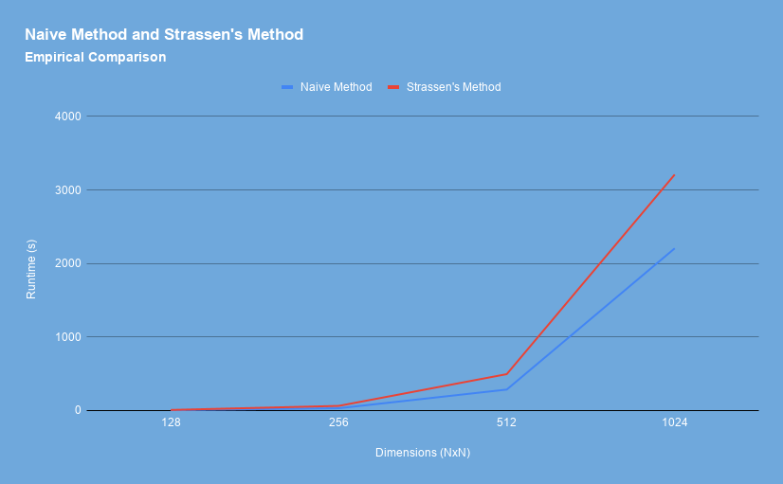

Slide 11
But isn't O(n^{2.8074}) < O(n³)?
🤔
Then why is Strassen's taking longer?

Slide 12
Disadvantages of using Strassen's for practical purposes
Recursion in Strassen's Algorithm increases stack memory as the parameters and variables for each call is stored
The extra calls to memory increase latency and add to the overall overhead

Slide 13

Feel free to ask any questions.

Slide 14
1. Add code snippets [Owais]
2. Add reasoning for why Strassen's doesn't work [Aaron]
3. Add empirical analysis [Owais]
3.5. Finishing touches
4. Distribute slides
5. Record our video
6. Create a report .tex file and add everything to it except for feedback (which we will get in class on Wednesday)

