Slide 1

WIPRO NGA Program –.NET Full Stack (25VID0820)
Capstone Project Presentation –14th June 2025
Project Title – Online Book Library System
Presented by - Manjunath Lakshminarayan Pallala
www.rpsconsulting.in

Slide 2

Project overview
The Online Book Library project is designed to provide a simple yet effective solution for managing a collection of books in a digital library setting.
It aims to serve library administrators and readers by offering an easy-to-use web interface where books can be added, edited, viewed, or deleted.
The main problem it addresses is the inefficiency and complexity involved in traditional library management systems by automating basic operations and providing centralized access.
The system supports essential features like maintaining book details and tracking availability, which helps streamline library workflows and improve user experience.
2025 - RPS Consulting all rights reserved

Slide 3
Features
- View list of books with details
- Add new books to the library
- Edit existing book records
- Delete books from the collection
- Responsive UI using Bootstrap
2025 - RPS Consulting all rights reserved

Slide 4
Technologies Used
- ASP.NET MVC Framework
- Entity Framework
- SQL Server for database
- Bootstrap 5 for responsive UI
- C# as the programming language
- HTML5, CSS3, and JavaScript
- VS Code 2022 IDE
2025 - RPS Consulting all rights reserved

Slide 5
Architecture
MVC Architecture: Model-View-Controller design pattern
- Models represent data (Book model)
- Views display UI (Razor views)
- Controllers handle user requests and responses
Entity Framework Core connects app to SQL database
Bootstrap framework for front-end styling
2025 - RPS Consulting all rights reserved

Slide 6
Database Design
Single table: Books
Fields include:
- Id (Primary Key)
- Title (string)
- Author (string)
- Genre (string)
- PublishedYear (int)
- IsAvailable (bool)
2025 - RPS Consulting all rights reserved

Slide 7
ASP .NET App Creation
Create an ASP .NET MVC app using C# with the templates provided in Visual Studio Code 2022
Retain default options and create the application
Add a class to the Models folder and name it Book.cs
Write the C# code for the schema logic here
Now add a Controller with Razor views , refer to the base class Book.cs and name it BooksController.cs
Now go to the views added in Views/Books after scaffolding is done
Edit all views for the BooksController with bootstrap CSS tags , for example changing the color and layout of buttons and the page with accent colors
Save the files
Now add a Data folder and add ApplicationDbContext.cs file to the app
Open NuGet Package Manager -> Package Manager Console
Type the following commands to create a migration and update the database:
Add-Migration -Name BookMigration -Context ApplicationDbContext
Update-Database -Migration BookMigration -Context ApplicationDbContext
Local DB is created , launch the app and test it.
2025 - RPS Consulting all rights reserved

Slide 8
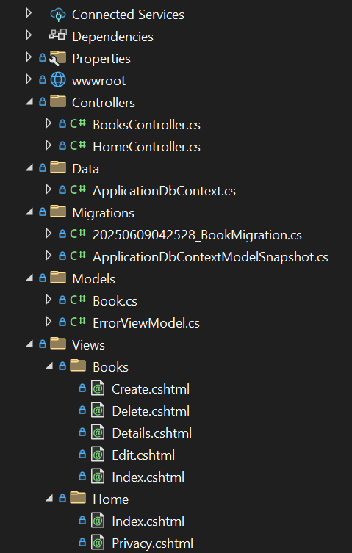
Folder Structure
2025 - RPS Consulting all rights reserved

Slide 9
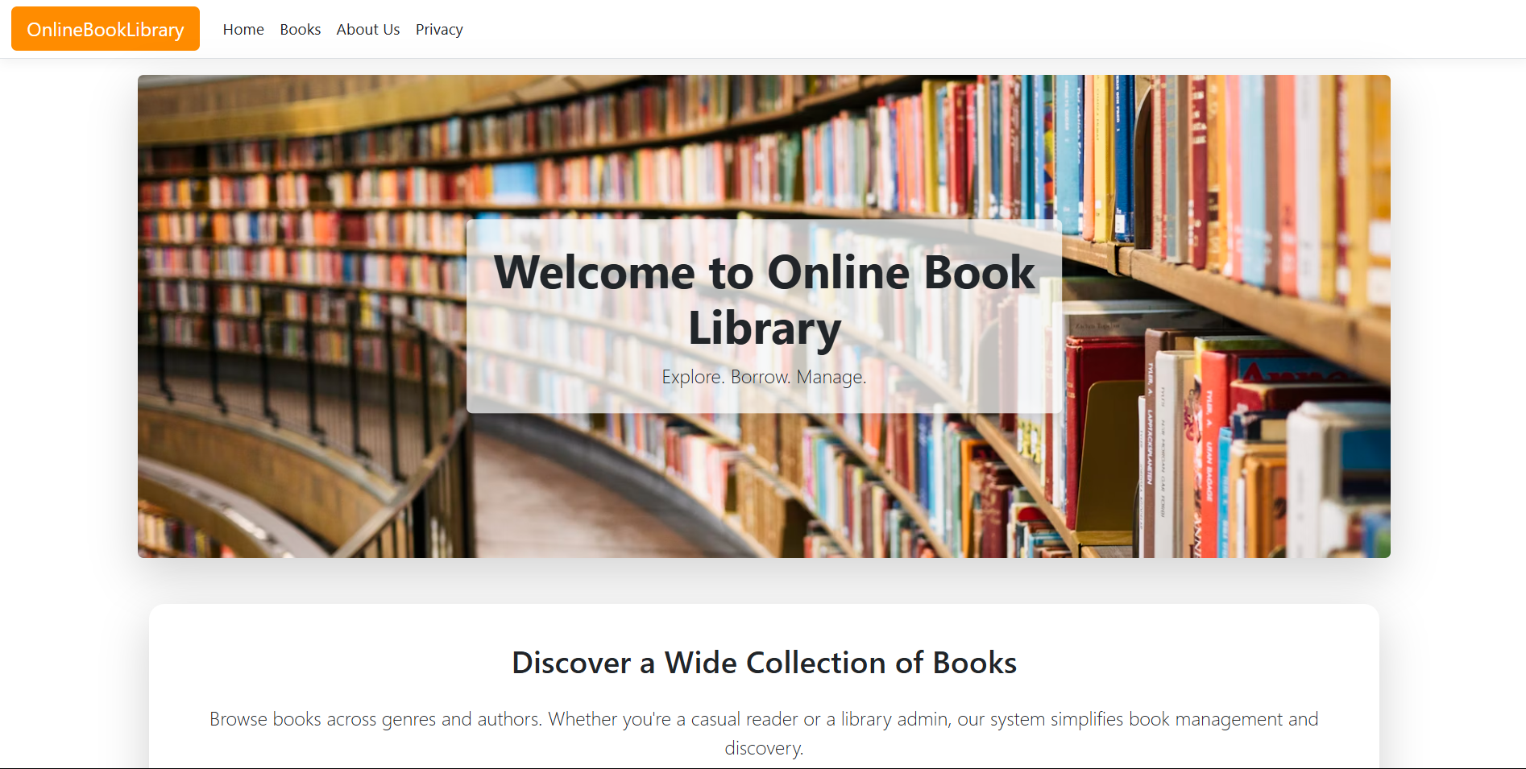
Home
2025 - RPS Consulting all rights reserved

Slide 10
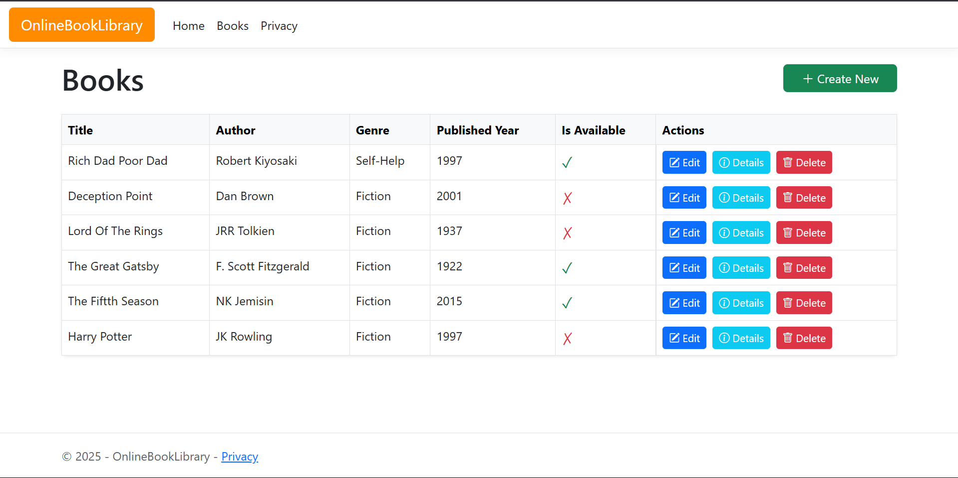
Books
2025 - RPS Consulting all rights reserved

Slide 11
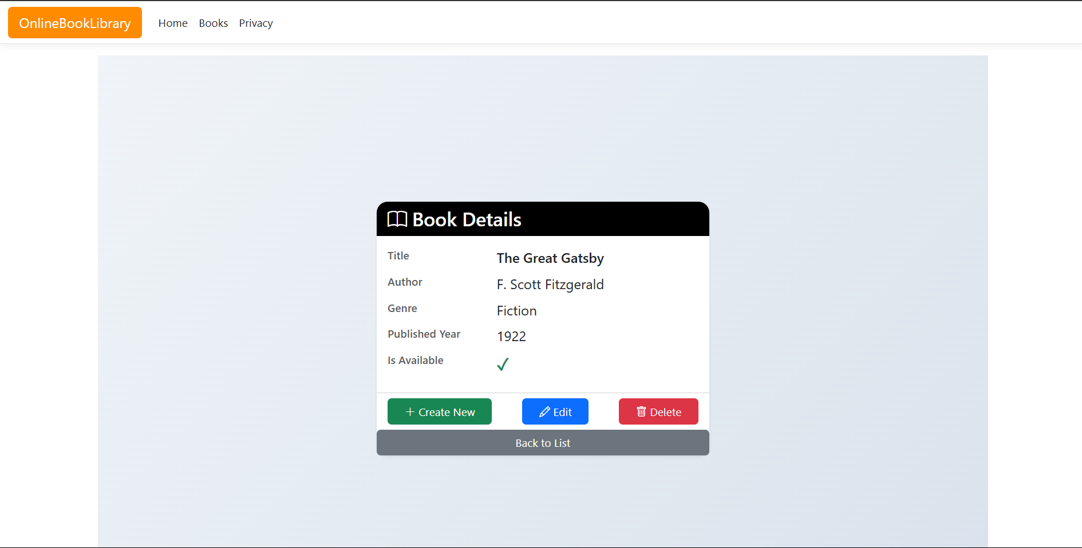
Details
2025 - RPS Consulting all rights reserved

Slide 12
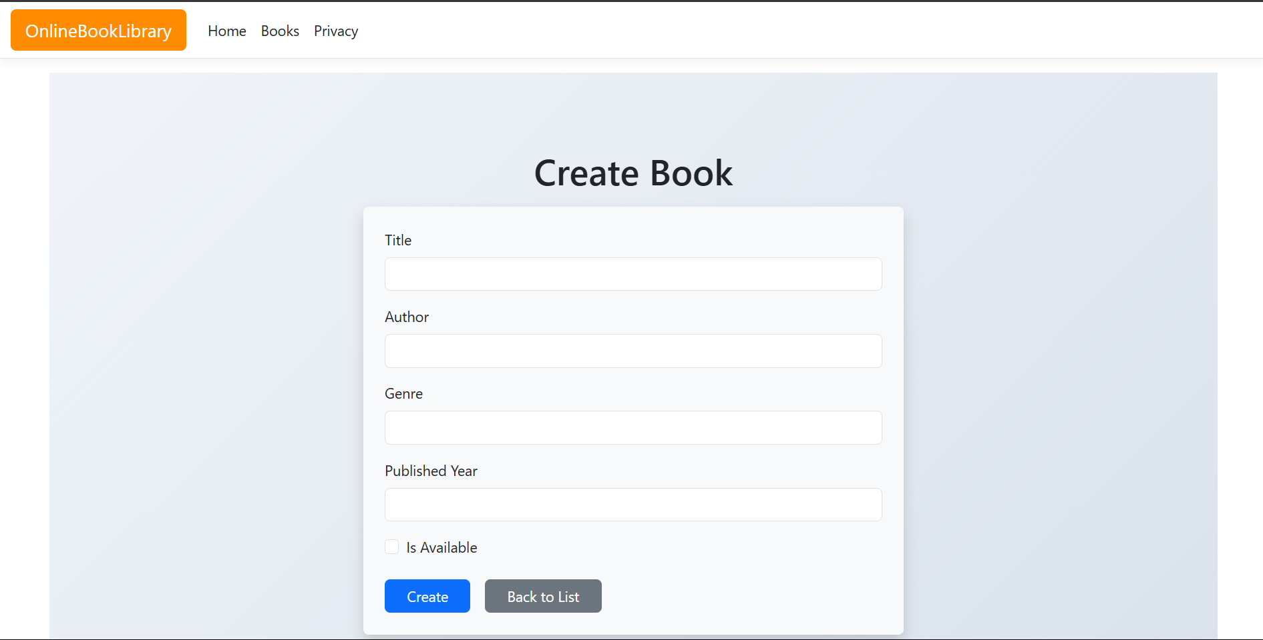
Create
2025 - RPS Consulting all rights reserved

Slide 13
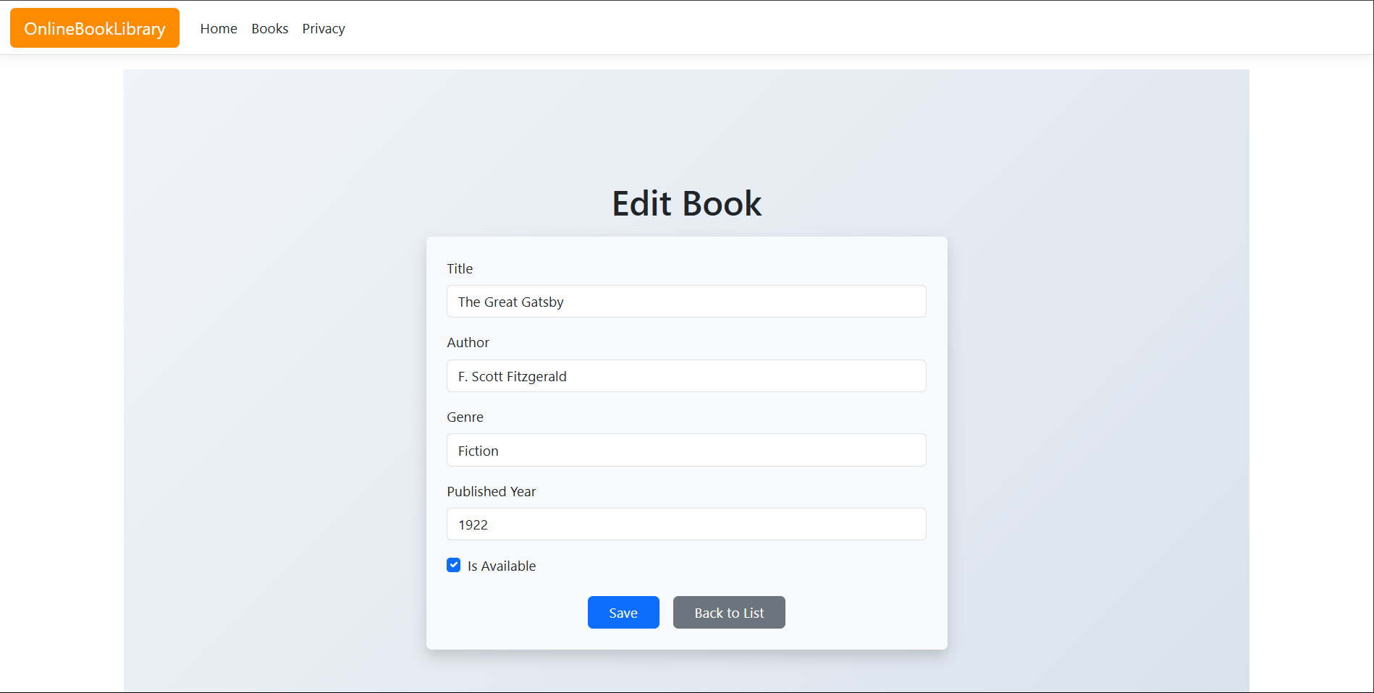
Edit
2025 - RPS Consulting all rights reserved

Slide 14
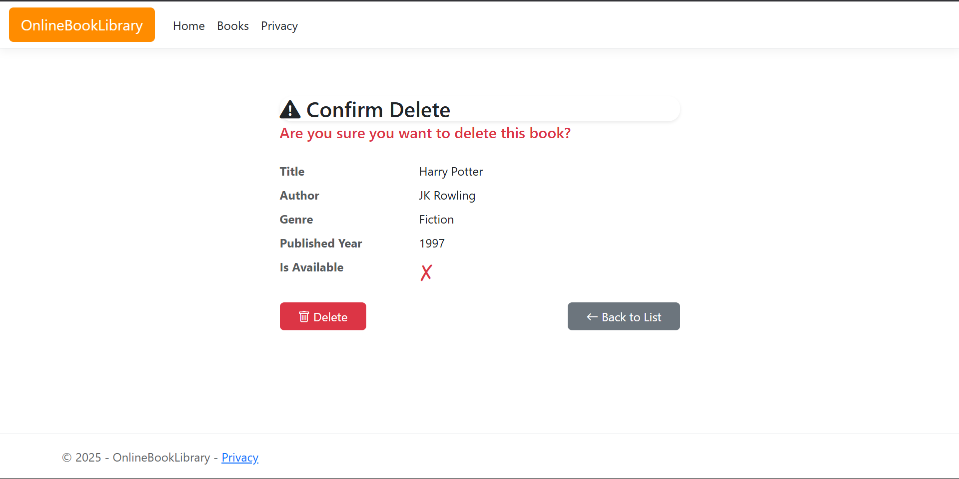
Delete
2025 - RPS Consulting all rights reserved

Slide 15
GitHub repository
Add a repository on GitHub with the name Online-Book-Library
Clone it on your local machine
Add the asp.net app folder into the cloned repository
Run the following commands to push it to the GitHub repository:
-git add .
-git commit -m "message"
-git push origin main
Open GitHub to verify committed files
2025 - RPS Consulting all rights reserved

Slide 16
Azure Deployment
Step 1 : Create App Service
Go to Azure Portal
Search for App Services → Click Create
Fill in the following:
-Name: online-book-library-app
-Publish: Code
-Runtime stack: .NET 8
Region: Choose nearest region
Under Deployment, select:
-GitHub as source
-Choose your repository and branch (main)
-Review and Create
2025 - RPS Consulting all rights reserved

Slide 17
Azure Deployment
Step 2 : Create Azure SQL Database
Go to Azure Portal → Search SQL databases → Click Create
Fill in:
-Database name: OnlineBookLibraryDb
-Server: Create new (note the admin username and password)
-Select Basic pricing tier (for free tier)
After deployment, go to the new database → Click Set Server Firewall → Allow Azure Services and your IP.|
In the Azure SQL database resource, click Connection strings
Copy the ADO.NET connection string.
Important:
Replace the placeholder in your appsettings.json file under "DefaultConnection"
2025 - RPS Consulting all rights reserved

Slide 18
Azure Deployment
Step 3 : Update Azure App Settings
Go to Azure App Service → Configuration
Under Application Settings, click + New application setting:
-Name: ConnectionStrings: DefaultConnection
-Value: Paste your full connection string
Save and restart the App Service
Run Migrations on azure and update the database
Step 4 : Test the deployed site
Open your deployed site
Check if everything works properly
2025 - RPS Consulting all rights reserved

Slide 19
THANK YOU!

