Slide 1
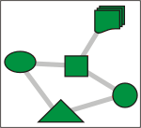
Introduction to Wireless Sensor Networks
WSN Routing II
21 March 2005

Slide 2

Organizational
Class Website
www.engineering.uiowa.edu/~ece195/2005/
Class Time
Monday | 4:30-5:20 | Room 4511 SC
Thursday | 12:30-1:20 | Room 3220 SC
Please note that the room numbers are different for Mondays and Thursdays.
Office Hours
Monday | 5:20-6:20 | Room 1126 SC
Thursday | 1:30-2:30 | Room 1126 SC
Other | By appointment | Room 523C SHL

Slide 3
WSN Routing Review
Geographic routing (more traditional view)
  Greedy distance
  Compass
  Convex perimeter routing
  Routing on a curve
  Energy-minimizing broadcast
Attribute-based routing (data-centric view)
  Directed diffusion
  Rumor routing
  Geographic hash tables

Slide 4
Greedy Perimeter Stateless Routing (GPSR)
Review
  Greedy routing algorithms are simple, but can get stuck
  Algorithms based on planar subdivisions guarantee delivery, but are more complex
GPSR is a hybrid
  Planar subgraph is computed
  Default is greedy distance routing, when this gets stuck, switch over to perimeter protocol until a node is found closer to destination than the node where packet got stuck
  Switch back to greedy distance routing

Slide 5
Hashing Review
Use some algorithm to map attributes of an object to an integer called a key
These integers are used as indexes
Same hash function is used to store and retrieve
Advantage
  Handles sparse data points well
  Fast
  Simple to implement
Disadvantage
    Collisions

Slide 6
Hashing Example
Attributes of animal
  Large (L=76), Medium (M=77 ), Small (S=83), Juvenile (J=74), Adult (A=65), Albino (O=79), Brown/Yellow (B=66), Lion (N=78), Zebra (Z=90)
Hash function
  Sum ASCII value of attributes and take modulus 255, this becomes the index or key
Example: Large, Juvenile, Brown, Lion
index/key = (76+74+66+78) mod 255 = 39
Example: Medium, Adult, Albino, Zebra
index/key = (77+65+79+90) mod 255 = 56

Slide 7
Hashing Example
Hash Index/Key
1
0
…
39
3
3 Large, juvenile, brown, lions
40
0
41
0
…
56
1
1 Medium, Adult, Albino, Zebra
…
Contents (count)

Slide 8
Collisions in Hashing
Collisions occur when multiple sets of attributes map to the same has location
Solution
  Perfect hashing algorithms
  Linked lists

Slide 9
Geographic Hash Tables (GHT)
View sensor network as a distributed database
Target applications
  Data space
  Low data rates
  No need to forward data immediately, but can keep it in the network/database until it is queried for
Modification: output from hash function are two numbers that is a geographic location. For example, (x,y), (lat, lon), etc.

Slide 10
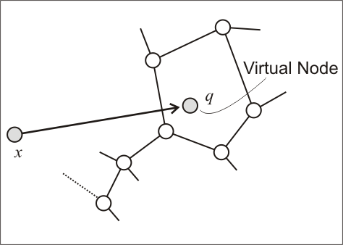
Geographic Hash Table - Store
The sensor at x makes an observation (e.g., two, adult, albino zebra), takes the attributes and applies the hash function.
The hash function produces the hash location q, that is in general not at a sensor node

Slide 11
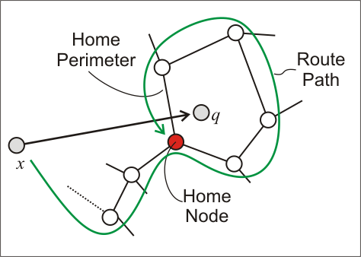
Geographic Hash Table - Store
Using GPSR, the payload (count = 2) is routed to the virtual node. Because of the perimeter part of GPSR, the packet will travel aground q.
The payload is stored at the home node (closest to q)

Slide 12
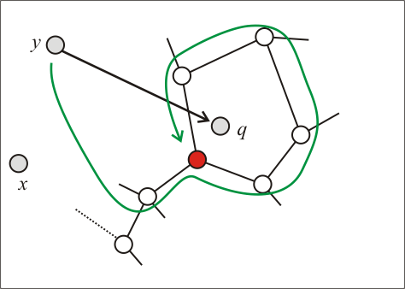
Geographic Hash Table - Retrieve
Node y: # of adult, albino, zebras were observed?
Node y applies hash function, determines virtual node q, and routes its query there.
Routing terminates in perimeter mode. Answer to query is at home node

Slide 13
Problems
Node failure
Nodes can move
Deployment of new nodes
Bottleneck at home nodes
Storage capacity of home nodes

Slide 14
Dynamic Nets: Perimeter Refresh
The payload is stored at all perimeter node (closest to q). Routing terminates at home node
Replicate nodes vs. home nodes
Home nodes periodically generate refresh packets, addressed to the hashed location of the key
This gives all nodes along the home perimeter chance to become home node

Slide 15
Geographic Hash Tables
Implementation
  put(key,value)
  v = get(key)
The proper hash function can spread data evenly across all nodes in sensor net-scalability.
Assumptions
  Nodes know their geographic location
  Each node is responsible for storing a range of keys

