Slide 1
Amortized Analyses
Haixu Tang
Luddy School of Informatics, Computing, and Engineering
Indiana University, Bloomington

Slide 2
What is Amortized Analysis?
A technique for running time analyses of algorithms that perform a sequence of similar operations.
It gives an often tighter (lower) estimate of asymptotic running time cost than the straightforward analyses
Straightforward: bounding the cost of each operation separately, and multiplying the worst-case cost of each operation
Amortized analysis: bounding the actual cost of the entire sequence.
Amortized analysis is not an average-case analysis in that probability is not involved; an amortized analysis guarantees the worst-case of an entire sequence of operations by ensuring each operation in the worst case, which can be converted into the average performance of each operation in the sequence (i.e., the amortized cost).
Amortized analysis is not just an analysis tool, however; it is also an way of thinking about the design of algorithms, since the design of an algorithm and the analysis of its running time are often closely intertwined.

Slide 3
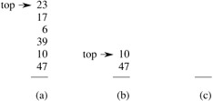
Example 1. Stack operations
Consider the cost of the operations of PUSH(S, x), POP(S) and MultiPop() onto a stack (Last-in-first-out, LIFO), where
PUSH(S, x): pushes object x onto stack S.
POP(S): pops the top of stack S and returns the popped object
MULTIPOP(S , k): removes the k top objects of stack S, or pops the entire stack if it contains fewer than k objects.
MULTIPOP(S, 4)
MULTIPOP(S , k)
while not STACK-EMPTY(S) and k ≠ 0
POP(S)
k ← k - 1

Slide 4
Example 1. Stack operations: aggregate analysis
Straightforward analysis
Consider the cost of a sequence of n operations, PUSH(S, x), POP(S) and MultiPop(), on an initially empty stack.
The worst-case cost of a MULTIPOP operation in the sequence is O(n), since the stack size is at most n. The worst-case time of any stack operation is therefore O(n), and hence a sequence of n operations costs O(n²), since we may have O(n) MULTIPOP operations costing O(n) each.
Although this analysis is correct, the O(n²) result, obtained by considering the worst-case cost of each operation individually, is not tight.
Amortized analysis
We can obtain a better upper bound for the entire sequence of n operations (i.e., aggregate analysis).
Each object can be popped at most once for each time it is pushed. Therefore, the number of times that POP can be called on a nonempty stack, including calls within MULTIPOP, is at most the number of PUSH operations, which is at most n.
For any value of n, any sequence of n PUSH, POP, and MULTIPOP operations takes a total of O(n) time. The average cost of an operation is O(n)/n = O(1).
We assign the amortized cost of each operation to be the average cost (of the worst case scenario). Here, an amortized cost of O(1).

Slide 5
Example 1. Stack operations: accounting (or the banker’s) method
Assign each operation the amortized costs (charges): PUSH 2, POP 0, MULTIPOP 0.
Charge (amortized cost) of MULTIPOP is a constant (0), whereas the actual cost is variable.
When an operation's amortized cost exceeds its actual cost, the difference is assigned as credit, which can be used later on to help pay for operations whose amortized cost is less than their actual cost.
This assignment assigns the amortized cost of each operation O(1)
We need to prove the charges (amortized cost) should be assigned in a way that the total amortized cost of a sequence of n operations must be no less than the total actual cost of the sequence.
In this example, when the PUSH is operated, the actual cost is 1, but a charge of 2 is applied, which gives a credit of 1. As such, each POP operation do not need to be charged as one can take the credit left by POP.
As the stack is empty initially, there should be at least one credit on the table because there should be at least one element in the stack for which the credit of the PUSH operation has not been used. The similar argument applies to MULTIPOP. Therefore, the assigned amortized cost gives the upper bound on a total actual cost of a sequence of n operations.
The accounting method is different from aggregate analysis, in which all operations have the same amortized cost. But the asymptotic costs of all operations are still the same: O(1).

Slide 6
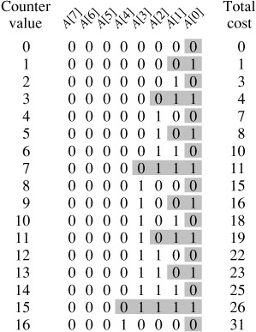
Example 2. Incrementing a binary counter
We use an array A of bits, where |A| = k, as the counter. A binary number x that is stored in the counter has its lowest-order bit in A[0] and its highest-order bit in A[k - 1], so that
Initially, x = 0, and thus A[i] = 0 for i = 0, 1, ..., k-1.
.
INCREMENT(A)
i ← 0
while i < |A| and A [i] = 1
A[i ] ← 0
i ← i + 1
if i < |A|
A[i ] ← 1

Slide 7

Example 2 Incrementing a binary counter: aggregate analyses
Straightforward analysis
A single execution of INCREMENT takes time O(k) in the worst case, in which array A contains all 1s. Thus, a sequence of n INCREMENT operations on an initially zero counter takes time O(nk) in the worst case.
Amortized analysis (aggregate analysis)
Count the number of bits flipped each time INCREMENT is called. A[0] does flip each time INCREMENT is called. A[1], flips only every other time: a sequence of n INCREMENT operations on an initially zero counter causes A[1] to flip ⌈n/2⌉ times. Similarly, A[2] flips only every fourth time, or ⌈n/4⌉ times in a sequence of n INCREMENT's. In general, for i = 0, 1, ..., ⌈lg n⌉, bit A[i] flips ⌈n/2^{i}⌉ times in a sequence of n INCREMENT operations on an initially zero counter. For i > ⌈lg n⌉, bit A[i] never flips at all.
So, the total number of flips in the sequence is
The worst-case time for a sequence of n INCREMENT operations on an initially zero counter is therefore O(n). The average cost of each operation, and therefore the amortized cost per operation, is O(n)/n = O(1).

Slide 8
Example 2. Incrementing a binary counter: accounting or the banker’s method
Assign an amortized cost (charge) of 2 to set a bit from 0 to 1, and 0 to reset a bit from 1 to 0.
When a bit is set to 1, there is always a credit of 1 (out of the charge of 2) left, which will be used later when the bit is reset to 0.
As the initial counter is 0, at any point in time, every 1 in the counter has a credit of 1 on it, and thus we don’t need to charge anything to reset a bit to 0; we just pay by using the credit.
Thus, for n INCREMENT operations, the total amortized cost is 2n, or O(n), which bounds the total actual cost.
The amortized cost of each operation is thus O(1).

Slide 9

Amortized Analysis: the potential (Physicist’s) method
Define potential function Φ(D_{i}) for the data structure D_{i}
D_{i} be the data structure after applying the ith operation; initially data structure D₀ (on which n operations are performed), D₁, D₂, …, D_{n}
Let c_{i} be the actual cost of the ith operation, the amortized cost of the ith operation with respect to potential function Φ is defined by
The total amortized cost of the n operations is
If we require that Φ (D_{i}) ≥ Φ(D₀) for all i, then we guarantee, the total amortized cost is an upper bound on the total actual cost for any n.
Intuitively, if the potential difference Φ(D_{i}) - Φ(D_{i-1}) > 0, the amortized cost represents an overcharge to the ith operation, and the potential of the data structure increases; otherwise the amortized cost represents an undercharge to the ith operation, and the actual cost of the operation is paid by the decrease in the potential.

Slide 10
Example 1. Stack operations: the potential method
We define the potential function Φ on a stack to be the number of objects in the stack.
Φ(D₀) = 0. Since the number of objects in the stack is never negative, we have Φ(D_{n}) ≥ Φ(D₀). Thus, the total amortized cost of n operations with respect to Φ represents an upper bound on the actual cost.
The ith operation is PUSH: the potential difference is Φ(D_{i}) - Φ(D_{i-1}) = 1; the amortized cost 1+1=2.
The ith operation is MULTIPOP(S, k): k′ = min(k, |s|) objects are popped off the stack, the actual cost is k′, the potential difference is -k′, and the amortized cost = k’ – k’ = 0.
The amortized cost of an ordinary POP operation is 0.
The amortized cost of each of the three operations is O(1), and the total amortized cost is O(n), which is an upper bound the actual cost of a sequence of n operations.

Slide 11
Example 2: Incrementing a binary counter (the potential method)
We define the potential of the counter b_{i} as the number of 1s in the counter after the ith operation.
Φ(D₀) = 0. Φ(D_{i}) ≥ Φ(D₀) for all i.
Amortized
cost
b
Suppose that the ith INCREMENT operation resets (1→0) t_{i} bits. The actual cost is t_{i} + 1, since it sets (0→1) one bit. So b_{i} - b_{i-1} = -t_{i} + 1, and the amortized cost is b_{i} - b_{i-1} + t_{i} + 1 = -t_{i} + 1 + t_{i} + 1=2, or O(1).
0
0
1
2
1
4
2
6
1
8
2
10
2
12
3
14
1
16
The total amortized cost of a sequence of n INCREMENT operations is an upper bound on the total actual cost, and so the worst-case cost of n INCREMENT operations is O(n),
2
18
2
20
3
22
2
24
3
26
3
28
4
30
1
32

Slide 12
Example 3: Dynamic table
Consider to insert elements into a table (array). How do we decide table size if we don’t know how many elements in total? The solution to this trade-off problem is to use dynamic table (arrays): starting from a small table size, and then it whenever the table becomes full.
If the table has space available, we simply insert new item in available space;
Otherwise, allocate memory for a larger table of size twice the old table;
Copy the contents of old table to new table;
Free the old table.
What is the time complexity of n insertions using the above scheme? If we use simple analysis, the worst case cost of an insertion is O(n). Therefore, worst case cost of n inserts is O(n²). This analysis gives an upper bound, but not a tight upper bound for n insertions as all insertions don’t take Θ(n) time.

Slide 13
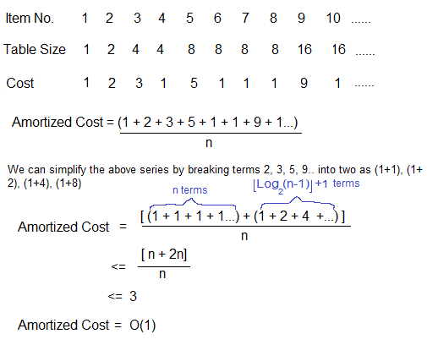
Example 3: Dynamic table: amortized analysis
Two types of operations: 1) copy a new element (every time); 2) copy the entire old array into a new array when the old array is full (after 2^{i} times)
Aggregate analysis
Full table sizes

