Slide 1
Binomial and Fibonacci Heap
Haixu Tang
Luddy School of Informatics, Computing, and Engineering
Indiana University, Bloomington

Slide 2
(Binary) heap and Binomial heap
A binary heap data structure implements the priority queue, in which one can retrieve a minimum element in O(1) time, while maintaining the data structure in O(log n) time when inserting or removing an element. However, to merge two binary heaps (with m and n elements) is slow: to extract-min m elements from the 1st heap, and insert each of them to the second heap.
Operation | Binary heap
find-min | Θ(1)
extract-min | Θ(log n)
Insert | Θ(log n)
decrease-key | Θ(log n)
Merge | Θ(m log n)
Binomial: a heap (priority queue) supporting quick merging of two heaps.

Slide 3
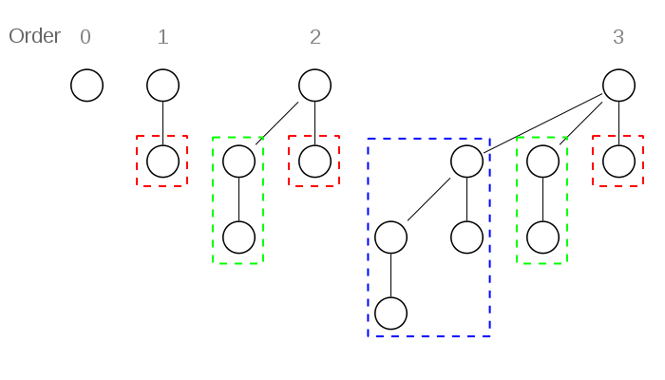
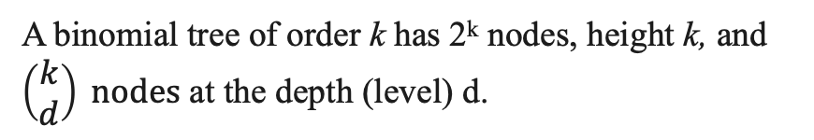
Binomial heap
Implemented as a collection of binomial trees, defined recursively: 1) a binomial tree of order 0 is a single node; 2) a binomial tree of order k has a root node whose children are roots of binomial trees of orders k−1, k−2, ..., 2, 1, 0 (in this order).
Levels 0. 1 2 3 4
Order
0 1
1 1 1
2 1 2 1
3 1 3 3 1
4 1 4 6 4 1
A binomial tree of order k has 2^{k} nodes, height k, and $\left(\begin{aligned}k \\ d\end{aligned}\right) nodes$ at the depth (level) d.
A binomial tree of order k can be constructed from two trees of order k−1 trivially by attaching one of them as the leftmost child of the root of the other tree.

Slide 4
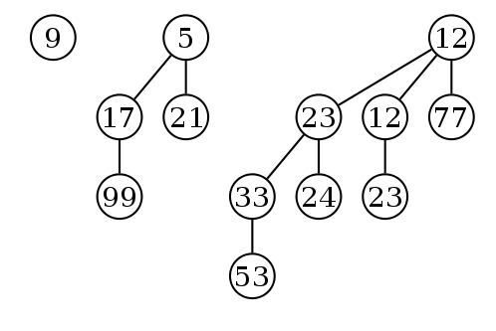
Binomial heap: binomial trees
In a binomial heap, 1) each binomial tree is implemented as a min-heap (with the min-heap property: the key of a node is greater than or equal to the key of its parent), and 2) there can only be either one or zero binomial trees for each order, including the order 0.
Because of 1), the root of each binomial tree contains the smallest key in the tree, which applies to the entire heap.
The roots of the binomial trees can be stored in a linked list, ordered by increasing order of the tree.
Because of 2), a binomial heap with n nodes consists of at most (log n +1) binomial trees.
The number and orders of binomial trees are uniquely determined by the number of nodes n: each binomial tree corresponds to one digit in the binary representation of number n.
13 is 1101 in binary, and thus a binomial heap with 13 nodes consists of three binomial trees of orders 3, 2, and 0.
k=0
k=2
k=3

Slide 5
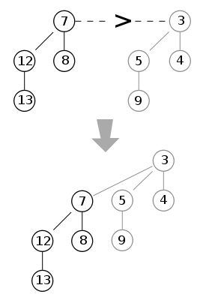
Merge two binomial heaps
Merge the binomial trees with the same order, respectively (if both are present)
As their root node is the smallest element within the tree, by comparing the two keys of the roots, the smaller of them is the minimum key, and becomes the new root node. Then the other tree becomes a subtree of the combined tree.
If only one heap contains a tree of order j, this tree is moved to the merged heap. If both heaps contain a tree of order j, the two trees are merged to one tree of order j+1 so that the min-heap property is satisfied. The resulting tree may later be merged with some other tree of order j+1 present in the heaps. In the course of the algorithm, we need to examine at most three trees of any order (two from the two heaps we merge and one composed of two smaller trees).
We merge the trees of the same order in two heaps with the increasing orders.
O(1) time

Slide 6
Merge two binomial heaps: run time analysis
Because each binomial tree in a binomial heap corresponds to one bit in the binary representation of its size, there is an analogy between the merging of two heaps and the binary addition of the sizes of the two heaps, from right-to-left (smallest digit to greatest digit).
Whenever a carry occurs during addition, this corresponds to a merging of two binomial trees.
Each binomial heap has order at most log n and therefore log n merging of three trees (taking O(1) time); so the running time of merging two binomial heap is O(log n).

Slide 7
Operations on a binomial heap
Insert an element: Creating a new heap containing only this element and then merging it with the original heap. Due to the merge, insert takes O(log n) time. However, across a series of n consecutive insertions, insert has an amortized time of O(1) (similar as the incrementing a binary counter).
Find minimum in the heap: Find the minimum among the roots of the binomial trees. This can again be done easily in O(log n) time, as there are just O(log n) trees. If we add a link to the root with the minimum key among all O(log n) binomial trees, the minimum can be retrieved in O(1) time. The link can be updated in O(1) amortized cost when an element is inserted, and in O(log n) time when two binomial heaps are merged.
Delete the minimum element from the heap (Extract-min or delete-minimum), First find this element (the root of a tree), remove it from its binomial tree, and transform its subtrees into a separate binomial heap. Then merge this heap with the original heap. Since each tree has at most log n children, creating this new heap is O(log n). Merging heaps is O(log n), so the entire delete minimum operation is O(log n).

Slide 8
Operations on a binomial heap
Decrease the key of an element. After decreasing the key, min-heapify the corresponding binary tree (heap), i.e., exchange the element with its parent, and possibly also with its grandparent, and so on, until the heap becomes a min-heap. Each binomial tree has height at most log n, so this takes O(log n) time. Update the link to the min among all roots, O(log n) time.
Increase the key of an element. Similarly. O(log n) time.
Delete an element from the heap. Increase its key to negative infinity (that is, some value smaller than any element in the heap) and then delete the minimum in the heap. O(log n) time.

Slide 9
(Binary) heap and Binomial heap
Operation | Binary | Binomial
find-min | Θ(1) | Θ(1)
extract-min | Θ(log n) | Θ(log n)
Insert | Θ(log n) | Θ(1)
decrease-key | Θ(log n) | Θ(log n)
Merge | Θ(m log n) | O(log n)

Slide 10
Fibonacci heap
Fibonacci heaps support the merging operation but have the advantage that operations except deleting the minimum element run in O(1) amortized time
Reduce the amortized cost of decreasing the key of an element from O(log n) to O(1).

Slide 11
From Binomial heap to Fibonacci heap
Modification 1: When inserting a node into the heap, just create a tree of order 0 and add it to the existing collection of trees.
Insertion: O(1)
Modification 2: When merging two heaps together, just combine all their trees together without doing any merging.
Merging: O(1)
Modification 3: Keep a pointer to the minimum element among all roots in a heap. It can be updated in O(1) time when insertion or merging is done.
Modification 4: When the extract-min (find and delete the minimum element) is operated, consolidate (merge) all trees (including the subtrees of the deleted node) to ensure there is at most one tree of each order.
Merging all trees into O(log n) trees only when extract-min is executed. This may take O(n) time in the worst case (see next slide).

Slide 12
Fibonacci heap: amortized analysis
Suppose we maintain a hash table that maps from tree orders to trees, starting from an empty set of trees and going through one tree after another. We could then do the following operation for each tree in the data structure: 1) see if there's already a tree of the order of the given tree; 2) if not, insert the current tree into the hash table; 3) otherwise, merge the given tree with the tree of that order, removing the old tree from the hash table. This process can be recursively carried out for each tree. Obviously, when we're done, there's at most one tree of each order. Also, it is quite efficient, the merge is conducted for each tree that is NOT in the set of (Θ(log n)) trees at the end of the process.

Slide 13
Fibonacci heap: amortized analysis
Potential function: the number of trees in a Fibonacci heap.
Insert: increases the potential by 1. Amortized cost O(1).
Merge: no net change in potential. Amortized cost O(1).
Extract-Min: O(#trees + #merges) actual cost + decreases the potential down to Θ(log n), the number of trees in the binomial tree. Let's have the number of trees as Θ(log n) + E before the consolidation, where E is the "excess" number of trees. After the consolidation, the potential function reduced from Θ(log n) + E to Θ(log n). Note that we will do one merge per excess tree, and so the total work done is Θ(log n + E). Therefore, the amortized cost of a extract-min is Θ(log n).

Slide 14
Further modification of the Fibonacci heap
Decrease the key of an element: O(1) amortized time
Modification 5: To decrease the key of a node and, if its key is now smaller than its parent's key (thus violate the min-heap property), cut it and add it to the root list (i.e., create a new tree rooted by the specific node).
Modification 6: Assign a mark bit to each node that is initially false. When a child is cut from an unmarked parent, mark the parent true. When a child is cut from a marked parent, unmark the parent and cut the parent from its parent.
See lecture notes for amortized analysis.

Slide 15
Summary
Operation | Binary | Binomial | Fibonacci
find-min | Θ(1) | Θ(1) | Θ(1)
extract-min | Θ(log n) | Θ(log n) | O(log n)
Insert | Θ(log n) | Θ(1) | Θ(1)
decrease-key | Θ(log n) | Θ(log n) | Θ(1)
Merge | Θ(m log n) | O(log n) | Θ(1)

