Slide 1
AI as Search CS B551 Fall 2016

Slide 2
Announcements
Check Canvas for announcements, discussions, syllabus, etc.
Course details on Syllabus!
Reading assignment and brief activity due before next class (will be posted on Canvas)
Sven

Slide 3
What is Intelligence?
“If there were machines which bore a resemblance to our bodies and imitated our actions as closely as possible for all practical purposes, we should still have two very certain means of recognizing that they were not real men. The first is that they could never use words, or put together signs, as we do in order to declare our thoughts to others… Secondly, even though some machines might do some things as well as we do them, or perhaps even better, they would inevitably fail in others, which would reveal that they are acting not from understanding, …”
Discourse on the Method, by Descartes (1598-1650)

Slide 4
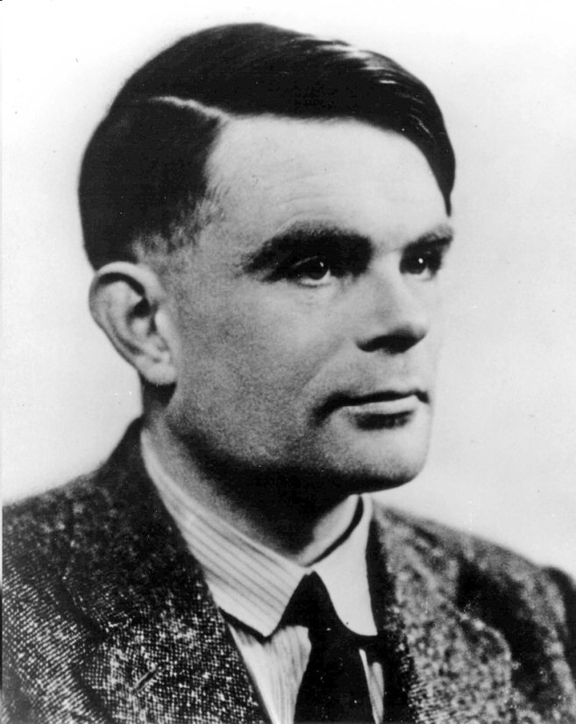
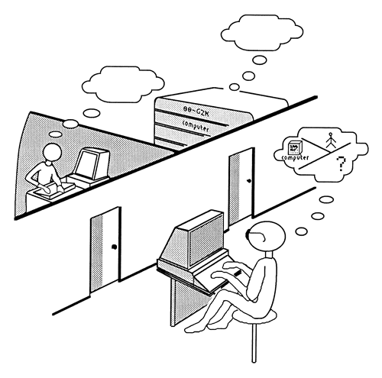
What is Intelligence?
Turing Test (c. 1950)

Slide 5
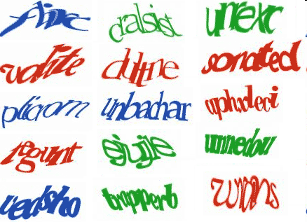
An Application of the Turing Test
CAPTCHA: Completely Automatic Public Turing tests to tell Computers and Humans Apart
Notes:
5

Slide 6
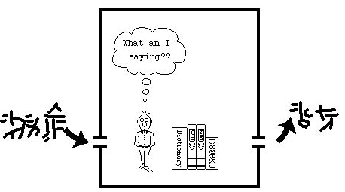
Chinese Room (John Searle)

Slide 7
Can Machines Act/Think Intelligently?
A1: Yes, if intelligence is narrowly defined as “information processing”
Many tasks initially assumed to require intelligence can be automated.
Notes:
7
Well on one hand, it’s hard to argue with all the progress we’ve made over the last few years. On the other hand, there have been many problems that people thought were the key milestones that would finally let us say that machines are intelligent. Each time we surpass one, it seems like we still really haven’t convinced ourselves that the machines are actually demonstrating intelligence.

Slide 8
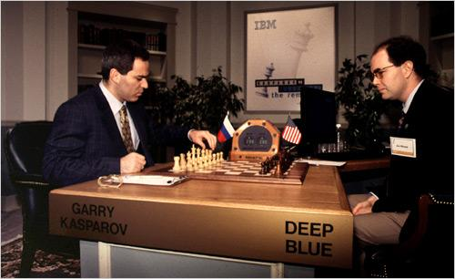
Big milestone: Chess (1997)
Deep Blue beats Garry Kasparov, 1997
Notes:
For instance, after 40 years of research, in 1997 a computer beat a chess grandchapmpion. But the computer just used brute force and algorithmic approximations to search through huge libraries of possible moves, which seems more like fast information processing versus real human intelligence.

Slide 9
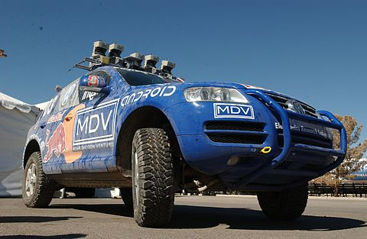
Milestone: DARPA Grand Challenge
Autonomous car travels 132 miles through challenging desert (2005)
Notes:
In 2005, people started really seriously investigating self driving cars, and today we have the Google car and even commercial products that can drive themselves autonomously. But again, they don’t really seem to be showing off intelligenve, just using lots of sensors to avoid hitting obstactles for example.

Slide 10
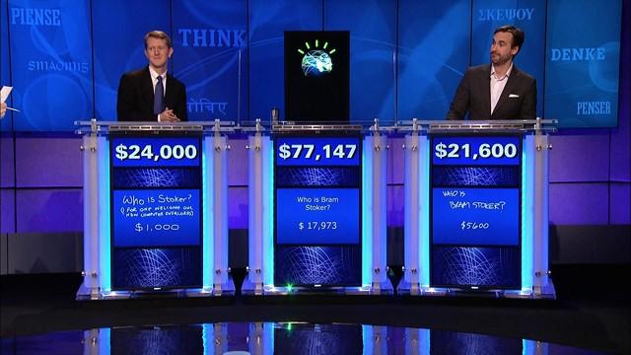
Milestone: Jeopardy (2010)
Watson beats Jeopardy champions, 2010
Notes:
IN 2010, a computer named Watson won Jeopardy. This was an amazing feat for natural language understanding and information retrieval. But did Watson know all those facts or just look them up in its gigantic memory banks?

Slide 11
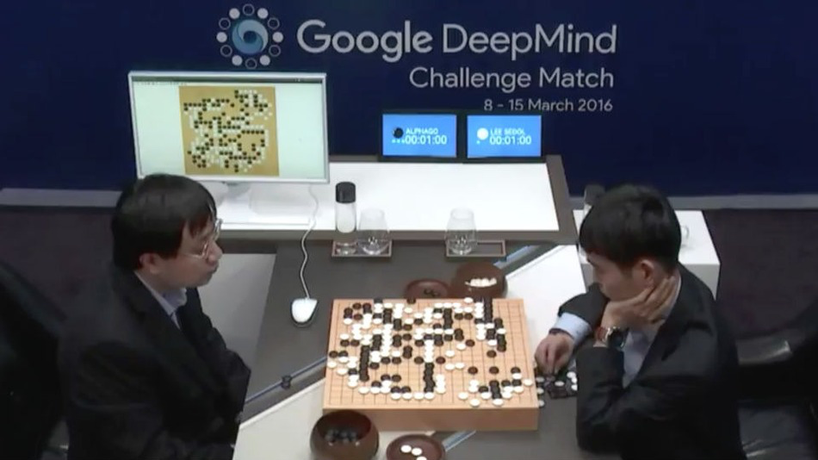
Milestone: Go (2016)
Google’s AlphaGo beats Lee Sodol (9-dan player), March 2016
Notes:
Most recently, a computer beat a top player in the game of Go, which has long been thought to be a key milestone that might be years or even decades off, because Go is so hard to model computationally. And yet, once again, the solution was more about using sheer memory and processing power than about really modeling human intelligence. It did use an artificial neural network, however, which at least in theory replicates what humans have in their brains. We still don’t know much about how the neural networks in either computers or the brains work, though, but it’s a really intriguing result.

Slide 12
Can Machines Act/Think Intelligently?
A1: Yes, if intelligence is narrowly defined as “information processing”
Many tasks initially assumed to require intelligence can be automated.
Each success of AI seems to push further the limits of what we consider “intelligence”
Notes:
12
So on one hand, the answer is that yes, machines can act intelligently. But each time we achieve some success in AI, people seem to end up saying that we’ll know intelligence when we see it and we haven’t seen it yet.

Slide 13
Can Machines Act/Think Intelligently?
A1: Yes, if intelligence is narrowly defined as “information processing”
Many tasks initially assumed to require intelligence can be automated.
Each success of AI seems to push further the limits of what we consider “intelligence”
A2: Maybe yes, maybe not, if intelligence cannot be separated from consciousness
Is the machine experiencing thought?
Strong vs. Weak AI
Notes:
13
This gets into the idea of strong versus weak AI. In Weak AI, the machines are acting intelligently, whereas Strong AI is where they are actually experiencing thought in the same way that humans do. How close are we to strong AI? Is it even possible?

Slide 14
AI as Search CS B551 Fall 2016

Slide 15
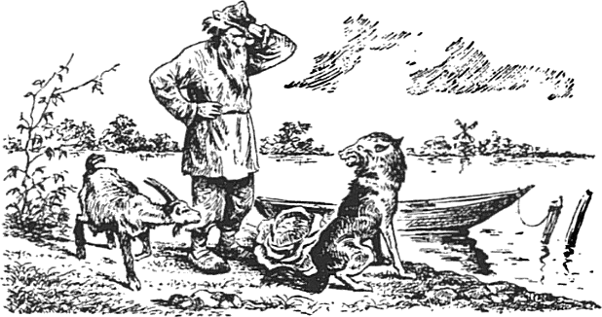
An old puzzle…

Slide 16
Puzzles and games have long been considered a challenge for human intelligence:
Chess in Persia and India ~4000 years ago
Checkers in 3600-year-old Egyptian paintings
Go in China over 3000 years ago
Notes:
Now this might seem like a silly place to start a CS course, but puzzles and games have always been a way for humans to exercise and show off their intelligence, so it makes sense for us to think about artificial intelligence in terms of these problems also.

Slide 17
Exploring Choices
Problems that seem to require intelligence usually require exploring multiple choices.
Search: a systematic way of exploring choices.

Slide 18
These abstractions have 5 parts:
Set of states S
Initial state s₀
A function SUCC: S → 2^{S} that encodes possible transitions of the system
Set of goal states
A cost function that calculates how “expensive” a given set of moves is
Notes:
When a new problem comes along, we can use the search abstraction by defining 5 key parts. First, we need a set of states, which we’ll call S. We need to define an initial state s_0. We’ll need a function called SUCC that records the possible transisions of the system. We’re using set notation here, and this means that SUCC is a function that takes an element of S and returns a set of states of S – 2^S here is what is known as the power set of S, the set of all possible subsets of S. We’ll need to define one or more goal states. And finally, we’ll usually have some measure of the cost of a particular solution. In the example we just saw, the man might measure cost in terms of number of river crossings since he probalby wants to get everyone across as quickly as possible.

Slide 19
Defining a Search Problem
S
State space S
Successor function: x ∈ S → SUCC(x) ∈ 2^{S}
Initial state s₀
Goal test:
x∈S → GOAL?(x) =T or F
Cost

Slide 20
State Graph
Each state is represented by a distinct node
An edge connects a node s to a node s’ if s’ ∈ SUCC(s)
The state graph may contain more than one connected component

Slide 21
Solution to the Search Problem
A solution is a path connecting the initial node to a goal node (any one)
The cost of a path is the sum of the edge costs along this path
An optimal solution is a solution path of minimum cost
There might be no solution !
G
I

Slide 22
Example: 8-Puzzle
8
2
1
2
3
3
4
7
4
5
6
5
1
6
7
8
Initial state
Goal state

Slide 23
Example: 8-Puzzle
8
2
1
2
3
3
4
7
4
5
6
5
1
6
7
8
Initial state
Goal state
State: Any arrangement of 8 numbered tiles and an empty tile on a 3x3 board
Successor function: given by available actions (sliding tiles) L, R, U, D.
Cost: How many moves were performed

Slide 24
Successor Function: 8-Puzzle
SUCC(state) → subset of states
The successor function is knowledge about the 8-puzzle game, but it does
not tell us which outcome to use, nor to
which state of the board to apply it.
8
2
7
3
4
5
1
6
8
2
8
2
7
8
2
7
3
4
7
3
4
6
3
4
5
1
6
5
1
5
1
6

Slide 25
Path Planning
What is the state space?

Slide 26
Formulation #1
Cost of one horizontal/vertical step = 1
Cost of one diagonal step = √2

Slide 27
Optimal Solution
This path is the shortest in the discretized state space, but not in the original continuous space

Slide 28
Formulation #2
Cost of one step: length of segment

Slide 29
Formulation #2
Visibility graph (any two points “see” each other
iff the line segment between them is NOT in the
exterior)
Cost of one step: length of segment

Slide 30
Solution Path
The shortest path in this state space is also the shortest in the original continuous space

Slide 31
What is a State?
A state does:
Represent all information meaningful to the problem at a given “instant in time” – past, present, or future
Exist in an abstract, mathematical sense
A state DOES NOT:
Necessarily exist in the computer’s memory
Tell the computer how it arrived at the state
Tell the computer how to choose the next state
Need to be a unique representation

Slide 32
What is a State Space?
An abstract mathematical object
E.g., the set of all permutations of (1,…,8,empty)
Membership should be trivially testable
So S = { s | s is reachable from the start state through transformations of the successor function } is a bad definition (not trivially testable).
Edges should be easily generated
Again: the state space does NOT contain information about which edge to take (or not to take) in a given state

Slide 33
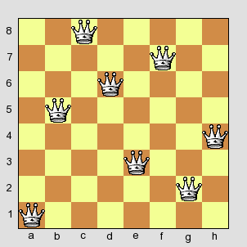
8-Queens Problem
Place 8 queens in a chessboard so that no two queens are in the same row, column, or diagonal.

