Slide 1
Analyzing AI problems,
and uninformed search
Notes:
Let’s start this class in a way you might not expect a CS class to start: by thinking about a classic puzzle.

Slide 2
Announcements
Office hours
Assignment 0 coming soon! (Tonight)
Practice with searching, and with Python.
Lots of online resources to learn Python: Google Code, CodeAcademy, many, many tutorials, etc.
Short Activity 0

Slide 3
Example: 8-Puzzle
8
2
1
2
3
3
4
7
4
5
6
5
1
6
7
8
Initial state
Goal state
State: Any arrangement of 8 numbered tiles and an empty tile on a 3x3 board
Successor function: given by available actions (sliding tiles) L, R, U, D.
Cost: How many moves were performed
Generalization: (n² – 1)-puzzle

Slide 4

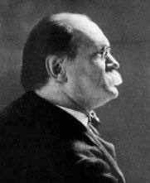
15-Puzzle
Invented by Chapman in 1874.
Sam Loyd, “America’s greatest puzzle-expert” claimed to have invented it first.

Slide 5
15-Puzzle
Sam Loyd offered $1,000 (about $24k today) to the first person who could solve:
1
2
3
4
1
2
3
4
5
6
7
8
5
6
7
8
?
9
10
11
12
9
10
11
12
13
14
15
13
15
14

Slide 6
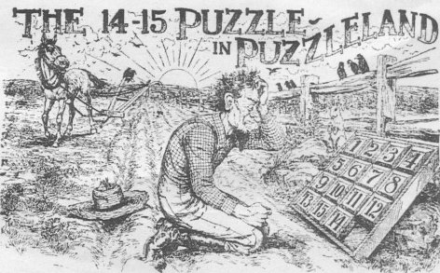
But no one ever won the prize !!

Slide 7
How big is the state space of the (n²-1)-puzzle?
8-puzzle → ?? states

Slide 8
How big is the state space of the (n²-1)-puzzle?
8-puzzle → 9! = 362,880 states
15-puzzle → 16! ~ 2.09 x 10¹³ states
24-puzzle → 25! ~ 10²⁵ states
But only half of these states are reachable from any given state (but you may not know that in advance)
Let’s see this for the 15-puzzle.

Slide 9
Permutation Inversions
Let’s say the goal is:
A tile j appears after a tile i if either j appears on the same row as i to the right of i, or on another row below the row of i.
For every i = 1, 2, ..., 15, let n_{i} be the number of tiles j < i that appear after tile i (permutation inversions)
N = n₂ + n₃ + … + n₁₅ + row number of empty tile
1
2
3
4
5
6
7
8
9
10
11
12
13
14
15
1
2
3
4
5
10
7
8
9
6
11
12
13
14
15

Slide 10
Permutation Inversions
Let’s say the goal is:
A tile j appears after a tile i if either j appears on the same row as i to the right of i, or on another row below the row of i.
For every i = 1, 2, ..., 15, let n_{i} be the number of tiles j < i that appear after tile i (permutation inversions)
N = n₂ + n₃ + … + n₁₅ + row number of empty tile
1
2
3
4
5
6
7
8
9
10
11
12
13
14
15
1
2
3
4
n₂ = 0 n₃ = 0 n₄ = 0
n₅ = 0 n₆ = 0 n₇ = 1
n₈ = 1 n₉ = 1 n₁₀ = 4
n₁₁ = 0 n₁₂ = 0 n₁₃ = 0
n₁₄ = 0 n₁₅ = 0
5
10
7
8
→ N = 7 + 4
9
6
11
12
13
14
15

Slide 11
Proposition: (N mod 2) is invariant under any legal move of the empty tile. So the parity of N is invariant.
Proof (sketch)
Any horizontal move of the empty tile leaves N unchanged
A vertical move of the empty tile changes N by an even increment (± 1 ± 1 ± 1 ± 1).
1
2
3
4
1
2
3
4
5
6
7
5
6
11
7
s =
s’ =
N(s’) = N(s) + 3 + 1
9
10
11
8
9
10
8
13
14
15
12
13
14
15
12

Slide 12
Proposition: (N mod 2) is invariant under any legal move of the empty tile. So the parity of N is invariant.
Corollary: For a goal state g to be reachable from a state s, a necessary condition is that N(g) and N(s) have the same parity
It can also be shown that this is also a sufficient condition.
Johnson and Story, American Journal of Mathematics, 1879.

Slide 13
So…
1
2
3
4
1
2
3
4
5
6
7
8
5
6
7
8
?
9
10
11
12
9
10
11
12
13
14
15
13
15
14
N = 4
N = 5
Loyd knew (or should have known) that his money was safe
The state graph for the 15-puzzle consists of two connected components of equal size.

Slide 14
Search algorithms
Notes:
Let’s start this class in a way you might not expect a CS class to start: by thinking about a classic puzzle.

Slide 15
Recall: Abstracting AI problems with graphs
Nodes are states
Start state, goal state(s)
Edges encode SUCC
Cost function
A solution is a path from initial node to a goal
The cost of a path is the sum of its edge costs
An optimal solution is a path of minimum cost
G
I
Notes:
Remember that our abstraction has 5 key ingredients: the set of states, the start state, the goal state, the successor function, and the cost function. We can visualize the abstraction using a state graph, where the nodes are states, there are start nodes and end nodes corresponding to start and states, the edges of the graph encode the successor function, and the cost function is represented by edge weights. Then a solution is a path on the graph from the start state to a goal state, the cost of a path is the sum of its edge costs, and an optimal solution is a path with minimum cost.

Slide 16
Graph search
G
I
Notes:
Now let’s think through how a graph search algorithm would work. Remember that the state graph may be really large, so large in fact that it often won’t even fit in the computer’s memory. That means we want to construct the graph incrementally. Initially the only state we may know about is the initial state I. We can call the successor function of I to find the next possible states, in this case there’s only one. After that, we can call the successor function on that state to find another state, again just one. Now calling the successor function on that state discovers two new states, c and d. So we can then expand those two states, and so on, until we find the state we’re looking for.

Slide 17
Fringe
The fringe (or frontier) is the set of all search nodes that haven’t been expanded yet
8
2
3
4
7
5
1
6
8
2
7
3
4
5
1
6
8
2
8
2
8
2
7
8
2
3
4
7
3
4
7
3
4
3
4
7
5
1
6
5
1
6
5
1
6
5
1
6
Notes:
To turn this into a more formal algorithm, let’s define the Fringe or Frontier to be a record of all the states we’ve already discovered but that we haven’t expanded yet. IN each step of the algorithm, we’ll take a state from the fringe, expand it by calling its successor function, check if any of those states is the goal, and if not, add them to the fringe. We just keep doing this until we find the goal or until the fringe is empty, which means we’ve explored all states that are reachable from the initial state and still haven’t found a goal.

Slide 18
Search Algorithm #1
1. If GOAL?(initial-state) then return initial-state
2. INSERT(initial-node, FRINGE)
3. Repeat:
4. If empty(FRINGE) then return failure
5. s ← REMOVE(FRINGE)
6. For every state s’ in SUCC(s):
7. If GOAL?(s’) then return s’ and/or path
8. INSERT(s’, FRINGE)
Expansion of s

Slide 19
Search Strategy
FRINGE is a data structure with two operations:
INSERT(node, FRINGE)
REMOVE(FRINGE)
Surprisingly, this algorithm supports many different search strategies depending on implementation of FRINGE
Yet another example of the power of abstraction!

Slide 20


Stacks, Queues, PQs, Oh my!
Stack
Queue
Priority Queue
You put (item, priority) pairs into queue
You remove the highest-priority item from the queue

Slide 21
8-, 15-, 24-Puzzles
8-puzzle → 362,880 states
15-puzzle → 2.09 x 10¹³ states
24-puzzle → 10²⁵ states
0.036 sec
~ 55 hours
> 10⁹ years
100 million states/sec
Tractability of search hinges on the ability to explore only a tiny portion of the state graph!

Slide 22
Intractability
Constructing the full state graph is intractable for most interesting problems
n-puzzle: (n+1)! states

Slide 23
Blind vs. Heuristic Strategies
Blind (or un-informed) strategies do not use properties of states to order FRINGE. All states are treated the same.
Heuristic (or informed) strategies order FRINGE so that more “promising” states are considered first

Slide 24
Example
For a blind strategy, N₁ and N₂ are just two nodes (at some position in the search tree)
For a heuristic strategy, N₂ seems more promising than N₁ (fewer misplaced tiles)

Slide 25
Breadth-first search
Notes:
Let’s start this class in a way you might not expect a CS class to start: by thinking about a classic puzzle.

Slide 26
Breadth-First Strategy
Nodes are inserted & removed on opposite sides of FRINGE
1
2
3
4
5
6
7

Slide 27
G
I
Notes:
Now let’s think through how a graph search algorithm would work. Remember that the state graph may be really large, so large in fact that it often won’t even fit in the computer’s memory. That means we want to construct the graph incrementally. Initially the only state we may know about is the initial state I. We can call the successor function of I to find the next possible states, in this case there’s only one. After that, we can call the successor function on that state to find another state, again just one. Now calling the successor function on that state discovers two new states, c and d. So we can then expand those two states, and so on, until we find the state we’re looking for.

Slide 28
Performance Measures
A search algorithm is complete if it finds a solution whenever one exists
A search algorithm is optimal if it returns a minimum-cost path if a solution exists
The complexity is the time and memory required by the algorithm

Slide 29
1. Is BFS complete?
2. Is BFS optimal?
3. What is the running time of BFS?
4. What are the memory requirements of BFS?

Slide 30
Time and Memory Requirements
d | # Nodes | Time | Memory
2 | 111 | .01 msec | 11 Kbytes
4 | 11,111 | 1 msec | 1 Mbyte
6 | ~10⁶ | 1 sec | 100 Mb
8 | ~10⁸ | 100 sec | 10 Gbytes
10 | ~10¹⁰ | 2.8 hours | 1 Tbyte
12 | ~10¹² | 11.6 days | 100 Tbytes
14 | ~10¹⁴ | 3.2 years | 10,000 Tbytes
Assumptions: b = 10; 1,000,000 nodes/sec; 100bytes/node

Slide 31
Depth-first search
Notes:
Let’s start this class in a way you might not expect a CS class to start: by thinking about a classic puzzle.

Slide 32
Depth-First Strategy
Nodes are inserted & removed on same side of FRINGE
1
2
3
4
5

Slide 33
G
I
Notes:
Now let’s think through how a graph search algorithm would work. Remember that the state graph may be really large, so large in fact that it often won’t even fit in the computer’s memory. That means we want to construct the graph incrementally. Initially the only state we may know about is the initial state I. We can call the successor function of I to find the next possible states, in this case there’s only one. After that, we can call the successor function on that state to find another state, again just one. Now calling the successor function on that state discovers two new states, c and d. So we can then expand those two states, and so on, until we find the state we’re looking for.

Slide 34
1. Is DFS complete?
2. Is DFS optimal?
3. What is the running time of DFS?
4. What are the memory requirements of DFS?

Slide 35
Search Graph != State Graph
8
2
3
4
7
5
1
6
8
2
7
If states are allowed to be revisited, the search tree may be infinite even
when the state space is finite
3
4
5
1
6
8
2
8
2
8
4
2
8
2
3
4
7
3
4
7
3
7
3
4
7
5
1
6
5
1
6
5
1
6
5
1
6

Slide 36
Refinements to BFS & DFS
Notes:
Let’s start this class in a way you might not expect a CS class to start: by thinking about a classic puzzle.

Slide 37
Bidirectional Strategy
2 fringe queues: FRINGE1 and FRINGE2
s
Time and space complexity is O(b^{d/2}) << O(b^{d}) if both trees have the same branching factor b

Slide 38
Depth-Limited Search
For k = 0, 1, 2, … do:
Perform depth-first search with depth cutoff k
Three possible outcomes:
Solution
Failure (no solution)
Cutoff (no solution within cutoff)

Slide 39
Iterative Deepening

Slide 40
Iterative Deepening

Slide 41
Iterative Deepening

Slide 42
1. Is IDS complete?
2. Is IDS optimal?
3. What is the running time of IDS?
4. What are the memory requirements of IDS?

Slide 43
Number of Generated Nodes (Breadth-First & Iterative Deepening)
d = 5 and b = 2
BF | ID
1 | 1 x 6 = 6
2 | 2 x 5 = 10
4 | 4 x 4 = 16
8 | 8 x 3 = 24
16 | 16 x 2 = 32
32 | 32 x 1 = 32
63 | 120
120/63 ~ 2

Slide 44
Number of Generated Nodes (Breadth-First & Iterative Deepening)
d = 5 and b = 10
BF | ID
1 | 6
10 | 50
100 | 400
1,000 | 3,000
10,000 | 20,000
100,000 | 100,000
111,111 | 123,456
123,456/111,111 ~ 1.111

Slide 45
Non-uniform cost functions
Breadth-first is no longer optimal
Instead of expanding the node in FRINGE with the shortest path from the initial state, we want to the one with the least costly path

Slide 46
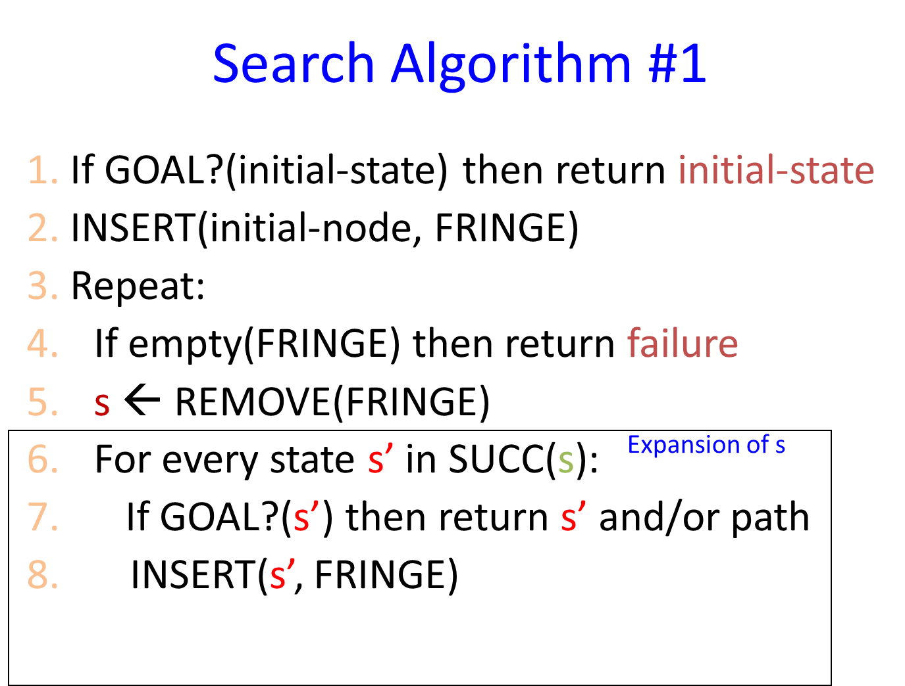
Priority Queue to the rescue! (sort of)
A
15
5
S
5
B
5
G
10
1
C
S
0
A
B
C
15
5
1
G
11
Suboptimal path!

Slide 47
Search Algorithm #2
Search Algorithm #1
1. If GOAL?(initial-state) then return initial-state
2. INSERT(initial-node, FRINGE)
3. Repeat:
4. If empty(FRINGE) then return failure
5. s ← REMOVE(FRINGE)
6. For every state s’ in SUCC(s):
7. If GOAL?(s’) then return s’ and/or path
8. INSERT(s’, FRINGE)
1. If GOAL?(initial-state) then return initial-state
2. INSERT(initial-node, FRINGE)
3. Repeat:
4. If empty(FRINGE) then return failure
5. s ← REMOVE(FRINGE)
6. If GOAL?(s) then return s and/or path
7. For every state s’ in SUCC(s):
8. INSERT(s’, FRINGE)
Expansion of s
47

Slide 48
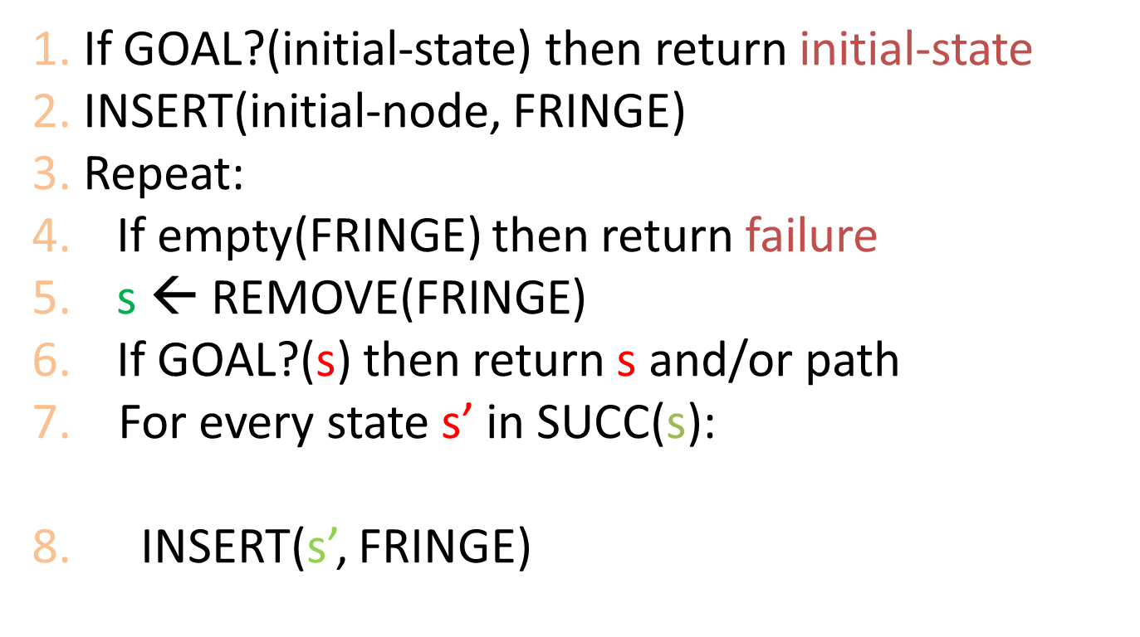
Priority Queue to the rescue! (sort of)
A
15
5
S
5
B
5
G
10
1
C

Slide 49
Avoiding Revisited States
Requires comparing state descriptions
Breadth-first search:
Store all states associated with generated nodes in VISITED
If the state of a new node is in VISITED, then discard the node

Slide 50
Avoiding Revisited States
Requires comparing state descriptions
Breadth-first search:
Store all states associated with generated nodes in VISITED
If the state of a new node is in VISITED, then discard the node
Implemented as hash-table
or as explicit data structure with flags

