Slide 1
Uninformed search wrapup,
and A* search
Notes:
Let’s start this class in a way you might not expect a CS class to start: by thinking about a classic puzzle.

Slide 2
Announcements
Assignment 0 released
Some short activities due tomorrow night
Are you getting Canvas notifications?
If not, you can change them; go to Profile -> Settings -> Notifications
Videos for some online lectures are available
May or may not be helpful… YMMV…

Slide 3
Non-uniform cost functions
Breadth-first is no longer optimal
Instead of expanding the node in FRINGE with the shortest path from the initial state, we want to the one with the least costly path
Requires some extra bookkeeping
Nodes in fringe now also store g(s), which is the cost of the path from initial state to s.

Slide 4
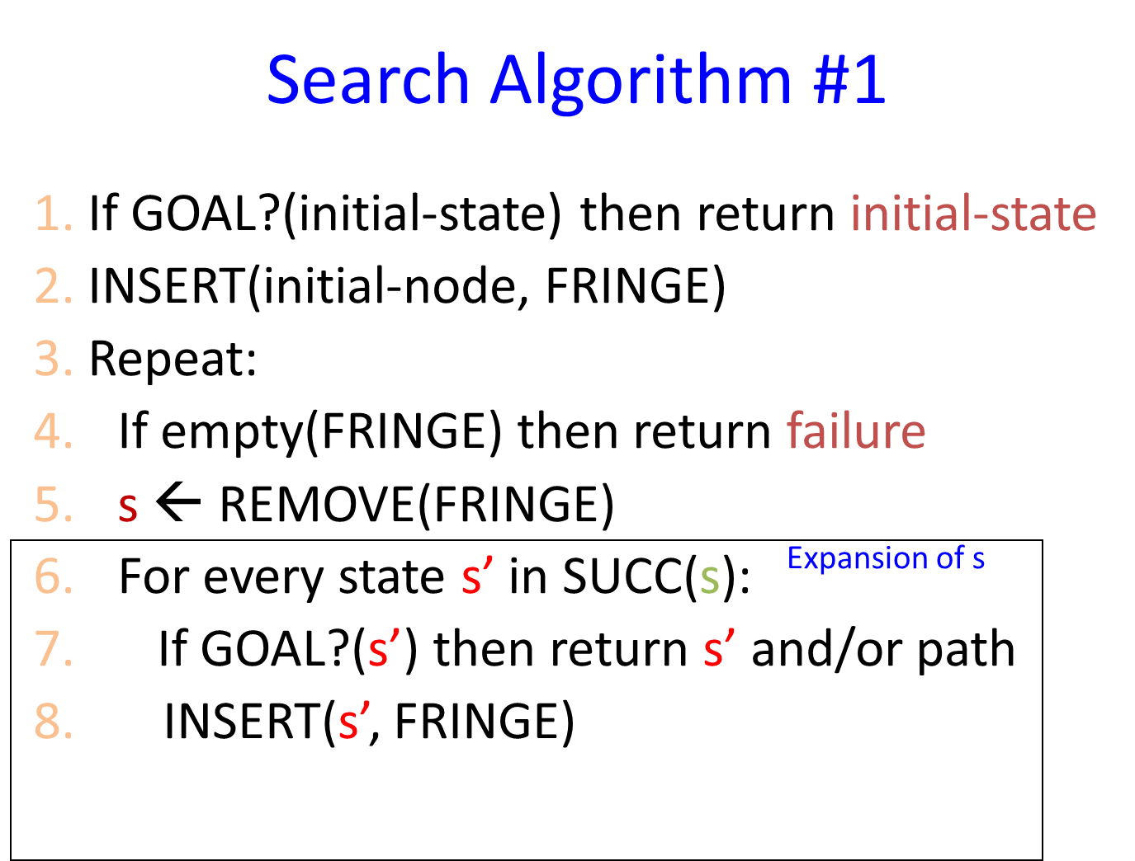
Priority Queue to the rescue! (sort of)
A
15
5
S
5
B
5
G
1
10
C
S
0
A
B
C
15
5
1
G
11
Suboptimal path!

Slide 5
Search Algorithm #2
Search Algorithm #1
1. If GOAL?(initial-state) then return initial-state
2. INSERT(initial-node, FRINGE)
3. Repeat:
4. If empty(FRINGE) then return failure
5. s ← REMOVE(FRINGE)
6. For every state s’ in SUCC(s):
7. If GOAL?(s’) then return s’ and/or path
8. INSERT(s’, FRINGE)
1. If GOAL?(initial-state) then return initial-state
2. INSERT(initial-node, FRINGE)
3. Repeat:
4. If empty(FRINGE) then return failure
5. s ← REMOVE(FRINGE)
6. If GOAL?(s) then return s and/or path
7. For every state s’ in SUCC(s):
8. INSERT(s’, FRINGE)
Expansion of s
5

Slide 6
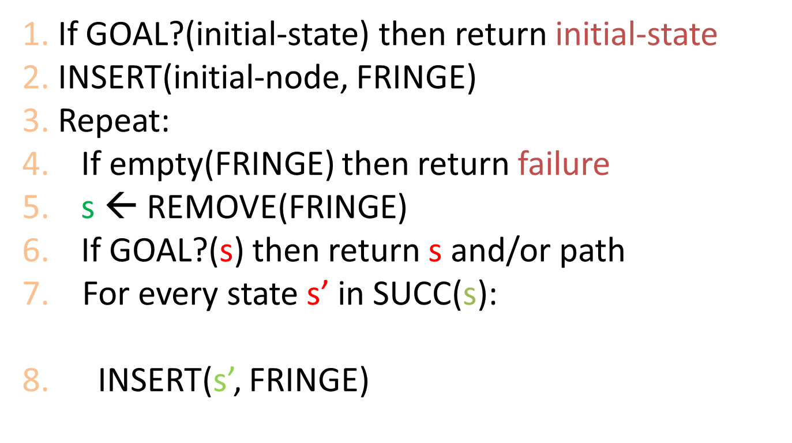
Priority Queue and Algo #2 to the rescue!
A
15
5
S
5
B
5
G
1
10
C

Slide 7
Avoiding Revisited States
Requires comparing state descriptions
Breadth-first search:
Store all states associated with generated nodes in VISITED
If the state of a new node is in VISITED, then discard the node

Slide 8
Avoiding Revisited States
Requires comparing state descriptions
Breadth-first search:
Store all states associated with generated nodes in VISITED
If the state of a new node is in VISITED, then discard the node
Implemented as hash-table
or as explicit data structure with flags

Slide 9
Heuristic search
Notes:
Let’s start this class in a way you might not expect a CS class to start: by thinking about a classic puzzle.

Slide 10
Heuristic vs blind search
For a blind strategy, N₁ and N₂ are just two nodes (at some position in the search tree)
For a heuristic strategy, N₂ seems more promising than N₁ (fewer misplaced tiles)

Slide 11
Best-First Search
Explores most “promising” state from FRINGE first
Typically implemented with a priority queue
Requires evaluation function f(s) ≥ 0 that estimates the “cost” from initial state, through s, to a goal state
Typical choices of f(s):
f(s) = h(s), where h estimates the cost of reaching a goal from s (greedy best first search)
f(s) = g(s) + h(s), where g is cost of path from start state to s and h estimates the cost of reaching a goal from s

Slide 12
Adding to our abstraction
Set of states S
Initial state s₀
A function SUCC: S → 2^{S} that encodes possible transitions of the system
Set of goal states
A cost function c() that calculates how “expensive” a given set of moves is
A heuristic function h() that estimates how “promising” a given state is
Notes:
When a new problem comes along, we can use the search abstraction by defining 5 key parts. First, we need a set of states, which we’ll call S. We need to define an initial state s_0. We’ll need a function called SUCC that records the possible transisions of the system. We’re using set notation here, and this means that SUCC is a function that takes an element of S and returns a set of states of S – 2^S here is what is known as the power set of S, the set of all possible subsets of S. We’ll need to define one or more goal states. And finally, we’ll usually have some measure of the cost of a particular solution. In the example we just saw, the man might measure cost in terms of number of river crossings since he probalby wants to get everyone across as quickly as possible.

Slide 13
Heuristic function h(s) ≥ 0
Estimates the cost to go from state s to a goal state
The better the estimate, the more efficient the search
BUT we want to be able to compute it efficiently
Typically there are many possibilities, each with trade-offs
How would you define h(s) for the 8-puzzle?
5
8
1
2
3
4
2
1
4
5
6
7
3
6
7
8
STATE(s)
Goal state

Slide 14
8-Puzzle
f(s) = h(s) = number of misplaced numbered tiles
4
3
4
3
4
3
2
1
5
2
1
5
2
1
5
2
4
3
2
4
3
6
7
8
6
7
8
6
7
8
3
3
4
1
7
5
1
5
6
8
6
7
8
5
3
2
4
3
6
1
5
7
8
1
2
3
4
6
4
7
8
2
4
3
2
1
7
5
2
3
1
2
3
6
8
1
4
5
4
5
4
2
4
3
2
3
6
7
8
6
7
8
2
1
1
5
1
4
5
1
2
3
6
7
8
6
7
8
4
5
3
3
6
7
8
2
3
0
1
4
5
6
7
8
4
2
4
3
2
4
3
1
7
5
1
5
6
8
6
7
8
5
4
The white tile is the empty tile

Slide 15
8-Puzzle
f(s) = g(s) + h(s) with h(s) = number of misplaced numbered tiles
4
3
2
1
5
2
4
3
2
4
3
6
7
8
3+3
1
7
5
1
5
6
8
6
7
8
1+5
2+3
2
4
3
6
1
5
7
8
1
2
3
3+4
6
4
7
8
2
4
3
5+2
1
7
5
2
3
1
2
3
6
8
1
4
5
4
5
0+4
2
4
3
2
3
6
7
8
6
7
8
3+2
4+1
1
5
1
4
5
1
2
3
6
7
8
6
7
8
4
5
1+3
2+3
6
7
8
2
3
5+0
1
4
5
6
7
8
3+4
2
4
3
2
4
3
1
7
5
1
5
6
8
6
7
8
1+5
2+4

Slide 16
8-Puzzle
f(N) = h(N) = Σ distances of numbered tiles to their goals
2
4
3
2
4
3
1
7
5
1
5
6
8
6
7
8
6
5
1
2
3
6
4
7
8
2
4
3
2
1
7
5
2
3
1
2
3
6
8
1
4
5
4
5
5
2
4
3
2
3
6
7
8
6
7
8
2
1
1
5
1
4
5
1
2
3
6
7
8
6
7
8
4
5
4
3
6
7
8
2
3
0
1
4
5
6
7
8
4
2
4
3
2
4
3
1
7
5
1
5
6
8
6
7
8
6
5

Slide 17
Admissible Heuristic
An heuristic h(s) is admissible if for any state s,
0 ≤ h(s) ≤ h*(s)
where h*(s) is the optimal cost from s to a goal.
In other words, an admissible heuristic never overestimates the cost to the goal
We’ll need to design h(s) so that it’s always less than h*(s), even though we don’t know h*(s)!

Slide 18
Which of these are admissible?
h₁(N) = number of misplaced numbered tiles = 6
h₂(N) = sum of Manhattan distances of tiles to goal positions = 2 + 3 + 0 + 1 + 3 + 0 + 3 + 1 = 13
h₃(N) = sum of permutation inversions = n₅ + n₈ + n₄ + n₂ + n₁ + n₇ + n₃ + n₆ = 4 + 6 + 3 + 1 + 0 + 2 + 0 + 0 = 16
5
8
1
2
3
4
2
1
4
5
6
7
3
6
7
8
STATE(s)
Goal state

Slide 19
A* Search
Best First Search using Algorithm #2, with f(s) = g(s) + h(s), where:
g(s) = cost of best path found so far to s
h(s) = admissible heuristic function

Slide 20
What to do with revisited states?
c = 1
2
h = 100
1
2
1
90
100
0

Slide 21
What to do with revisited states?
c = 1
2
f = 1+100
2+1
h = 100
1
2
1
90
4+90
?
100
0
104
If we discard this new node, A* expands the goal next, returning a non-optimal solution

Slide 22
1. Is A* complete?
2. Is A* optimal?
3. What is the running time of A*?
4. What are the memory requirements of A*?

Slide 23
A* is complete and optimal if:
Algorithm #2 is used,
Duplicate states are revisited, and
h is admissible.
Proof sketch:
First show that if a solution exists, A* terminates and finds a solution.
Then show that whenever A* expands a node, the path to that node is optimal.

Slide 24
A* is complete and optimal if h is admissible.
Proof sketch:
If a solution exists, A* terminates and returns a solution
- For each node N on the fringe, f(N) = g(N)+h(N) ≥ g(N) ≥ d(N)×ϵ, where d(N) is the depth of N in the tree
- As long as A* hasn’t terminated, a node K on the fringe lies on a solution path
- Since each node expansion increases the length of one path, K will eventually be selected for expansion, unless a solution is found along another path
K

Slide 25
A* is complete and optimal if h is admissible.
Proof sketch:
Whenever A* chooses to expand a goal node, the path to this node is optimal
- C*= cost of the optimal solution path
- G’: non-optimal goal node in the fringe f(G’) = g(G’) + h(G’) = g(G’) > C*
- A node K in the fringe lies on an optimal path:
f(K) = g(K) + h(K) ≤ C*
- So, G’ will not be selected for expansion
G’
K

Slide 26
Complexity of A*
A* expands all nodes with f(s) < C*
May also expand non-goal states with f(s) = C*
May be an exponential number of nodes unless the heuristic is sufficiently accurate
1
1
1
1+1
1+1
1
1
1
2+1
2+1
2+1
2+1
2
2
4
4
4
4
4
4
4
4

Slide 27
Consistent Heuristic
An admissible heuristic h is consistent (or monotone) if for each node N and each child N’ of N:
N
c(N,N’)
h(N) ≤ c(N,N’) + h(N’)
(triangle inequality)
N’
h(N)
h(N’)
Intuition: a consistent heuristics becomes more precise as we get deeper in the search tree

Slide 28
Consistency Violation
If h says that N is 100 units from the goal, then moving from N along an edge costing 10 units should not lead to a node N’ that h estimates to be 10 units away from the goal
N
c(N,N’) =10
N’
h(N) =100
h(N’) =10
(triangle inequality)

Slide 29
Admissibility and Consistency
A consistent heuristic is also admissible
An admissible heuristic may not be consistent, but many admissible heuristics are consistent

Slide 30
Search Algorithm #3
Search Algorithm #1
1. If GOAL?(initial-state) then return initial-state
2. INSERT(initial-node, FRINGE)
3. Repeat:
4. If empty(FRINGE) then return failure
5. s ← REMOVE(FRINGE)
6. INSERT(s, CLOSED)
7. If GOAL?(s) then return s and/or path
8. For every state s’ in SUCC(s):
9. If s’ in CLOSED, discard s’
10. If s’ in FRINGE with larger s’, remove from FRINGE
11. If s’ not in FRINGE, INSERT(s’, FRINGE)
Expansion of s
30

Slide 31
A* is optimal if
h admissible (but not necessarily consistent)
Revisited states not discarded
Search #2 is used
h is consistent
(Many) revisited states discarded
Search #3 is used

Slide 32
Experimental Results (see R&N for details)
Random 8-puzzles with:
h₁ = number of misplaced tiles
h₂ = sum of distances of tiles to their goal positions
Average “effective branching factors” based on actual # of nodes expanded:
d | IDS | A₁* | A₂*
2 | 2.45 | 1.79 | 1.79
6 | 2.73 | 1.34 | 1.30
12 | 2.78 (3,644,035) | 1.42 (227) | 1.24 (73)
16 | -- | 1.45 | 1.25
20 | -- | 1.47 | 1.27
24 | -- | 1.48 (39,135) | 1.26 (1,641)

