Slide 1
Heuristic search wrap-up,
and local search
Notes:
Let’s start this class in a way you might not expect a CS class to start: by thinking about a classic puzzle.

Slide 2
Announcements
Assignment 0 released
Some short activities due tomorrow night
Are you getting Canvas notifications?
If not, you can change them; go to Profile -> Settings -> Notifications
Videos for some online lectures are available
May or may not be helpful… YMMV…

Slide 3
What to do with revisited states?
c = 1
2
h = 100
1
2
1
90
100
0

Slide 4
What to do with revisited states?
c = 1
2
f = 1+100
2+1
h = 100
1
2
1
90
4+90
?
100
0
104
If we discard this new node, A* expands the goal next, returning a non-optimal solution

Slide 5
1. Is A* complete?
2. Is A* optimal?
3. What is the running time of A*?
4. What are the memory requirements of A*?

Slide 6
A* is complete and optimal if:
Algorithm #2 is used,
Duplicate states are revisited, and
h is admissible.
Proof sketch:
First show that if a solution exists, A* terminates and finds a solution.
Then show that whenever A* expands a node, the path to that node is optimal.

Slide 7
A* is complete and optimal if h is admissible.
Proof sketch:
If a solution exists, A* terminates and returns a solution
- For each node N on the fringe, f(N) = g(N)+h(N) ≥ g(N) ≥ d(N)×ϵ, where d(N) is the depth of N in the tree
- As long as A* hasn’t terminated, a node K on the fringe lies on a solution path
- Since each node expansion increases the length of one path, K will eventually be selected for expansion, unless a solution is found along another path
K

Slide 8
A* is complete and optimal if h is admissible.
Proof sketch:
Whenever A* chooses to expand a goal node, the path to this node is optimal
- C*= cost of the optimal solution path
- G’: non-optimal goal node in the fringe f(G’) = g(G’) + h(G’) = g(G’) > C*
- A node K in the fringe lies on an optimal path:
f(K) = g(K) + h(K) ≤ C*
- So, G’ will not be selected for expansion
G’
K

Slide 9
Complexity of A*
A* expands all nodes with f(s) < C*
May also expand non-goal states with f(s) = C*
May be an exponential number of nodes unless the heuristic is sufficiently accurate
1
1
1
1+1
1+1
1
1
1
2+1
2+1
2+1
2+1
2
2
4
4
4
4
4
4
4
4

Slide 10
When can a revisited state be discarded safely?
1
1
1
1+1
1+1
1
1
1
2+1
2+1
2+1
2+1
2
2
4
4
4
4
4
4
4
4
When the cost of the new path to state s is greater than or equal to the cost of the previous path to state s. But this ignores the information in h(s).

Slide 11
But ...
If we do not discard nodes revisiting states, the size of the search tree can be exponential in the number of visited states
1
1
1+1
1+1
1
1
1
2+1
2+1
2+1
2+1
1
2
2
4
4
4
4
4
4
4
4
2n+1 states
O(2^{n}) nodes

Slide 12
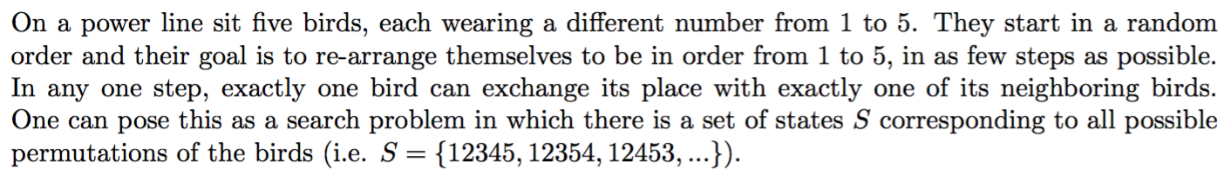
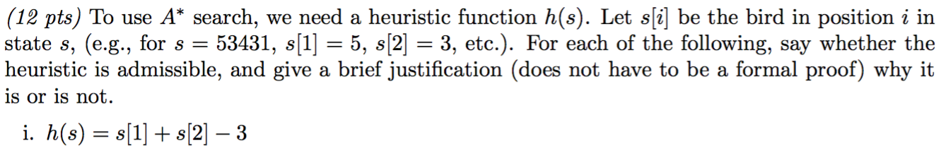
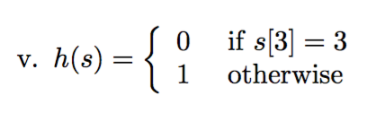

If you could choose one of the above to use for A*, which would you choose?

Slide 13
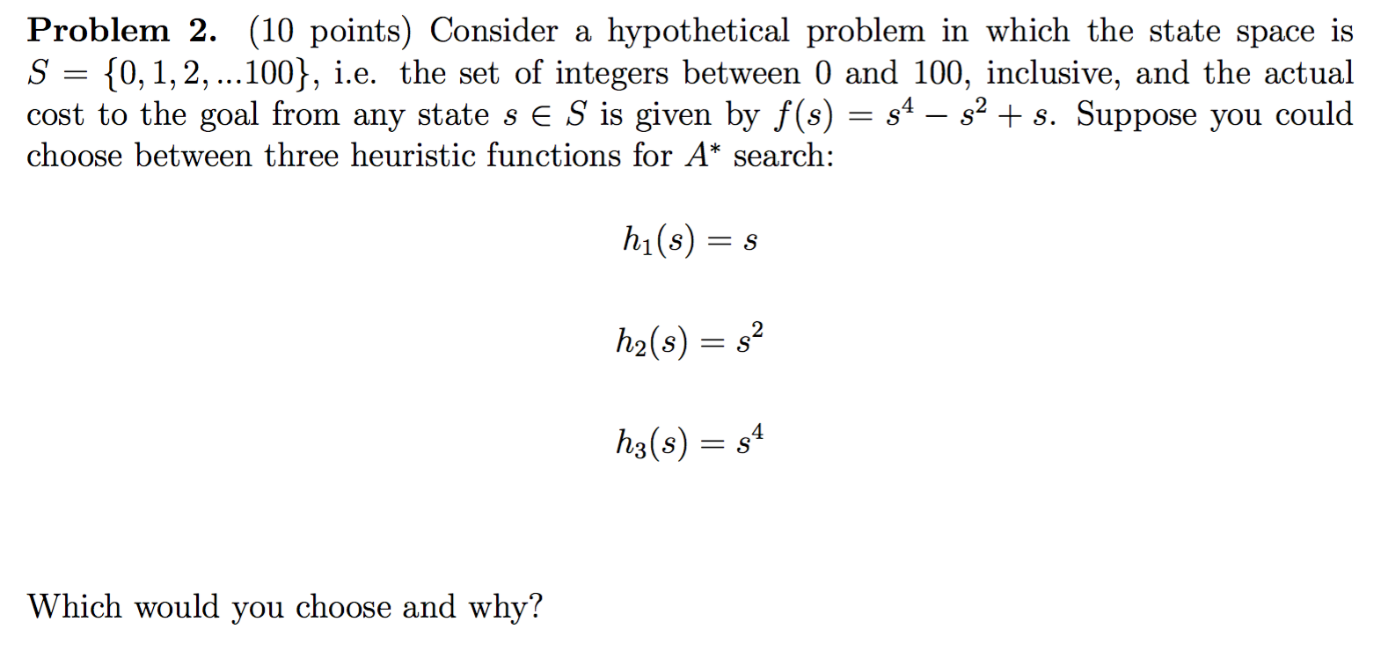

Slide 14
Consistent Heuristic
An admissible heuristic h is consistent (or monotone) if for each node N and each child N’ of N:
N
c(N,N’)
h(N) ≤ c(N,N’) + h(N’)
(triangle inequality)
N’
h(N)
h(N’)
Intuition: a consistent heuristics becomes more precise as we get deeper in the search tree

Slide 15
Consistency Violation
If h says that N is 100 units from the goal, then moving from N along an edge costing 10 units should not lead to a node N’ that h estimates to be 10 units away from the goal
N
c(N,N’) =10
N’
h(N) =100
h(N’) =10
(triangle inequality)

Slide 16
Admissibility and Consistency
A consistent heuristic is also admissible
An admissible heuristic may not be consistent, but many admissible heuristics are consistent

Slide 17
8-Puzzle
5
8
1
2
3
are both consistent (why?)
4
2
1
4
5
6
7
3
6
7
8
N
STATE(N)
goal
c(N,N’)
N’
h(N)
h₁(N) = number of misplaced tiles
h₂(N) = sum of the (Manhattan) distances of every tile to its goal position
h(N’)
h(N) ≤ c(N,N’) + h(N’)

Slide 18
Robot Navigation
N
c(N,N’)
N’
h(N)
h(N’)
h(N) ≤ c(N,N’) + h(N’)
Cost of one horizontal/vertical step = 1
Cost of one diagonal step =
is consistent
is consistent if moving along
diagonals is not allowed, and
not consistent otherwise
h₂(N) = |x_{N}-x_{g}| + |y_{N}-y_{g}|

Slide 19
Result #2
If h is consistent, then whenever A* expands a node, it has already found an optimal path to this node’s state

Slide 20
Proof (1/2)
N
N’
Consider a node N and its child N’ Since h is consistent: h(N) ≤ c(N,N’)+h(N’) f(N) = g(N)+h(N) ≤ g(N)+c(N,N’)+h(N’)
= g(N’) + h(N’)
= f(N’) So, f is non-decreasing along any path

Slide 21
Proof (2/2)
Result #2
Suppose K has been selected for expansion by A* and we have found path P so far.
Suppose there exists another path through N, not selected for expansion by A* with cost smaller than P.
Then f(N) ≥ f(K) (N was not selected by A* for expansion). But since f is non-decreasing, f(N) ≤ f(K). Thus f(N) = f(K). But since edges have positive costs, this cannot happen.
Thus P is optimal.
If h is consistent, then whenever A* expands a node, it has already found an optimal path to this node’s state
P
N
K

Slide 22
Search Algorithm #3
Search Algorithm #1
1. If GOAL?(initial-state) then return initial-state
2. INSERT(initial-node, FRINGE)
3. Repeat:
4. If empty(FRINGE) then return failure
5. s ← REMOVE(FRINGE)
6. INSERT(s, CLOSED)
7. If GOAL?(s) then return s and/or path
8. For every state s’ in SUCC(s):
9. If s’ in CLOSED, discard s’
10. If s’ in FRINGE with larger s’, remove from FRINGE
11. If s’ not in FRINGE, INSERT(s’, FRINGE)
Expansion of s
22

Slide 23
A* is optimal if
h admissible (but not necessarily consistent)
Revisited states not discarded
Search #2 is used
h is consistent
(Many) revisited states discarded
Search #3 is used

Slide 24
Heuristic Accuracy
If h₁ and h₂ are consistent heuristics such that h₁(N) ≤ h₂(N) for all nodes N, then h₂ is more accurate (or informative) than h₁
The more accurate h is, the less work A* has to do!
h₁(N) = number of misplaced tiles
h₂(N) = sum of distances of every tile to its goal position
Which is more accurate?
5
8
1
2
3
4
2
1
4
5
6
7
3
6
7
8
STATE(N)
Goal state

Slide 25
Result #3
Let h₂ be more accurate than h₁
Let A₁* be A* using h₁ and A₂* be A* using h₂
Whenever a solution exists, all the nodes expanded by A₂*, except possibly for some nodes such that f₁(N) = f₂(N) = C* (cost of optimal solution) are also expanded by A₁*
Result #3
If h₂ is more accurate than h₁, then every node expanded by A* using h₂ is also expanded by A* using h₁ (except, perhaps, nodes N such that f₁(N)=f₂(N)=C*).
So the more accurate a heuristic is, the less work A* does

Slide 26
Proof
C* = h*(initial-node) [cost of optimal solution]
Every node N such that f(N) < C* is eventually expanded. No node N such that f(N) > C* is ever expanded
Every node N such that h(N) < C*−g(N) is eventually expanded. So, every node N such that h₂(N) < C*−g(N) is expanded by A₂*. Since h₁(N) ≤ h₂(N), N is also expanded by A₁*
If there are several nodes N such that f₁(N) = f₂(N) = C* (such nodes include the optimal goal nodes, if there exists a solution), A₁* and A₂* may or may not expand them in the same order (until one goal node is expanded)

Slide 27
How to create good heuristics?
One approach: solve “relaxed” problems that ignore some constraints
E.g. ignore interactions among parts of the problem
In the 8-puzzle, the sum of the distances of each tile to its goal position (h₂) corresponds to solving 8 simple problems:
5
8
1
2
3
d_{i} is length of shortest path to
move tile i to its goal position,
ignoring the other tiles, and
h₂ = Σ_{i=1,...8} d_{i}
4
2
1
4
5
6
7
3
6
7
8
5
5

Slide 28
Can we do better?
For example, we could consider two more complex relaxed problems:
→ h = d₁₂₃₄ + d₅₆₇₈ [disjoint pattern heuristic]
These distances can be pre-computed and stored
[Each requires generating a tree of 3,024 states (breadth-first search)]
5
8
1
2
3
d₁₂₃₄ = length of shortest path to move 1, 2, 3, and 4 to goal positions,
Ignoring other tiles
4
2
1
4
5
6
→ Several order-of-magnitude speedups for the 15- and 24-puzzle (see R&N)
7
3
6
7
8
d₅₆₇₈
1
2
3
5
8
4
2
1
4
5
6
3
7
6
7
8

Slide 29
Experimental Results (see R&N for details)
Random 8-puzzles with:
h₁ = number of misplaced tiles
h₂ = sum of distances of tiles to their goal positions
Average “effective branching factors” based on actual # of nodes expanded:
d | IDS | A₁* | A₂*
2 | 2.45 | 1.79 | 1.79
6 | 2.73 | 1.34 | 1.30
12 | 2.78 (3,644,035) | 1.42 (227) | 1.24 (73)
16 | -- | 1.45 | 1.25
20 | -- | 1.47 | 1.27
24 | -- | 1.48 (39,135) | 1.26 (1,641)

Slide 30
Iterative Deepening A* (IDA*)
Idea: Reduce memory requirement of A* by applying cutoff on values of f
Consistent heuristic function h
Algorithm IDA*:
Initialize cutoff to f(initial-node)
Repeat:
Perform depth-first search by expanding all nodes N such that f(N) ≤ cutoff
Reset cutoff to smallest value f of non-expanded (leaf) nodes

Slide 31
8-Puzzle
f(s) = g(s) + h(s) with h(s) = number of misplaced numbered tiles
2
4
3
2
4
3
1
7
5
1
5
6
8
6
7
8
1+5
2+3
2
4
3
1
7
5
6
8
0+4
2
4
3
2
3
1
5
1
4
5
1
2
3
6
7
8
6
7
8
4
5
1+3
2+3
6
7
8
Cutoff=4
2
4
3
2
4
3
1
7
5
1
5
6
8
6
7
8
1+5
2+4

Slide 32
8-Puzzle
f(s) = g(s) + h(s) with h(s) = number of misplaced numbered tiles
4
3
2
1
5
2
4
3
2
4
3
6
7
8
3+3
1
7
5
1
5
6
8
6
7
8
1+5
2+3
2
4
3
6
1
5
7
8
1
2
3
3+4
6
4
7
8
2
4
3
5+2
1
7
5
2
3
1
2
3
6
8
1
4
5
4
5
0+4
2
4
3
2
3
6
7
8
6
7
8
3+2
4+1
1
5
1
4
5
1
2
3
6
7
8
6
7
8
4
5
1+3
2+3
6
7
8
2
3
5+0
1
4
5
Cutoff=4
6
7
8
3+4
2
4
3
2
4
3
1
7
5
1
5
6
8
6
7
8
1+5
2+4

Slide 33
8-Puzzle
f(s) = g(s) + h(s) with h(s) = number of misplaced numbered tiles
4
3
2
1
5
2
4
3
2
4
3
6
7
8
3+3
1
7
5
1
5
6
8
6
7
8
1+5
2+3
2
4
3
6
1
5
7
8
1
2
3
3+4
6
4
7
8
2
4
3
5+2
1
7
5
2
3
1
2
3
6
8
1
4
5
4
5
0+4
2
4
3
2
3
6
7
8
6
7
8
3+2
4+1
1
5
1
4
5
1
1
2
2
3
3
6
7
8
6
7
8
4
4
5
1+3
2+3
5
6
6
7
7
8
2
3
8
5+0
1
4
5
Cutoff=5
6
7
8
3+4
2
4
3
2
4
3
1
7
5
1
5
6
8
6
7
8
1+5
2+4

Slide 34
Advantages/Drawbacks of IDA*
Advantages:
Still complete and optimal
Requires less memory than A*
Avoid the overhead to sort the fringe
Drawbacks:
Can’t avoid revisiting states not on the current path
Available memory is poorly used
(→ memory-bounded search, see R&N p. 101-104)

