Slide 1
Local search
Notes:
Let’s start this class in a way you might not expect a CS class to start: by thinking about a classic puzzle.

Slide 2
Announcements
Assignment 1 posted!
Contact your group!
Start early!
Get help if needed!
Check Piazza for updates!

Slide 4
Steepest descent
Notes:
Let’s start this class in a way you might not expect a CS class to start: by thinking about a classic puzzle.

Slide 5
Local Search
No search tree – just remember current state
No need for fringe = much less memory
Applicable to pathless problems (e.g. 8-queens)
Key idea: Try to find s that minimizes h(s)
Since h(goal) = 0

Slide 6
Steepest Descent
S ← initial state
Repeat:
S’ ← arg min_{S’∈SUCC(S)}{h(S’)}
if GOAL?(S’) return S’
if h(S’) < h(S) then S ← S’ else failure

Slide 7
Application: 8-Queen
Repeat n times:
Pick an initial state S at random with one queen in each column
Repeat k times:
If GOAL?(S) then return S
Pick an attacked queen Q at random
Move Q in its column to minimize the number of attacking queens → new S [min-conflicts heuristic]
Return failure
1
2
2
0
3
2
3
2
2
2
2
2
3
2

Slide 8
Application: 8-Queen
Repeat n times:
Pick an initial state S at random with one queen in each column
Repeat k times:
If GOAL?(S) then return S
Pick an attacked queen Q at random
Move Q in its column to minimize the number of attacking queens → new S [min-conflicts heuristic]
Return failure
1
2
2
0
3
2
3
2
2
2
2
2
3
2

Slide 9
Application: 8-Queen
Why/when does it work well?
There are many goal states that are well-distributed over the state space
If no solution has been found after a few steps, it’s better to start it all over again.
Building a search tree would be much less efficient because of the high branching factor
Repeat n times:
Pick an initial state S at random with one queen in each column
Repeat k times:
If GOAL?(S) then return S
Pick an attacked queen Q at random
Move Q in its column to minimize the number of attacking queens → new S [min-conflicts heuristic]
Return failure
1
2
2
0
3
2
3
2
2
2
2
2
3
2

Slide 10
Gradient descent
Notes:
Let’s start this class in a way you might not expect a CS class to start: by thinking about a classic puzzle.

Slide 11
Gradient Descent in Continuous Space
Minimize y=f(x)
Move in opposite direction of derivative df/dx(x)
df/dx(x₁)
x
x₁

Slide 12
Gradient Descent in Continuous Space
Minimize y=f(x)
Move in opposite direction of derivative df/dx(x)
df/dx(x₁)
x
x₁
x₂

Slide 13
Gradient Descent in Continuous Space
Minimize y=f(x)
Move in opposite direction of derivative df/dx(x)
df/dx(x₂)
x
x₁
x₂

Slide 14
Gradient Descent in Continuous Space
Minimize y=f(x)
Move in opposite direction of derivative df/dx(x)
df/dx(x₂)
x
x₁
x₂
x₃

Slide 15
Gradient Descent in Continuous Space
Minimize y=f(x)
Move in opposite direction of derivative df/dx(x)
df/dx(x₃)
x
x₁
x₂
x₃

Slide 16
Gradient Descent in Continuous Space
Minimize y=f(x)
Move in opposite direction of derivative df/dx(x)
x
x₁
x₂
x₃

Slide 17
Gradient: analogue of derivative in multivariate functions f(x₁,…,x_{n})
Direction that you would move x₁,…,x_{n} to make the steepest increase in f
f
x₁
x₂

Slide 18
f
GD works well
f
GD works poorly

Slide 19
Algorithm for Gradient Descent
Input: continuous objective function f, initial point x⁰=(x₁⁰,…,x_{n}⁰)
1. For t=0, …, N-1:
Compute gradient g^{t}=(∂f/∂x₁(x^{t}),…,∂f/∂x_{n}(x^{t}))
If length of g^{t} is small enough, return x
Pick a step size α^{t}
Let x^{t+1}= x^{t} -α^{t}g^{t}
Return failure
When will this work? What can go wrong?

Slide 20
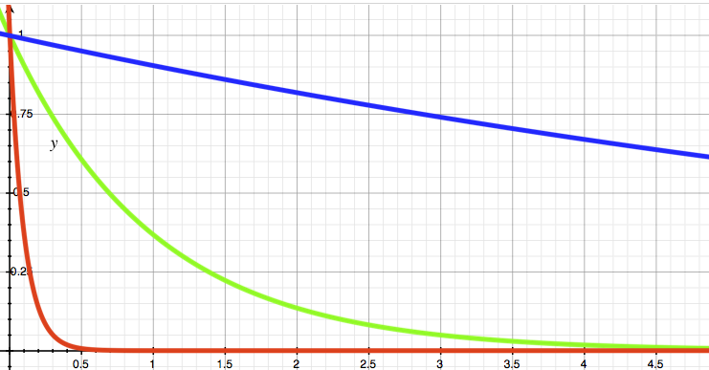
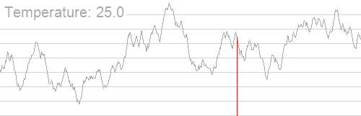
Monte Carlo Descent
T=10
1. S ← initial state
2. Repeat k times:
If GOAL?(S) then return S
S’ ← successor of S picked at random
if h(S’) ≤ h(S) then S ← S’
else with prob. exp(−(h(S’)-h(S))/T) (for some T), S ← S’
3. Return failure
Simulated annealing lowers T
as k increases
T=0.1
T=0.1
h(S’)-h(S)

Slide 21
Other local search techniques:
Beam, genetic, branch-and-bound
Notes:
Let’s start this class in a way you might not expect a CS class to start: by thinking about a classic puzzle.

Slide 22
Beam search: Explore promising states in “parallel”
1. A ← Set of n randomly-generated states
2. Repeat k times:
A’ ← Successors of states in A
If there exists S in A’ such that GOAL?(S), then return S
A ← Subset of n best states in A’
3. Return failure
Idea: Searches that find states will “recruit” other searches to join them
Problems?

Slide 23
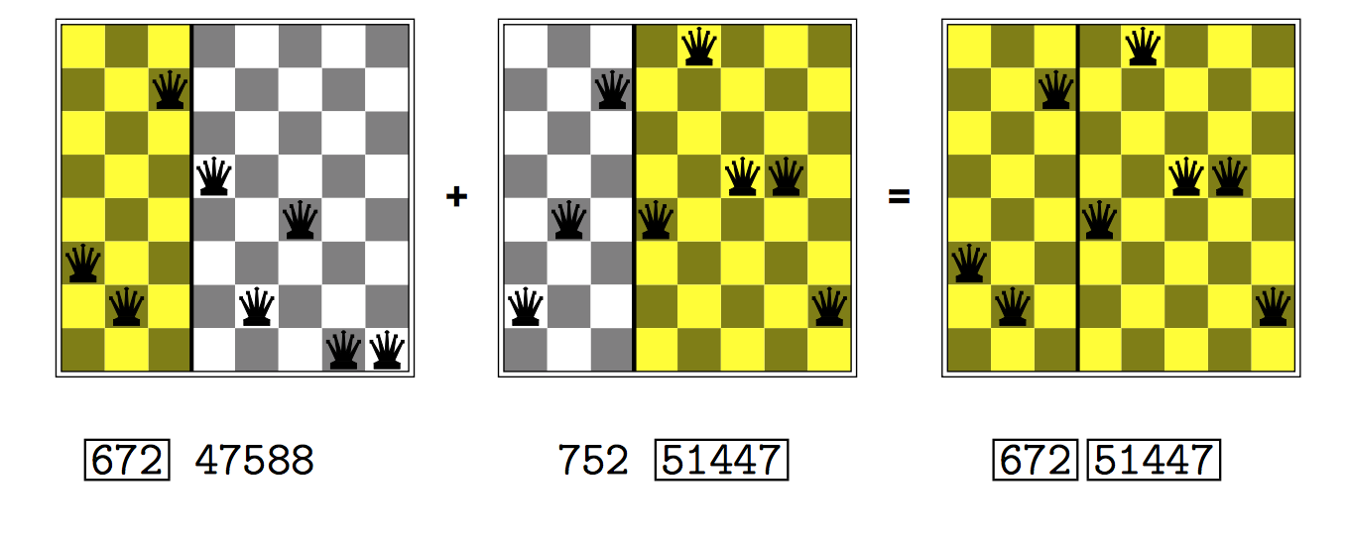
Genetic search: “Evolve” promising states
Idea: Successors are generated by combining pairs of promising states. Most promising “offspring” states are kept.

Slide 24
What if we need to find a global minimum?
f

Slide 25
Exhaustive Search
S
ε

Slide 26
Exhaustive Search
S

Slide 27
Lower-bound function
f_{L}(A): for any set A ⊆ S, returns a lower bound on f(x) for all x∈A
f
x₂
S
x₁
A
f_{L}(A)

Slide 28
Pruning the Search Tree
1
2
4
2.5
3
Values of f_{L}(A)
f(x) = 3.2

Slide 29
Branch-and-bound Algorithm
Init: f* = f(midpt(S))
FRINGE = {S}
While FRINGE not empty, repeat:
A = remove an item (region) from FRINGE
If f_{L}(A) ≥ f* or |A|<ε, then discard A
f* = min(f*,f(midpt(A))
Split A and add subregions to FRINGE
Pruning step

Slide 30
Performance
Works well when
f_{L} is relatively tight
n isn’t too large
Methods for generating f_{L}
Interval arithmetic
Solving “relaxed” versions of f
Problem-specific ways

Slide 31
We need to place two sensors in the sea, each as deep as possible, but close to 100m apart horizontally.
Sea bottom, given by function f(x):
Placement cost function:
C(x₁, x₂) = f(x₁) + f(x₂) + (x₂-x₁-100)²
Want to choose x₁ and x₂ to minimize C(x₁, x₂)
What’s the (conceptually) easiest way?
What’s a better way?
50000
40000
30000
20000
10000
0
x
0 100 200 300 400 500

Slide 32
50000
40000
30000
20000
10000
0
C(x₁,x₂) = f(x₁) + f(x₂) + (x₂-x₁-100)²
x
0 100 200 300 400 500
x₁
Given a region A, can we quickly compute a lower bound L(A) bound on C inside A?
500
400
300
200
100
0
x₂
0 100 200 300 400 500

Slide 33
50000
40000
30000
20000
10000
0
C(x₁,x₂) = f(x₁) + f(x₂) + (x₂-x₁-100)²
x
0 100 200 300 400 500
x₁
500
400
300
200
100
0
x₂
0 100 200 300 400 500

Slide 34
50000
40000
30000
20000
10000
0
C(x₁,x₂) = f(x₁) + f(x₂) + (x₂-x₁-100)²
x
0 100 200 300 400 500
x₁
500
400
300
200
100
0
x₂
0 100 200 300 400 500

Slide 35


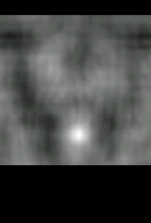
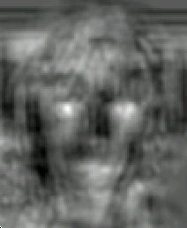
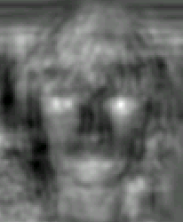
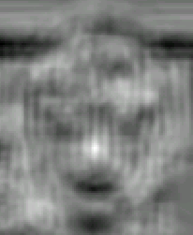



Object recognition example
Marginal on
Nose
Left eye
Right eye
Nose
Graphical
model
Inference, branch and bound
Left mouth
Right mouth
Chin
From: Crandall, Felszenswalb, Huttenlocher, CVPR 2005.

Slide 36
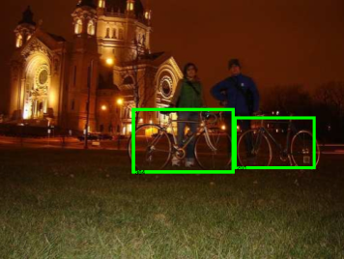
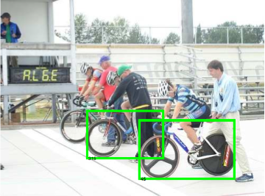
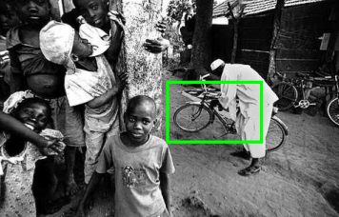
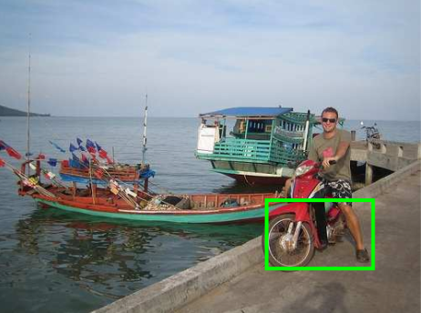
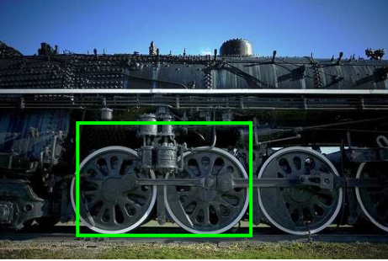
Sample “bicycle” localizations
Correct detections:
False positives:

Slide 37
Traveling Salesman Problem
Given a complete, weighted graph on n nodes, find the least weight Hamiltonian cycle, a cycle that visits every node once.
Though this problem is easy enough to explain, it is very difficult to solve.
Finding all the Hamiltonian cycles of a graph takes exponential time. Therefore, TSP is in the class NP.
E.g. How many routes must be considered for 16 cities?
Slides credit: Susan Ott

Slide 38
Traveling salesman problem
Input: graph (V,E)
Problem: Find shortest path via all nodes and returning to start node.

Slide 39
Collision Checking
Check whether objects overlap

Slide 40
Hierarchical Collision Checking
Enclose objects into bounding volumes (spheres or boxes)
Check the bounding volumes

Slide 41
Hierarchical Collision Checking
Enclose objects into bounding volumes (spheres or boxes)
Check the bounding volumes first
Decompose an object into two

Slide 42
Hierarchical Collision Checking
Enclose objects into bounding volumes (spheres or boxes)
Check the bounding volumes first
Decompose an object into two
Proceed hierarchically

Slide 43
Hierarchical Collision Checking
Enclose objects into bounding volumes (spheres or boxes)
Check the bounding volumes first
Decompose an object into two
Proceed hierarchically

Slide 44
Online search
Notes:
Let’s start this class in a way you might not expect a CS class to start: by thinking about a classic puzzle.

Slide 45
How to handle imperfect observations?
Classical search assumes that:
World states are perfectly observable, → the current state is exactly known
Action representations are perfect, → states are exactly predicted
How an agent can cope with adversaries, uncertainty, and imperfect information?

Slide 46
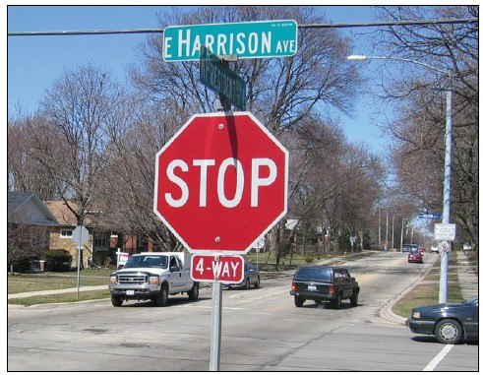
Distance, speed, acceleration?
Intent?
Personality?

Slide 47
Online Search
On-line search: repeatedly observe effects, and replan
A proactive approach for planning
A reactive approach to uncertainty
Example: A robot must reach a goal position. It has no prior map of the obstacles, but its vision system can detect all the obstacles visible from a the robot’s current position

Slide 48
Assuming no obstacles in the unknown region and taking the shortest path to the goal is similar to searching with an admissible (optimistic) heuristic

Slide 49
Assuming no obstacles in the unknown region and taking the shortest path to the goal is similar to searching with an admissible (optimistic) heuristic

Slide 50
Assuming no obstacles in the unknown region and taking the shortest path to the goal is similar to searching with an admissible (optimistic) heuristic
Just as with classical search, on-line search may detect dead-ends and move to a more promising position (~ node
of search tree)

