Slide 1
Introduction to uncertainty
Notes:
Let’s start this class in a way you might not expect a CS class to start: by thinking about a classic puzzle.

Slide 2
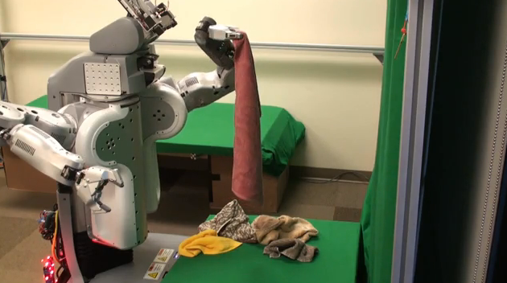
Probabilistic techniques
AI is full of uncertainty
Can’t observe full state of system
Observations we can make are noisy
Our models of the world are imperfect
Some systems can’t be modeled anyway (chaotic and apparently nondeterministic systems)
Probabilistic frameworks give us a principled way of dealing with and reasoning about this uncertainty
Largely championed by Judea Pearl (2011 Turing Award)
Martin-Shepard 2010

Slide 3
But they’re not a silver bullet!
We’ll still face challenges like…
Probability distributions that are impossibly complex, with intractably many dimensions
Parameter estimation problems that would require exponential amounts of data
Inference problems that are NP hard
Much work is thus devoted to balancing between what we’d like to model and what we are able to model
Probabilistic graphical models are a popular framework

Slide 4
Probability 101
Notes:
Let’s start this class in a way you might not expect a CS class to start: by thinking about a classic puzzle.

Slide 5






Probability definitions
A finite probability space consists of:
A finite set S of mutually-exclusive outcomes
A function such that:
An event A is a subset of S, .
The probability of an event is defined as

Slide 6

Basic identities
For two events A and B…
What’s the probability that either A or B (or both) occur?
If A and B are disjoint, their intersection is the empty set, and the last term is 0.

Slide 7
Basic identities
For two events A and B…
What’s the probability that either A or B (or both) occur?
If A and B are disjoint, their intersection is the empty set, and the last term is 0.

Slide 8
Super simple example #1
Suppose you roll a six-sided die 5 times. What’s the probability of rolling a “three” all 5 times?

Slide 9
Super simple example #2
Suppose you roll a six-sided die 5 times. What’s the probability of rolling a “three” during the first roll?

Slide 10
Super simple example #3
Suppose you roll a die 5 times. What’s the probability of getting at least 1 six?

Slide 11
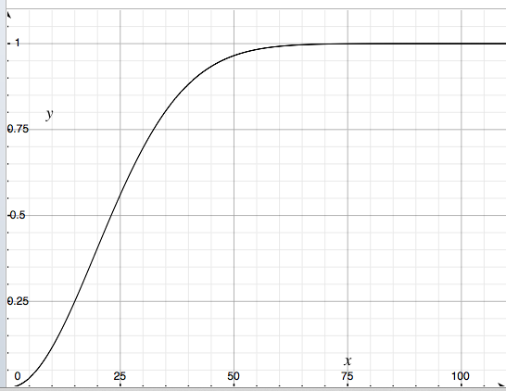
The Birthday Problem
Given a class of ~25 people, what’s the probability that at least two of us share the same birthday?
Probability of shared birthday
# of people

Slide 12
Conditional probabilities and
Bayes’ Law
Notes:
Let’s start this class in a way you might not expect a CS class to start: by thinking about a classic puzzle.

Slide 13

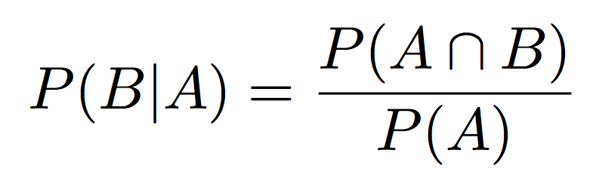
Conditional probabilities
Probability that one event occurs, given that another event is known to have occurred
Denoted . “Probability of A given B”
Defined as:

Slide 14
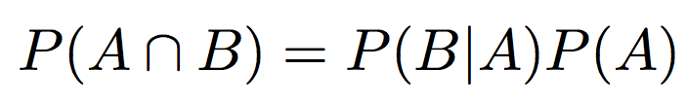
Conditional probabilities
Probability that one event occurs, given that another event is known to have occurred
Denoted . “Probability of A given B”
Defined as:
Leads directly to the chain rule:
More generally:

Slide 15




Independence of events
Two events are independent if
Or, equivalently, if
Independence denoted
The joint probability of independent events A and B both occurring is then simply:
This idea of factoring a distribution into a product of two simpler distributions will be a recurring theme!

Slide 16
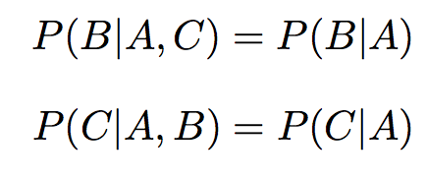

Conditional independence
Sometimes events are both conditioned on the same event, but otherwise are independent
Mary and Bob live in same city but independently
A denotes event that it’s raining, B denotes event that Mary has an umbrella, C denotes event that Bob has an umbrella
Events B and C are not independent
But B and C are conditionally independent given A,
Denoted

Slide 17
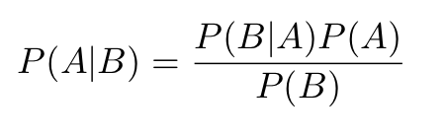
Bayes’ Law
For two events A and B,
Useful when you want to know something about A, but all you can directly observe is B
This process is called Bayesian inference
Likelihood
Priors
Posterior

Slide 18
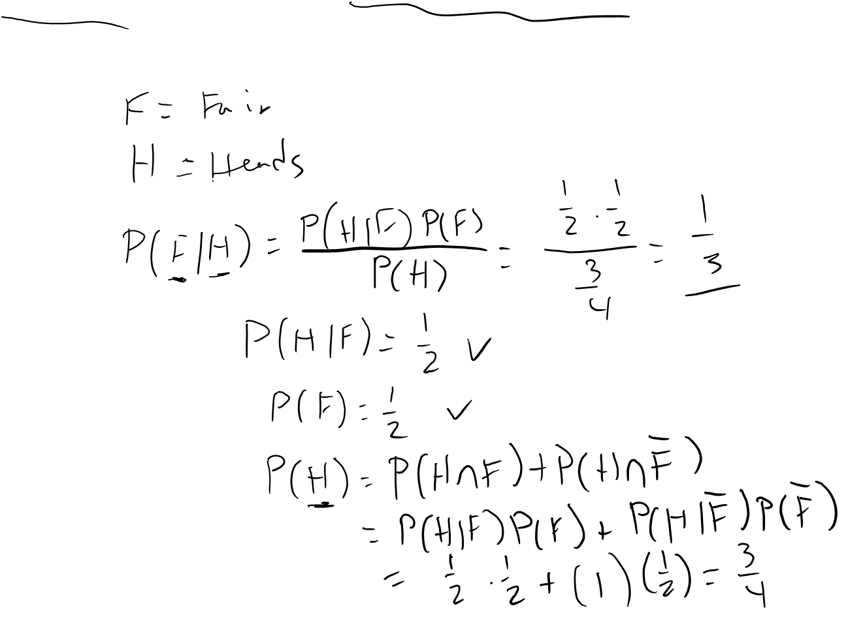
Bayes’ Law Example #1
I have two coins, one fair and one with heads on both sides. I choose a coin at random, flip it, and get heads. What is the probability that it is the fair coin?

Slide 19
Making decisions with Bayes’ Law
Notes:
Let’s start this class in a way you might not expect a CS class to start: by thinking about a classic puzzle.

Slide 20
Applications to AI
Perhaps the simplest application of probabilistic methods to AI is the Bayesian Classifier
Want to make a decision based on some evidence
“Train” the classifier by computing prior probability distributions and likelihood functions from training data
Then apply Bayes law to compute posterior probabilities

Slide 21
Bayes’ Law: An example
You’re a juror in a murder case
You need to decide between guilt (G) and innocence (G)
You have heard some evidence (E)
Bayesian approach: Compute P(G|E), and vote to convict if
P(G|E) > τ
where τ is a threshold
Or, compute an odds ratio and convict if:

Slide 22
Bayes’ Law: An example
Say you have to decide before hearing any evidence
what is the prior probability, P(G)?
How to estimate P(G)?
Based on population constraints
1 person in Bloomington (~20,000 people) did it
P(G) ≈ 1/20000 = 0.00005
Based on historical data
U.S. murder conviction rate: 0.06/1000 [BJS96]
P(G) ≈ 0.00006

Slide 23

Bayesian inference example
Eyewitness testimony (T) identifies the suspect
Now we want to compute
P(G) = 0.00005
P(T|G) = 0.55,
P(T|G) = 0.32 [Wells02]
Alternatively, we can compute an odds ratio:

Slide 24
Bayesian inference example (2)
Now you hear that the murderer had a red car, and that the suspect owns a red car (R)
We want to compute . How?
Assuming that T and R are independent conditioned on G,
Computing odds:
The posterior odds
New evidence
Prior odds

Slide 25

Bayesian inference example (3)
Given the testimony (T) and red car evidence (R),
P(R|G) = 1, P(R|G) ≈ 0.13 [DuPont07]

Slide 26
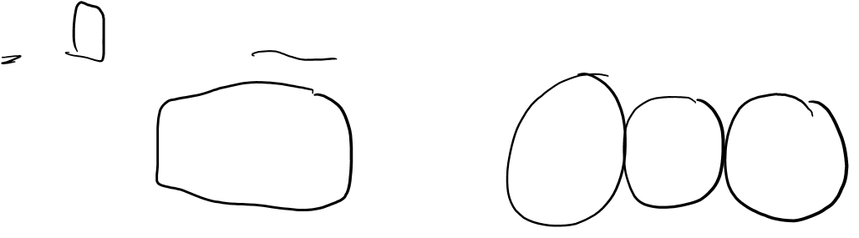
Bayesian inference example (4)
Now suppose a partial fingerprint (F) matches the suspect
P(F|G) = 1, P(F|G)=0.001

Slide 27
Probabilistic inference
Notice that we avoided making hard classification decisions until all evidence had been considered
Very useful when evidence is weak, noisy, imprecise

Slide 28
An actual application:
Spam Filtering
Notes:
Let’s start this class in a way you might not expect a CS class to start: by thinking about a classic puzzle.

Slide 29
Spam
Spam = junk e-mail
A big problem! [Commtouch07]
~96% of all email traffic on the Internet
~150 billion junk emails per day
>2 petabytes (= 2,000 terabytes = 2,000,000 gigabytes) daily
Spreads malware, worms, phishing schemes, etc.
Possible solutions
Block e-mails from blacklisted users and servers
Accept e-mails only from whitelisted addresses
Cost-based solutions (e.g. micropayments)
Filtering rules (ignore mail with “debt”, “viagra”, “stock”)
Content-based statistical filtering

Slide 30

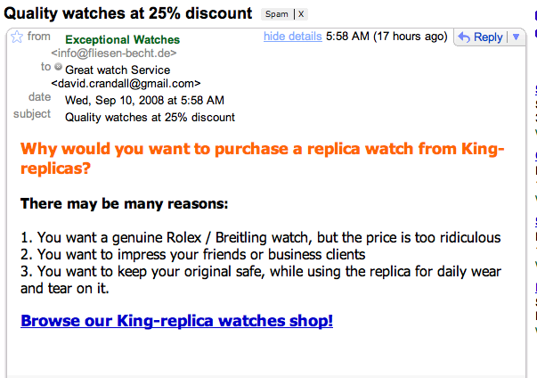

Slide 31

Modeling a document
Represent a document as an unordered collection of words
(a bag of words model)
want
reasons
Rolex
There
impress
genuine
original
You
may
be
friends
many
tear
to
safe

Slide 32
Statistical motivation
Spam and (my) non-spam are statistically very different

Slide 33
Statistical motivation
Spam and (my) non-spam are statistically very different

Slide 34
Bayesian spam filtering
Suppose we get an email containing the word “debt”
What is the probability it is spam (S), P(S|debt)?
P(debt | S) = 0.309 , P(debt | not S) = 0.00447
P(S) = 0.5
P(debt) = 0.157
0.986/0.014 ≈ 70:1 odds that message is spam

Slide 35
More examples
Assuming a uniform prior, P(S)=0.5
Word | P(word|spam) | P(word|not spam) | P(word) | P(spam|word)
debt | 0.309 | 0.00447 | 0.157 | 0.986
news | 0.215 | 0.0395 | 0.127 | 0.845
investment | 0.288 | 0.0137 | 0.151 | 0.955
david | 0.012 | 0.575 | 0.294 | 0.020
want | 0.101 | 0.268 | 0.185 | 0.274
thanks | 0.0491 | 0.196 | 0.123 | 0.200
Computed from Bayes’ Law

Slide 36
Bayesian spam filtering
A new email has the words “debt” and “price”
What is the probability it is spam (S), P(S|debt, price)?
If we assume that the occurrence of the words “debt” and “price” are independent events conditioned on S,
This is called the naïve Bayes assumption.

Slide 37
Bayesian spam filtering
Generalize to an arbitrary number of words,
which is equivalent to,
For example,

Slide 38
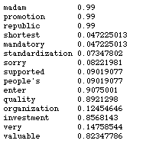

A practical spam filter [Graham02]
Break a message into tokens of words, numbers, etc.
Look for the 15 “most interesting words”
I.e. words for which P(S|W) is farthest from 0.5
Then compute P(S|W₁, W₂, …, W₁₅)
P(S|W₁, W₂, …, W₁₅)=0.9

Slide 39
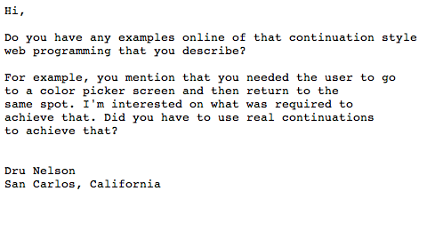
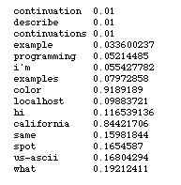
A true negative

Slide 40
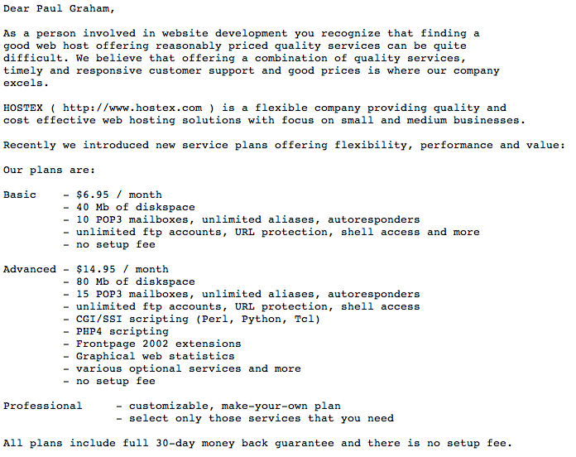
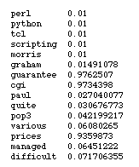
A false negative

Slide 41
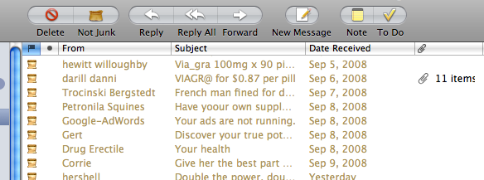
Learning
The advantage of a Bayesian classifier is that it can learn optimal values for its parameters
Given a set of training data
No need for hand-crafted rules. More accurate, less work.
But a good set of training data is critical
The classifier can be continue to learn with time
User corrects the classifier’s errors, classifier adjusts probabilities accordingly

Slide 42
Naïve Bayes
Our framework assumes that evidence is independent, given a class label, e.g.
This is not generally true
It is very popular anyway and often works surprisingly well

