Slide 1
Bayes nets

Slide 2

1
2
3

Slide 3
1
2
✔
3

Slide 4
1
2
✔
Prove that P=NP.
3

Slide 5
Assumptions
Easy exam randomly placed in one of the 3 folders
The teacher always reveals a hard exam
If the student chooses a hard exam, the teacher reveals the other hard exam
If the student chooses an easy exam, the teacher reveals one of the hard exams, chosen at random

Slide 7
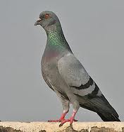
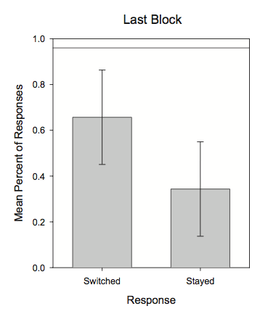
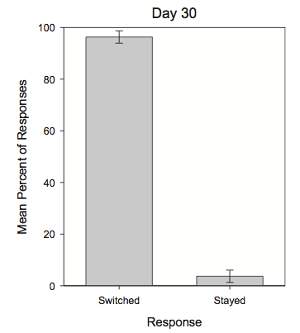
Monty Hall Problem
Behavior of undergrads
after 200 trials:
Behavior of pigeons:
Herbranson & Schroeder 2010
Notes:
Marilyn vos Savant, person with highest IQ according to Guinness Book of World Records
Column in parade magazin > people kept writing her for years that she’s wrong
Our brains don’t really think in terms of bayes law. Instead do our own logic

Slide 9



Random variables
A random variable is like a multi-valued “attribute” that can be used to specify sets of outcomes
Formally, it’s a function that associates an attribute with each outcome, typically or
E.g. Roll a die 5 times. Let random variable X be the number of 1’s rolled.
Now P(X=2) denotes probability of rolling two 1’s, i.e.
where f(a) counts the number of 1’s in a given outcome, i.e. f(11111)=5, f(11114)=4, …
Notes:
Some notations necessary for our next topic, Bayes’ nets -> really powerful important framework
-RV = more convenient way of selecting various outcomes than actually listing them out or creating a new event
- We can talk about various subsets of outcomes (=events)

Slide 10
Marginal distributions
A probability distribution over the values of a random variable is called a marginal distribution
E.g. Roll a die 5 times. Let random variable X be the number of 1’s rolled.
P(X) is the marginal distribution over X
Notes:
Draw marginal distribution (low for X=5, etc.)

Slide 11

Joint distributions
A probability distribution over multiple random variables is called a joint distribution
E.g. Roll a die 5 times. Let random variable X be the number of 1’s rolled, and Y be the sum of the rolls.
P(X,Y) is the joint distribution, i.e.
E.g. P(X=3, Y=6) refers to the probability that a given roll has 3 1’s and sums to 6

Slide 12
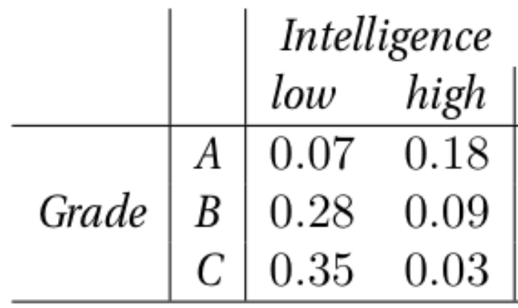
An example
Given set of students, define random variables X for Intelligence and Y for grade in class
Joint distribution P(X,Y) given by:
What are the marginal distributions P(X) and P(Y)?
Notes:
Here is an example to illustrate joint distributions and marginal distributions
Y = Grade, X = Intelligence
Table shows join distribution, P(X,Y), e.g. P(low,B) = 0.28
Marginals: P(X=low) = ? P(X=low, A) + P(low,B) + P(low,C) = 0.7
P(Y=A) = 0.07 + 0.18

Slide 13
Conditional probabilities
Conditional probabilities can also be written using random variables
Denoted P(X|Y) for random variables X and Y
For any value of Y, this is a distribution over X
Example: What’s P(X=low | Y=B)?
Notes:
Example: P(X=low|Y=B) = P(X = low, Y=B) / P(Y=B)
P(X = low, Y=B) directly from table: 0.28
P(Y=B) -> sum up row (i.e. marginalize intelligence) -> 0.37
P(X=low|Y=B) roughly 0.76

Slide 14
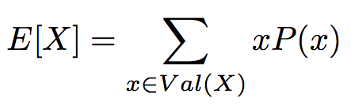
Expectation
The expected value of a (discrete) random variable X,
E.g. Let X be the amount of money you win in the $200 million Powerball Jackpot (Sept 2015). The probability of winning is about 1 in 300 million. What is E[X]?
Notes:
With random variables we can also define a concept called expectation
Expectation: What value on average to we expect a random variable to have?
Example: E[X] = 0 * 299,999,999/300,000,000 + (200)*(1/300) = 2/3 = 67 cents
Coin flip example: $1 to enter. Win: get $2 back, lose: get nothing. Expected win: $1
Coin flip 2: $1 to enter: Win: get $1.50 back, lose: get nothing: Expected win: $0.75 -> Casino makes profit…

Slide 15
Statistical Inference
Notes:
- Bayes Law, again: Gives us power to say something about a variable we can’t observe given some other variables that we can observe
- General Idea: Statistical Inference
- First talk about general idea, then show how to use Bayes Law for more interesting inference then previous example

Slide 16
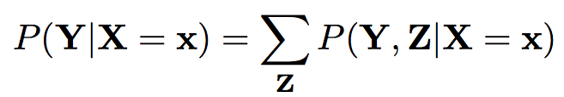
Inference: Using distributions to answer questions
Several main types of queries
Type 1: Probability queries
Calculate distribution over some random variables given observed values for others
e.g. calculate P(Y | X = x), where X and Y are sets of random variables
There might be a set of other random variables Z that are neither the query variables nor the observations; these can be “marginalized out”:
Notes:
3 types of queries we might be interested in
We want a distribution over variables we can observe, e.g. weather example
There might be other variables in model that we don’t care about, in this case we will usually “marginalize them out”
E.g. What’s weather tomorrow, given weather today? Model might involve lots of variables. I can’t actually observe those, but they are in the model. You can kind of “average them out using marginalization, and still say something about how the weather will be tomorrow.

Slide 17
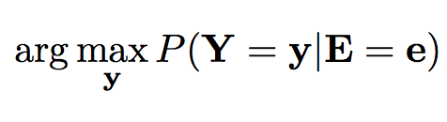
Using distributions to answer questions
Type 2: Expectation queries
Calculate the expected value “on average” for some random variables, given observed values for others
i.e. E[Y | E=e]
Type 3: Maximum A Priori (MAP) queries
Calculate the most likely values for some random variables, given observed values for others,
Notes:
- Type 2 example: Expected amount of money I am going to win, given the state of my hand.
- Type 3 example: MAP queries. Not distribution over variable, but most likely variable. E.g. what is the most likely weather tomorrow?

Slide 18
Back to AI…
In AI we often want to predict an unknown answer given known answers to past problems
E.g., Given current weather observations, will it rain later?
Whether it will rain (R) may depend on hundreds or thousands of observations, V₁, V₂, … V₁₀₀₀
Temperatures across U.S., moisture in atmosphere, etc…
Given enough days of data, we could directly estimate a probability function P(R | V₁, V₂, …, V₁₀₀₀)
Then problem would be solved!
How many days of data would you need?
Notes:
- One could create a giant table with observations, e.g. given one combination of V1…V1000, count how many times it rains the next day

Slide 19
A huge problem
Say all variables of (R, V₁, V₂, …, V₁₀₀₀) are binary
Need at least 2¹⁰⁰⁰ days of data just to observe all possible combinations of the variables
Need to observe multiple days for each combination of variables to estimate conditional probability robustly
Simply impossible from a computational, representational, or intuitive point of view
This seemed fatal for the first ~30 years of AI research
Graphical models are a framework for avoiding this problem by making assumptions about the structure of a model
Notes:
One of the reason that people did not investigate probabilistic models in early beginnings of AI
Graphical models avoid problem (to some extend) by making some assumption about relationship of variables
Are they all equally influential on each other?

Slide 20
Bayesian Networks

Slide 21

Another example
Say we want to decide whether someone has the flu (F) based on their temperature (T) and achiness (A)
A, T, and F are clearly not independent
But a weaker assumption of conditional independence may be appropriate,
Says that A and T are independent for a given value of F
We can represent this assumption with a Bayesian network:
Flu
Achiness
Temperature
Notes:
If you fix the value of F to either having the flu, or not having the flu, then your achiness and flu are independent from another.
The only reason they might be related to each other is because of common “flu” variable that can lead to either one occurring
For now, you can think of arrows as representing causation (they don’t really!), but good intuition
Intuition: If I they have high temperature, they might also report achiness because I assume that temperature is caused by flu, and flu also causes achiness. However, if I already know they have the flu, knowing that they have high temperature does not tell me anything new about achiness, because I assume that achiness is caused by flu and I already know they have the flu

Slide 22

Another example
Now we can factor P(A,T,F) as:
To decide whether someone has the flu given observed symptoms, we’ll want to compute P(F | A, T)
How to compute this?
Flu
Achiness
Temperature
Notes:
- We can now factor big joint probabilities:
P(A,T,F) = P(A,T|F)P(F) (chain rule)
Because of independence assumption of model, we can factor P(A,T|F) to P(A|F)P(T|F)
How does this help us?
P(F|A,T) = P(A,T|F)*P (F) / P(A,T) → turns into P(A|F)P(T|F)P(F) → I can more easily learn distributions for P(A|F) and P(T|F) than P(A,T|F), i.e. I need fewer examples

Slide 23
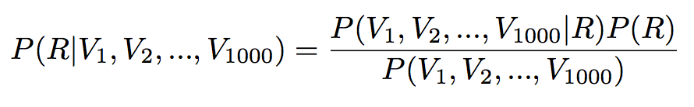
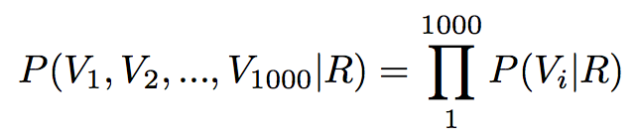
Back to the weather…
We want to compute probability of rain (R) given observed variables V₁, V₂, … V₁₀₀₀. Using Bayes’ law,
Now, assuming that V₁ … V₁₀₀₀ are conditionally independent given R:
Under this assumption, what is P(V₁, V₂, … V₁₀₀₀)?
How many parameters do we need to estimate in this factored model?
Notes:
We can see this effect even more dramatically here:
Same idea as in Spam filter

Slide 24
Naïve Bayes model
Assuming conditional independence among observed variables is called naïve Bayes
Class label C we want to infer
Set of observable variables X1, X2, … Xn
Assume that observable variables are independent conditioned on the class label C
Estimate prior distribution P(C) and conditional distributions P(X1|C), …, P(Xn | C) from training data
Use Bayes’ Law to calculate P(C | X1 … Xn)
C
…
X1
X2
X3
Xn
Notes:
- We presented this idea in spam model, but now define it much more formally

Slide 25
Another example
Suppose we want to model students in B551, using several random variables:
Intelligence (I)
GPA (G)
SAT score (S)
Difficulty of courses taken (D)
Strength of letter of recommendation (L)
Intuitively, arrows in the BN represent direct dependencies between variables
Assuming these dependences, how does the joint distribution P(I,G,S,D,L) factor?
Notes:
Really GPA is not just about your intelligence, but also about the courses you’ve been taking
Write down a multiplication of factors (each factor as simple as you can) to express this full joint distribution

Slide 26
Notes:
- Go over factorization…
- Factors are easier to measure...

Slide 27
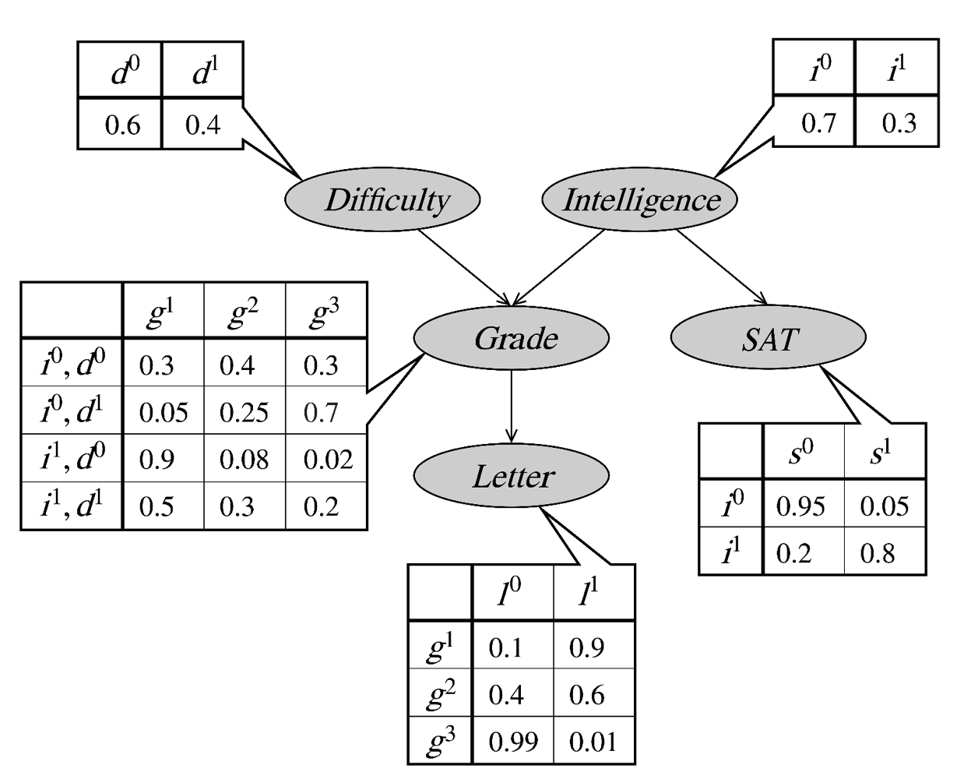
Conditional probability distributions
Easy Hard
Low High
Low, Easy
Low, Hard
High, Easy
High, Hard
A B C
Bad Good
Low
High
Weak Strong
A
B
C
Notes:
- Here are examples for distribution I would need to estimate for each of those factors

Slide 28
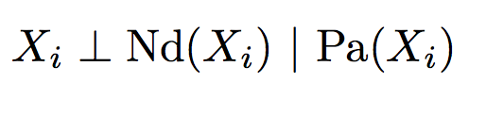
Bayesian networks
A Bayesian network is defined by a pair (G,P), where:
G is a dag (directed acyclic graph), with nodes corresponding to variables {X1, X2, … Xn} and edges to direct dependencies
P is a probability distribution that satisfies independence assumptions induced by G
The dag G encodes the conditional independence assumptions:
where Nd(Xi) is the set of non-descendants of Xi,
and Pa(Xi) is the set of parents of Xi
Notes:
What we’ve just seen is a Bayesian network, more on that later
Let’s define formally what a Bayesian network is

Slide 29
Types of reasoning in Bayes nets
Causal reasoning
Probabilities “flow downwards” towards leaves of tree
Evidential reasoning
Probabilities “flow upwards” away from leaves
Intercausal reasoning
Knowledge about one cause affects your belief of another cause
Probabilities “flow” downwards and then upwards
Notes:
Not important to know these names, but it is important to remember that reasoning can flow in these directions
Know GPA (G), want to know letter (L) -> example of causal reasoning
I can see Letter of Recommendation, that would let me say something about GPA -> example of evidential reasoning
Intercausal example: You took really hard classes (D), and you got an A+ GPA -> that lets me tell something about your intelligence (I)

Slide 30
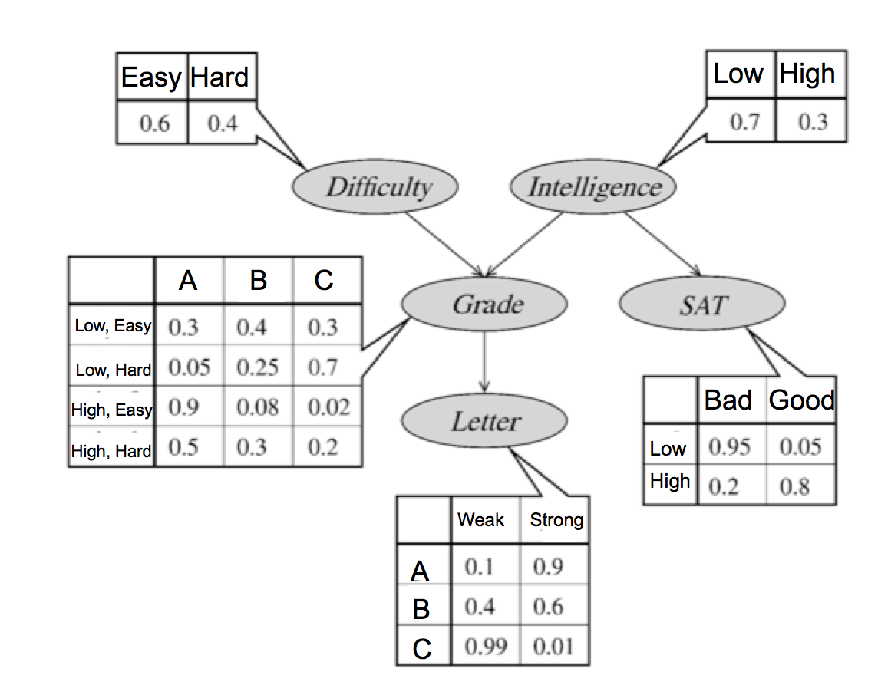






Independencies in this example
Is ?
Is ?
Is ?
Is ?
Is ?
Is ?

