Slide 1
Bayes nets

Slide 2
Announcements
More probability problems online (Module 7)
Please will out A1 survey (see Canvas)
A2 will be ready soon (prob. this week)
Another review quiz will be online soon
Prof. Crandall back for next lecture

Slide 3
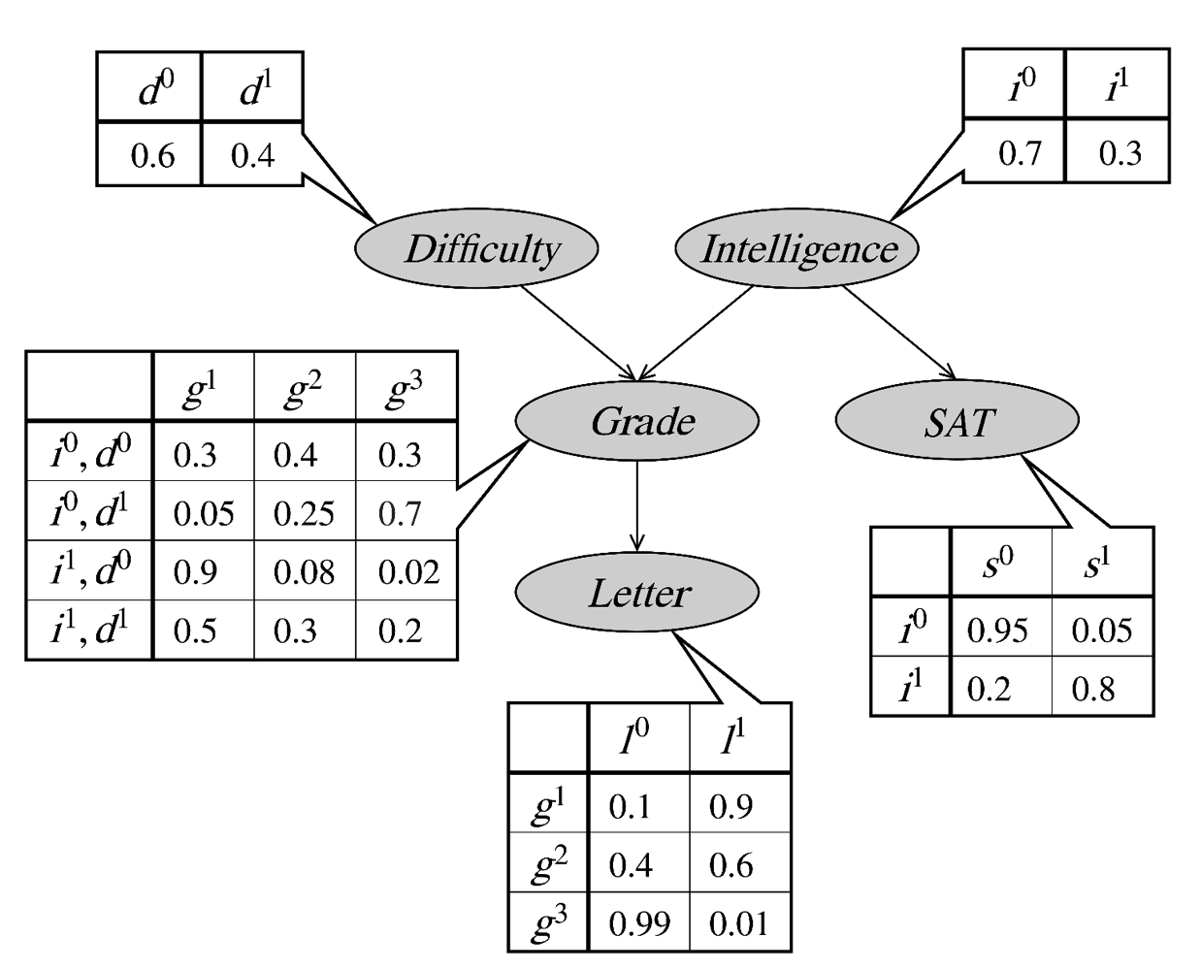
Conditional probability distributions
Easy Hard
Low High
Low, Easy
Low, Hard
High, Easy
High, Hard
A B C
Bad Good
Low
High
Weak Strong
A
B
C
Notes:
- Here are examples for distribution I would need to estimate for each of those factors

Slide 4
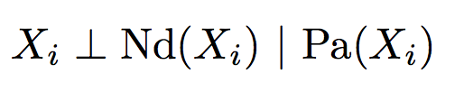
Bayesian networks
A Bayesian network is defined by a pair (G,P), where:
G is a dag (directed acyclic graph), with nodes corresponding to variables {X1, X2, … Xn} and edges to direct dependencies
P is a probability distribution that satisfies independence assumptions induced by G
The dag G encodes the conditional independence assumptions:
where Nd(Xi) is the set of non-descendants of Xi,
and Pa(Xi) is the set of parents of Xi
Notes:
What we’ve just seen is a Bayesian network, more on that later
Let’s define formally what a Bayesian network is

Slide 5
Types of reasoning in Bayes nets
Causal reasoning
Probabilities “flow downwards” towards leaves of tree
Evidential reasoning
Probabilities “flow upwards” away from leaves
Intercausal reasoning
Knowledge about one cause affects your belief of another cause
Probabilities “flow” downwards and then upwards
Notes:
Not important to know these names, but it is important to remember that reasoning can flow in these directions
Know GPA (G), want to know letter (L) -> example of causal reasoning
I can see Letter of Recommendation, that would let me say something about GPA -> example of evidential reasoning
Intercausal example: You took really hard classes (D), and you got an A+ GPA -> that lets me tell something about your intelligence (I)

Slide 6
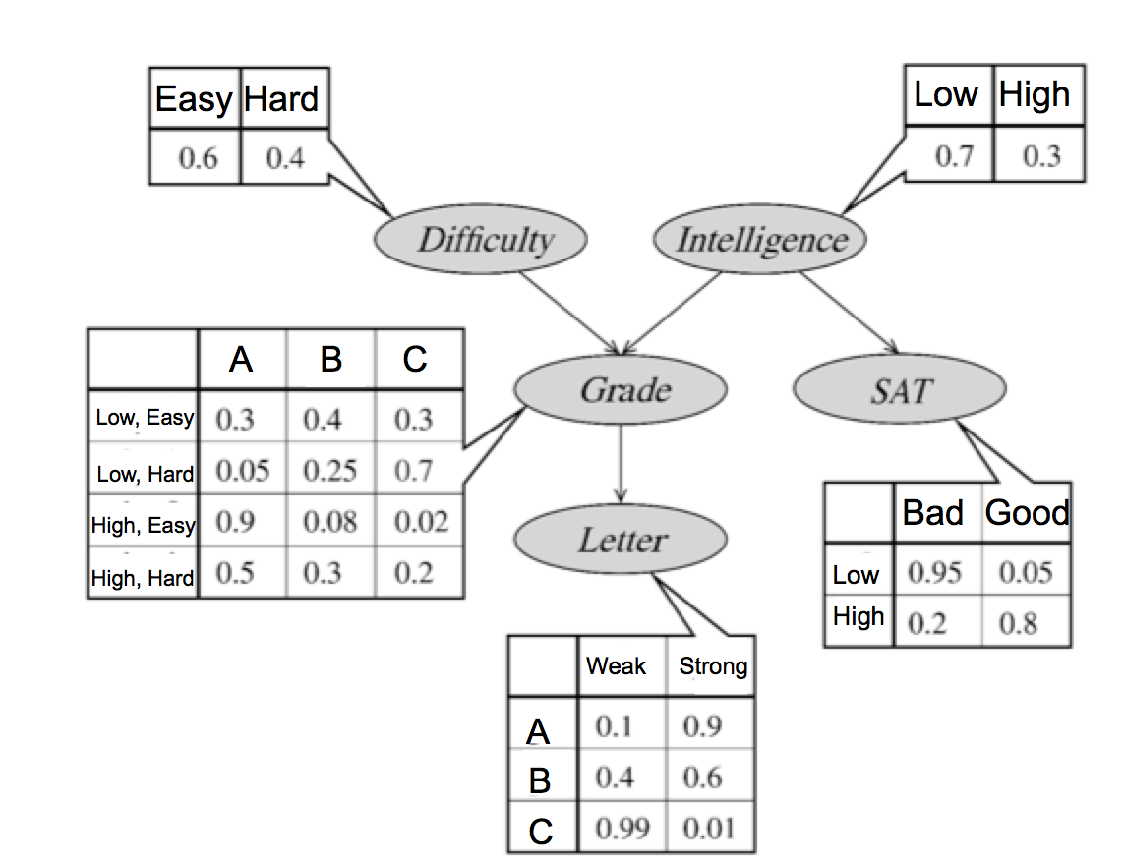






Independencies in this example
Is ?
Is ?
Is ?
Is ?
Is ?
Is ?
Notes:
No, yes, yes, yes , no, yes

Slide 7
Bayes Nets Inference

Slide 8
Bayes nets
(But other independencies may also hold!)
Notes:
- Sufficient condition, but no necessary condition

Slide 9
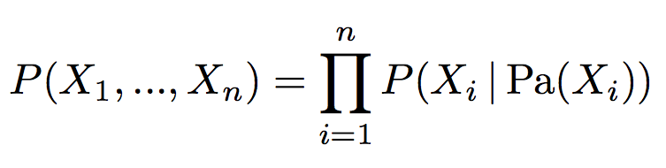
Factorization of Bayes nets
Given a Bayes net (G,P) over variables {X1, X2 … Xn}, the joint probability distribution factors as,

Slide 10
Independencies in Bayes nets
We already have a set of some conditional independence relationships, given by:
These are just the relationships directly defined by G; there are often others
We’d like to derive all conditional independence relationships
(Why?)
Notes:
- It’s interesting to derive all independence assumptions because that will tell us explicitly what the assumptions of our model are?

Slide 11


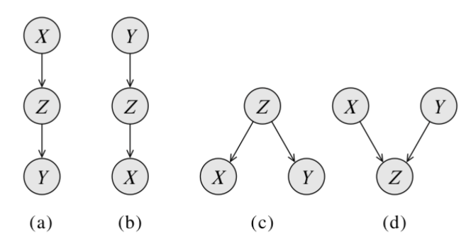
For three nodes, Four cases
Is in each case? Is in each case?

Slide 12
Active trails
Influence can “flow” from X to Y along active trails
Patterns (a), (b), and (c) are active iff Z is not observed
Pattern (d) is active iff Z is observed
In general, a trail is active given a set of nodes Z if
In any “v-structure” (type (d)) above, the middle node or one of its descendants is in Z
No other node along the trail is in Z
Notes:
Active = no independence
V-structure: active if Z or one of its decedents is observed…

Slide 13
Solving problems with Bayes Nets

Slide 14
Solving problems with Bayes nets
We’d like to use Bayes nets to estimate (distributions of) variables, given observed values for some variables
aka Conditional Probability Queries: Given a set of variables E and corresponding values e, estimate distributions over unobservable values Y, i.e. P(Y | E=e)

Slide 15
Sample application: Constraint Satisfaction Problems (CSPs)
Say someone gives us a Boolean expression like,
Where Q’s may repeat and may include negation
We’d like to decide if there exists an assignment of boolean values to the Q’s such that the expression is true
This problem can be solved using a Bayes nets
Use conditional probabilities to “program” AND and OR operations
Notes:
Q1 AND ~Q1 -> not satisfiable
Q1 OR ~Q1 -> satisfiable

Slide 16
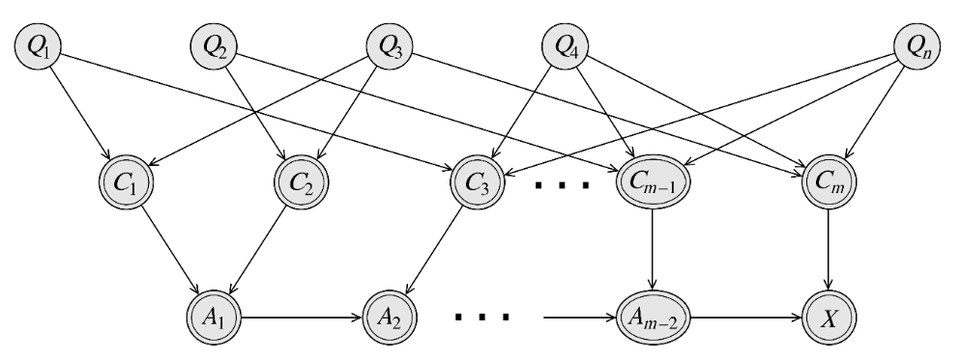
CSP with a Bayes net
Q nodes represent variables in CSP
C nodes have CPDs that implement “OR” operations
A nodes have CPDs that implement “AND” operations
CSP can be satisfied iff P(X) > 0
Notes:
Build truth table for C1 as example
If P(X) > 0, then expression can be satisfied

Slide 17
Bad news!
We just showed a reduction from 3-SAT to Bayes net inference!
I.e., if we could solve Bayes net inference efficiently, then we can solve 3-SAT efficiently
But 3-SAT is NP-hard
So Bayes net inference is NP hard also
☹
Even approximate inference to within an absolute or relative error bound is NP-hard
☹
Fortunately, for some Bayes nets inference is tractable
Notes:
SAT are NP-Complete!

Slide 18
Inference on chains
Notes:
Let’s start this class in a way you might not expect a CS class to start: by thinking about a classic puzzle.

Slide 19
Marginal inference example
Suppose we have a Bayes net with a chain topography:
How to compute P(B=b)? Running time to compute P(B=b)?
A
B
C
D

Slide 20
Marginal inference example
Suppose we have a Bayes net with a chain topography:
How to compute P(B=b)? Running time to compute P(B=b)?
How to compute P(C=c)? Running time to compute P(C=c)?
A
B
C
D

Slide 21
Marginal inference example
Suppose we have a Bayes net with a chain topography:
How to compute P(B=b)? Running time to compute P(B=b)?
How to compute P(C=c)? Running time to compute P(C=c)?
For chain of length N, where each variables has k possible values, what is the running time to compute P(X_{N}=x)?
A
B
C
D
Notes:
One extra loop for new variable = O(k)
That gives me P(Xn=x), doing that for all x in X would then be O(k^2)
I have to do this N times for N nodes: O(k^2*N) as opposed to O(K^N)

Slide 22
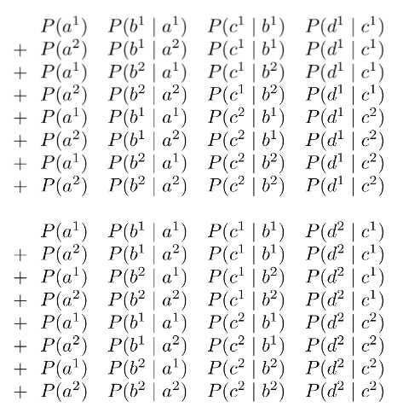
Alternative view
What makes efficient inference possible?
Form of joint distribution, P(A,B,C,D)?
Supposing binary variables, we’d need to sum up 2⁴ terms,
A
B
C
D
P(D=d¹)=
P(D=d²)=
Notes:
Exponential amount of work: 4 nodes, sum over 2^4 terms

Slide 23
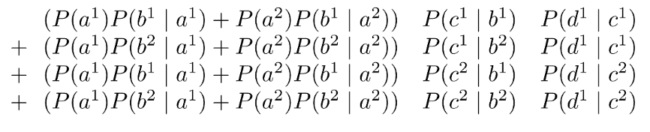
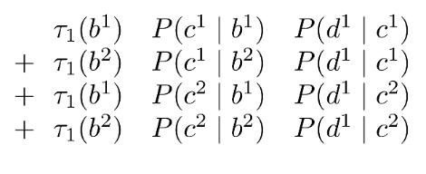
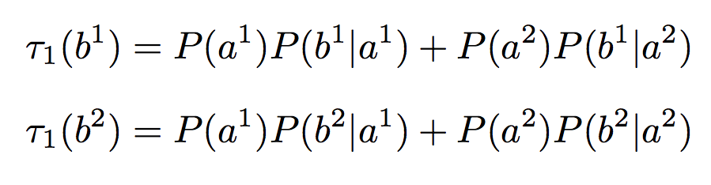
P(D=d¹)=
Using distributive property of multiplication over addition,
P(D=d¹)=
Which can be re-written as,
P(D=d¹)=
where,
Notes:
Same think as pulling out summation a few slides ago
Line 1 and 3 the same -> tau_1(b_1), Line 2 and 4 the same -> tau_1(b_2), only compute each 1 time
Only sum with 4 terms

Slide 24
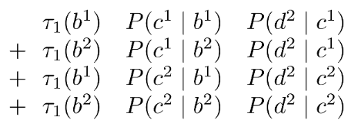
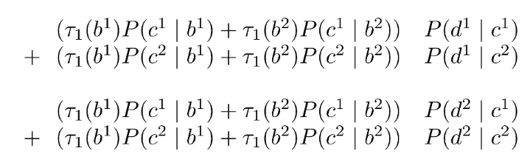
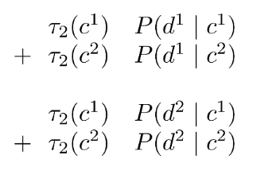
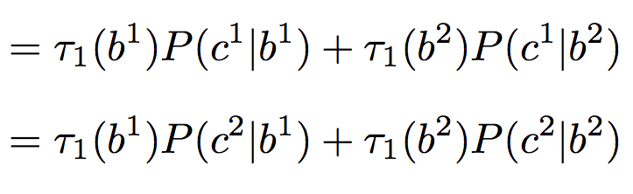
P(D=d¹)=
P(D=d²)=
P(D=d¹)=
P(D=d²)=
P(D=d¹)=
P(D=d²)=
where,
Notes:
Do this for both values of D, d_1 and d_2
Same thing again -> now only adding 2 terms
Line 1 and 3 the same -> tau_2 of (c_1), Line 2 and 3 the same -> tau_2(c_2)

Slide 25
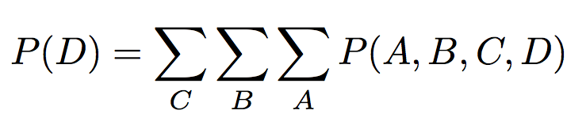
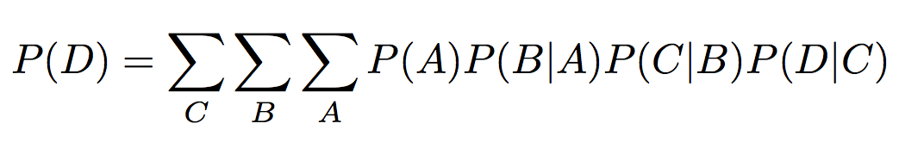
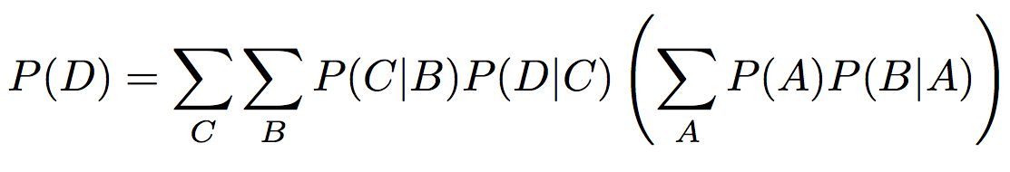
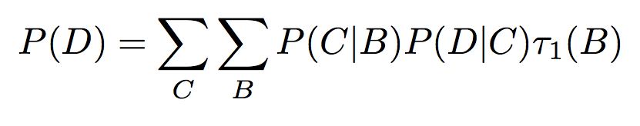
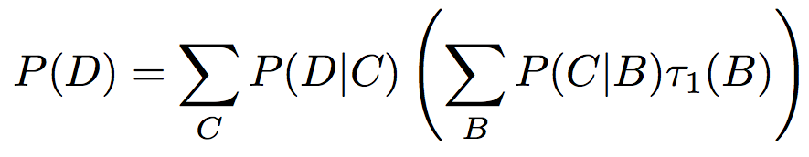
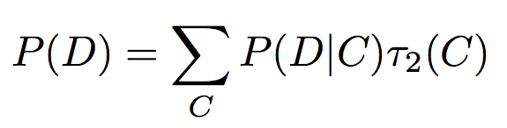
Summary of what just happened…
We want to compute P(D)
Notes:
Summary:
Large sum
Apply conditional independence assumptions
Re-arrange terms (factor out) because some terms don’t depend on A
Pre-compute the part that depends on A, call it tau_1 (got rid of one nested for loop)
Do the same thing for B
Exponential to linear -> just keep building tau_1, tau_2, etc. -> each of those is just 1 summation

Slide 26
Dynamic programming
This idea of caching intermediate results (in the form of tables τ₁ and τ₂) is called dynamic programming
General algorithmic concept
Other examples: Dijkstra’s algorithm, string algorithms (e.g. for bioinformatics), Tower of Hanoi puzzle, …
Notes:
- A* search had dynamic programming baked into it
Only makes sense if you don’t have to store and exponential amount of data
In this case: store 1 table (1 tau) at the time as we work through chain (not exponential)

Slide 27
How did we avoid exponential time?
Two important ingredients:
1. The independence assumptions of the Bayes net allowed us to factor the joint distribution into simpler terms, each of which involved only a few variables.
2. Dynamic programming let us “cache” intermediate results, avoiding re-computing them repeatedly.
A
B
C
D

Slide 28

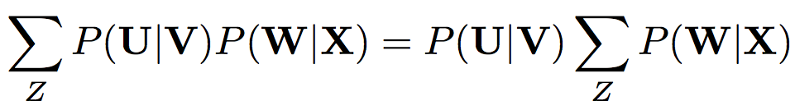
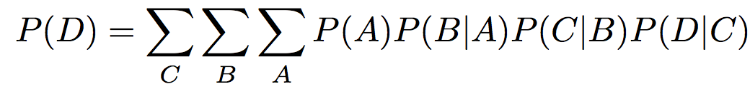
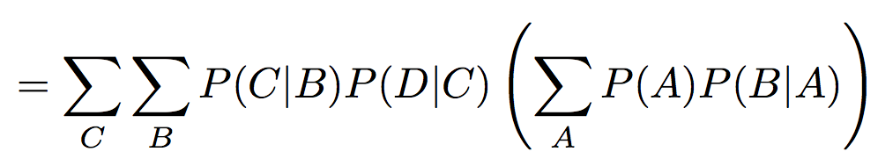
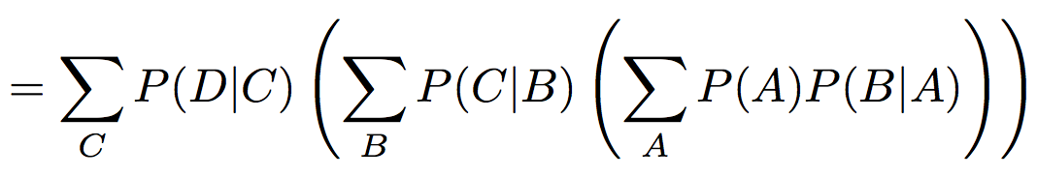
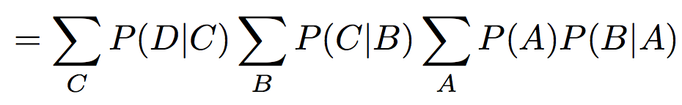
More generally…
More generally, notice that for any sets of random variables U, V, W, and X, and random variable ,
So, in the chain example above, this lets us do:
Notes:
Written in bold to emphasize they are sets of random variables (not individual random variables)
If Z ins not in U or V, factor out!

Slide 29
Variable elimination algorithm
Sort the non-query variables in some order, Z1, Z2, … Zn
Initialize set of factors F to be the conditional probability distributions, P(Zi | Pa(Zi)).
For each i=1..n,
Identify subset of factors F’ involving Zi; these factors have some subset of variables V as parameters
Take product of factors F’, parameterized by V
Sum this product over all values of Zi, producing a new factor f parameterized by V-{Zi}
Remove elements in F’ from F, then add f to F
Notes:
VE: General algorithm to perform inference on any Bayes net:
Non-query variables: the ones on the left-hand side for which we want to compute marginal
Order does not matter for correctness (more later)
Initialize set of factors F

Slide 30
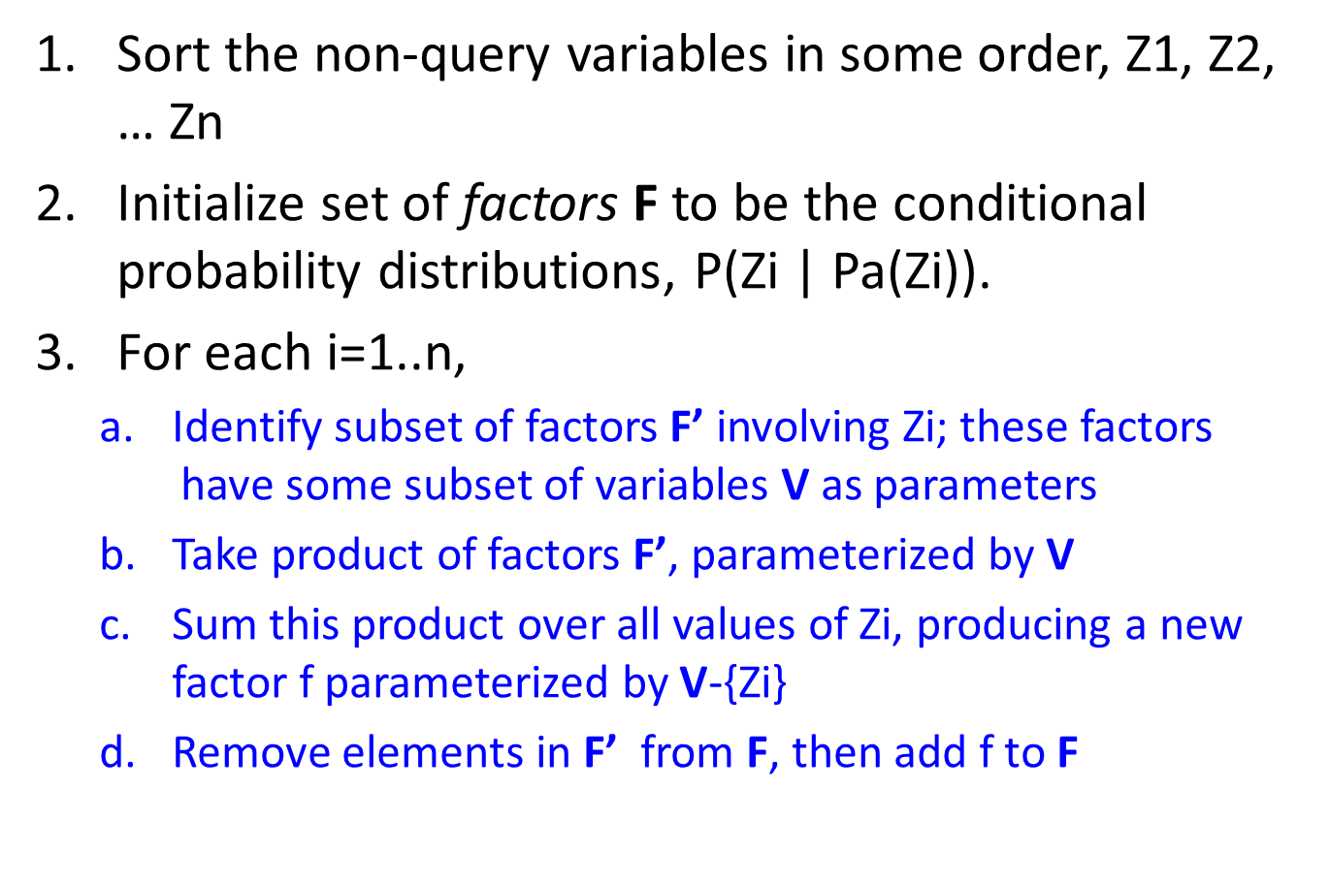

Slide 31
Handling evidence
Suppose we want to compute P(Y | E=e)
Set variables in E to their known values
Eliminate all remaining variables except for Y, resulting in P(Y, E=e)
Then marginalize over Y to compute P(E=e), in order to compute P(Y | E=e)
Notes:
Usually I have evidence: E.g. Probability of writing a letter given student got an A
P(Y | E=e) = P(Y, E=e) / P(Y)
P(Y | E=e) = P(Y, E=e) / SUM_Y P(Y, E=e)

Slide 32
Running time of Variable Elimination
Notice that VE is not necessarily efficient
Say we want to compute P(E)
A smart elimination order: A, B, C, D
A less smart order: D, C, B, A
A
B
C
D
E
Notes:
- Running time depends on elimination order

Slide 33
Reasoning about running time
Define the induced graph to be an undirected graph over the nodes of the Bayes net
Edge between nodes u and v iff some factor generated during VE involved both u and v
Note that this depends on the ordering of VE
Theorem: Every maximal clique in the induced graph is the scope of some intermediate factor in VE
And every intermediate factor corresponds to a clique
Running time is exponential in the size of the max clique
So we’d like to find the “best” elimination ordering for a given Bayes net – i.e. one with the smallest possible maximal clique in the induced graph
Unfortunately, this problem is NP hard!
Notes:
Induce graph: depends on ordering of VE → good ordering = fewer edges in induced graph
Maximum clique: complete sub-graph of a graph
Some Bayes nets will have large cliques, no matter what
Some nets have good ordering: but finding good ordering is NP hard

Slide 34
Special cases: Chains and polytrees
For chains, we can always find an elimination ordering that takes time linear in the number of nodes
Start at the beginning of the chain and eliminate variables in node order
A polytree is a dag such that there is at most one trail between every pair of nodes
In a polytree, it is always possible to find an elimination ordering that takes time linear in the size of the conditional probability distributions
E.g. start at leaves of tree and work upwards towards root(s)

