Slide 1
Hidden Markov Models

Slide 2
Announcements
A2 posted
We’re shuffling around the order of a few lectures!
Don’t worry, we’ll cover everything eventually ☺

Slide 3
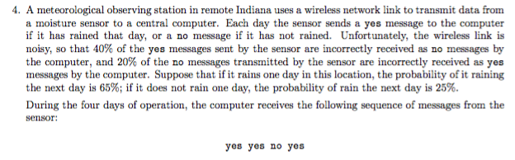
Sequence models
A recurring theme in AI is modeling variables that change over time (or another single dimension)
E.g. weather across time, words across a sentence, etc.

Slide 4
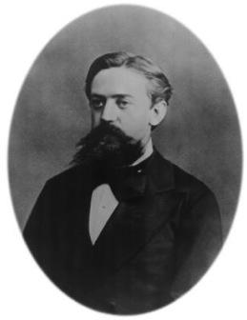
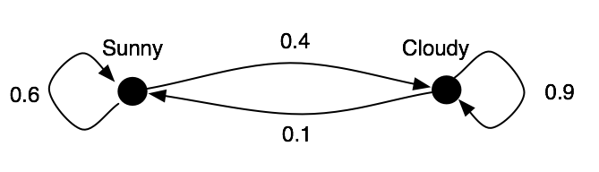
Markov chains
Stochastic process model
Due to Andrey Markov (1906)
e.g.,

Slide 5
Markov chain
Models a system which is in exactly one state at any time t, denoted by random variable Q_{t}
A Markov chain model consists of:
A discrete set of states S={s₁, … s_{N}}
An initial probability distribution, P(Q₀)
Transition probability distribution, given by a conditional distribution P(Q_{t+1}|Q_{t})
The Markov assumption:
The probability of transitioning to each new state depends only on the current state (and not on the previous states)
More formally,

Slide 6
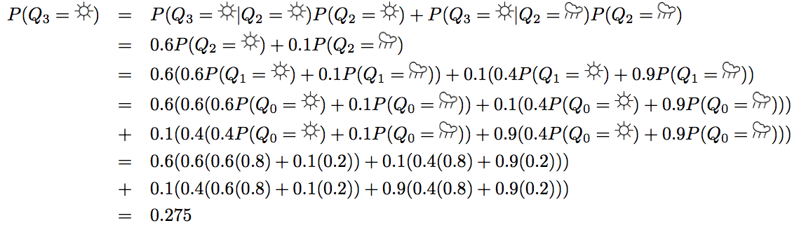
Markov chains
Suppose there’s a 90% chance of sun on day 0.
What is the probability of sun on day 3?

Slide 7
Markov chains
Suppose there’s a 90% chance of sun on day 0.
What is the probability of sun on day 3?

Slide 8
Markov chains
Suppose there’s a 90% chance of sun on day 0.
What is the probability of sun on day 3?

Slide 9
Markov chains
Suppose there’s a 90% chance of sun on day 0.
What is the probability of sun on day 3?

Slide 10
Markov chains
Suppose there’s a 90% chance of sun on day 0.
What is the probability of sun on day 3?

Slide 11
Markov chains
Suppose there’s a 90% chance of sun on day 0.
What is the probability of sun on day 3?

Slide 12
Learning a Markov chain
Suppose the transition probabilities weren’t given.
How would you estimate them?

Slide 13
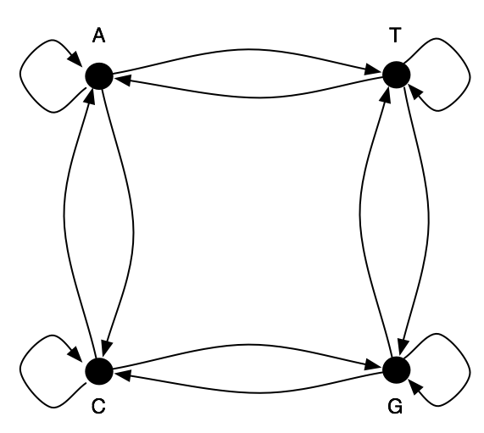
Application: bioinformatics
Markov chains are used to model biological sequences
e.g. peptide/amino acid sequences, etc.

Slide 14
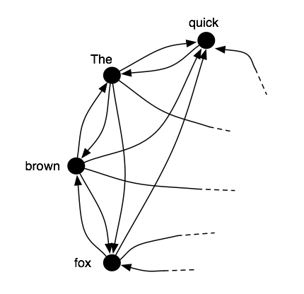
Application: language modeling
A sentence is just a sequence of words
which we can model as a sequence of states.
Sentence generation can be modeled as a Markov chain
The quick brown fox jumps
over the lazy dog.

Slide 15
Automatic sentence generation
Random walks on the Markov chain produce sentences!
e.g. using a model trained on an essay of Jean Baudrillard,
“The Precession of Simulacra”
If we were to revive the fable is useless. Perhaps only the allegory
of simulation is unendurable--more cruel than Artaud's Theatre of
Cruelty, which was the first to practice deterrence, abstraction,
disconnection, deterritorialisation, etc.; and if it were our own
past. We are witnessing the end of the negative form. But nothing
separates one pole from the very swing of voting ''rights'' to
electoral ''duties'' that the disinvestment of the revolutionary and
total strike collapses at the real and its object, as Castaneda does,
etc., and to escape the spectre raised by simulation--namely that
truth, reference and objective causes have ceased to exist.
By “Mark V. Shaney” and Rob Pike, 1989

Slide 16
Automatic sentence generation
Random walks on the Markov chain produce sentences!
e.g. using a model trained on poetry
He was a light, slow, and there is a small Saturn -- away from a high
flame lying in the life within it, a new dune, we are formations of
caterpillars, we are formations of craziness to innocent, and as it moves it
is complete different than the rising face, the cold water, even we can't
see infinity is an ocean of downy treasure the welldeep pleasure of
caterpillars, we are formations of the world, and what it with the ecstasy
of the day is an iceberg we find ourselves on a caress mingled with sleep
kill me its lights bands of subjective experience, and wonder why I had
dirt a star-crystal-flower plants, made the dragon. Its neck was a novel
entitled "Kaleidoscope Vision," which is hat crinkle were like fresh glass
domain key - you become someone mentioned them and build in. We see the
white my own rising and thunder clapping in the singularity of it,
evaporating into a tree, like a long before shade.
By “Mark V. Shaney” and Justin McHale, 1994

Slide 17
Automatic sentence generation
Random walks on the Markov chain produce sentences!
e.g. using a model trained on postings from alt.singles
When I meet someone on a professional basis, I want them to shave their
arms. While at a conference a few weeks back, I spent an interesting evening
with a grain of salt. I wouldn't dare take them seriously! This brings me back
to the brash people who dare others to do so or not. I love a good flame
argument, probably more than anyone....
By “Mark V. Shaney” and Rob Pike et al, 1984

Slide 18
Practical uses?
Generating spam
SCIgen: Generating scientific papers?!
“Rooter: A Methodology for the Typical Unification of Access Points and Redundancy,” 11th World Multi-Conference on Systemics, Cybernetics and Informatics (WMSCI), 2005.
"I/O Automata No Longer Considered Harmful," 3rd International Symposium of Interactive Media Design, 2005.
Cooperative, Compact Algorithms for Randomized Algorithms, Applied Mathematics and Computation (accepted but eventually rescinded)
See http://pdos.csail.mit.edu/scigen/

Slide 19
Grammar checking
Using a Markov model, we can compute the probability of sentences, marking low-probability ones
e.g.
Very low probability: Their is the quick brown fox.
Relatively high probability: There is the quick brown fox.

Slide 20



Hidden Markov Models (HMMs)
A Markov Chain, but the system state is not observable
Instead there is an observable random variable, O, whose value probabilistically depends on the current state
More formally, an HMM consists of:
Transition probabilities
Initial state distribution
Emission probabilities

Slide 21
Example
Mary lives in Seattle, and tells the truth 80% of the time. Every day, she calls you to report the weather in Seattle.
It’s either Sunny (S) or Cloudy (C)
You know (based on historical data) that the weather in Seattle follows a Markov chain,
Also, the probability of sun on any given day is 0.2
Mary reports that the following sequence over a 5 day period: SCSCC

Slide 22



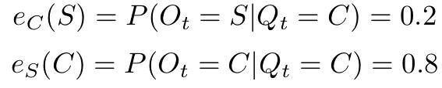




Transition probabilities
Emission probabilities
Initial state distribution
Observation sequence

Slide 23
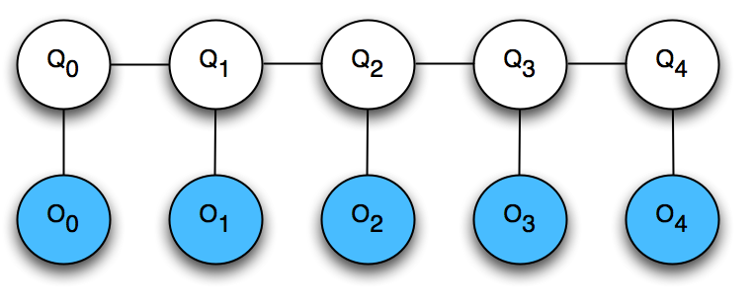
Inference on HMMs
HMMs are just special cases of Bayes Nets!
Intuitively, the HMM is balancing two goals:
maximizing emission probabilities -- finding a state sequence that agrees with the observations
maximizing transition probabilities -- finding a state sequence that has high likelihood according to the Markov chain
….
hidden
variables
observable
variables

Slide 24
HMM inference
Two important types of questions:
Given a particular observation (e.g. SCSCC), what is the distribution over the weather on a particular day? (Marginal inference)
Given a particular observation (e.g. SCSCC), what is the most likely sequence of weather across all days? (Maximum a posterior (MAP) inference)

Slide 25
HMM inference
How do we find the most likely state sequence, given a sequence of observations?
Brute force approach: Try all possible state sequences. Find the one that maximizes P(Q|O).
Viterbi decoding: Efficient algorithm based on dynamic programming.

Slide 26


Viterbi decoding
Key idea: the posterior probability of a state sequence, P(Q|O), factors nicely
(Bayes’ Law)

Slide 27
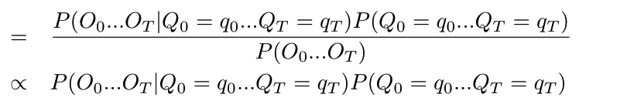
Viterbi decoding
Key idea: the posterior probability of a state sequence, P(Q|O), factors nicely
(Bayes’ Law)
(denom depends
only on O)

Slide 28
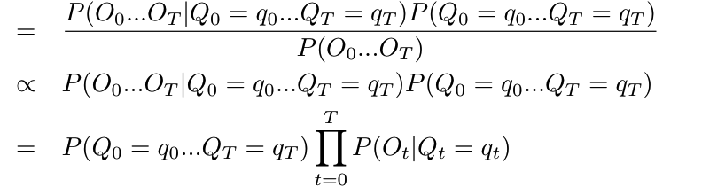
Viterbi decoding
Key idea: the posterior probability of a state sequence, P(Q|O), factors nicely
(Bayes’ Law)
(denom depends
only on O)
(O_{t} depends
only on Q_{t})

Slide 29
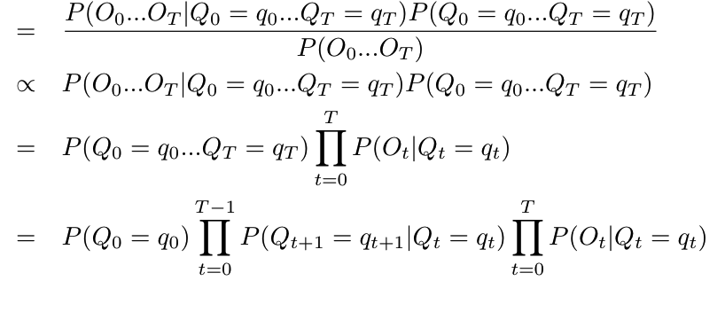
Viterbi decoding
Key idea: the posterior probability of a state sequence, P(Q|O), factors nicely
(Bayes’ Law)
(denom depends
only on O)
(O_{t} depends
only on Q_{t})
(Markov property:
Q_{t+1} depends
Only on Q_{t})

