Slide 1
Hidden Markov Models

Slide 2
Announcements
A2 posted
We’re shuffling around the order of a few lectures!
Don’t worry, we’ll cover everything eventually ☺

Slide 3



Hidden Markov Models (HMMs)
A Markov Chain, but the system state is not observable
Instead there is an observable random variable, O, whose value probabilistically depends on the current state
More formally, an HMM consists of:
Transition probabilities
Initial state distribution
Emission probabilities

Slide 4
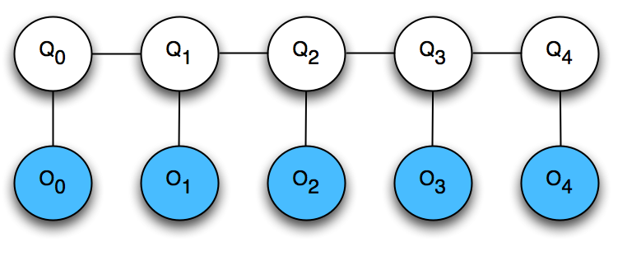
Inference on HMMs
HMMs are just special cases of Bayes Nets!
Intuitively, the HMM is balancing two goals:
maximizing emission probabilities -- finding a state sequence that agrees with the observations
maximizing transition probabilities -- finding a state sequence that has high likelihood according to the Markov chain
….
hidden
variables
observable
variables

Slide 5
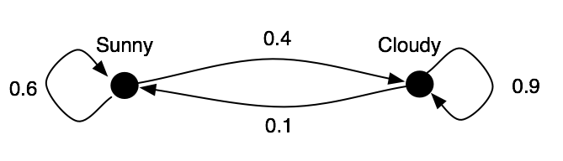
HMM inference
Two important types of questions:
Given a particular observation (e.g. SCSCC), what is the distribution over the weather on a particular day? (Marginal inference)
Given a particular observation (e.g. SCSCC), what is the most likely sequence of weather across all days? (Maximum a posterior (MAP) inference)

Slide 6
HMM inference
How do we find the most likely state sequence, given a sequence of observations?
Brute force approach: Try all possible state sequences. Find the one that maximizes P(Q|O).
Viterbi decoding: Efficient algorithm based on dynamic programming.

Slide 7

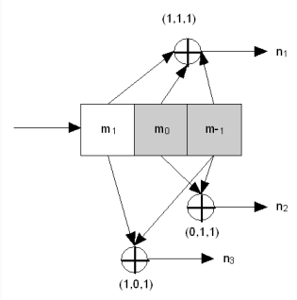
Convolution and turbo codes
Used extensively in wireless communications
Adds redundancy to a signal, so that transmission errors can be detected and corrected
Andrew Viterbi
Transmitted bits are a combination of the last k input bits
Transmitted bits are possibly corrupted by interference
The decoder uses Viterbi to infer the (hidden) state of the transmitter, from the (noisy) received bits

Slide 8

Natural Language Processing
Statistical techniques like HMMs are very popular
“Every time I fire a linguist, my performance goes up.”
--- attributed to Fred Jelinek, 1980’s, IBM Watson
For example: Part-of-speech (POS) tagging

Slide 9
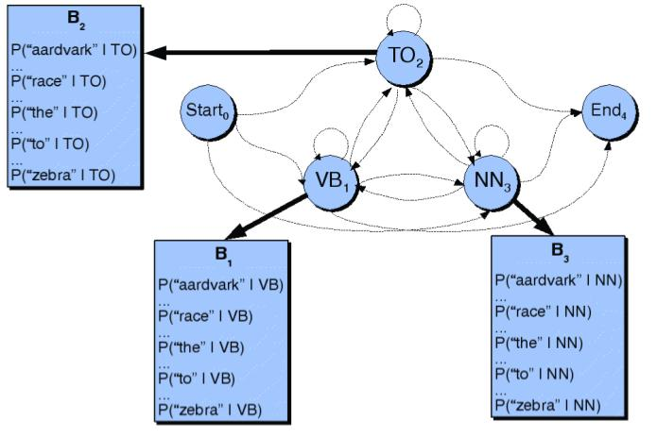
HMM-based POS tagging

Slide 10
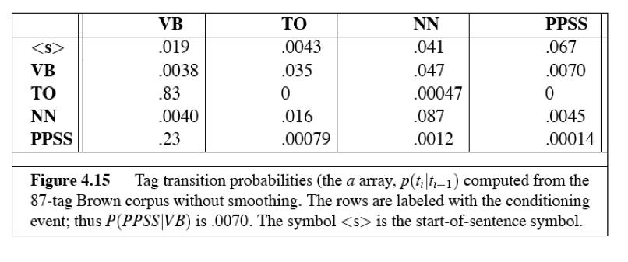
HMM-based POS tagging
Transition probabilities

Slide 11
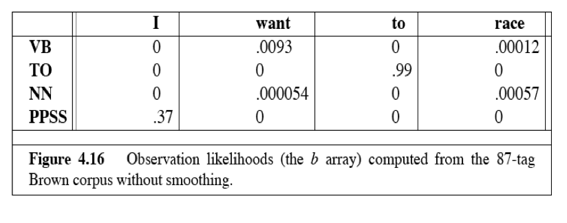
HMM-based POS tagging
Emission probabilities

Slide 12
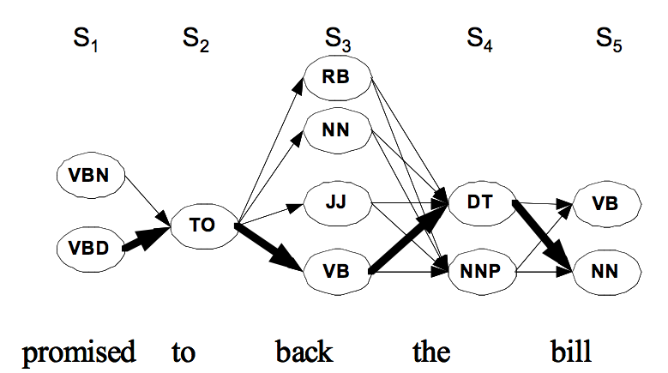
POS decoding

Slide 13
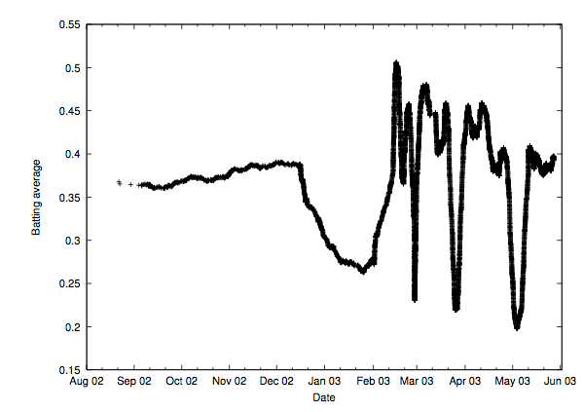
Application: Analyzing noisy data
Click-through rate for a particular webpage:
[Aizen04]

Slide 14
Application: Analyzing noisy data
Model the world’s interest in page as Markov chain
Changes with news events, etc.
But it is hidden -- we can’t observe it directly
Instead we can observe raw click-through rates
Use HMM inference to denoise the data
The states are the different interest levels
Observable variable is the empirical click-through rate
The Markov chain is learned from actual data
Viterbi gives the most likely interest level sequence

Slide 15
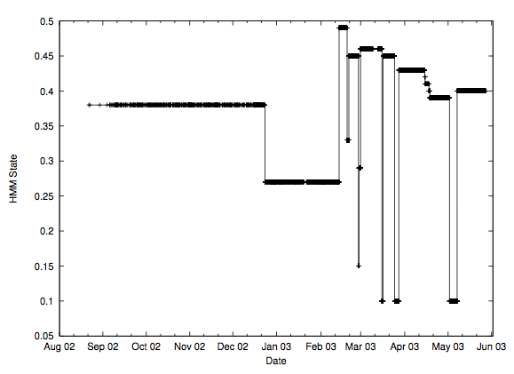
Application: Analyzing noisy data

Slide 16
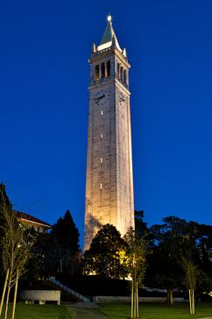

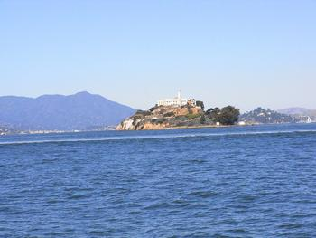
Classifying photo streams
3:35pm 9:27pm
8:03pm
Alcatraz, SF bay?
Ellis Island, NYC?
Piazza San Marco, Venice?
Sather Tower, Berkeley?
Bay Bridge, SF bay?
Geo Wash Bridge, NYC?

Slide 17
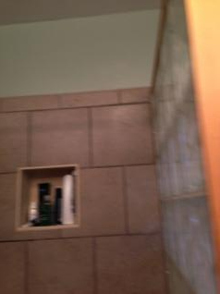

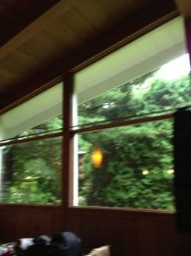
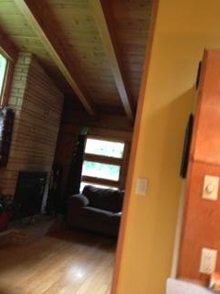
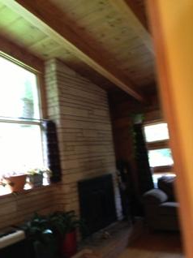
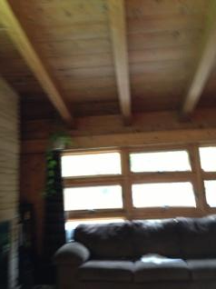

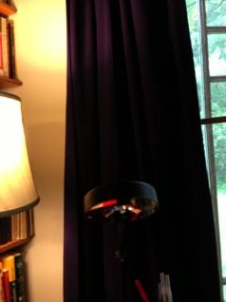


Classifying photo streams with HMMs
Probabilities with individual photo classifiers:
Bathroom:
Bedroom:
Garage:
Living:
Office:
0.931
0.006
0.006
0.014
0.042
0.0230.734
0.192
0.020
0.031
0.002
0.461
0.117
0.420
0.000
0.007
0.120
0.744
0.127
0.001
0.0090.082
0.746
0.162
0.001
0.018
0.002
0.168
0.811
0.001
0.0160.885
0.059
0.023
0.018
0.073
0.018
0.003
0.005
0.901
Probabilities after applying HMM:
Bathroom:
Bedroom:
Garage:
Living:
Office:
0.8960.010
0.009
0.079
0.006
0.436
0.052
0.045
0.441
0.027
0.060
0.026
0.024
0.881
0.009
0.015
0.004
0.004
0.968
0.009
0.010
0.002
0.002
0.975
0.012
0.006
0.002
0.002
0.873
0.116
0.002
0.002
0.006
0.125
0.865
0.000
0.000
0.001
0.005
0.994
Notes:
Here’s an actual example of the HMM applied in our dataset. Here’s a sequence of 8 images from our life-logging dataset, where the person started in the bathroom (point to left image) walked to the living room (next 5 images), then ended up in their office (last two images). The local and global classifiers process each individual image, giving us a probability distribution over the 5 possible rooms (animate), and then the estimated room is given by the label with the highest probability. But most of these are wrong (animate) – the individual classifier has us jumping around from room to room. After we apply the HMM, we get a new set of probabilities (animate), which incorporate the prior information that neighboring pictures are more likely to be taken in the same room than in different rooms. For instance, for the third image, you can see that the individual classifier wasn’t sure if the photo was taken in bedroom or living room, and hence those two probabilities are almost the same, but after applying the HMM, we are much more certain it was taken in the living room because of evidence that has propagated forwards and backward. (Animate) All of these new estimates turn out to be right.

Slide 18


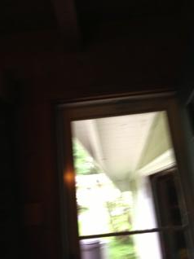
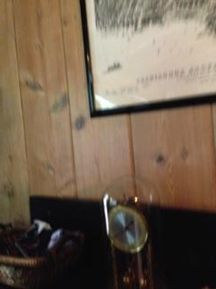
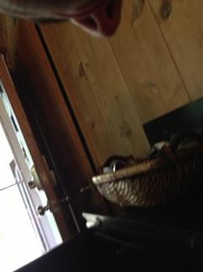

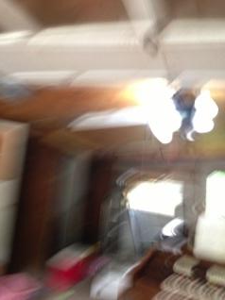

Incorporating human feedback
Bathroom:
Bedroom:
Garage:
Living:
Office:
0.027
0.003
0.179
0.162
0.630
0.019
0.003
0.261
0.241
0.476
0.013
0.003
0.573
0.242
0.169
0.007
0.002
0.647
0.264
0.079
0.001
0.002
0.793
0.192
0.012
0.001
0.004
0.879
0.113
0.003
0.001
0.009
0.953
0.036
0.001
0.000
0.000
0.994
0.005
0.000
Ask user for correct label
Bathroom:
Bedroom:
Garage:
Living:
Office:
0.011
0.003
0.006
0.352
0.628
0.000
0.000
0.000
1.000
0.000
0.001
0.001
0.103
0.894
0.001
0.001
0.001
0.128
0.870
0.001
0.001
0.001
0.372
0.626
0.001
0.001
0.009
0.622
0.367
0.001
0.001
0.010
0.757
0.231
0.001
0.002
0.023
0.857
0.117
0.002
Notes:
Sometimes the image sequences are so hard that even the HMM makes a lot of mistakes. Here’s an example of that – note how these images are particularly blurry and poorly-composed, and the HMM thinks the middle three images were taken in the garage, which is clearly not right. In these cases, quick feedback from the user can be incorporated into the HMM framework and correct errors. We’ve tried a simple version of this where the HMM looks for images where it is not very confident, and then asks the user to verify or correct the hypothesized label. In this example(animate), the HMM is not sure about the second image, with the highest probability less than 50% and the next two labels having nearly the same probability. Animate. So the system asks for clarification on this low-confidence image. Animate. In this case, the user would say that the correct answer is the living room, and we put this information into our HMM by setting the living room probability to 1.0 and all others to 0.0. Animate. Now we re-run the automatic HMM inference with this new piece of evidence, animate, and the HMM gives us new marginal probabilities estimates for each image, again propagating this along with all other evidence along the sequence. These new estimated labels turn out to be mostly right, animate, except for the sixth image which is still incorrectly classified.

Slide 19


Viterbi decoding
Key idea: the posterior probability of a state sequence, P(Q|O), factors nicely
(Bayes’ Law)

Slide 20
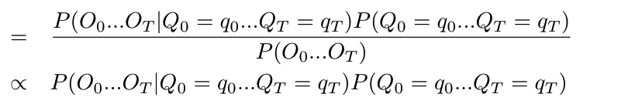
Viterbi decoding
Key idea: the posterior probability of a state sequence, P(Q|O), factors nicely
(Bayes’ Law)
(denom depends
only on O)

Slide 21
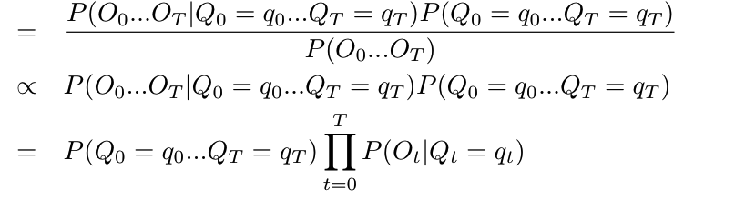
Viterbi decoding
Key idea: the posterior probability of a state sequence, P(Q|O), factors nicely
(Bayes’ Law)
(denom depends
only on O)
(O_{t} depends
only on Q_{t})

Slide 22
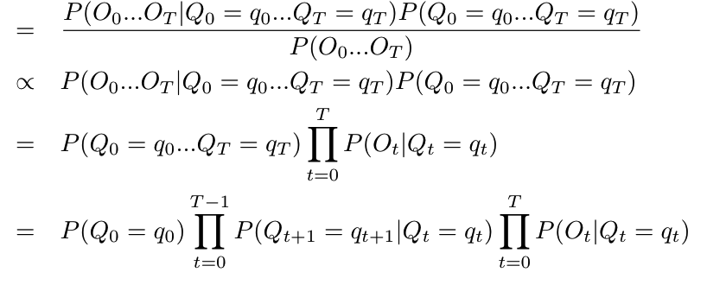
Viterbi decoding
Key idea: the posterior probability of a state sequence, P(Q|O), factors nicely
(Bayes’ Law)
(denom depends
only on O)
(O_{t} depends
only on Q_{t})
(Markov property:
Q_{t+1} depends
Only on Q_{t})

Slide 23

Viterbi decoding
Based on dynamic programming
Let v_{i}(t) be the probability of the most probable path ending at state i at time t,
Then we can recursively find the probability of the most probable path ending at state j at time t+1,
Probability of
transition from
state i to j
Probability that system
is in state j at time
t+1 (Q_{t+1}=j)
Probability that
system in state i
at time t
Probability of observing
O_{t+1} given that system
is in state j at time t+1
Max over all
possible
states at time t

Slide 24
Viterbi decoding
Takes time O(N²T)
N is the number of states
T is the length of the sequence
For many useful state transition probability functions, it’s possible to do this faster

Slide 25
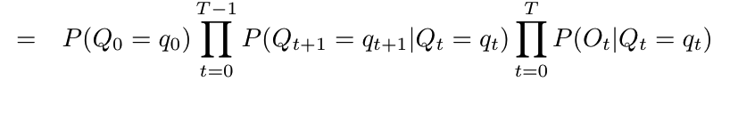

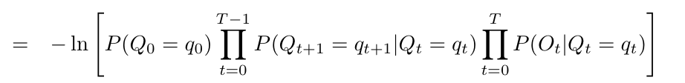
Max probability vs Min cost
Maximizing the probability P(Q|O),
is equivalent to minimizing a negative log,

Slide 26
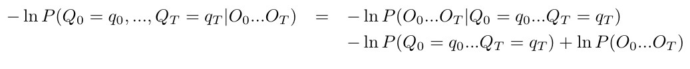
Cost minimization view
Viterbi finds a state sequence q₀…q_{T} that maximizes the posterior probability,
Equivalently, we can find a sequence that minimizes,
View the negative log probabilities as “costs”
More convenient computationally (avoids multiplying very small probabilities)

Slide 27
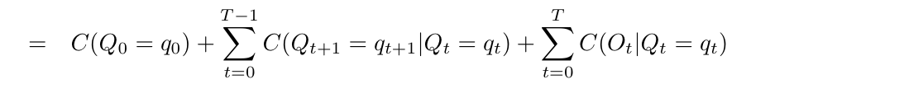
Max probability vs Min cost
Maximizing the probability P(Q|O),
is equivalent to minimizing a negative log,
where C(A) = -ln P(A), C(A|B) = -ln P(A|B)

Slide 28
HMM inference as a graph problem
We can pose HMM inference as a search problem! Find a minimum-length path through a specially-constructed graph.
Graph constructed so that each path from source to sink corresponds to exactly 1 state sequence
And every state sequence corresponds to exactly 1 path
For N states and sequences of length T, graph needs O(TN) nodes and O(TN²) edges

Slide 29
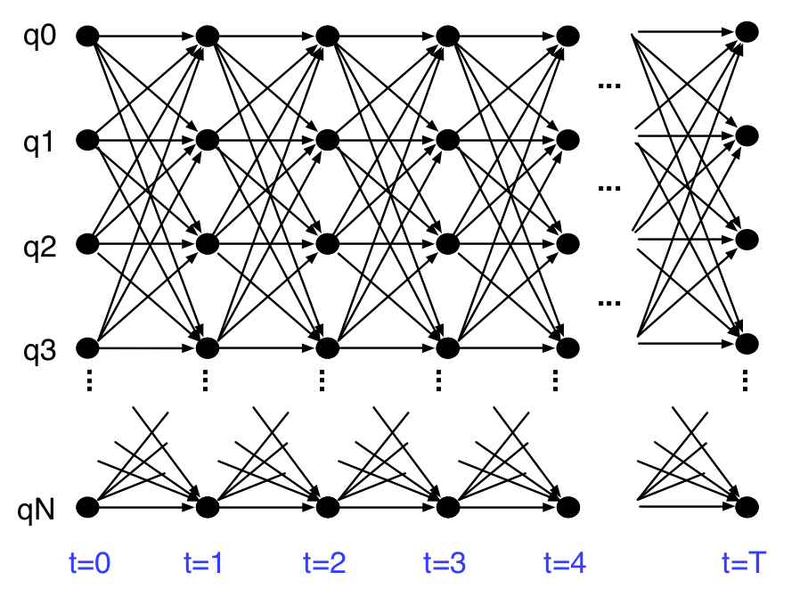

Slide 30
Sink
Source

Slide 31
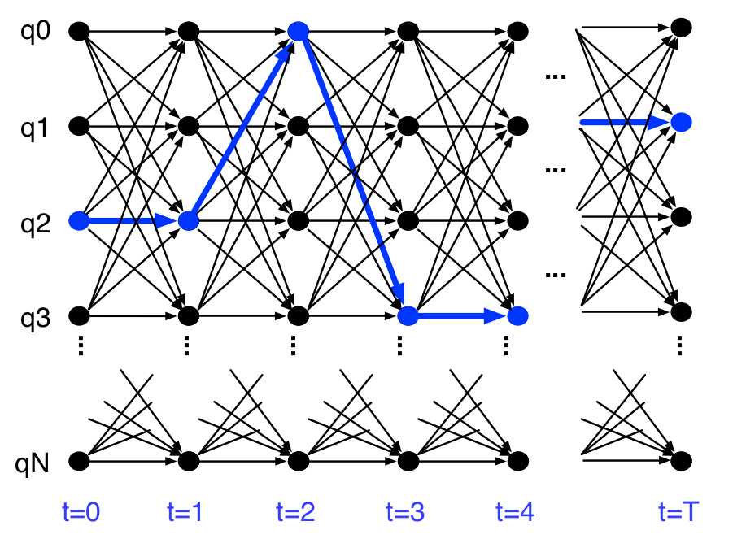
Sink
Source

Slide 32
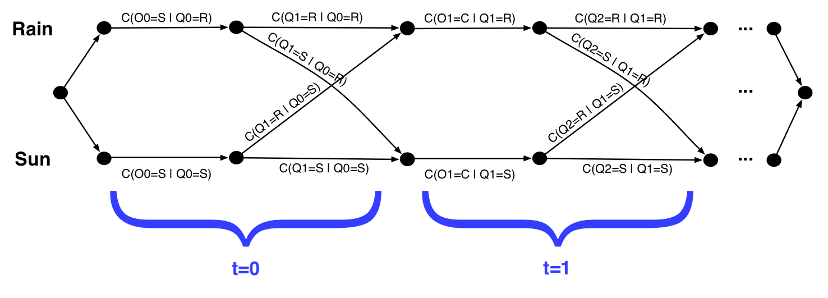
Example
Use Dijkstra to do HMM inference
Let “cost of A given B” be C(A | B) = - ln P(A|B)
Extra C(O_{i} | Q_{i}) edges added for clarity; could remove them by adding C(O_{t} | Q_{t}) to C(Q_{t+1} | Q_{t})

Slide 33
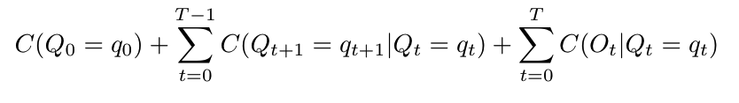
Example
Use Dijkstra to do HMM inference
Let “cost of A given B” be C(A | B) = - ln P(A|B)

Slide 34
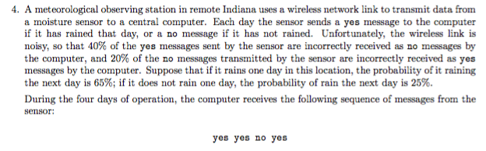
A sample problem

