Slide 1
Approximate inference

Slide 2
Announcements
A3 posted shortly!
Exam next Wednesday in class

Slide 3
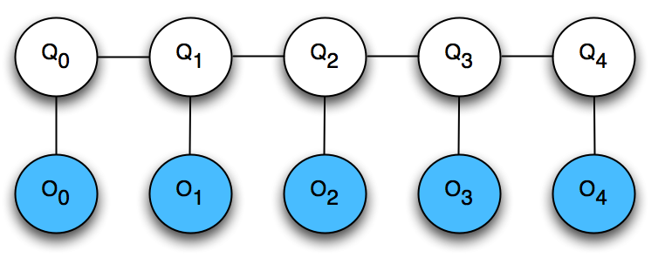
Inference on HMMs
HMMs are just special cases of Bayes Nets!
….
hidden
variables
observable
variables
Two important types of questions:
Given a particular observation (e.g. SCSCC), what is the distribution over the weather on a particular day? (Marginal inference – use Variable Elimination!)
Given a particular observation (e.g. SCSCC), what is the most likely sequence of weather across all days? (Maximum a posterior (MAP) inference – use Viterbi!)

Slide 4
Structures beyond chains
There are other structures where efficient inference (variable elimination or Viterbi) is always possible
E.g.: any Bayes Net that is a rooted tree where there is exactly one path from root to each node
An arborescence

Slide 5
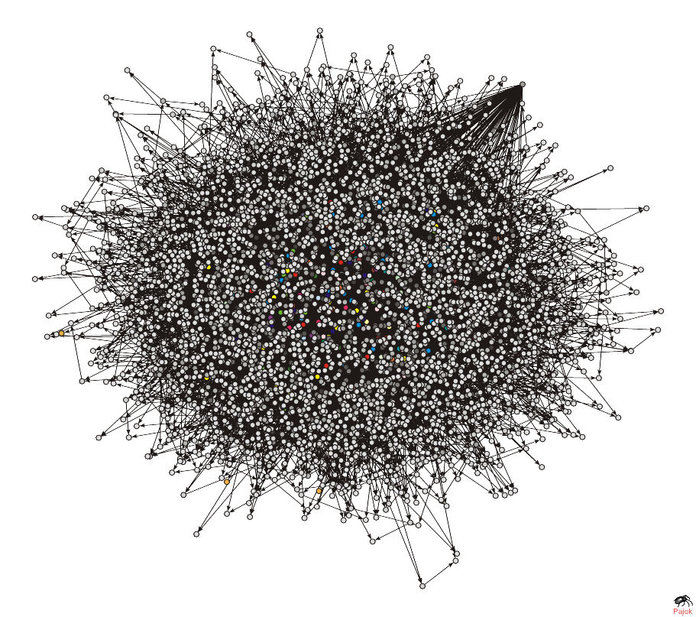
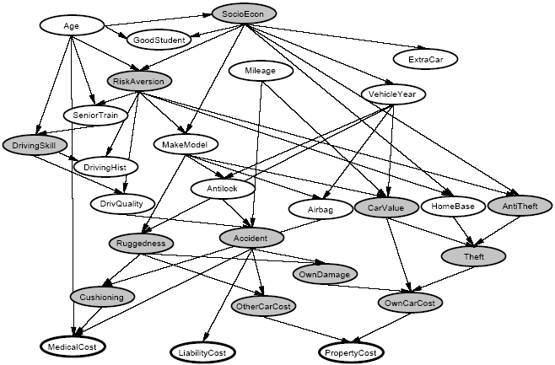
What about complicated Bayes Nets?
http://bi.snu.ac.kr/NRL/HBN/hbn.htm

Slide 6
Making inference tractable
In practice, making inference tractable is a key challenge in applying graphical models to applications
Typically, the options are:
Exact inference with arbitrary conditional probability distributions, but with a simplified graphical structure
Exact inference with arbitrary graphical structure, but restricted conditional probability distributions
Arbitrary graphical structure and arbitrary potentials, but approximate inference

Slide 7
Particle-based techniques
A particle is an assignment of values to (some) variables of a graphical model
Basic idea: Sets of particles can be used to approximate a distribution
E.g. Many samples from a distribution can be a good representation of original distribution

Slide 8
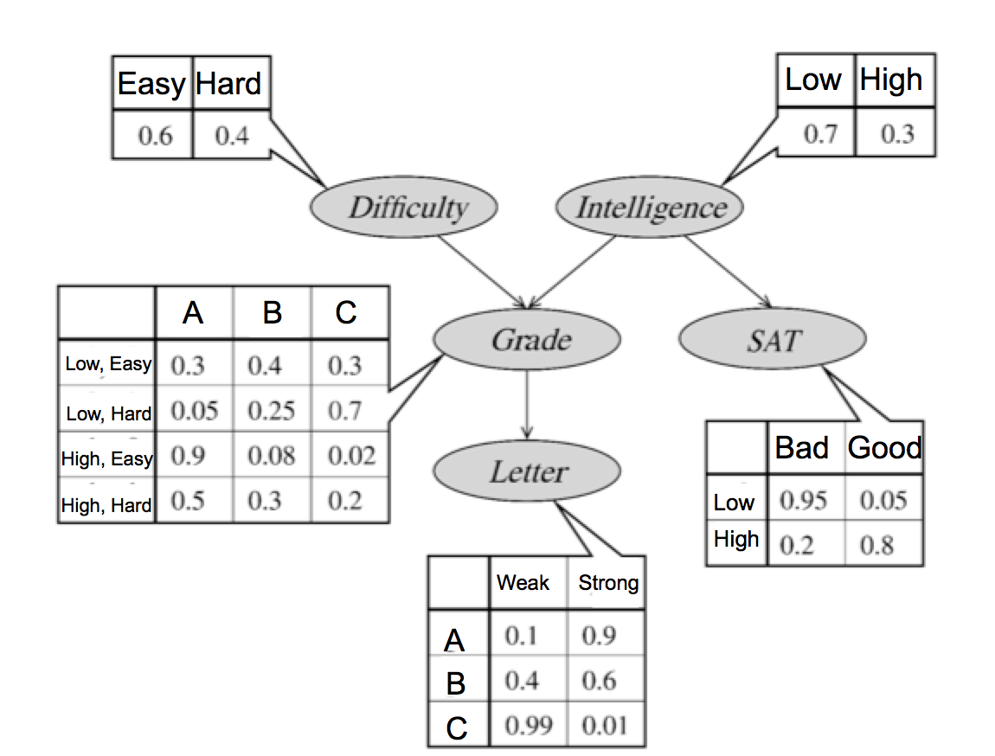
Forward sampling
We can sample particles using the simple Forward sampling algorithm
Sample values from priors at root nodes
For a node X for which values have been sampled for all parents, sample from P(X | Parents(X) )

Slide 9
Computing marginals
Forward sampling gives a very simple technique for computing marginals over set of variables X
Collect many particles using Forward sampling
For each possible value of X, count the percentage of sampled particles that have that value

Slide 10
Some sampled particles
Hard Low C Bad Strong
Hard High A Good Strong
Easy High A Good Strong
Hard Low C Bad Strong
Easy Low C Bad Strong
Easy Low C Bad Strong
Easy Low B Bad Strong
Hard High A Bad Strong
Easy Low B Bad Weak
Easy Low A Bad Strong
What is P(G=A)?
What is P(L=Weak)?
What is P(S=Good | Grade = A)?
What is P(L=Strong | Grade = C)?

Slide 11
Handling evidence
In general, we’re interested in computing marginals conditioned on some evidence, i.e. P(X | Y=y)
One easy way to do this with forward sampling:
Sample many particles from the Bayes net
If a particle has Y=y, then keep it, else discard it
Compute marginals as before, using only the remaining particles
Disadvantages of this approach?

Slide 12
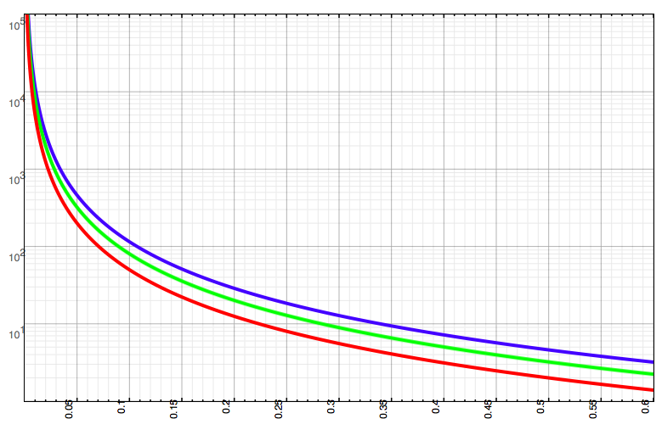
Approximation bounds
# of samples needed
99% certainty
80% certainty
95% certainty
Desired bound (ε)

Slide 13
Markov Chain Monte Carlo (MCMC)
General class of techniques that produce a sequence of samples
Main idea: Save effort by using information from past samples in producing future samples
Initial samples are from a proposal (approximate) distribution Q
Subsequent sampling is biased towards P
Eventually the samples are drawn from a distribution that is closer and closer to P

Slide 14


Special case of MCMC: Gibbs sampling
Generate initial sample x[0]
For each sample t=1…T
Let x[t] = x[t-1]
For each unobserved variable X_{i},
Sample a value for X_{i} given values for all other variables in x[t]; i.e. sample from:
where
Put this sampled value in x_{i}[t]

Slide 15
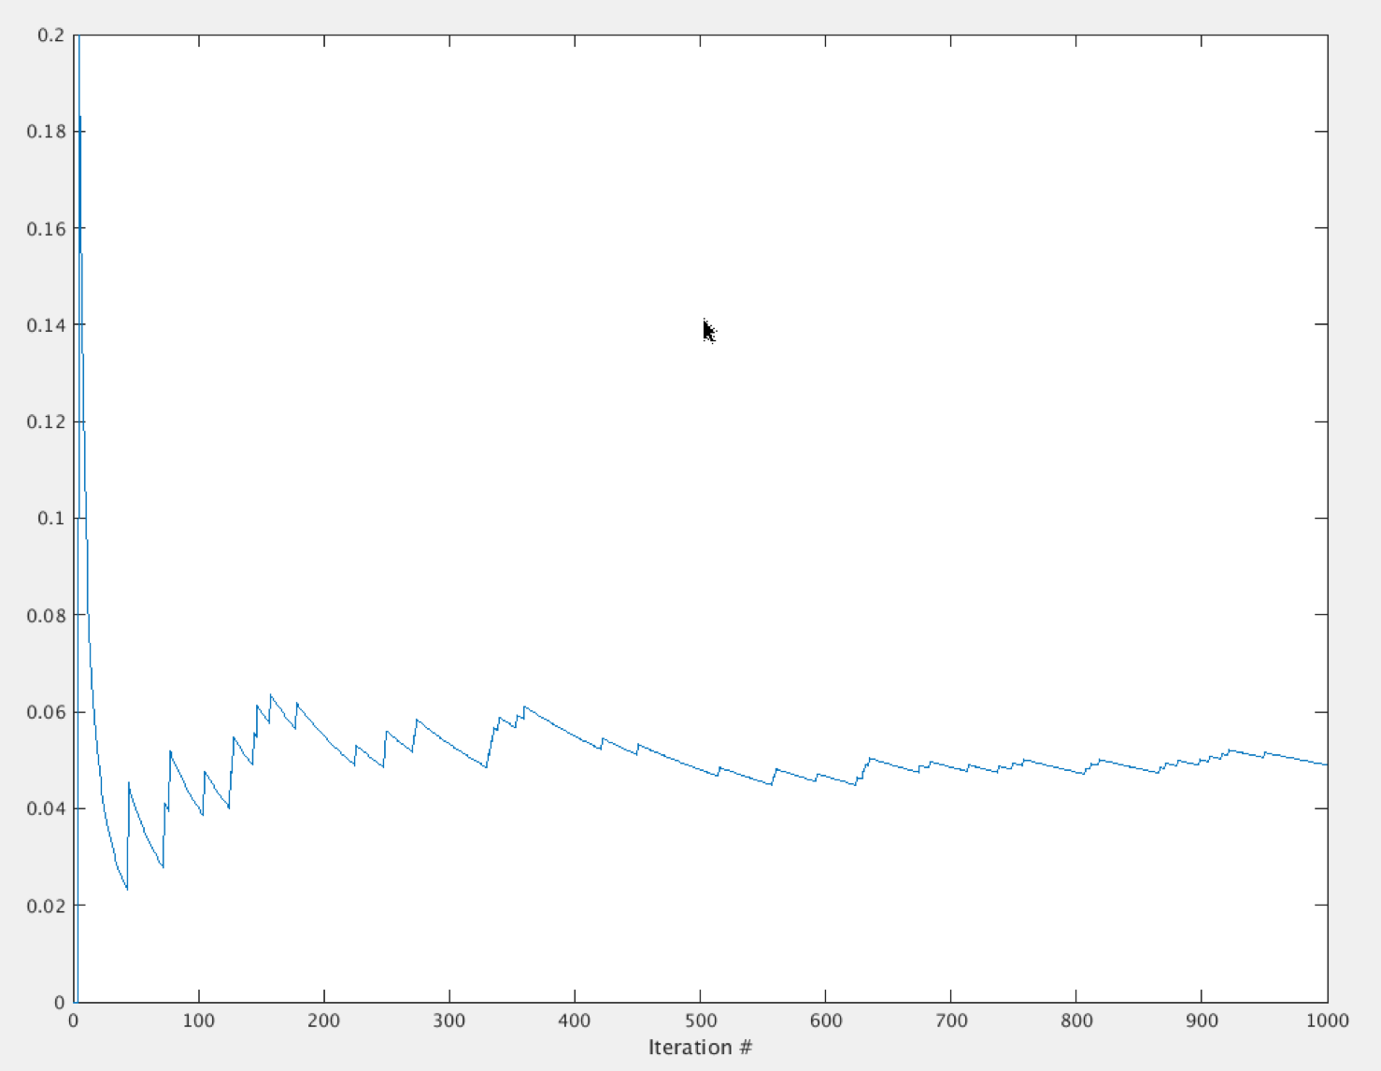

Slide 16
Properties of Gibbs sampling
Gibbs can be applied to any Bayes networks
Gibbs sampling will converge to sampling from the correct distribution, eventually
But may require a long time to converge
Why does this happen?

Slide 17
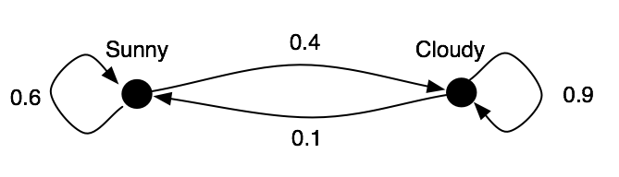
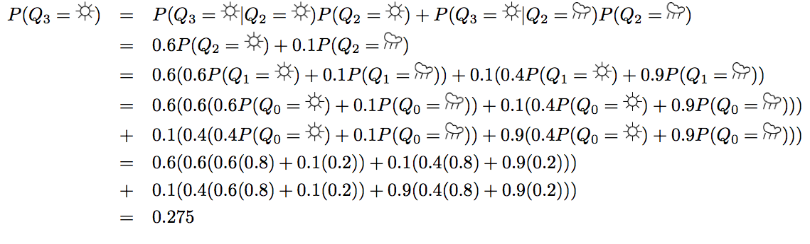
Markov chains
Suppose there’s an 80% chance of sun on day 0.
What is the probability of sun on day 3?

Slide 18
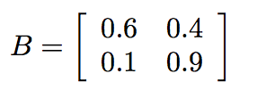
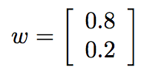
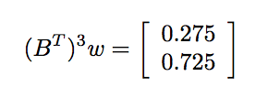
Markov chains
Suppose there’s an 80% chance of sun on day 0.
What is the probability of sun on day 3?
P(X₃ = sun)
P(X₃ = cloudy)

Slide 19

Stationary distributions
For an ergodic chain, a stationary distribution exists
ergodic: all states are recurrent and aperiodic
stationary distribution: for large t, the probability of being in state i at time t depends only on the transition probabilities
the stationary distribution π is the vector satisfying

Slide 20
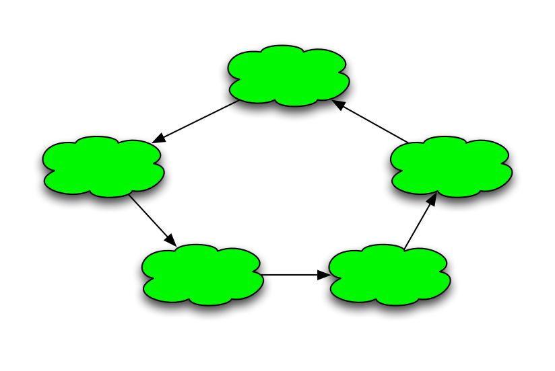
4
5
3
1
2

Slide 21
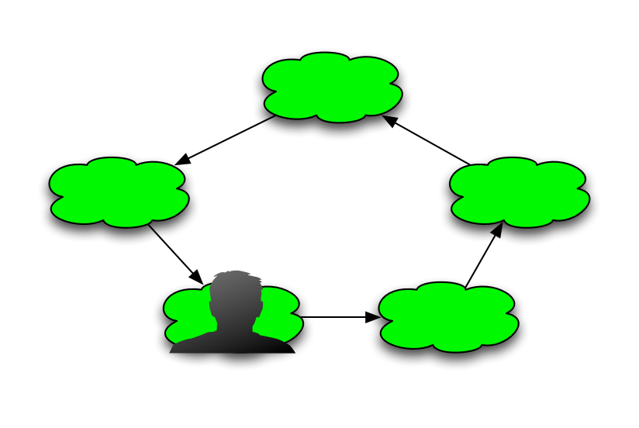
4
5
3
1
2

Slide 22
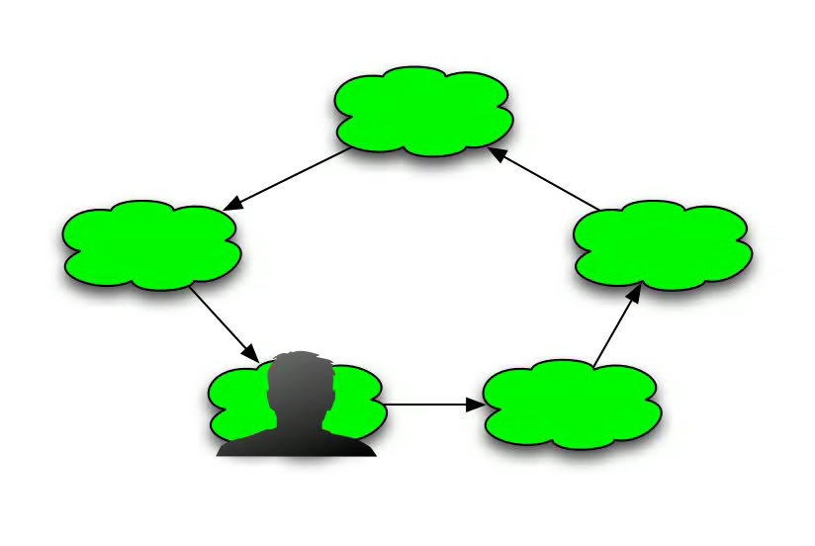
Q: At any moment in time, what’s the probability that the frog is on pad 1?
4
5
3
1
2

Slide 23
Stationary distributions
For an ergodic chain, a stationary distribution exists
ergodic: all states are recurrent and aperiodic
stationary distribution: for large t, the probability of being in state i at time t depends only on the transition probabilities
the stationary distribution π is the vector satisfying
How do we compute π?

Slide 24

Stationary distribution of Markov chain
What is the stationary distribution of this chain?
>> % e.g. in Matlab:
>> [v d]=eigs([0.6 0.4; 0.1 0.9]',1)
v =
-0.24253562503633
-0.97014250014533
d =
1
>> v/sum(v)
ans =
0.20000000000000
0.80000000000000

Slide 25
Monte Carlo Methods
Monte Carlo techniques involve random sampling for applications like numerical integration and optimization
Originally invented for nuclear physics, now widely used across a wide range of domains
Useful when it’s difficult to measure some quantity but it’s easy to generate samples from a distribution related to that quantity

Slide 26
Back to Markov Chain Monte Carlo (MCMC)
Recall we want to estimate some distribution P(X)
But inference is too hard to compute it directly
Basic idea: Construct a Markov Chain whose stationary distribution is exactly P(X)
Then take random walks on the Markov Chain
If we walk long enough, sampling from the Markov Chain is exactly equivalent to sampling from P(X)

Slide 27
MCMC
Each state in the Markov Chain is one possible assignment of values to all variables
So how many states are there?
In Gibb’s Sampling, we chose the transition probabilities such that:
a stationary distribution exists and,
the stationary distribution is exactly the posterior probability distribution we want to sample from

Slide 28
Why does Gibbs work?
To prove that Gibbs sampling works and is practical, we need to show that:
1. A stationary distribution for this Markov Chain exists (under some assumptions)
2. The stationary distribution of the Markov Chain is the posterior distribution of the Markov network
3. It’s possible to sample from efficiently

Slide 29
MCMC in practice
Might take a long time for samples to be close to the stationary distribution – to “mix”
The “burn-in” or “warm-up” time
The burn-in time depends on the structure of the chain and the transition probabilities
When might the burn-in time be particularly long?
It’s possible to compute bounds on the burn-in time, by spectral analysis of the transition matrix
I.e. computing eigenvalues and eigenvectors of the Markov Chains’ transition matrix
But this is completely unhelpful in practice – why?

Slide 30
Practical solutions
Construct a small number of identical Markov chains
Take random walks on each of the chains for a large number of time steps, starting from different initial states
Run the chains until the samples seem to be coming from the same distribution across all (or most) of the chains
Now use each of the chains to generate (estimated) samples from the posterior distribution

