Slide 1
Statistical learning (Or: Where do Bayes Nets come from?)

Slide 2
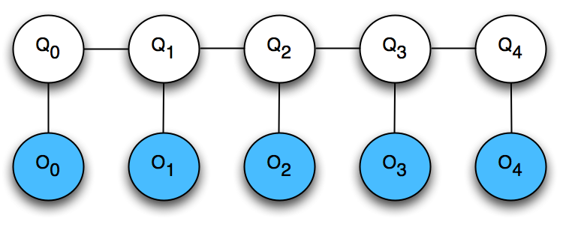



Hidden Markov Models (HMMs)
More formally, an HMM consists of:
Transition probabilities
Initial state distribution
Emission probabilities
….

Slide 3
Learning HMM parameters
How do we learn e_{i}(a), p_{ij}, w_{i}?
Case 1: Probabilities have some natural meaning
Case 2: Training data is available having both state sequences and corresponding observation sequences (i.e. states are visible in training but hidden for testing)
Case 3: Training data is available with observation sequences, but state sequences are NOT available (i.e. states hidden in both test and training)

Slide 4
Various Bayes learning scenarios
Assumptions about model
May have graph structure but need to learn parameters
May need to learn graph structure and parameters
May need to learn graph, parameters, and variables
Observability of variables
Completely observable: exemplars include known values for all variables
Partially observable: values of some variables are unknown in some exemplars
Hidden or latent variables: values of some variables are never observed

Slide 5
Learning in General
Agent has made observations (data)
Now must make sense of it (model hypotheses)
Why?
Hypotheses alone may be important (e.g., in basic science)
For inference (e.g., forecasting)
To take sensible actions (decision making)
A basic component of economics, social and physical sciences, engineering, …

Slide 6
Machine Learning vs. Statistics
Machine Learning ≈ automated statistics
Today
Statistical learning (aka Bayesian learning)
Maximum likelihood (ML) learning
Maximum a posteriori (MAP) learning
Learning Bayes Nets (R&N 20.1-3)
Future lectures try to do more with even less data
Neural nets
Support vector machines
…

Slide 7

Candy Example
Candy comes in 2 flavors, cherry and lime, with identical wrappers
Manufacturer makes 5 indistinguishable bags
Suppose we draw
What bag are we holding? What flavor will we draw next?
h1 C: 100% L: 0%
h2 C: 75% L: 25%
h3 C: 50% L: 50%
h4 C: 25% L: 75%
h5 C: 0% L: 100%

Slide 8
Bayesian Learning
Main idea: Compute the probability of each hypothesis, given the data
Data d:
Hypotheses: h₁,…,h₅
h1 C: 100% L: 0%
h2 C: 75% L: 25%
h3 C: 50% L: 50%
h4 C: 25% L: 75%
h5 C: 0% L: 100%

Slide 9
Bayesian Learning
Main idea: Compute the probability of each hypothesis, given the data
Data d:
Hypotheses: h₁,…,h₅
P(h_{i}|d)
We want this…
P(d|h_{i})
But all we have is this!
h1 C: 100% L: 0%
h2 C: 75% L: 25%
h3 C: 50% L: 50%
h4 C: 25% L: 75%
h5 C: 0% L: 100%

Slide 10
Using Bayes’ Rule
P(h_{i}|d) = α P(d|h_{i}) P(h_{i}) is the posterior
(Recall, 1/α = P(d) = Σ_{i} P(d|h_{i}) P(h_{i}))
P(d|h_{i}) is the likelihood
P(h_{i}) is the hypothesis prior
h1 C: 100% L: 0%
h2 C: 75% L: 25%
h3 C: 50% L: 50%
h4 C: 25% L: 75%
h5 C: 0% L: 100%

Slide 11
Computing the Posterior
Assume draws are independent
Let P(h₁),…,P(h₅) = (0.1, 0.2, 0.4, 0.2, 0.1)
d = { 10 x }
P(d|h₁) = 0
P(d|h₂) = 0.25¹⁰
P(d|h₃) = 0.5¹⁰
P(d|h₄) = 0.75¹⁰ P(d|h₅) = 1¹⁰
P(d|h₁)P(h₁)=0 P(d|h₂)P(h₂)=9e-8 P(d|h₃)P(h₃)=4e-4 P(d|h₄)P(h₄)=0.011 P(d|h₅)P(h₅)=0.1
P(h₁|d) =0 P(h₂|d) =0.00 P(h₃|d) =0.00 P(h₄|d) =0.10 P(h₅|d) =0.90
Sum = 1/α = 0.1114

Slide 12
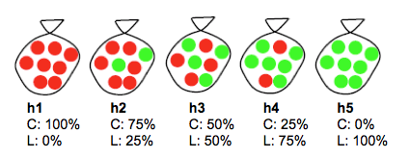
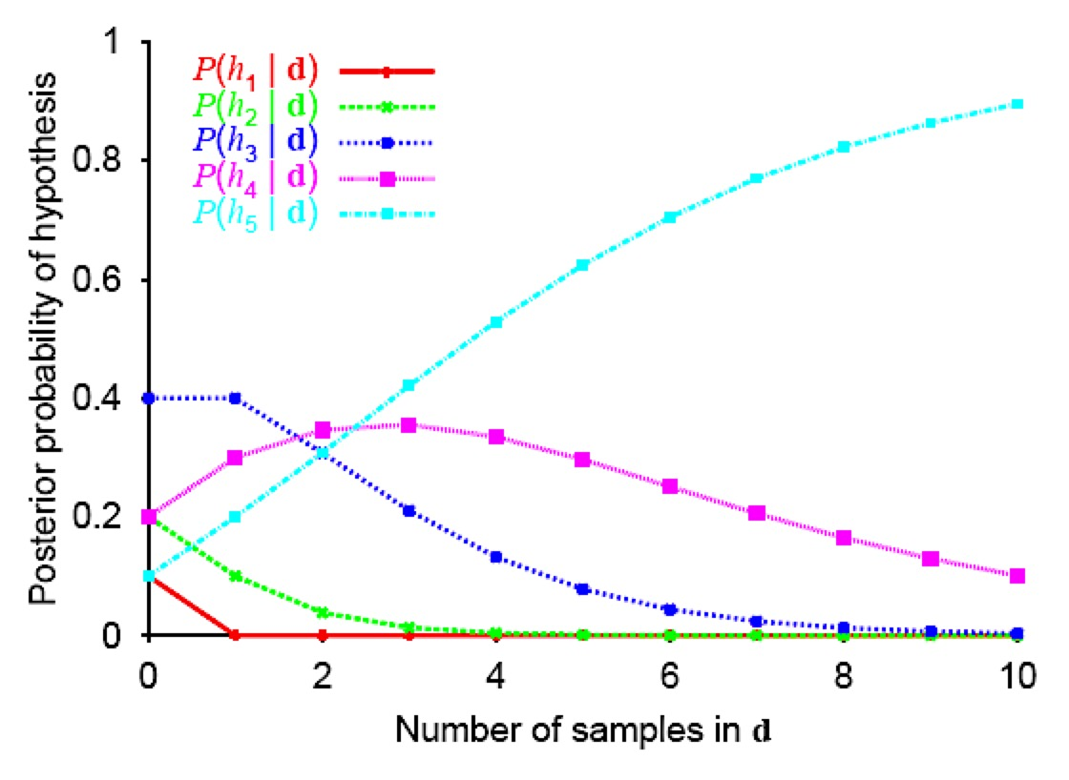
Posterior Hypotheses
Let P(h₁),…,P(h₅) = (0.1, 0.2, 0.4, 0.2, 0.1)
Data: All our samples are limes.

Slide 13
Predicting the Next Draw
H
P(X|d) = Σ_{i} P(X|h_{i},d)P(h_{i}|d) = Σ_{i} P(X|h_{i})P(h_{i}|d)
D
X
Probability that next candy drawn is a lime
P(h₁|d) =0 P(h₂|d) =0.00 P(h₃|d) =0.00 P(h₄|d) =0.10 P(h₅|d) =0.90
P(X|h₁) =0 P(X|h₂) =0.25 P(X|h₃) =0.5 P(X|h₄) =0.75 P(X|h₅) =1
P(X|d) = 0.975

Slide 14
P(Next Candy is Lime | d)

Slide 15
Properties of Bayesian Learning
If exactly one hypothesis is correct, then the posterior probability of the correct hypothesis will tend toward 1 as more data is observed
The effect of the prior distribution decreases as more data is observed

Slide 16
Hypothesis Spaces often Intractable
But: a hypothesis is a joint probability table over state variables
6 boolean variables => over 10²² hypotheses
What if we don’t have a reasonable prior?
In practice, we’ll need to use additional information about the structure of the model
E.g. conditional independent assumptions
Some parametric form for the hypotheses

Slide 17
Learning Coin Flips
We have a coin with unknown P(H)
Let P(H) be θ (hypothesis)
Flips are i.i.d. – independent, identically distributed
We flip N times to get a sequence of outcomes D. Of these, c flips are heads (data).
Consider P(D | θ), the likelihood of the data given the model.

Slide 18
N=2, c=1
N=2, c=2
N=3, c=2
N=4, c=2
N=5, c=2
N=20, c=10

Slide 19
N=2, c=1
N=4, c=2
N=20, c=10
N=100, c=50

Slide 20
Announcements
A3 posted!
Intelligent & Interactive Systems Seminars
Mondays 2:30-3:30 130 Info East
To receive announcements, send email to list@list.indiana.edu with subject line:
subscribe iis-seminar-l

Slide 21

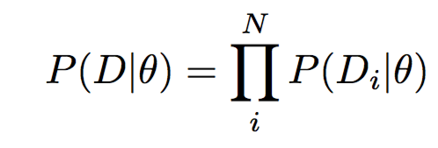

Maximum Likelihood Estimation (MLE)
Say we have a set of training samples D=(x₁,…,x_{N})
We’ve decided on a parametric model for the distribution, having parameters
We define a likelihood function measuring the probability of the data for a given model ,
In MLE, we want to find a model that maximizes the probability of the observed data given the model,

Slide 22
Other Closed-Form MLE results
Multi-valued variables: take fraction of counts for each value
Continuous Gaussian distributions: take average value as mean, standard deviation of data as standard deviation

Slide 23
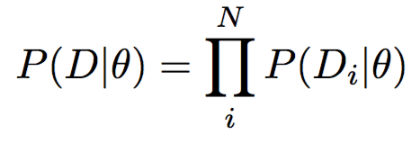
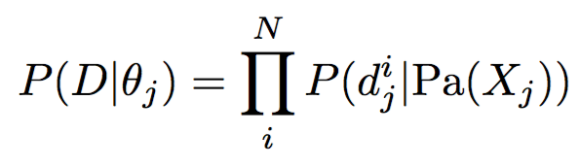
MLE in Bayes Networks
The likelihood function can be factored into a product over variables,
where θ=(θ₁, …, θ_{M}), θ_{j} is the CPD for variable X_{j}, D=(d₁, d₂, …, d_{N}), and each d_{i}=(d_{i}¹, d_{i}², … d_{i}^{M})
If all variables can be observed, each of these factors can be maximized individually
So we can estimate parameters of each variable’s probability distribution individually
Key result: ML estimate of Bayes Net parameters is given by the set of ML estimates of CPDs of each variable.
where

Slide 24
Maximum Likelihood for BN
For any BN, the ML parameters of any CPT can be derived by the fraction of observed values in the data, conditioned on matched parent values
N=1000
E | B | P(A|E,B)
T | T | 0.95
F | T | 0.95
T | F | 0.34
F | F | 0.003
E: 500
B: 200
P(E) = 0.5
P(B) = 0.2
Earthquake
Burglar
A|E,B: 19/20 A|¬E,B: 188/200 A|E, ¬B: 170/500 A|¬E,¬B : 1/380
Alarm

Slide 25
Bayes Net ML Algorithm
Input: BN with nodes X₁,…,X_{n}, dataset D=(d₁,…,d_{N})
Each d_{i}=(d_{i}¹, d_{i}², … d_{i}^{M}) is a sample of the full state of the world
For each node X with parents Y₁,…,Y_{k}:
For all y₁∈Val(Y₁),…, y_{k}∈Val(Y_{k})
For all x∈Val(X)
Count the number of times (X=x, Y₁=y₁,…, Y_{k}=y_{k}) is observed in D. Let this be m_{x}
Count the number of times (Y₁=y₁,…, Y_{k}=y_{k}) is observed in D. Let this be m. (note m=Σ_{x}m_{x})
Set P(x|y₁,…,y_{k}) = m_{x} / m for all x∈Val(X)

Slide 26
Maximum Likelihood Properties
As the number of data points approaches infinity, the MLE approaches the true estimate
With little data, MLEs can vary wildly

Slide 27

MLE in candy example
h_{ML} = argmax_{i} P(d|h_{i})
P(X|d) ≈ P(X|h_{ML}), with a large enough sample size
P(X|h_{ML})
P(X|d)

Slide 28
Back to Coin Flips
The MLE is easy to compute… but what about with small sample sizes?
You hand me a coin from your pocket
1 flip, turns up tails
What’s the MLE?

Slide 29
Disadvantages of ML Estimation
Tells us nothing about the certainty of our estimates
Note that we get exactly the same answer whether we flip 1 head out of 3, or 1,000 out of 3,000
If we have no observations, can’t estimate anything
Or: if we have a large number of variables, some values will never be seen and we can conclude nothing
No way to incorporate prior evidence
E.g. that most coins are unbiased (or not very biased)

Slide 30
Maximum A Posteriori Estimation
Maximum a posteriori (MAP) estimation
Idea: use the hypothesis prior to get a better initial estimate than ML, without full Bayesian estimation
“Most coins I’ve seen have been fair coins, so I won’t let the first few tails sway my estimate much”
“Now that I’ve seen 100 tails in a row, I’m pretty sure it’s not a fair coin anymore”

Slide 31
Maximum A Posteriori
P(θ|d) is the posterior probability of the hypothesis, given the data
argmax_{θ} P(θ|d) is known as the maximum a posteriori (MAP) estimate
Posterior of hypothesis θ given data d={d₁,…,d_{N}}
P(θ|d) = 1/α P(d|θ) P(θ)
Max over θ doesn’t affect α
So MAP estimate is argmax_{θ} P(d|θ) P(θ)

Slide 32
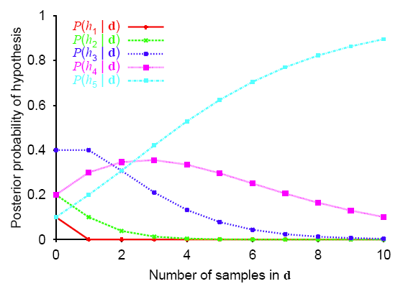
Maximum a Posteriori
h_{MAP} = argmax_{hi} P(h_{i}|d)
P(X|d) ≈ P(X|h_{MAP})
P(X|h_{MAP})
P(X|d)
h_{MAP} =

Slide 33
Advantages of MAP and MLE over Bayesian estimation
Involves an optimization rather than a large summation
Local search techniques
For some types of distributions, there are closed-form solutions that are easily computed

