Slide 1
Learning & Decision Trees

Slide 2
Learning
Generalization from experience
“Our experience of the world is specific, yet we are able to formulate general theories that account for the past and predict the future.” --M.R. Genesereth and N.J. Nilsson, Logical Foundations of AI, 1987
Agent has made observations (data)
Now must make sense of it (hypotheses)

Slide 3
Techniques Bayesian learning Decision trees Neural networks Support vector machines Boosting Case-based reasoning Dimensionality reduction …
Tasks & settings Classification Ranking Clustering Regression Decision-making Supervised Unsupervised Semi-supervised Active Reinforcement
Applications
Document retrieval
Document classification
Data mining
Computer vision
Scientific discovery Robotics …

Slide 4
Supervised
Given pairs (x,y) with y=f(x), agent builds model to predict f(x) for new x
Unsupervised
Given data points x, agent learns patterns in the data (e.g. clusters)
Reinforcement
Agent performs actions a₁ … a_{n}, receives reward R; decides which actions caused R
Semi-supervised
Some labels are missing in the training set, or some labels are erroneous
Active
Learner asks an oracle for correct output y=f(x) for some input points x

Slide 5
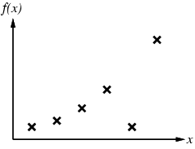
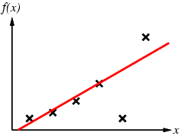
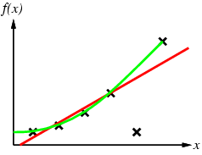
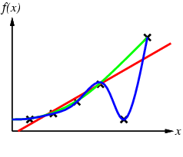
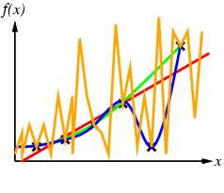
Supervised learning
Construct/adjust h to agree with f on training set
h is consistent if it agrees with f on all examples
E.g., curve fitting:

Slide 6
Supervised learning
Construct/adjust h to agree with f on training set
h is consistent if it agrees with f on all examples
E.g., curve fitting:
h=D is a trivial, but perhaps uninteresting solution (memorization)

Slide 7
Tasks
Depending on the task, the goal is to produce values for f(x) of different forms:
Regression: Predict continuous values
Classification: Predict one of a discrete set of labels
Binary Classification: Predict positive or negative
Structured: Predict complex structure (e.g. tree, sequence, etc.)

Slide 8
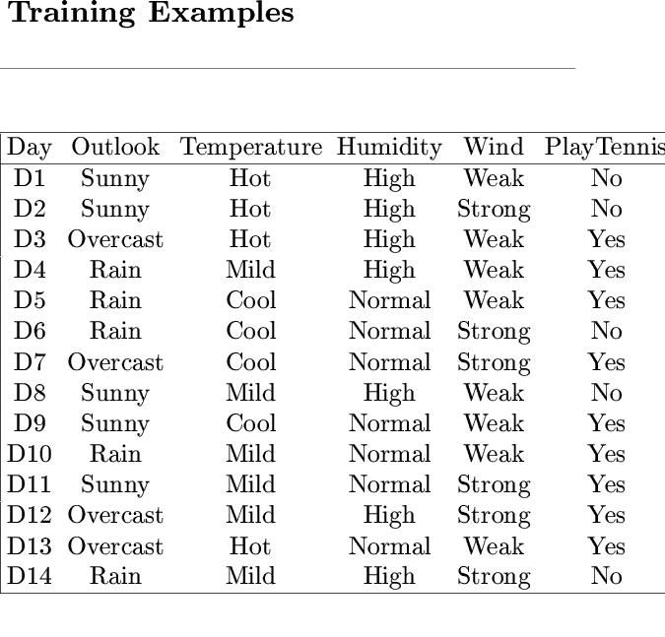
Logic-Based Inductive Learning
Here, examples (x, f(x)) take on discrete values

Slide 9
Learning a Logical Predicate (Concept Classifier)
Given set E of objects, predicates A(x), B(x), …, goal is to predict CONCEPT(x) ∈ {T,F}, for x ∈ E, where CONCEPT is a sentence of predicates, e.g.:
CONCEPT(x) ⇔ A(x) ∧ (¬B(x) v C(x))
Training set: values of CONCEPT for subset of predicate values
A hypothesis is a possible model, CONCEPT(x) ⇔ S(A,B, …)
The set of all hypotheses is called the hypothesis space
A hypothesis agrees with an example if it gives the correct value of CONCEPT

Slide 10
Inductive Learning Scheme
Inductive hypothesis h
Training set D
-
-
-
+
+
-
-
-
-
+
+
+
+
-
-
+
+
+
+
-
-
-
+
+
Example set X
{[A, B, …, CONCEPT]}
Hypothesis space H
{[CONCEPT(x) ⇔ S(A,B, …)]}

Slide 11
Size of Hypothesis Space
With n observable predicates, there are 2^{n} entries in truth table defining, CONCEPT and each entry can be filled with True or False
How many possible hypotheses are there?
For n = 6, about 2x10¹⁹ hypotheses!

Slide 12
Keep-It-Simple (KIS) Bias
Capacity: Ability of a machine to learn training set
Too much or too little capacity is bad; good generalization achieved with the right balance between the two
Examples
Use many fewer observable predicates than the training set
Constrain the learned predicate, e.g., use only “high-level” observable predicates and/or have simple syntax
Motivation
If an hypothesis is too complex it is not worth learning
There are many fewer simple hypotheses than complex ones, hence the hypothesis space is smaller
Einstein: “A theory must be as simple as possible, but not simpler than this”

Slide 13
Predicate as a Decision Tree
The predicate CONCEPT(x) ⇔ A(x) ∧ (¬B(x) v C(x)) can
be represented by the following decision tree:
Example: A mushroom is poisonous iff it is yellow and small, or yellow,
big and spotted
x is a mushroom
CONCEPT = POISONOUS
A = YELLOW
B = BIG
C = SPOTTED
A?
True
False
B?
False
True
False
C?
True
True
False
True
False

Slide 14
Predicate as a Decision Tree
The predicate CONCEPT(x) ⇔ A(x) ∧ (¬B(x) v C(x)) can
be represented by the following decision tree:
Example: A mushroom is poisonous iff it is yellow and small, or yellow,
big and spotted
x is a mushroom
CONCEPT = POISONOUS
A = YELLOW
B = BIG
C = SPOTTED
D = FUNNEL-CAP
E = BULKY
A?
True
False
B?
False
True
False
C?
True
True
False
True
False

Slide 15
Training Set
Ex. # | A | B | C | D | E | CONCEPT
1 | False | False | True | False | True | False
2 | False | True | False | False | False | False
3 | False | True | True | True | True | False
4 | False | False | True | False | False | False
5 | False | False | False | True | True | False
6 | True | False | True | False | False | True
7 | True | False | False | True | False | True
8 | True | False | True | False | True | True
9 | True | True | True | False | True | True
10 | True | True | True | True | True | True
11 | True | True | False | False | False | False
12 | True | True | False | False | True | False
13 | True | False | True | True | True | True

Slide 16
Possible Decision Tree
CONCEPT ⇔
(D∧(¬EvA))v(¬D∧(C∧(Bv(¬B∧((E∧¬A)v(¬E∧A))))))
D
T
F
E
C
CONCEPT ⇔ A ∧ (¬B v C)
T
F
A
B
A?
True
False
T
F
T
E
B?
False
True
False
C?
True
A
A
True
False
True
False
F
T
T
F

Slide 17
Possible Decision Tree
CONCEPT ⇔
(D∧(¬EvA))v(¬D∧(C∧(Bv(¬B∧((E∧¬A)v(¬E∧A))))))
D
T
F
E
C
CONCEPT ⇔ A ∧ (¬B v C)
T
F
A
B
A?
True
False
KIS bias → Build smallest decision tree
T
F
T
E
B?
False
True
False
C?
True
A
A
Computationally intractable problem → greedy algorithm
True
False
True
False
F
T
T
F

Slide 18
Top-down induction of decision tree
Ex. # | A | B | C | D | E | CONCEPT
1 | False | False | True | False | True | False
2 | False | True | False | False | False | False
3 | False | True | True | True | True | False
4 | False | False | True | False | False | False
5 | False | False | False | True | True | False
6 | True | False | True | False | False | True
7 | True | False | False | True | False | True
8 | True | False | True | False | True | True
9 | True | True | True | False | True | True
10 | True | True | True | True | True | True
11 | True | True | False | False | False | False
12 | True | True | False | False | True | False
13 | True | False | True | True | True | True
What should the classifier do if it observes none of the predicates?
What should it do if it can choose only one predicate?

Slide 19
Choice of Second Predicate
A
T
F
C
False
F
T
True:
False:
6, 8, 9, 10, 13
7
11, 12
→ The number of misclassified examples from the training set is 1

Slide 20
Choice of Third Predicate
A
T
F
C
False
F
T
True
B
T
F
True:
False:
11,12
7

Slide 21
Final Tree
A
A?
True
False
True
False
C
False
B?
False
True
False
True
False
B
C?
True
True
True
False
True
False
True
False
False
True
CONCEPT ⇔ A ∧ (C v ¬B)
CONCEPT ⇔ A ∧ (¬B v C)

Slide 22
Top-Down Induction of a DT
A
True
False
C
False
True
False
True
B
True
False
DTL(D, Predicates)
If all examples in D are positive then return True
If all examples in D are negative then return False
If Predicates is empty then return failure
A ← error-minimizing predicate in Predicates
Return the tree whose:
- root is A,
- left branch is DTL(D^{+A},Predicates-A),
- right branch is DTL(D^{-A},Predicates-A)
False
True

Slide 23
Capacity is Not the Only Criterion
Accuracy on training set isn’t the best measure of performance
Training set D
-
-
-
+
+
-
-
-
-
Test
+
+
+
+
-
-
+
+
Learn
+
+
-
-
-
+
+
Example set X
Hypothesis space H

Slide 24
Generalization Error
A hypothesis h is said to generalize well if it achieves low error on all examples in X
-
-
Test
-
+
+
-
-
-
-
+
+
+
+
-
-
Learn
+
+
+
+
-
-
-
+
+
Example set X
Hypothesis space H

Slide 25
Assessing Performance of a Learning Algorithm
Samples from X are typically unavailable
Take out some of the training set
Train on the remaining training set
Test on the excluded instances
Cross-validation

Slide 26
Cross-Validation
Split original set of examples, train
Examples D
-
+
-
-
+
-
-
-
-
+
+
+
+
-
-
+
Train
+
+
+
-
-
-
+
+
Hypothesis space H

Slide 27
Cross-Validation
Evaluate hypothesis on testing set
Testing set
-
-
-
-
+
+
+
+
+
+
-
-
+
Hypothesis space H

Slide 28
Cross-Validation
Evaluate hypothesis on testing set
Testing set
-
+
+
-
+
+
+
Test
-
+
+
-
-
-
Hypothesis space H

Slide 29
Cross-Validation
Compare true concept against prediction
9/13 correct
Testing set
-
-
-
+
-
+
-
-
+
+
+
+
+
+
+
-
+
+
+
+
-
-
-
-
+
-
Hypothesis space H

Slide 30
Performance Issues
Assessing performance:
Training set and test set
Learning curve
100
% correct on test set
size of training set
Typical learning curve

Slide 31
Performance Issues
Assessing performance:
Training set and test set
Learning curve
100
Some concepts are unrealizable within a machine’s capacity
% correct on test set
size of training set
Typical learning curve

Slide 32
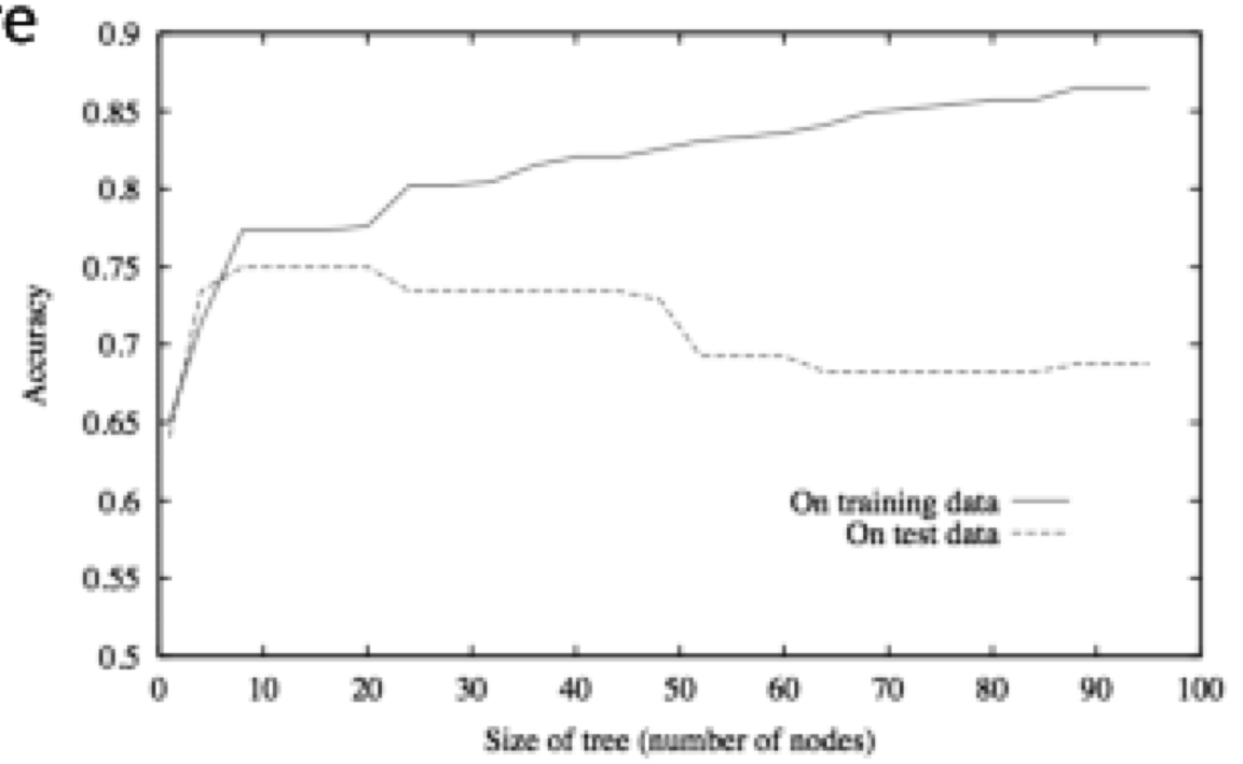
Performance Issues
Assessing performance:
Training set and test set
Learning curve
Overfitting
Classifier works well on training set, poorly on test set

Slide 33
Supervised Learning Flow Chart
Datapoints
Target function
Unknown concept we want to approximate
Training
set
Hypothesis space
Learner
Choice of learning algorithm
Observations we have seen
Inductive Hypothesis
Test set
Better quantities to assess performance
Prediction
Observations we will see in the future

Slide 34
Generalizing decision trees

Slide 35
Building Decision Trees
Goal: Build a small tree such that all samples at leaves have same class
Greedy solution:
At each node, pick test such that branches are closest to having same class
Split into subsets with least “disorder”
(Disorder ~ Entropy)
Find test that minimizes disorder

Slide 36
Minimizing Disorder
Hair Color
Height
Blonde
Brown
Tall
Short
Red
Average
Sarah: B
Dana: N
Annie: B
Katie: N
Alex: N
Pete: N
John: N
Alex:N
Annie:B
Katie:N
Sarah:B
Emily:B
John:N
Dana:N
Pete:N
Emily: B
Lotion
Weight
No
Yes
Light
Heavy
Average
Sarah:B
Annie:B
Emily:B
Pete:N
John:N
Dana:N
Alex:N
Katie:N
Sarah:B
Katie:N
Dana:N
Alex:N
Annie:B
Emily:B
Pete:N
John:N

Slide 37
Minimizing Disorder
Height
Tall
Short
Average
Splitting Blonde!
Annie:B
Katie:N
Sarah:B
Dana:N
Lotion
Weight
No
Yes
Light
Heavy
Average
Sarah:B
Annie:B
Dana:N
Katie:N
Sarah:B
Katie:N
Dana:N
Annie:B

Slide 38
Sunburn Identification Tree
Hair Color
Blonde
Brown
Red
Lotion Used
Emily: Burn
Alex: None
John: None
Pete: None
No
Yes
Sarah: Burn
Annie: Burn
Katie: None
Dana: None

Slide 39
Measuring Disorder
Problem:
In general, tests on large DB’s don’t yield homogeneous subsets
Solution:
General information theoretic measure of disorder
Desired features:
Homogeneous set: least disorder = 0
Even split: most disorder = 1

Slide 40
Measuring Entropy
If split m objects into 2 bins size m₁ and m₂, what is the entropy?

Slide 41
Computing Disorder
N instances
Branch1
Branch 2
N_{1 a}
N_{1 b}
N_{2 a}
N_{2 b}
Fraction of samples down branch i
Disorder of class distribution on branch i

Slide 42
Entropy in Sunburn Example

Slide 43
Continuous Attributes
Continuous attributes can be converted into logical ones via thresholds
X<a (yes or no?)
When considering splitting on X, pick the threshold a to minimize # of errors / entropy

Slide 44
Decision tree properties
Widely used algorithm
Greedy
Robust to noise (incorrect examples)
Easily understood by humans; this is important in medical, financial, military applications

