Slide 1
Ensemble Learning (Boosting)

Slide 2
Idea
It may be difficult to search for a single hypothesis that explains the data
Construct multiple hypotheses (ensemble), and combine their predictions
“Can a set of weak learners construct a single strong learner?” – Michael Kearns, 1988
Adapted from K. Hauser’s slide

Slide 3
Motivation
5 classifiers with 80% accuracy
On a new example, run them all, and pick the prediction using majority voting
What will the accuracy of the combined classifier be?
If errors are independent, new classifier has 94% accuracy!
(In reality errors will not be independent, but we hope they will be mostly uncorrelated)
Adapted from K. Hauser’s slide

Slide 4
Boosting
Main idea:
If learner 1 fails to learn an example correctly, this example is more important for learner 2
If learner 1 and 2 fail to learn an example correctly, this example is more important for learner 3
…
Weighted training set
Weights encode importance
Adapted from K. Hauser’s slide

Slide 5
Boosting
Weighted training set
Ex. # | Weight | A | B | C | D | E | CONCEPT
1 | w₁ | False | False | True | False | True | False
2 | w₂ | False | True | False | False | False | False
3 | w₃ | False | True | True | True | True | False
4 | w₄ | False | False | True | False | False | False
5 | w₅ | False | False | False | True | True | False
6 | w₆ | True | False | True | False | False | True
7 | w₇ | True | False | False | True | False | True
8 | w₈ | True | False | True | False | True | True
9 | w₉ | True | True | True | False | True | True
10 | w₁₀ | True | True | True | True | True | True
11 | w₁₁ | True | True | False | False | False | False
12 | w₁₂ | True | True | False | False | True | False
13 | w₁₃ | True | False | True | True | True | True
Adapted from K. Hauser’s slide

Slide 6
Boosting
Start with uniform weights w_{i}=1/N
Use learner 1 to generate hypothesis h₁
Adjust weights to give higher importance to misclassified examples
Use learner 2 to generate hypothesis h₂
…
Weight hypotheses according to performance, and return weighted majority
Adapted from K. Hauser’s slide

Slide 7
Example
“Decision stumps” - single attribute DT
Ex. # | Weight | A | B | C | D | E | CONCEPT
1 | 1/13 | False | False | True | False | True | False
2 | 1/13 | False | True | False | False | False | False
3 | 1/13 | False | True | True | True | True | False
4 | 1/13 | False | False | True | False | False | False
5 | 1/13 | False | False | False | True | True | False
6 | 1/13 | True | False | True | False | False | True
7 | 1/13 | True | False | False | True | False | True
8 | 1/13 | True | False | True | False | True | True
9 | 1/13 | True | True | True | False | True | True
10 | 1/13 | True | True | True | True | True | True
11 | 1/13 | True | True | False | False | False | False
12 | 1/13 | True | True | False | False | True | False
13 | 1/13 | True | False | True | True | True | True
Adapted from K. Hauser’s slide

Slide 8
Example
Pick C first, learns CONCEPT = C
Ex. # | Weight | A | B | C | D | E | CONCEPT
1 | 1/13 | False | False | True | False | True | False
2 | 1/13 | False | True | False | False | False | False
3 | 1/13 | False | True | True | True | True | False
4 | 1/13 | False | False | True | False | False | False
5 | 1/13 | False | False | False | True | True | False
6 | 1/13 | True | False | True | False | False | True
7 | 1/13 | True | False | False | True | False | True
8 | 1/13 | True | False | True | False | True | True
9 | 1/13 | True | True | True | False | True | True
10 | 1/13 | True | True | True | True | True | True
11 | 1/13 | True | True | False | False | False | False
12 | 1/13 | True | True | False | False | True | False
13 | 1/13 | True | False | True | True | True | True
Adapted from K. Hauser’s slide

Slide 9
Example
Pick C first, learns CONCEPT = C
Ex. # | Weight | A | B | C | D | E | CONCEPT
1 | 1/13 | False | False | True | False | True | False
2 | 1/13 | False | True | False | False | False | False
3 | 1/13 | False | True | True | True | True | False
4 | 1/13 | False | False | True | False | False | False
5 | 1/13 | False | False | False | True | True | False
6 | 1/13 | True | False | True | False | False | True
7 | 1/13 | True | False | False | True | False | True
8 | 1/13 | True | False | True | False | True | True
9 | 1/13 | True | True | True | False | True | True
10 | 1/13 | True | True | True | True | True | True
11 | 1/13 | True | True | False | False | False | False
12 | 1/13 | True | True | False | False | True | False
13 | 1/13 | True | False | True | True | True | True
Adapted from K. Hauser’s slide

Slide 10
Example
Update weights (precise formula given in R&N)
Ex. # | Weight | A | B | C | D | E | CONCEPT
1 | .125 | False | False | True | False | True | False
2 | .056 | False | True | False | False | False | False
3 | .125 | False | True | True | True | True | False
4 | .125 | False | False | True | False | False | False
5 | .056 | False | False | False | True | True | False
6 | .056 | True | False | True | False | False | True
7 | .125 | True | False | False | True | False | True
8 | .056 | True | False | True | False | True | True
9 | .056 | True | True | True | False | True | True
10 | .056 | True | True | True | True | True | True
11 | .056 | True | True | False | False | False | False
12 | .056 | True | True | False | False | True | False
13 | .056 | True | False | True | True | True | True
Adapted from K. Hauser’s slide

Slide 11
Example
Next try A, learn CONCEPT=A
Ex. # | Weight | A | B | C | D | E | CONCEPT
1 | .125 | False | False | True | False | True | False
2 | .056 | False | True | False | False | False | False
3 | .125 | False | True | True | True | True | False
4 | .125 | False | False | True | False | False | False
5 | .056 | False | False | False | True | True | False
6 | .056 | True | False | True | False | False | True
7 | .125 | True | False | False | True | False | True
8 | .056 | True | False | True | False | True | True
9 | .056 | True | True | True | False | True | True
10 | .056 | True | True | True | True | True | True
11 | .056 | True | True | False | False | False | False
12 | .056 | True | True | False | False | True | False
13 | .056 | True | False | True | True | True | True
Adapted from K. Hauser’s slide

Slide 12
Example
Next try A, learn CONCEPT=A
Ex. # | Weight | A | B | C | D | E | CONCEPT
1 | .125 | False | False | True | False | True | False
2 | .056 | False | True | False | False | False | False
3 | .125 | False | True | True | True | True | False
4 | .125 | False | False | True | False | False | False
5 | .056 | False | False | False | True | True | False
6 | .056 | True | False | True | False | False | True
7 | .125 | True | False | False | True | False | True
8 | .056 | True | False | True | False | True | True
9 | .056 | True | True | True | False | True | True
10 | .056 | True | True | True | True | True | True
11 | .056 | True | True | False | False | False | False
12 | .056 | True | True | False | False | True | False
13 | .056 | True | False | True | True | True | True
Adapted from K. Hauser’s slide

Slide 13
Example
Update weights
Ex. # | Weight | A | B | C | D | E | CONCEPT
1 | 0.07 | False | False | True | False | True | False
2 | 0.03 | False | True | False | False | False | False
3 | 0.07 | False | True | True | True | True | False
4 | 0.07 | False | False | True | False | False | False
5 | 0.03 | False | False | False | True | True | False
6 | 0.03 | True | False | True | False | False | True
7 | 0.07 | True | False | False | True | False | True
8 | 0.03 | True | False | True | False | True | True
9 | 0.03 | True | True | True | False | True | True
10 | 0.03 | True | True | True | True | True | True
11 | 0.25 | True | True | False | False | False | False
12 | 0.25 | True | True | False | False | True | False
13 | 0.03 | True | False | True | True | True | True
Adapted from K. Hauser’s slide

Slide 14
Example
Next try E, learn CONCEPT=E
Ex. # | Weight | A | B | C | D | E | CONCEPT
1 | 0.07 | False | False | True | False | True | False
2 | 0.03 | False | True | False | False | False | False
3 | 0.07 | False | True | True | True | True | False
4 | 0.07 | False | False | True | False | False | False
5 | 0.03 | False | False | False | True | True | False
6 | 0.03 | True | False | True | False | False | True
7 | 0.07 | True | False | False | True | False | True
8 | 0.03 | True | False | True | False | True | True
9 | 0.03 | True | True | True | False | True | True
10 | 0.03 | True | True | True | True | True | True
11 | 0.25 | True | True | False | False | False | False
12 | 0.25 | True | True | False | False | True | False
13 | 0.03 | True | False | True | True | True | True
Adapted from K. Hauser’s slide

Slide 15
Example
Next try E, learn CONCEPT=¬E
Ex. # | Weight | A | B | C | D | E | CONCEPT
1 | 0.07 | False | False | True | False | True | False
2 | 0.03 | False | True | False | False | False | False
3 | 0.07 | False | True | True | True | True | False
4 | 0.07 | False | False | True | False | False | False
5 | 0.03 | False | False | False | True | True | False
6 | 0.03 | True | False | True | False | False | True
7 | 0.07 | True | False | False | True | False | True
8 | 0.03 | True | False | True | False | True | True
9 | 0.03 | True | True | True | False | True | True
10 | 0.03 | True | True | True | True | True | True
11 | 0.25 | True | True | False | False | False | False
12 | 0.25 | True | True | False | False | True | False
13 | 0.03 | True | False | True | True | True | True
Adapted from K. Hauser’s slide

Slide 16
Example
Update Weights…
Ex. # | Weight | A | B | C | D | E | CONCEPT
1 | 0.07 | False | False | True | False | True | False
2 | 0.03 | False | True | False | False | False | False
3 | 0.07 | False | True | True | True | True | False
4 | 0.07 | False | False | True | False | False | False
5 | 0.03 | False | False | False | True | True | False
6 | 0.03 | True | False | True | False | False | True
7 | 0.07 | True | False | False | True | False | True
8 | 0.03 | True | False | True | False | True | True
9 | 0.03 | True | True | True | False | True | True
10 | 0.03 | True | True | True | True | True | True
11 | 0.25 | True | True | False | False | False | False
12 | 0.25 | True | True | False | False | True | False
13 | 0.03 | True | False | True | True | True | True
Adapted from K. Hauser’s slide

Slide 17
Example
Final classifier, order C,A,E,D,B
Classifier makes decision by taking a weighted “vote” of the classifiers
Various strategies to compute weights (see R&N), but is function of accuracy of each classifier on weighted exemplars, e.g.: A=2.1, ¬B=0.9, C=0.8, D=1.4, ¬E=0.09
This algorithm is called AdaBoost
Has many variants and many different strategies
Adapted from K. Hauser’s slide

Slide 18
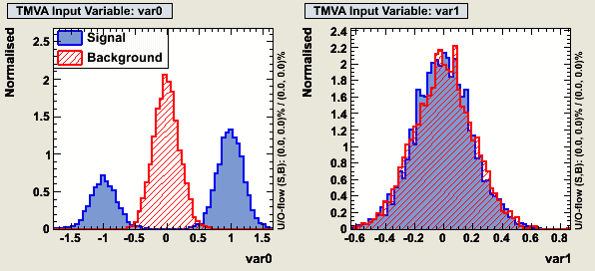
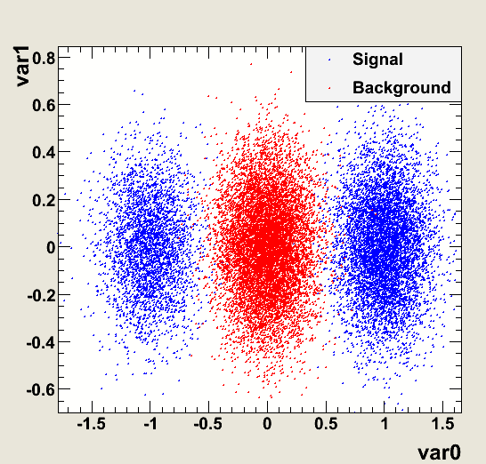
Boosted Decision Trees
var(i) > x
var(i) <= x
B
S
b)
a)
Two reasonable cuts:
a) Var0 > 0.5 → ε_{signal}=66% ε_{bkg} ≈ 0% misclassified events in total 16.5%
or
b) Var0 < -0.5 → ε_{signal}=33% ε_{bkg} ≈ 0% misclassified events in total 33%
the training of a single decision tree stump will find “cut a)”

Slide 19
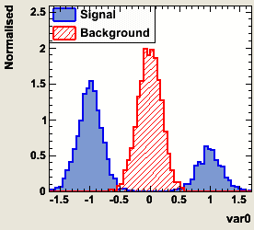
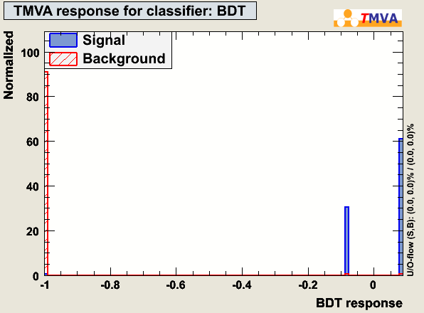
The first “tree”, choosing cut a) will give an error fraction: err = 0.165
➔ before building the next “tree”: weight wrong classified training events by ( 1-err/err) ) ≈ 5
➔ the next “tree” sees essentially the following data sample:
re-weight
.. and hence will chose: “cut b)”: Var0 < -0.5
a)
b)
var0(i)<a
var0(i)>=a
var0(i)>b
var0(i)<=b
-1
1
-1
1
X 1.65 + x 1.0
Slide adapted from H. Voss

Slide 20
Robust Real-time Object Detection
Paul Viola, Michael Jones
MERL, Compaq RL
Grenoble, France
2001

Slide 21
Viola-Jones face detection
Viola-Jones [Viola01] vastly improved face detection accuracy, yet runs in real-time
Discriminative modeling (face vs non-face)
Exploits two key strategies to run in real time:
simple, super-efficient features
pruning (cascaded classifiers)

Slide 22
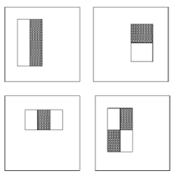
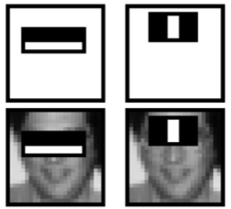
Viola & Jones features
Simple rectangular filters:
Filter just computes sum of pixels in white area, minus sum of pixels in black area.
22
K. Grauman, B. Leibe
Notes:
22

Slide 23
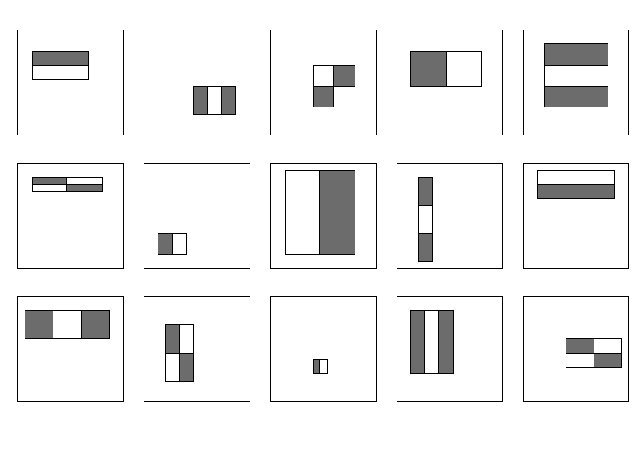
Large library of filters
Considering all possible filter parameters, position, scale, and type:
180,000+ possible features associated with each 24 x 24 window
Use AdaBoost both to select the informative features and to form the classifier
Notes:
23

Slide 24



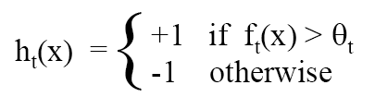



AdaBoost (Adaptive Boosting)
Want to select the single rectangle feature and threshold that best separates positive (faces) and negative (non-faces) training examples, in terms of weighted error.
Resulting weak classifier:
For next round, reweight the examples according to errors, choose another filter/threshold combo.
…
Outputs of a possible rectangle feature on faces and non-faces.
Notes:
24

Slide 25
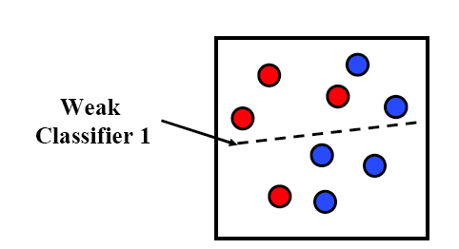
AdaBoost: Intuition
Consider a 2-d feature space with positive and negative examples.
Each weak classifier splits the training examples with at least 50% accuracy.
Examples misclassified by a previous weak learner are given more emphasis at future rounds.
Figure adapted from Freund and Schapire
25
Notes:
25

Slide 26
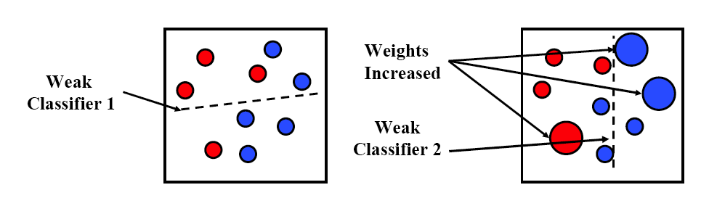
AdaBoost: Intuition
26
Notes:
26

Slide 27
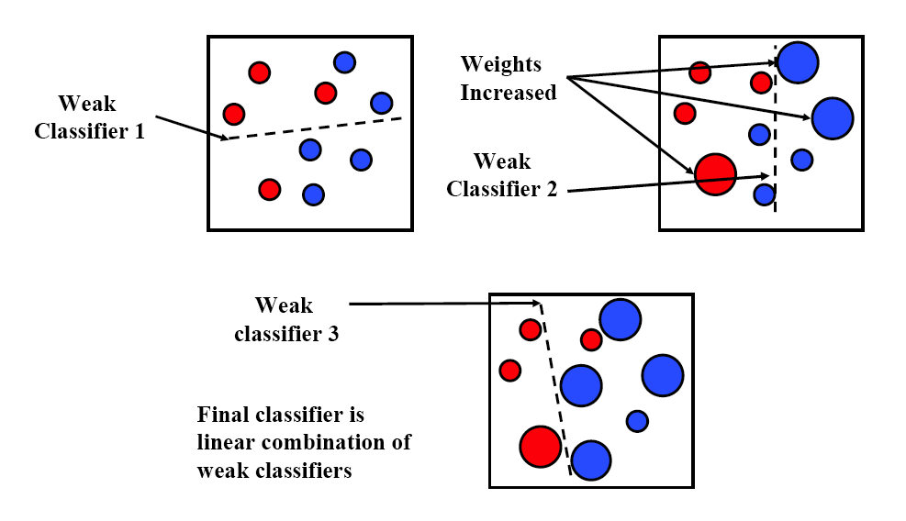
AdaBoost: Intuition
Final classifier is combination of the weak classifiers
27
Notes:
27

Slide 28
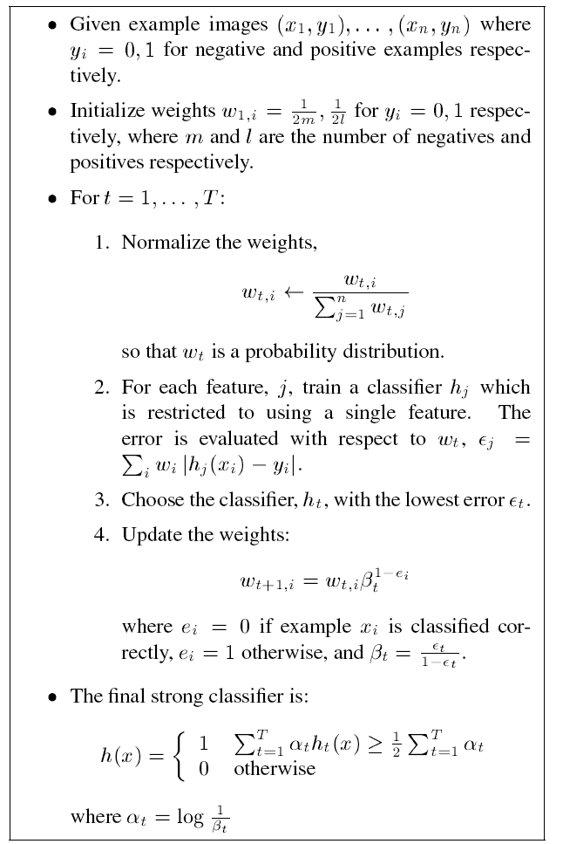
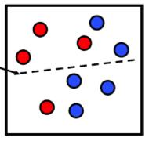
AdaBoost Algorithm
Start with uniform weights on training examples
{x₁,…x_{n}}
For T rounds
Evaluate weighted error for each feature, pick best.
Re-weight the examples:
Incorrectly classified -> more weight
Correctly classified -> less weight
Final classifier is combination of the weak ones, weighted according to error they had.
Freund & Schapire 1995
Notes:
28

Slide 29
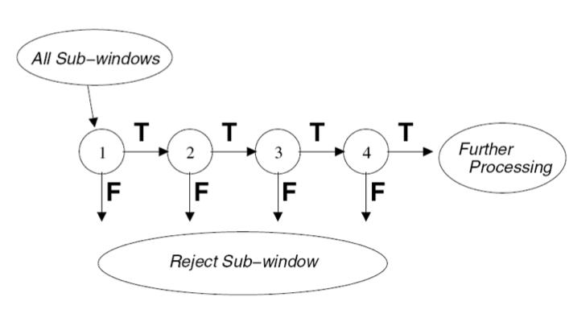
Cascading classifiers for detection
For efficiency, apply less accurate but faster classifiers first to immediately discard windows that are clearly negative; e.g.,
Filter for promising regions with an initial inexpensive classifier
Build a chain of classifiers, choosing cheap ones with low false negative rates early in the chain
29
Figure from Viola & Jones CVPR 2001
Notes:
29

Slide 30
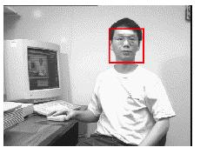
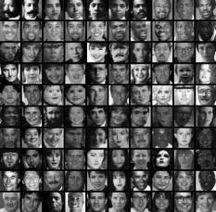
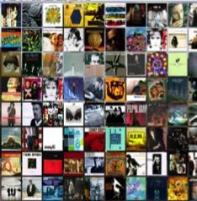
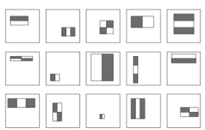
Viola-Jones : Summary
Train cascade of classifiers with AdaBoost
Apply to each subwindow
Faces
New image
Selected features, thresholds, and weights
Non-faces
Train with 5K positives, 350M negatives
Real-time detector using 38 layer cascade
6061 features in final layer
[Implementation available in OpenCV: http://www.intel.com/technology/computing/opencv/]
30
Notes:
30

Slide 31

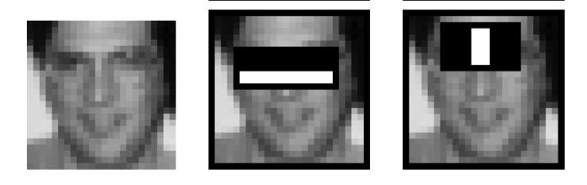
Viola-Jones Face Detector: Results
First two features selected
31
Notes:
31

Slide 32
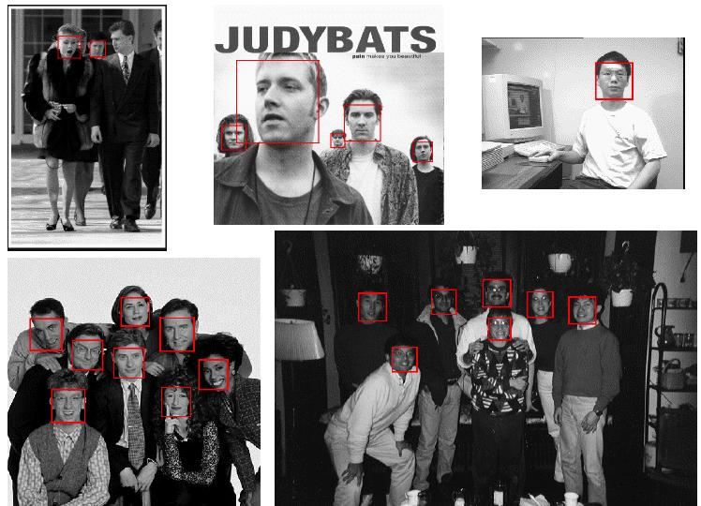
Viola-Jones Face Detector: Results
Notes:
32

Slide 33
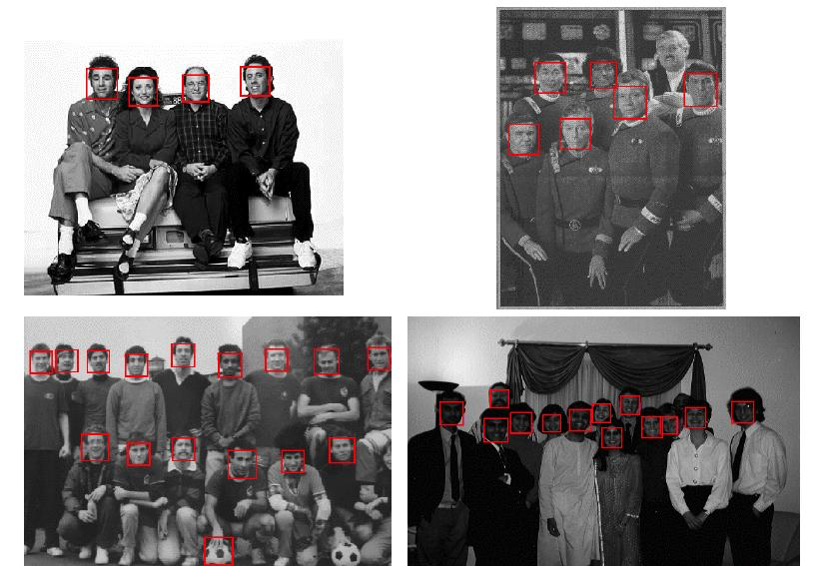
Viola-Jones Face Detector: Results
Notes:
33

Slide 34
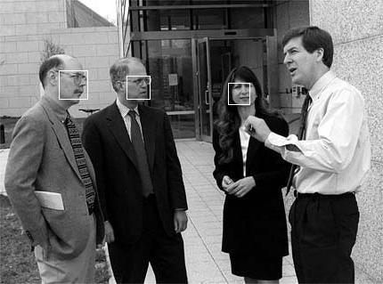
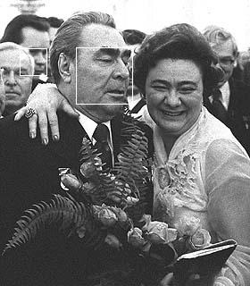
Viola-Jones Face Detector: Results

Slide 35
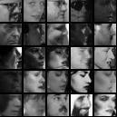
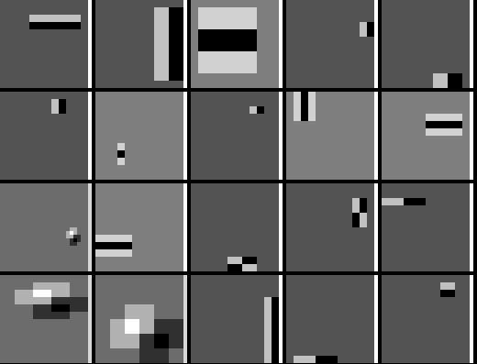
Detecting profile faces?
Detecting profile faces requires training separate detector with profile examples.

Slide 36
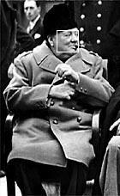
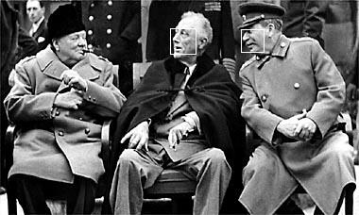
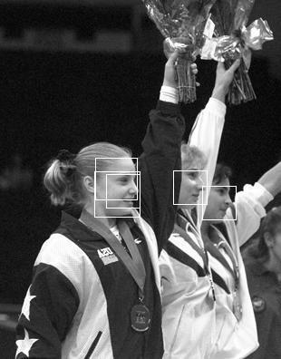
Viola-Jones Face Detector: Results
Paul Viola, ICCV tutorial

Slide 37
Real-Time Human Pose Recognition in Parts from Single Depth Images
Jamie Shotton, Andrew Fitzgibbon,
Mat Cook, Toby Sharp, Richard Moore, Alex Kipman, Andrew Blak

Slide 38
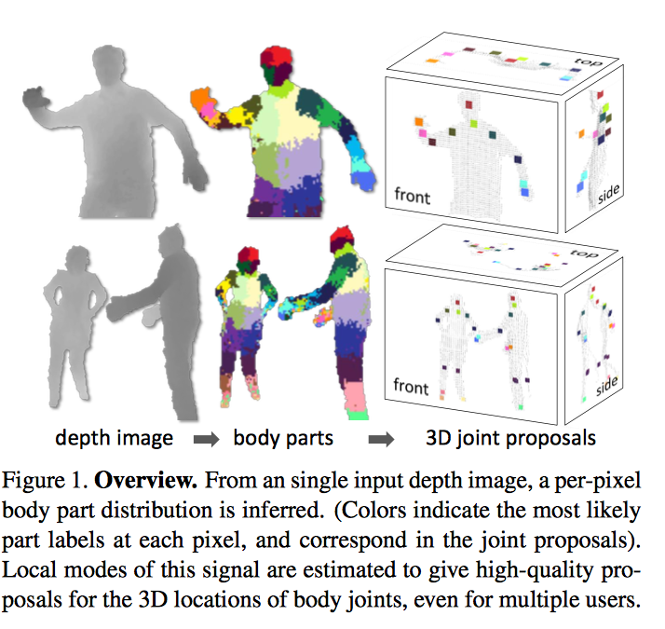

Slide 39
https://youtu.be/lntbRsi8lU8

Slide 40
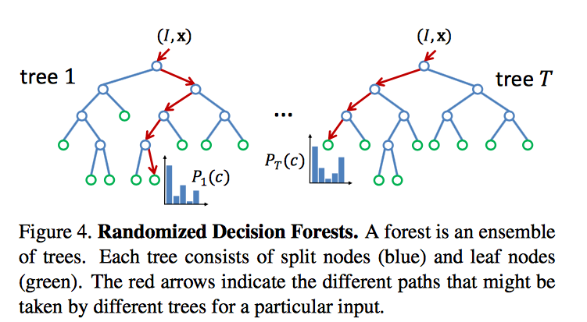
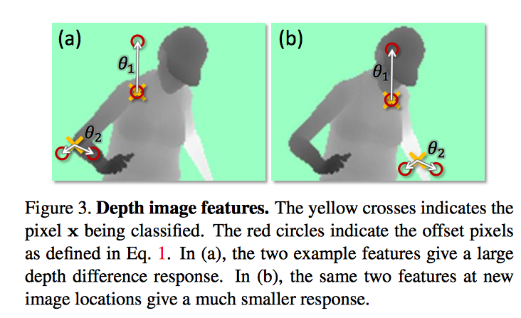
Random Decision Forests

