Slide 1
Learning under partial observations

Slide 2
Various Bayes learning tasks
Type of network
Bayes or Markov network
Assumptions about model
May have graph structure but need to learn parameters
May need to learn graph structure and parameters
May need to learn graph, parameters, and variables
Observability of variables
Completely observable: exemplars include known values for all variables
Partially observable: values of some variables are unknown in some exemplars
Hidden or latent variables: values of some variables are never observed

Slide 3
Structure Learning
So far we’ve assumed a BN structure, which assumes we have enough domain knowledge to declare strict independence relationships
Problem: how to learn a sparse probabilistic model whose structure is unknown?

Slide 4
Bayesian Structure Learning
Are Earthquake and Burglar independent?
P(E,B) = P(E)P(B)?
B | E
0 | 0
1 | 1
0 | 1
1 | 0
… | …
?
Earthquake
Burglar
Adapted from K. Hauser’s slide

Slide 5
Bayesian Structure Learning
Hypothesis 1: dependent
P(E,B) as a probability table has 3 free parameters
Hypothesis 2: independent
Individual tables P(E),P(B) have 2 total free parameters
Maximum likelihood will always prefer hypothesis 1!
B | E
0 | 0
1 | 1
0 | 1
1 | 0
… | …
Earthquake
Burglar
Adapted from K. Hauser’s slide

Slide 6
Bayesian Structure Learning
Occam’s razor: Prefer simpler explanations
Penalize free parameters in probability tables
B | E
0 | 0
1 | 1
0 | 1
1 | 0
… | …
Earthquake
Burglar
Adapted from K. Hauser’s slide

Slide 7
Iterative Greedy Algorithm
Fit a simple model (ML), compute likelihood
Repeat:
B | E
0 | 0
1 | 1
0 | 1
1 | 0
… | …
Earthquake
Burglar
Adapted from K. Hauser’s slide

Slide 8
Iterative Greedy Algorithm
Fit a simple model (ML), compute likelihood
Repeat:
Pick a candidate edge to add to the BN
B | E
0 | 0
1 | 1
0 | 1
1 | 0
… | …
Earthquake
Burglar
Adapted from K. Hauser’s slide

Slide 9
Iterative Greedy Algorithm
Fit a simple model (ML), compute likelihood
Repeat:
Pick a candidate edge to add to the BN
Compute new ML probabilities
B | E
0 | 0
1 | 1
0 | 1
1 | 0
… | …
Earthquake
Burglar
Adapted from K. Hauser’s slide

Slide 10
Iterative Greedy Algorithm
Fit a simple model (ML), compute likelihood
Repeat:
Pick a candidate edge to add to the BN
Compute new ML probabilities
If new likelihood exceeds old likelihood + threshold,
Add the edge
Otherwise, repeat with a different edge
B | E
0 | 0
1 | 1
0 | 1
1 | 0
… | …
Earthquake
Burglar
Adapted from K. Hauser’s slide

Slide 11
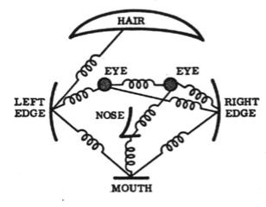




Deformable part models
Idea: Model local part appearances, and spatial relationships between parts
Model with parts
Object configuration
Goal: given image , find configurations that maximize
If part appearances are independent, from Bayes’ law,
[Fischler73]
How well does configuration fit spatial model?
How well does part location fit local image data?

Slide 12
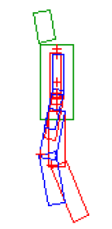
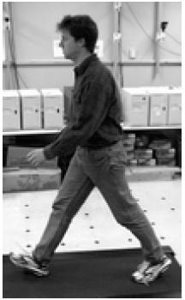
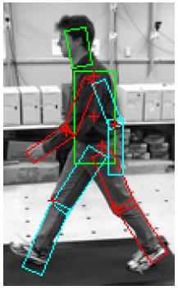
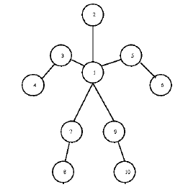
Flexible Models for Human Pose
Part relationships of human body modeled as a tree
Rigid parts connected by joints
Limbs undergo relative rotation and scaling
Augment configuration space of each part with these 2 extra dimensions; part configuration is now (x,y,θ,s)

Slide 13
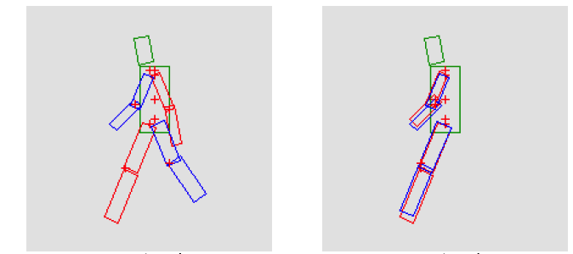
Limitations of Trees
Only represent relationships between connected parts
Other constraints (e.g. coordination between limbs, gravity constraints) cannot be encoded
Equally good under tree model

Slide 14
One approach: MAP vs Sampling
We saw how to maximize
Finds the single best object configuration in an image
We also so how to sample from
Generate many of high-likelihood configurations
Then evaluate the configurations according to some other, external criterion (that can’t be captured in the tree model)
MAP solution
Samples
P(L|I)
P(L|I)
L
(visualized here in 1 dim – actually has high dimensionality)
L

Slide 15
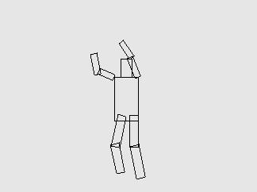
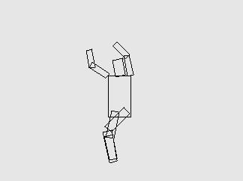
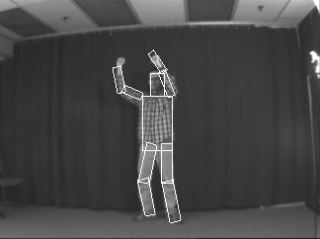
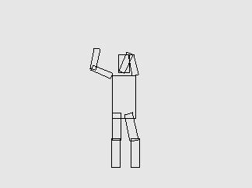
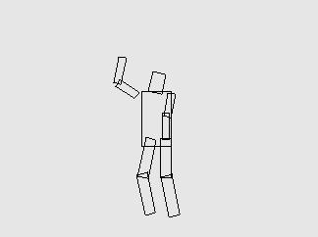
Sampling limb configurations

Slide 16
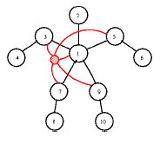
Alternative: Add a latent variable [Lan05]
Augment tree with additional latent variables
Latent variables can encode high-level information like global pose: e.g. “sitting” vs. “standing”

Slide 17
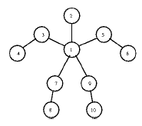
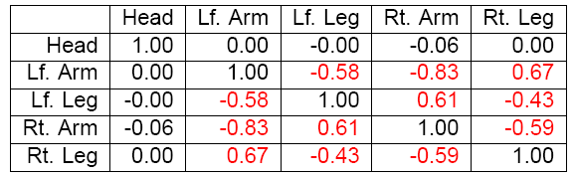
Identify Violations of Tree Model
Tree model assumes conditional independence
Parts with common “parent” should have uncorrelated locations given location of parent
Compute actual correlation between these parts
Non-zero entries indicate correlation not explained by model

Slide 18
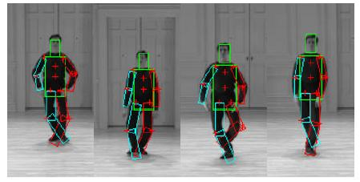
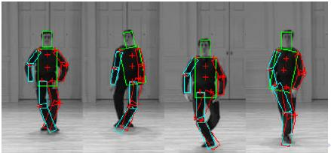
Examples
Factor model
Tree model
[Lan05]

Slide 19
Various learning tasks
Type of network
Bayes or Markov network
Assumptions about model
May have graph structure but need to learn parameters
May need to learn graph structure and parameters
May need to learn graph, parameters, and variables
Observability of variables
Completely observable: exemplars include known values for all variables
Partially observable: values of some variables are unknown in some exemplars
Hidden or latent variables: values of some variables are never observed

Slide 20
Learning with unobserved variables
So far, we’ve assumed that our exemplars for learning include values for all variables
What if we can’t observe all variables?

Slide 21
A chicken and egg problem!
If we knew the model θ, then we could guess the missing values in D
Or marginalize them out
If we knew the unknown values of D, then we could estimate the model θ

Slide 22
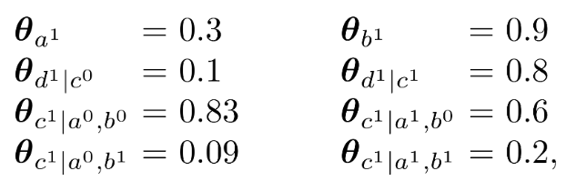
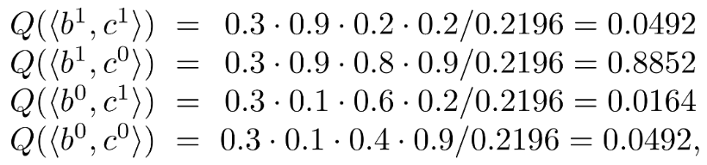
One approach
Estimate an initial model, and then compute distributions over unknown variable values
E.g. Initial model:
For exemplar o=(a1, ?, ?, d0), compute P(B,C|o, θ):

Slide 23
One approach
Given this distribution over unknown variables:
Pretend as though we had four exemplars for the single exemplar (a1, ?, ?, d0)
Each one weighted by the corresponding probability above
Then re-estimate θ using these new exemplars

Slide 24
Expectation-Maximization
EM is a general technique for learning when some variables are not observable
Consists of two steps, run iteratively:
E Step: Use current parameter estimates θ^{t} to compute expected (“virtual”) counts for the number of samples having some property
(i.e., compute marginals over unknown variables given known variables and current model estimate)
M Step: Use Maximum Likelihood to estimate new parameters, θ^{t+1}, given these virtual counts

Slide 25
Properties of EM
Running time
The M-step is easy – just arithmetic!
The E-step could be quite difficult; Need to do inference for each exemplar, in each iteration of EM
Convergence
In each step, EM is guaranteed to increase the likelihood of the parameters
Thus EM will converge to at least a local maximum
Choice of initial parameter estimates is often critical

Slide 26
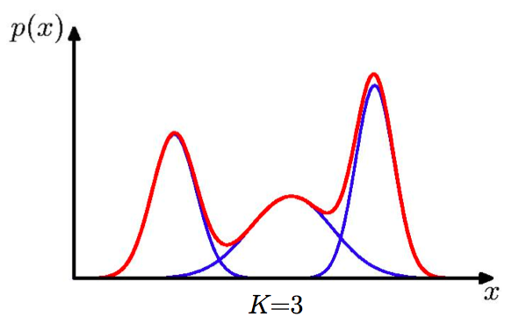
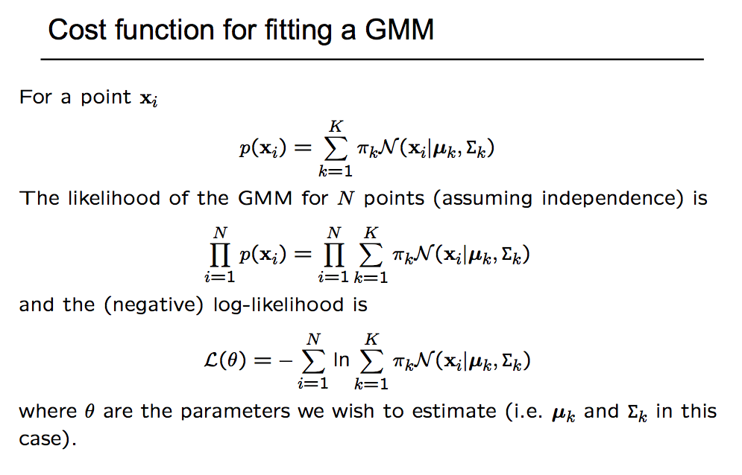
Example: Gaussian Mixture Model
Useful for data that can be modeled by sum of a small number of Gaussians,
How to learn parameters from training data with MLE?

Slide 27
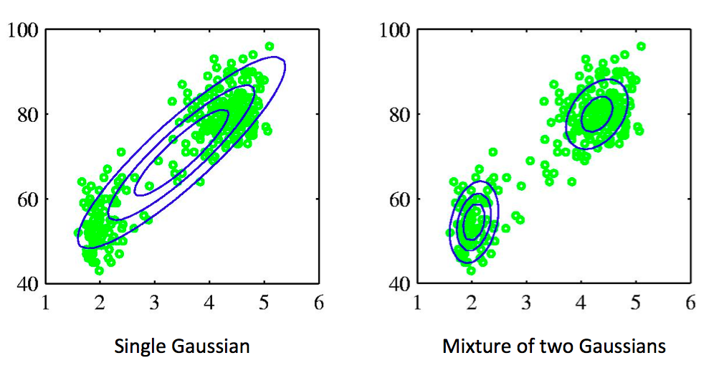
Multivariate case
Slide adapted from A. Zisserman

Slide 28
Example: Gaussian Mixture Model
Useful for data that can be modeled by sum of a small number of Gaussians,
How to learn parameters from training data with MLE?

Slide 29
C. Bishop

Slide 30
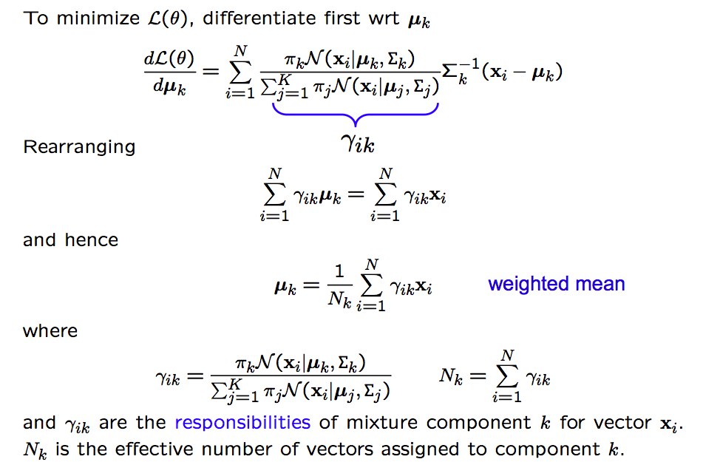
C. Bishop

Slide 31
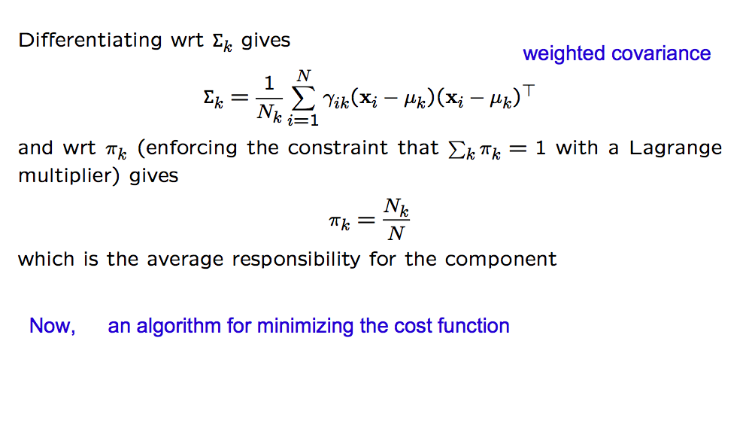
C. Bishop

Slide 32
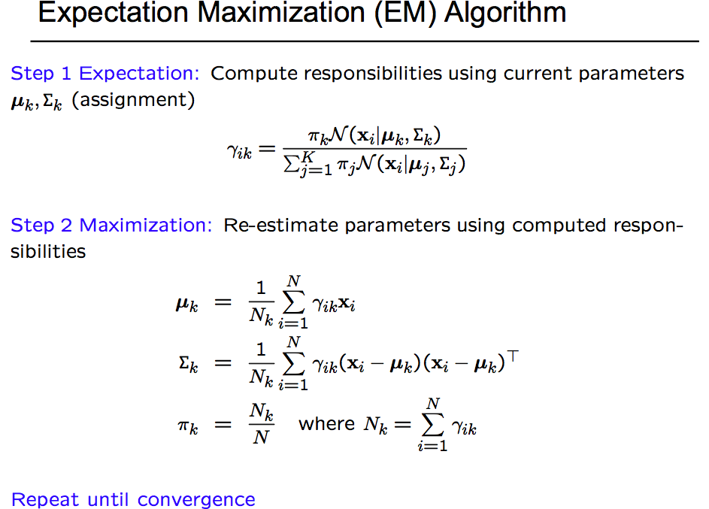
C. Bishop

Slide 33
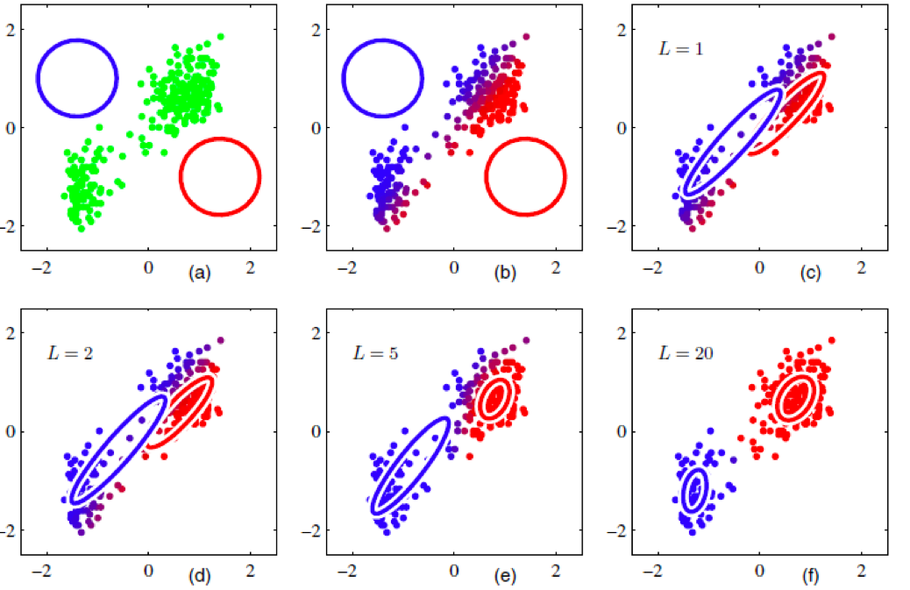
C. Bishop

Slide 34
Practical issues
How to initialize models?
How to choose K?
Will it converge?

Slide 35
Hard EM
Hard EM (or MAP-EM or Max-EM) computes a MAP estimate of missing latent variables
Instead of computing a marginal distribution
Example: k-means clustering
E-step: Assign each cluster to the nearest centroid (aka highest probability one for a Gaussian of unit variance)
M-step: Estimate new centroid for set of points in each assigned cluster

Slide 36






Part-based deformable models
Idea: Model local part appearances, and spatial relationships between parts
Model with parts
[Fischler73]
Object configuration
Goal: given image , find configurations that maximize
If part appearances are independent, from Baye’s law,
How well does configuration fit spatial model?
How well does part location fit local image data?

Slide 37




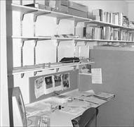
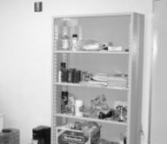
Learning object models
Fully-supervised (e.g. [FH05], [CFH05])
Given part configuration in each training image
Partially-supervised (e.g. [Dalal05], [FMR08])
Given object bounding boxes
Weakly-supervised (e.g. [Fergus03], [Winn05], [Amit07])
Given presence/absence flag for each image
…
…
…
…
…
…

Slide 38

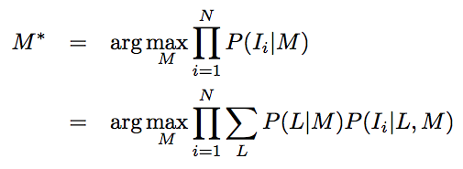
Weakly-supervised learning for k-fans
Goal: learn appearance and spatial models simultaneously
Given set of positive training images , find model M*:
We approximate this using Expectation-Maximization
Hill-climbing approximation
In iteration t+1, maximize expectation of the posterior, computed using last estimate of the model M^{t}
Requires an initial estimate of the model, M⁰
In D. Crandall and D. Huttenlocher, “Weakly-supervised learning of part-based spatial models for visual object class recognition”, ECCV 2006.

Slide 39

Weakly-supervised learning
Need to learn an initial estimate of model, M⁰
Step 1: Generate candidate appearance operators
Randomly sample many (~10,000) patches from training images

Slide 40
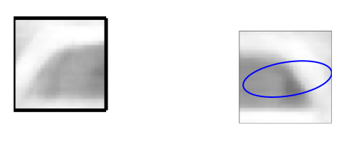

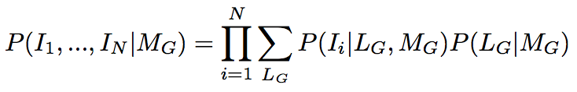
Weakly-supervised learning
Step 2: Score candidate pairs
Idea: patches may be poor individually but valuable together
For each candidate pair G, learn a Gaussian spatial model on relative part configuration
Then score each candidate pair individually,
For general k, candidate k+1-cliques instead of pairs

Slide 41
Weakly-supervised learning
Step 3: Build initial k-fan model
Consider all possible reference sets
For each reference set R, greedily add cliques containing R
Choose R whose model maximizes likelihood of the training data

Slide 42
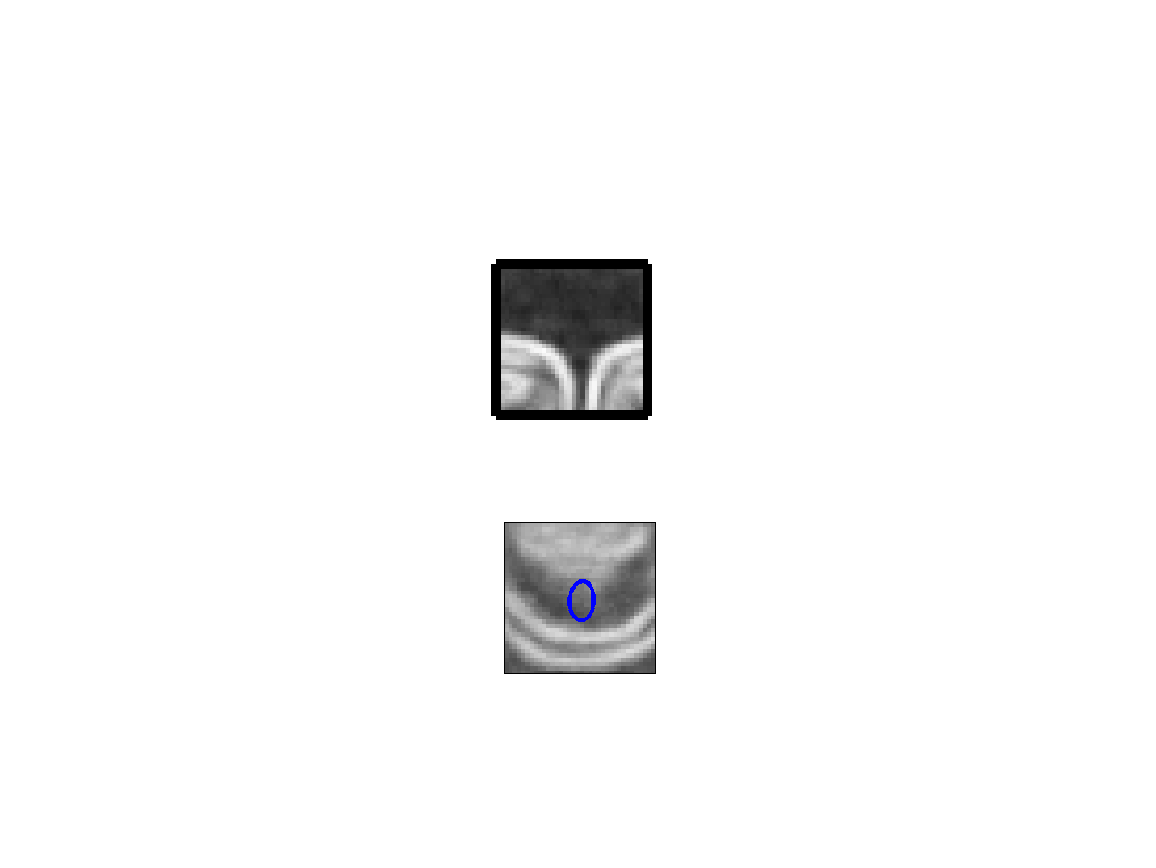
Weakly-supervised learning
Step 3: Build initial k-fan model
Consider all possible reference sets
For each reference set R, greedily add cliques containing R
Choose R whose model maximizes likelihood of the training data

Slide 43
Weakly-supervised learning
Step 3: Build initial k-fan model
Consider all possible reference sets
For each reference set R, greedily add cliques containing R
Choose R whose model maximizes likelihood of the training data

Slide 44
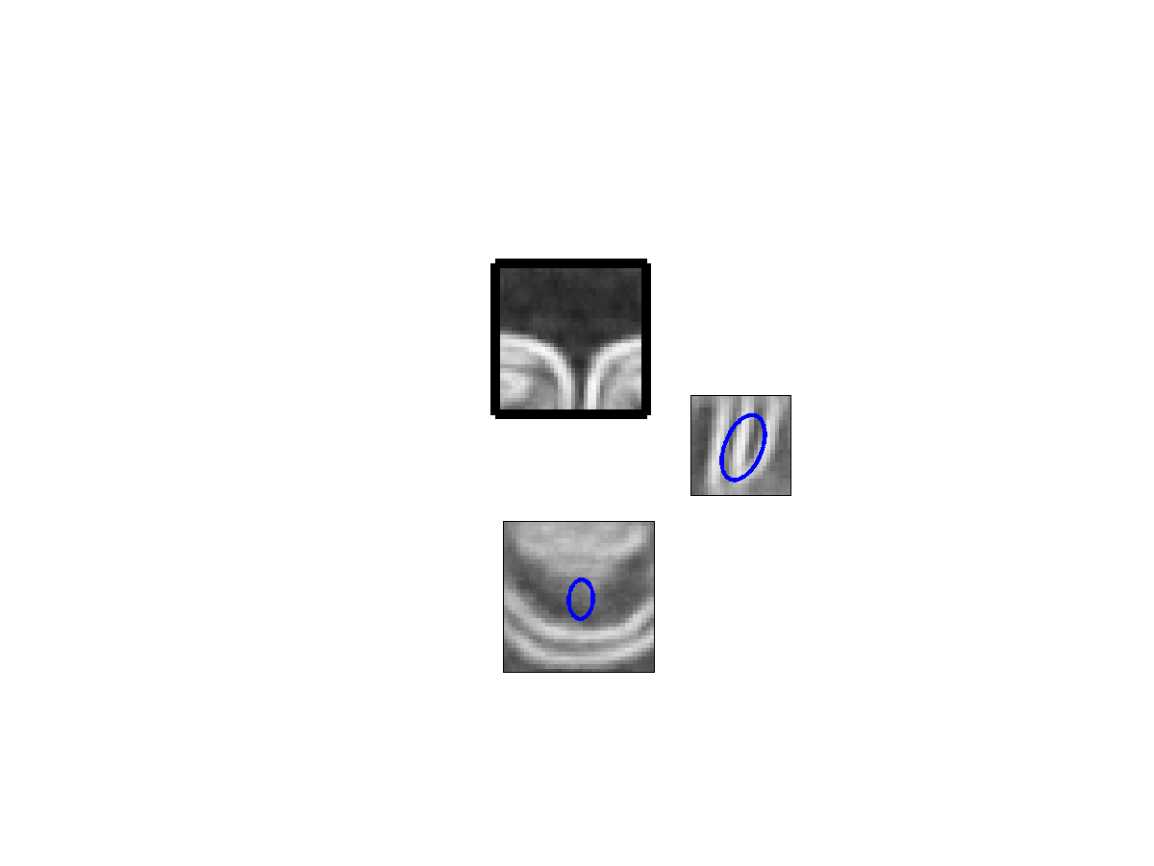
Weakly-supervised learning
Step 3: Build initial k-fan model
Consider all possible reference sets
For each reference set R, greedily add cliques containing R
Choose R whose model maximizes likelihood of the training data

Slide 45
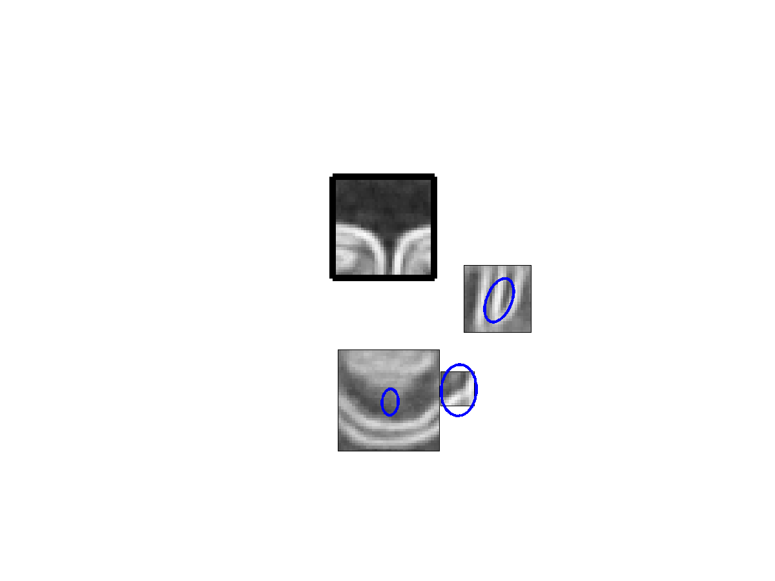
Weakly-supervised learning
Step 3: Build initial k-fan model
Consider all possible reference sets
For each reference set R, greedily add cliques containing R
Choose R whose model maximizes likelihood of the training data

Slide 46
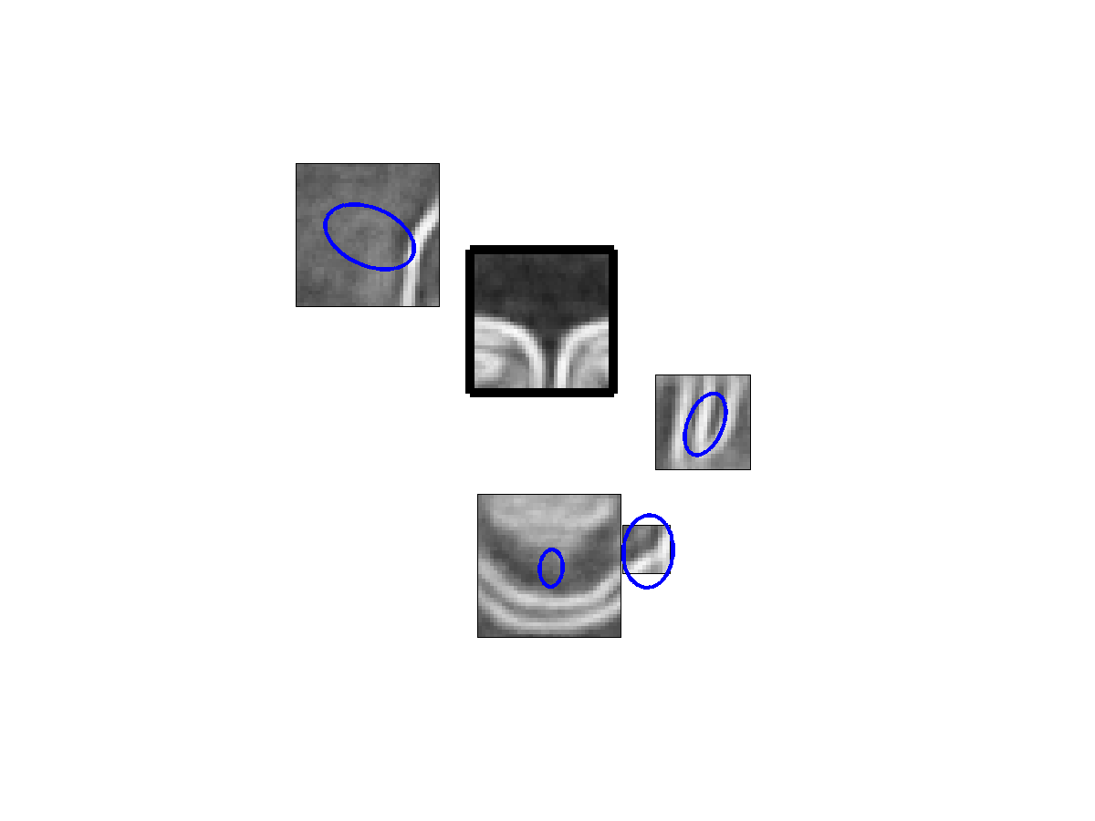
Weakly-supervised learning
Step 3: Build initial k-fan model
Consider all possible reference sets
For each reference set R, greedily add cliques containing R
Choose R whose model maximizes likelihood of the training data

Slide 47
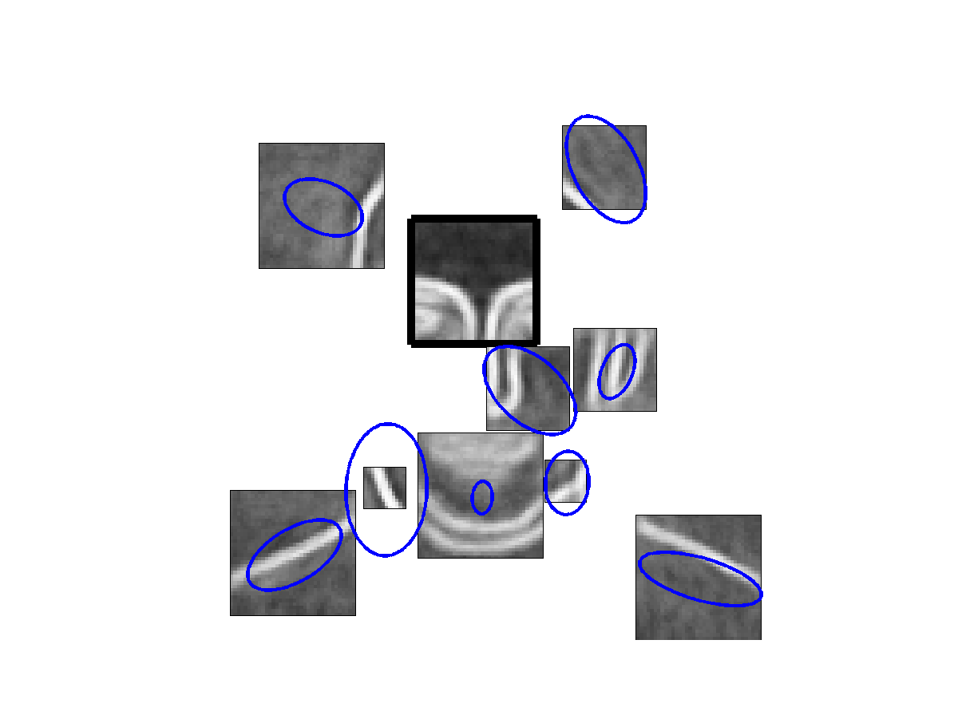
Weakly-supervised learning
Step 3: Build initial k-fan model
Consider all possible reference sets
For each reference set R, greedily add cliques containing R
Choose R whose model maximizes likelihood of the training data

Slide 48
Weakly-supervised learning
Step 4: Expectation-Maximization
Use an EM-like procedure to refine model
1. Holding model constant, do localization on training data
2. Given localizations, re-estimate appearance and spatial models
Typically converges in <10 iterations
In practice, some approximations are used
Sampling
Pruning low-probability candidate patches and cliques

Slide 49
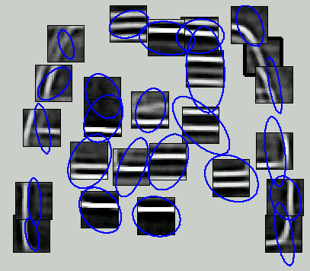
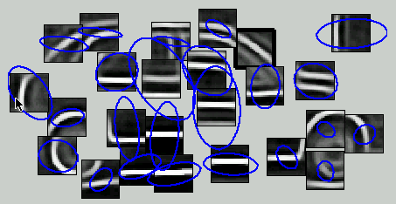
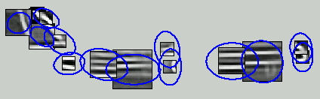
Some learned object models

Slide 50
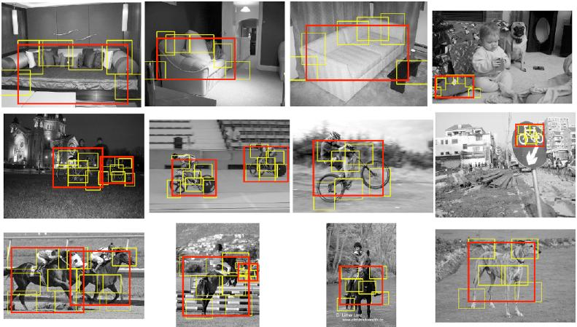
Examples [FMR08]

