Slide 1
Similarity Dependency Dirichlet Process for Aspect Based Sentiment Analysis
Presenter: Wanying Ding
Drexel University
Notes:
Let’s get started.
Thank you for coming
My name is Wanying Ding, a 2nd year PhD student from Drexel University. It’s my honor today to present our work here.
Our work is about “Similarity Dependency Dirichlet Process for Aspect Based Sentiment Analysis”.
If you have any questions in my presentation, I’ll be very happy to answer them as we go along

Slide 2
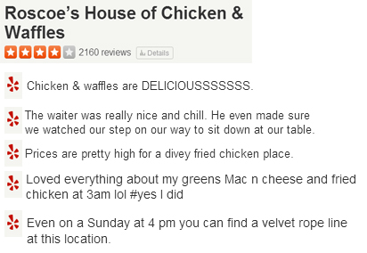
The Big Picture: Why do We Need Sentiment Analysis
Sentiment Analysis could help to recommend most helpful reviews to end user.
Figure 1. Reviews about a Restaurant
from Yelp
Figure 2. Sentiment Analysis Result
Notes:
Our topic is about “Sentiment Analysis”, so the very first and important question is “Why do we need Sentiment Analysis?” and “What is its relationship to Recommendation System?”
As we known, social media has provided an open platform for users to exchange opinions online. Take reviews as an example, websites like Amazon and Yelp will publish millions of reviews one day. Online reviews, on one hand are becoming indispensable in people’s daily life, because people need to rely on these reviews to make their decisions, but on the other hand, the profusely growing reviews require users to spend hours going through them.
This is a restaurant example from Yelp. As it is shown, this restaurant has 2160 reviews in total. It will be very time and energy consuming if one wants to seek useful information from so many reviews. A proper sentiment analysis system could help to transform the review list in Figure1 to the graph in Figure2, it will help a lot. In Figure 2, it is very clear that this restaurant has a very good Food, Service and Atmosphere, but a higher price. For end users, this information will be helpful for his final decision make, and for a recommendation system, it will facilitate a better recommendation result.

Slide 3
Related Work
Carbonell,J(1979), Wilks(1984)
Linguistic Analysis
Machine Learning
Method
Granularity
Supervised
Unsupervised
Document
Sentence
Entity(Aspect)
Bayesian
Maximum Entropy
SVM
Probabilistic Model(LDA)
Where we are
Notes:
Actually, sentiment analysis has been long researched.
Carbonell and Wilks firstly tried to unfold the subjectivity from messages, and their works inspired a lot of successors to follow up. But in the early days, researchers tended to conduct explanatory studies from linguistics or psychology perspectives.
Since about 2000, the developed Internet has marked the new beginning of widespread awareness of this research problem. Supervised methods were widely applied and laid a solid foundation. However, the requirement of training dataset has presented a challege for related works, since more and more data are appearing as unlabeled, and labelling these data is very laborious. Thus, unsupervised methods are becoming more and more acctractive because of its label-free and flexible in use.

Slide 4
Foundation Mechanism
Latent Dirichlet Allocation(LDA)
Pro:
Training Data Free.
Efficient in Aspect(Topic) and Sentiment Detection
Con:
LDA require a pre-defined number of aspects.
Hierarchical Dirichlet Process (HDP)
Notes:
The birth of LDA has inspired a lot of researchers in adapting and implementing in Sentiment Analysis. LDA extended models inherit both LDA’s advantage and disadvantages.
Speaking of advantages, LDA extended models are all training data free, and efficient in aspect and sentiment discovery.
The disadvantage us that they require users to decide the number of aspects beforehand. Such decisions are hard to make, especially when one has little knowledge about the dataset at hand.
Although it is possible to repeatedly check the perplexity values to find the optimal aspect number, it has a major practical limitation in use, because it requires a large number of trails and errors.
In this situtaion, HDP comes to rescue.

Slide 5
Hierarchical Dirichlet Process
DP(Dirichlet Process)
DP(Dirichlet Process): Replacing the static Dirichlet allocation in LDA with dynamic Dirichlet process.
HDP: Hierarchical Dirichlet Process
CRP(Chinese Restaurant Process):
A perspective to explain HDP
Document: restaurant
Word: Customer
Local Word Group: Table
Topic: Dish.
Aspect/Topic Discovery → Dish Assignment
Notes:
This slice gives a brief view about HDP.
Firstly, let’s talk about DP. DP is the abbreviation of Dirichlet Process. DP has replaced the static Dirichlet Allocation in LDA with dynamic Dirichlet process, and thus realize dynamic aspect number generation.
HDP is actually composed of multiple levels of DP.
Actually there are many different perspectives to describe a HDP, and the most understandable one is the Chinese Restaurant Process(CRP).
In CRP, we deem a document as a restaurant, a word as a customer, a local word group as a table and a topic as a dish. Thus the aspect or topic discovery process has been converted as a dish assignment process.

Slide 6
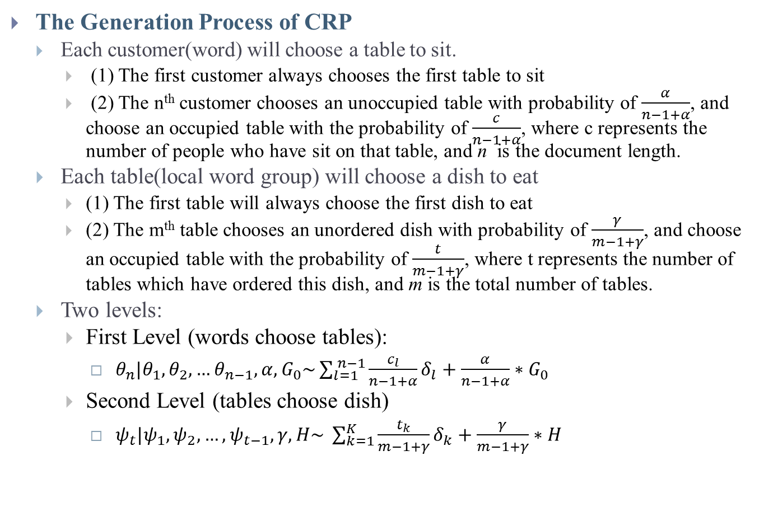
Hierarchical Dirichlet Process
The Generation Process of CRP
Each customer(word) will choose a table to sit.
(1) The first customer always chooses the first table to sit
(2) The n^{th} customer chooses an unoccupied table with probability of $\frac{α}{n−1+α}$, and choose an occupied table with the probability of $\frac{c}{n−1+α}$, where c represents the number of people who have sit on that table, and n is the document length.
Each table(local word group) will choose a dish to eat
(1) The first table will always choose the first dish to eat
(2) The m^{th} table chooses an unordered dish with probability of $\frac{γ}{m−1+γ}$, and choose an occupied table with the probability of $\frac{t}{m−1+γ}$, where t represents the number of tables which have ordered this dish, and m is the total number of tables.
Two levels:
First Level (words choose tables):
${ θ}_{n}|θ_{1},θ_{2},…θ_{n−1},α,G_{0}\sim \sum_{l=1}^{ n−1}{\frac{c_{l}}{n−1+α}δ_{l}+\frac{α}{n−1+α}∗G_{0} }$
Second Level (tables choose dish)
${ ψ}_{t}|ψ_{1},ψ_{2},…,ψ_{t−1},γ,H\sim \sum_{k=1}^{K}{\frac{t_{k}}{m−1+γ}}δ_{k}+\frac{γ}{m−1+γ}∗H$
Notes:
The generative process of CRP can be described as this:
The first customer will always choose the first table to sit, and the following customers will have two choices. First, it may choose to sit an unoccupied table with the probability of …, and then a new table will be created. or choose an occupied table with the probability with ….
Similarly, when table assignment has been settled, different tables will choose dishes to eat. The first table will always choose the first dish to eat, the following tables will have choices. It can create a new dish to eat, with probability of $\frac{γ}{m−1+γ}$ or choose an existing dish to eat.
After these two steps, we can discover topics or aspects from the data set. Mathmatically, the two steps can be written as these formations.

Slide 7
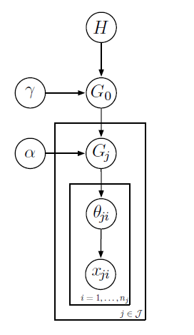
Hierarchical Dirichlet Process
Graphical Model
Notes:
This slice shows the graphical model of HDP, which we will adapt in the later part.
According to a generative process, this graphical model can be understood as:
Assume we need to write a list of reviews, and the first thing we need to consider is how many topics should we use, and how these topics distribute. For example, for a restaurant review list, we might decide that maybe there should be 6 topics, and food should dominate, and the second is service. But, in the meanwhile, we might find 6 topics are not enough or too many to describe all the aspects about a restaurant, we still have chance to add or remove topics. This process is controlled by H.
We use H to generate the topic distribution among all the review list, this distribution is called G0. Now, we need to focus on one review, so we need to decide the specific topic distribution for this specific review. Although, food might dominate in the whole review list, for a specific review, it still have chance to focus on service. Thus, we generate a specific topic distribution Gj from G0.
The rest part is much similar to LDA now. Once we have dicide the topic distribution of a review, for each word position, we need to decide what the specific topic for this position. Theta is geneated from Gj to decide the topic distribution for a specific word position, and then form theta, we can generate the specific word.
This is the whole workflow of HDP.

Slide 8
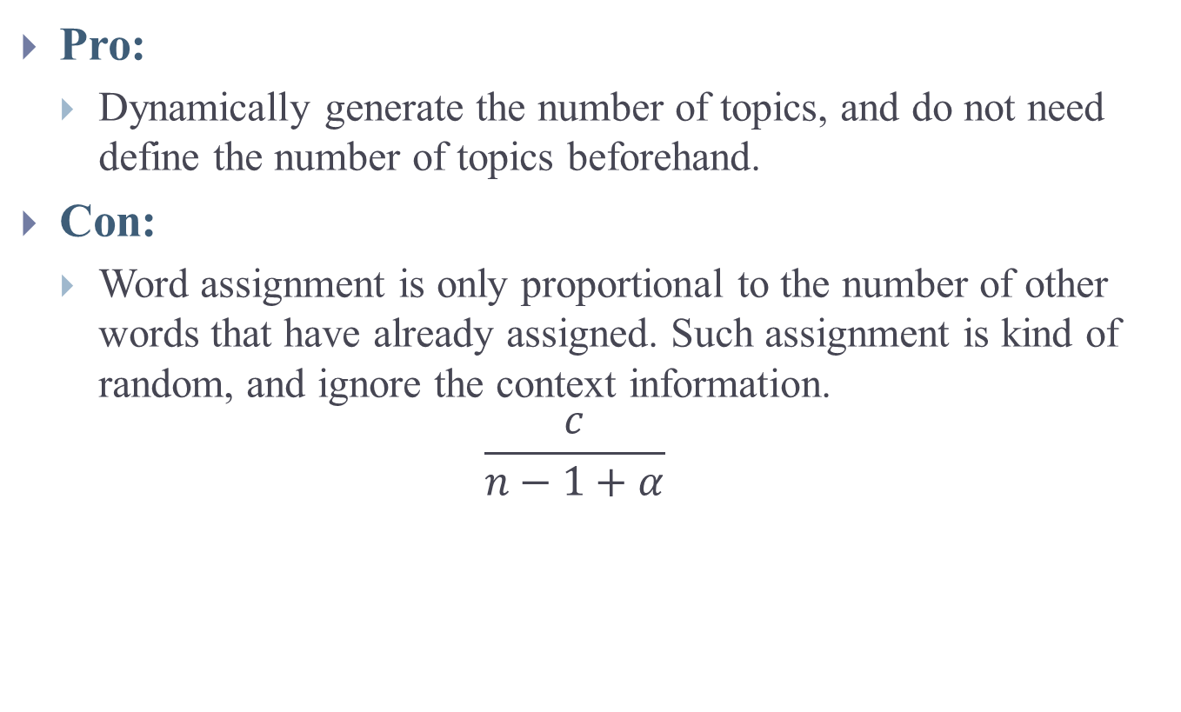
Hierarchical Dirichlet Process
Pro:
Dynamically generate the number of topics, and do not need define the number of topics beforehand.
Con:
Word assignment is only proportional to the number of other words that have already assigned. Such assignment is kind of random, and ignore the context information.
$$\frac{c}{n−1+α}$$
Notes:
The advantage of HDP is that it can dynamically generate the number of topics.
But its shortcoming is that it ignores the context information.
Actually, LDA’s success partly roots from its exploitation of words’ co-occurrence information. While HDP overlooks such information by implementing the private theta. Word assignment in HDP is only proportional to the number of words that have already assigned. Such assignment is kind of random, undermine the accuracy of this model.

Slide 9
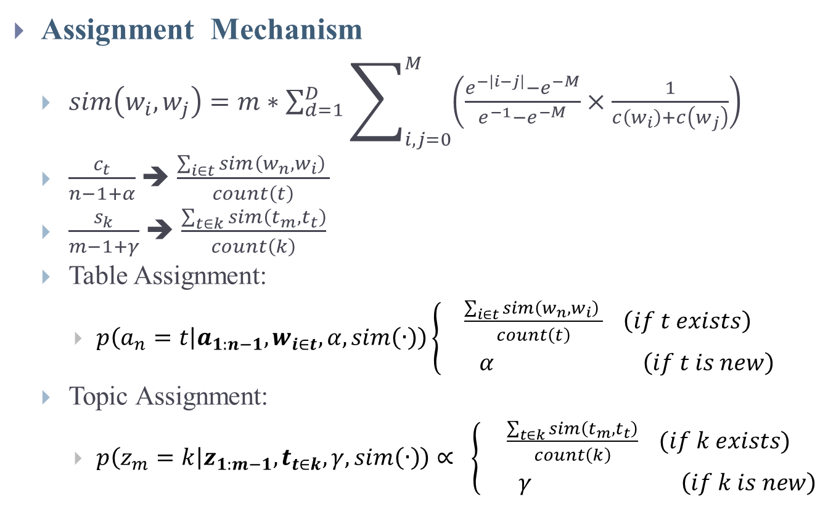
Similarity Dependency Dirichlet Process(SDDP)
Assignment Mechanism
$sim\left(w_{i},w_{j}\right)=m∗\sum_{d=1}^{D}{\sum_{i,j=0}^{M}{\left(\frac{e^{−\left|i−j\right|}−e^{−M}}{e^{−1}−e^{−M}}×\frac{1}{c\left(w_{i}\right)+c\left(w_{j}\right)}\right)}}$
$\frac{c_{t}}{n−1+α}$➔ $\frac{\sum_{i∈t}{sim\left(w_{n},w_{i}\right) }}{count\left(t\right)}$
$\frac{s_{k}}{m−1+γ}$➔ $\frac{\sum_{t∈k}{sim\left(t_{m},t_{t}\right)}}{count\left(k\right)}$
Table Assignment:
$p\left(a_{n}=t | a_{1:n−1},w_{i∈t},α,sim\left(∙\right)\right)\left\{\begin{aligned}\frac{\sum_{i∈t}{sim\left(w_{n},w_{i}\right) }}{count\left(t\right)} \left(if t exists\right) \\ α \left(if t is new\right)\end{aligned}\right.$
Topic Assignment:
$p\left(z_{m}=k | z_{1:m−1},t_{t∈k},γ,sim\left(∙\right)\right)∝ \left\{\begin{aligned}\frac{\sum_{t∈k}{sim\left(t_{m},t_{t}\right)}}{count\left(k\right)} (if k exists) \\ γ \left(if k is new\right)\end{aligned}\right.$
Notes:
Thus, this paper has proposed a Semantic Dependency Dirichlet Process (SDDP) as the foundational framework for sentiment analysis.
In SDDP, we replace the random count assignment mechanism with the one based on similarity.
According to our understanding, there are two ways to reflect two words’ similarity: word co-occurrence and word distance. The more two words co-occur, or close to each other, the more possible these two words describe the same thing.
We use this function to calculate two words’ similarity. The first part is used to describe two words’ distance within a document, and because co-occurrence information has already embed in word’s distance mechanism, the second part is just used to normalize.
A larger sim value indicate a higher probability these two words are similar.
Thus ,we adapt the assignment mechanism as this.

Slide 10
Two Logistics in Sentiment Analysis
Word Model
Phrase Model
Word Model: relies on “bag of word” assumption
(1) Pure Word Model: A word simultaneously conveys both aspect and sentiment.
JST, ASUM
(2) Mixture Word Model: Noun word conveys aspect and Adjective word conveys sentiment.
JAS, MaxEntLDA
Phrase Model: relies on “bag of phrase” assumption
Documents need to be pre-processed as phrases series like <head word, modifier word> . The head word is used to infer aspect and sentiment word is used to infer sentiment.
Notes:
OK, we just finish the foundation statistical framework. Now, let’s take a look at Sentiment analysis models.
Generally speaking, there are two logistics in sentiment analysis models. One is the word model, and the other is the phrase model.
Word model relies on the “Bag of Word" assumption, which Phrase model relies on the “Bag of Phrase” assumption.
Specially the word model consists of Pure Word Model and Mixture Model.
Pure Word Model assume a word simultaneously conveys both aspect and sentiment information, models like JST and ASUM belong to this class.
Mixture Word Model distinguish the words into two classes, one is used to infer the aspect and one is used to infer sentiment. In most cases, noun words are used to for aspect inference, and adjective words are used for sentiment inference.
Phrase model needs more data pre-process. Documents need to be process into a list of phrases, like <head word, modifier word>. The head word is used to infer aspect, and the modifier word is used to infer sentiment.
As we see, Mixture Word Model is kind of like Phrase Model. In order to make a contrast comparison, we implement Pure Word Model and Phrase Model in our later work and discuss.

Slide 11
Two Models
Based on SDDP, we build two models, one Word Model and one Phrase Model.
Word Model: W-SDDP
Implement the Pure Word Model Framework
Phrase Model: P-SDDP
Implement the Phrase Model Framework
Notes:
Thus, we construct two models based on our SDDP framework. A word model W-SDDP, and a phrase model P-SDDP

Slide 12
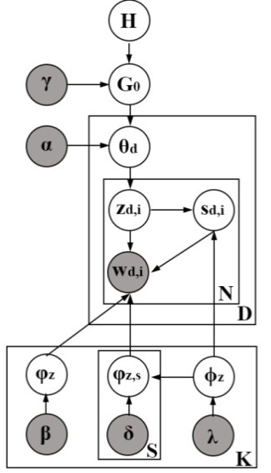
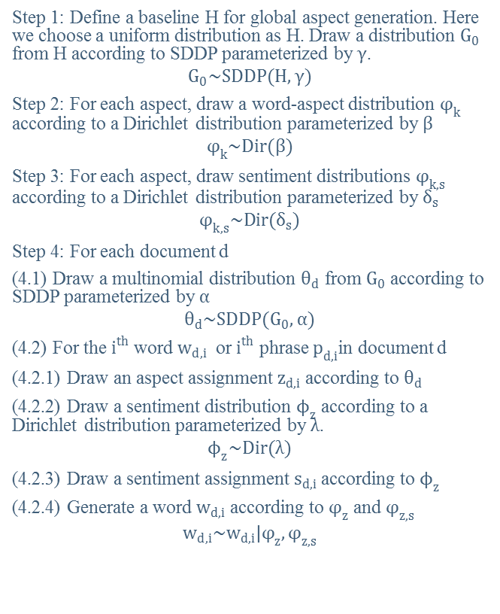
Word Model (W-SDDP)
Step 1: Define a baseline H for global aspect generation. Here we choose a uniform distribution as H. Draw a distribution $G_{0}$ from H according to SDDP parameterized by $γ$.
$$G_{0}\sim SDDP(H,γ)$$
Step 2: For each aspect, draw a word-aspect distribution $φ_{k}$ according to a Dirichlet distribution parameterized by $β$
$$φ_{k}\sim Dir(β)$$
Step 3: For each aspect, draw sentiment distributions $φ_{k,s}$ according to a Dirichlet distribution parameterized by $δ_{s}$
$$φ_{k,s}\sim Dir(δ_{s})$$
Step 4: For each document d
(4.1) Draw a multinomial distribution $θ_{d}$ from $G_{0}$according to SDDP parameterized by $α$
$$θ_{d}\sim SDDP(G_{0},α)$$
(4.2) For the $i^{th}$ word $w_{d,i}$ or $i^{th}$ phrase $p_{d,i}$in document d
(4.2.1) Draw an aspect assignment $z_{d,i}$ according to $θ_{d}$
(4.2.2) Draw a sentiment distribution $ϕ_{z}$ according to a Dirichlet distribution parameterized by $λ$.
$$ϕ_{z}\sim Dir(λ)$$
(4.2.3) Draw a sentiment assignment $s_{d,i}$ according to $ϕ_{z}$
(4.2.4) Generate a word $w_{d,i}$ according to $φ_{z}$ and $φ_{z,s}$
$$w_{d,i}\sim w_{d,i}|φ_{z},φ_{z,s}$$
Notes:
This slice shows the graphical model for W-SDDP.
In word model, we assume each word conveys both aspect and sentiment. The generative process is like:

Slide 13
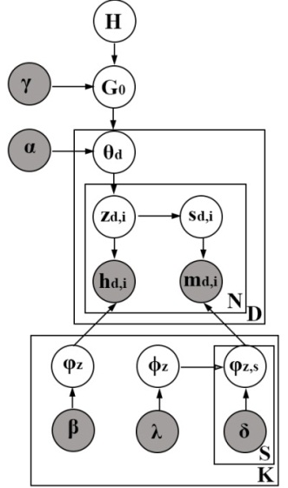
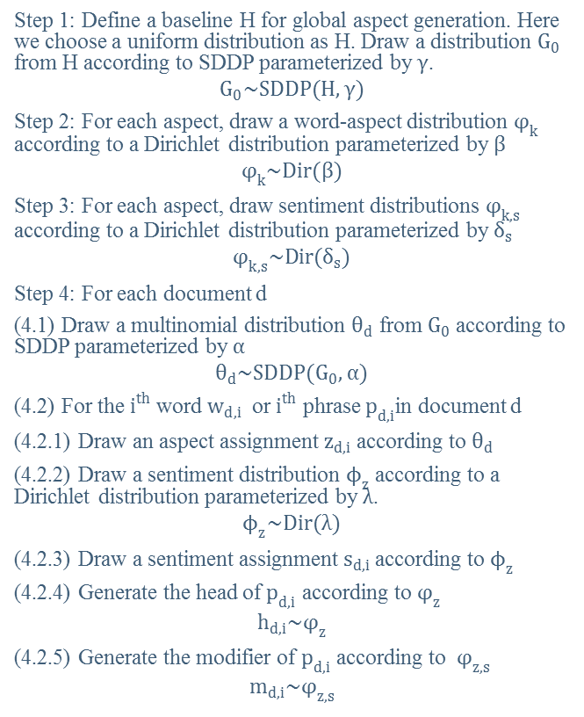
Phrase Model
Step 1: Define a baseline H for global aspect generation. Here we choose a uniform distribution as H. Draw a distribution $G_{0}$ from H according to SDDP parameterized by $γ$.
$$G_{0}\sim SDDP(H,γ)$$
Step 2: For each aspect, draw a word-aspect distribution $φ_{k}$ according to a Dirichlet distribution parameterized by $β$
$$φ_{k}\sim Dir(β)$$
Step 3: For each aspect, draw sentiment distributions $φ_{k,s}$ according to a Dirichlet distribution parameterized by $δ_{s}$
$$φ_{k,s}\sim Dir(δ_{s})$$
Step 4: For each document d
(4.1) Draw a multinomial distribution $θ_{d}$ from $G_{0}$according to SDDP parameterized by $α$
$$θ_{d}\sim SDDP(G_{0},α)$$
(4.2) For the $i^{th}$ word $w_{d,i}$ or $i^{th}$ phrase $p_{d,i}$in document d
(4.2.1) Draw an aspect assignment $z_{d,i}$ according to $θ_{d}$
(4.2.2) Draw a sentiment distribution $ϕ_{z}$ according to a Dirichlet distribution parameterized by $λ$.
$$ϕ_{z}\sim Dir(λ)$$
(4.2.3) Draw a sentiment assignment $s_{d,i}$ according to $ϕ_{z}$
(4.2.4) Generate the head of $p_{d,i}$ according to $φ_{z}$
$$h_{d,i}\sim φ_{z}$$
(4.2.5) Generate the modifier of $p_{d,i}$ according to $φ_{z,s}$
$$m_{d,i}\sim φ_{z,s}$$

Slide 14
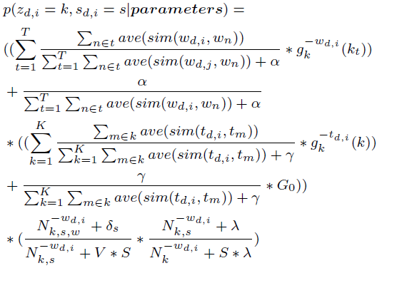
Model Inference
We use Gibbs Sampling to realize the model inference, and the inference function is shown as following:

Slide 15
Data set and Benchmark
NO. | Dataset Content | Source | Volume | Labeled
1 | Restaurant | Gayatree Ganu / Citysearch | 3400 sentences | Yes
2 | Coffee Machine | Yohan Jo/ Amazon | 3000 reviews | No
3 | Laptop | Yohan Jo/ Amazon | 3000 reviews | No
4 | Car | Ganesan Kavita/tripAdviser | 3000 reviews | No
5 | Hotel | Ganesan Kavita/ tripAdviser | 3000 reviews | No
Benchmarks
LDA, HDP, JST, ASUM, MaxEnt-LDA, JAS, and our two models: W-SDDP, and P-SDDP
Notes:
We experiment our models on 6 datasets. They mainly come from three sources, namely CitySearch, Amazon and tripAdviser. The first one is with golden standard, and the others have no label data.
The benchmark algorithms are LDA, HDP, JST, ASUM, MaxEnt-LDA and JAS

Slide 16
Phrase Construction
Stanford Dependency Parser (SDParser)
Adjectival Modifier: amod(A,B) → <A, B>
Adjectival Complement: acomp(A,B) + nsubj(A,C) → <C,B>
Copula Relationship: cop(A,B) + nsubj(A,C) → <C,A>
Direct Object Relationship: dobj(A,B) +nsubj(A,C) → <B,A>
And Relationship: <A, B> + conj_and(A,C) → <C,B> or <A, B> + conj_and(B,C) → <A,C>
Negation Modifier: <A, B> + neg(B, not) → <A, not+B>
Noun Compound: <A,B>+nn(A,C)→ <C+A,B>, or <A,B>+nn(C,A→<A+C,B>
Agent Relationship: agent(A,B)→ <B,A>
Nominal Subject: nsubj(A,B) → <B,A>
Infinitival Modifier: infmod(A,B) →<A,B>
Passive Nominal Subject: nsubjpass<A,B> →<B,A>
Participial Modifier: partmod(A,B)→<A,B>
Controlling Subject: xsubj(A,B)→<B,A>
Notes:
In order to implement Phrase model, we need to pre-process the document into a series of phrase. We apply the Stanford Dependency Parser to conduct such task.
This slice shows the rules we use to construct phrases.

Slide 17
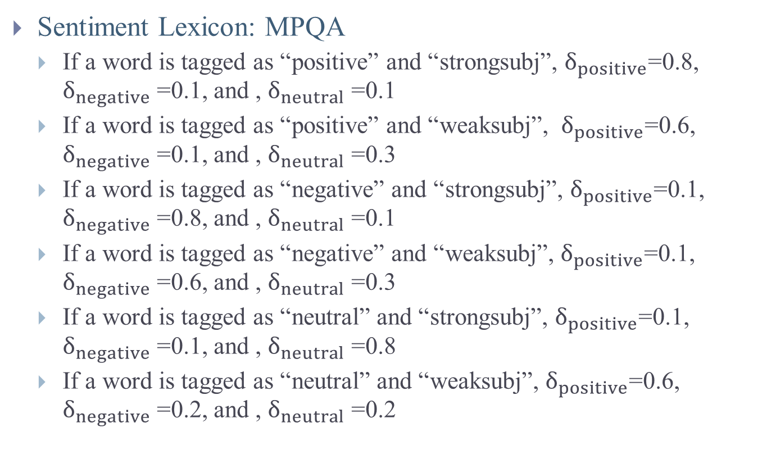
Prior Knowledge
Sentiment Lexicon: MPQA
If a word is tagged as “positive” and “strongsubj”, $δ_{positive}$=0.8, $δ_{negative}$ =0.1, and , $δ_{neutral}$ =0.1
If a word is tagged as “positive” and “weaksubj”, $δ_{positive}$=0.6, $δ_{negative}$ =0.1, and , $δ_{neutral}$ =0.3
If a word is tagged as “negative” and “strongsubj”, $δ_{positive}$=0.1, $δ_{negative}$ =0.8, and , $δ_{neutral}$ =0.1
If a word is tagged as “negative” and “weaksubj”, $δ_{positive}$=0.1, $δ_{negative}$ =0.6, and , $δ_{neutral}$ =0.3
If a word is tagged as “neutral” and “strongsubj”, $δ_{positive}$=0.1, $δ_{negative}$ =0.1, and , $δ_{neutral}$ =0.8
If a word is tagged as “neutral” and “weaksubj”, $δ_{positive}$=0.6, $δ_{negative}$ =0.2, and , $δ_{neutral}$ =0.2
Notes:
MPQA
In sentiment assignment part, we use a Dirichlet allocation. Prior knowledge is required in order to get a better result. In our work, we use MPQA sentiment lexicon as the prior knowledge. However, MPQA just provide sentiment polarity but not sentiment score. Thus, we use these rules to define the prior score.

Slide 18
Evaluation with Golden Standard
The Restaurant Dataset has been manually labeled and has golden standard.
According the Restaurant Dataset, all the words have been manually annotated to six aspects, namely Food, Staff, Price, Ambience, Anecdote, and Miscellaneous, and Three Sentiments: Positive, Negative and Neutral.
Two Group:
JST, ASUM, and JAS. They provide sentiment polarities
LDA, MaxEnt, and HDP. They do not provide sentiment polarities.
Method:
Precision: Count the ratio of words that have been correctly assigned.

Slide 19
Evaluation with Golden Standard
Aspect Comparison among the Popular Models
 | LDA | HDP | ASUM | JST | MaxEnt | JAS | W-SDDP | P-SDDP
Food | 0.639 | 0.806 | 0.751 | 0.632 | 0.808 | 0.779 | 0.760 | 0.817
Staff | 0.429 | 0.460 | 0.411 | 0.299 | 0.559 | 0.527 | 0.563 | 0.655
Price | -- | 0.353 | 0.278 | -- | 0.232 | 0.351 | 0.366 | 0.494
Ambience | 0.412 | 0.452 | 0.347 | 0.226 | 0.299 | 0.451 | 0.469 | 0.545
Anecdote | 0.379 | 0.444 | 0.259 | 0.188 | 0.397 | 0.443 | 0.450 | 0.450
Miscellaneous | 0.441 | 0.471 | 0.504 | 0.347 | 0.330 | 0.532 | 0.565 | 0.590

Slide 20
Evaluation with Golden Standard
Sentiment Comparison among
Models with Sentiment Polarities
Sentiment Comparison among
Models with no Sentiment Polarities
 |  | ASUM | JST | JAS | W-SDDP | P-SDDP
Food | + | 0.655 | 0.461 | 0.658 | 0.822 | 0.786
 | - | 0.368 | 0.225 | 0.224 | 0.440 | 0.400
 | * | 0.104 | 0.064 | -- | 0.136 | 0.304
Staff | + | 0.445 | 0.241 | 0.243 | 0.667 | 0.662
 | - | 0.388 | 0.164 | 0.322 | 0.438 | 0.651
 | * | 0.022 | 0.037 | -- | 0.071 | 0.063
Price | + | -- | -- | 0.255 | 0.333 | 0.431
 | - | 0.150 | -- | 0.088 | 0.333 | 0.273
 | * | -- | -- | -- | 0.000 | 0.000
Ambience | + | -- | -- | 0.273 | 0.701 | 0.565
 | - | 0.174 | -- | 0.124 | 0.286 | 0.400
 | * | 0.056 | 0.029 | -- | 0.078 | 0.158
Anecdote | + | -- | 0.089 | 0.093 | 0.500 | 0.256
 | - | -- | -- | 0.143 | 0.333 | 0.250
 | * | 0.243 | 0.113 | -- | 0.200 | 0.444
Miscellaneous | + | 0.302 | 0.241 | 0.227 | 0.636 | 0.583
 | - | 0.218 | -- | 0.176 | 0.250 | 0.400
 | * | 0.219 | -- | -- | 0.500 | 0.231
 | LDA | HDP | MaxEnt | W-SDDP | P-SDDP
Food | 0.230 | 0.161 | 0.221 | 0.602 | 0.530
Staff | 0.197 | 0.090 | 0.205 | 0.583 | 0.391
Price | -- | 0.059 | 0.134 | 0.301 | 0.263
Ambience | 0.187 | 0.082 | 0.107 | 0.440 | 0.406
Anecdote | 0.164 | 0.083 | 0.131 | 0.281 | 0.333
Miscellaneous | 0.190 | 0.000 | 0.091 | 0.452 | 0.500

Slide 21
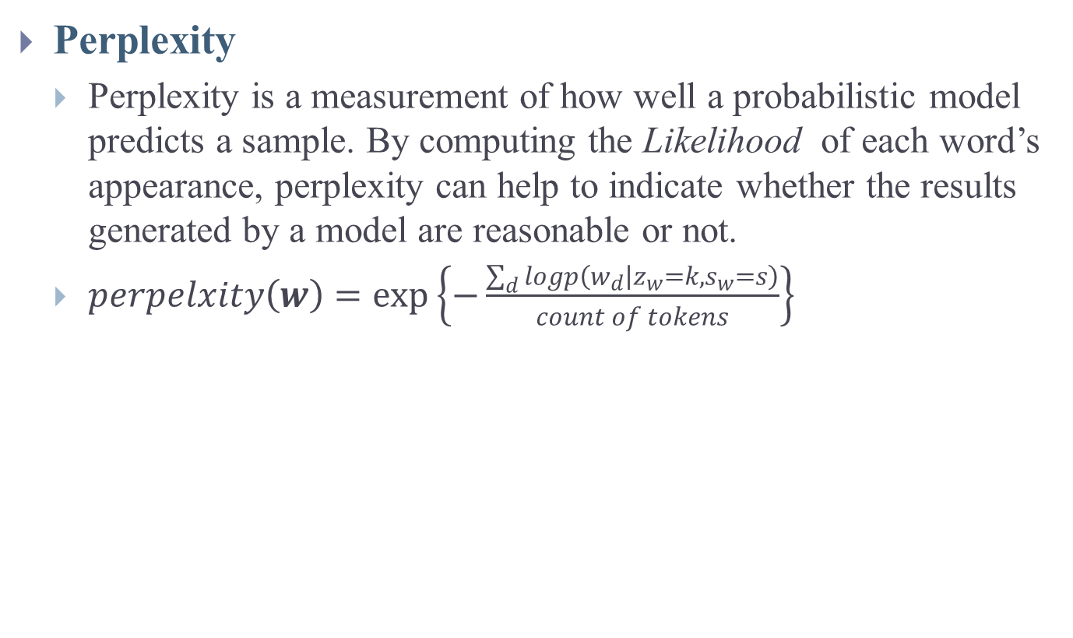
Evaluation with Plaint Text
Perplexity
Perplexity is a measurement of how well a probabilistic model predicts a sample. By computing the Likelihood of each word’s appearance, perplexity can help to indicate whether the results generated by a model are reasonable or not.
$perpelxity\left(w\right)=\exp\left\{−\frac{\sum_{d}{logp\left(w_{d} | z_{w}=k,s_{w}=s\right)}}{count of tokens}\right\}$

Slide 22
Evaluation of Plaint Text
Notes:
From these indicators, we can see P-SDDP performs better.

Slide 23
Experiment
W-SDDP
P-SDDP
Aspect | Sentiment
Atmosphere&Service Service, Place, Time, Menu, Atmosphere, Staff, Dishes, Drinks | + | Nice, Great, Wonderful, Decent, Popular, Relax, Superb, Friendly
 | - | Dim, Horrible, Mediocre, Disappointing, Crowded, Poorly, Slow, Worst
Food-Pizza: Pizza, Crust, Slice, Tomato, Pizzas, Cheese, Williamsburg, Mushroom | + | Adorable, Delicate, Crisp, Fancy, Best, Pretty, Supreme, Perfect,
 | - | Horrific, Vomit, Disgusting, Complaints, Tiny, Gross, Expensive, Not-Special
Food-Japanese/Chinese: Sushi, Sichuan, Roll, Eel, Sea, Chongqing, Fish, Chinatown, Shanghai | + | Good, Heavenly, Rejoice, Special, Best, Amazingly, Favorite, Fresh, Elegant
 | - | Mock, Rigid, Dull, Overdone, Fatty, Weird, Poor, Not-Fresh
Food-American: Bagel, Bagels, Coffee, Freeze, Cream, Cheeses, Takeaway, Mayo | + | Nice, Colossal, Outstanding, Best, Plentiful, Big, Original, Pleasantly, Fabulous
 | - | Strange, Pricey, Not-Nice, Not-Authentic, Bland, Spot, Disappointed,
Staff: Table, Dinner, Waitstaff, Minute, Service, Minutes, Bartender, Waiter, | + | Hospitable, Experienced, Nice, Stylish, Not-Unable, Helpful, Ready, Attentive
 | - | Confused, Not-Amazed, Annoying, Not-Competent, Unpleasant, Noisy, Clumsy, Pretentious
Aspect | Sentiment
Atmosphere&Service: Service, Place, Dishes, Atmosphere, Dinner, Ambiance, Night, Staff, | + | Reasonable, Accommodating, Friendly, Relaxing, Romantic, Excellent, Expected, Cool
 | - | Rude, Noisy, Disappointing, Biting, Dark, Poor, Drafty, Slow
Food-Pizza: Pizza, Slice, Crust, Ingredients, Codfish, Addition, Lobster, Pie | + | Crisp, Fresh, Thin, Expanded, Fresh-Tasting, Well-Seasoned, Delicious, Tasty
 | - | Shredded, Vomit-Inducting, Not-Topped, Skimp, Not-Want, Common, Bitter, Bland
Food-Japanese Food: Sushi, Rice, Tuna, Fish, Sauces, Scallop, Roll, Appetizer | + | Spicy, Matches, Please, Healthy-Looking, Recommended, Favorite, Refreshing, Superb
 | - | Disgusting, Flavorless, Not-Exciting, Broken, Horrid, Rough, Murky, Awful
Food-Chinese Food: Pork, Soup, Dumpling, Chicken, Shanghai, Shanghainese, Scallion, Eggplant | + | Tasting, Traditional, Amazing, Watery, Love, Wonderful, Authentic, Complimentary
 | - | Sour, Mock, Lacking, Horrible, Overcompensate, Oily, Overpriced, Small
Staff: Staff, Service, Manager, People, Cooks, Menu, Tables, Reservation | + | Friendly, Great, Enthusiastic, Attentive, Helpful, Knowledgeable, Wonderful
 | - | Not-recommend, Lies, Bad, Unavailable, Repeatable, Unpleasant, Not-inspired, Lazy
Notes:
They have detected very similar aspects.
P-SDDP has split Chinese Food and Japanese food

Slide 24
Experiment
Comparison between W-SDDP and P-SDDP
 | W-SDDP | P-SDDP
Number Of Tokens | 30035 | 20274
Converged Aspect Number | 20-30 | 8-10
Perplexity | Around 900 | Around 300
Notes:
Information loss

Slide 25
Conclusion
This paper has constructed a Similarity Dependency Dirichlet Process(SDDP)
Solved the aspect number determination problem in LDA
Alleviated the random word assignment in HDP
Based on SDDP, this paper constructed two different models: Word Model(W-SDDP) and Phrase Model(P-SDDP)
Both W-SDDP and P-SDDP performs well comparing to other classical models
P-SDDP performs better than W-SDDP, but also it lose more information than W-SDDP

Slide 26
The End
Thank you for
Your Attention!
Any Question?

