Slide 1

NYC Children Lead Testing Data Analysis
Data Cleaning, Visualization & Regression Modeling
Nathaly Kos

Slide 2
Project Overview
NYC dataset on lead testing in children under 3
Focus: data cleaning, visualization, regression
Objective: Understand relationships and make predictions

Slide 3
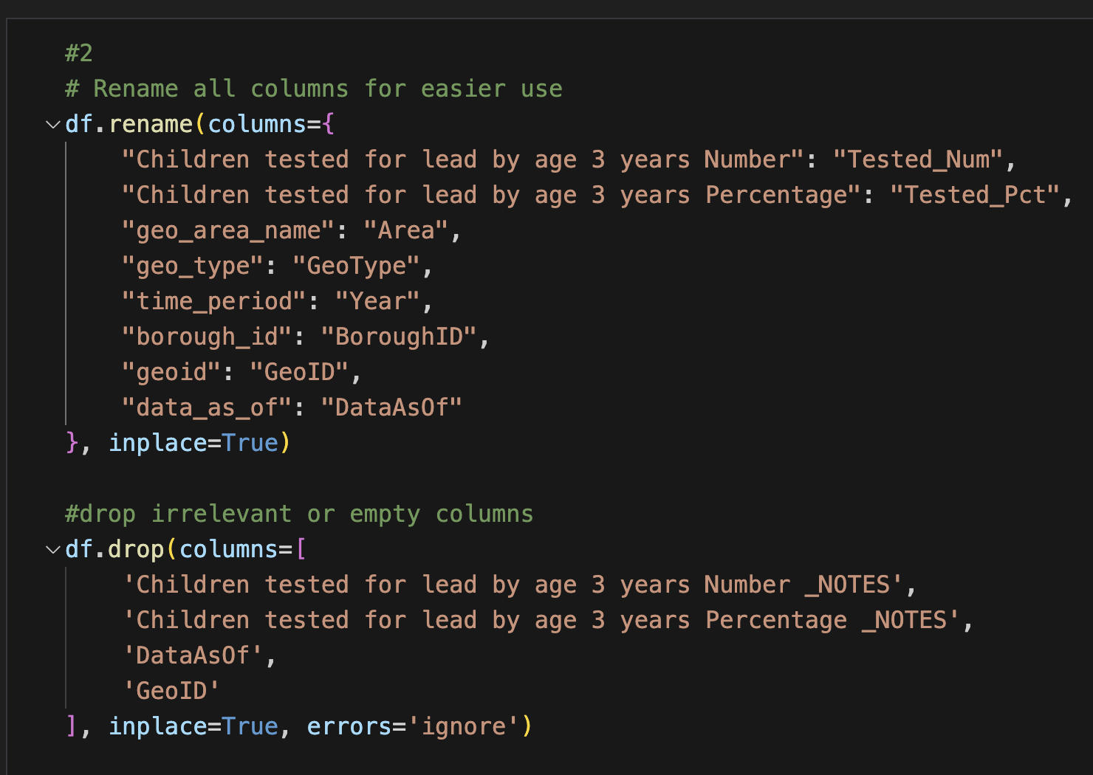
Task 1: Data Preparation
Renamed long column names
Dropped unnecessary or metadata columns
Converted data types, handled missing and zero values
One-hot encoded the 'GeoType' categorical column

Slide 4
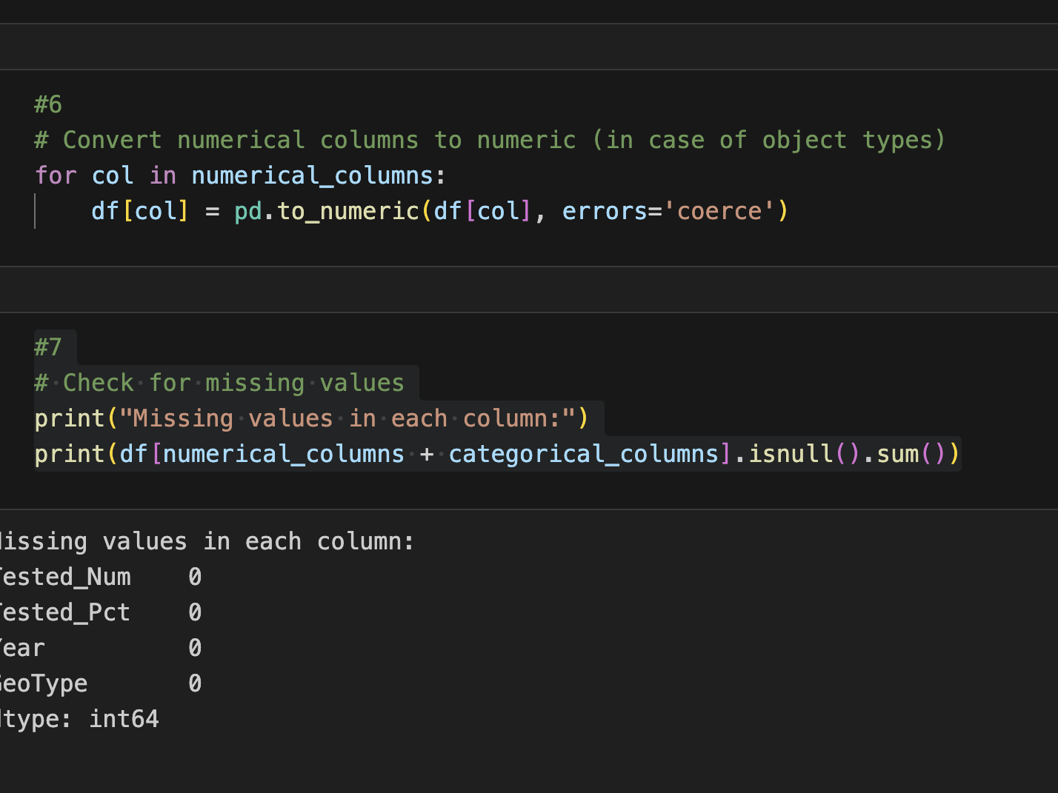

Slide 5
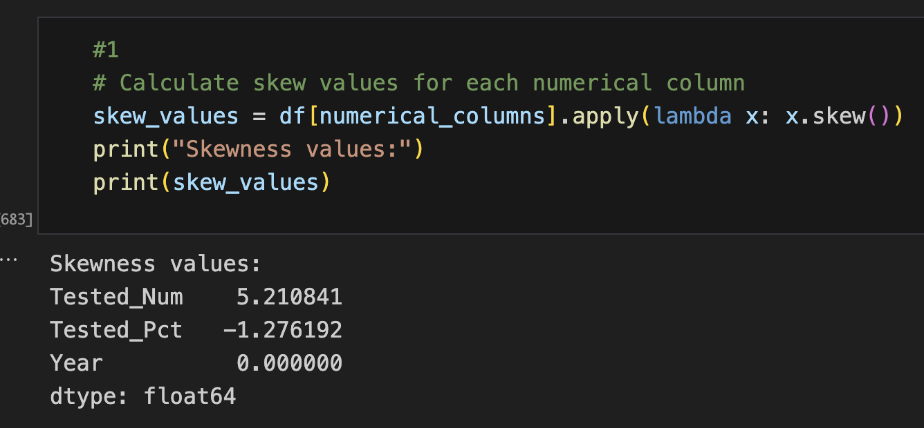
Task 2: Data Visualization
Used Pearson and Spearman heatmaps to analyze correlations.
Used histograms, scatter plots, and boxplots to examine feature distributions and relationships.
Applied transformations (log, sqrt, Yeo-Johnson) to reduce skewness in features.

Slide 6
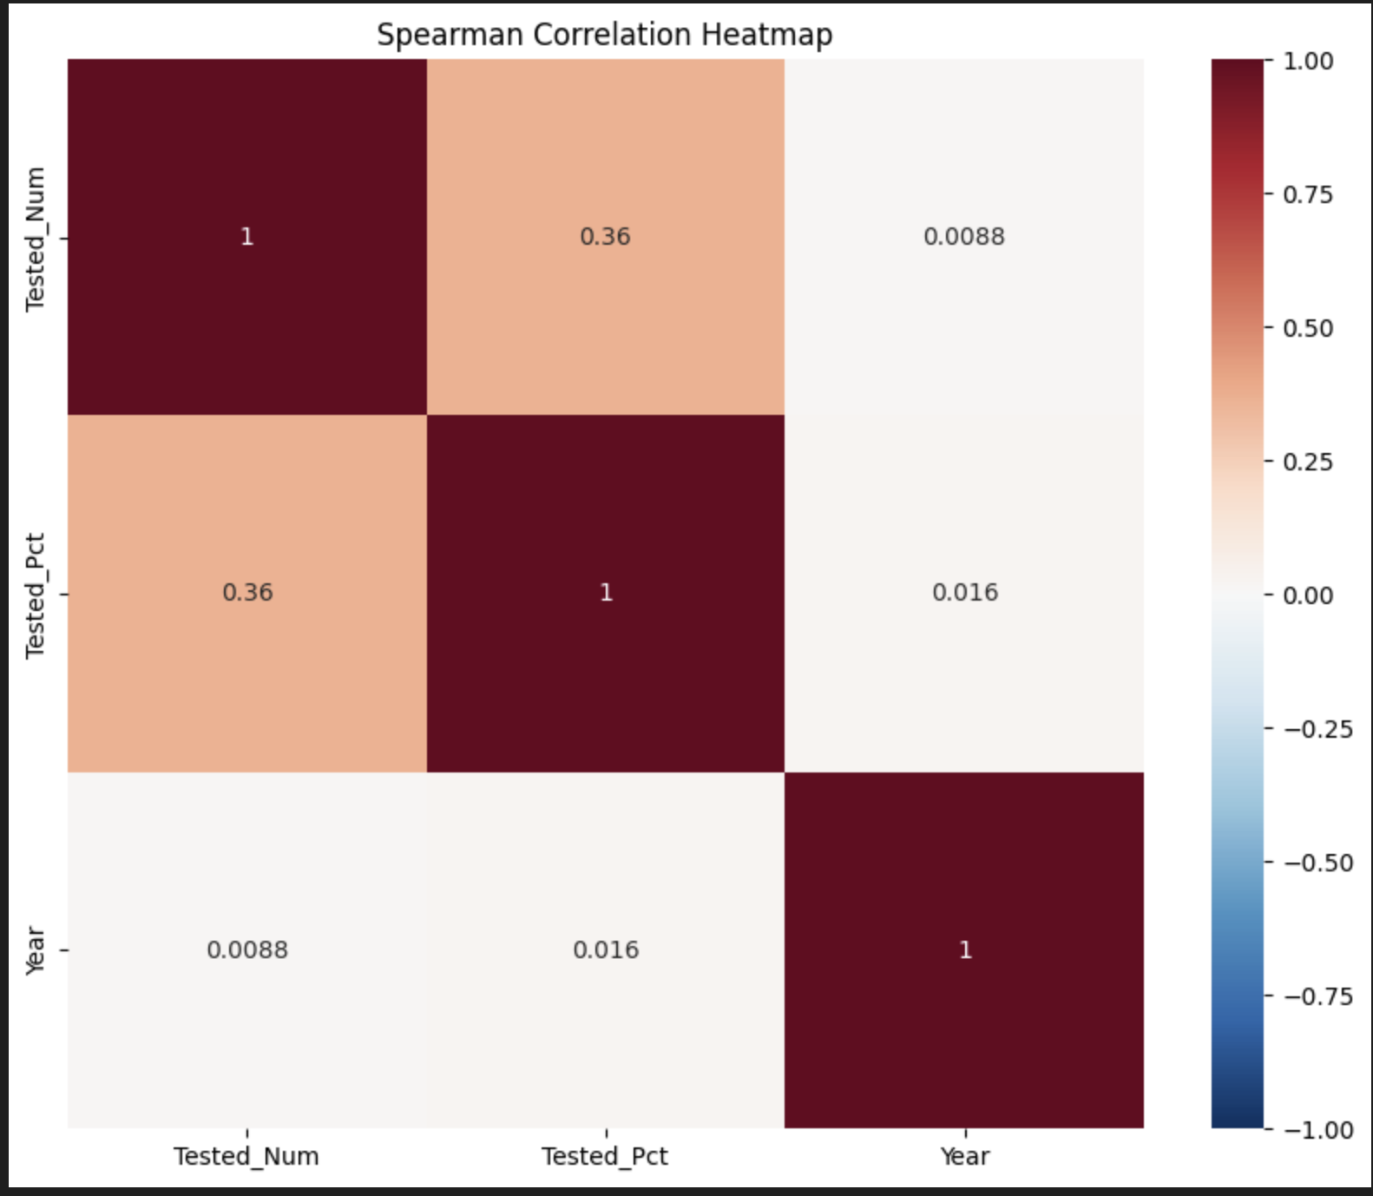
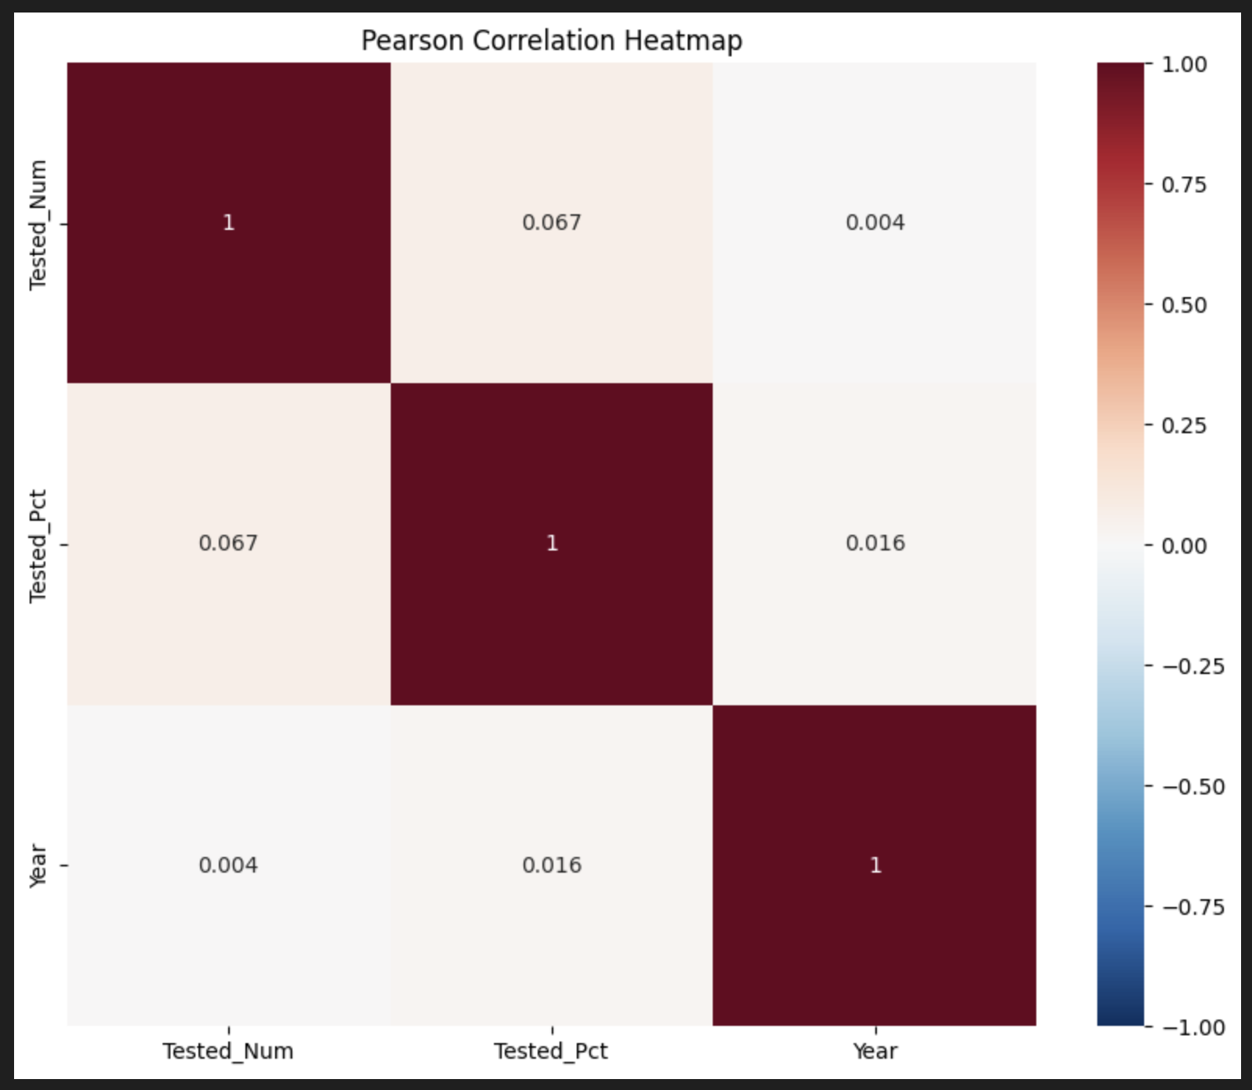

Slide 7
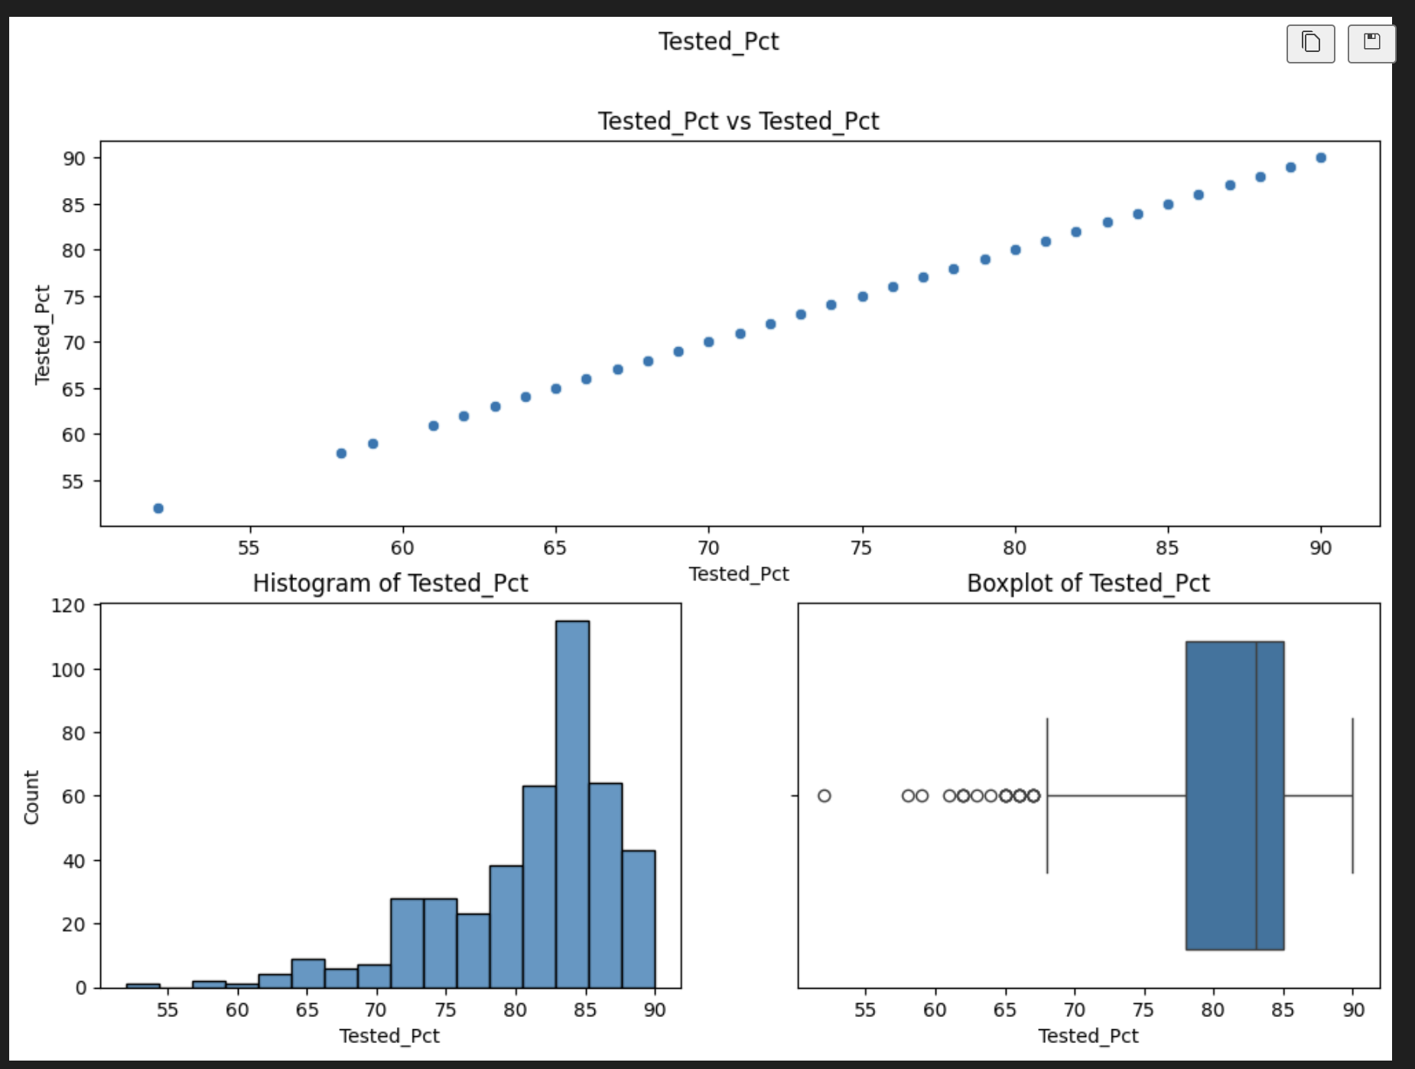
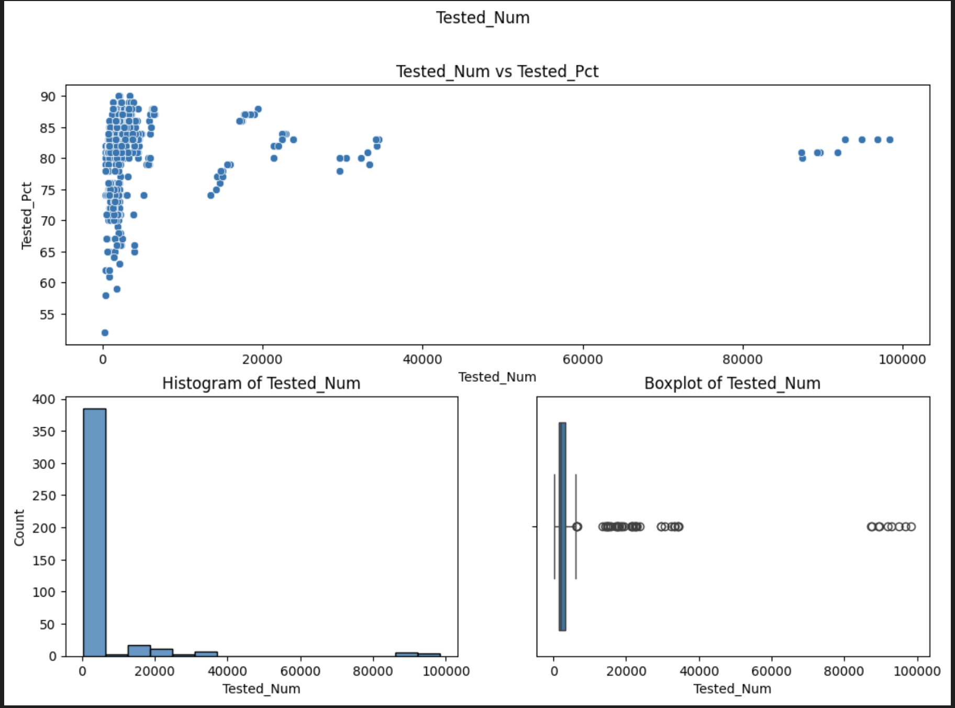

Slide 8
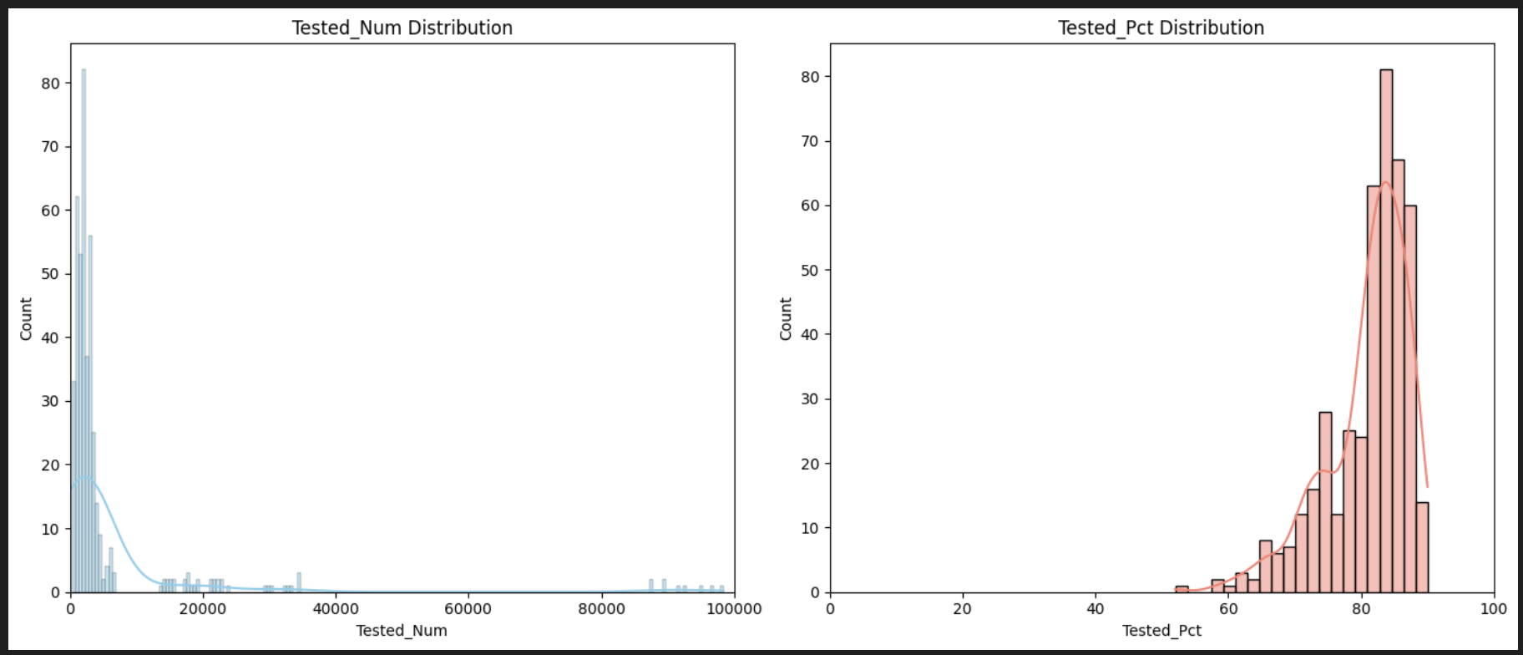
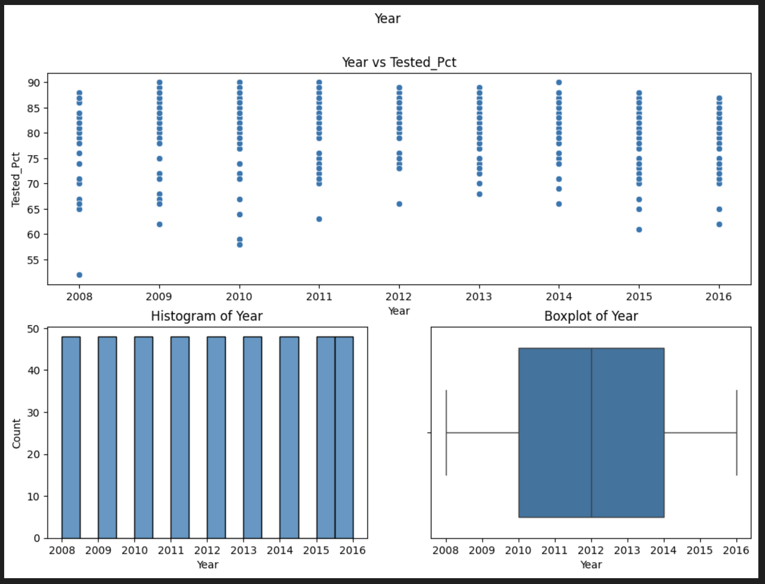

Slide 9
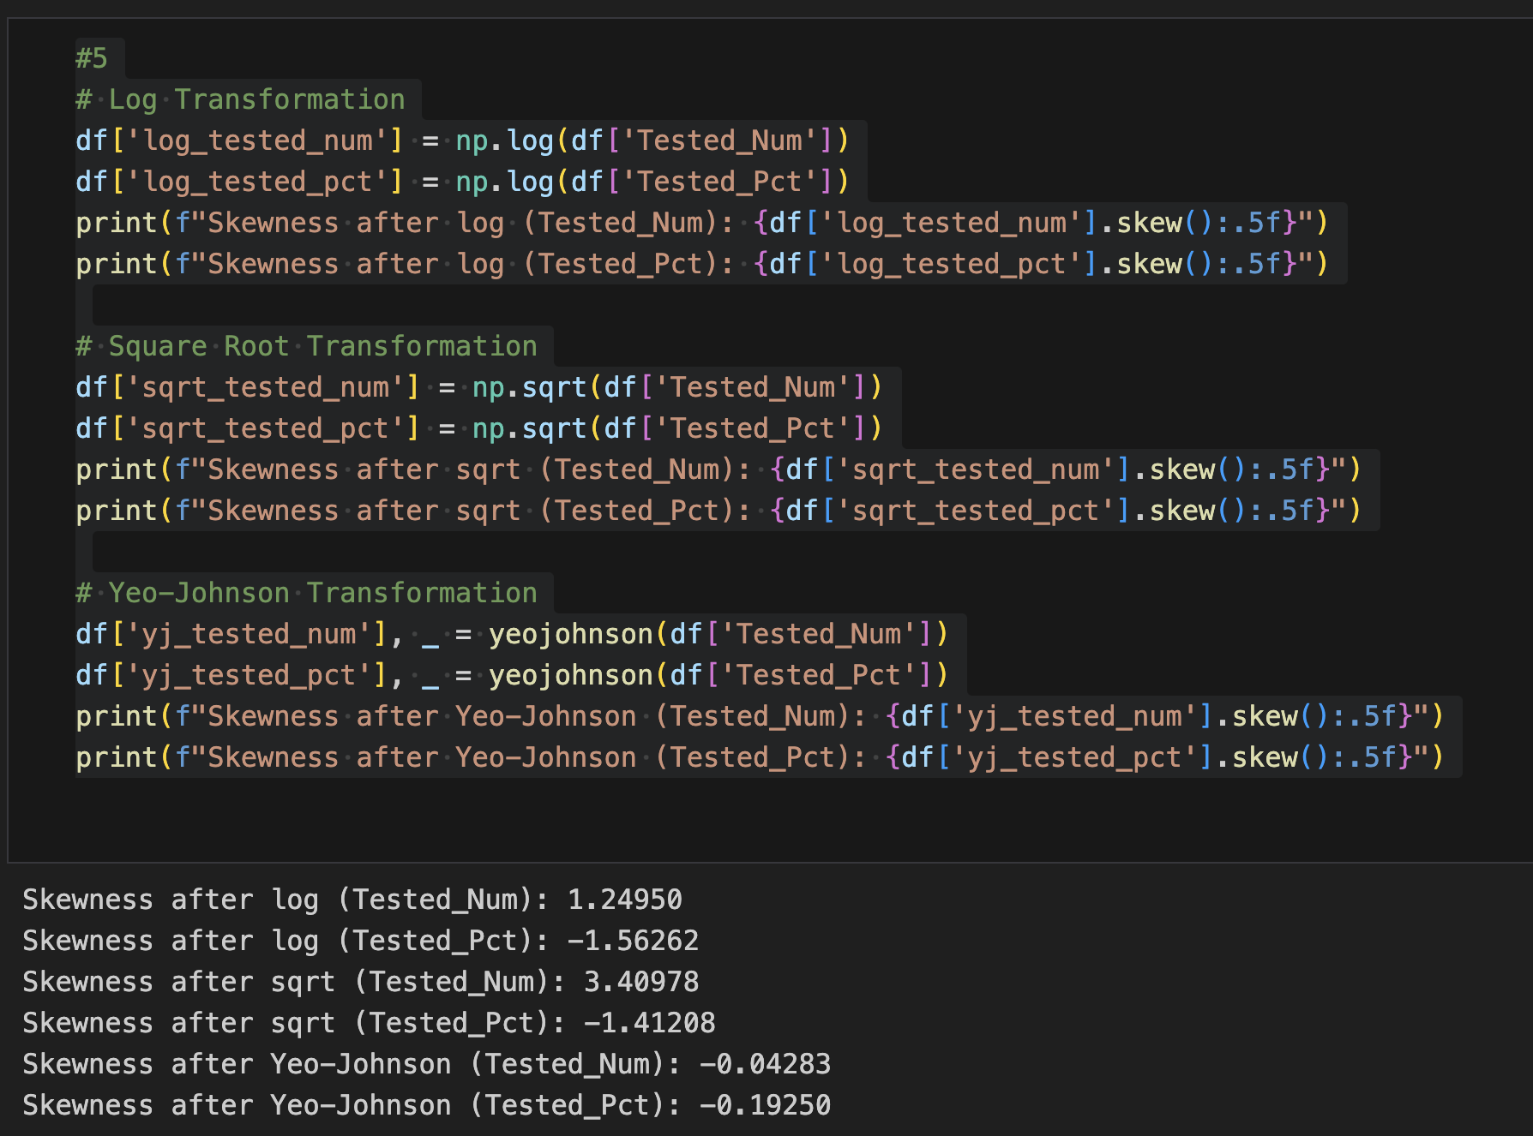

Slide 10
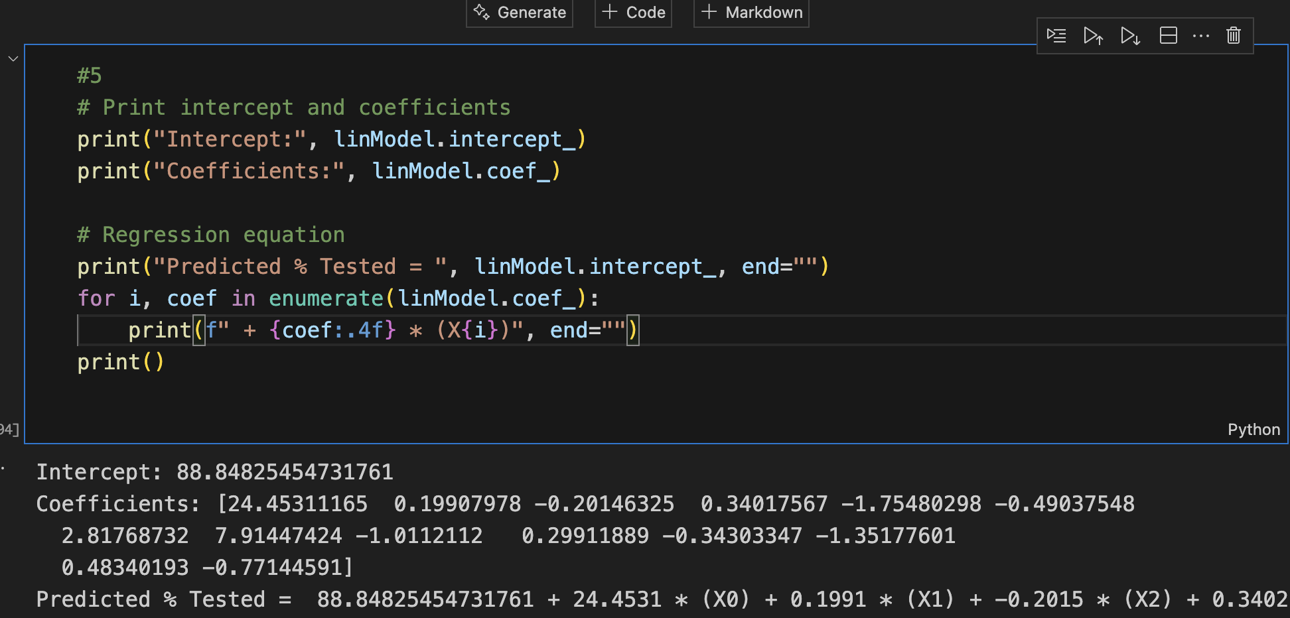
Task 3: Regression Analysis
Target: Tested_Pct
Features: Tested_Num, Year, GeoType (encoded).
Applied polynomial regression to capture non-linear relationships.
Evaluation: MAE = 4.37, RMSE = 5.34, R² = 0.1889.
Non-linear model improved performance from initial negative R² values.

Slide 11
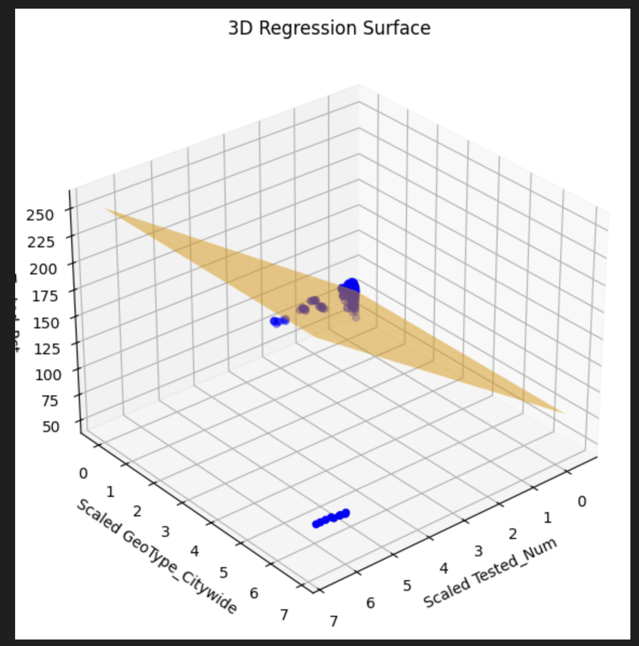

Slide 12
Model Evaluation Metrics
R² improved to 0.19 (was negative before)
MAE reduced to 4.37, RMSE to 5.34
Better performance with polynomial regression

Slide 13
Conclusion
Task 1 ensured clean, usable data through preprocessing steps.
Task 2 visualizations exposed data skewness, relationships, and outliers.
Task 3 demonstrated how model accuracy improved with polynomial features.
Insights support future modeling with richer feature engineering and regularization.

