Slide 1
Q
false
false
J
K
true
true
false
K
Q = J
true
Q = Q’

Slide 2
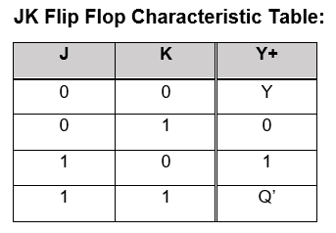
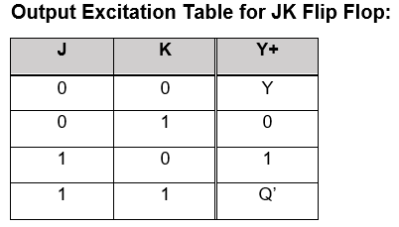
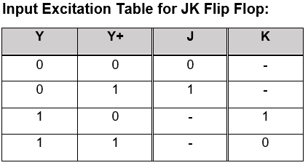

Slide 3


