Slide 1
CS1025 - Electrotechnology
Timetable, Course Content and Assessment

Slide 2
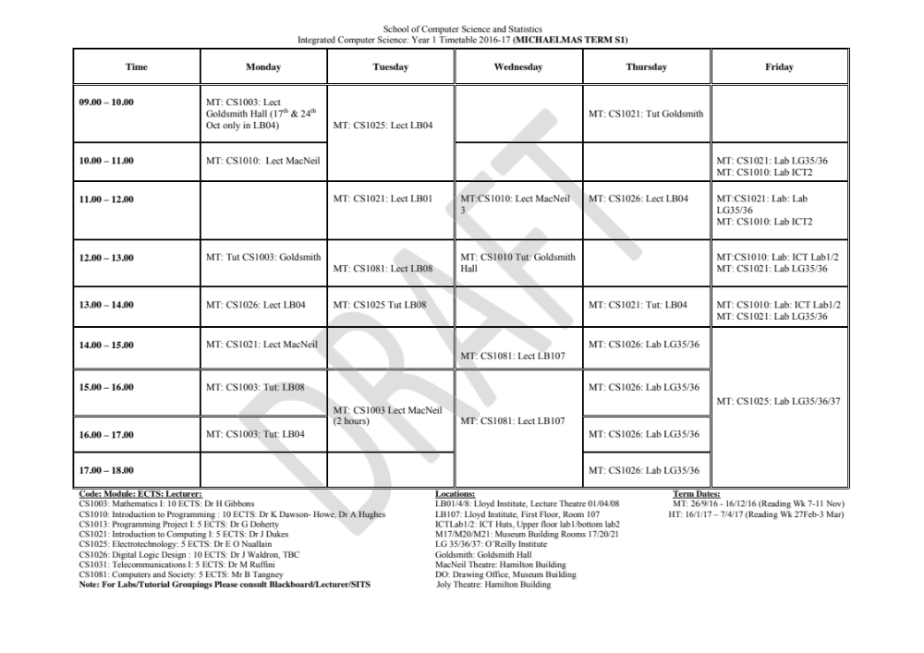
Timetable and duration

Slide 3
Syllabus
Section I Electrical Fundamentals
Section II Electric Circuit Components – Resistors
Section III Sources and Instrumentation
Section IV Semiconductors and Diodes
Section V The Transistor
Section VI Electric Circuit Components - Capacitors and Inductors
Section VII Electromagnetism

Slide 4
Books
Foundations of Electronics: Circuits and Devices (Conventional Flow Version) by R. Meade - Highly Recommended
Grob’s Basic Electronics by Michael Schultz
Introductory Circuit Analysis by R. Boylestad
Electronic Devices and Circuit Theory by R. Boylestad and L. Nashelsky
Students should attempt to get these books second-hand – in particular the first recommendation. Note there is no need for the latest editions of these books.

Slide 5
Lectures/Labs/tutorials
Lectures cover theory
Labs are practical implementations of material covered in Lectures
Tutorials are time devoted to assisting students with the course material (incl. Lecture Notes, Problem Sheets and Labs/Lab Reports)

Slide 6
Lab/Tutorial Start Dates
These will be announced well in advance at lectures and by email
Tutorials usually 2-3 weeks from beginning of term
Labs usually 3-5 weeks from beginning of term

Slide 7
Labs
These are two-hour sessions in LG35/36
Attendance at Labs is mandatory (an attendance list will be taken)
The class divides into groups of 2 or 3 (there are no fixed groupings)
The lab is performed as instructed and the results taken.
An individual lab report is written by each student and submitted at the following lab session

Slide 8
Tutorials
A number of Problem Sheets will be given throughout the course. There is no obligation on students to hand up solutions but you may hand up your solutions for correction by a demonstrator - This is very advisable
At tutorials students will be assisted with the Problem Sheets, Lecture Notes and Lab Material/Reports. You may, for example, bring your lab report to a tutorial to ask for an opinion on it.

Slide 9
Assessment
Assessment in the Annual Examination is by Written Examination and Coursework (Labs)
In the Annual Examination the Written Examination counts for 60% and the Coursework for 40% of the overall mark.
To pass the Annual Examination you must achieve a minimum of 40% overall.
It is NOT necessary to pass both the written examination and the coursework separately
The Supplemental Examinations are by Written Examination only. To pass the Supplemental Examination you must achieve a minimum of 40% in this exam.

